Slide 1
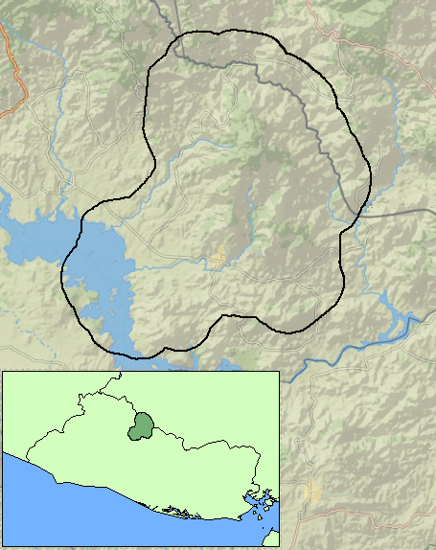
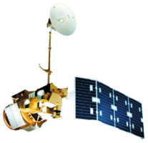
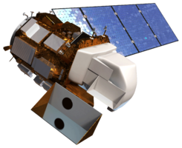
El Salvador Ecological Forecasting II
Utilizing NASA Earth Observations to Develop a Historically Based Trajectory of Deforestation and Degradation in El Salvador
Britta Dosch (Project Lead), Garrett Kidd, Labreshia Mims, Rebekke Muench, Jacob Patrick, and Amy Wolfe
DEVELOP National Program at NASA Langley Research Center
Abstract
Objectives
Keep this blank for now.
Body text point size should be at least 24.
Caption text point size should be at least 16.
Feel free to rename, move, and resize sections as needed.
Develop methodology for monitoring and forecasting ecological change in study area
Delineate Land Use/Land Cover (LULC) classifications into: dominant tree species, agriculture and pastoral plots, and urban development
Contribute to (1) the Regional Forest Inventory (RFI), (2) highlight forest extent and the distinction between primary and secondary forests, and (3) quantify the percent of forest cover and distribution of biomass
Identify patterns in LULC changes, specifically looking at changes in forest cover
Methodology
Data Acquisition
Landsat CDR 4/5 & 8
ABES Project Field Survey
Data Processing
Landsat Scenes clipped using Google Earth Engine (GEE) Code Editor
QuickBird and RapidEye imagery resampled in ArcGIS to fit resolution of Hansen and Landsat data
Data Analysis
End Product
Hansen dataset clipped to QuickBird extant
LandTrends historical land change patterns and forecasting model
RFI accuracy checked with field surveys, RapidEye, GeoCenter imagery, and Hansen data
USAID GeoCenter High Resolution Images
Un/Supervised classification (LULC) Forest masks & RIF LULC Time Series: 2015, 2014, 2009, 2000, 1995 & 1986
Maximum entropy and random forest classification run using GEE Code Editor
Resampled (30m) QuickBird imagery utilized to “validate” Hansen data at the regional scale
Accuracy assessment preformed using RapidEye imagery and Landsat comparison
MARN Ground Truth Data
Study Area
La Mancomunidad La Montanona, Chalatenango, El Salvador
Honduras
Rio Lempa
Guatemala
Honduras
Results
El Salvador
N
Use images.
Make sure that it has some sort of flow, that it makes sense. Show your results in a logical order.
No bullets.
--Study Area
Earth Observations
Landsat 4/5 Landsat 8
Conclusions
Use bullets.
Use complete sentences with periods.
Team Members
Project Partners
Acknowledgements
Use a professional-looking photo.
Individual headshots are ok, if they aren’t pixelated and are all the same size.
Include a caption that states the team members’ names.
Collaborator:
The Earth Institute, Columbia University (ABES Project) POC: Dr. Sean Smukler & Sean Kearney
End Users:
La Mancomunidad La Montanona, Chalatenango
POC: Arnulfo Alberto
Ministerio de Medio Ambiente y Recursos Naturales (MARN)
POC: Giovanni Molina
Dr. Kenton Ross
NASA DEVELOP National Program
Emily Adams
NASA DEVELOP at NASA Langley Research Center
NASA Langley Research Center

