Slide 1
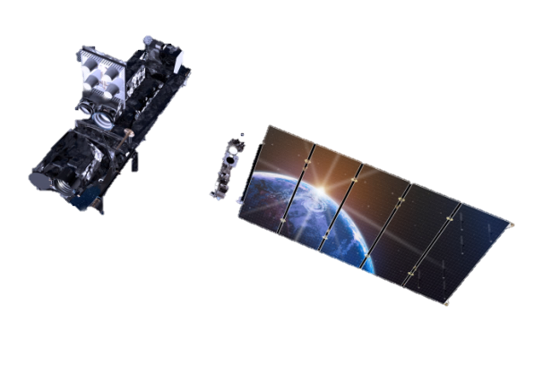
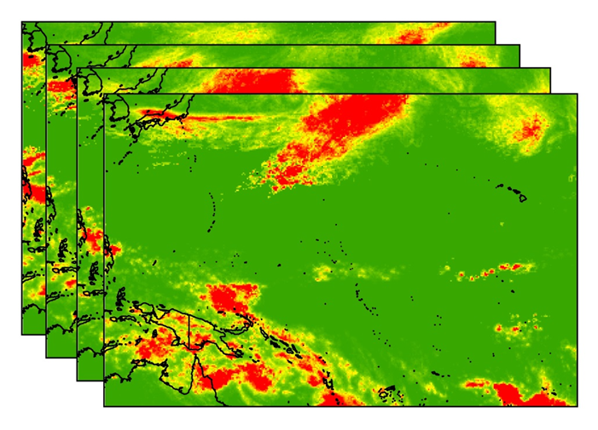
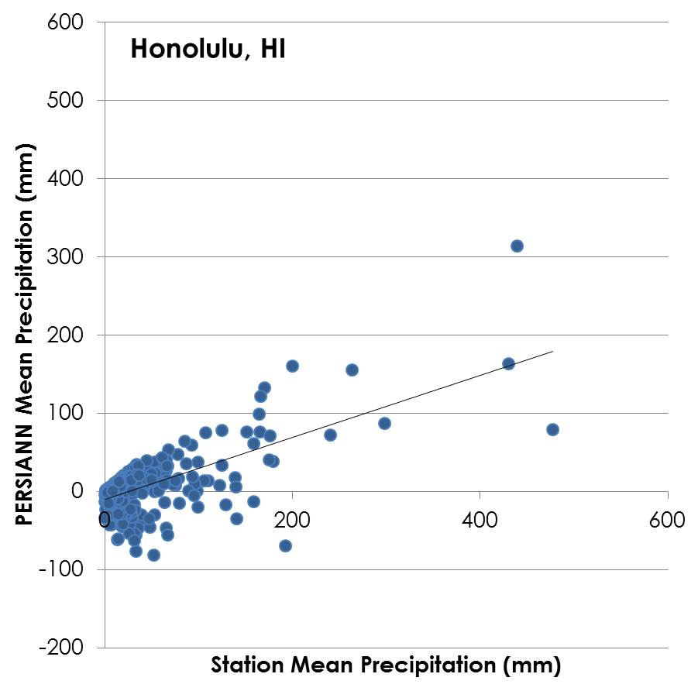
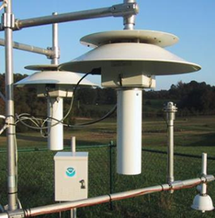
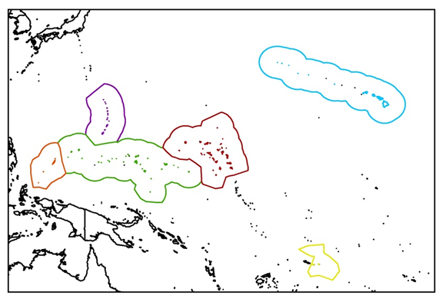
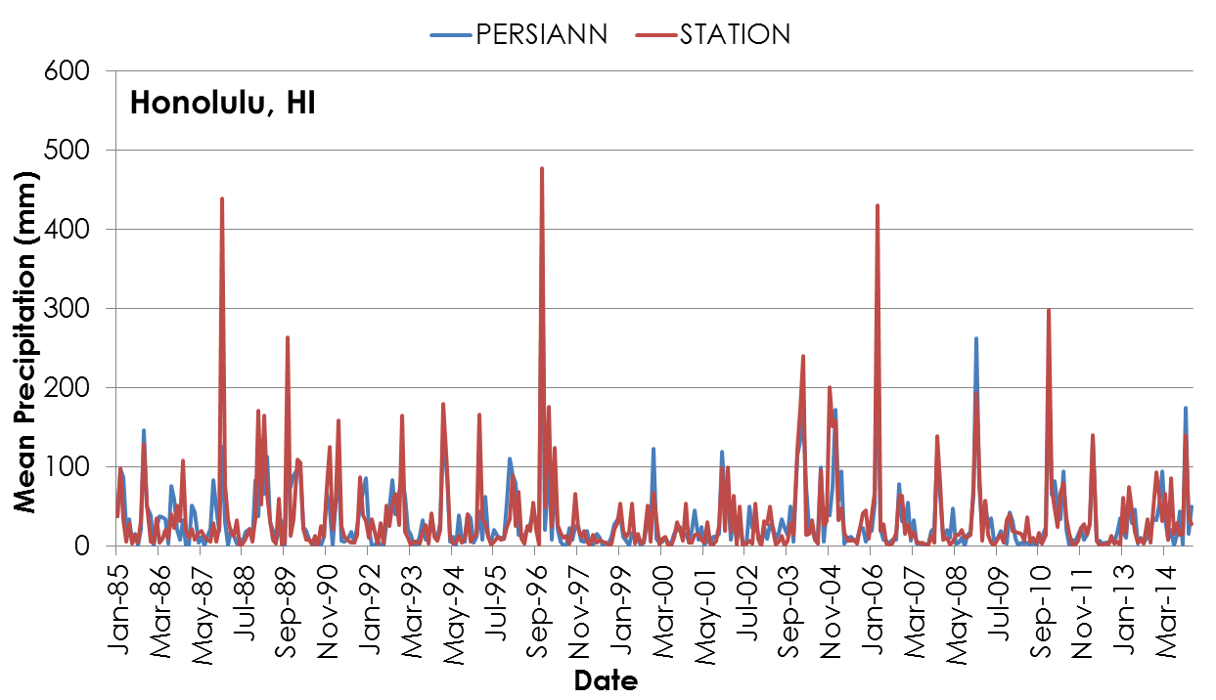
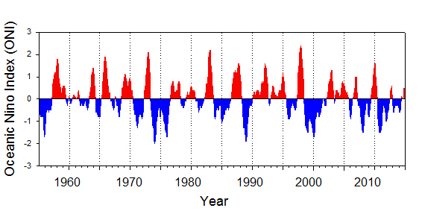
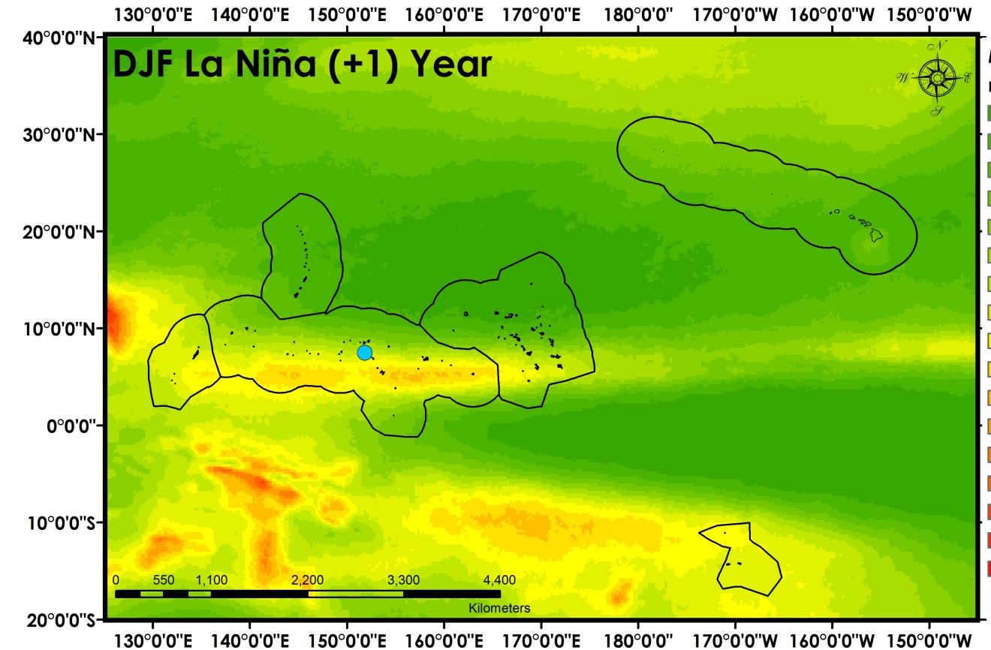
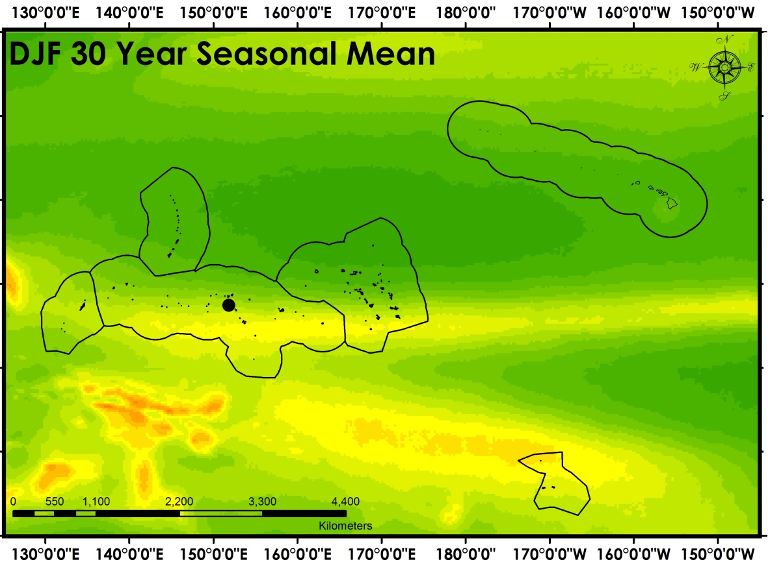
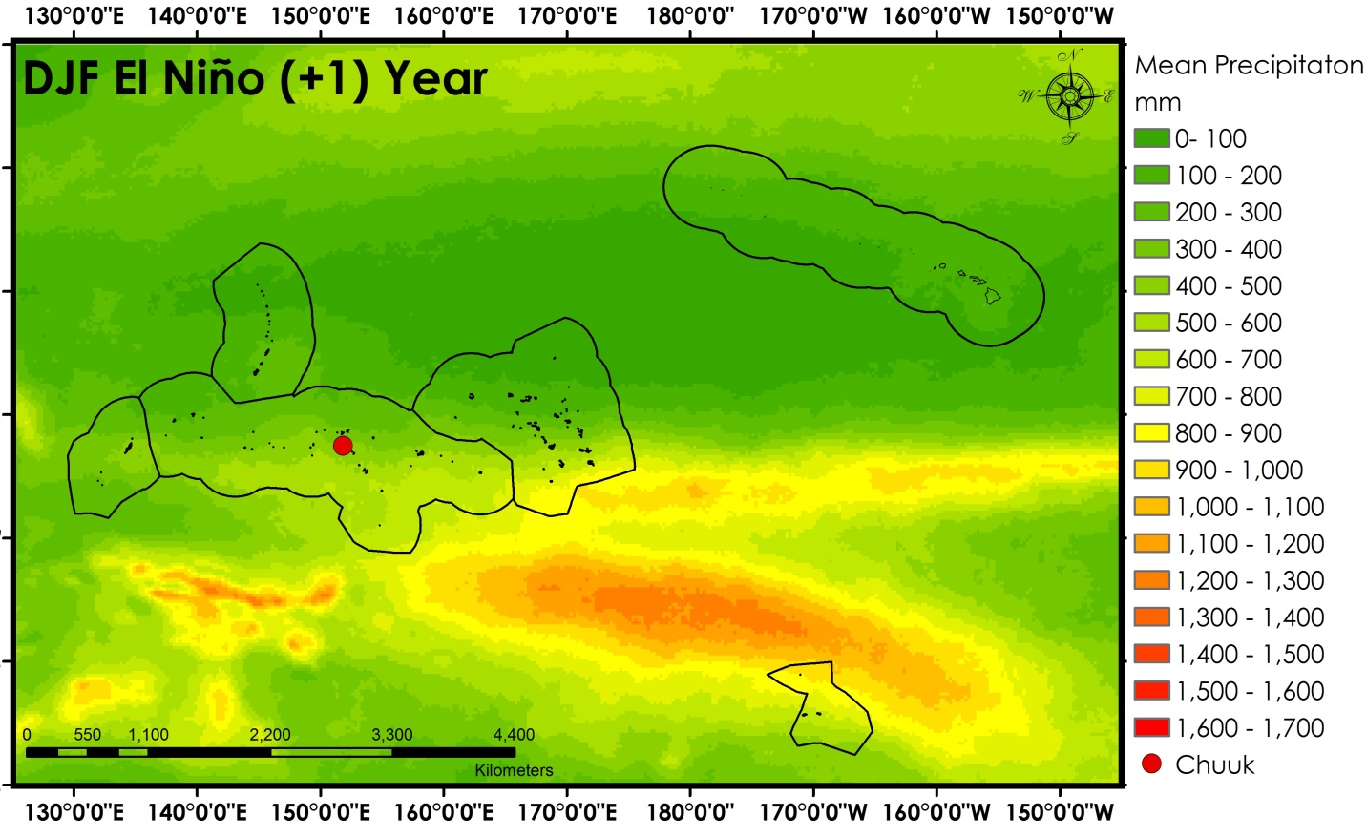
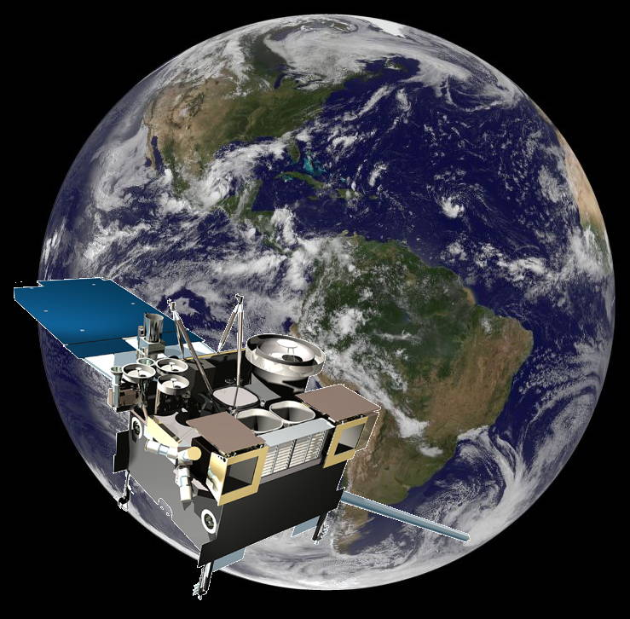
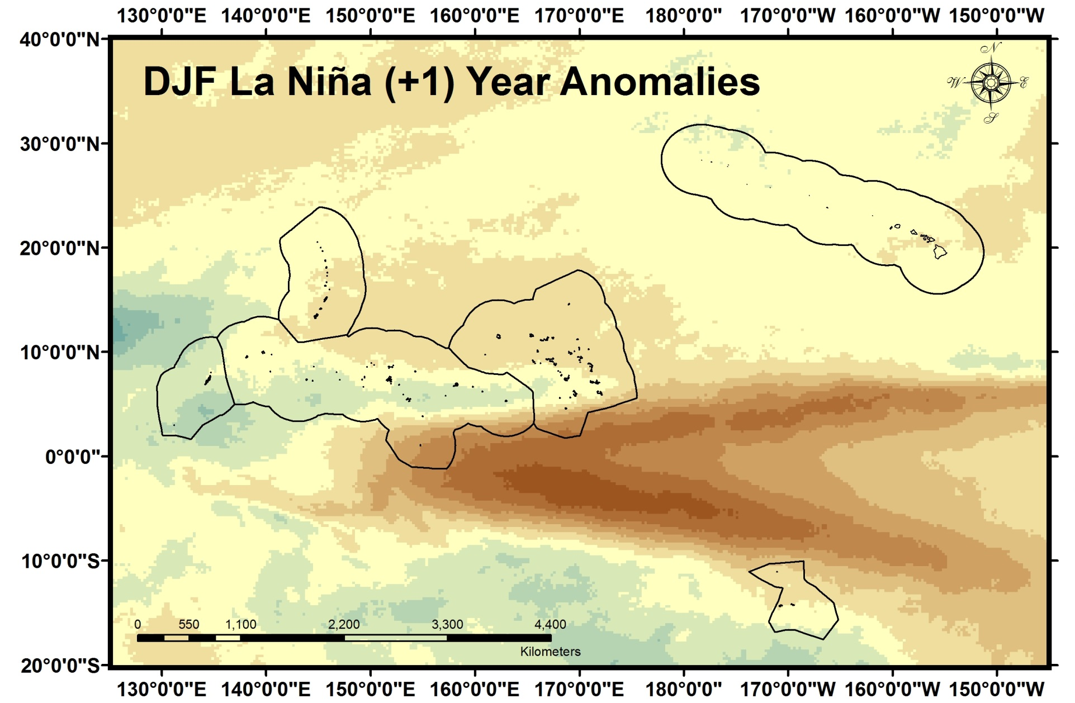
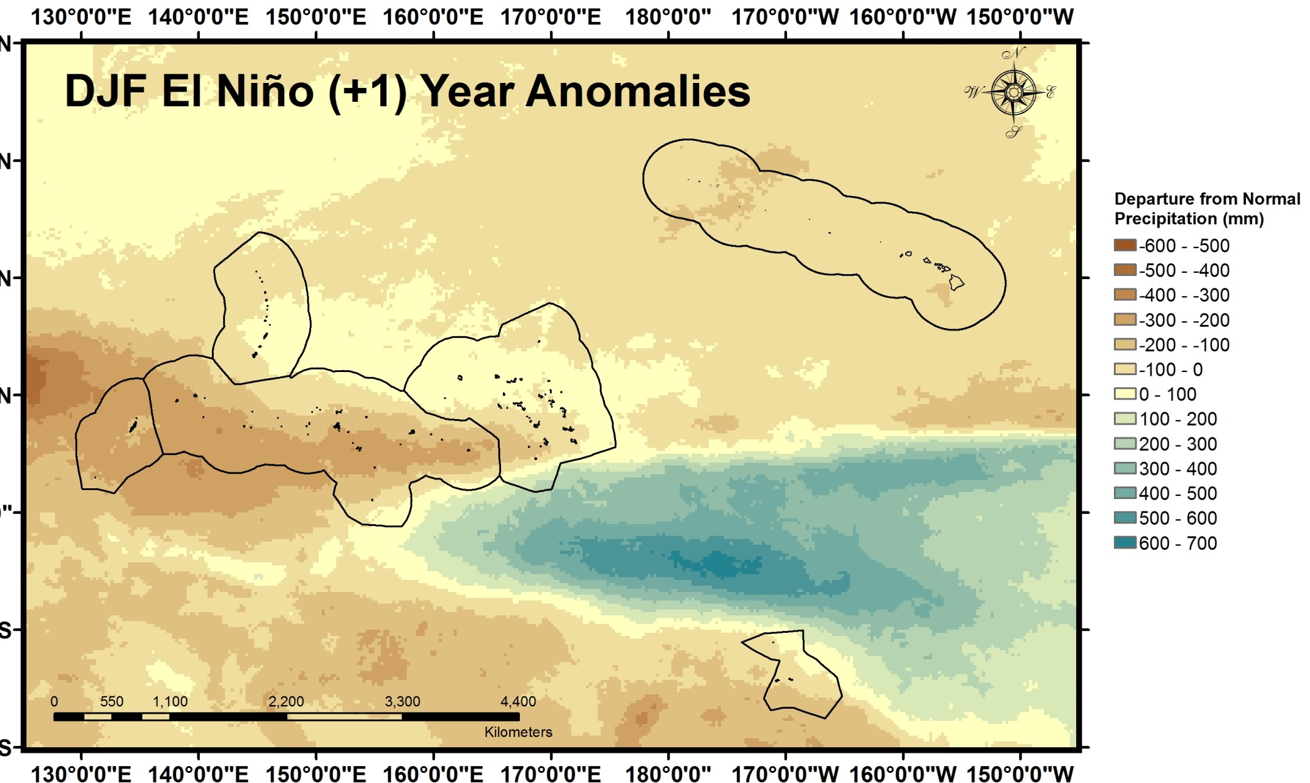
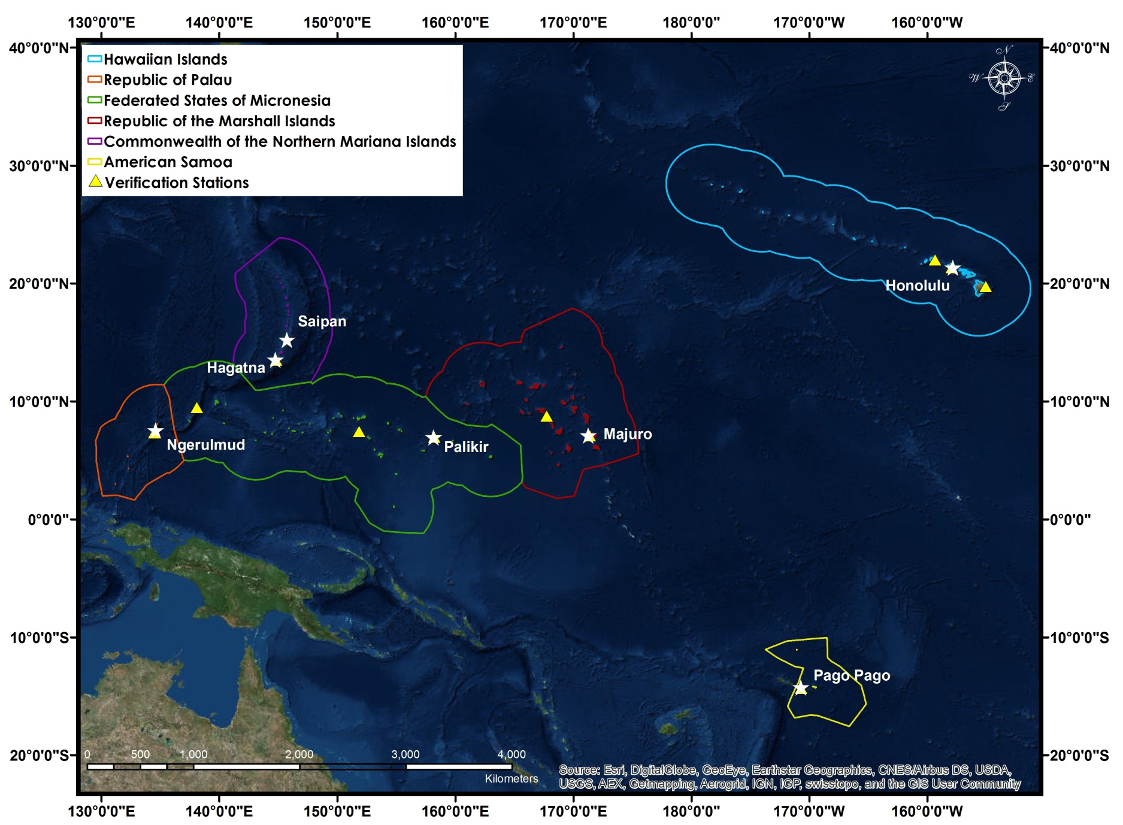
Pacific Water Resources
Using NOAA CDRs and Satellite Data to Connect Phases of the El Niño Southern Oscillation (ENSO) with Precipitation across Hawaii and the U.S. Affiliated Pacific Islands (USAPI)
Jessica Sutton¹, Nicholas Luchetti², Ethan Wright³, Michael Kruk⁴, and John Marra⁵
¹University of South Carolina, ² East Carolina University, ³University of North Carolina-Asheville, ⁴Pacific Water Resources Product Development, and ⁵NOAA Region Climate Services
Abstract
Methodology
Will add for final draft
DATA PREPARATION & ANALYSIS
IN SITU VS. PERSIANN VERIFICATION
GLOBAL PERSIANN PRECIPITATION
MONTHLY
SEASONAL
YEARLY
NOAA STATIONS
LOCATIONS
sum
Daily 0.25° resolution
EXCLUSIVE ECONOMIC ZONES (EEZ)
Place holders not final
Oceanic Niño Index (ONI)
Objectives
Results
Provide an updated ENSO based climatology (1985-2014) of long-term precipitation patterns for each USAPI using the NOAA PERSIANN Climate Data Record (CDR)
Conduct verification analyses with in situ precipitation data
Determine the relationship between PERSIANN CDR precipitation and the seven ENSO phases
Determine precipitation ranges for each USAPI Exclusive Economic Zone (EEZ) during the seven ENSO phases
Results
Earth Observations
GOES
More satellites to come
Figure 2. Mean DJF PERSIANN precipitation for eight moderate to strong La Niña years (88/89, 95/96, 98/99, 99,00, 00/01, 07/08, 10/11, 11/12) (top left), 30 year normal (1985-2014)(top middle), and for the eight moderate to strong El Niño years (86/87, 87/89, 91/92, 94/95, 97/98, 02/03, 04/05,09/10)(top right). The Exclusive Economic Zones are shown outlined in black and the Chuuk NOAA station is highlighted using a colored circle which corresponds to the time series figure (bottom). The time series plot showing mean PERSIANN precipitation in Chuuk for each three month season for the eight moderate to strong El Niño years (red) and La Niña years (blue). The 30 year mean precipitation for each three month season is also shown (black).
Place holders for now
Project Partners
Need to put these in
Study Area
Figure 3. PERSIANN precipitation anomalies for mean DJF for the eight moderate to strong La Niña years (88/89, 95/96, 98/99, 99,00, 00/01, 07/08, 10/11, 11/12) (left) and for the eight moderate to strong El Niños (86/87, 87/89, 91/92, 94/95, 97/98, 02/03, 04/05,09/10)(top right). The Exclusive Economic Zones are shown outlined in black.
Conclusions
Team Members
To be determined.
Need to take photo of team
Acknowledgements
Will add for final
Figure 1. Map of the study area with the Exclusive Economic Zones (EEZs) outlined, NOAA stations ( ), and capital cities ( ) highlighted for each U.S. Affiliated Pacific Island (USAPI) chain. This made map was made using the imagery basmap from ArcGIS.
NOAA National Centers for Environmental Information

