Slide 1
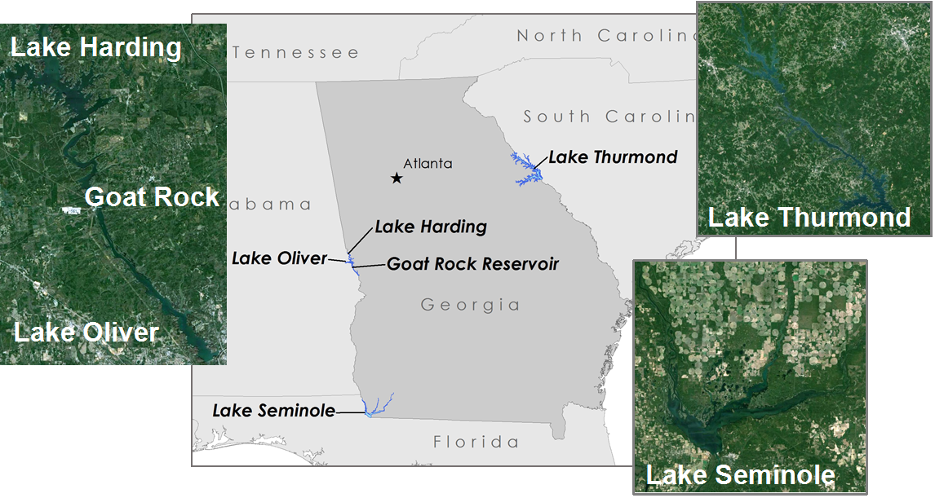
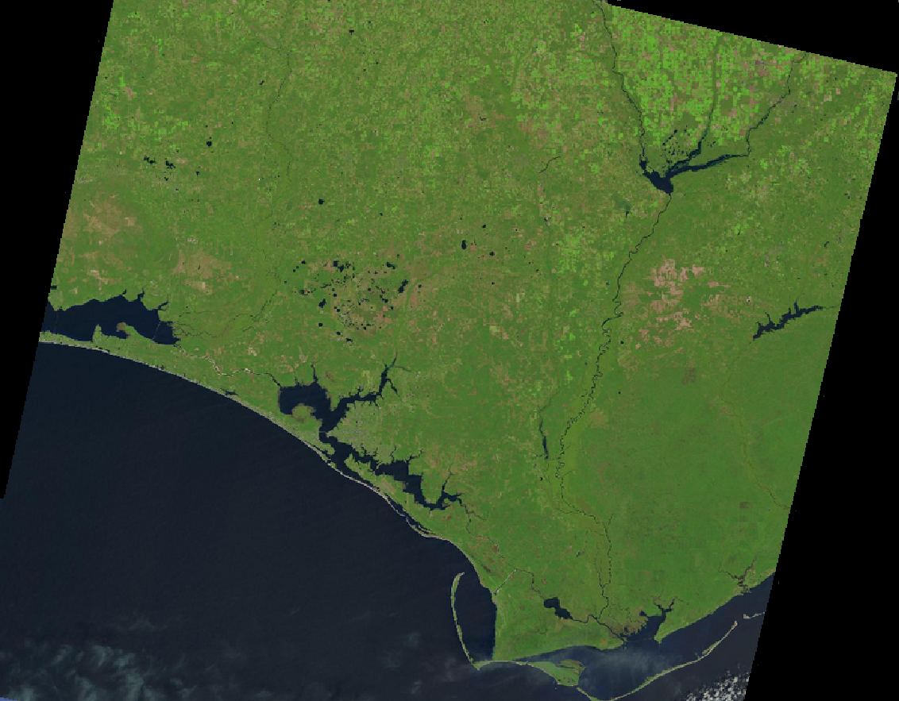
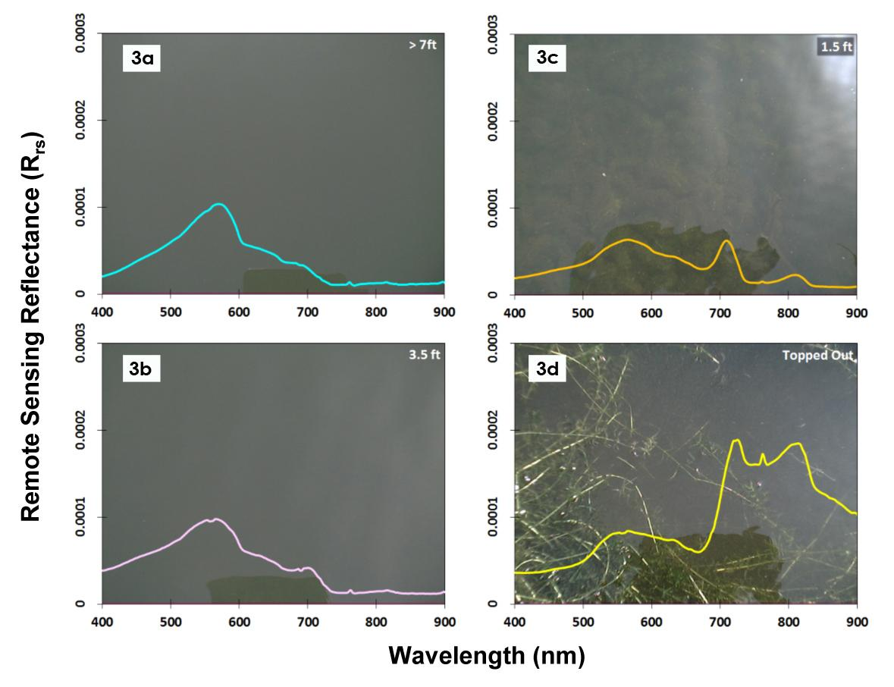
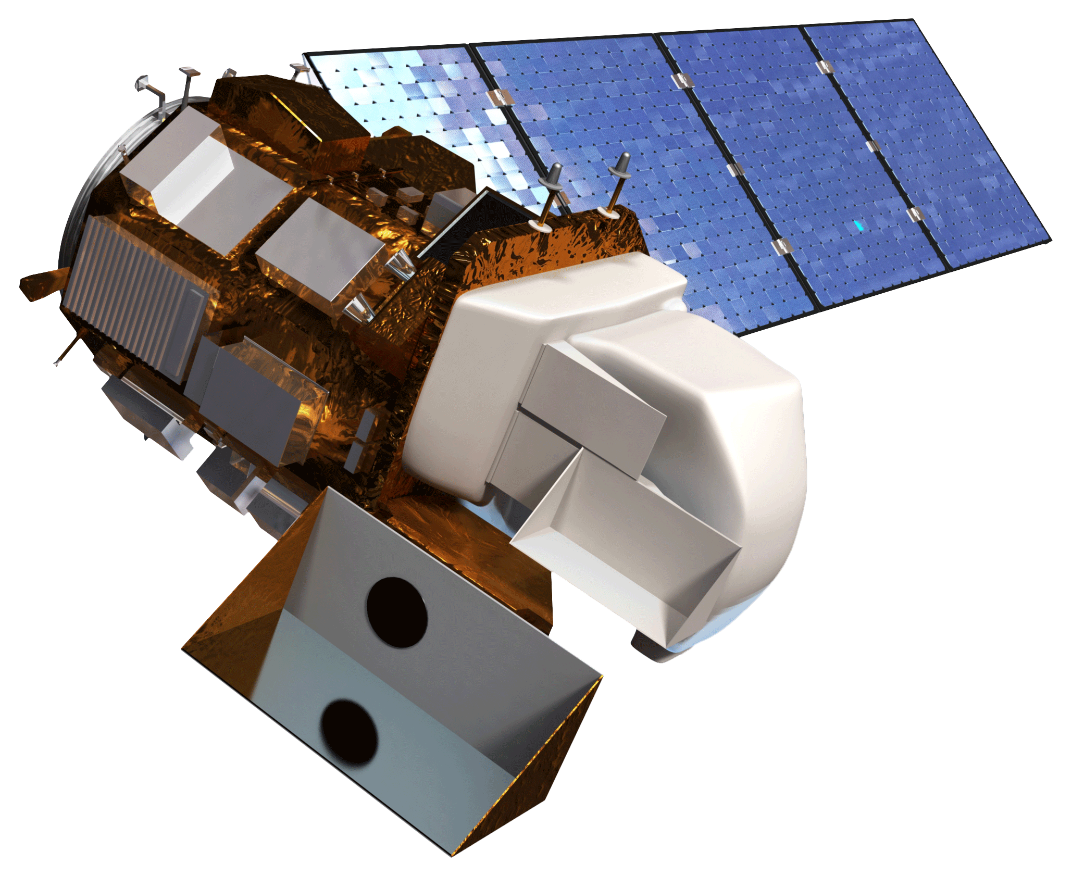
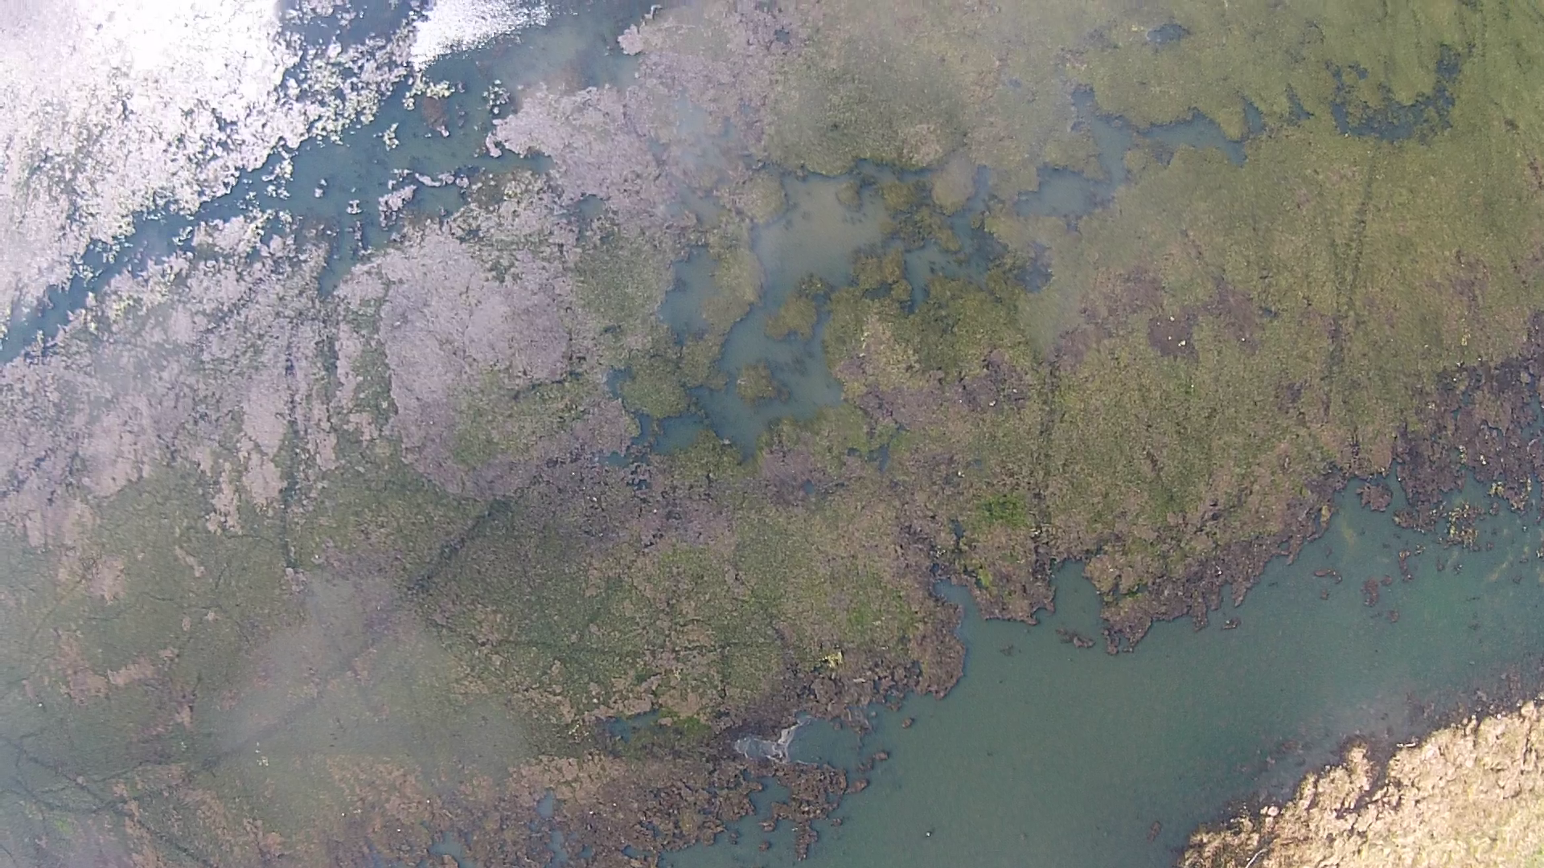
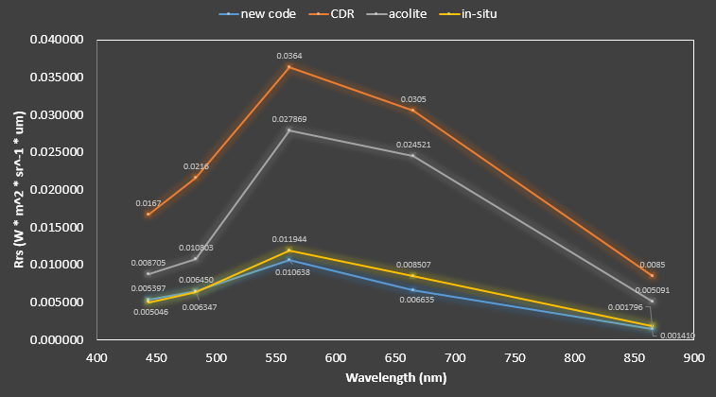
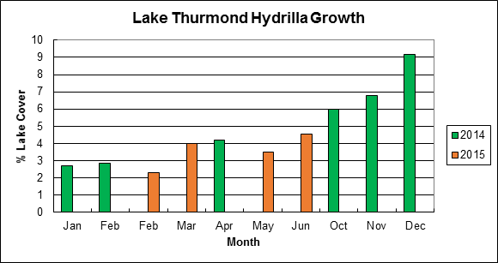
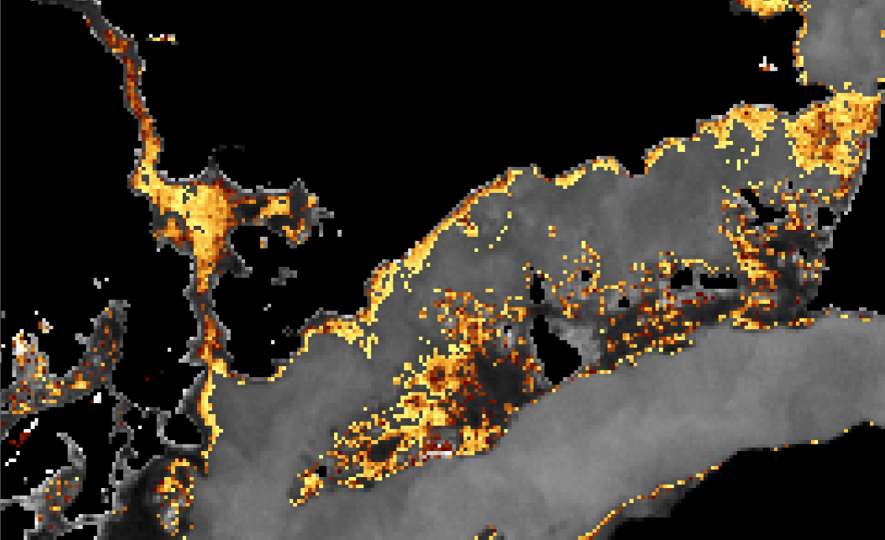
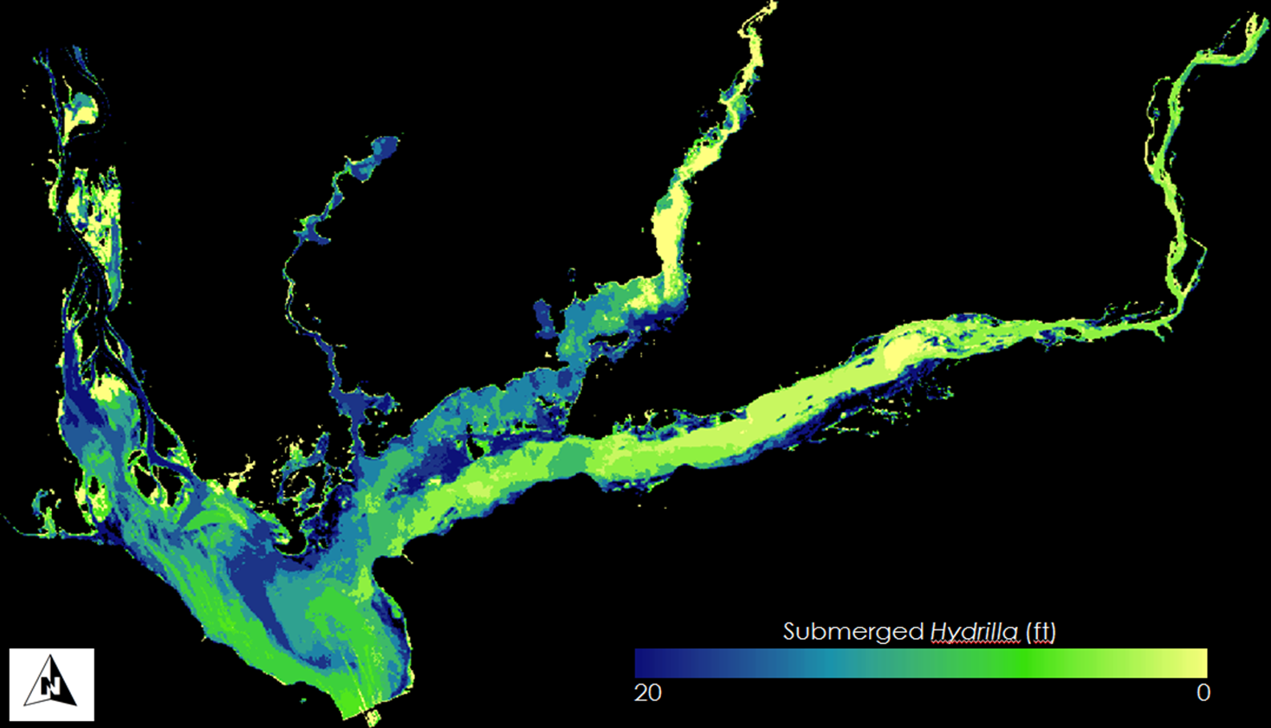
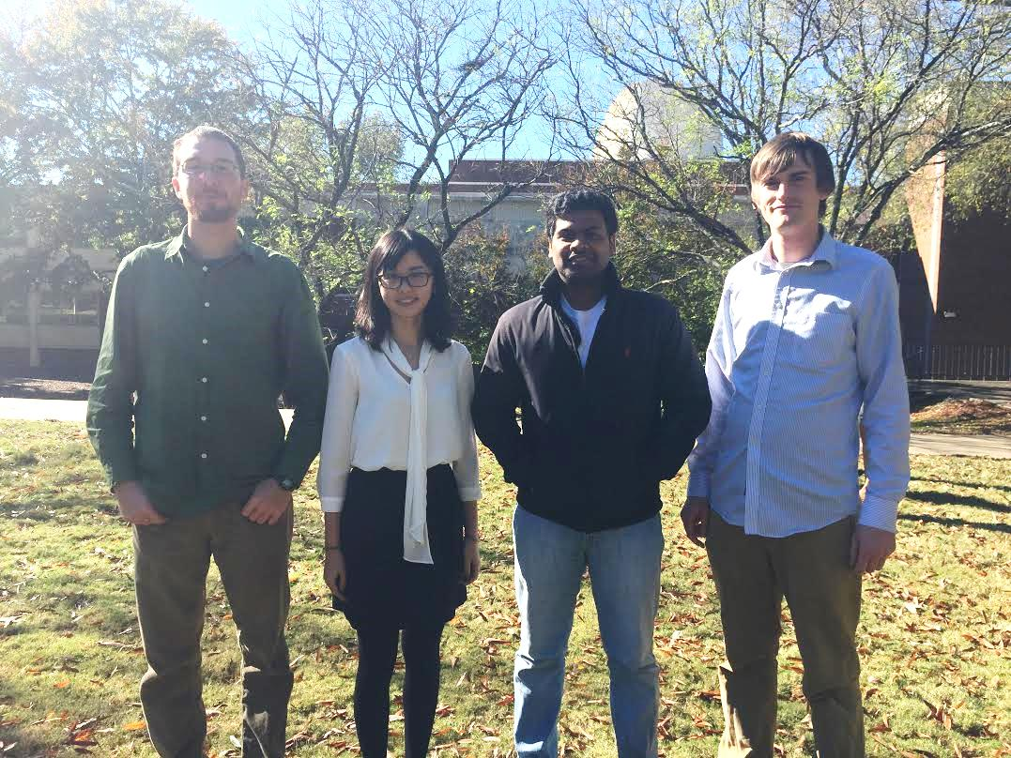
Southeast US Ecological Forecasting II
Using NASA Earth Observations to Map the Spatio-Temporal Distribution of Hydrilla verticillata
Benjamin Page (Project Lead), Brandon Hays, Pradeep Kumar Ragu Chanthar, Linli Zhu
DEVELOP National Program at the University of Georgia
Abstract
Objectives
Hydrilla verticillata is an invasive aquatic plant which has rapidly spread through many inland water-bodies across the Southeastern United States (SEUS) by outcompeting native aquatic plants and displacing fish populations. Consumption of water for drinking and power generation as well as recreational use of lakes has been threatened by the spread of Hydrilla. In recent years, Hydrilla has served as a vehicle for the spread of a toxic cyanobacteria (Aetokthonos hydrillicola) responsible for the neuro-disease Avian Vacuolar Myelinopathy (AVM), which causes massive fish kills and bald eagle deaths throughout Georgia. Using NASA’s Landsat 8 Operational Land Imager (OLI) data, rapid assessment tools were developed to map the extent of Hydrilla and predict future spread throughout the SEUS by quantifying seasonal growth through time-series analysis. Data collected from 2013-2015 were used to create true-color composites depicting the phenological patterns of Hydrilla. A normalized difference vegetation index (NDVI) was performed on these images to quantify floating vegetation. The time series of NDVI images was then analyzed to identify areas of expanding Hydrilla presence. A Visible Atmospherically Resistant Index (VARI) was performed to provide an additional measure of the spatial distribution of Hydrilla. Subsequently, in situ depth measurements were used to train a maximum likelihood classification capable of differentiating Hydrilla at varying depths. This classification was and is continued to be validated with aerial imagery acquired by an unmanned aerial system. With an NDVI time series, in conjunction with a quantitative model of Hydrilla growth, a feasible forecasting model can predict future Hydrilla hot spots.
Characterize the seasonal patterns of Hydrilla distribution in inland waters using NASA’s Earth Observing System (EOS)
Quantify total area covered by topped-out/floating vegetation
Create a predictive model to forecast future growth of Hydrilla
Methodology
Study Area
Data Acquisition
Processing
Output
EOS Remote Sensing
Atmospheric Correction
VARI
Landsat 8 OLI Imagery
Other
NDVI
Time Series
Vicarious Calibration
True Color Composite
In Situ Data
Classified Imagery
Earth Observations
Hyper-spectral Data
Unsupervised Classification
Landsat 8 Operational Land Imager (OLI)
Drone Footage
Model Training
Model Validation
Predictive Model
Results
Conclusions
Figure 1 (Left). Spectral profiles of tested atmospheric corrections. The vicarious calibration based on in situ data had the lowest Root Mean Squared Error
Mapped phenological patterns of Hydrilla in SE US water bodies
Mapped current spatio-temporal distribution of hydrilla
Identified hotspots/areas of management concern
Created tool for forecasting future growth of floating vegetation
Figure 2 (Right). Hydrilla coverage of Lake Thurmond from 2014-2015
0.2
NDVI
0.5
Figure 3 (Left). NDVI map showing seasonal patterns of topped out Hydrilla growth
Figure 4 (Right). Maximum Likelihood Classification of submerged Hydrilla at varying depths
Acknowledgements
Team Members
We would like to thank our Science Advisors, Drs. Deepak Mishra and Susan Wilde of UGA, for their advice and guidance
Thanks to Brigette Haram of the Warnell School of Forestry for her help in collecting field data and her valuable knowledge of Hydrilla in our field site
We are grateful to Kenneth Boyd and Allen Dean of the United States Army Corps of Engineers at Lake Thurmond for their help collecting field data
This project builds upon previous work done by the SEUS Ecological Forecasting I NASA DEVELOP team: Shuvankar Ghosh, Peter Hawman, Wuyang Cai, and Elizabeth Dyer
Project Partners
Georgia Power
United States Army Corps of Engineers
J.W. Jones Ecological Research Center
Henry County Water Authority
Brandon Hays, Linli Zhu,
Pradeep Kumar Ragu Chanthar, Benjamin Page
The University of Georgia

