Slide 1
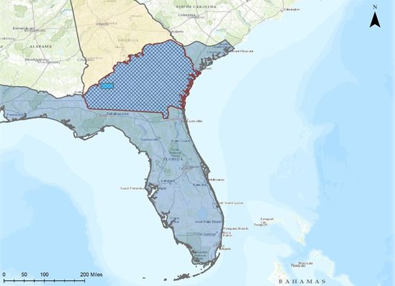
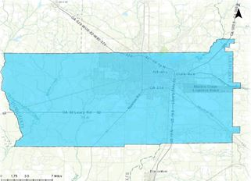
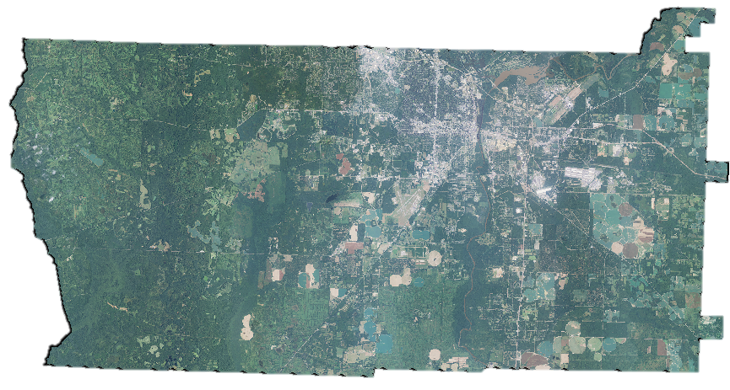
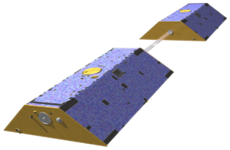
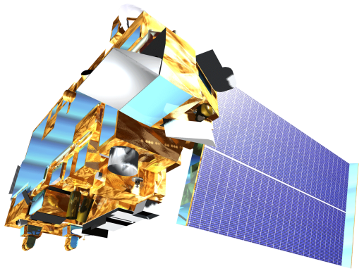
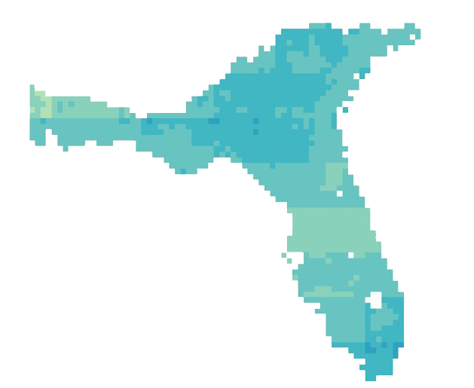
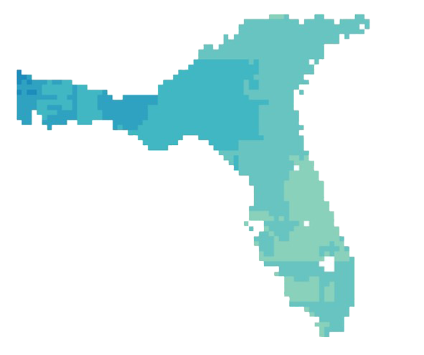
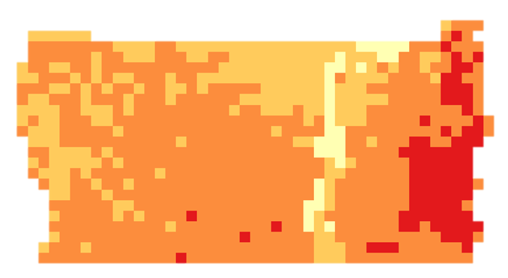
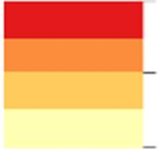
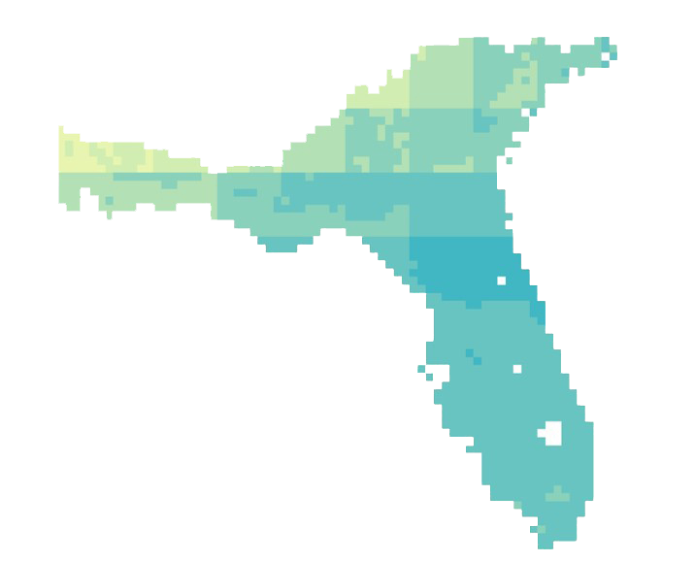
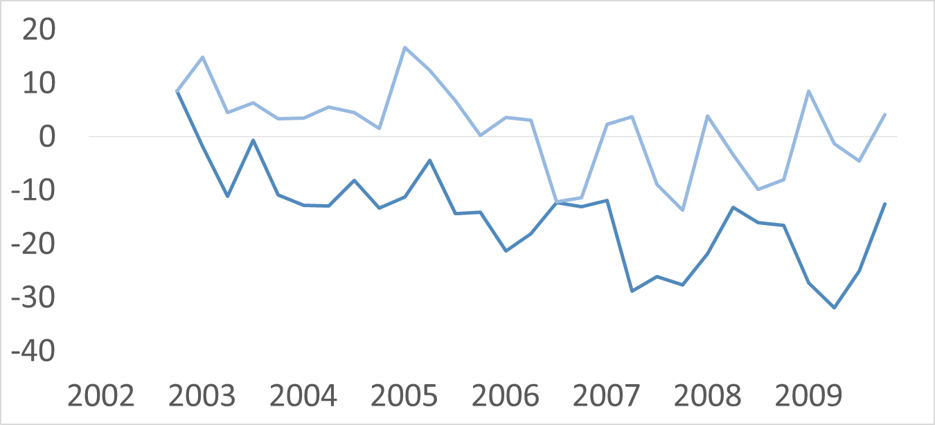
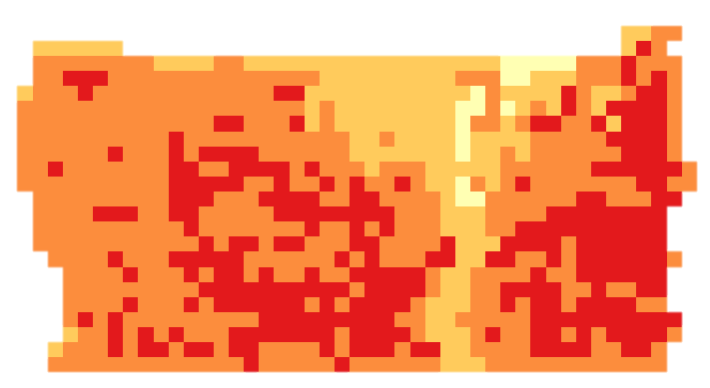
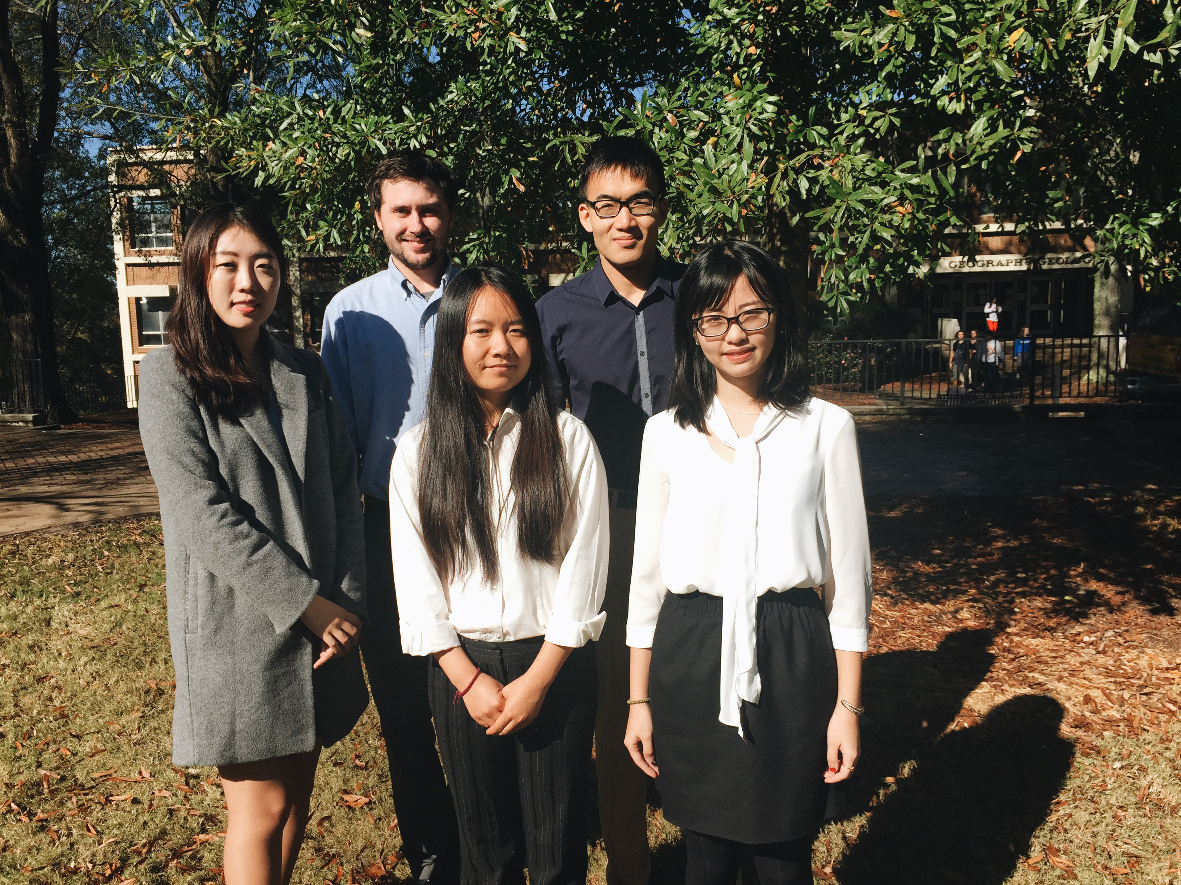
Georgia Water Resources
Assessing Groundwater Storage Change and Contamination Risk in Southwest Georgia
Wenjing Xu (Project Lead), Jason Reynolds (Project Co-Lead), Doori Oh, Mingshu Wang, Linli Zhu
DEVELOP National Program at The University of Georgia
Abstract
Objectives
Groundwater from karst aquifers is the primary water source for domestic, industrial, and agricultural use in southwest Georgia. However, these aquifers are highly vulnerable to pollution due to their high geological conductivity. Groundwater storage and contamination risk monitoring can improve water consumption and protection management decisions. This project used an applied methodology that incorporated remote sensing data for groundwater monitoring. Specifically, the Gravity Recovery and Climate Experiment (GRACE) was used to estimate groundwater depth change from 2002 to 2009, which was correlated with sinkhole inventory data during this time period. The DRASTIC model was combined with sinkhole susceptibility maps generated by the Summer 2015 DEVELOP Georgia Disasters team to create corresponding groundwater contamination vulnerability maps. Building upon the traditional DRASTIC model, sinkhole susceptibility was incorporated as a multiplier term to calculate a final, modified DRASTIC index (DRASTICS). This augmented DRASTIC model will provide end-users working in karst aquifer systems a tool designed to enhance decision-making processes associated with managing groundwater contamination risks.
Develop groundwater storage change map of southern Georgia using GRACE satellite data
Assess groundwater quality and produce risk maps using a modified DRASTIC model accounting for sinkhole proximity
Identify areas susceptible to groundwater contamination
Methodology
Study Area
Data Acquisition
Data Analysis
End Products
QUANTITY
Water Storage data (GRACE)
Soil Moisture and Snow data (NLDAS)
Groundwater Storage (GW)
Total Water Storage (TWS)
Soil Moisture (SM)
Snow Water Equivalent (SWE)
Groundwater Storage Variability Map
$\text{ΔGW}\text{ = }\text{ΔTWS}\text{(}\text{GRACE}\text{)− (}\text{ΔSM}\text{(}\text{NLDAS}\text{) + }\text{ΔSWE}\text{(}\text{NLDAS}\text{)}$)
Floridan Aquifer
QUALITY
Depth to Water
Recharge
Aquifer Media
Soil Media
Topography
Impact of Vadose Zone
Conductivity
Georgia
Traditional DRASTIC
Groundwater contamination susceptibility map
Floridan Aquifer, Georgia Portion
Well log data (USGS)
Precipitation data (PRISM)
Evapotranspiration data (MODIS 16)
Geological data(USGS)
DEM data (NED)
Soil Data (STATSGO)
DRASTICS
Dougherty County
Earth Observations
Sinkhole susceptibility
Results
GRACE
Terra MODIS
GRACE
High Anomaly
Low Anomaly
Conclusions
2002
2005
DRASTICS
High: 257.1
A significant decline in groundwater storage occurred in the Floridan Aquifer from 2002 – 2009.
Depletion of groundwater storage increases the risk of water shortages and sinkhole development.
Due to the dramatic increases of groundwater contamination risk in the western part of Dougherty County, we recommend a detailed monitoring in this area.
High-risk areas were dominated by agricultural land close to urban areas.
Floridan Aquifer Water Storage Anomalies
Low: 99.8
2002
2009
TWS
GWS
2009
Team Members
Project Partners
Acknowledgements
City of Albany and Dougherty County Planning and Development Services
Southwest Georgia Water Resources Task Force
We would like to thank our Science Advisors, Dr. Adam Milewski and Matthew Cahalan for their guidance on this project.
We would like to acknowledge past contributors Mohamed Amin, Kimberly Berry, and Tunan Hu.
We would like to extend our appreciation to our main contact from our partner organizations, Randy Weathersby.
From left to right: Doori Oh, Jason Reynolds, Wenjing Xu, Mingshu Wang, Linli Zhu
The University of Georgia

