Slide 1
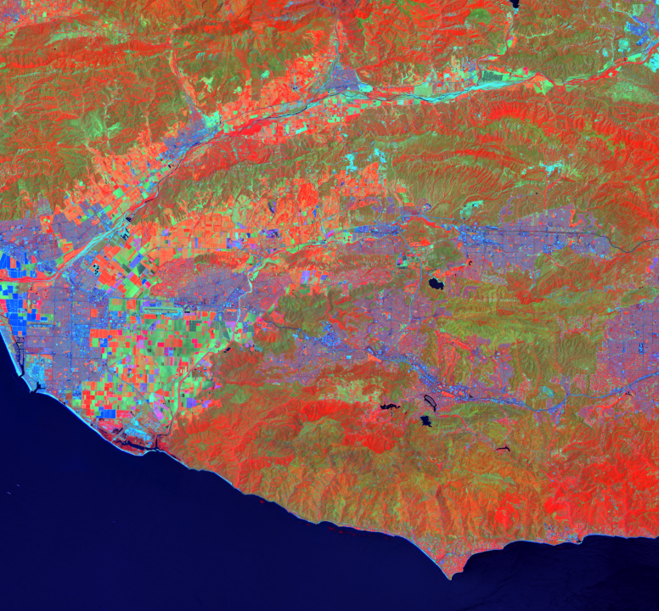
SANTA MONICA MOUNTAINS ECOLOGICAL FORECASTING III
Analyzing Recent Wildfire Impacts to Assist the Resource Conservation District of the Santa Monica Mountains in Identifying Tree Species to Replant
Melissa Ferriter
Laura Jessup
Roger Ly
Joshua Spector
California – JPL | Summer 2019
Notes:
Photo source: Generated by the Santa Monica Mountains III team
Speaker Notes
We are the Santa Monica Mountains Ecological Forecasting III Team
Name, School, Major, Number of Terms
Laura Jessup, PhD student at Purdue University study Forestry and Natural Resources

Slide 2
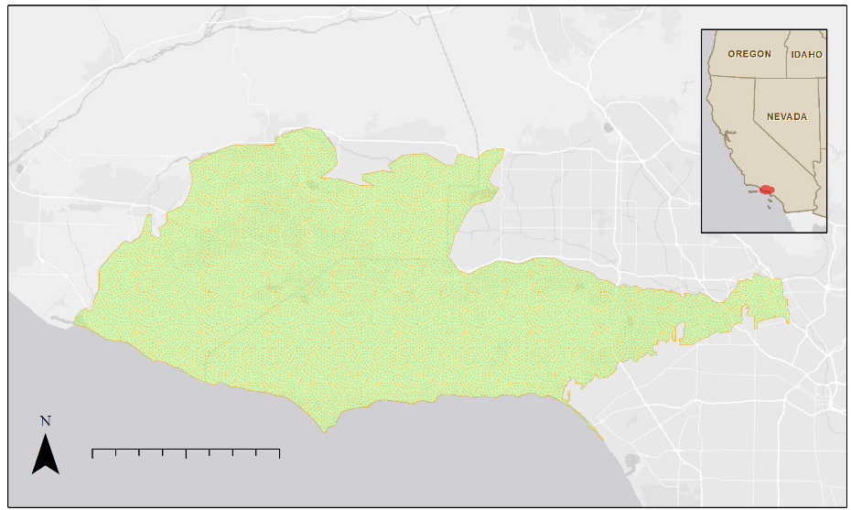
Santa Monica Mountains National Recreation Area
Santa Monica Mountains National Recreation Area
Oregon
Idaho
Nevada
California
0 5 10 20 Kilometers
Notes:
Map 1: Generated by the Santa Monica Mountains III team, Base layer source: ESRI OpenStreetMap , ArcMap 10.6
Speaker Notes
This is our study area The Santa Monica Mountains National Recreation Area
which is about 63,000 ha and lies between Ventura and Los Angeles County
This area is managed by various public and private groups such as Tree People, the Resource Conservation District of the Santa Monica Mountains, and the National Park Service

Slide 3
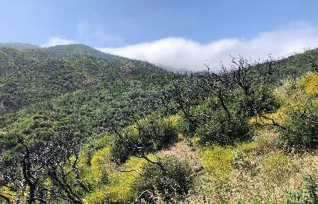
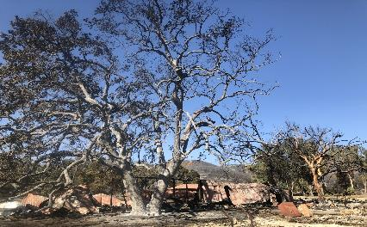
Study Area: Native Species
The Santa Monica Mountains are one of the top 25 global biodiversity hotspots
The area has a mosaic of diverse vegetation
Native vegetation provides ecosystem services
Image Credit: Laura Jessup
222
Image Credit: Rosi Dagit
Notes:
Image 1 Source: Laura Jessup (Written Permission)
Image 2 Source: Rosi Dagit (Written Permission)
Speaker Notes
The SMM are part of the CA floristic region, which is one of the top 25 global biodiversity hotspots
The area is home to 12 vegetation communities, which include California Walnut, California Bay Laurel, Coast Live Oak Woodland, Valley Oak Savanna, and Riparian Woodland
These vegetation communities provide valuable ecosystem services such as carbon sequestration, slope stability, and temperature moderation

Slide 4
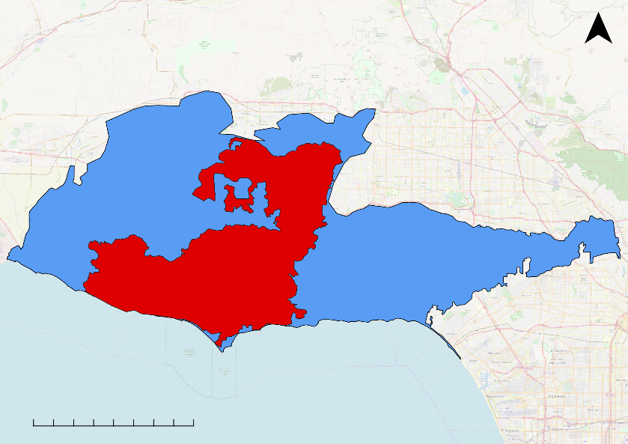
Study Area: Woolsey Fire
0 5 10 20 Kilometers
Fire Burn Area
Study Area
Notes:
Map 1: Generated by the Santa Monica Mountains III team, Base Layer Source: Open Street Map. QGIS 3.4.
Speaker Notes
This map displays the Woolsey Fire burn area overlayed on the study area

Slide 5
Community Concerns
Loss of ecosystem services and degradation of the landscape
Threats from wildfires, floods, drought, and invasive beetles
The Woolsey Fire burned almost 100,000 acres of the study area
Notes:
Image 1: Generated by the Santa Monica Mountains Eco III Team
Speaker Notes
Native oak and riparian woodlands support hundreds of species and provide billions of dollars of ecosystem services to the Los Angeles region
Current threats from wildfires, floods, drought, and invasive beetles have caused extensive mortality in the past seven years.
The recent Woolsey Fire (November 8-21, 2018), has damaged this sensitive area further by burning a large section of the study area.

Slide 6
Partners
Resource Conservation District of the Santa Monica Mountains
National Park Service, Santa Monica Mountains National Recreation Area
California Department of Parks and Recreation, Los Angeles Division
County of Los Angeles Fire Department, Prevention Services Bureau, Forestry Division
County of Los Angeles Department of Regional Planning
University of Montana, Department of Geography
Notes:
NASA Logo: NASA https://www.nasa.gov/audience/forstudents/5-8/features/symbols-of-nasa.html
JPL Logo: NASA https://www.jpl.nasa.gov/
DEVELOP Logo: NASA https://develop.larc.nasa.gov/2014/fall_term/DEVELOPediaandtheArtofCommunicatingwithEndUsers.html
Speaker Notes
Our amazing partners made this project possible and many of them are here today which we are very grateful for
We partnered with
the Resource Conservation District of the Santa Monica Mountains
the National Park Service
the California Department of Parks and Recreation
the County of Los Angeles Fire Department
the County of Los Angeles Department of Regional Planning
and the University of Montana

Slide 7
Objectives
Determine where and what tree species were still alive after the recent fires and drought
Map existing topographical and environmental conditions
Identify sites with suitable conditions to support native woodlands in the next century
Notes:
Speaker Notes
We had three objectives which were to
determine where and what species were still alive after the recent fires and drought
map existing topographical and environmental conditions,
and identify sites with suitable conditions to support native woodlands in the next century

Slide 8
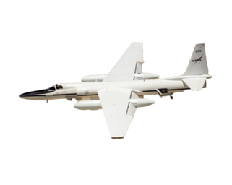
Data: NASA Earth Observations
SRTM
Shuttle Radar Topography Mission
Landsat 8 OLI
Operational Land Imager
AVIRIS
Airborne Visible Infrared Imaging Spectrometer
Image Credit: Developedia
Notes:
Images Source: http://www.devpedia.developexchange.com/dp/index.php?title=List_of_Satellite_Pictures
Speaker Notes
The NASA Earth Observations we used were from the Shuttle Radar Topography Mission, Landsat 8 Operational Land Imager, and Airborne Visible Infrared Imaging Spectrometer.
Note: Landsat 8 OLI and SRTM are NASA Earth Observing Systems; AVIRIS is a NASA Earth Observation, but not considered an EOS.

Slide 9
Data: Ancillary
NASA Earth Exchange (NEX) Downscaled Climate Projections (DCP30) - 250m
Planet Labs RapidEye satellite imagery - 5m
Resource Conservation District of the Santa Monica Mountains Oak Study in situ observation data
NPS SMMNRA Inventory and Monitoring Plots
USGS-NPS Mapping Program - Vegetation Classification of the Santa Monica Mountains (2007)
Notes:
Image 1: Generated by the Santa Monica Mountains Eco III Team
Speaker Notes
In addition to NASA Earth observations, we used
NASA Earth Exchange Climate Projections
RapidEye Imagery
Vegetation polygons provided by our partners
and other in situ data

Slide 10
Workflow
Data Source
Species Mapping
Post-processing
End Products
Landsat 8 OLI
Burn Severity
Burn Severity Map
Regroup spectral library classes
AVIRIS
MESMA
Shade Normalization
Confusion Matrices
Vegetation Guild and Vegetation Health Current Conditions Map
RapidEye
Create spectral library training data
Data Source
Maxent Input Preparation
Maxent Modeling
End Products
NASA NEX DCP30
Min/Max Temp
& Precipitation
Average historic and projected data
Map of Annual Climate Variables
Combine models for climate and topography
NASA SRTM
Slope, aspect, flow accumulation
MaxEnt Model
Predicted Suitable Woodlands Planting Sites Map
SMMNRA Vegetation
Sort vegetation into guilds
Vegetation occurrence points
Notes:
Image 1: Flowchart generated by the Santa Monica Mountains Eco III team
Speaker Notes
This is a general overview of our workflow
It is broken into species mapping on the top and species distribution modeling along the bottom
To map species we used AVIRIS and RapidEye imagery in a MESMA classification in ENVI
For our second part of species distribution modeling we used projected climate data, topographical variables, and remotely sensed vegetation occurrence
points in a MaxEnt model
We modeled distribution under the IPCC representative concentration pathways (RCP) 4.5 and 8.5 climate scenarios, 8.5 is considered the most severe while 4.5 is somewhere in the middle
The resulting suitability maps for each vegetation guild will help determine areas that will support seedlings during the first several decades after planting and adult trees as the seedlings mature
Additional Notes
MaxEnt is a software that bases predictions of distribution on the principle of maximum entropy
The inputs to our model were species occurrence points derived from high quality vegetation polygons from the NPS and various topographical and climate variables derived from the NASA SRTM and NEX DCP30 datasets
The NEX DCP30 dataset contains historic and projected climate data following representative concentration pathway (RCP) 4.5 and 8.5; 8.5 is the most severe climate scenario
Climate and topographical variables were used to build separate species distribution models due to differing spatial resolutions among the two datasets
Additionally, separate species distribution models were built based on climate variables for seedling and mature life stages. This was done to account for the different climate conditions that are most suitable in each life stage
We then combined and averaged the climate and topography suitability rasters for the seedling and mature life stages to identify suitability throughout the lifespan of trees regenerating after the Woolsey Fire

Slide 11
AVIRIS
Notes:
Images: Generated by the Santa Monica Mountains Eco III Team

Slide 12
Methods: AVIRIS
Dominant pixel classification using Multiple Endmember Spectral Mixture Analysis
Spectral training data from last term regrouped
Random sample of training data along with NPS vegetation classification used to assess accuracy
Vegetation Class | Species Name
Annual Grass | California Annual Grasses
Chaparral | Adenostoma fasciculatum, Ceanothus megacarpus, Ceanothus spinosus, Cercocarpus betuloides, Malosma laurina, Quercus berberidifolia
Coastal Sage Scrub | Artemisia spp., Eriogonum cinereum, Eriognum fasciculatum, Cercocarpus fasciculatum, Salvia spp.
Coast Live Oak Woodland | Quercus agrifolia
Riparian | Alnus rhombifolia, Juglans californica, Platnaus racemosa, Salix spp.
Notes:
Speaker Notes
We used MESMA to create a classification of 5 classes
Spectral library was created by the last term, we followed their suggestions and combine classes
To assess accuracy we used the training data along with nps polygon data as ground control points

Slide 13
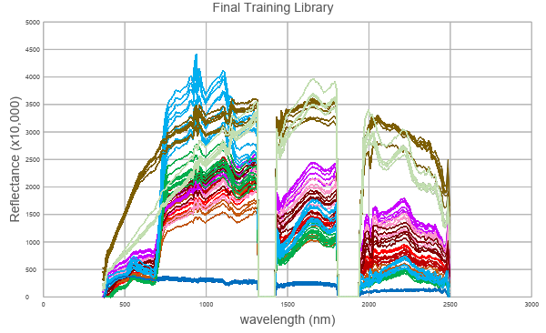
AVIRIS Spectral Library
5000
4500
4000
3500
3000
2500
2000
1500
1000
500
0
Annual grass
Ceanothus megacarpus
Ceanothus spinosus
Chaparral - common
Coastal sage – drought decid.
Reflectance (x10,000)
Coastal sage – summer active
Malosma laurina
Coast live oak woodland
Riparian
Substrate
Water
0 500 1000 1500 2000 2500 3000
Wavelength (nm)
Notes:
Speaker Notes
This graph shows the endmember spectra used in the final library
Coastal Sage classes were combined
Chaparral species were combined

Slide 14
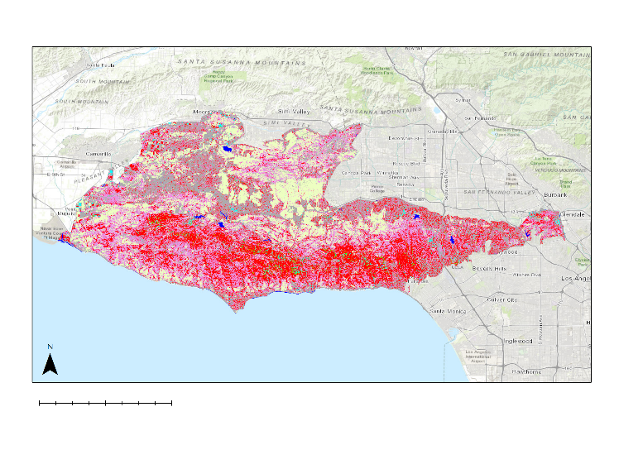
Results: AVIRIS Land Cover Classification
 | Area (M²) | Percent of Area
Chaparral | 380,068,354 | 31.11%
Coastal Sage | 322,478,677 | 26.40%
Annual Grass | 253,353,514 | 20.74%
Non-Photosynthetic | 223,616,221 | 18.31%
Riparian | 27,940,627 | 2.29%
Coast Live Oak | 8,307,206 | 0.68%
Water | 5,691,947 | 0.47%
Riparian
Annual Grass
0
10
20 km
Coast Live Oak
Chaparral
Non-Photosynthetic
Coastal Sage Scrub
Water
Notes:
Map 1: Generated by the Santa Monica Mountains Eco III Team, Base layer source: ESRI OpenStreetMap , ArcMap 10.6
Speaker Notes
Final classification map
Chaparral was the largest class followed by coastal sage scrub and annual grasses
reiterate that its dominant pixel

Slide 15
RapidEye
Notes:
Images: Generated by the Santa Monica Mountains Eco III Team

Slide 16
Methods: RapidEye
Dominant pixel classification using Multiple Endmember Spectral Mixture Analysis
Spectra used to make training data
Used in situ observations 4 days after imagery was taken to assess accuracy
 | Description
Thriving Vegetation | Vegetation in the best condition
Healthy Vegetation | Vegetation that is healthy
Vegetation Presence | Vegetation that is alive
Non-photosynthetic | Dead vegetation, bare ground, or urban areas
Water | Water bodies
Notes:
Speaker Notes
RapidEye imagery taken 06/30/2019
Used for high spatial resolution vegetation health
Classified based on spectra, high NIR values = denser and healthier veg

Slide 17
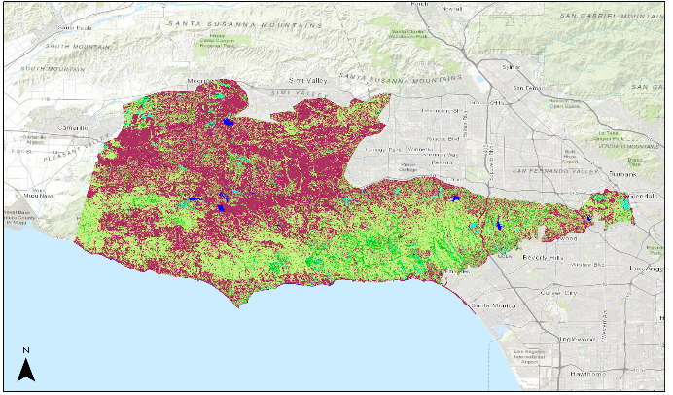
Results: RapidEye Vegetation Health Classification
 | Area (M²) | Percent of Area
Non-Photosynthetic | 594,096,800 | 50.83%
Vegetation Presence | 461,446,225 | 39.51%
Healthy Vegetation | 94,258,650 | 8.07%
Thriving Vegetation | 13,429,625 | 1.15%
Water | 5,169,750 | 0.44%
0
10
20 km
Thriving Vegetation
Vegetation Presence
Healthy Vegetation
Non-Photosynthetic
Water
Notes:
Map 1: Generated by the Santa Monica Mountains Eco III Team, Base layer source: ESRI OpenStreetMap , ArcMap 10.6
Speaker Notes
Post fire 06/30/2019, very recent, 5 meter resolution
Potential exploration of altering this library to find riparian areas/ denser tree canopies

Slide 18
MaxEnt
Species Distribution Model
Notes:
Images: Generated by the Santa Monica Mountains Eco III Team
MaxEnt Explanation
MaxEnt’s algorithm estimates the probability distribution of maximum entropy, as derived from patterns found within the data.
It estimates the optimal probability distribution from which it is assumed that the presence data are drawn .
The best model output (as a set of probabilities) is that which creates the most uniform distribution, or where the distribution is closest to the average observed distribution based on habitat occurrence likelihoods over the entire dataset.
It yields the conditional probability of presence, given a particular set of environmental conditions, where the response variable is the probability of a site being suitable.
The output is a grid of probabilities that refer to the likelihood of suitable habitat being found in that pixel

Slide 19
Study Period: Forecasting Timeline
Woolsey
Fire
Replanting
Seedling
Trees
Future Mature
Trees
Mature
Trees
Seedling
Trees
1950
1979
2017
2018
2020
2060
2099
Maturation
Maturation
Notes:
Figure 1: Generated by the Santa Monica Mountains Eco III Team
Speaker Notes
The study period spans from June 2017 to June 2019 with species distribution models forecasting from 2020 to 2099
This period includes a seven year drought that lasted from 2011 until 2017 as well as the Woolsey Fire which caused significant damage the study area
We assumed that the current distribution of mature trees were seedlings between 1950 and 1979, and these same trees were maturing from 1980 to 2005.
Because seedling trees are generally more sensitive to environmental conditions, we modeled seedling trees and mature trees separately.
We did this by using climate data from the historical seedling period (1950-1979) to predict future seedling distribution (2020-2059) and data from the historical mature period (1979-2005) to predict the future mature distribution (2060-2099).
We averaged future seedling and future mature distributions to determine areas where trees will thrive throughout their lifespan.
We set aside data from 2005-2019 to represent current climatic conditions so we could compare range shifts between future and current distributions.

Slide 20
Methods: Maxent
Climate Inputs
minimum temperature
maximum temperature
precipitation rate
Maxent
Climate Suitability
Weighted by AUC
Species Occurrence
Habitat Suitability
Topographic Inputs
slope
aspect
flow accumulation
Maxent
Topographic Suitability
Weighted by AUC
Notes:
Speaker Notes
We focused our species distribution models on four vegetation guilds (oak woodland, riparian woodland, California bay woodland, and walnut woodland)
The occurrence data for these guilds were derived from NPS polygons and used as inputs to Maxent along with climate and topography data.
Our climate variables were minimum temperature, maximum temperature, and precipitation rate
and our topographic variables were slope, aspect, and flow accumulation.
We created separate suitability models for climate and topography variables in Maxent
This gave us projections of species distribution based on climate in the seedling and mature life stages and a projection of species distribution based on topography
To do this we first calculated a weighted average of climate suitability maps for seedling and mature life stages with topography suitability maps
We then averaged seedling and mature life stages to create a habitat suitability map which reflects suitability based on climate and topography for the predicted life span of trees that will hopefully be planted by our partners.

Slide 21
Model Performance
Topography SDM
Climate SDM - Seedling, RCP 4.5
Guild | AUC (±SD)
Walnut Woodland | 0.777 | ±0.006
Oak Woodland | 0.675 | ±0.003
Riparian Woodland | 0.732 | ±0.015
Bay Woodland | 0.852 | ±0.014
Guild | AUC (±SD)
Walnut Woodland | 0.673 | ±0.017
Oak Woodland | 0.598 | ±0.010
Riparian Woodland | 0.685 | ±0.020
Bay Woodland | 0.819 | ±0.011
Notes:
Speaker Notes
We used area under the curve (AUC) as a metric of model performance.
AUC scores were higher for topography models than climate models
AUC scores did not appear to differ much between models of different climate scenarios or life stages.
AUC declined (roughly exponentially, although there are not enough degrees of freedom to fit a curve) with the number of observed points
Additional Notes
What to do if someone asks about AUC:
AUC is the area under the receiver operating characteristic (ROC) curve. The ROC curve is a plot sensitivity (the rate of true positives) against specificity (the rate of false positives). An AUC of 0.5 indicates model performance that is as good as random. As AUC approaches 1, model performance (or confidence in the model) increases.

Slide 22
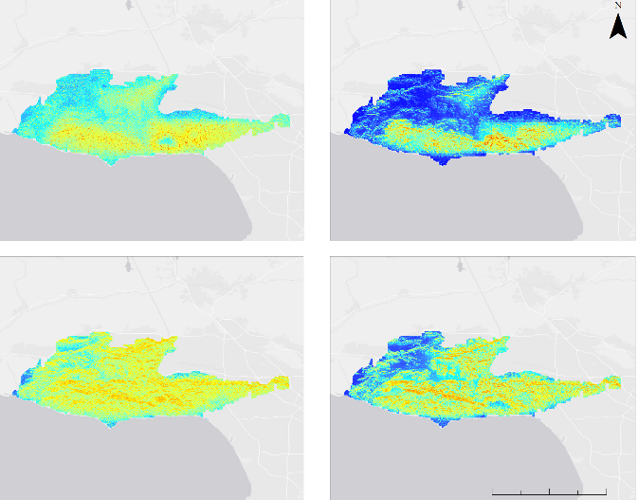
Projected Distributions
RCP 4.5
Riparian Woodland
Bay Woodland
Oak Woodland
Walnut Woodland
Occurrence Probability
High: 1
Low: 0
0
5
10
20 km
Notes:
Map 1: Generated by the Santa Monica Mountains III team, Base layer source: ESRI OpenStreetMap , ArcMap 10.6
Speaker Notes
Map A in the top left displays the Riparian Woodland suitability for the RCP 4.5 climate projection
Map B in the top right displays the California Bay Woodland suitability for the RCP 4.5 climate projection
Map C in the bottom left displays the Oak Woodland suitability for the RCP 4.5 climate projection
Map D in the bottom right displays the California Walnut Woodland suitability for the RCP 4.5 climate projection
Conditions were most suitable for riparian vegetation in the southern portion of the study area, especially in the valleys.
Conditions for California bay laurel are predicted to be most suitable near the coast in upland areas.
Conditions may be moderately suitable for oaks throughout the Santa Monica Mountains, with a preference for north facing slopes.
Conditions for walnut are similar to oaks in that there is a higher probability of occurrence on north facing slopes, although slope was the most important topographical variable

Slide 23
Range Shifts
RCP 4.5 Range Shifts (km²): Current - 2099
 | Expansion | Contraction | No Change | No Occupancy
Bay Woodland | 34.15 | 29.87 | 148.08 | 978.70
Oak Woodland | 83.08 | 61.62 | 741.21 | 301.66
Riparian Woodland | 101.01 | 65.63 | 348.80 | 672.12
Walnut Woodland | 99.93 | 67.45 | 424.04 | 596.14
Notes:
Speaker Notes
This is a table showing distributional shifts in square km between current and future habitat suitability under the RCP 4.5 scenario
Expansion is presence in the future where there was absence in the past
Contraction in absence in the future where there was presence in the past
No Change is presence in both
and No Occupancy is absence in both
We saw that all vegetation guilds had a marginally higher amount of expansion than contraction
with Oak Woodland expanding by approximately 83 square km and contracting by about 61 square km
More investigation will have to be done to see whether these species are expanding into novel climates

Slide 24
Variable Importance
Climate SDM - RCP 4.5 averages
Topography SDM
 | Most Important Variable | Permutation Importance
Bay Woodland | Precip. rate | 89.05%
Oak Woodland | Precip. rate | 48.3%
Riparian Woodland | Precip. rate | 84.3%
Walnut Woodland | Precip. rate | 83.3%
 | Most Important Variable | Permutation Importance
Bay Woodland | Slope | 59.4%
Oak Woodland | Aspect | 70.0%
Riparian Woodland | Flow Accumulation | 82.1%
Walnut Woodland | Slope | 52.1%
Notes:
Speaker Notes
Precipitation rate was the most important variable for all guilds across life stages and climate scenarios.
Precipitation rate was far less important for Oak Woodlands than other vegetation types. This may be due to the large precipitation range that can be tolerated by some oak species in the study area according to data we received from the RCDSMM.
The most important variable in the topography model varied by species/guild.
Slope was most important for bay laurel and walnut
Aspect for oak woodland
Flow accumulation for riparian

Slide 25
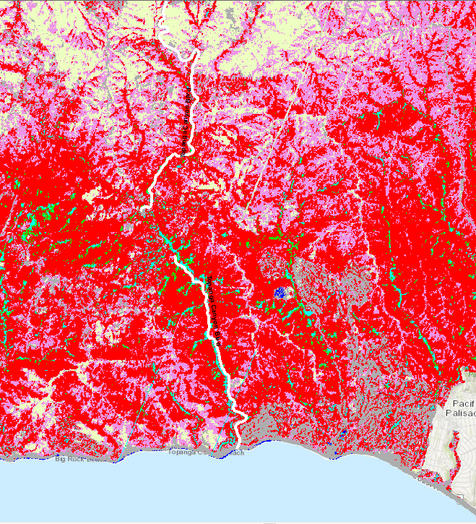
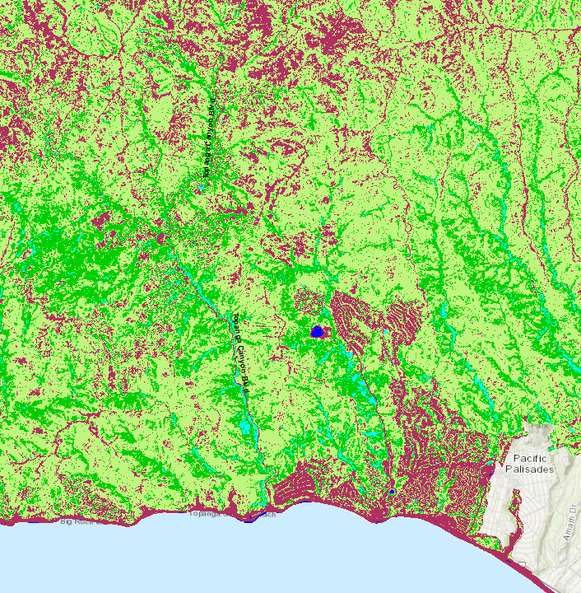
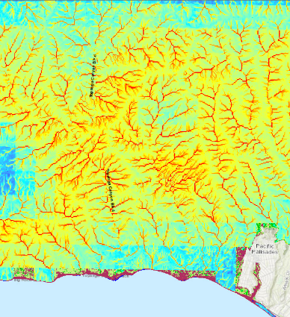
Summary
AVIRIS Vegetation Community Classification (06/25/2018)
RapidEye Vegetation Health Classification (06/30/2019)
Riparian Suitability Map (Topography & Climate RCP 4.5, 2020 - 2099)
Coast Live Oak
Annual Grass
Thriving Vegetation
Vegetation Presence
Water
High probability: 1
Riparian
Chaparral
Healthy Vegetation
Non-
photosynthetic
Substrate/Urban
Coastal Sage Scrub
Low probability: 0
Water
Notes:
Map 1 - 3: Generated by the Santa Monica Mountains III team, Base layer source: ESRI OpenStreetMap , ArcMap 10.6
Speaker Notes
The first map displays a zoomed-in view of the AVIRIS MESMA dominant vegetation classification
The second map displays the RapidEye MESMA vegetation health classification
The third map displays the Riparian guild suitability for the RCP 4.5 climate projection
To summarize, we:
classified vegetation community types using a multi-endmember spectral mixing analysis of AVIRIS imagery,
determined vegetation health in the study area using RapidEye imagery,
and projected guild distributions from 2020-2099 using Maxent.

Slide 26
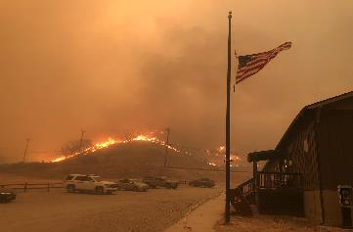
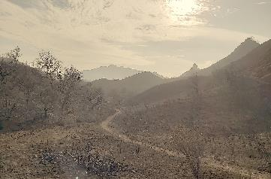
Conclusions
Precipitation rate had the highest permutation importance across all guilds
Topographic variables had differing permutation importance across the guilds
Bay Woodland range shifted South East, while Riparian, Walnut Woodland, and Oak Woodland ranges shifted North West
Suitable habitat did not change significantly from RCP 4.5 to 8.5 for all species
Image Credit: Rosi Dagit
Image Credit: Rosi Dagit
Notes:
Image 1 Source: Rosi Dagit (Written Permission)
Image 2 Source: Rosi Dagit (Written Permission)
Speaker Notes
One of the MaxEnt outputs is permutation importance which determines how heavily the model depends on each variable input
Across all vegetation guilds, precipitation had the highest permutation importance
Among the three topographical variables slope had the highest permutation importance for Bay Woodland and Walnut Woodland, while aspect had the highest for Oak Woodland, and flow accumulation had the highest for Riparian
We also saw that Bay Woodland range generally shifted South East while Walnut Woodland, Riparian, and Oak Woodland range shifted approximately North West
If these guilds are in fact shifting into novel climatic conditions, that may suggest these particular vegetation guilds are adapting to the changing climate
Suitable habitat did not change significantly from the forecasted rcp 4.5 to 8.5 scenarios and this could be because of a variety of factors related to our errors and uncertainties

Slide 27
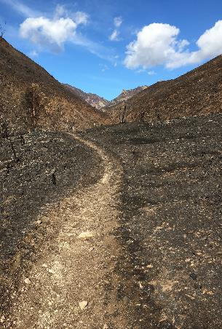
Errors & Uncertainties
Climate data is too coarse to capture microclimate refugia
Only looking at species occurrence within the study area
Combining climate and topography suitability maps may be erasing differences in climate suitability
Image Credit: Rosi Dagit
Notes:
Image Source: Rosi Dagit (Written Permission)
Speaker Notes
Because our climate data was at about 250 m resolution, we could not accurately capture microclimate refugia which are very important sources of protection and stability especially in the face of climate change scenarios
Also because we are only looking at species occurrence within the study area, we are not taking into the full range of climatic variables the species may see in the future
This introduces spatial bias that we did not account for
Finally, by running separate MaxEnt models for climate and topography and then recombining them we may be erasing how climate suitability is changing across the difference RCP scenarios and time periods
We want to further investigate running climate and topography together so that the importance of each variable is decided by MaxEnt
This leads into our future work...
Additional Notes
Microclimate refugia are sites that support locally favorable climates amidst unfavorable regional climates, which allow populations of species to persist outside of their main distributions

Slide 28
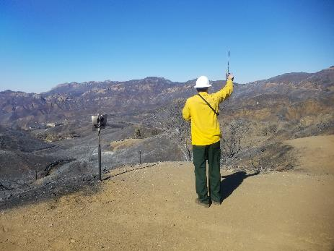
Future Work
Incorporate more climate variables in species distribution model
Max temperature of warmest month
Evapotranspiration
Solar insolation
Water capacity
Use AVIRIS data from June 2019 when it becomes available to more accurately assess post-Woolsey condition
species specific conditions rather than general vegetation health
Picture
Image Credit: Rosi Dagit
Notes:
Image Source: Rosi Dagit (Written Permission)
Speaker Notes
Because we only had the three climate variables, our model may not have captured what the true distribution of these various vegetation guilds could be in the future
so the addition of climatic variable such as evapotranspiration, solar insolation, and water capacity can be included in the modeling process to increase our projection confidence
We also would want to incorporate the most recent AVIRIS data from the June 2019 flight to more accurately classify vegetation health and species post Woolsey fire.
We did not use this data because it was not available during our analysis

Slide 29
Science advisors Natasha Stavros and Latha Baskaran
Project partners Rosi Dagit, Marti Witter, Danielle LeFer, Joseph Algiers, Jay Lopez, Joseph Decruyenaere, and Zachary Holden
Additional collaborators Megan Jennings, Kim Corella, Carly Simon, Tanessa Hartwig, and the TAC Committee
Past team members Kelsey Foster, Natalie Queally, Emil Chang, Ariana Nickmeyer, Nick Rousseau
Center Lead Erika Higa and Assistant Center Lead Erica O’Connor
Mentor Benjamin Holt
Notes:
Speaker Notes
Finally, we would like to acknowledge all the great people that made this project happen
We would like to thank our science advisors
our project partners and additional collaborators who are here today
as well as past team members, our center lead, assistant center lead, and mentor

Slide 30
Questions?

Slide 31
Validation: AVIRIS
AVIRIS
Confusion Matrix
Overall Accuracy: 90.54%
Kappa Coefficient: .845
Annual
Grass
100
0
0
0
 | User’s Accuracy | Producer’s Accuracy
Annual Grass | 100 | 100
Oak Woodland | 84.62 | 51.16
Riparian | 56.76 | 65.63
Chaparral | 50 | 92.43
100
Oak
Woodland
0
51.60
15.63
8.57
75
50
25
Riparian
0
18.60
65.60
0
0
Chaparral
0
30.23
18.75
91.43
Annual
Grass
Oak
Woodland
Riparian
Chaparral
Notes:
Speaker Notes
Substrate and Water classes are omitted from this confusion matrix (they were 100%)
Oaks, Riparian had some confusion with each other, makes sense since they are found in similar areas
High chapparal percentages, could be because there was a lot more chaparralin 2018 than the training data and nps made in 2013/2007

Slide 32
Validation: RapidEye
RapidEye
Confusion Matrix
Overall Accuracy: 94.63%
Kappa Coefficient: .893
Green Vegetation
 | User’s Accuracy | Producer’s Accuracy
Green Vegetation | 92.11 | 97.33
Non Photosynthetic Vegetation | 97.26 | 92.21
97.22
7.79
100
75
50
25
Non
Photosynthetic Vegetation
0
2.78
92.21
Non
Photosynthetic Vegetation
Green Vegetation
Notes:
Speaker Notes
Since in-situ measurements only gave alive/dead we did a green veg / npv veg comparison
Very high accuracy since the two classes are very distinct spectra

Slide 33
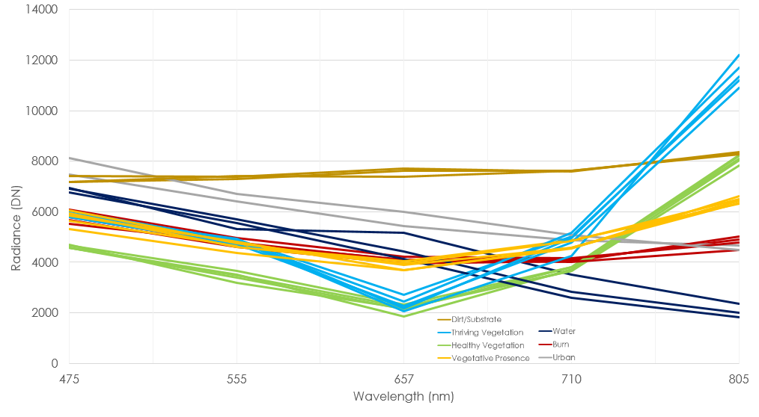
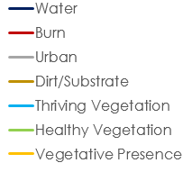
RapidEye Training Spectra

