Slide 1
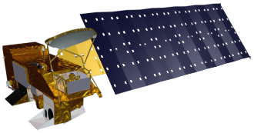
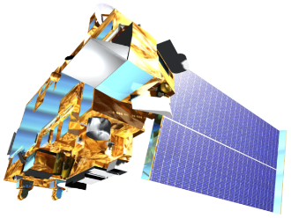
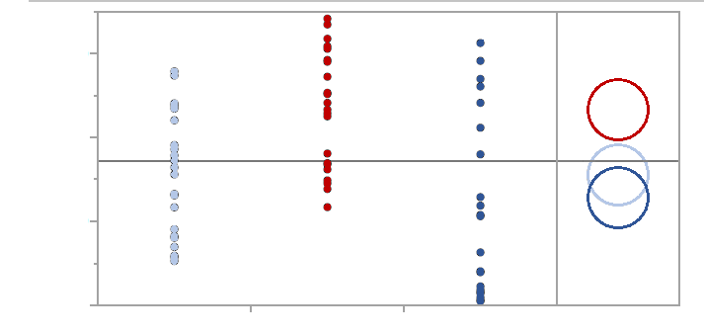
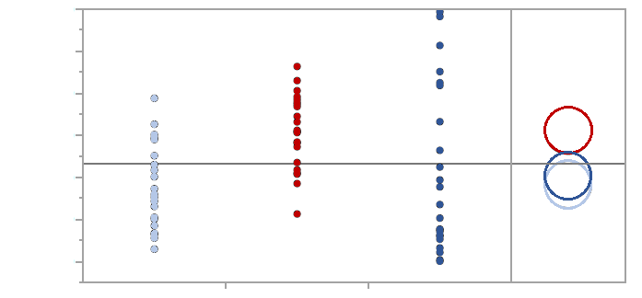
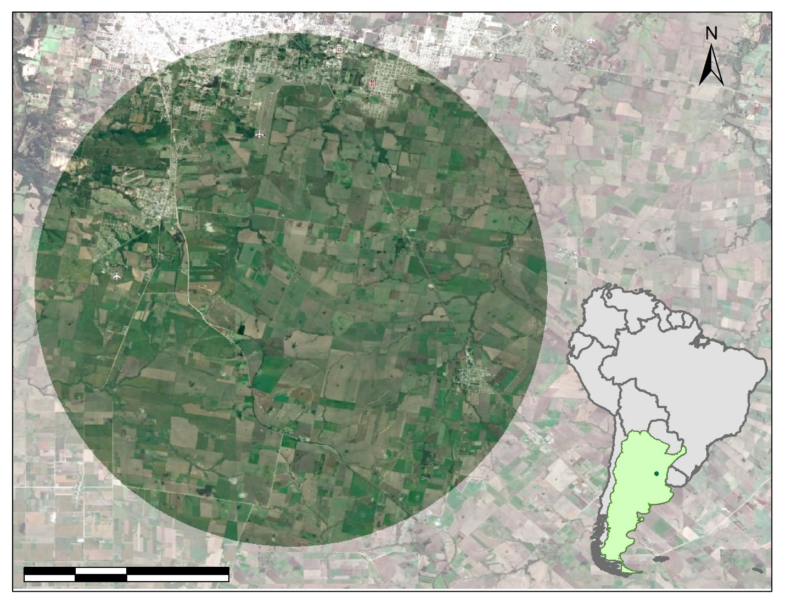
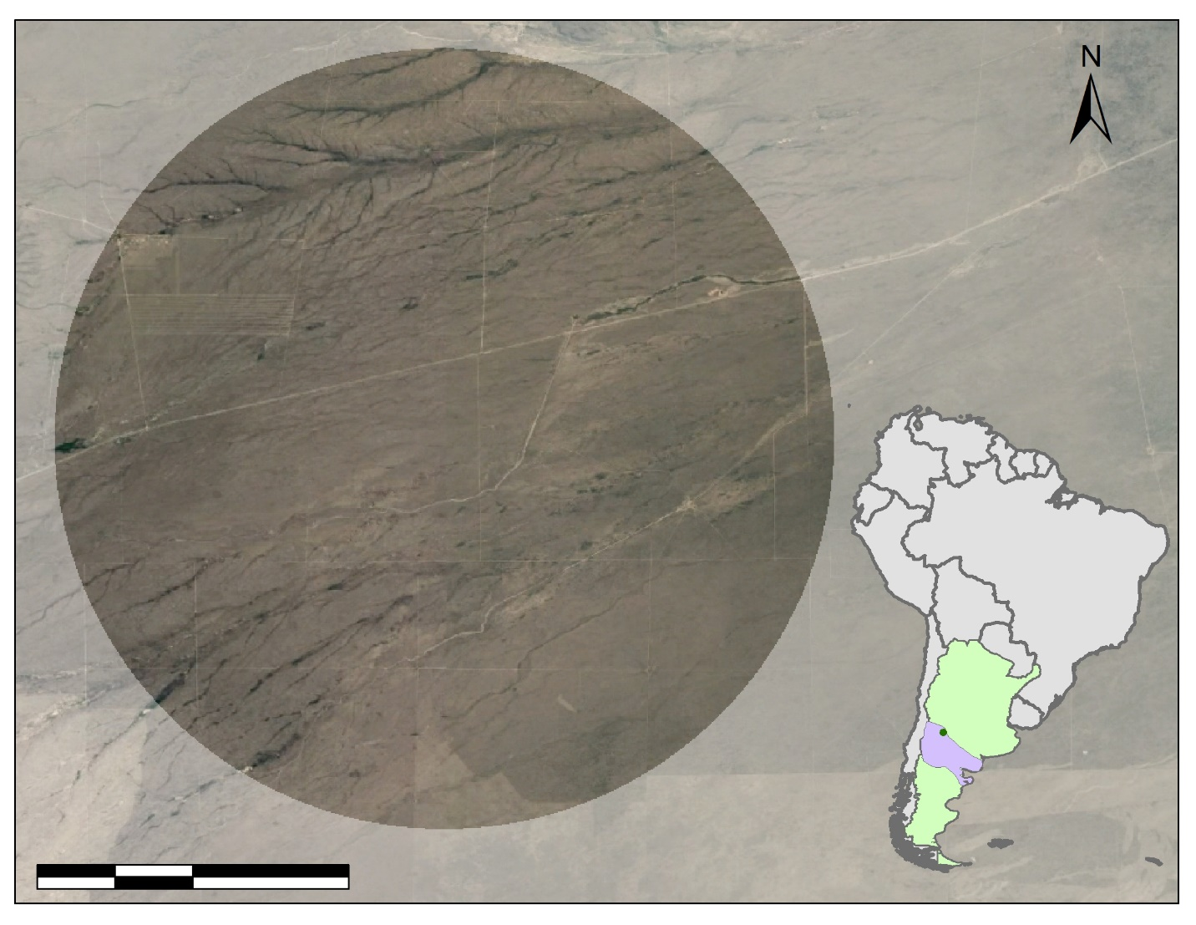
Evaluating Evapotranspiration in Humid Subtropical and Semi-Arid Climates with NASA Earth Observations to Understand Water Balance in Paraná and the Patagonian Steppe of Argentina
Abstract
Objectives
Argentina Water Resources
Evapotranspiration (ET) is a key indicator of hydrological balance across different ecosystems. Water availability is a vital ecosystem service for biota and communities. The transpiration and evaporation of water from vegetation and soil can be estimated through in situ ET measurements. However, in situ ET data sampling represents an expensive and challenging task, especially in geographically remote areas. Models used in this study utilized data from sensors aboard multiple NASA satellites including, Landsat 8, Aqua, and Terra. Two models, Operational Simplified Surface Energy Balance (SSEBop) and MODIS Global ET Project (MOD16) were validated by the Fall 2018 NASA DEVELOP Idaho Water Resources II team. The Global Land Data Assimilation Noah evapotranspiration (GLDAS-2-Noah) was validated in Reynolds Creek Experimental Watershed (RCEW) by our Argentina Water Resources team. SSEBop, MOD16, and GLDAS-2-Noah were applied in two study areas: Paraná, province Entre Ríos, Argentina, a humid subtropical (Pampean) bioregion, and the Patagonian Steppe in Argentina, a semi-arid region, climatically similar to the validation site at RCEW. Validation and implementation of the models applied in this study will allow our partners at CONICET and land managers in Argentina to use the model that best suits their needs while also making empirically based decisions regarding water resources.
Evaluate the multiple ET models in Paraná & Patagonia Steppe
Compare the models’ ET outputs and run statistical analysis
Validate which model works best for humid subtropical and semi-arid environments
Earth Observations
Aqua MODIS
Landsat 8
OLI & TIRS
Terra MODIS
Results
ET (mm)
Methodology
2016
2017
DATA
ET Models
MOD 16
SSEBop
GLDAS
In situ Data
Paraná
RCEW
Paraná
Month
120
Patagonia Steppe
Statistics
Time series, regression, Kruskal Wallis, Student’s t post hoc
150
Group A
100
Group A
Analysis
ArcGIS Pro
Clip study areas
Comparison
ET outputs to other ET outputs
100
80
60
50
MOD16
40
MOD16
SSEBop
20
SSEBop
Final Products
ET Maps, statistics, and graphs
0
GLDAS
Group B
0
GLDAS
Group B
Output
GLDAS
MOD16
SSEBop
Each Pair Student’s t
GLDAS
MOD16
SSEBop
Each Pair Student’s t
Water Years | Kruskal Wallis | Student’s t
 | All Models | MOD16 vs. SSEBop | MOD16 vs. GLDAS | GLDAS vs. SSEBop
Two Water Years | 0.0009** | 0.0001** | 0.0035** | 0.2927
2016 | 0.0144* | 0.0032** | 0.0181* | 0.4939
2017 | 0.0523 | 0.0169* | 0.0920 | 0.4400
* Significant Level at 95%
** Significant Level at 99%
Water Years | Kruskal Wallis | Student’s t
 | All Models | MOD16 vs. SSEBop | MOD16 vs. GLDAS | GLDAS vs. SSEBop
Two Water Years | 0.0009** | 0.0001** | 0.0035** | 0.2927
2016 | 0.0144* | 0.0032** | 0.0181* | 0.4939
2017 | 0.0523 | 0.0169* | 0.0920 | 0.4400
* Significant Level at 95%
** Significant Level at 99%
Study Area
The study areas are 10 km radius circles in the Paraná region and Patagonian Steppe, Argentina, South America
The validation site is in Reynolds Creek, Idaho, USA
The study period is from January 01, 2015, to December 31, 2017
Paraná
Patagonian Steppe
Conclusions
MOD16 is significantly different from other models across both study areas possibly due to applying a Penman-Monteith equation, which has been shown to occasionally over predict ET in semi-arid regions.
GLDAS-2-Noah and SEEBop have no significant statistical difference in their ET values across both study areas.
GLDAS-2-Noah and SSEBop have potential to be applied in semi-arid regions similar to the Patagonia Steppe.
A hybrid model using both the high temporal resolution data from GLDAS-2-Noah and the high spatial resolution data from SSEBop models can be an effective way to measure ET more accurately.
0
2
4
8
km
0
2
4
8
km
Project Partners
Team Members
National Scientific and Technical Research Council (Argentina)
Acknowledgements
The Argentina Water Resources team would like to thank the following:
CONICET
Dr. Pablo G. Aceñolaza, Researcher
Sebastián Anibal Gavilán, Researcher
Special thank you to our Idaho – Pocatello Node Science Advisor:
Keith T. Weber, GIS Director at Idaho State University, GIS TReC
Carl Jurkowski
Project Lead
Ahmed Baqai
Jose Ochoa
A. R. Williams
Idaho – Pocatello | Spring 2019

