Slide 1
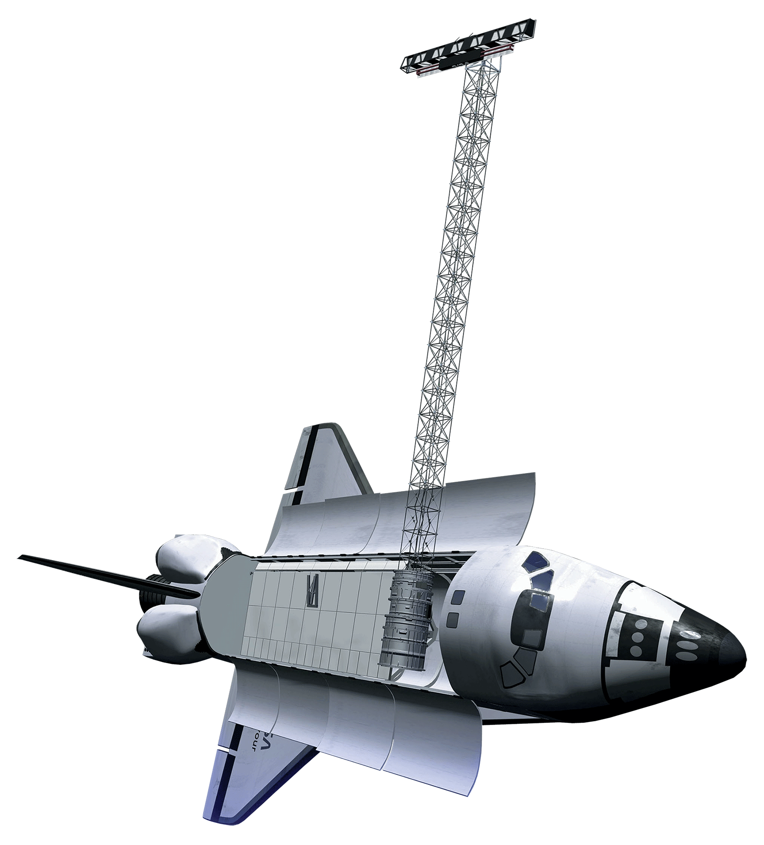
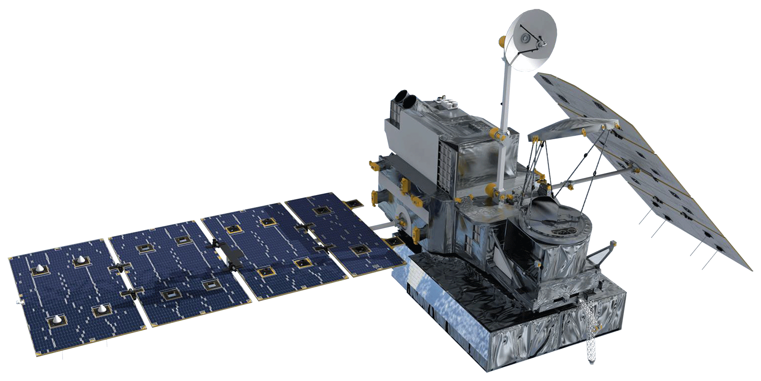
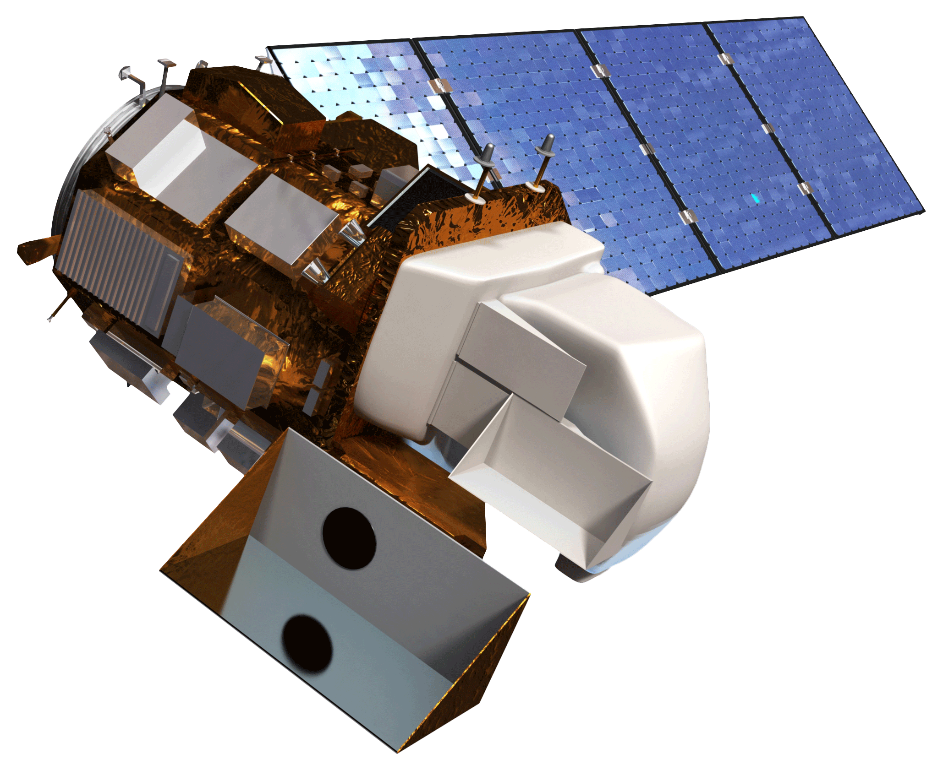
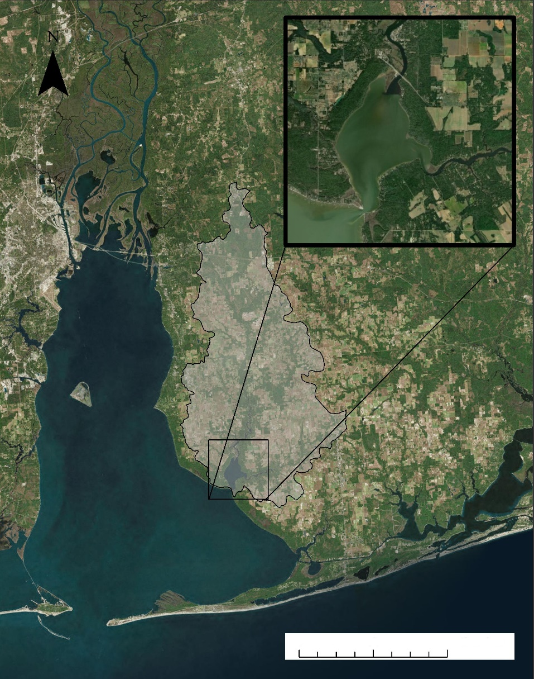
Using NASA Earth Observations to Evaluate Changes in Water Quality in the Weeks Bay Watershed
Abstract
Objectives
Keep this blank for your rough draft. For your final draft version, this abstract should be the same as the abstract in your Project Summary final draft.
Conduct a comparative analysis of a previous SWAT model derived from in-situ data to a SWAT model informed primarily by NASA Earth observations
Demonstrate parameters observed by NASA EO’s to contribute to the knowledge base of the Weeks Bay National Estuarine Research Reserve
Identify sub-watersheds of special concern for prioritizing conservation efforts aimed at improving water quality in Weeks Bay
Communicate the history of and changes in the region to a broader audience through Weeks Bay NERR education programs
Methodology
Earth Observations
The team took parameters derived from NASA Earth observations and input them into the Soil and Water Assessment Tool (SWAT). The outputs were then compared to a previous SWAT model created using in-situ data to examine the feasibility of using remotely sensed data for future water monitoring efforts.
NASA-Eo- Derived SWAT Outputs
Previous SWAT Outputs
SWAT Model
Soil Data
Weather Data
Precipitation GPM IMERG Data
In-Situ Data Calibration
SWAT Model
In-situ and Local Measurements from Thompson Engineering
NLCD Landcover Landuse Data
Comparative Analysis
GPM IMERG
Landsat8 OLI
SRTM
Results
Subwatershed Endangerment Zone Map
SWAT Model Projection w/ 2040 Land Cover Map
Seasonal Variation Graph(s)
Weeks Bay Water Resources
Study Area
Weeks Bay
Conclusions
WORK IN PROGRESS: Comparative analysis of NASA-Eo-derived model to Thompson Engineering report…
Ancillary Datasets
Thompson Engineering Data
Alabama Water Watch water quality Data
Project Partners
Weeks Bay Estuary
0
5
10
20
Alabama Department of Conservation and Natural Resources, Weeks Bay National Esturaine Research Reserve
Weeks Bay Watershed
km
Acknowledgements
Team Members
The team would like to acknowledge the efforts of Sarah Johnston, Angela Underwood, Eric Brunden, and Dr. Scott Phipps of Weeks Bay National Estuarine Research Reserve for their contribution to the team’s understanding of the Weeks Bay Estuary region. The team would also like to thank Alabama Water Watch for providing site specific water quality data. Thank you to Joe Spruce, the Science Advisor on this project, for unending patience and sharing of his expertise.
Vanessa Van Auken
Project Lead
Dillon Blankenship
Michelle Carver
Ara Metz
Mobile – Alabama | Spring 2019

