Slide 1
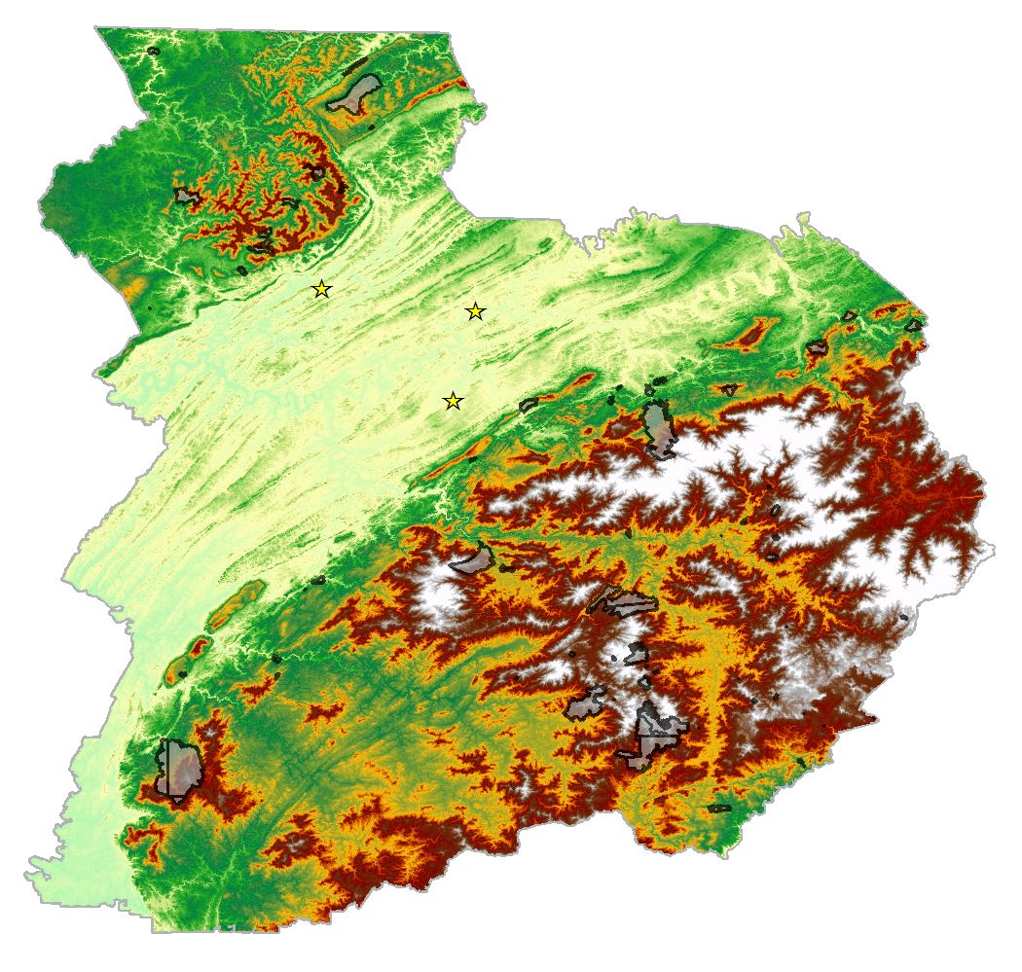



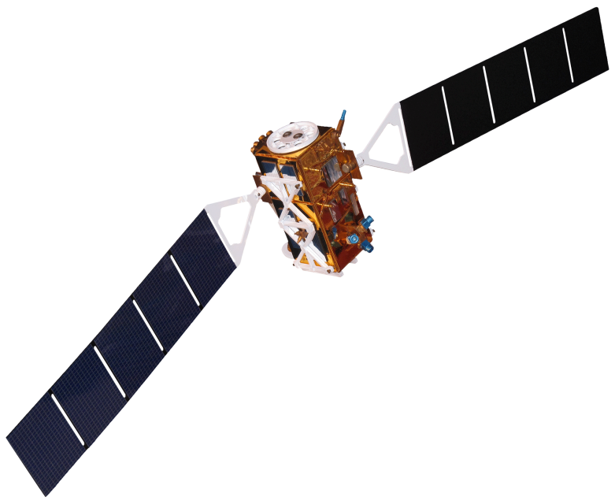
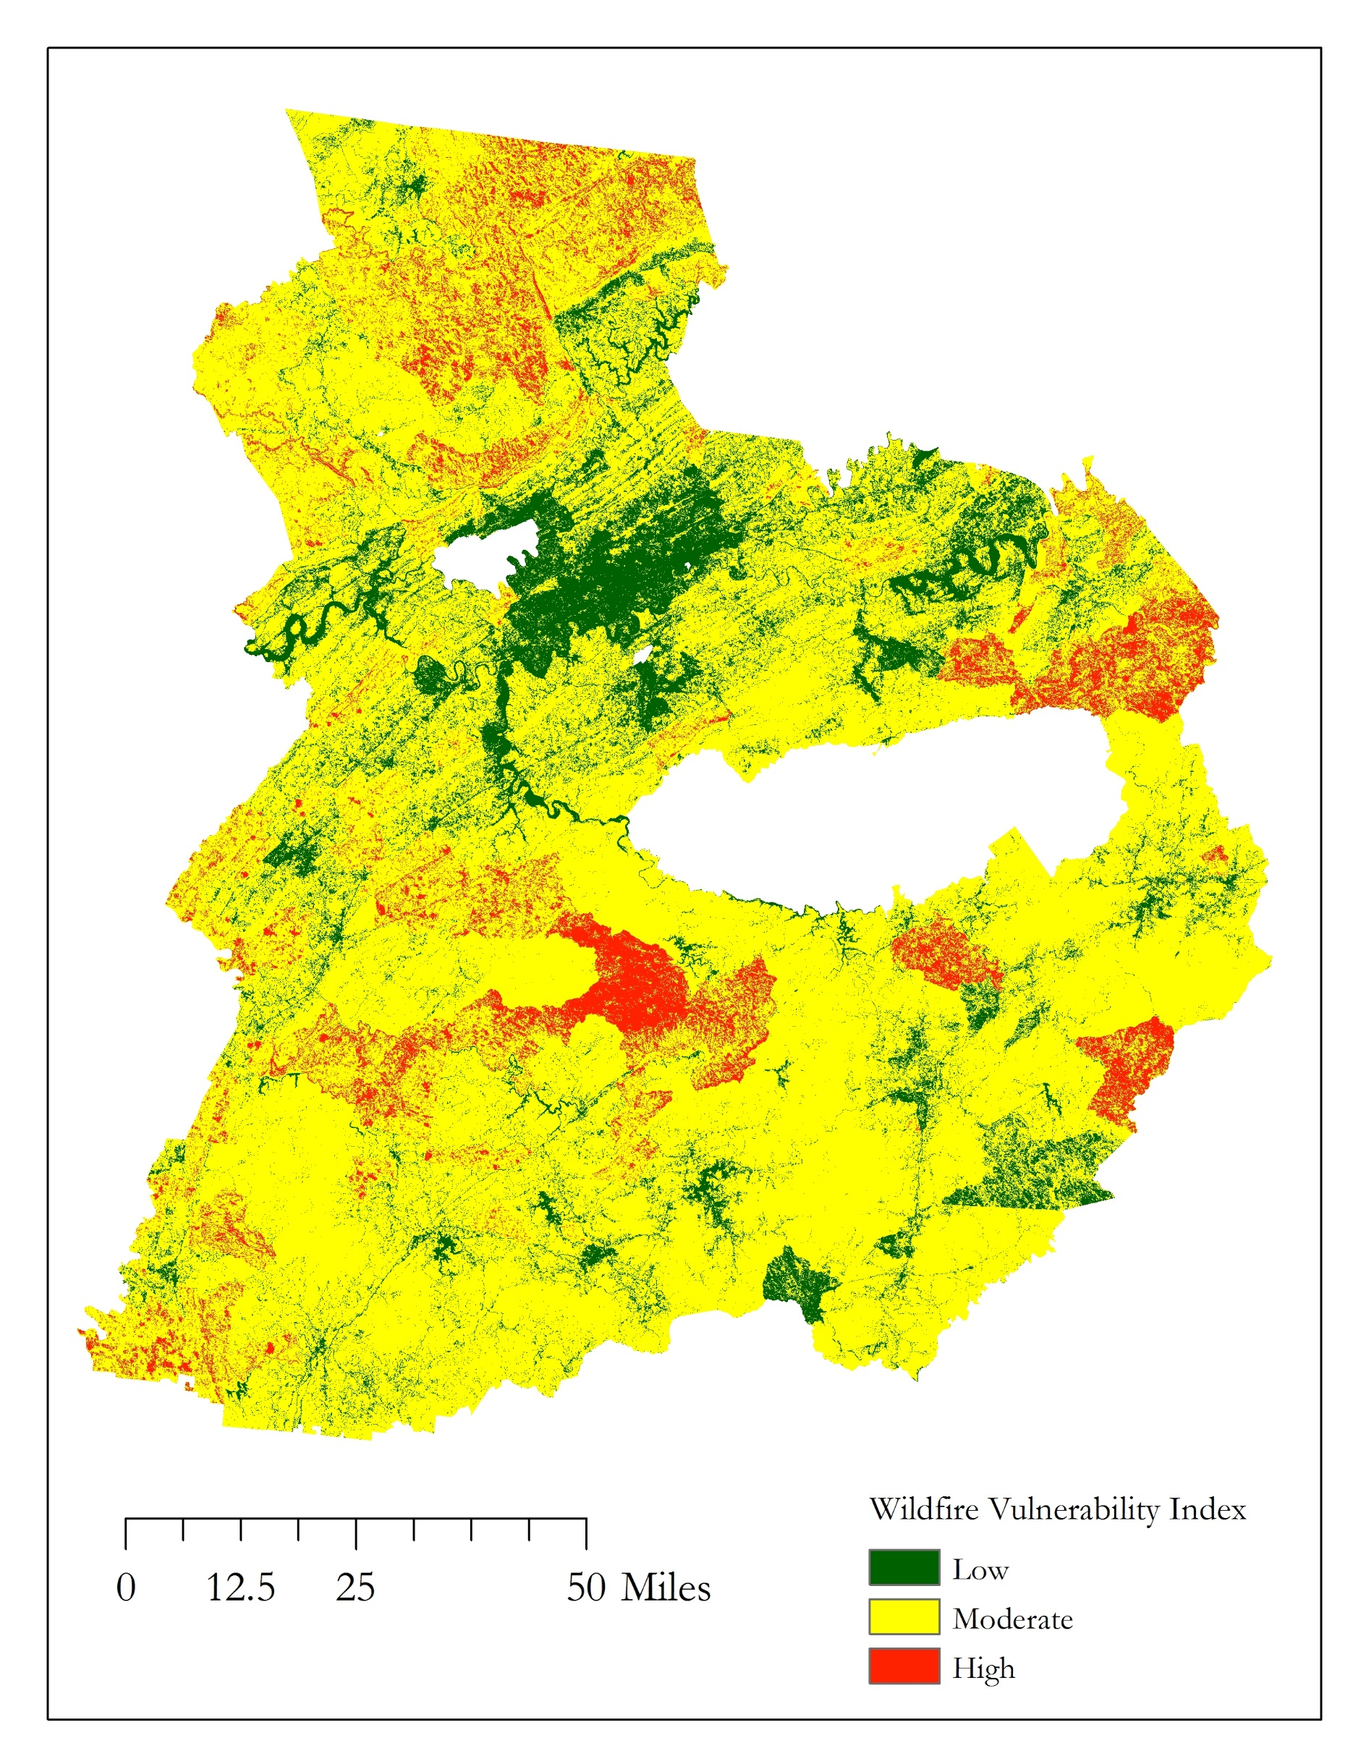
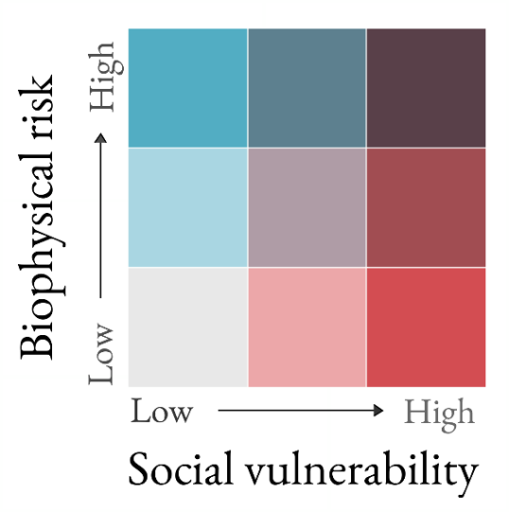
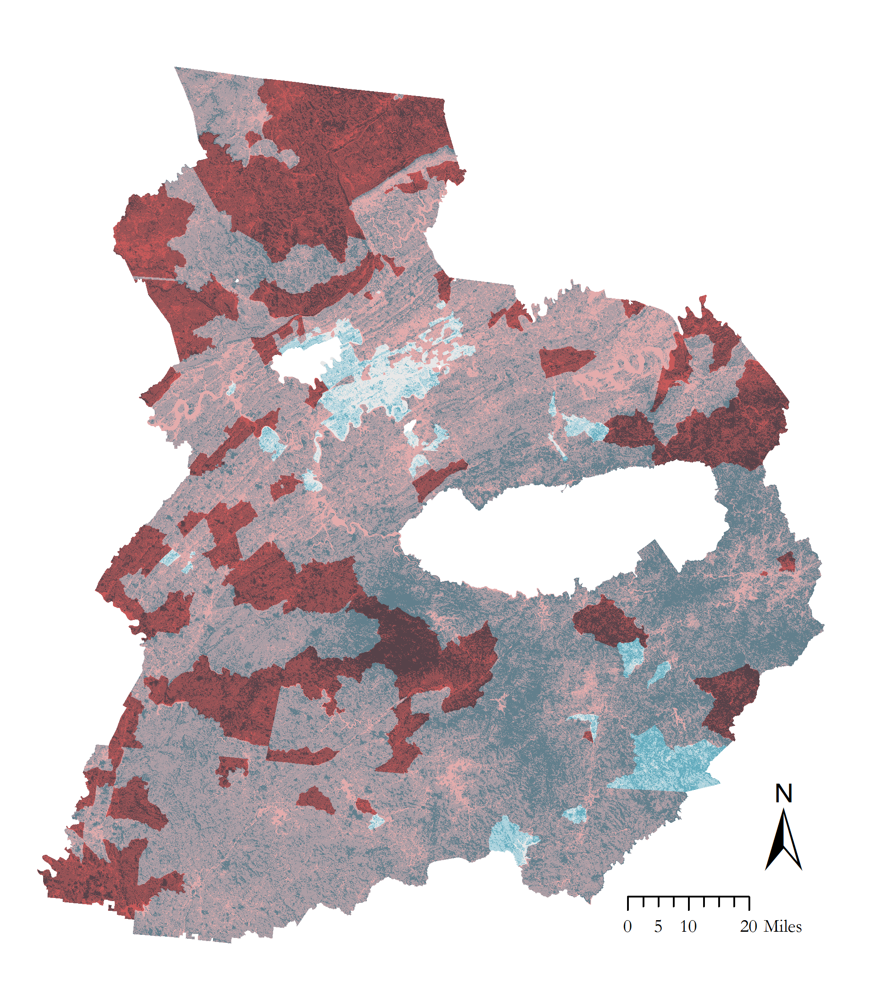
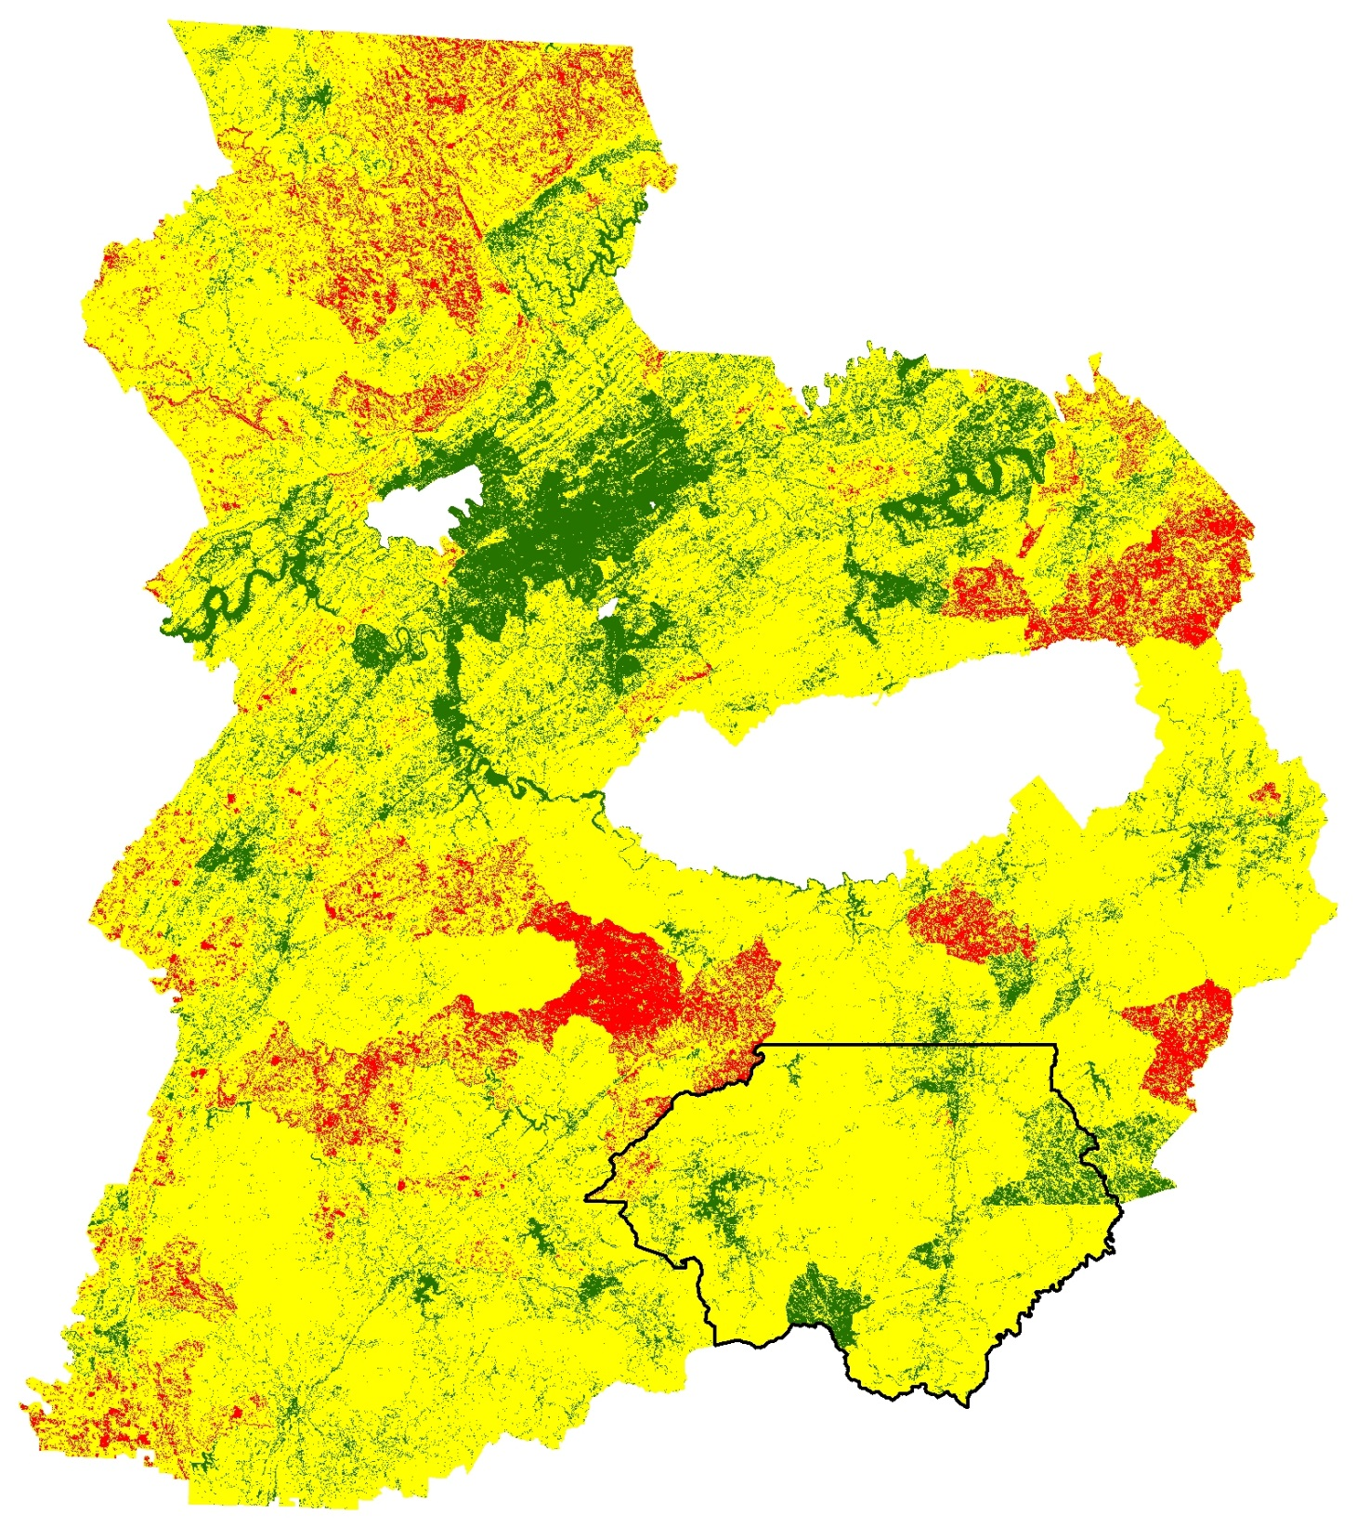

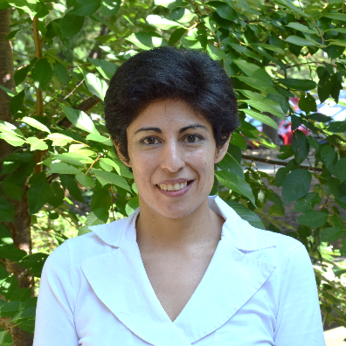

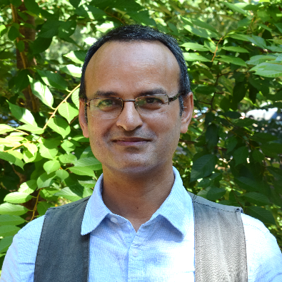

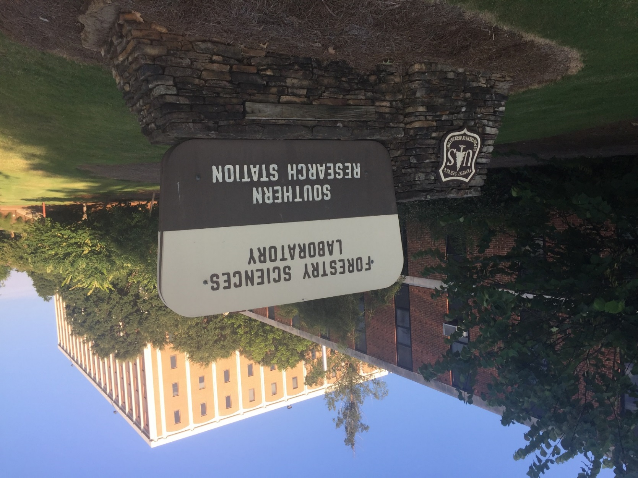

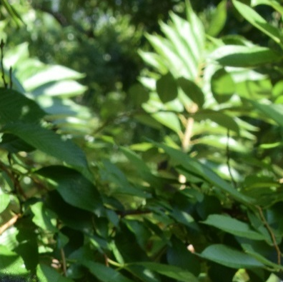

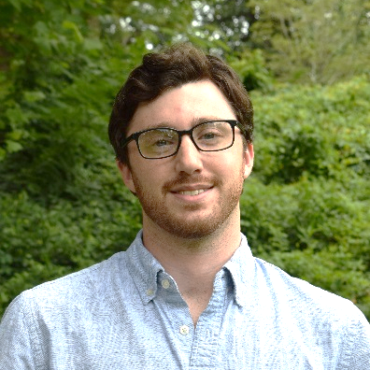

Using NASA Earth Observations to Monitor Vulnerability, Wildfire Damage, and Recovery in the Appalachian Forests
Abstract
Objectives
Wildfires in the southeastern US are understood less than those in other portions of the nation. In October and November 2016, over sixty individual wildfires ignited among seven states in the Southern Appalachian region. These fires damaged hundreds of buildings, caused numerous power outages, and resulted in fatalities. These unusually destructive events highlight the need to improve awareness of fire susceptibility and risk in the southeastern US. The US Forest Service requires a thorough understanding of wildfire vulnerability, damage, and recovery to effectively help local communities respond to and prepare for these events. The University of Georgia NASA DEVELOP team partnered with the US Forest Service Southern Research Station to assess vegetation dynamics before and after the 2016 wildfire events, focusing on GA, NC, and TN. This was accomplished by utilizing Landsat 8 OLI, Terra ASTER, and Terra MODIS data to evaluate land cover changes from October to December 2016 and assess the severity of these fires. In addition, this project incorporated demographic data to examine the association between fire risk and under-managed lands, such as heirs’ properties, and to construct a model of social vulnerability to wildland fire hazards in the study area. The results of this project provided researchers at the US Forest Service with an increased understanding of how property ownership and community management practices can affect future wildfires, as well as how the spatial distribution of socioeconomic variables affects residents’ ability to adapt and recover.
Analyze vegetation and fire fuel change before, during, and after the fall 2016 wildfires using Landsat 8, Terra MODIS, Terra ASTER, and Sentinel-2 MSI data
Explore the physical, biological, and social factors that may lead to increased wildfire susceptibility in the Southern Appalachian region of the United States
Create an integrated wildfire vulnerability model based on a range of environmental factors (elevation, vegetation, and land cover) and socioeconomic factors (income, race, and housing)
Study Area
KY
VA
Knoxville
TN
NC
Oak Ridge
GA
SC
Maryville
Methodology
Data Acquisition | Inputs and Processing |  | Output | End Product
 | NDVI (250m) Forest Thrive/Decline | Biological Risk Factors | Fire Risk Model
 | Land Cover NDVI (30 & 10m) NDMI (30 & 10m) NBRI (10m)
 | DEM (30 & 10m) Slope (30 & 10m) Aspect (30 & 10m) | Physical Risk Factors
 | CWPPs FireWise Communities Heirs’ Properties Census Data
 | Global Population Grid National Land Cover Data
Terra MODIS
(ForWarn data)
Biological Risk Factors
Earth Observations
Landsat 8 OLI
& Sentinel 2
Fire Risk Model
Terra ASTER
& NED
Physical
Risk Factors
Integrated
Wildfire Vulnerability
Index
Socio-
Economic Data
  Social Vulnerability Index
Southern Appalachia Disasters II
Landsat 8 OLI
Terra ASTER & MODIS
Sentinel-2 MSI
Population Density
  Dasymetry of Vulnerable Population
Conclusions
Additional, high-resolution Earth observation data improved the accuracy of our wildfire risk model.
Incorporating socioeconomic data allowed this project to explore other dimensions of wildfire vulnerability.
Our analysis identified clusters of both high wildfire risk and social vulnerability to wildfires in the Southern Appalachia region.
Suburban areas near Knoxville, TN exhibited low vulnerability, while some rural areas exhibited higher vulnerability.
Future work could investigate the health and air quality aspects of the 2016 wildfire events.
Results
Acknowledgements
We would like to thank our science advisors Dr. Marguerite Madden and
Dr. Sergio Bernardes for their advice and guidance on this project, as well as our past contributors, Natalia Bhattacharjee, Christopher Cameron, Stephen Jordan, Caren Remillard, and Joshua Willis.
We also would like to thank our partners at the US Forest Service Southern Research Station, Dr. Cassandra Johnson Gaither, and the US Forest Service Eastern Forest Environmental Threat Assessment Center, Dr. Steven Norman and William Christie for their support and involvement throughout the project.
Wildfire vulnerability index, summed score
Wildfire vulnerability index, bivariate
Team Members
Project Partners
Amanda Aragón Team Lead
Ruth Buck
Jayanta Ganguly
US Forest Service Southern Research Station
Matt Hevert
Holly Hutcheson
David Rickless
Yangjiaxin Wei
University of Georgia – Summer 2017

