Slide 1
PHILIPPINES DISASTERS II
Utilizing NASA and NOAA Earth Observations to Enhance Cyclone Movement and Intensity Measurements to Improve Disaster Relief Planning in the Philippines
Michael Marston (Team Lead)
Aaron Mackey
Brittany Thomas
NOAA National Centers for Environmental Information
2017 Summer
Notes:
Good afternoon everyone we are the Philippines Disasters II team and we are excited to tell you about our work this term utilizing NASA & NOAA Earth Observations to enhance cyclone movement and intensity measurements to improve disaster relief planning in the Philippines.

Slide 2
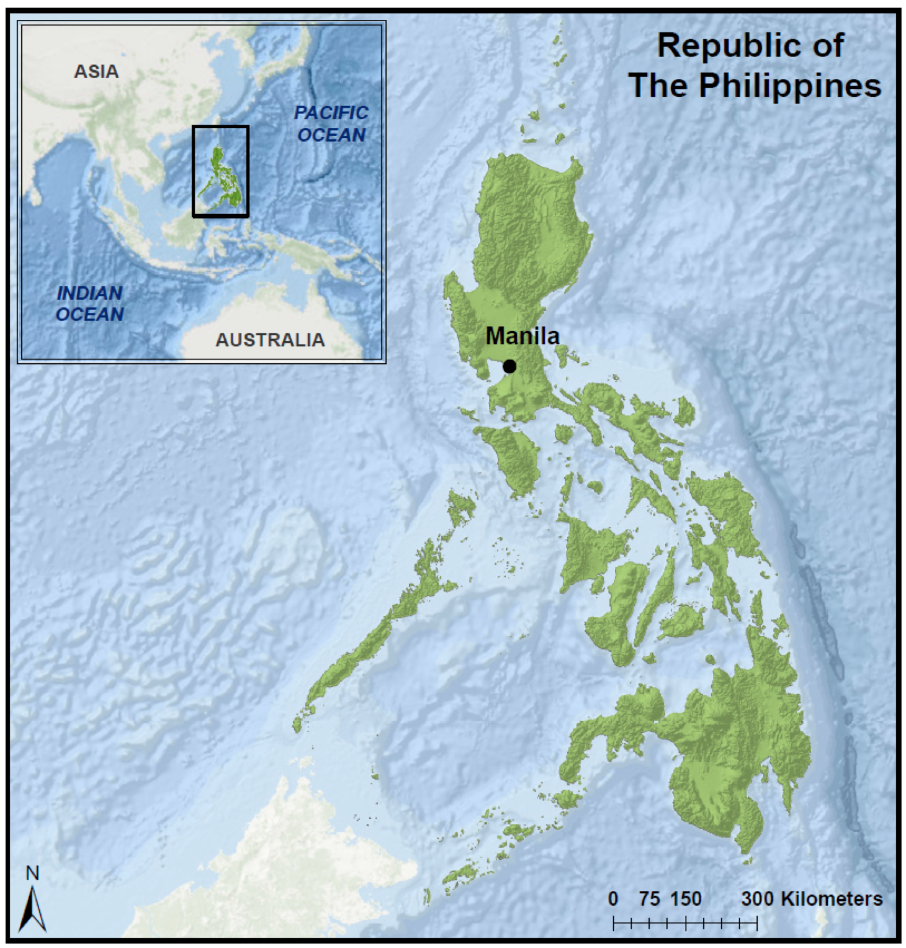
Study Area
The Philippines:
Over 7,000 islands
Population: 98 Million
Study Period: 1985 - 2015
Image credit: Philippines Disasters I Team
Notes:
Our study area was comprised of more than 7000 islands, home to 98 million people, over a thirty year period.

Slide 3
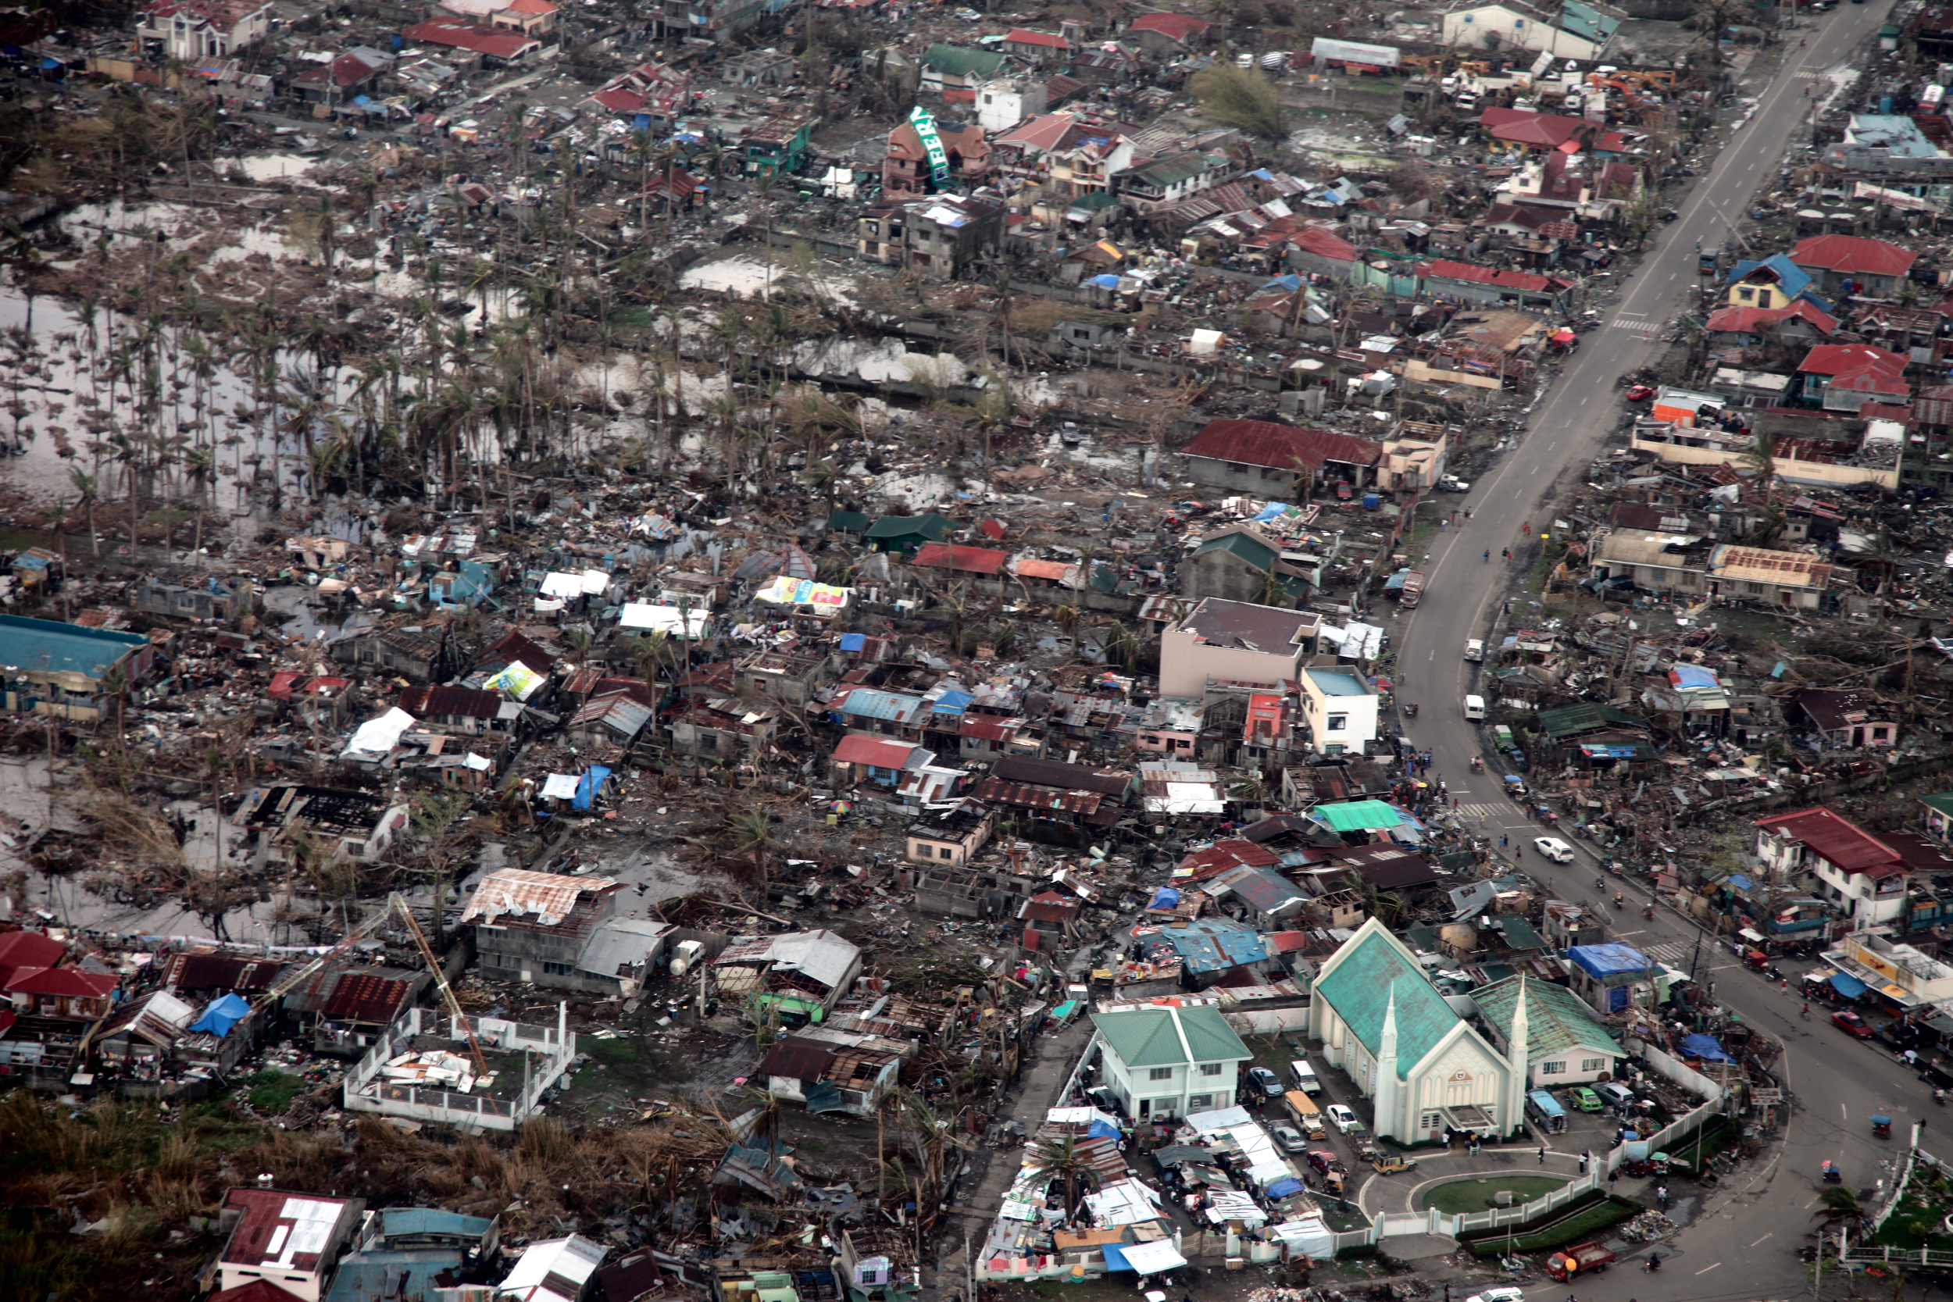
Project Partnership
End User: United Nations Office for the Coordination of Humanitarian Affairs (UN-OCHA)
Collaborators: Netherlands Red Cross, the United Nations Institute for Research and Technology’s (UNITAR) Operational Satellite Applications Programme (UNOSAT), and Dr. John Knaff (NOAA)
Decision: Target areas of greatest need for development in disaster response and mitigation
Image Credit: Flickr
Notes:
Our team worked closely with the United Nations Office for the Coordination of Humanitarian Affairs, or UNOCHA.
We were assisted in our work with demographic variable weighting schemes from the Netherlands Red Cross and results distribution from the United Nations Operational SAtellite Applications Programme (UNOSAT) to target area for future aid response and mitigation.

Slide 4
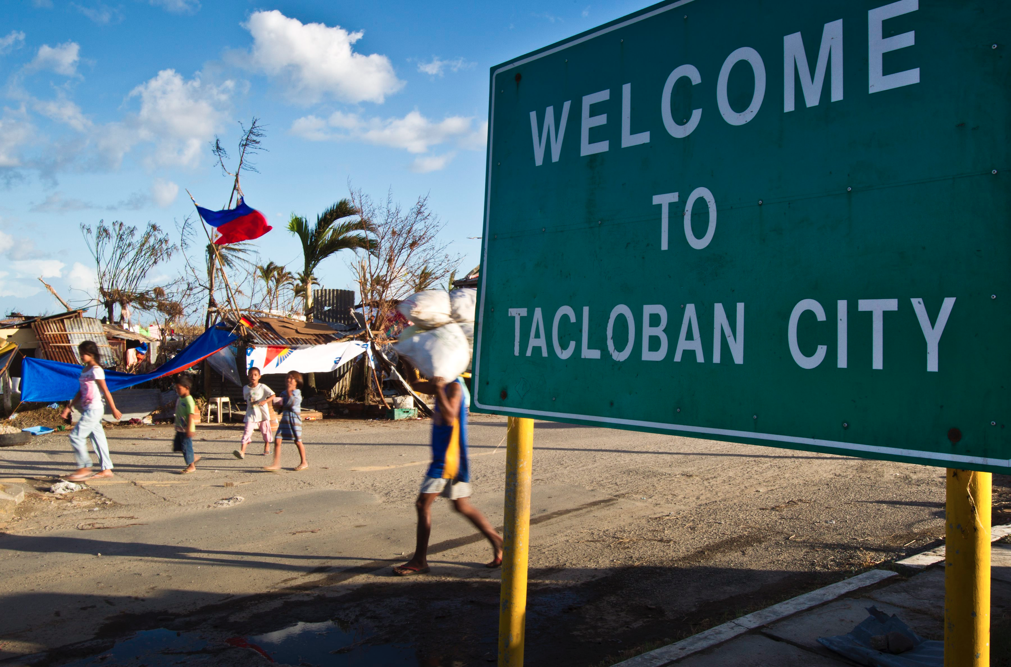
Community Concern
Approximately 19 tropical cyclones affect the Philippine islands annually
Tropical cyclones lead to widespread displacement
Women and children are especially vulnerable
Gender-based violence occurrences spike during and after natural disasters
Image Credit: Flickr
Notes:
The Philippines are affected by upwards of 19 typhoons a year battering communities with high winds, flooding, and landslides.
The destructive force of typhoons is felt most acutely by women and children. In the wake of typhoons rates of gender-based violence and human trafficking already present in an area will go even higher.

Slide 5
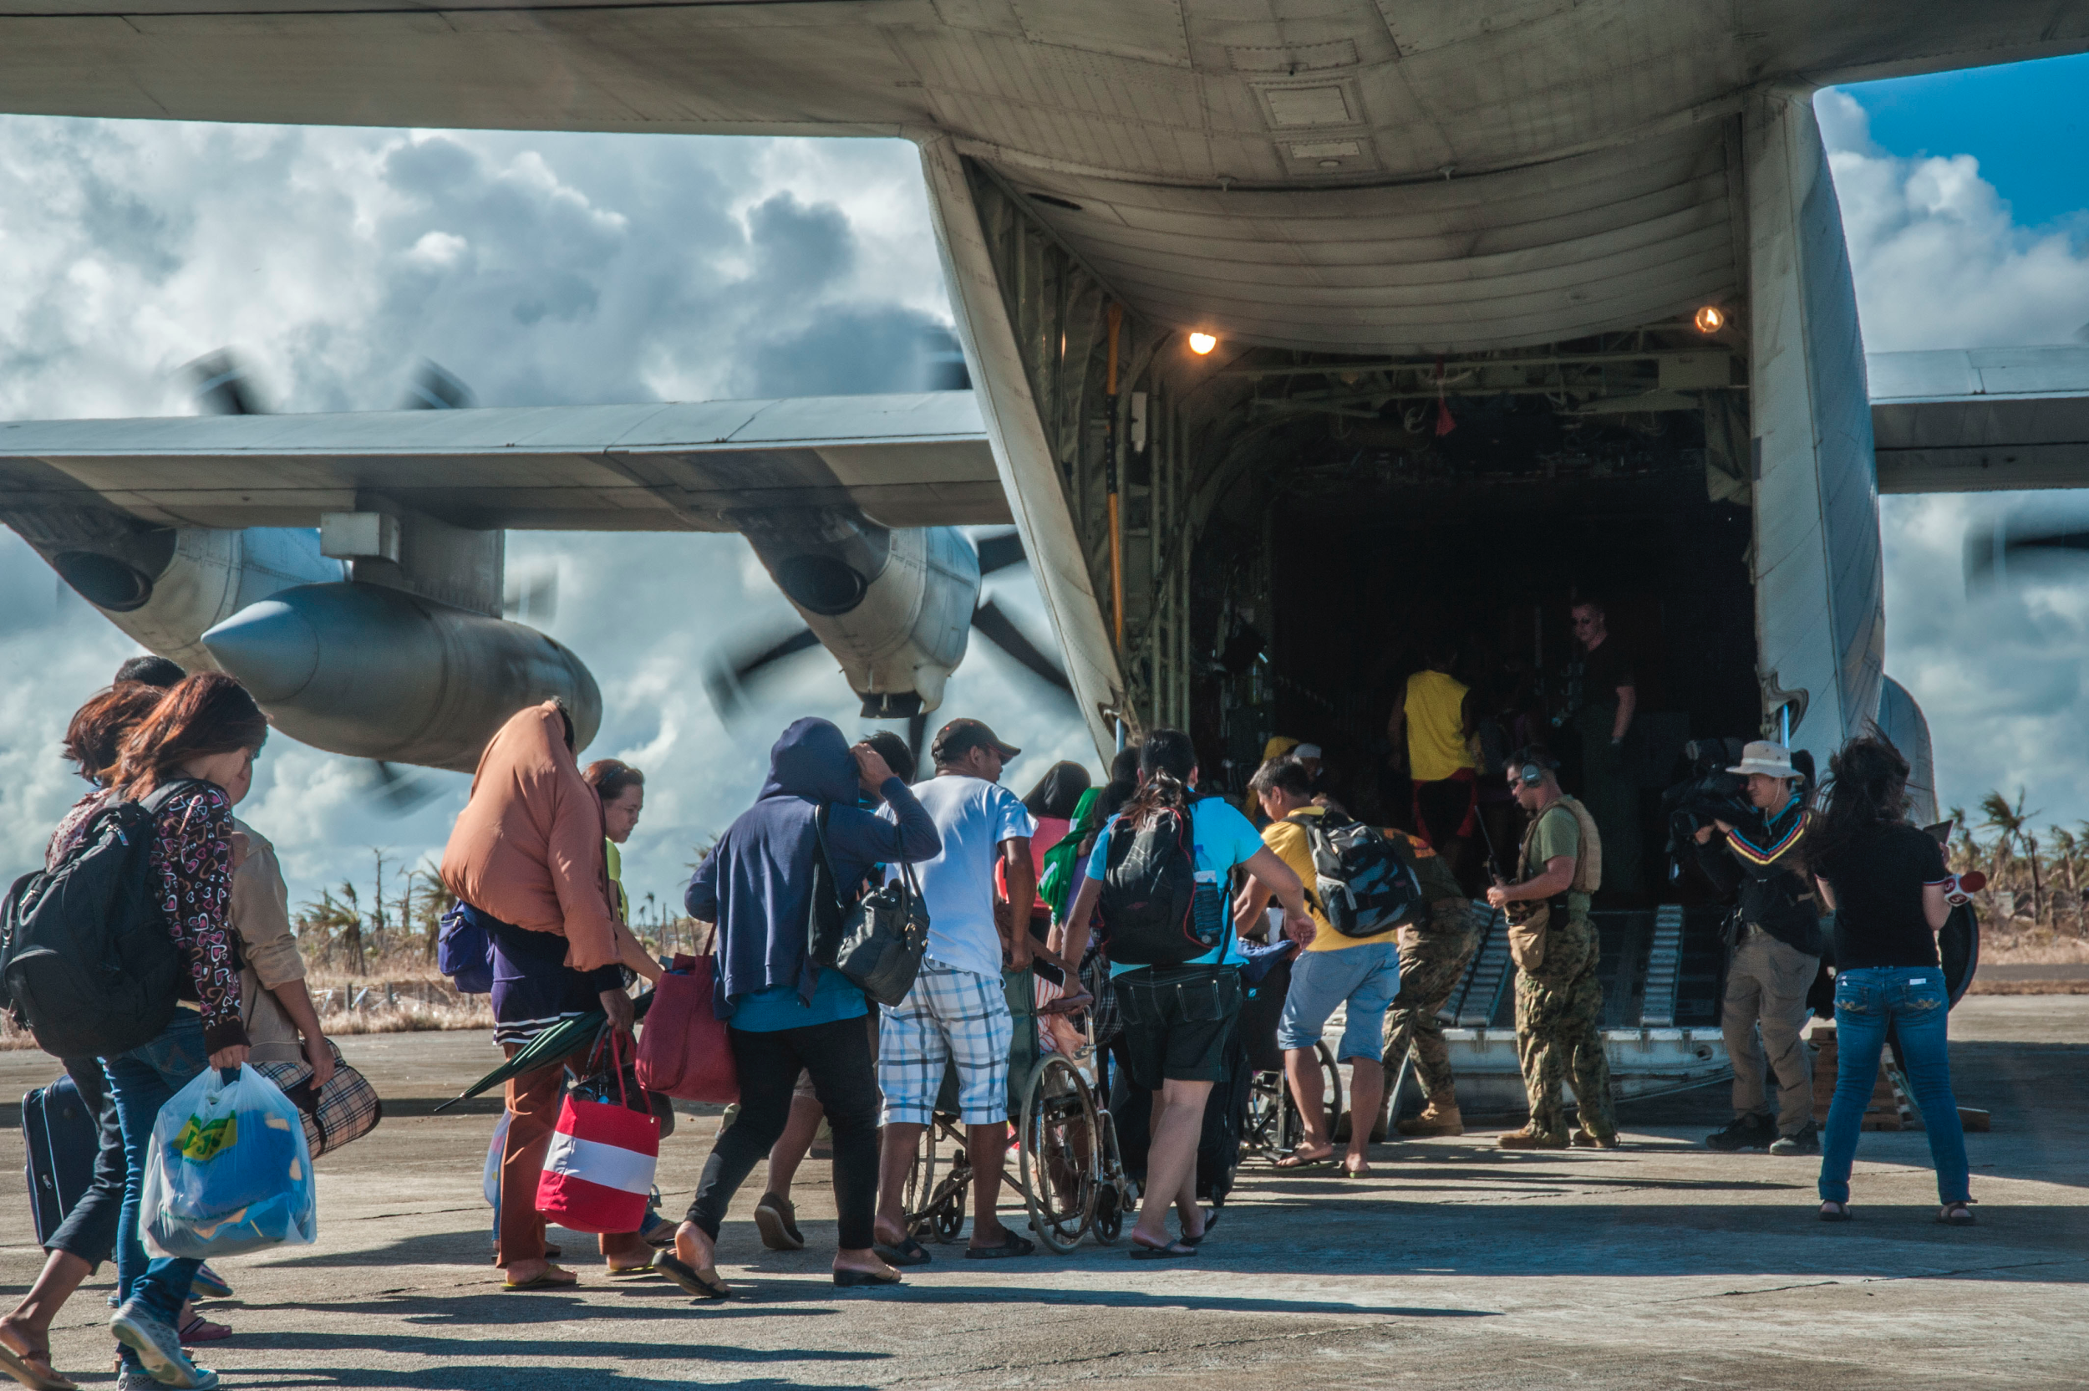
Objectives
Enhance vulnerability maps with storm size and intensity
Assess gender vulnerability based on improved storm climatology
Enable our partners to predict areas of greatest vulnerability
Image Credit: Flickr
Notes:
Our objective this term was to enhance the capability of our partners through hazard climatology measuring storm size and intensity to better assess gender vulnerability on a municipal level. Our enhanced storm data coupled with the prior terms demographic data will allow our partners in the Philippines to better predict areas greatest risk and coordinate aid.

Slide 6
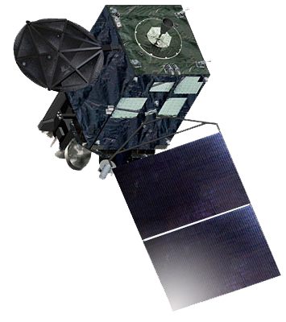
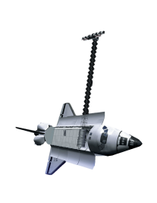
Satellite & Sensors
Geostationary Operational Environmental Satellite (GOES) Suite
Hurricane Satellite (HURSAT) data derived from suite of satellites
Geostationary Monitoring Satellite (GMS) Hurricane Satellite (HURSAT) data derived from suite of satellites
Shuttle Radar Topography Mission (SRTM) Global DEM
Notes:
Working within NCEI we implemented both NASA and NOAA data to great effect. From NOAA we utilized Hurricane Satellite (HURSAT) data from the Geostationary Operational Environmental Satellite Suit (GOES) to calculate storm size and intensity
NASA data was critical in evaluating landslide risk across the Philippines utilizing DEM dataset from the Shuttle Radar Topography Mission (SRTM).

Slide 7
Notes:
•We employed datasets from UN OCHA & the Humanitarian Data Exchange for demographic assessment.
•For each variable, we calculated the demographic risk by the number of households per municipality that fell into a category, such as households with single mothers, weak roofs or outer walls, & unsafe drinking water, over the total number of households in that municipality .

Slide 8
Methodology
Typhoon Haiyan 2013
Natural Hazards
IKE calculated by integrating the wind field of each tropical cyclone, every 6 hours
Spatially Accumulated Integrated Kinetic Energy (SpIKE) value for each municipality
Notes:
We calculated the Integrated Kinetic Energy or IKE of every storm, every 6 hours, from 1985 to 2015, before interpolating for every hour.

Slide 9
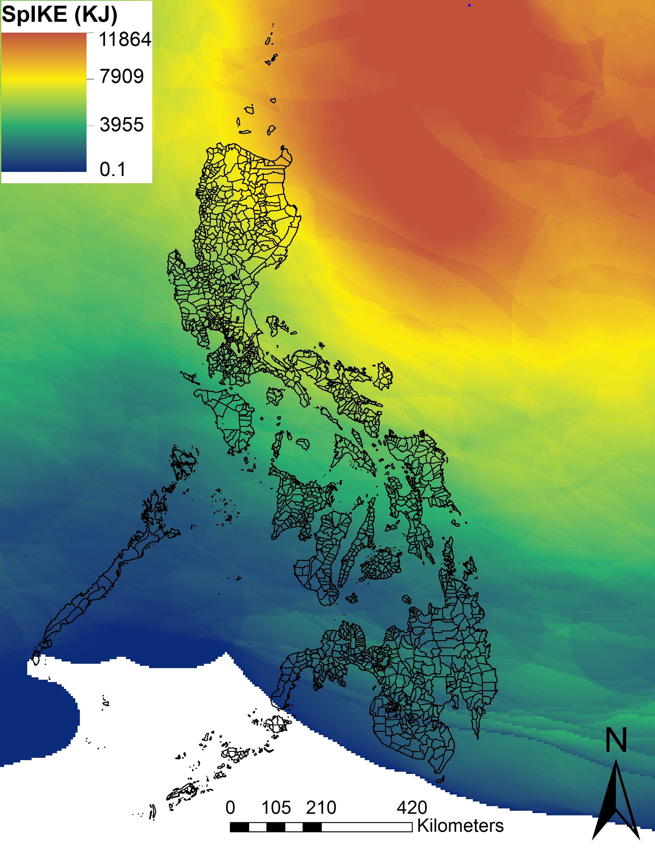
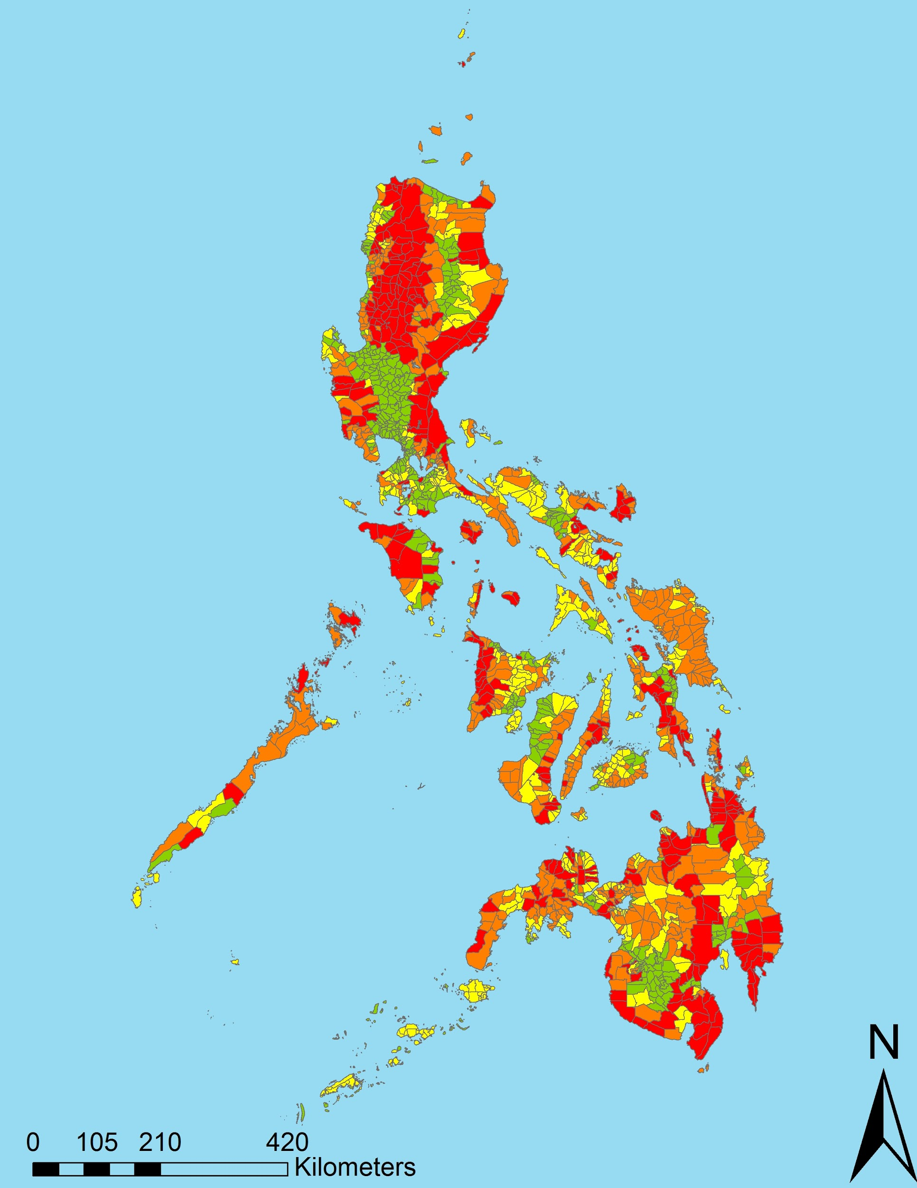
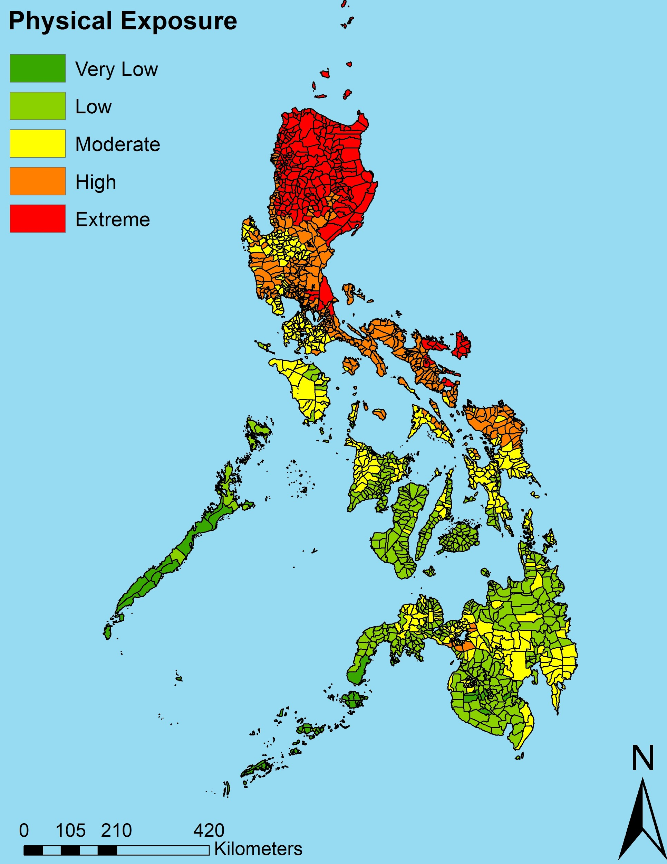
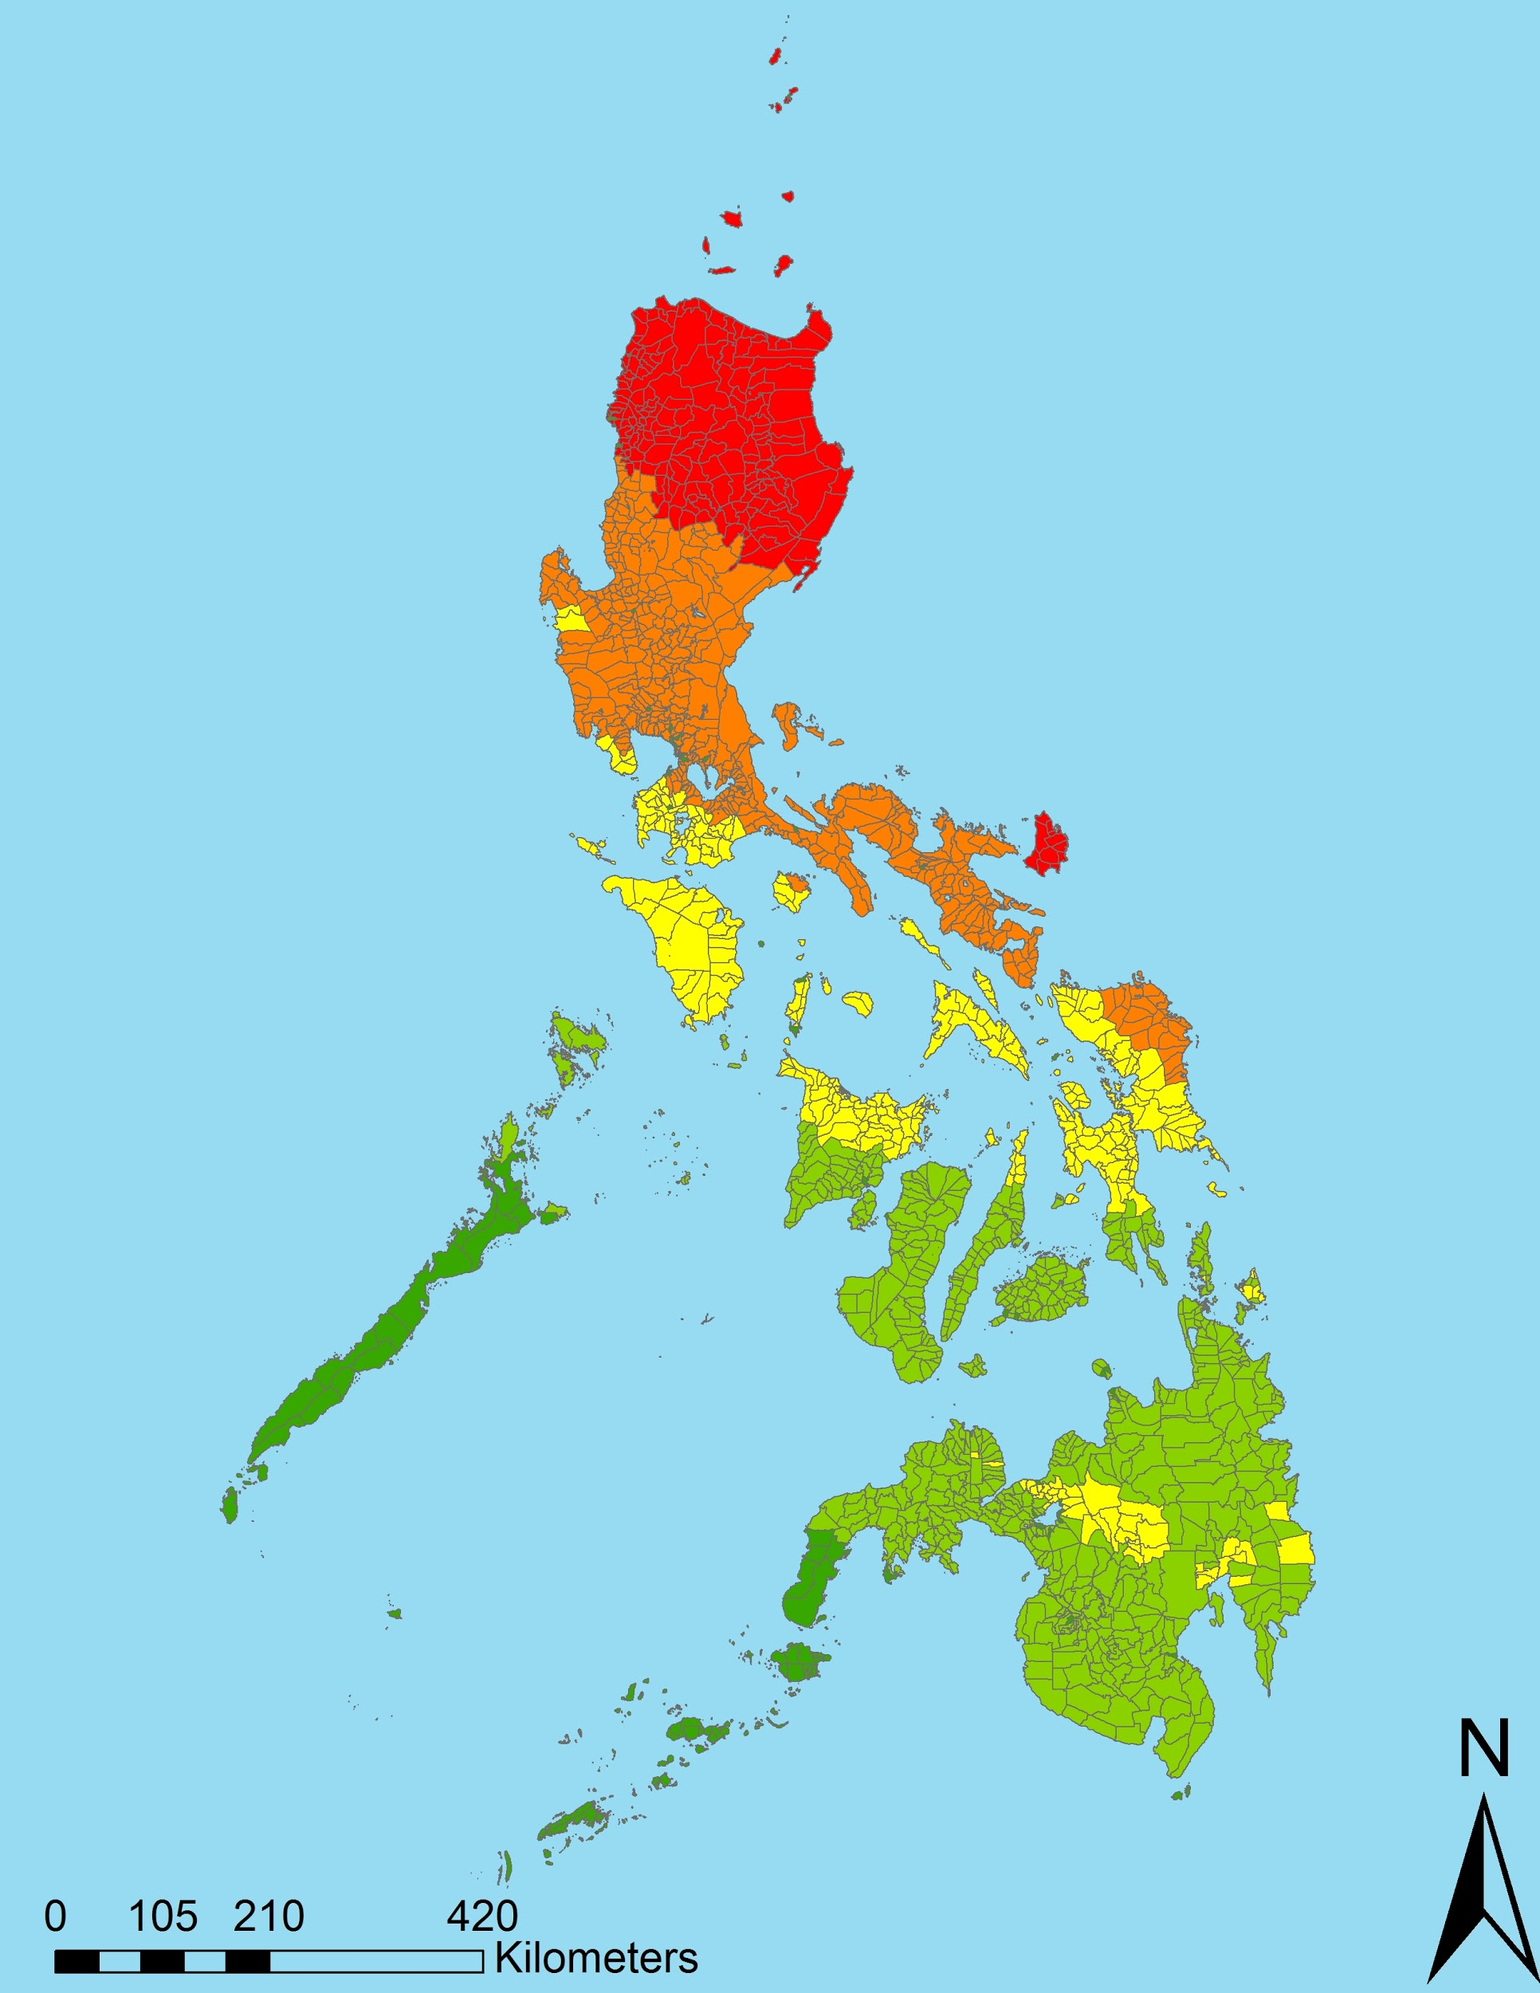
Results
Landslide Risk
Physical Exposure
Typhoon Risk
Average Annual Spatially Accumulated Integrated Kinetic Energy, 1985 to 2015
Notes:
The result was a map of the average seasonal integrated kinetic energy for our period of study. This was overlaid on a municipal level to evaluate typhoon risk. Combining our measure of typhoon with landslide risk we created a comprehensive map of exposure to natural hazards in the Philippines.

Slide 10
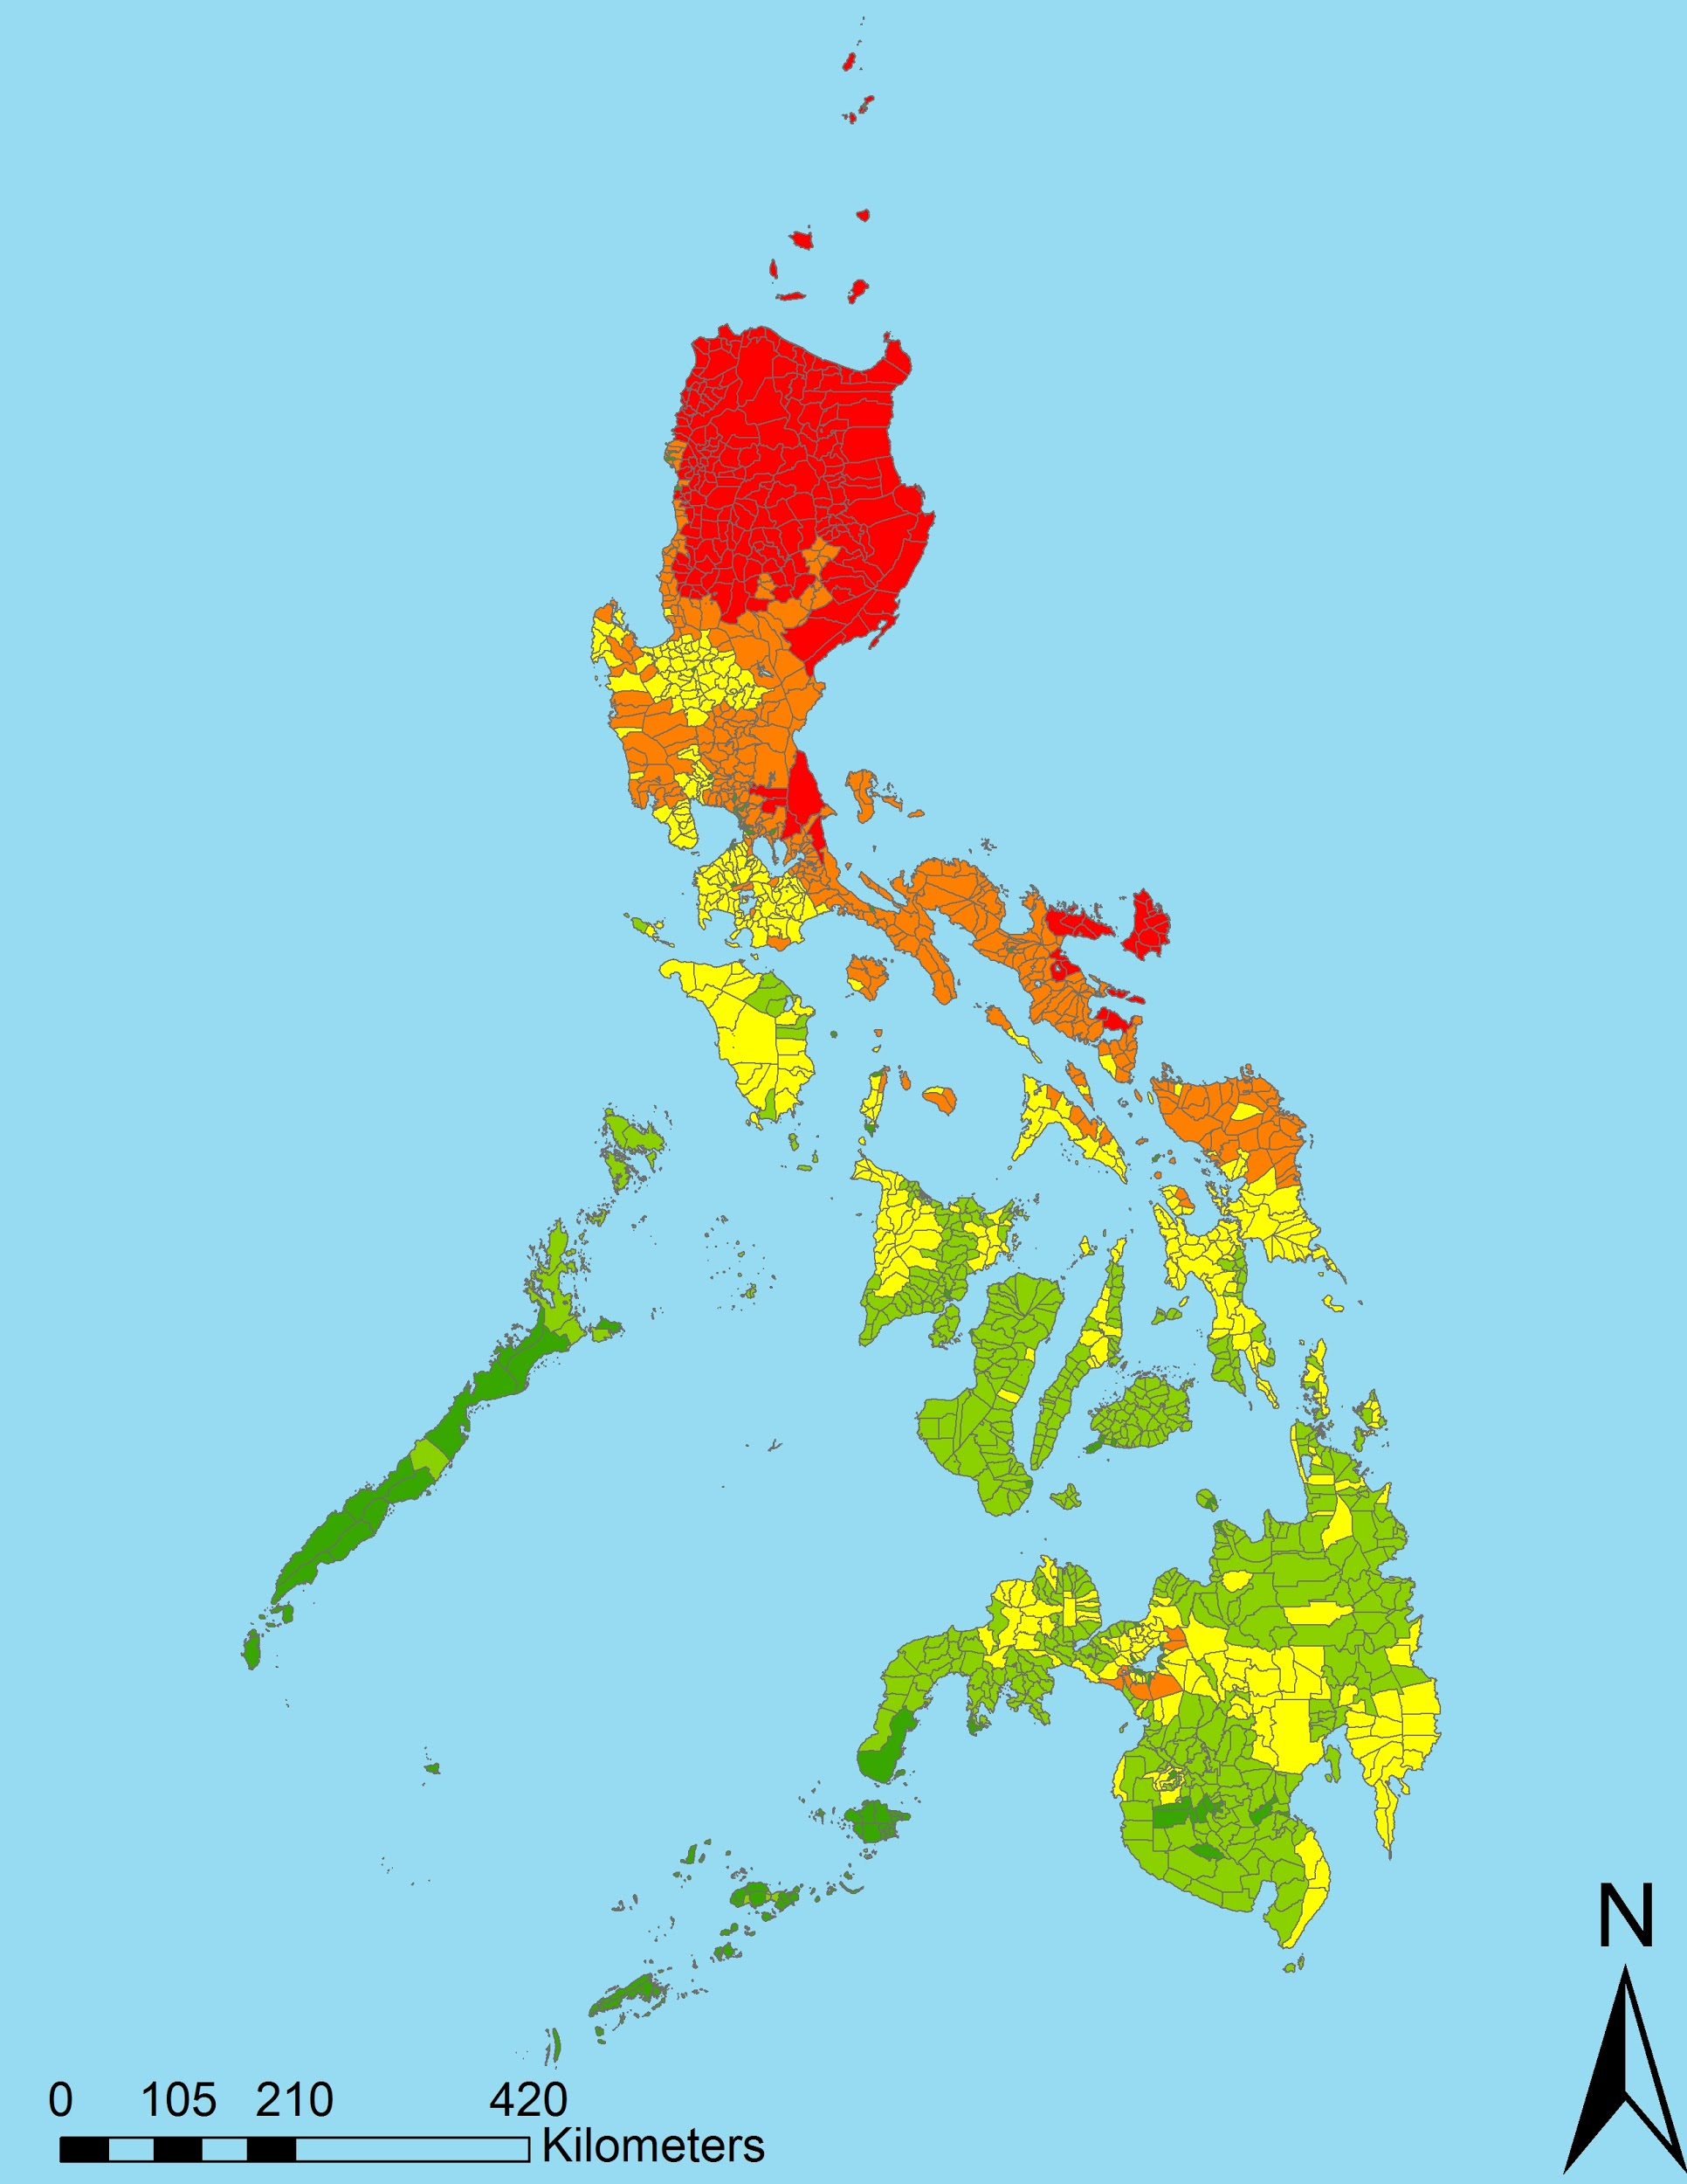
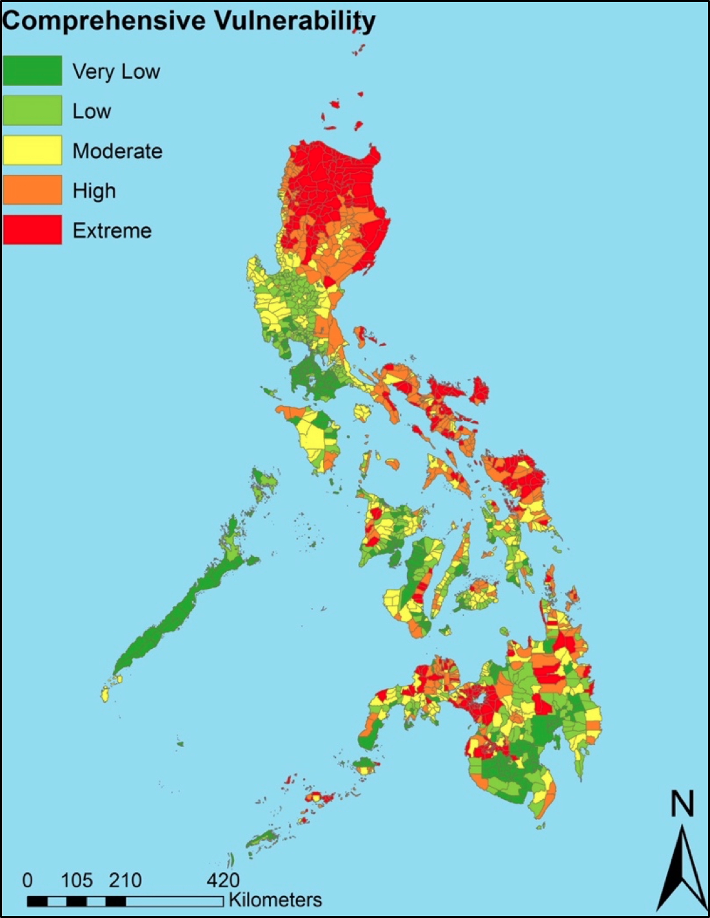
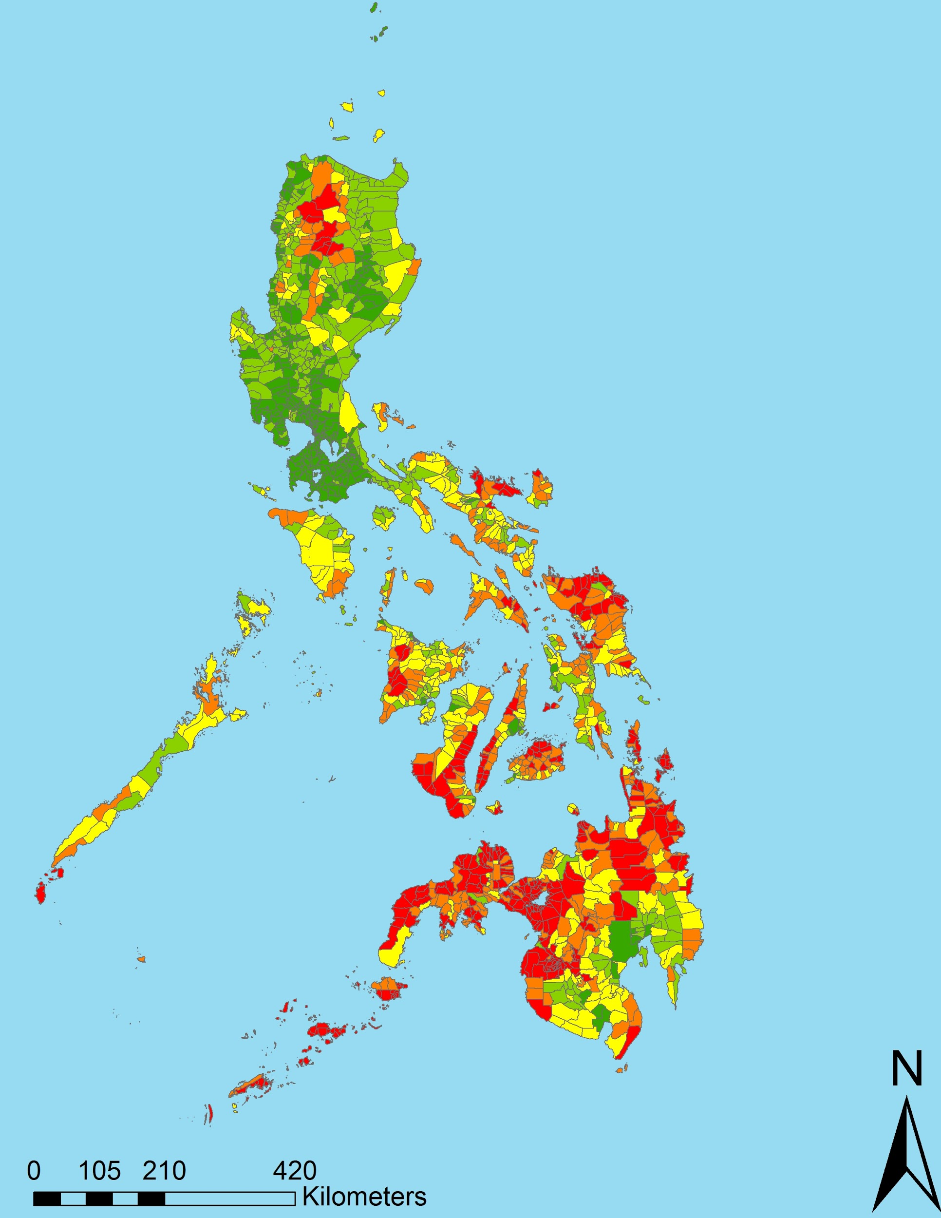
Conclusions
Physical Exposure
Comprehensive Vulnerability
Demographic Risk
SpIKE data
more accurately determined areas of greatest need
Improved identification of areas with the greatest risk
Notes:
•At end of term, we will hand off an ArcMap file to UN-OCHA, containing the enhanced risk assessment scores to assist in IDENTIFYING areas of greatest vulnerability for decision-making processes,
•such as the PRIORITIZING of advanced warning systems
•and MITIGATING the multiplying effect of typhoons on gender based violence.
•This risk assessment can be EXPANDED to other Pacific nations impacted by typhoons and associated gender-based violence.

Slide 11
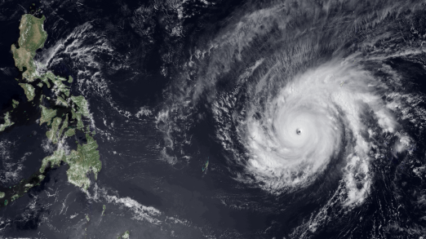
Future Work
Consider other variables and different weighting schemes
Continue in depth analysis of precipitation/flooding threats, corroborate with in situ observations (i.e., rain gauge data) as available
Expand to other tropical cyclone threatened nations
Image Credit: NOAA
Notes:
With feedback from our partner we developed a table allowing modification of the weighting schemes to tailor the data towards specific groups and agencies.
A more in situ data becomes available we would like to see further analysis of how well the EO data is supported by Automated weather stations, rain guages, buoy data, etc.
Finally, gender-based violence spikes in the wake of natural disasters is not unique to the Philippines. Our work could be expanded to other Pacific Island Nations at risk to typhoons.

Slide 12
Acknowledgements
Philippines Disasters I Team:
Daniel T. Martin (Lead), Allison Daniel, Kelly Meehan, Jessica Vermillion
Science Advisors
Dr. Carl Schreck, Cooperative Institute for Climate and Satellites - North Carolina, NOAA National Centers for Environmental Information (NCEI)
Dr. Ken Knapp, NOAA NCEI
Dr. L. DeWayne Cecil, Global Science and Technology, NOAA NCEI
Partners
Joseph Addawe, Information Management Analyst, UNOCHA
Rowena Dacsig, Gender Advisor, UNOCHA
Luca Delloro, Programme Specialist, UNOSAT
Maarten van der Veen, Initiator, Netherlands Red Cross
Dr. John Knaff, Tropical/Satellite Meteorologists, National Environmental Satellite, Data, and Information Service (NESDIS)
Notes:
Our team would like to acknowledge the Spring 2017 Philippines Disaster I team, ( Daniel T. Martin, Allison Daniel, Kelly Meehan, Jessica Vermillion), our science advisors Dr. Ken Knapp & Dr. Carl Shreck, our collaborators from UNOSAT and the Netherlands Red Cross, as well as our partners in the Philippines: Joseph Addawe and Rowena Dacsig of UNOCHA, thank you.

