Slide 1
Virginia Water Resources
Utilizing NASA Earth Observations to Monitor the Extent of Harmful Algal Blooms in Virginia’s Chesapeake Bay Watershed
Cassandra Morgan (Project Lead)
Sara Lubkin

Slide 2
Harmful Algal Blooms
An overgrowth of marine microorganisms that have negative effects on the environment or other organisms
jknk
Block sunlight
Consume dissolved oxygen
Produce toxins
Produce unpleasant or noxious odors
Source: Chesapeake Bay Foundation, Environmental Protection Agency
Notes:
Harmful algal blooms or HABs are overgrowths of algae or other marine microorganisms that have an adverse effect on other living things. In the Chesapeake Bay, harmful algal blooms are most abundant between May and October when the water is warm and there an adequate supply of nutrients. When HABs occur, they discolor water and produce noxious odors. They block sunlight that is needed by underwater plants and prevent filter feeders from being able to obtain food. But the effects of HABs can last long past the bloom period, when harmful algal blooms decompose, they remove large amounts of dissolved oxygen from the water creating anoxic dead zones.
Image Source: Chesapeake Bay Program http://www.chesapeakebay.net/images/blog/june_23_15big.jpg
US Environmental Protection Agency http://www2.epa.gov/sites/production/files/nutrientpollution/images/dead_fish.jpg
US Environmental Protection Agency http://www2.epa.gov/sites/production/files/nutrientpollution/images/notice_algaeblooms.jpg

Slide 3
Community Concerns
HABs (Cochlodinium polykrikoides and Alexandrium monilatum):
Are becoming increasingly common in Virginia Rivers
Reduce oxygen in water and produce toxins, which kill fish and may cause human illness
Have negative economic impact on Virginia fisheries, as well as the tourist industry
Source: Virginia Institute of Marine Science, Kim Reece
Notes:
In Virginia, scientists are especially concerned Cochlodinium polykrikoides and Alexandrium monilatum, a dinoflagellate that was not found north of Florida until 2007. It now occurs regularly in Virginia.
Both species produce red or mahogany tides and are of special concern because they are toxic to fish and may cause disease in humans. These HABs have a negative economic impact on Virginia fisheries, as well as the tourist industry.
Photo: http://www.vims.edu/newsandevents/_photosets/hab_2013/york_river_475.jpg

Slide 4
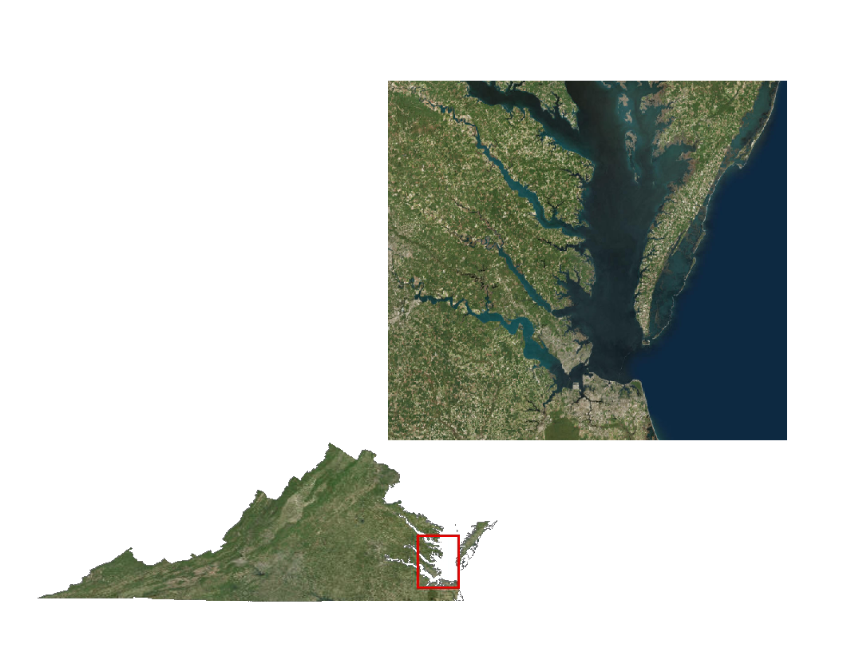
Study Area & Study Period
May - October
2011 - 2015
Source: Esri, DigitalGlobe
Notes:
We focused our study on the Lower Chesapeake Bay of Virginia, including the Lower James River, Lower York River, Elizabeth River, and Mobjack Bay

Slide 5
Source: Virginia Institute of Marine Science
Virginia Institute of Marine Science
Virginia Department of Environmental Quality
Project Partners
Notes:
Our partners include the Virginia Institute of Marine Science and the Virginia Department of Environmental Quality.
Photo Source: https://www.flickr.com/photos/vims_photos/13999101114/in/album-72157644229420316/

Slide 6
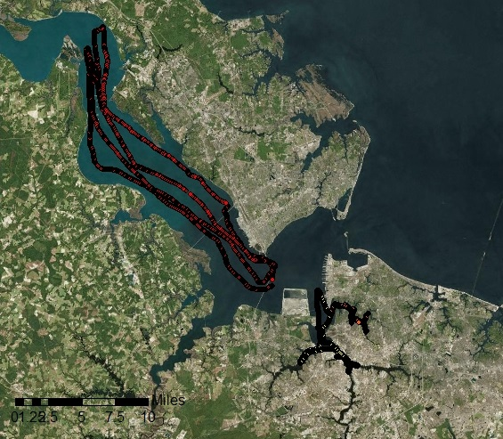
Current Monitoring
Data Collection Methods
Fixed interval; fixed stations
Monthly/weekly data flow cruises
Automated continuous sampling
Limitations
Temporal scope
Spatial resolution
Expensive
Background imagery: Esri, DigitalGlobe
Notes:
The Virginia Institute of Marine Science monitors harmful algal blooms in the lower Chesapeake Bay watershed using both fixed stations and periodic data cruises. The Hampton Roads Sanitation District provides automated continuous sampling in several locations.
While this sampling is on-going, it is limited. Processing samples takes time. Information is not available until the end of the growth season. Unless a scientist happens upon a bloom during routine monitoring, bloom activity may go unnoticed. There is no way to monitor the entire bay at one time using ground samples.
Monitoring is also expensive. There is no guarantee that funding for Chesapeake Bay monitoring will continue to be a priority.
Image Source: Source: Esri, DigitalGlobe, GeoEye, Earthstar Geographics, cNES/Airbus DS, USDA, USGS, AEX, Getmapping, Aerogrid, IGN, IGP, swisstopo, and the Esri User Community

Slide 7
Aqua Moderate Resolution Imaging Spectroradiometer
(MODIS)
Chlorophyll estimates - NASA OC3M algorithm derived
Chlorophyll and Total Suspended Matter - NOAA Coastwatch
1.4 km resolution (TSM at 250 meters)
Notes:
Satellite data provides the potential to monitor bloom over the entire Chesapeake Bay at minimal cost. The Aqua MODIS satellite measures the reflectance of chlorophyll, which can be used as a proxy for algal blooms. NOAA obtains MODIS data from NASA’s Goddard Space Flight Center and processes the data using a regionally tuned OC3 algorithm. Easy-to-access level 2 Aqua MODIS chlorophyll-a estimates can be downloaded from NOAA CoastWatch’s East Coast node as.png or .hdf. files on a daily, weekly or monthly basis. While NOAA’s MODIS estimates are easy to use, the 1.4 km resolution is too large to be useful for Virginia’s rivers.
Image Source: DEVELOPedia

Slide 8
Landsat 8
Operational Land Imager (OLI)
30 meter resolution
Chlorophyll and TSM estimates are not readily available
Notes:
Landsat 8 has much better resolution at 30 meters and can be used to view Virginia rivers. However, Landsat data must be processed to detect chlorophyll. There are no publicly available chlorophyll-a Landsat products.
Image Source: DEVELOPedia

Slide 9
NASA Satellite/Sensors
Landsat 8
Operational Land Imager (OLI)
Aqua Moderate Resolution Imaging Spectroradiometer
(MODIS)
Notes:
Our goal was to combine the resolution of Landsat 8 with the chlorophyll imaging capabilities of Aqua MODIS.
Image Source: DEVELOPedia

Slide 10
Objectives
Create
Create an algorithm toe estimate chlorophyll and total suspended material from Landsat data
Create ArcGIS tools to process Landsat 8 OLI/TIRS data for chlorophyll estimates at 30 meter resolution
Provide
Provide more comprehensive overview of harmful algal bloom activity in the Chesapeake Bay watershed
Identify
Identify potential sampling locations based on estimated chlorophyll concentrations
Credit: Chesapeake Bay Foundation
Notes:
This would allow us to create imagery that would help our partners determine probable locations of harmful algal blooms (HABs) in Virginia rivers (James, York, Elizabeth), the Mobjack Bay (Mathews, Va), and the Chesapeake Bay.
Our objectives were to calibrate Landsat reflectance data with Aqua MODIS chlorophyll estimates to produce an algorithm that would estimate approximate chlorophyll from Landsat data AND use that algorithm to produce an ArcGIS tool that our partners could use to process data on their own. This would allow our partners to identify algal “hot spots” before blooms spread.

Slide 11
Methodology
Acquisition
Processing
Processing
Landsat 8
USGS Earth Explorer
Remove land and clouds from image
Focal statistics
1.4 km Smoothed Landsat image
ArcGIS
ArcGIS
MODIS, Chlorophyll
NOAA CoastWatch
MODIS, Chlorophyll Pointfile
ArcGIS
ArcGIS
ArcGIS
VECOS Water Quality Data
Extract Landsat band values to MODIS points
Analysis
Product
Regression Equation
R software
Notes:
Imagery was obtained for May - October of 2011 through 2014, the peak period for bloom growth. We downloaded Landsat Surface Reflectance products for Landsat 8, Path 14 Row 34 from the United States Geological Survey’s Earth Explorer System. We obtained daily Aqua MODIS Level 2 chlorophyll data for the Chesapeake Bay Watershed from the NOAA’s CoastWatch’s East Coast Node. In situ chlorophyll measurements were downloaded from the Virginia Estuarine and Coastal Observing System to serve as cross reference measurement for remote sensing data. Because we thought that water depth would be factor in our analysis, we also downloaded bathymetric data from VECOS.
In order to create a chlorophyll estimation tool, we cross calibrated Landsat data from the 2013 bloom season with CoastWatch MODIS chlorophyll-a estimates for corresponding dates. The Landsat band data was filtered through a 1.4 kilometer moving window to match the MODIS scale. MODIS chlorophyll-a values were joined to bathymetry measurements and the values of each smoothed masked Landsat spectral reflectance band. This provided the information we needed for our regression equations.
Regression equations were calculated using R software. Several regression methods were tested.

Slide 12
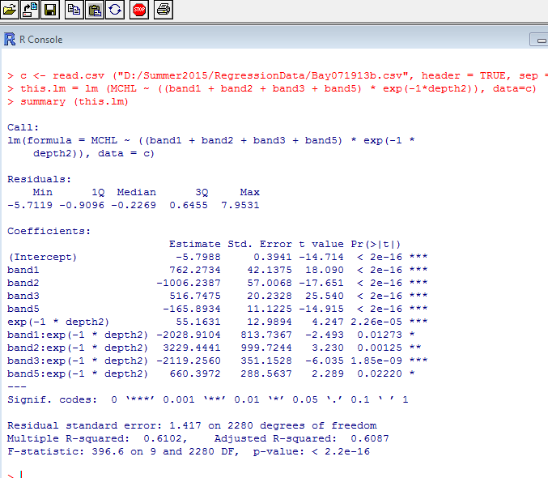
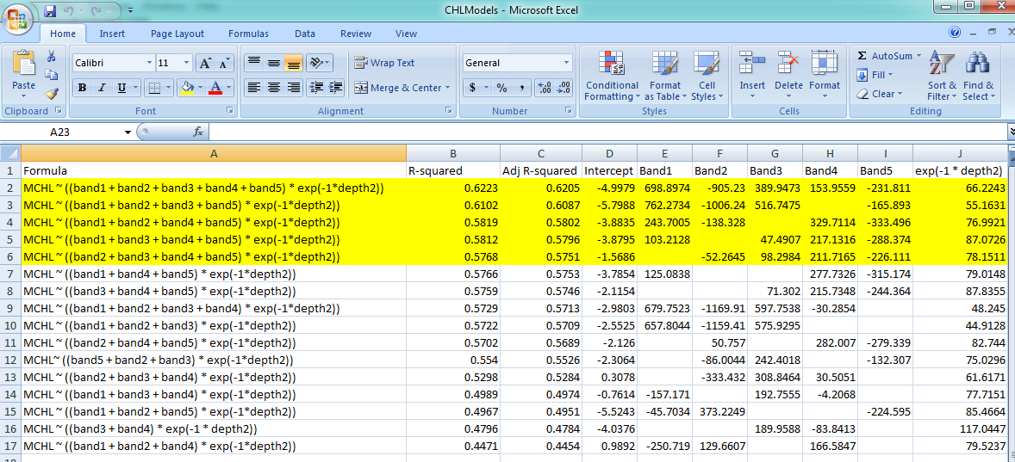
Methodology
Notes:
We chose the five equations with the highest R-squared value for our models. The resulting regression formulae were used to produce rough estimates of chlorophyll using ArcGIS. The equations were then used to create a tool in ArcGIS model builder that will be provided to our partners. This will allow our partners to independently process Landsat 8 data to show chlorophyll estimates
We followed a similar process to create a tool to image total suspended matter or TSM.
at a 30 meter resolution.
Image Source: PHB DEVELOP Team Screenshots

Slide 13
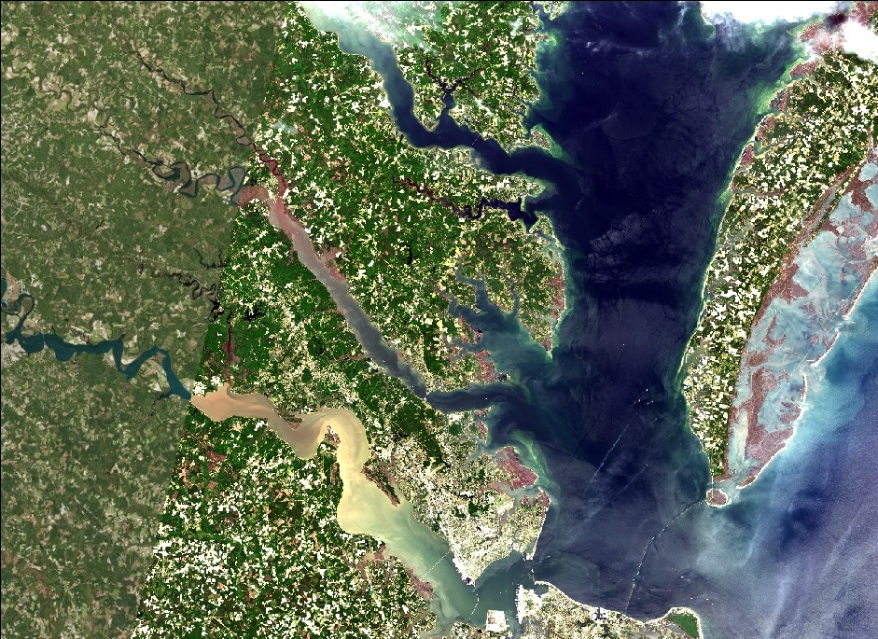
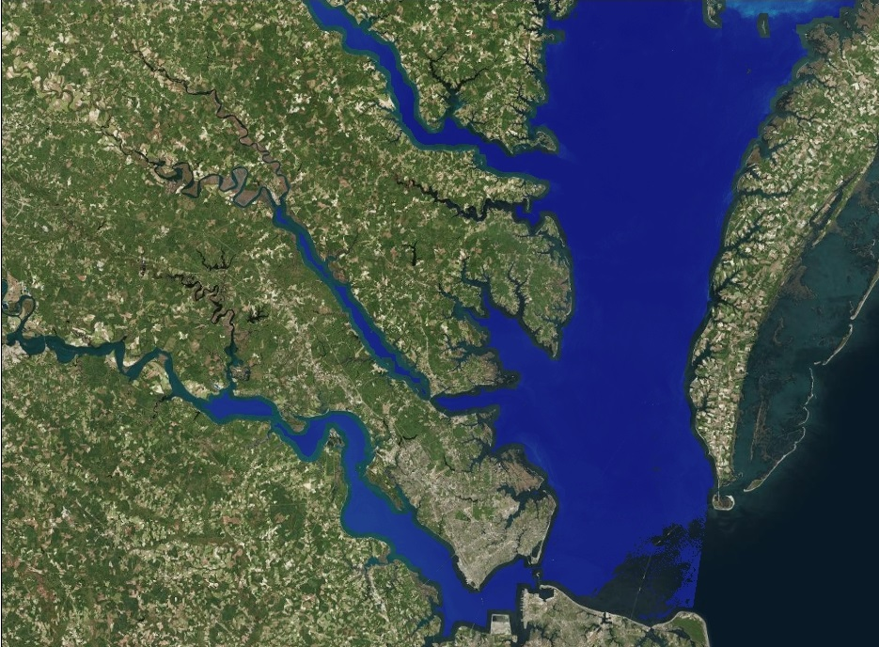
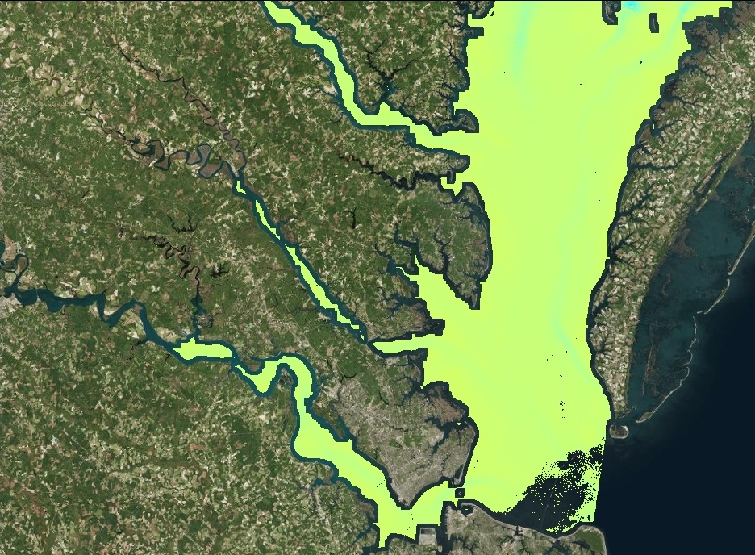
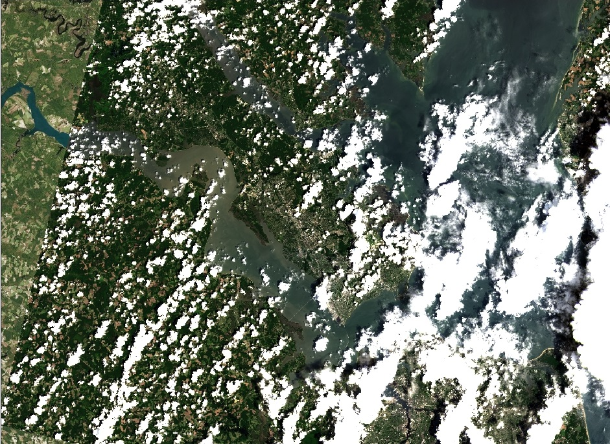
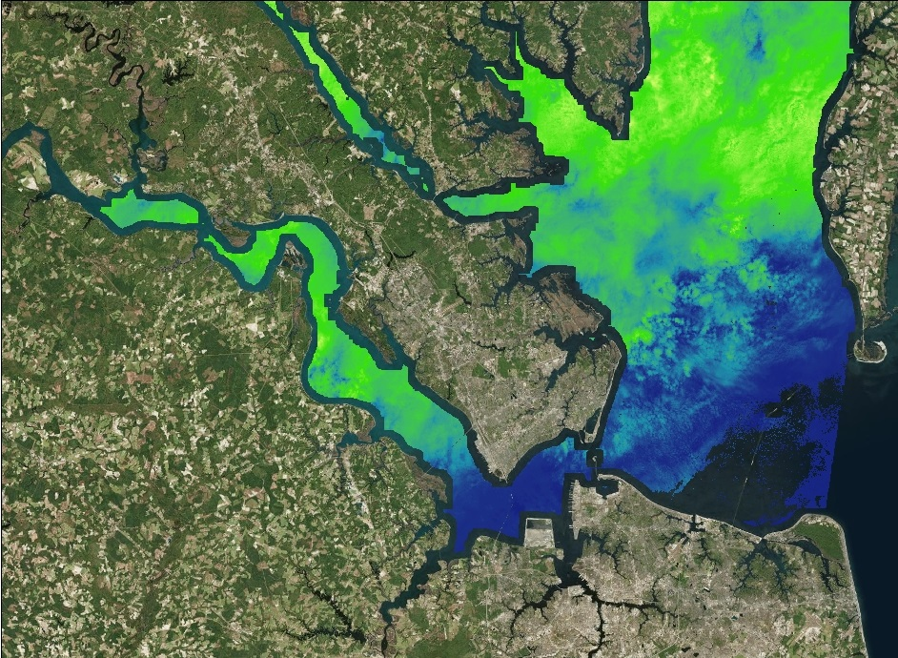
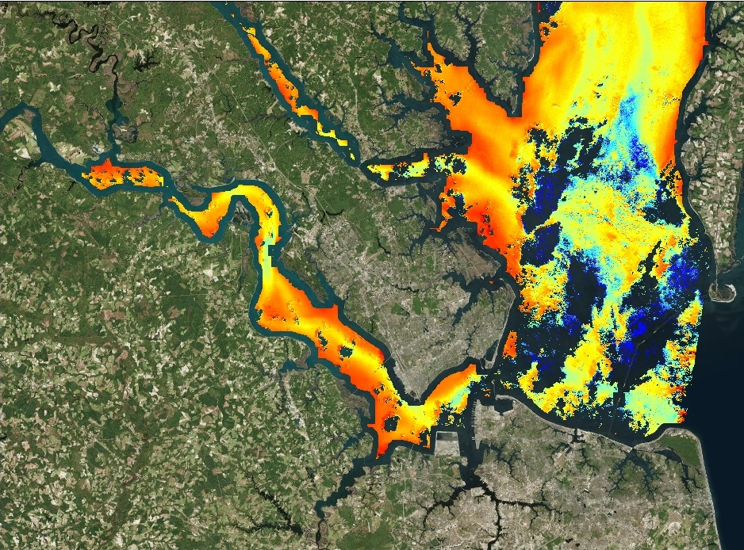
Results
May 16, 2013
Landsat 8
Total Suspended Matter
Chlorophyll
July 3, 2013
Landsat 8
Total Suspended Matter
Chlorophyll
Background imagery: Esri, DigitalGlobe
Notes:
We used the intercepts and coefficients calculated by R to model chlorophyl and TSM in ArcGIS. These maps show variation between May 16 – early in the bloom season – and July 3 when the water is warm. (hoping this will be animation)
Image Source: Background imagery: Esri, DigitalGlobe, GeoEye, Earthstar Geographics, cNES/Airbus DS, USDA, USGS, AEX, Getmapping, Aerogrid, IGN, IGP, swisstopo, and the Esri User Community

Slide 14
Processed Landsat 8
May 16, 2013
July 3, 2013
Background imagery: Esri, DigitalGlobe
Notes:
We used the intercepts and coefficients calculated by R to model chlorophyl in ArcGIS. These maps show variation between May 16 – early in the bloom season – and July 3 when the water is warm.
Image Source: Background imagery: Esri, DigitalGlobe, GeoEye, Earthstar Geographics, cNES/Airbus DS, USDA, USGS, AEX, Getmapping, Aerogrid, IGN, IGP, swisstopo, and the Esri User Community

Slide 15
Estimated Chlorophyll
May 16, 2013
High
July 3, 2013
Low
Background imagery: Esri, DigitalGlobe
Notes:
We used the intercepts and coefficients calculated by R to model chlorophyl in ArcGIS. These maps show variation in chlorophyll on May 16 – early in the bloom season – and on July 3 when the water has had time to warm.
Image Source: Background imagery: Esri, DigitalGlobe, GeoEye, Earthstar Geographics, cNES/Airbus DS, USDA, USGS, AEX, Getmapping, Aerogrid, IGN, IGP, swisstopo, and the Esri User Community

Slide 16
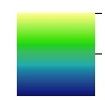
Estimated Total Suspended Matter
May 16, 2013
July 3, 2013
High
Low
Background imagery: Esri, DigitalGlobe
Notes:
We used the intercepts and coefficients calculated by R to model TSM in ArcGIS. These maps show variation between May 16 – early in the bloom season – and July 3 when the water is warm.
Image Source: Background imagery: Esri, DigitalGlobe, GeoEye, Earthstar Geographics, cNES/Airbus DS, USDA, USGS, AEX, Getmapping, Aerogrid, IGN, IGP, swisstopo, and the Esri User Community

Slide 17
Future Work
Test and validate the five best regression formulas for each model
Calibrate models using in-situ data
Refine ArcGIS tools for partners’ computer systems
Credit: Chesapeake Bay Program
Notes:
This is a two term project. Creating a model was the first step. Next term, the model will be tested, validated and refined. Once completed, a python tool will be created that will allow our partners to better assess the timing, magnitude, duration and frequency of Harmful Algal Blooms in the lower Chesapeake Bay watershed and better predict the environmental and water quality conditions that favor bloom development. This understanding will help the state of Virginia to develop policies that will protect the water and keep the Chesapeake Bay healthy.
Image Source: https://www.flickr.com/photos/29388462@N06/5185642966

Slide 18
Advisors
NASA DEVELOP National Science Advisor
Dr. Kenton Ross
Partners
Virginia Institute of Marine Science
Kim Reece, Jian Shian, Wolf Vogelbein
Virginia Department of Environmental Quality
John Kennedy, Tish Robertson, Anne Schlegal
Others
Virginia Deputy Secretary of Natural Resources for the Chesapeake Bay
Russ Baxter
Dept. of Biological Sciences, Old Dominion University
Todd Egerton
Hampton Roads Sanitation District
Will Hunley
Notes:
Cassandra and I would like to thank our science advisor Dr. Kenton Ross, our partners the Virginia Institute of Marine Science and the Virginia Department of Environmental Quality. Virginia’s Deputy Secretary of Natural Resources for the Chesapeake Bay, Russ Baxter; Todd Egerton from Old Dominion University and Will Hunley from the Hampton Roads Sanitation District.

