Slide 1
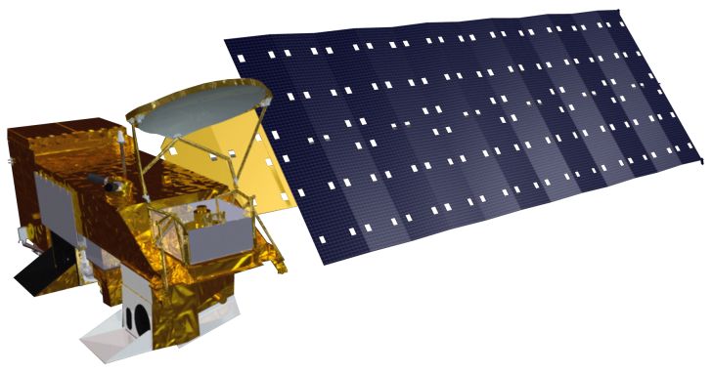
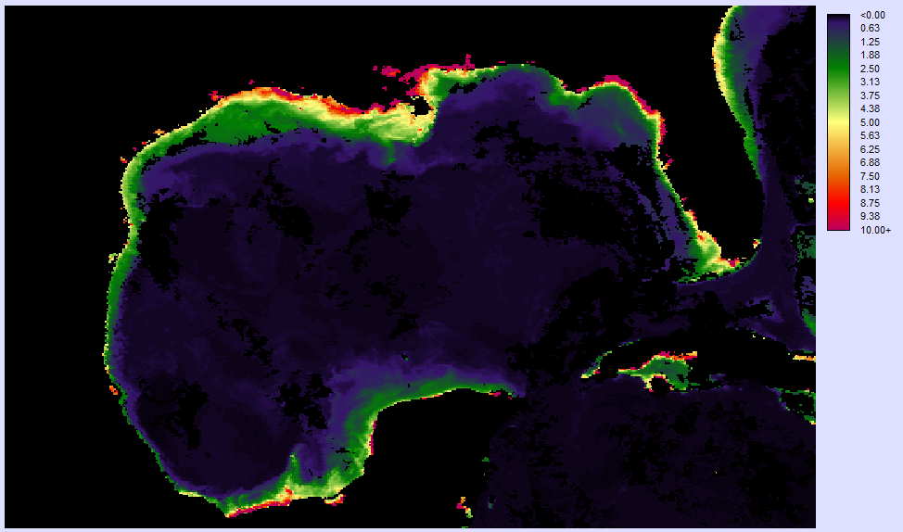
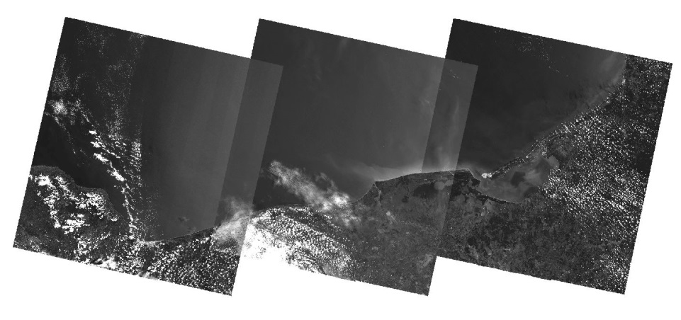
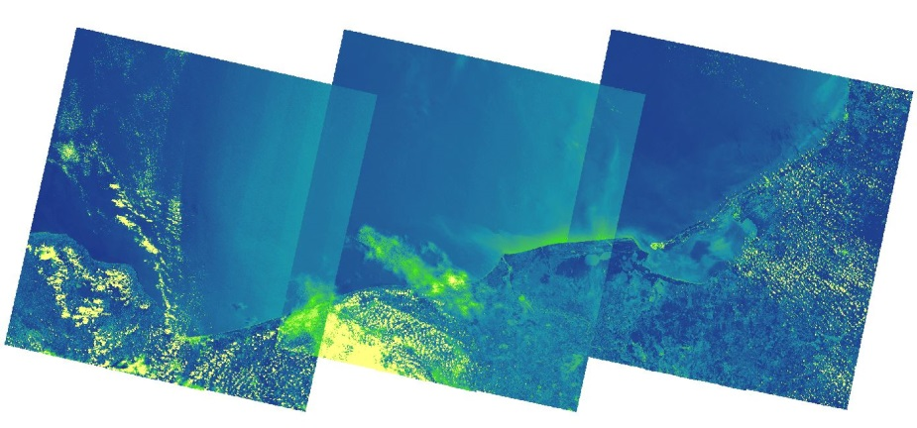
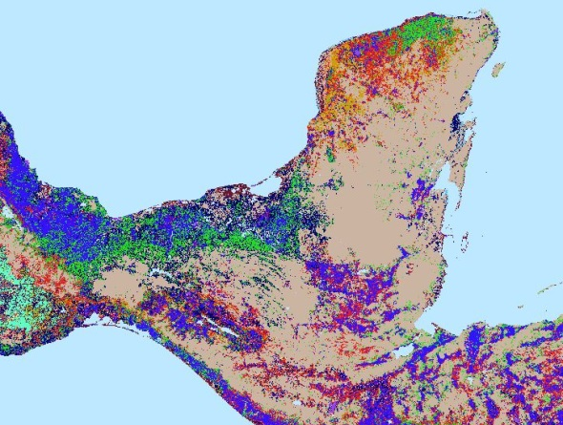
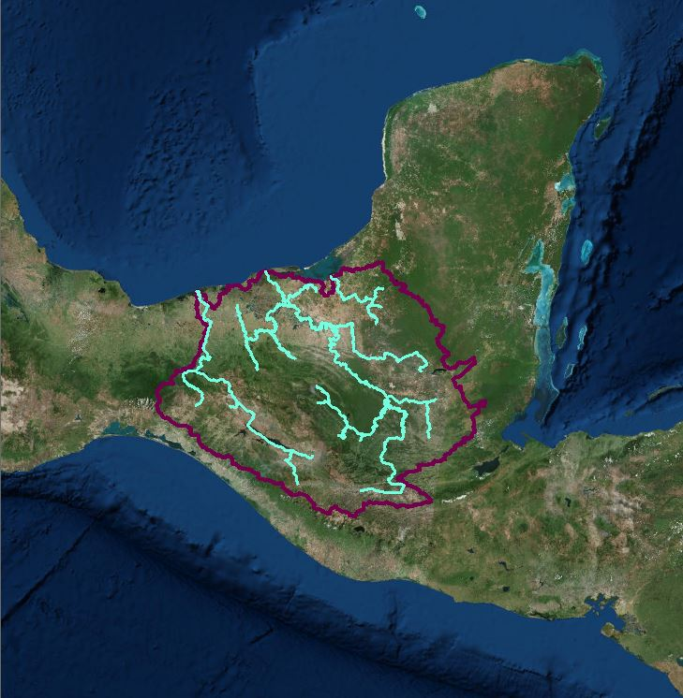
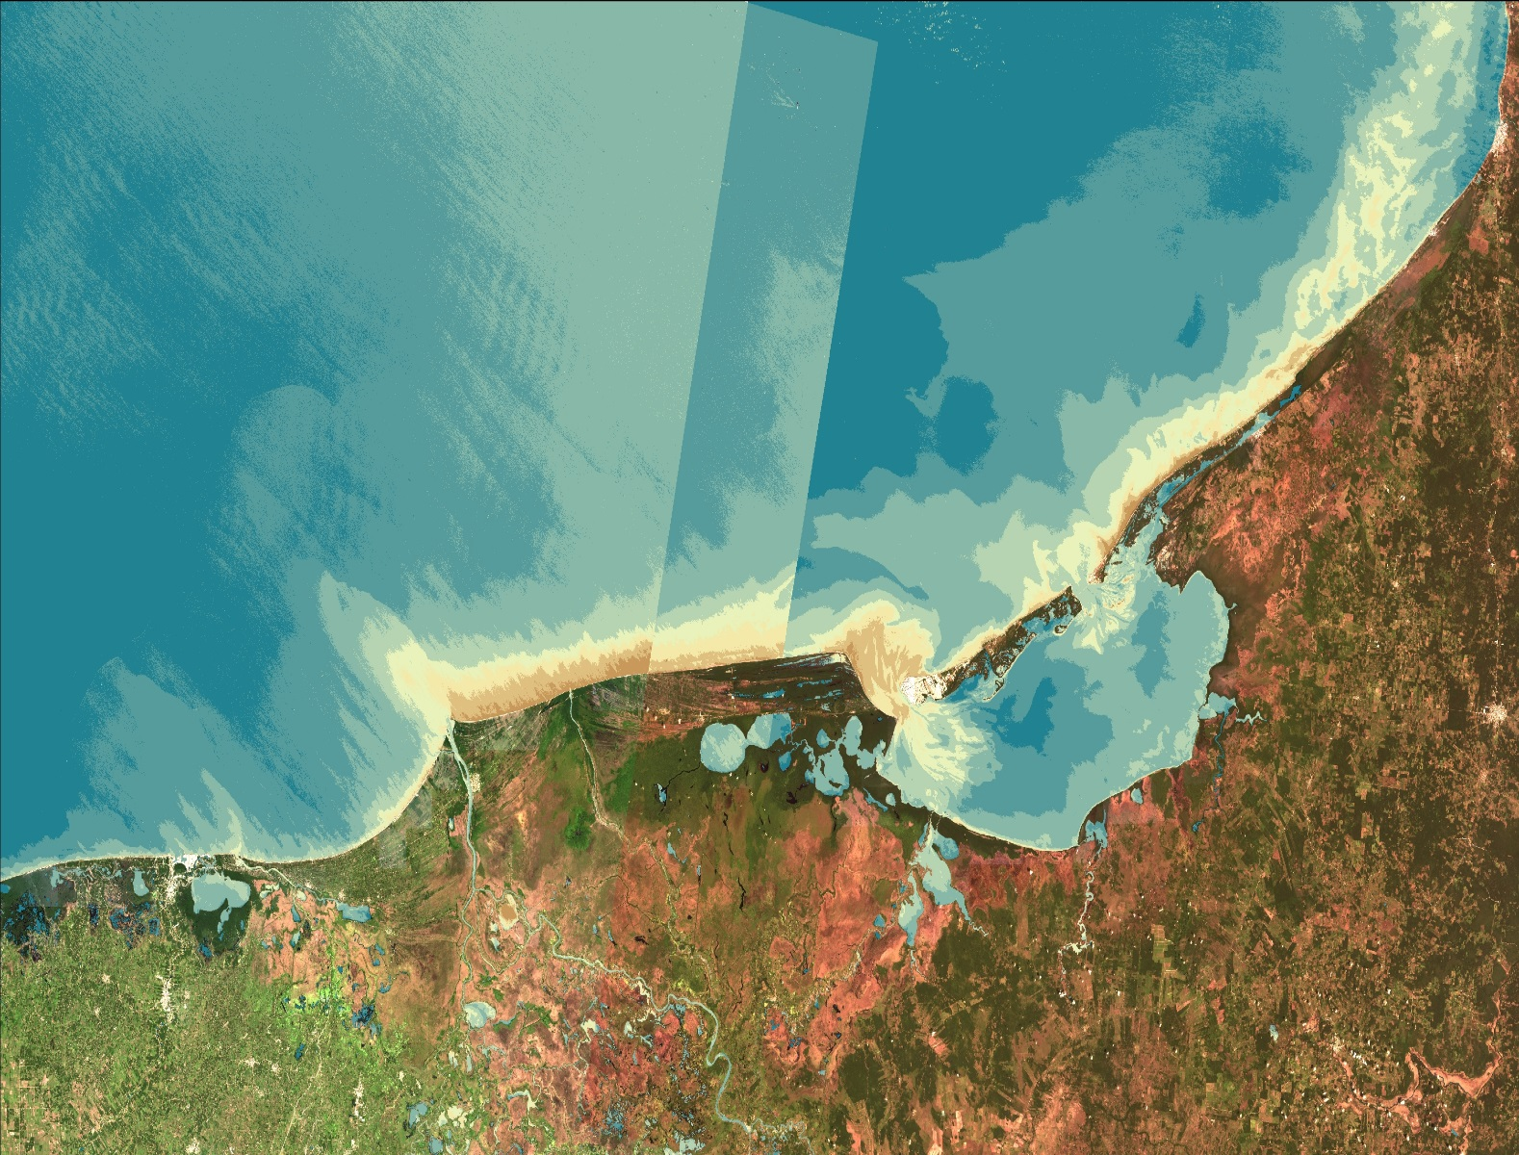
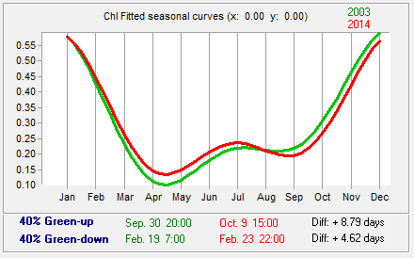
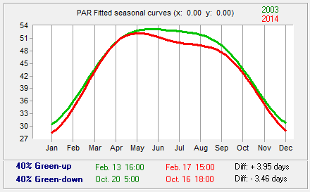
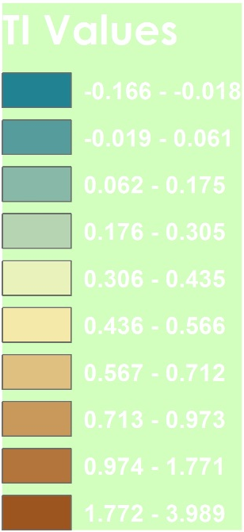
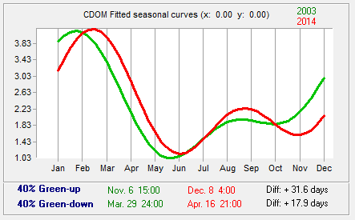
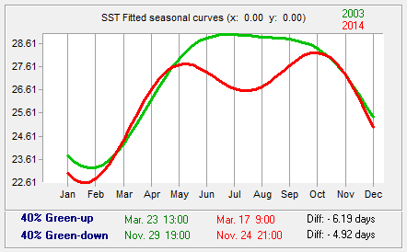
Gulf of Mexico Water Resources
Utilizing NASA Earth Observations to Detect Factors Contributing to Hypoxic Events in the Southern Gulf of Mexico
Rebecca Chapman (Project Lead), Irma Caraballo Álvarez, Alannah Johansen, Åse Mitchell, Bridget Smith, Mackenzie Taggart
NASA Ames DEVELOP Program
Abstract
Earth
Observations
Objectives
This study uncovered trends and dynamic characteristics of chlorophyll-a (Chl) concentration, sea surface temperature (SST), colored dissolved organic matter (CDOM) index, and photosynthetically available radiation (PAR), as evident in 8-day standard mapped images (SMI) from the MODIS instrument on the Aqua platform from 2002-2015 using the Earth Trends Modeler (ETM) in TerrSet. Predicted dissolved oxygen images were classified using a Multi-Layer Perceptron (MLP) with in-situ data from the northern GoM. Additionally, sediment and nutrient loading was modeled for the Grijalva-Usumacinta watershed using the ArcGIS Soil and Water Assessment Tool (SWAT). Lastly, a turbidity index (TI) was generated using Landsat 8 Operational Land Imager (OLI) scenes for 2013-2014. Results will assist local authorities in revising water quality standards and mitigating the impacts of harmful algal blooms and hypoxic events in the region. This project uses NASA’s Earth observations as a viable alternative for studying regions with no in-situ data.
Utilize NASA Earth observations to identify indicators of hypoxic events and HABs in the southern Gulf of Mexico.
Conduct time series analysis on MODIS Level III 8-day SMI of Chl, SST, CDOM, and PAR.
Apply the Turbidity Index to Landsat 8 OLI data.
Run the Soil Water Assessment Tool (SWAT) to model nutrient and sediment loading for the Grijalava-Usumacinta river basin.
Aqua MODIS
Methodology
Run TerrSet
ETM
Inter-annual and Seasonal Trend Analysis
Run MLP
Predict DO
Study Areas
Landsat 8 OLI
Aqua MODIS SMI
Apply
TI
Measure Plumes
Landsat 8 OLI
Elevation, Soil, Weather & Land Use
Run SWAT
Nutrient &
Sediment loading
Results
Soil and Water Assessment Tool
Conclusions
ETM and MLP analyses can be used to forecast the timing of hypoxic events and HABs.
The turbidity index can be performed as a method of remote water quality monitoring.
The SWAT model can be used to revise regulatory water quality standards.
Earth observations can be used for environmental monitoring when in-situ data are scarce.
Project Partners
Consorcio de Instituciones de Investigación Marina del Golfo de México y del Caribe (CiiMar-GoMC)
Centro del Cambio Global y la Sustentabilidad en el Sureste (CCGSS)
Comisión Nacional para el Conocimiento y Uso de la Biodiversidad (CONABIO)
The Federal Ministry of Health
Centro Nacional de Datos Oceanográficos (CENDO)
Universidad Autónoma de Baja California (UABC)
Universidad Juárez Autónoma De Tabasco (UJAT)
Secretaría de Marina (SEMAR)
Figure 1: Map of turbidity along the southern coast. Our index correlated with in-situ turbidity (R-squared = .328).
Figures 2-5: Fitted seasonal curves of Chl, CDOM, PAR, and SST for the Bay of Campeche, generated from TerrSet’s ETM Seasonal Trend Analysis (STA). Green curves represent the first 6 years and red curves represent the last 6 years of each time series. For each parameter, green-up and green-down refer to the dates corresponding to the maximum rates of increase and decrease, respectively.
[DO]
Acknowledgements
Special thanks to our science advisors Dr. Juan L. Torres-Pérez, Dr. Sherry L. Palacios, and Chase Mueller from the Bay Area Environmental Research Institute. The authors also thank the NASA Ames DEVELOP management team for their feedback and support.
Team Members
Left to Right:
Mackenzie Taggart,
Irma Caraballo Álvarez,
Bridget Smith,
Alannah Johansen,
Rebecca Chapman,
Åse Mitchell
Figure 6: Map of predicted dissolved oxygen (DO) generated from TerrSet’s Multi-Layer Perceptron (MLP). DO was estimated using Chl, CDOM, SST, PAR, and bathymetry, and trained using in-situ dissolved oxygen from buoy stations in the northern GoM.
Figure 7: SWAT delineated watershed with rivers in blue, basins in yellow, and outlets in red.
NASA Ames Research Center

