Slide 1
NORTHERN BRAZIL AGRICULTURE
Measuring Soybean Yields in Northern Brazil During El Niño-Southern Oscillation Conditions to Evaluate Trends in Agricultural Production and Support Crop Forecasting, 1984 – 2023
Devon V. Maloney
Manpreet K. Singh
Grayson Shanley Barr
Sofya Goncharenko
North Carolina – NCEI | Spring 2024
Notes:
Good afternoon everyone, and welcome to the Northern Brazil Agriculture presentation. Thank you all for joining us today. My name is _______ and I am the Team Lead for this project. First, we will provide an outline of our presentation and then we will introduce our team members.

Slide 2
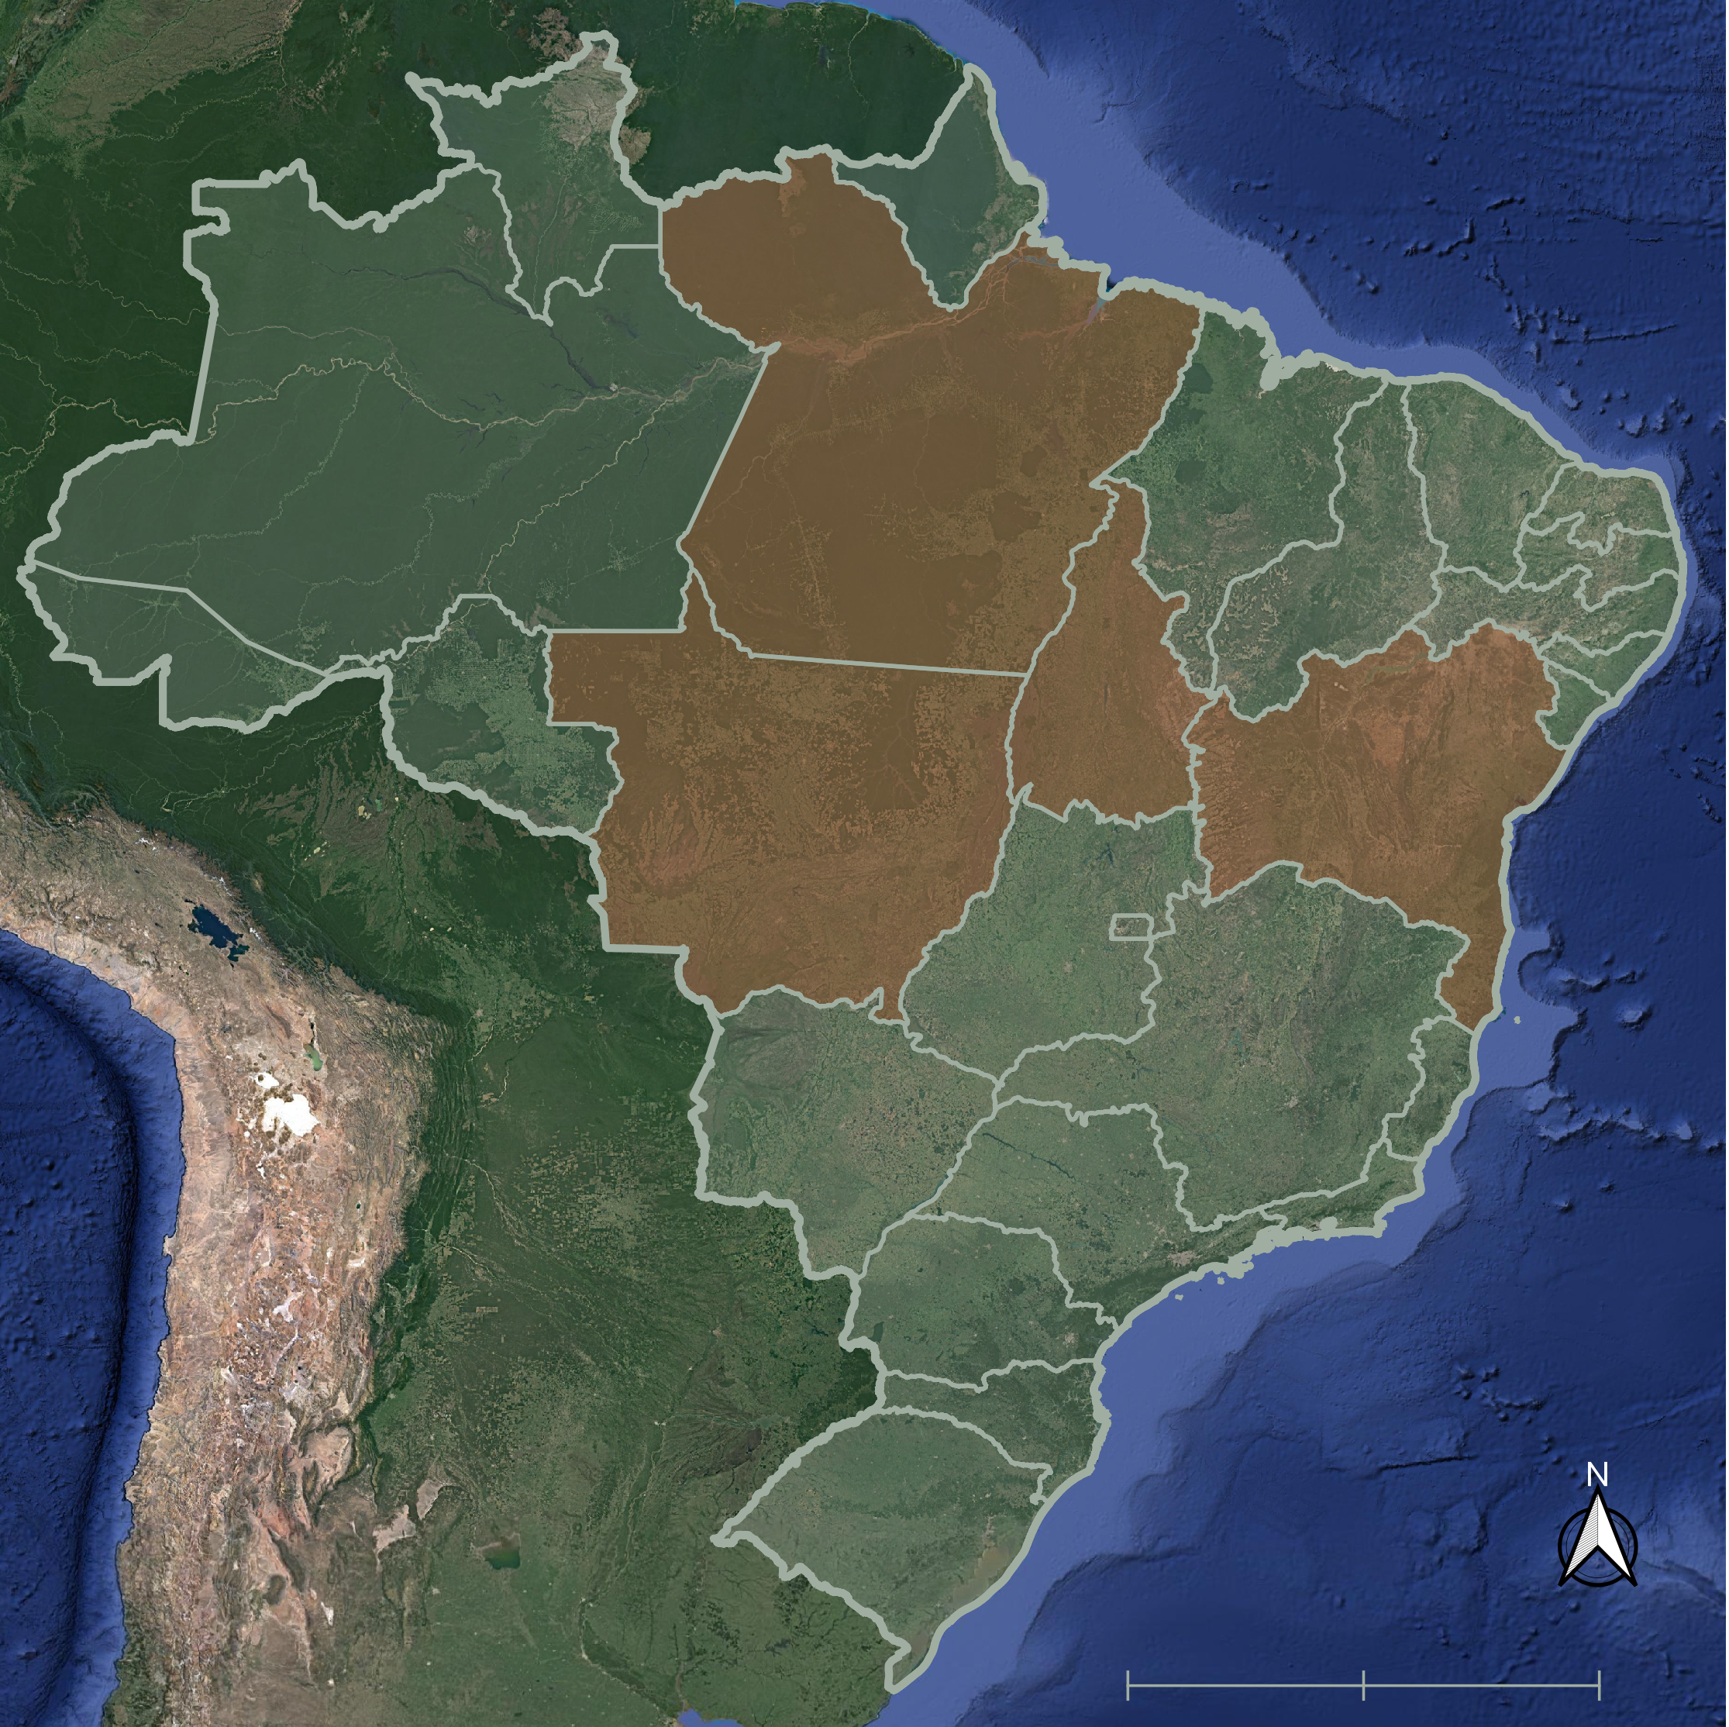
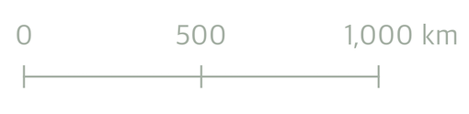
PRESENTATION ROAD MAP
Study Area and Period
Study Objectives
Partners
Community Concerns
Earth Observations
Methods
Results
Errors and Uncertainty
Feasibility
Future Recommendations
Acknowledgements
Pará
Tocantins
Mato
Grosso
Bahia
Study Area
Brazil State Boundaries
Base map: Google Satellite Imagery
0
500
1,000 km
Notes:
We will begin by introducing our team and study area for this project. From there, we will provide background information and objectives of the study. Next, we will explain why this project is important and the community concerns that our analysis seeks to address for our project partners. Subsequently, we will discuss our project’s methodology and results and address any potential errors or other uncertainties regarding our data. Finally, we will conclude by reflecting upon the feasibility of the study and recommendations for future work.
------------------------------------------Image Information Below-----------------------------------------
Study area map created by Grayson Shanley Barr
Cite map base layer: Google Satellite

Slide 3





PROJECT TEAM
Devon V. Maloney
Project Lead
Manpreet K. Singh
Grayson Shanley Barr
Sofya Goncharenko
Notes:
[Team Introductions]

Slide 4
Study Area & Period
Study Area
Northern & central Brazilian states of Pará, Tocantins, Bahia, and Mato Grosso
Study Period
1984–2023
El Niño years: 1987– 88, 1991–92, 1994–95, 1997–98, 2002–03, 2009–10, 2015–16, 2023–24
Pará
Tocantins
Mato
Grosso
Bahia
Study Area
Brazil State Boundaries
Base map: Google Satellite Imagery
0
500
1,000 km
Notes:
In our project, we focused on Northern and Central Brazil. We specifically analyzed the states of Pará, Mato Grosso, Tocantins, and Bahia as these states are some of the largest producers of soybean in Brazil. Each state is unique in its environment, plays a crucial role in Brazil's agriculture sector, and is considerably impacted by extreme climactic conditions.
Our study period spans from 1984-2023, the time period for which Landsat data is available. We specifically examine indices of soybean production through crop yield and the normalizied difference vegtation index, or NDVI, which serves as a crucial indicator of crop health. Our aim is to understand how these factors vary with El Niño-Southern Oscillation, or ENSO, conditions which include drier than normal conditions and lower than normal precipitation.
------------------------------------------Image Information Below-----------------------------------------
Study area map created by Grayson Shanley Barr
Cite map base layer: Google Satellite

Slide 5
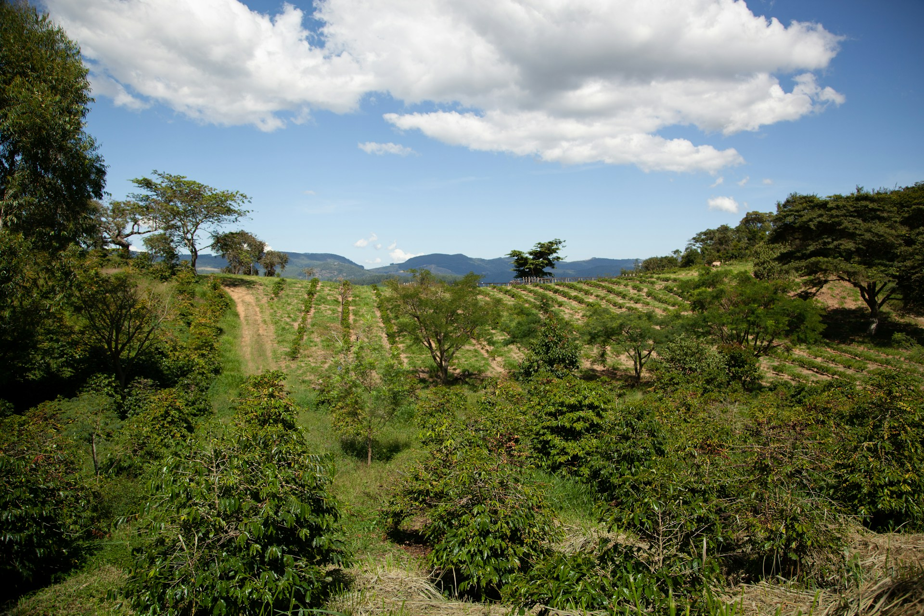
Background
Reductions in crop yields due to climatic variability in Brazil affect food supply globally
El Niño-Southern Oscillation (ENSO) causes variation in the Brazilian climate
As El Niño returns, it is critical to assess the impact of ENSO conditions on crop production to inform estimates of agricultural production in the country
Image Credit: Photo by PROJETO CAFÉ GATO-MOURISCO on Unsplash
Notes:
Brazil, due to its role as a top global agriculture producer, plays a crucial role in the global food supply. Agriculture products are grown all throughout Brazil but in recent years, corn and soybean production have expanded towards the northern and central areas of Brazil. The region faces reductions of agricultural productivity due to climactic variability caused by the previously mentioned ENSO conditions. In particular, the northeastern region of Brazil faces challenges due to El Niño conditions that lead to drier weather and lower levels of participation which result from irregular variations in winds and seas surface temperatures over the tropical Pacific Ocean. Currently, this region is expecting the return of El Niño, conditions which is why we are interested in assessing the impact of ENSO conditions on crop production to inform estimates of agricultural production in the country.
------------------------------------------Image Information Below-----------------------------------------
Image Credit: Photo by PROJETO CAFÉ GATO-MOURISCO on Unsplash
Image Source: https://unsplash.com/photos/a-landscape-with-trees-and-bushes-YFvjs8-JTVU (CCO License)

Slide 6
Study Objectives
Examine the relationship between soybean production yield, normalized difference vegetation index (NDVI), and ENSO conditions
Produce a time series analysis from 1984 to 2023 comparing crop yield and environmental conditions during ENSO phases
Conduct statistical analysis to examine relationships at the state level
Image Credit: Photo by PROJETO CAFÉ GATO-MOURISCO on Unsplash
Notes:
The main objectives of this feasibility study included the following:
First, we sought to examine the relationship between soybean production yield, NDVI, and ENSO conditions which include precipitation and temperature using correlation analysis
Next, we aimed to produce a time series analysis from 1984 to 2023 comparing crop yield and climate conditions during ENSO phases. This involved plotting the relationship over time to determine temporal trends.
And finally, we aimed to conduct a statistical analysis to examine relationship between soybean crop yield, NDVI, temperature, precipitation, and ENSO conditions to determine spatial trends
------------------------------------------Image Information Below-----------------------------------------
Image Credit: Photo by PROJETO CAFÉ GATO-MOURISCO on Unsplash
Image Source: https://unsplash.com/photos/a-landscape-with-trees-and-bushes-YFvjs8-JTVU (CCO License)

Slide 7
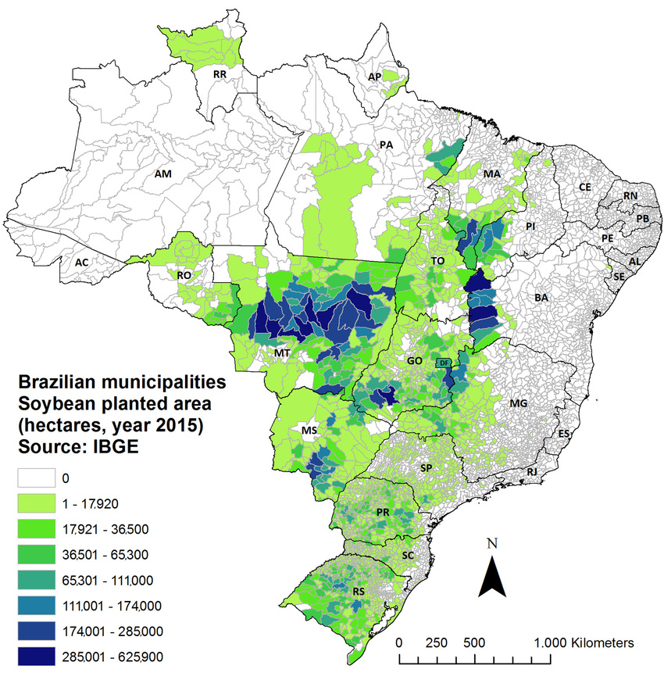
Community Concerns
Brazil has emerged as one of the top exporters of agricultural commodities, supplying over 200 countries and territories around the world
Brazil engages in 50% of world soybean trade and manages a top global corn production
With Brazil's changing climate and the oncoming ENSO effects, global food security concerns are rising
Brazilian municipalities
Soybean planted areas (hectares, year 2015)
Source IBGE
0
1-17,920
17,921-36,500
N
36,501-65,300
65,301-111,000
111,001-174,000
174,001-285,000
250
0
500
1000 km
285,001-625,900
Image Credit: Martinelli et al., 2017
Notes:
With anthropogenic climate change impacting agriculture production globally, food security is a growing issue that is affecting many communities around the world. Brazil plays a crucial role in the global food supply as top 3 exporter of agriculture products, that serves over 200 countries and territories. For example, Brazil provides 50% of the world's soybean exports and serves as one of the top producers of corn.
Domestically, the agriculture sector of Brazil composed 29% of Brazil's GDP in 2021 and serves not only the source of national food security, but also as a source of employment for the country's citizens. As Brazil expands agriculture production into the northern part of the country, climactic variability, including dry weather and extreme precipitation, threatens food production nationally as well as in countries that rely on Brazil’s food commodity exports, making this a global food security issue.
------------------------------------------Image Information Below-----------------------------------------
Image Credit: USDA, R. Martinelli, L. A., Batistella, M., Silva, R. F. B. D., & Moran, E. (2017). Soy expansion and socioeconomic development in municipalities of Brazil. Land, 6(3), 62.
Image Source: https://www.mdpi.com/2073-445X/6/3/62
--------------------------------------Information Sources--------------------------------------------------
https://www.ers.usda.gov/amber-waves/2022/september/brazil-s-momentum-as-a-global-agricultural-supplier-faces-headwinds/#:~:text=The%20University%20of%20S%C3%A3o%20Paulo's,at%20%241.8%20trillion%20in%202021.

Slide 8

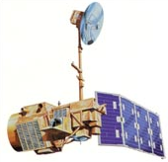
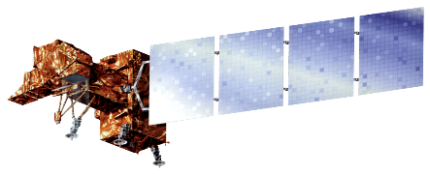
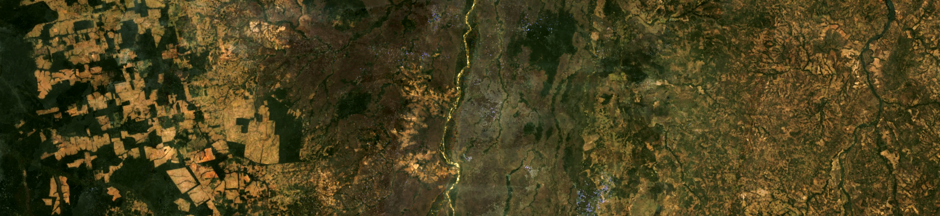
Earth Observations
Landsat 5 TM
Landsat 7 ETM+
Landsat 8 OLI
Image Credit: NASA
Landsat 5 Image of Mato Grosso, Brazil
Notes:
For this analysis, we used data from multiple earth observations. As the longest-running, moderate-resolution satellite mission, we choose to use multispectral Landsat imagery for this analysis.
------------------------------------------Image Information Below-----------------------------------------
Image Credits: NASA and USGS
Image Source: https://science.nasa.gov/get-involved/toolkits/spacecraft-icons, https://landsat.gsfc.nasa.gov/satellites/landsat-5/, https://earthexplorer.usgs.gov/

Slide 9

Project Partners
We are working with partners at the United States Department of Agriculture (USDA):
USDA Foreign Agricultural Service International Production Assessment Division
USDA Office of the Chief Economist
and World Agriculture Outlook Board
Image Credit: US Dept of Agriculture
Notes:
This project collaborated with the Untied States Department of Agriculture, specifically the Foreign Agricultural Services (USDA FAS).
------------------------------------------Image Information Below-----------------------------------------
Image Credit: US Department of Agriculture
Image Source: https://usda-eu.org/

Slide 10
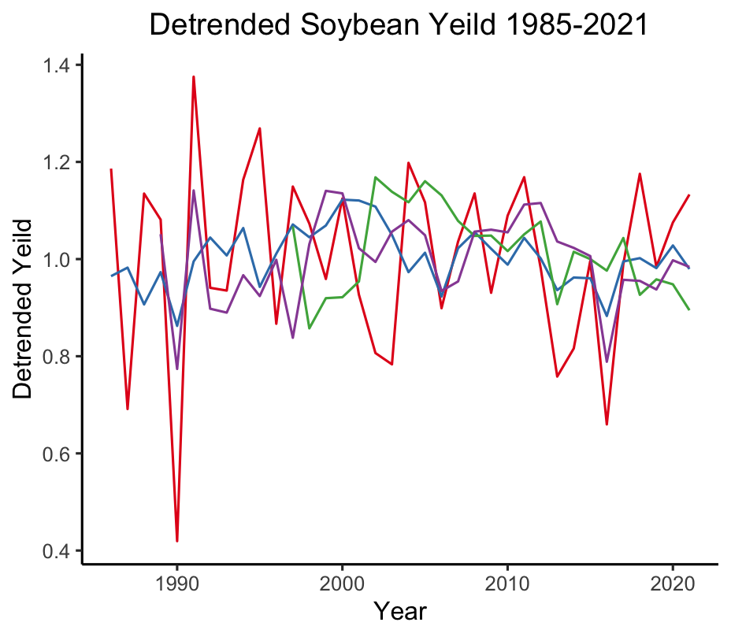
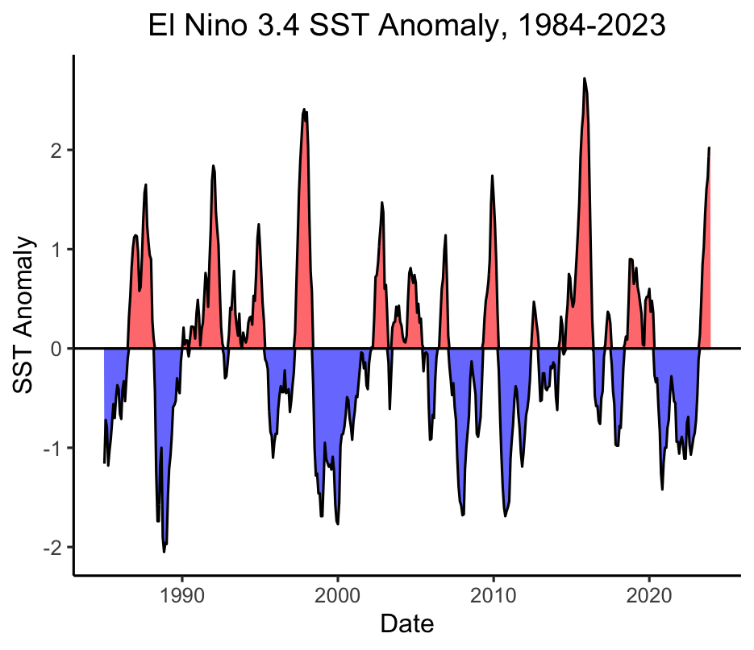
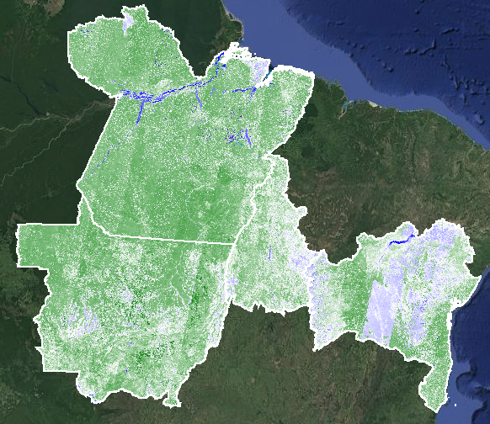
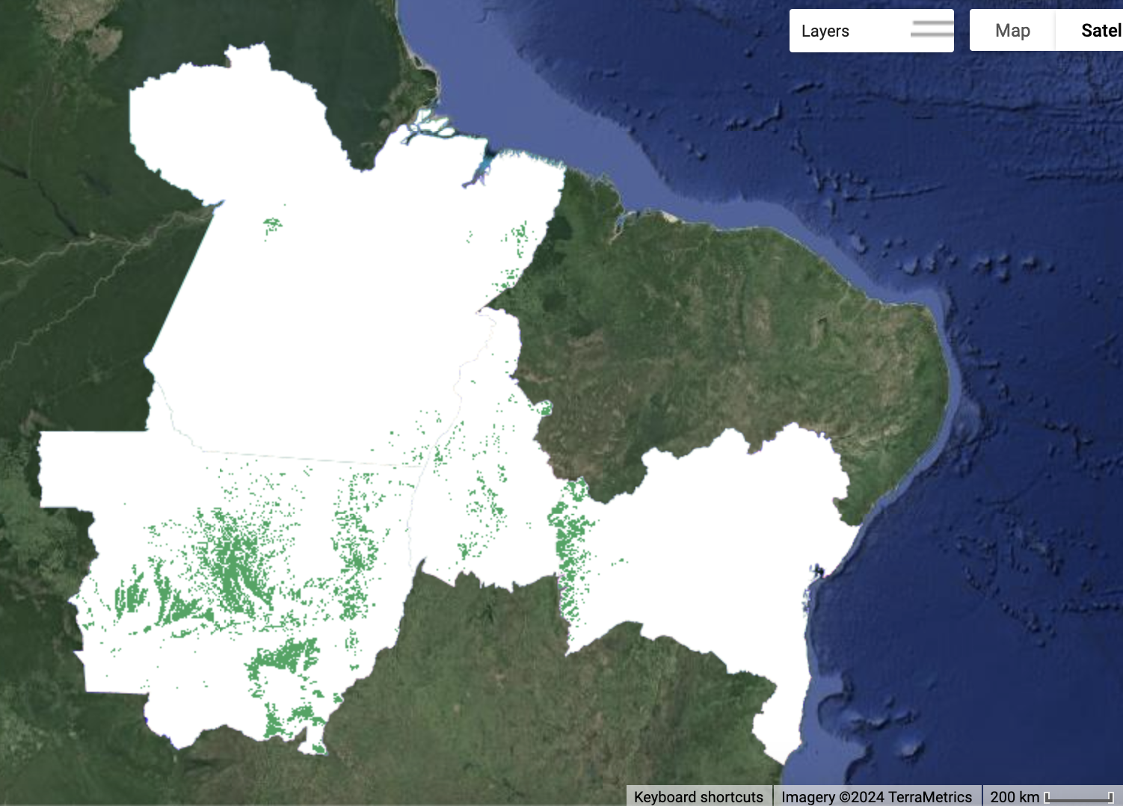
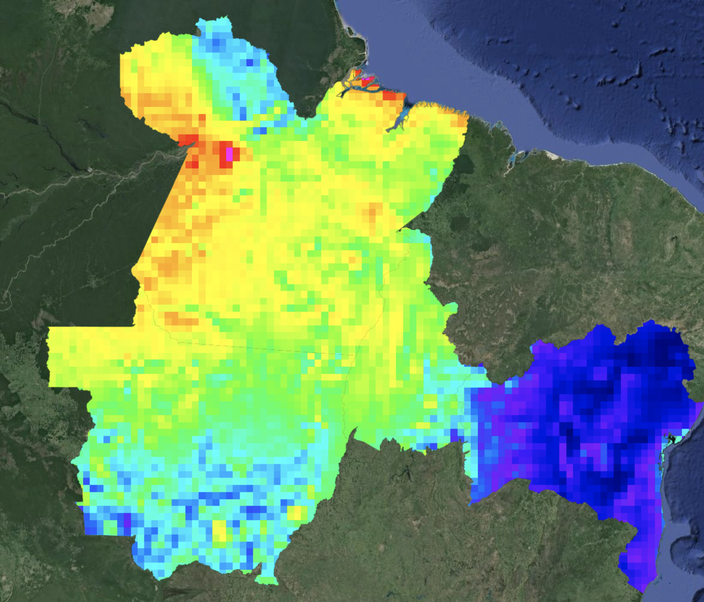

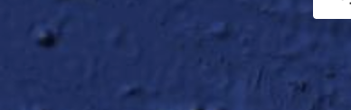
Datasets
Detrended Soybean Yield 1985-2021
El Nino 3.4 SST Anomaly, 1984-2023
State
SST Anomaly
Bahia
Detrended Yield
Mato Grosso
Pará
Tocantins
El Nino
La Nina
Year
Year
Base map credit: Google Satellite
Landsat NDVI
MapBiomas LULC
ERA5 Rainfall
1
Soy
0.34 m
0
Other
-1
0.04 m
Notes:
For this analysis, we used several datasets including NASA climate and multispectral imagery datasets. We specifically used multispectral imagery from Landsat 5, 7, and 8 to calculate Normalized Difference Vegetation Index (NDVI). We also used ERA5 Monthly Aggregates by European Centre for Medium-Range Weather Forecasts (ECMWF) and their Copernicus Climate Change Service (CCCS) for temperature data acquisition and the Climate Hazards Group InfraRed Precipitation with Station data (otherwise known as CHIRPS) to derive precipitation. We used the NSO 3.4 SST Anomaly dataset from NOAA to determine El Nino conditions. And finally, we used the land use land cover classification by MapBiomas (derived from Landsat) and annual crop yield from the Brazilian Institute of Geography and Statistics Municipal Agricultural Production.
------------------------------------------Image Information Below-----------------------------------------
Map Credit: Maps created by Devon Maloney in Google Earth Engine
Basemap Credit: Google Satellite

Slide 11
Methods: Calculating NDVI & Crop Yield
Cumulative annual growing season NDVI for soybean planted areas by state
MapBiomas
Annual LULC Classification
Mask soybean pixels
Calculate monthly mean NDVI of soybean areas
Landsat 5,7,8
Filter dataset annually for cloud-free pixels
Sum NDVI for each soybean growing season by state
Soybean Crop Yield
Detrend Annual Yield Data
Detrended annual soybean crop yield by state
Notes:
To isolate soybean growing areas, the team used the MapBiomas land use/land cover (LULC) classification and created a mask of pixels classified as soybean for each year in the study period. Using the annual soybean growing area mask, NDVI monthly mean values of soybean were extracted per year within the study region. The team then calculated mean monthly NDVI for soybean growing areas per state.

Slide 12
Methods: Temperature & Precipitation
El Niño 3.4 Dataset
ENSO SST temperature anomalies
Measure monthly total precipitation and temperature
Mean monthly temperature and total precipitation
ERA5 Data
Filter by study states
Measure temperature and total precipitation
CHIRPS
Gap-fill data
Aggregate into monthly means
Notes:
First,tTemperature and precipitation data were filtered to the study dates and aggregated into monthly means per study state. As some gaps in the ERA5 dataset presented temporal continuity issues, the team filled in gaps with the CHIRPS daily precipitation dataset for the year of 1984, July – December 2020, and 2021 – 2023.
Next, CHIRPS precipitation was aggregated into monthly means to correspond with data derived from ERA5.
The team chose to use monthly aggregated ERA5 data over most of the study period due to computational challenges associated with processing daily CHIRPS data.
Finally, the ENSO anomaly data from the El Niño 3.4 dataset required no additional processing for this project.

Slide 13
Methods: Data Analysis
Detrended annual soybean crop yield by state
NDVI & Crop Yield Maps
Sum of soybean harvest NDVI by state
Correlation Analysis
Correlation Analysis
Correlation Analysis
Correlation Analysis
Monthly mean temperature per state
Time Series Analysis
Monthly mean precipitation per state
ENSO anomaly data
Notes:
For the data analysis, our first step was to aggregate our collected data, which included the detrended annual soybean crop yield, sum of NDVI for soybean harvest, monthly mean temperature and precipitation, and the ENSO anomaly data, to conduct a correlation analysis using R. Our goal was to create both geospatial maps showcasing relationship between NDVI and crop yield along with a time series analysis to showcase relationships among our variables.

Slide 14
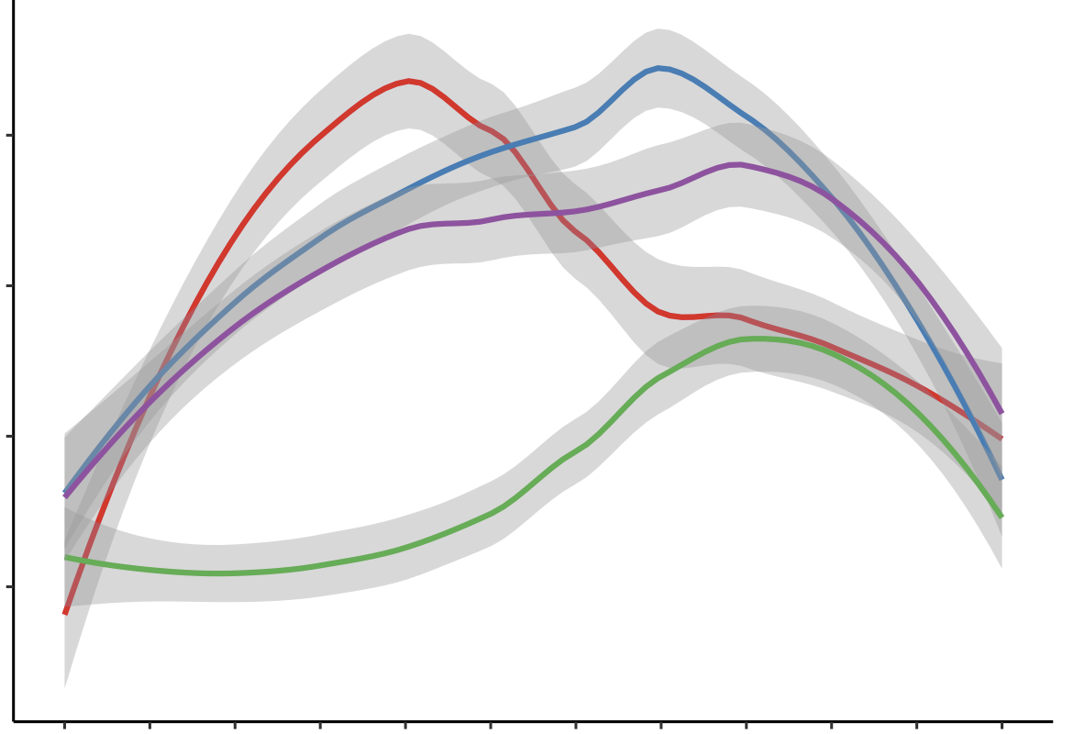
Results: NDVI Seasonality
Average NDVI of Soybean Planted Areas per Month 1985–2021
State | Growing Season
Pará | Nov–July
Mato Grosso | Oct–June
Tocantins | Oct–June
Bahia | Oct–June
0.20
0.15
NDVI*
State
Bahia
0.10
Mato Grosso
Pará
Tocantins
0.05
*Scale of -1 to 1, values between 0 and 1 represent vegetation greenness, with higher values corresponding with increased greenness
10
11
12
01
02
03
04
05
06
07
08
09
Month
Notes:
Utilizing our research methodology, our results include the following.
For NDVI Seasonality: Monthly soybean NDVI trends from 1985-2021 are consistent with the planting/harvesting calendar for each of the states. Higher NDVI values correspond to each state's growing season.

Slide 15
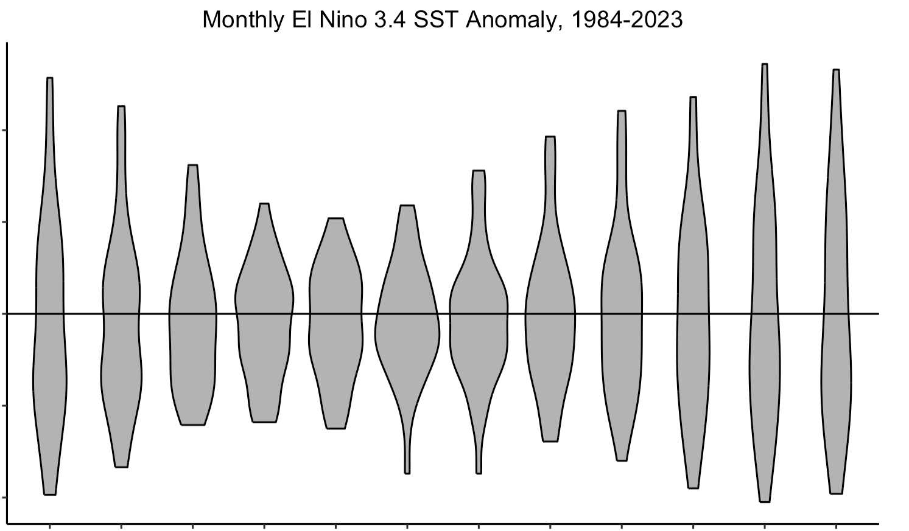
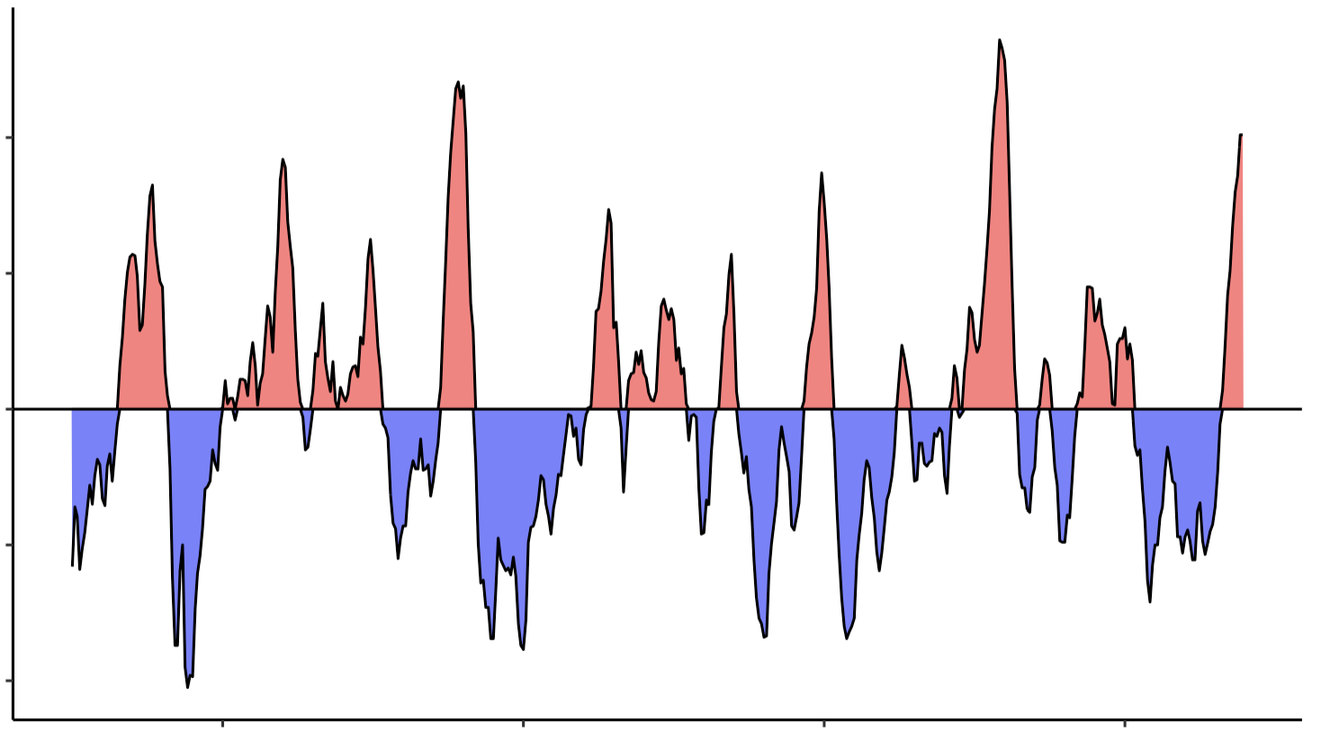
Results: ENSO Anomaly
El Nino 3.4 Sea Surface Temperature (SST)
Anomaly, 1984-2023
Monthly El Nino 3.4 SST Anomaly, 1984-2023
2
2
1
1
SST Anomaly
SST Anomaly
0
0
-1
-1
-2
-2
1990
2000
2010
2020
01
02
03
04
05
06
07
08
09
10
11
12
Year
Month
El Nino
La Nina
Notes:
This slide shows the EL Nino Anomalies based on the sea surface temperature from 1984-2023. As you can see, there is variations in terms of El Nino and La Nina conditions. During El Nino, you can see high anomalies, particularly in the late 1990s and around 2015 and the onset of 2023. Similarly, there are La Nina conditions exhibited during the late 1980s, around the 2000s, 2010, and early 2020s. This helped to identify years of focus for our project.
In this left figure, areas represented in red represent El Nino periods, or periods with higher sea surface temperatures in the El Nino 3.4 region of the Pacific, while blue areas represent periods of La Nina.
These sea surface temperature anomalies are often seasonality concentrated. On the right, this graphic demonstrates that anomalies often peak in November - February while anomalies tend to be less intense in April – June.

Slide 16
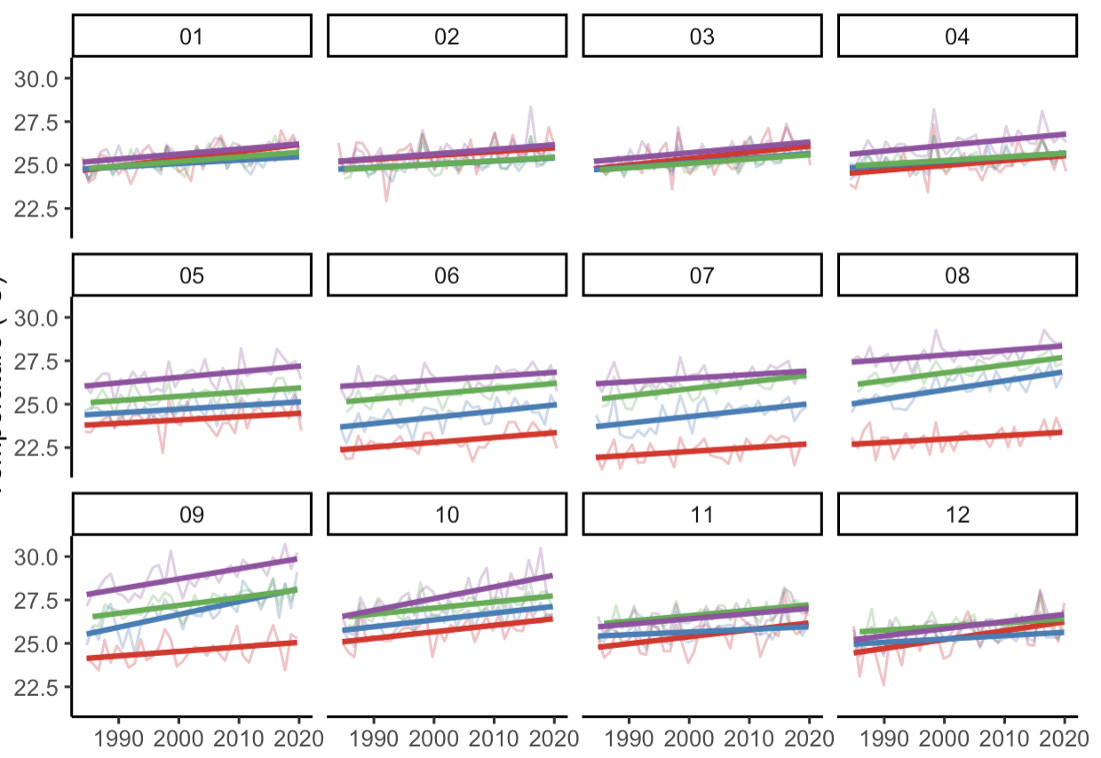
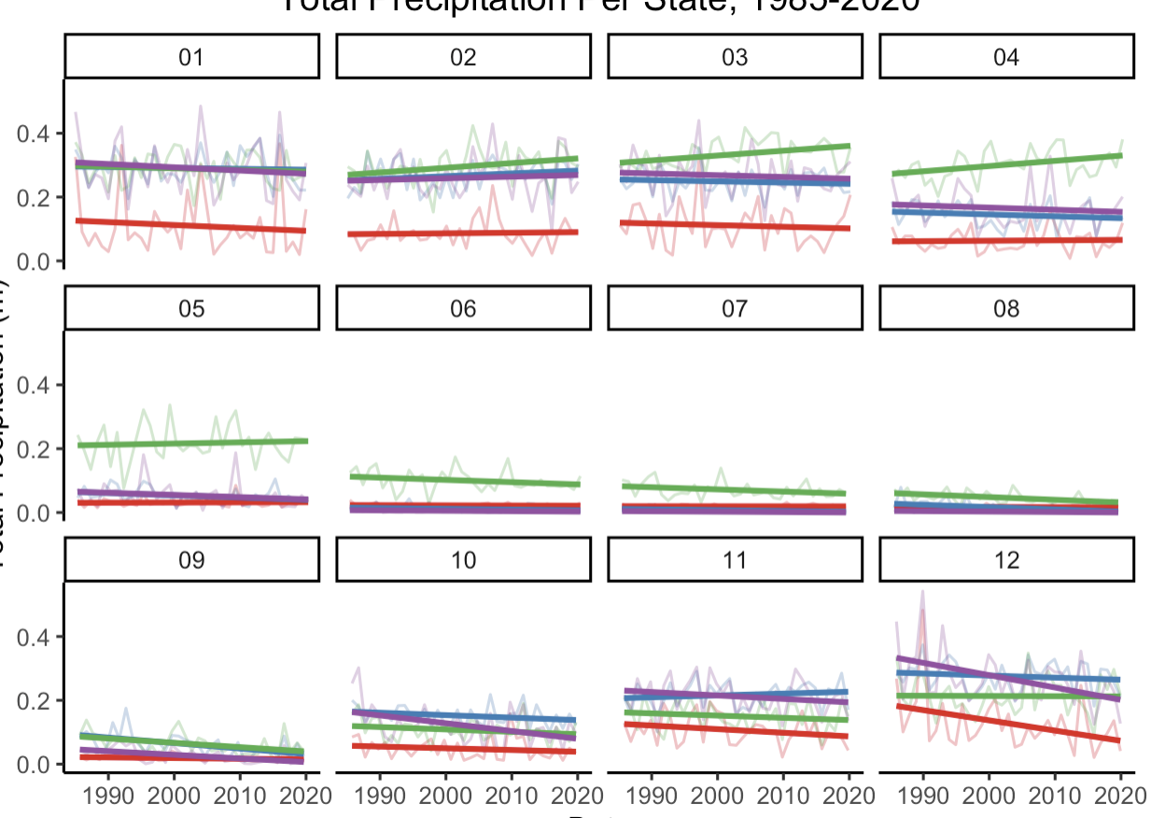
Results: Temperature and Precipitation Trends
Average Temperature per State, 1985–2020
Average Precipitation per State, 1985–2020
Jan
Feb
Mar
Apr
Jan
Feb
Mar
Apr
May
Jul
Jun
Aug
May
Jul
Jun
Aug
Temperature (°C)
Total Precipitation (meters)
Sep
Oct
Nov
Dec
Sep
Oct
Nov
Dec
Year
Year
Bahia
Pará
State
Mato Grosso
Tocantins
Notes:
Temperature varies significantly between states throughout the calendar year. Overall, we find that temperature has been steadily increasing from 1985-2020. Some states and months experienced higher rates of warming. In this region, Aug-Oct is experiencing the highest rates of warming.
Precipitation is also found to be seasonal— as summer yields the least rainfall. Total precipitation has decreased for every state aside from Para from 1985-2020. Precipitation is decreasing significantly in December, an important month for the soy growing season, in both Tocantins and Bahia. We also saw increased precipitation in Para in March and April.

Slide 17
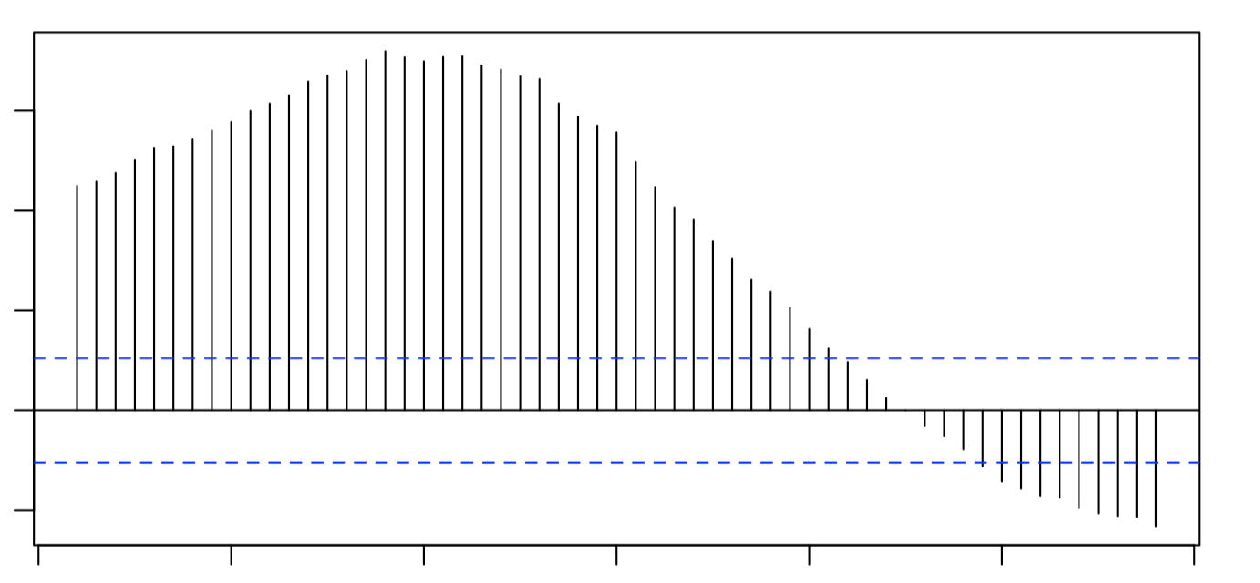
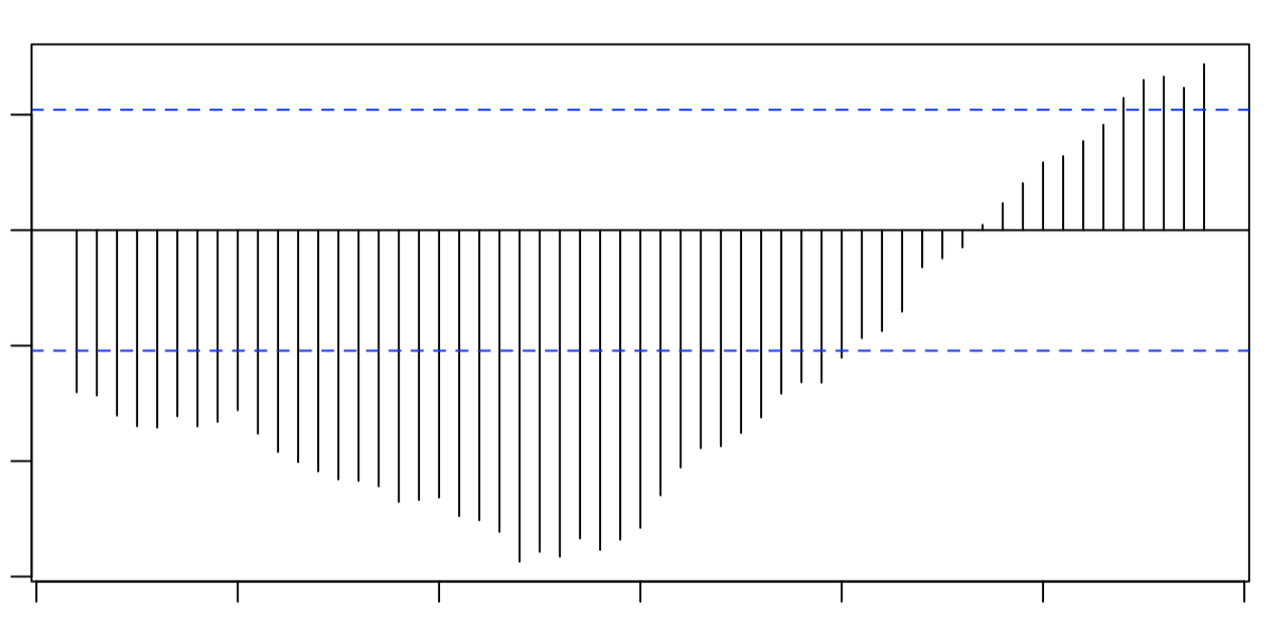
Results: ENSO and Local Climate Lag
ENSO and Temperature Anomaly
ENSO and Precipitation Anomaly
0.3
0.05
0.2
0.0
0.1
-0.05
Cross correlation function
0
-0.10
-0.1
-0.15
-30
-20
-10
0
10
20
30
-30
-20
-10
0
10
20
30
Lag (months)
Lag (months)
8-month lag between ENSO
anomalies and precipitation and temperature
anomalies in study region
Notes:
Based on published literature showing a temporal lag between ENSO warm events and vegetation greenness, we tested the temporal or lagged relationship between ENSO, temperature, and precipitation. As you can see on the right, higher ENSO anomalies are correlated with high temperatures 8 months later.
On the left, we found that higher ENSO anomalies were correlated with lower precipitation rates. This suggests that ENSO effects impact weather conditions 8 months after sea surface temperatures are measured in the Pacific

Slide 18
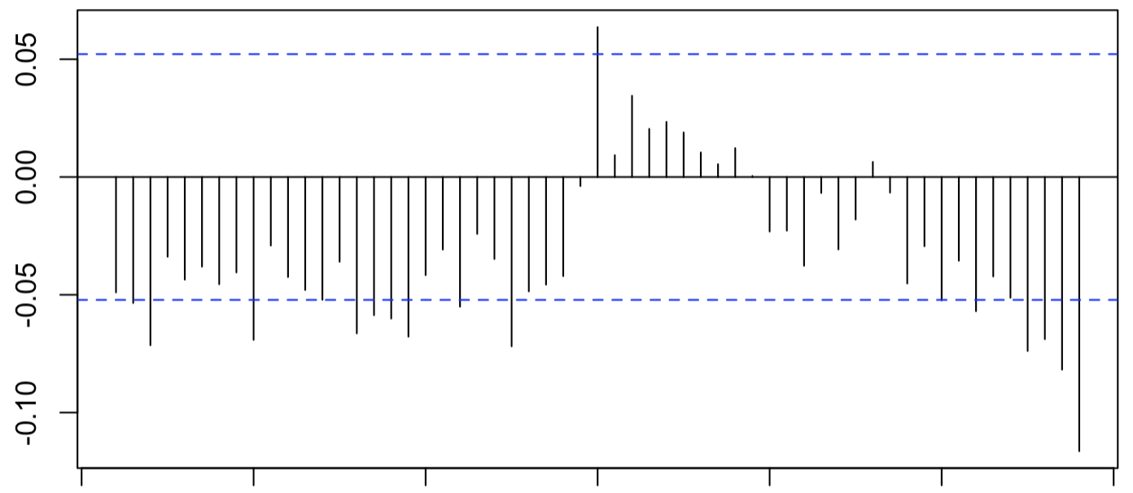
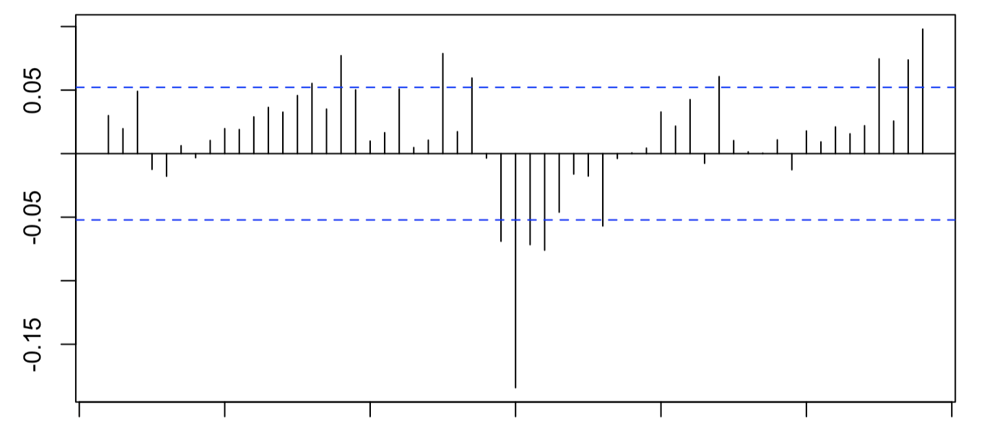
Results: Climate and Soy NDVI Lag
Temperature Anomaly and Soy NDVI Anomaly
Precipitation Anomaly and Soy NDVI Anomaly
Cross correlation function
-30
-20
-10
0
10
20
30
-30
-20
-10
0
10
20
30
Lag (months)
Lag (months)
No lag (0-month) between precipitation and temperature anomalies and NDVI anomaly
in study region
*Soy crop mask by MapBiomas
Notes:
We ran these tests again to see if there was any temporal lag between NDVI and temperature/precipitation.
We found the highest correlation at 0 months lag, meaning there was not a lagged relationship between NDVI and temperature/precipitation. This shows a real time relationship between NDVI and the climactic conditions.

Slide 19
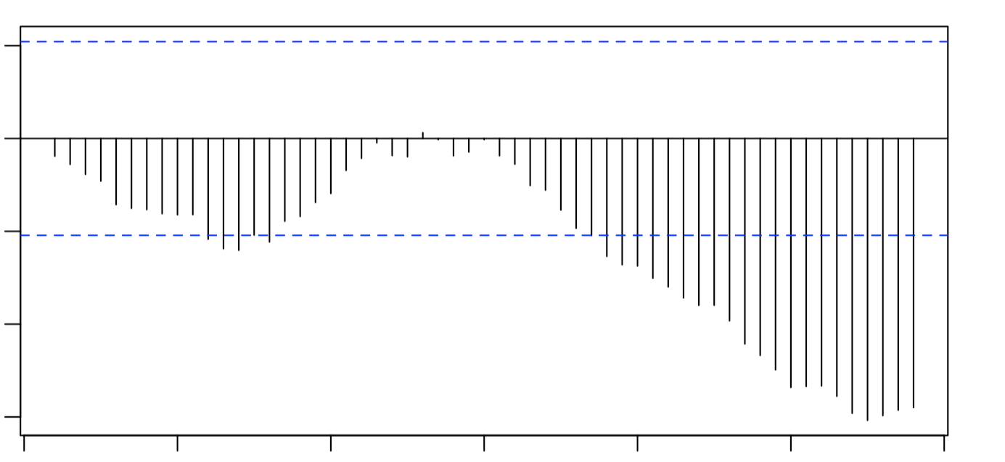
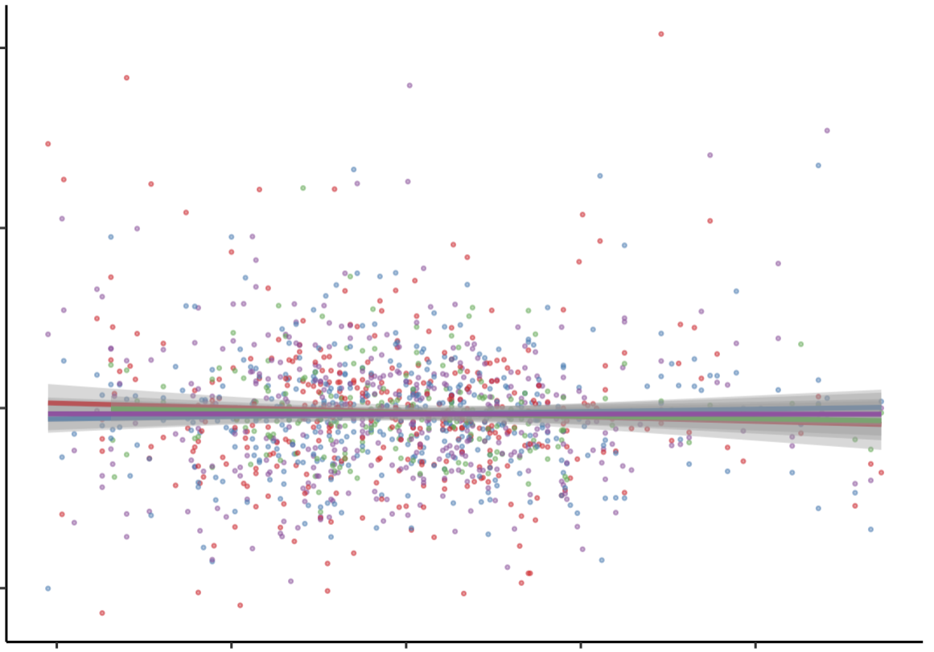
Results: ENSO and NDVI lag
ENSO Anomaly and Soy* NDVI Anomaly
Soy NDVI Anomaly and ENSO
Anomaly (8-Month Lag)
0.05
0.4
0.0
-0.05
Cross correlation function
0.2
-0.10
NDVI Anomaly
-0.15
0
-30
-20
-10
0
10
20
30
Lag (months)
-0.2
No clear lag or statistically significant relationship between ENSO Anomaly and NDVI
-2
-1
0
1
2
ENSO Anomaly
Bahia
Pará
State
*Soy crop mask by MapBiomas
Mato Grosso
Tocantins
Notes:
Finally, we tested the lagged relationship between ENSO and NDVI. Given that we saw an 8-month lag between ENSO and temperature/precipitation and no lag between temperature/precipitation and NDVI, we assumed we would see a correlation between ENSO and NDVI at 8 months lag.
However, we did not find a strong correlation between ENSO and NDVI when testing various lag times. When analyzing the data at the state level at an 8-month lag (as seen on the right), we still did not see a linear relationship between NDVI and the lagged ENSO anomalies in any of the states.

Slide 20
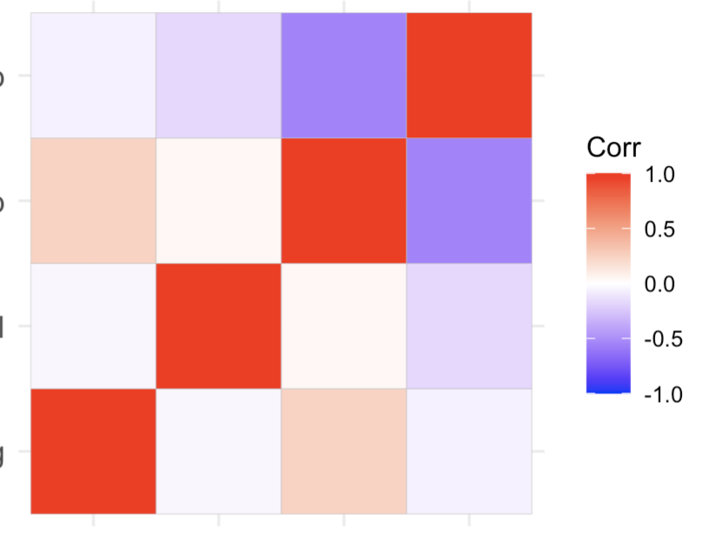
Results: Principal Component Analysis
Correlation Coefficient Matrix
Little to no correlation between NDVI and the 8-month lag ENSO
This suggests that ENSO anomaly cannot be used to forecast NDVI anomaly
Precipitation
Anomaly
-0.06
-0.17
-0.55
1.0
Temperature
Anomaly
Correlation
0.24
0.04
1.0
-0.55
1.0
0.5
0
NDVI Anomaly
-0.04
1.0
0.04
-0.17
-0.5
-1.0
ENSO Anomaly
(8-month lag)
1.0
-0.04
0.24
-0.06
ENSO Anomaly
(8-month lag)
Temperature
Anomaly
Precipitation
Anomaly
NDVI Anomaly
Notes:
Although we observed a correlation between 8-month lagged ENSO and temperature/precipitation AND we found correlations between temperature/precipitation and NDVI, we did NOT find a correlation between NDVI and the 8-month lagged ENSO. This suggests that ENSO anomaly can not be used to forecast NDVI anomaly.
This was further supported by the principal component analysis, also known as a PCA, that we conducted to reduce the dimensionality of the dataset and identify any meaningful underlying variables. We found the following results:
There was no correlation between NDVI and 8-month lag ENSO as showcased through our previously mentioned statistical analysis.
There was a positive correlation between NDVI and temperature, but a negative correlation between NDVI and precipitation.
There was a positive correlation between ENSO and temperature and a negative correlation between ENSO and precipitation.
And finally, there was a negative correlation between temperature and precipitation.

Slide 21
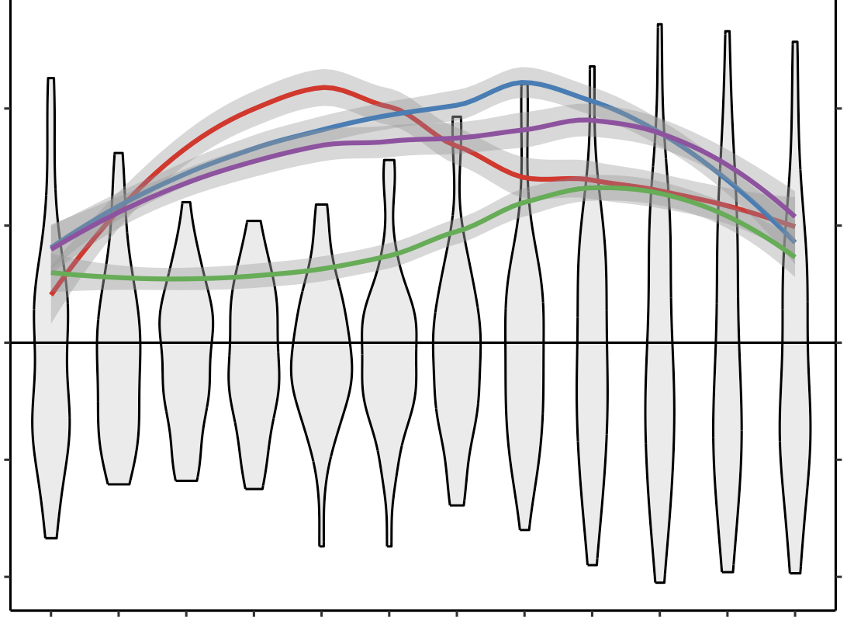
Results: Soy and Local ENSO Seasonality
Monthly Soy* NDVI and ENSO Anomaly (8-Month Lag)
**Scale of -1 to 1, values between 0 and 1 represent vegetation greenness, with higher values corresponding with increased greenness
2
0.2
1
0.1
State
Bahia
ENSO SST Anomaly
NDVI**
Mato Grosso
0
0
Pará
Tocantins
-1
-0.1
-2
-0.2
10
11
12
01
02
03
04
05
06
07
08
09
Month
*Soy crop mask by MapBiomas
Notes:
In this visualization, we overlay the seasonal NDVI curves for soy croplands with the monthly ENSO anomalies. The ENSO anomalies are shown here with an 8-month lag to reflect locally experienced ENSO effects.
As seen here, there is a seasonal mismatch between locally experienced ENSO effects and the soy growing season, suggesting that the impact of ENSO on soy production in the region is more limited.

Slide 22
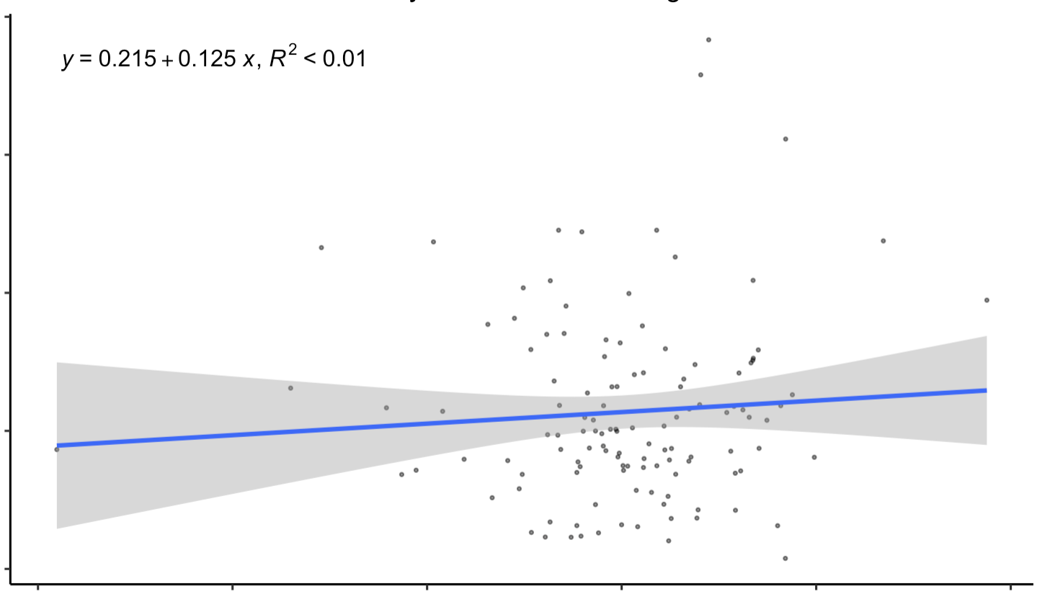
Results: Production Yield
Detrended Yield by Cumulative Soy Growing Season NDVI
1.2
No correlation between cumulative soy growing season NDVI and the detrended production yield statistics
This suggests NDVI is not a feasible indicator for forecasting soy production yield
𝑦 = 0.215 + 0.125 𝑥, R² < 0.01
0.9
0.6
Cumulative NDVI*
0.3
0
0.4
0.6
0.8
1.0
1.2
1.4
Detrended Soy Production Yield (kilograms per hectare)
*Scale of -1 to 1, values between 0 and 1 represent vegetation greenness, with higher values corresponding with increased greenness
Notes:
When analyzing the production yield: Detrended production yield data shows no relationship with cumulative growing season NDVI, meaning NDVI is not a sufficient indicator for the forcasting production yield.

Slide 23
Errors and Uncertainties
Missing values:
Some missing monthly NDVI values due to clouds, so we relied on gap - filling
Due to missing temperature and precipitation years in ERA5, we supplemented with data from CHIRPS
Methodological limitations:
MapBiomas LULC classification
Changing crop seasonality
Notes:
Some sources of errors and uncertainty include our data and methodological limitations. First, we encountered missing monthly NDVI values due to clouds, so we relied on averaged gap filling
Additionally, due to missing temperature and precipitation years in the ERA5 dataset, we supplemented with data from CHIRPS. Both these data limitations created potential for error.
Methodologically, our analysis also relied on an external, machine-learning produced land use/land class (LULC) classification from MapBiomas which creates uncertainty as we were unable to validate their classification.
Finally, changing crop seasonality in the region creates uncertainty around our cumulative growing season NDVI metric.

Slide 24
Feasibility
Challenges using ENSO conditions to forecast soybean crop productivity
Temperature and precipitation data is viable to examine relationships between NDVI and seasonality
Correlation analyses can assist with producing time series and crop yield maps to examine factors that affect production yield
Notes:
Given our results that NDVI is not correlated with ENSO, there are challenges in using ENSO conditions to forecast soybean crop productivity.
Nevertheless, the methodology developed in this project may be useful for examining the impact of temperature and precipitation on crop productivity.
Furthermore, a combination of temperature and precipitation data is viable to ascertain relationships between NDVI, seasonality, and progression over time.
And finally, correlation analyses producing time series and NDVI or crop yield maps provide a means of obtaining accurate trends and determining which factors affect crop production yield.
------------------------------Image Information Below ------------------------------
•Image Credit: Microsoft Icons

Slide 25
Conclusions
Correlation and time-series analysis can identify trends and determine which factors are affecting soy NDVI
Temperature and precipitation data can provide insights into the relationships between NDVI and seasonality through a temporal analysis
Monthly soy NDVI anomaly had little to no correlation with monthly ENSO anomaly. ENSO have complex impact on soy in the study area and period warranting further study
Monthly ENSO anomaly cannot be used to forecast monthly soy NDVI anomaly nor soy yearly production yield
Notes:
In conclusion, the correlation analyses performed on annual soybean crop yield data, the sum of soybean harvest NDVI, the monthly mean temperature and precipitation, as well as ENSO anomaly data disclose trends and factors affecting climate conditions and crop production yield in each of the four Brazilian study areas of Pará, Mato Grosso, Tocantins, and Bahia
Temperature and precipitation data, especially, are viable for determining how NDVI, seasonality, and time correlate to one another due to obvious results showing increases/decreases in both temperature and precipitation.
However, we found that using NDVI as a measure of ENSO is not an effective method to determine whether or not crop production yield is affected by ENSO conditions. As we have seen in our results, there is little to no relationship between ENSO and NDVI.
Furthermore, based on our results, this includes the following key takeaways:
NDVI was not correlated with ENSO, indicating that changes in ENSO conditions have a complex relationship with soy NDVI in the study area and period
NDVI does not serve as a sufficient indicator for crop production yield due to no relationship between the detrended production yield and the cumulative growing season.
Although ENSO anomalies are correlated with higher temperatures and lower precipitation with an 8-month lag, ENSO anomaly cannot be used to forecast NDVI anomaly.
Both NDVI and climactic conditions such as temperature and precipitation occurs in real time with no lag.
High NDVI's are correlated with each states growing season
Temperature and precipitation varies with each state, but overall temperature has been increasing and precipitation has been decreasing, except for Para.
ENSO effects impact weather conditions 8 months after sea surface temperatures are measured in the Pacific
------------------------------Image Information Below ------------------------------
•Image Credit: Microsoft Icons

Slide 26
Future Recommendations
Conduct analysis with a multivariate ENSO index
Examine multi-year events
Assess methods on 2nd season corn production
Focus on a smaller geographic region – state, sub-state level
Notes:
In the future, it will be beneficial to fine tune the methodology and conduct an analysis using a multivariate index for SST and ENSO conditions.
In addition, it will be interesting to examine multi-year events where multiple growing seasons are impacted to assess longer temporal trends and impacts.
It will also be useful to test the methods on an additional crop, such as second planting corn production in Brazil to examine if the findings are consistent across crops planted during different parts of the growing season.
Finally, it will be helpful to use the methodology on a smaller geographic region, such as northern Mato Grosso, as there can be significant climactic variation which can impact crop production within states.
------------------------------Image Information Below ------------------------------
•Image Credit: Microsoft Icons

Slide 27
NASA DEVELOP
Kathryn Caruso, Lead, NOAA's National Centers for Environmental Information
Maya Hall, Impact Analysis Fellow, Ames Research Center
Partners
Dr. Sunita Yadav-Pauletto, USDA Foreign Agricultural Services International Production Assessment Division
Dr. Mark Brusberg, USDA Office of Chief Economist and World Agriculture Outlook Board
Science Advisors
Dr. Garrett Graham, North Carolina Institute for Climate Studies
Dr. Boyin Huang, NOAA's National Centers for Environmental Information
Molly Woloszyn, NOAA's National Integrated Drought Information System
Notes:
Thank you very much for your attention through this presentation. To conclude, we would like to thank everyone that has helped to make this project possible!
First, we would like to thank our project Lead, Katie Caruso. Her insightful comments and feedback throughout our term were invaluable.
Next, we would like to thank our project partners, Dr. Sunita Yadav-Pauletto and Dr. Mark Brusberg. Thank you very much for your time and feedback.
Finally, we would like to thank our science advisors, Dr. Garrett Graham, Dr. Boyin Huang, and Molly Wolosyzn. Thank you for your guidance and support throughout this project.

