Slide 1
Louisiana Ecological Forecasting II
Using UAVSAR, AVIRIS, and AirSWOT to Model Coupled Water Flow and Sediment Transport in Delta Building within the Wax Lake Delta, Louisiana to Inform Coastal Restoration Efforts
Erika Higa (Project Lead)
Emily Beck
Mark Barker

Slide 2
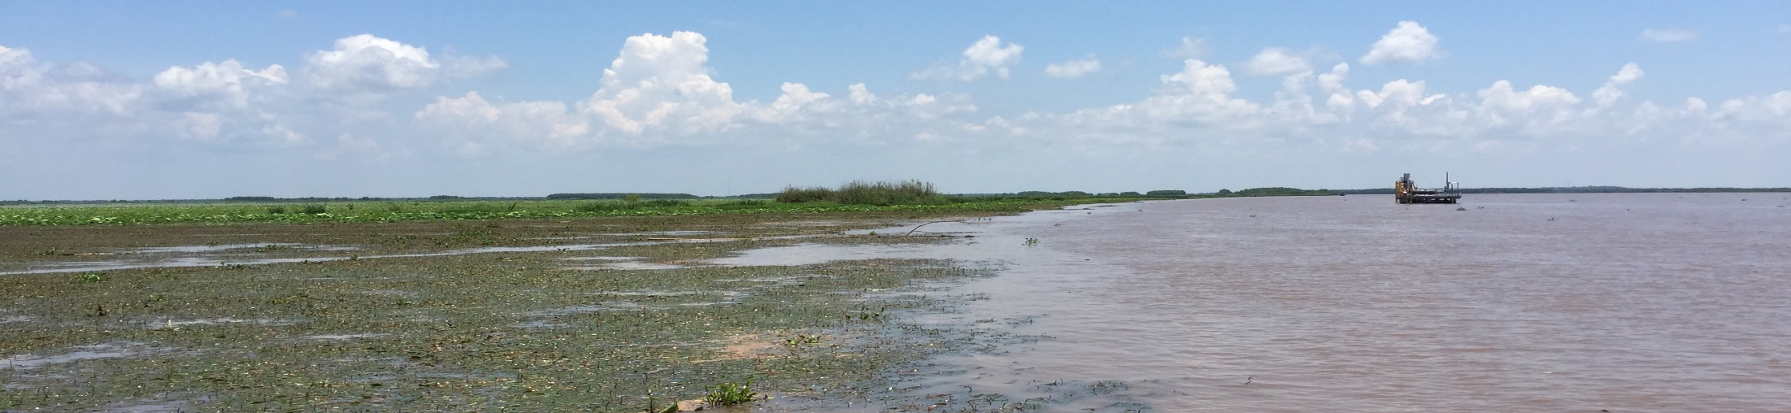
Introduction
Wetlands help reduce the impacts from storm damage and flooding.
Louisiana's 3 million acres of wetlands are lost at the rate about 75 square kilometers annually.
Certain areas are gaining land however, like Wax Lake delta.
Image Credit: Dr. Alex Kolker
Notes:
Wetlands play a key role in global environments and are linked to major issues such as climate change, water quality, and the carbon cycle. Wetlands are crucial in maintaining a balanced hydrological system and since wetlands help reduce the impacts of storm damage and flooding by slowing down water, reducing wave energy, and increasing water storage. Unfortunately, 3 million acres of Louisiana’s wetlands are lost at a rate of about 75 square kilometers a year.
*Optional: Wetlands maintain good river water quality, recharge ground water, store carbon, help stabilize climatic conditions and control pests.

Slide 3
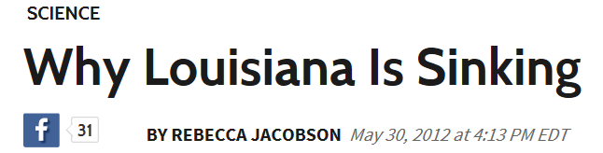
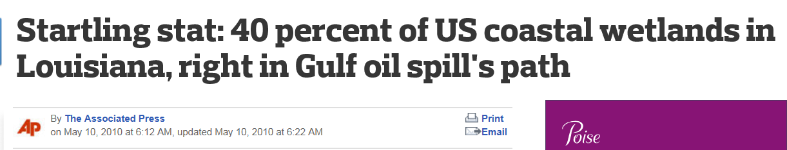
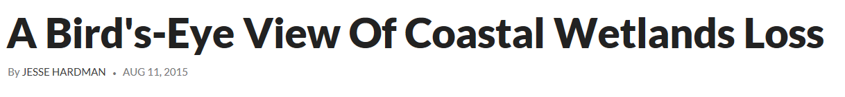
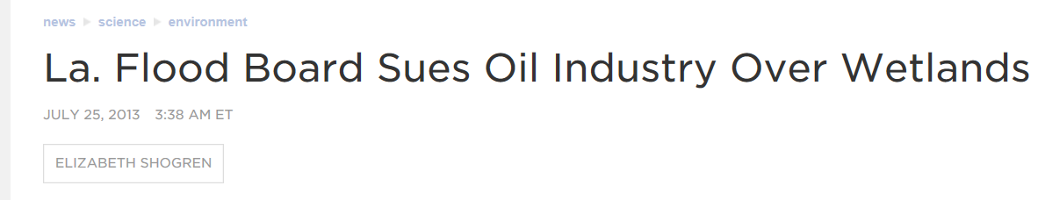
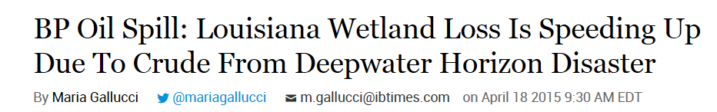
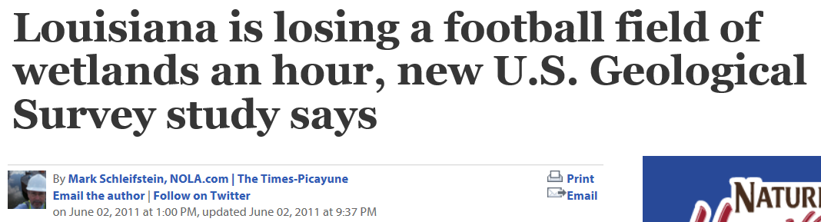
Community Concerns
Notes:
These are just a few examples of the headlines that highlight the concern of wetland loss across Louisiana.

Slide 4
Community Concerns
Wetland loss in Louisiana
Louisiana could loose up to 1/3 of its coastal wetlands by 2050 or sooner
80 miles of state coastal area 1 foot above sea level
Loss of critical habitat and vital economic industry (shrimping/fishing)
40% of national wetlands are in Louisiana
Notes:
Louisiana could loose up to one-third of its coastal wetlands by 2050 or up to an additional 4500 square kilometers of land over the next 50 years due to erosion, land subsidence, and sea level rise. This will result with a loss of critical habit for a variety of fauna and flora along Louisiana’s coast and a loss to the economic fishing industry. According to the USGS, Louisiana has 40 percent of all wetlands found across the United States and is also experiencing 80 percent of the wetland losses. Wetlands are being lost at a rate equivalent to a football field of wetlands an hour.

Slide 5
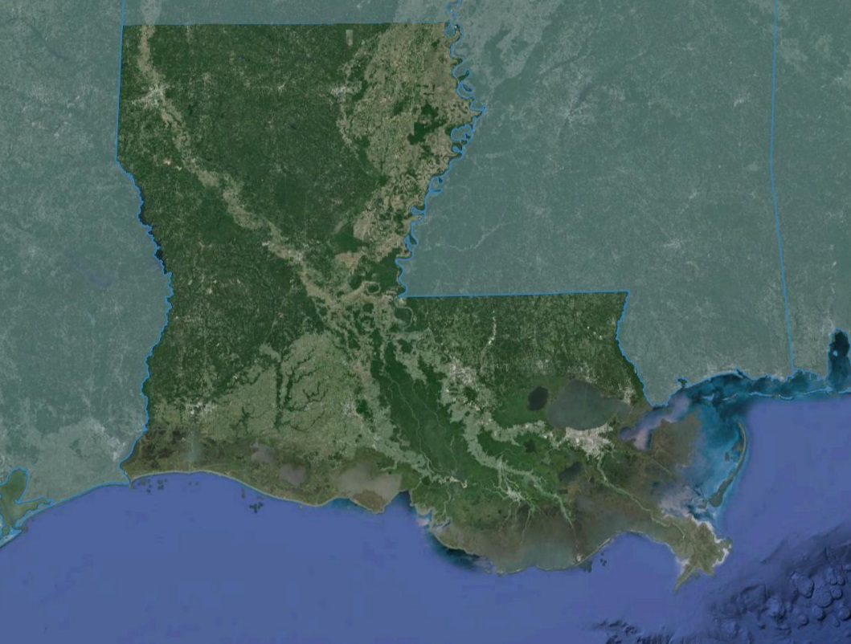
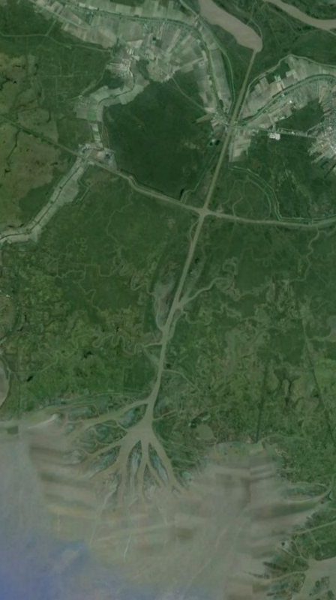
Study Area
Wax Lake Delta, Louisiana
Study Period: May 2009 – May 2015
Notes:
The study area for this project is the Wax Lake Delta in Louisiana.

Slide 6
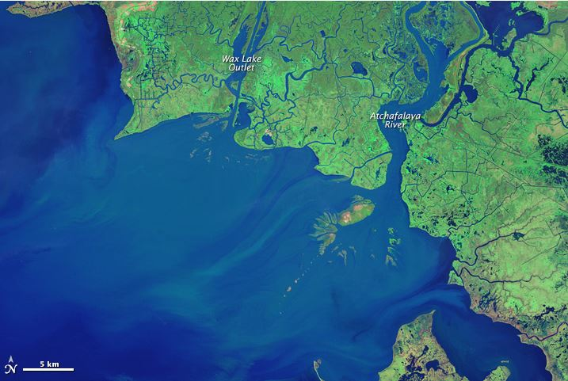
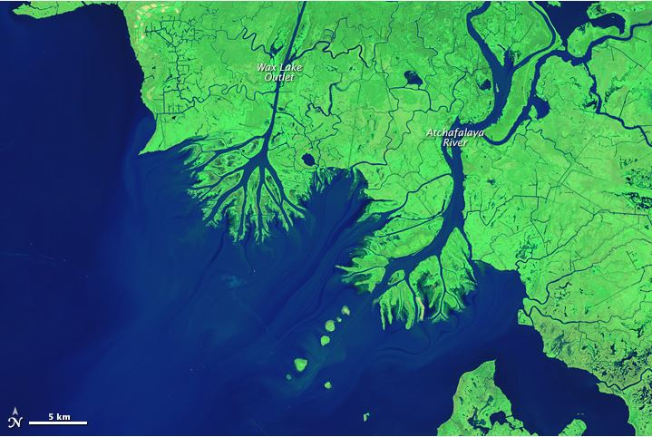
Wax Lake Delta
Delta is built by sediment carried by the Atchafalaya River
The delta grows 1.2 square kilometers (0.46 square miles) per year
Rate of growth varies with the timing of floods and hurricanes
1984
2014
Image Credit: NASA
Notes:
The Wax Lake Delta in Louisiana is a well-studied area since it is one of two deltas in the United States that is currently aggregating.
The delta was created by deposition of sediment which occurred after the creation of a canal through Wax Lake in 1942. The United States Army Corps of Engineers created an artificial channel in the outlet to reduce the amount of flooding in Morgan City, Louisiana by diverting about 30 percent of the flow from the Atchafalaya River to the Gulf of Mexico.
Currently, the delta grows 1.2 square kilometers, or about half a square mile, per year although this rate of growth varies with the timing and severity of floods and hurricanes.

Slide 7
Objectives
Extrapolate delta vegetation elevations using UAVSAR
Model water flow and sediment transport using Deltares Delft3D
Calibrate resulting model with AirSWOT
Examine delta formation processes to gain a better understanding of why the Wax Lake Delta is aggregating
Notes:
Our objective is to extrapolate a delta vegetation elevation using UAVSAR imagery. UAVSAR data will be used in combination with the delta and estuarine bathymetry DEM data to create a full coverage bathymetry image which will be used in Delft3D.
The second objective is to then model water flow and sediment transport using Delft3D.
The third objective is to calibrate the results from Delft3D with readings from AirSWOT.
Finally, our fourth objective is to examine the delta formation processes to gain a better understanding of why the Wax Lake Delta is aggregating.

Slide 8
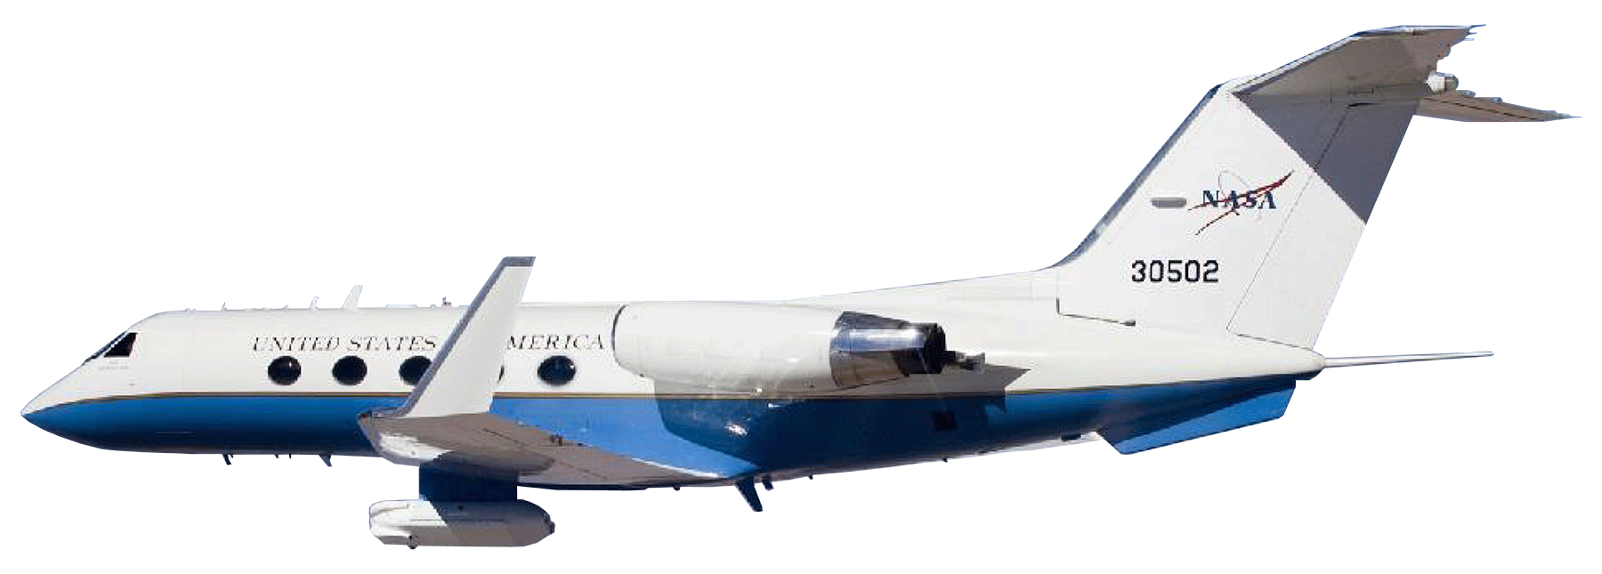
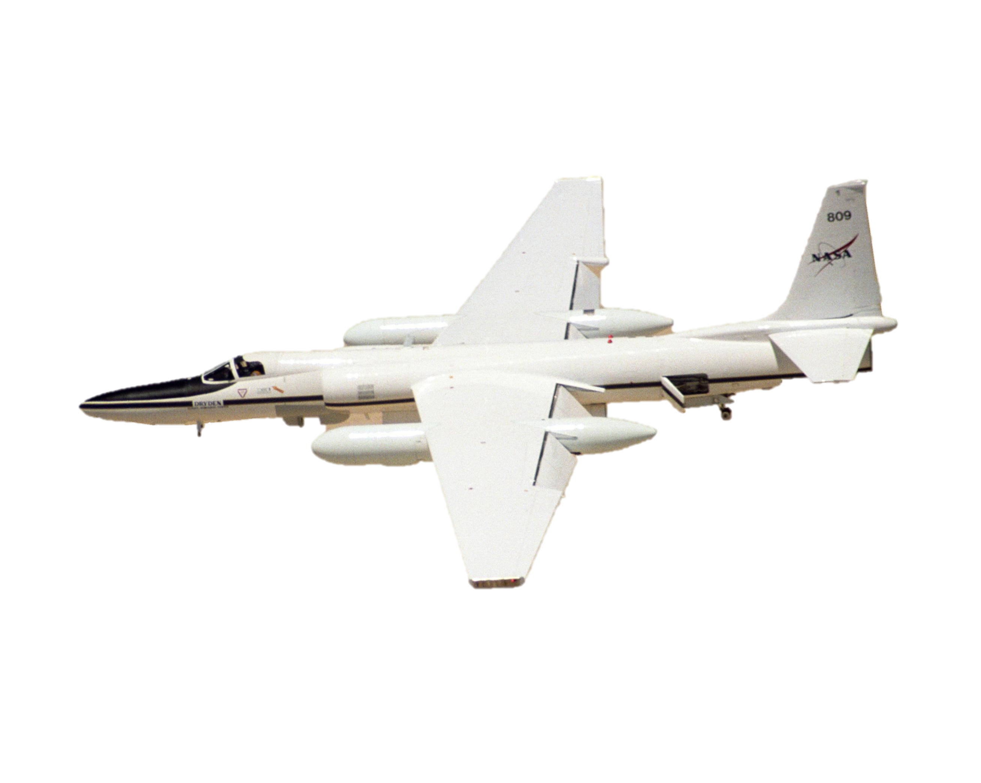
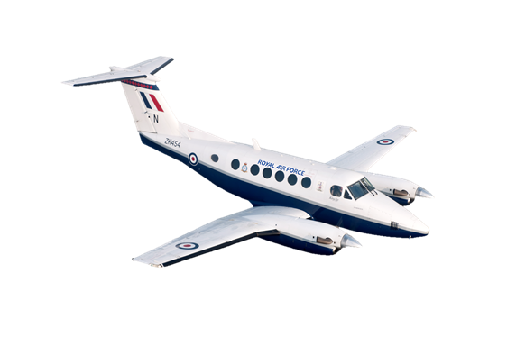
NASA Earth Observation Systems
UAVSAR
L- band Radar
High spatial resolution (6m)
Penetrates cloud and smoke
HVHV
AVIRIS-NG
Hyperspectral Sensor
High spatial resolution (1m)
AirSWOT
Centimeter-level water surface detection
Image Credit: NASA JPL
Notes:
We used three NASA Earth Observations in this project.
The Uninhabited Aerial Vehicle Synthetic Aperture Radar (UAVSAR) is airborne on the NASA Gulfstream III aircraft and is a sensor that uses a L-band radar that can penetrate smoke and clouds. UAVSAR data has a high spatial resolution of 6 meters and is available in different types of polarization. In our study, we focused on the HVHV polarization which shows the most radar backscatter interaction with the vegetation. UAVSAR data was used to create the vegetation elevation layer in our bathymetry image.
The Airborne Visible Infrared Imaging Spectrometer Next Generation (AVIRIS-NG) is a hyperspectral sensor aboard the NASA ER-2 Jet. It has a high spatial resolution of 1 meter and is used to identify vegetation types.
The Air Surface Water Ocean Topography (AirSWOT) is a new airborne sensor, on NASA KingAir B200, that can detect water surfaces and flood plains at a centimeter-level. AirSWOT data is used to calibrate our modeled results produced from Delft3D.

Slide 9
Methodology
Raster Datasets of Bathymetry
(ArcGIS)
Vegetation Species Classification from AVIRIS
(Exelis ENVI)
Modeled Sediment Transport
Delft3D Hydrological Model
Calibrate Model using AirSWOT Data
In Situ Data: Vegetation Species, Water Level, Flow Rate
Modeled Water Flow
Vegetation Elevation Mask from UAVSAR
(Python)
Notes:
Inputs in the Delft3D Hydrological Model include a bathymetry layer created from a reclassified vegetation elevation UAVSAR image that is combined with a delta bathymetry, interpolated channel bathymetry, and estuarine bathymetry rasters. In situ data, including water level and flow rates, was also inputted into the model.
The outputs from the Delft3D model were then calibrated using AirSWOT sensor data. The end products from the model include a modeled sediment transport and water flow to predict the future conditions in the Wax Lake Delta.

Slide 10
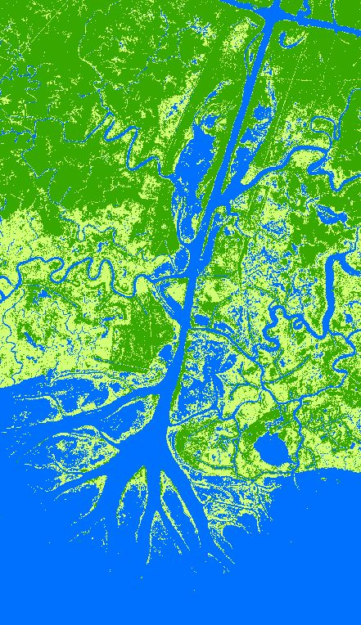
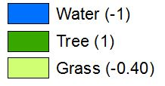
UAVSAR Classification
Decibel values reclassifed into 3 Vegetation-Elevation Classes
Decibel ranges | Vegetation classification | Elevation (m)
< -24 | Water | -1
< -17 | Grass | -0.40
< -2 | Tree | 1
Notes:
We received a processed mosaicked UAVSAR image from Dr. Marc Simard that was collected on May 2015. The image was reclassified into three vegetation classes based on the backscatter values. Water was classified in areas that had a decibel value below -24. Grass was classified in areas that had a value below -17, and trees was classified in areas that had a decibel value below -2.
The data was given preliminary elevation values according to the vegetation type— -1 meters for water, -0.40 meters for grass, and 1 meter for trees. These elevation values will be changed later as discussed in the next slides.
Note: The UAVSAR data reclassification process was processed through a python script using tools from GDAL. The decibel ranges were chosen by creating Region of Interests (ROIs) on the image for each vegetation class and observing the mean and standard deviation ranges of the decibel value per class.

Slide 11
AVIRIS
Tentative slide
{Work in Progress}

Slide 12
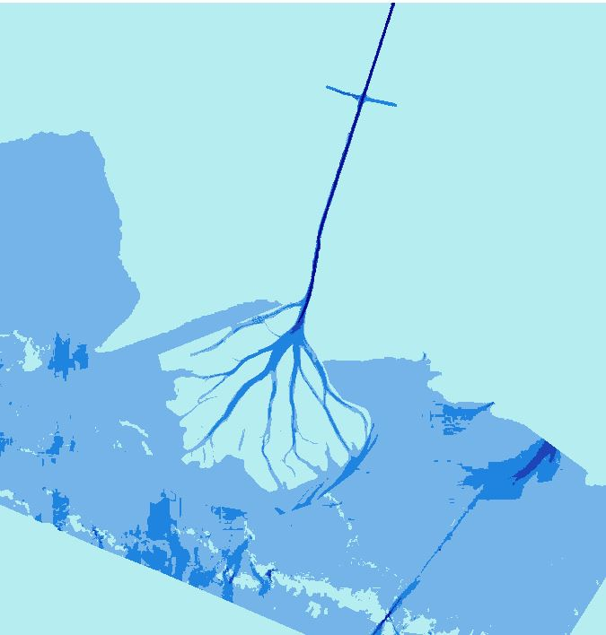
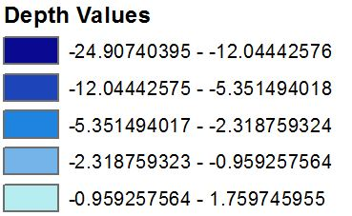
Bathymetry
Interpolated channel derived from transects
Delta layer from John Shaw
NOAA’s Estuarine Bathymetry
Notes:
We created the bathymetry layer by combining three different datasets. We used a Wax Lake Outlet channel bathymetry that was interpolated from the US Army Corps of Engineers (USACE) transect points 1999 Atchafalaya River Hydrographic Survey. Dr. John Shaw from the University of Arkansas created and provided the bathymetry for the Wax Lake Delta. For the offshore bathymetry, we used the National Oceanic and Atmospheric Administration’s (NOAA) Estuarine bathymetry that was collected in 1935.

Slide 13
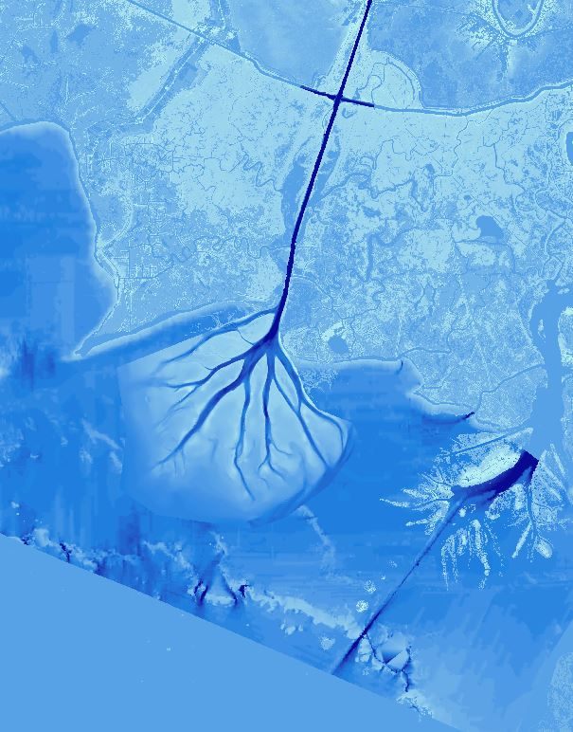
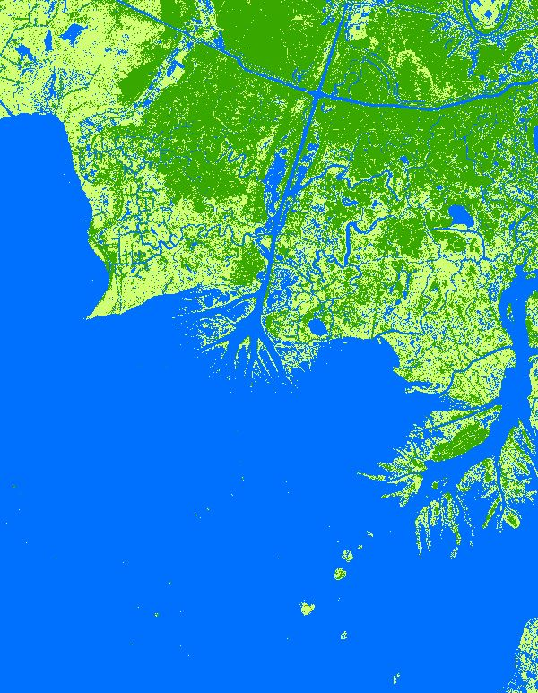
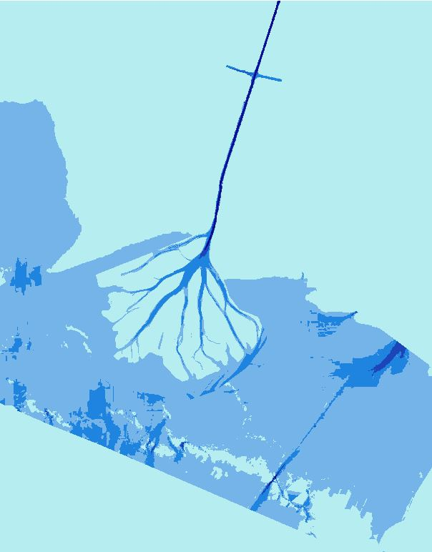

Bathymetry and Vegetation Elevation
Merged the classified UAVSAR image with the Bathymetry layer
Areas classified as trees in the UAVSAR image were replaced with bare earth elevation values
Notes:
We created this bathymetry and vegetation elevation raster by combining the bathymetry and classified UAVSAR data. The areas that were classified as water but were not covered in the bathymetry layer were given an arbitrary value of -1 meter. This value was mainly given to streams and other water bodies located outside of the channel.
The areas that were classified as trees (and given an arbitrary elevation value of 1 meter) in the UAVSAR image were replaced with bare earth elevation values from the USGS National Elevation Dataset (NED).
The elevation value of -0.40 meters remained for areas that were classified as grass.

Slide 14
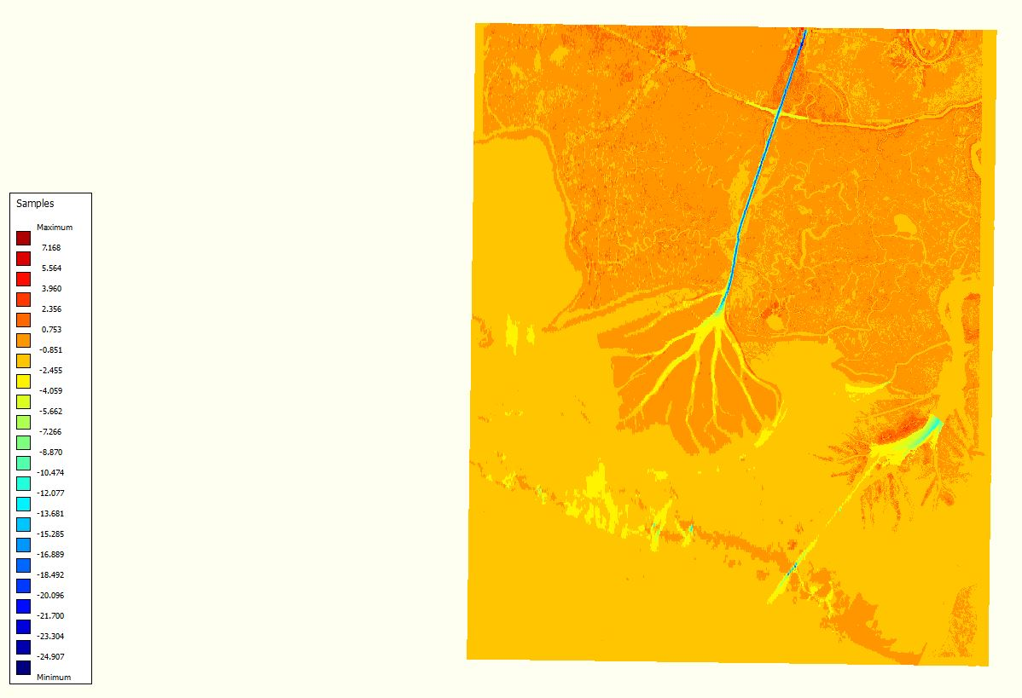
Delft3D
WIP
3D modeling suite to investigate hydrodynamics, sediment transport and morphology and water quality for fluvial, estuarine and coastal environments.
30 year track record and frequently used in published scientific research
What will it tell us? potentially

Slide 15
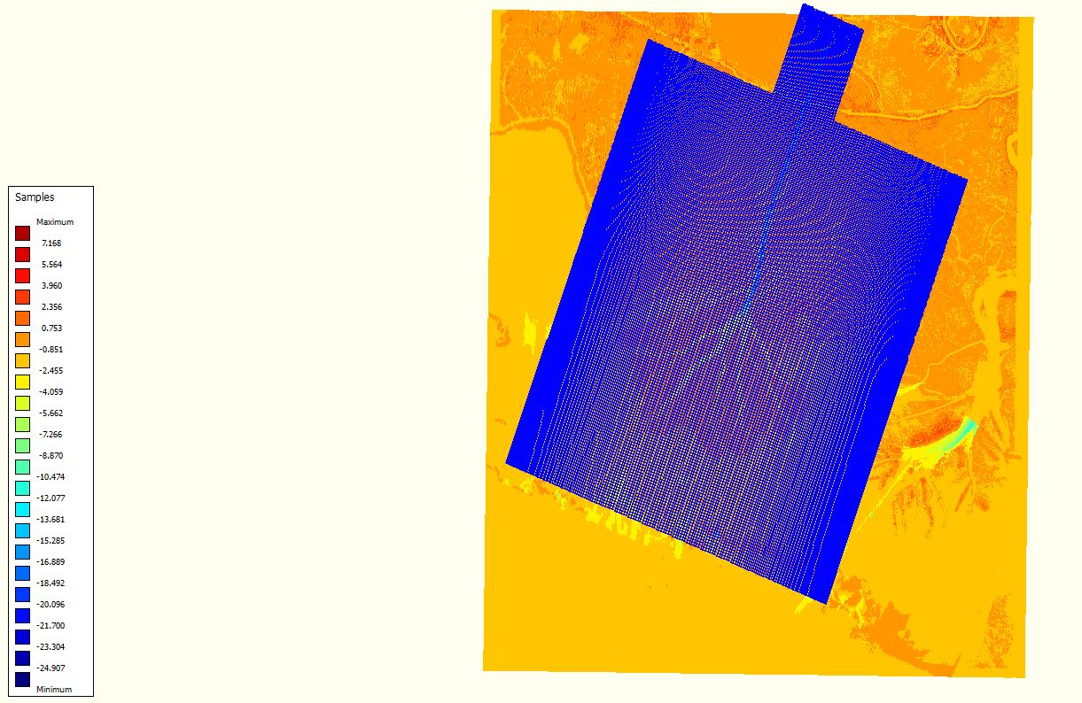
Delft results
WIP
Hopefully we will have an awesome picture of the working model here and be able to explain what is going on.

Slide 16
AirSWOT
Tentative slide
{Work in Progress}

Slide 17
Charts of results
WIP
We can include some hard numbers here or the previous slide on what we are seeing happening within the model in terms of time, etc.

Slide 18
Errors & Uncertainties
WIP
Offshore bathymetry…

Slide 19
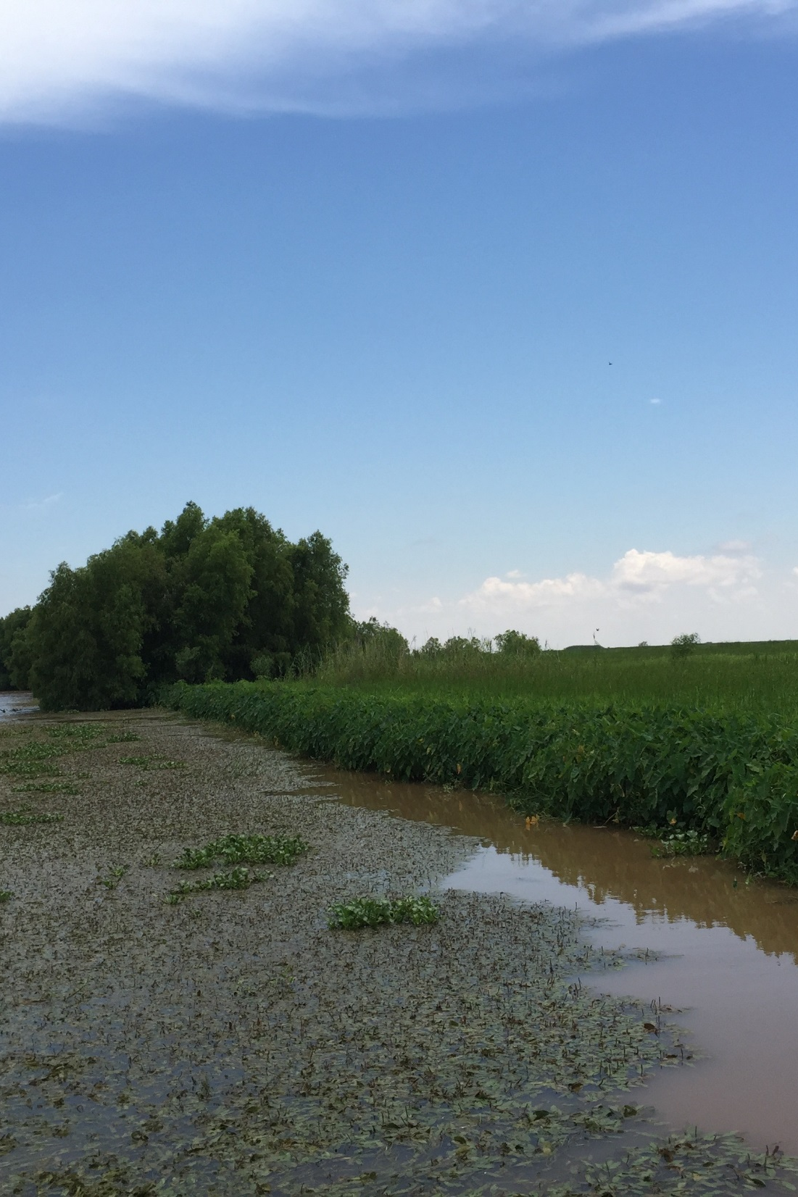
Partners
Alex Kolker
Louisiana Universities Marine Consortium
Working on 2017 Louisiana coastal Master Plan
Richard Krout
United States Naval Research Laboratory, Stennis Space Center
Image Credit: Dr. Alex Kolker
Notes:
Our project partners in this project includes Dr. Alex Kolker of the Louisiana Universities Marine Consortium and Dr. Richard Crout of the United States Naval Research Laboratory.
Dr. Kolker is an academic liaison to the 2017 Louisiana’s Comprehensive Master Plan for a Sustainable Coast. The products from this project will provide Dr. Kolker a broad-scale picture of the accretion process to inform the development of an improved sediment distribution algorithm that will help these managers understand how to direct land restoration efforts along the Louisiana coast.
Dr. Crout is currently investigating buoyancy plume modulation of coastal processes in the area impacted by the Mississippi and Atchafalaya River discharge. Dr. Crout is working on a project that utilizes an ocean circulation model that requires water level and discharge rates from the Atchafalaya Bay. The products from this project will be useful as an input in his model.

Slide 20
Conclusions
WIP
If all goes well then we can make some decent assumptions and reiterate the importance of the project where our partners are concerned.

Slide 21
Future Work
WIP
We can mention Marc’s team of people he has and what they will ultimately incorporate into models like this to improve accuracy, etc.

Slide 22
Advisors
Dr. Cathleen Jones, NASA Jet Propulsion Laboratory
Dr. Marc Simard, NASA Jet Propulsion Laboratory
Partners
Richard Crout, Naval Research Laboratory
Dr. Alexander Kolker, Louisiana Universities Marine Consortium
Others
Gwen Miller, DEVELOP at NASA Jet Propulsion Laboratory
Doug Edmonds, Delft3D
Brittany Zajic and Raul Garcia, past DEVLOP team member
Ben Holt, DEVELOP mentor at NASA Jet Propulsion Laboratory
Nick Rousseau, DEVELOP Center Lead at NASA Jet Propulsion Laboratory

Slide 23
Questions?

