Slide 1
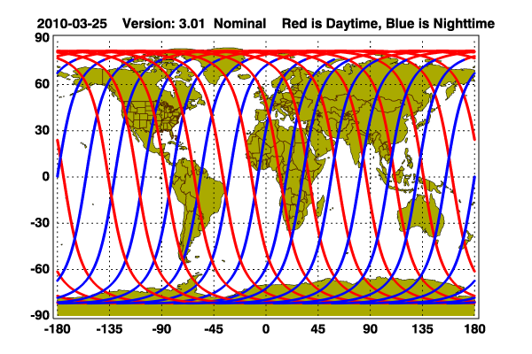
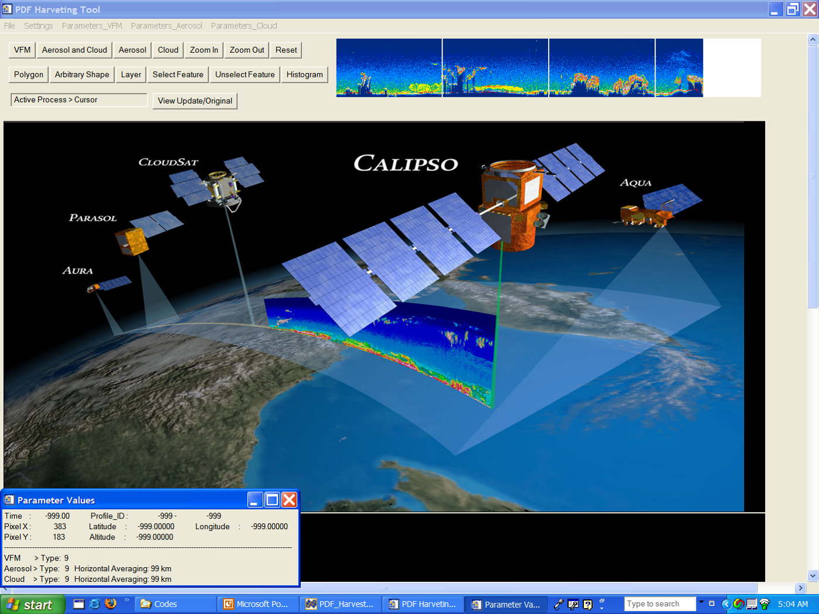
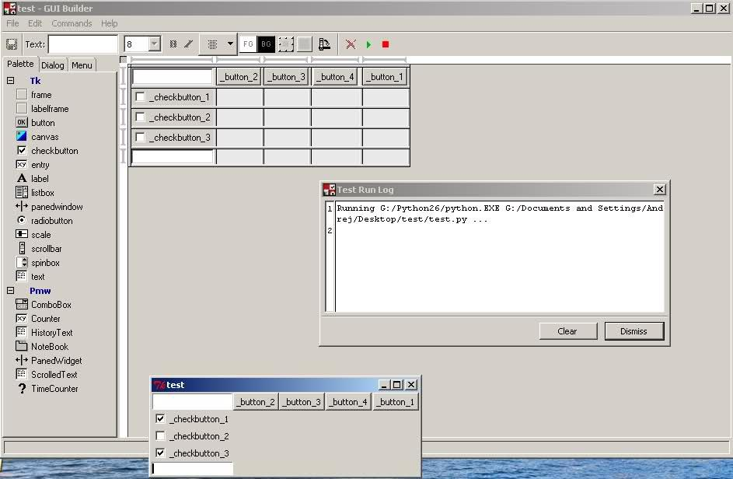
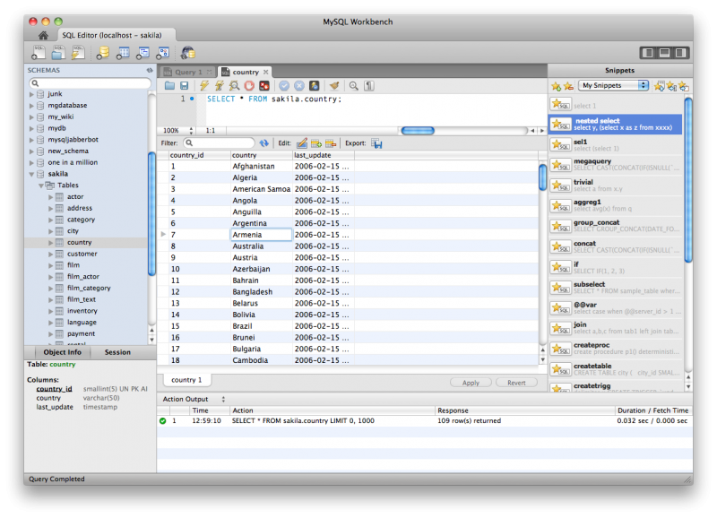
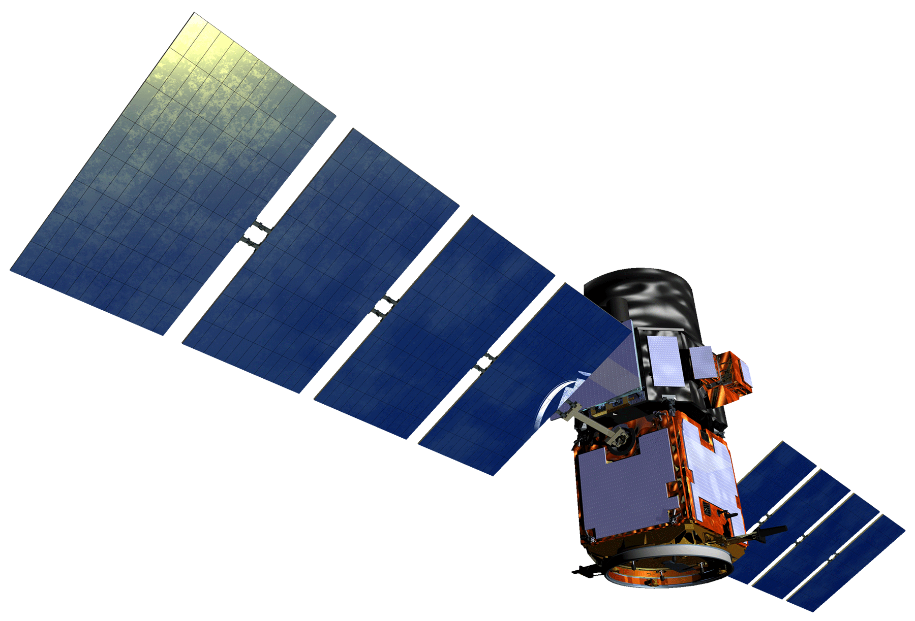
CALIPSO Health & Air Quality
Creating tool to help identify Smoke Plumes Observed with CALIPSO to Improve Future Research and Decision-making
Jordan Vaa (George Mason University), Ashna Aggarwal (College of William and Mary),
Courtney Duquette (Christopher Newport University)
NASA Langley Research Center
*** Placeholder Abstract ***
Create a tool for the visualization and selection of objects within CALIPSO data files
Groom data for storage in a database in order to facilitate searching based on data characteristics
Placeholder Images
CALIPSO
Jordan Vaa
Ashna Aggarwal
Courtney Duquette
Dr. Charles Trepte
Dr. Amber Soja
Dr. Kenton Ross
DEVELOP National Science Advisor

