Slide 1
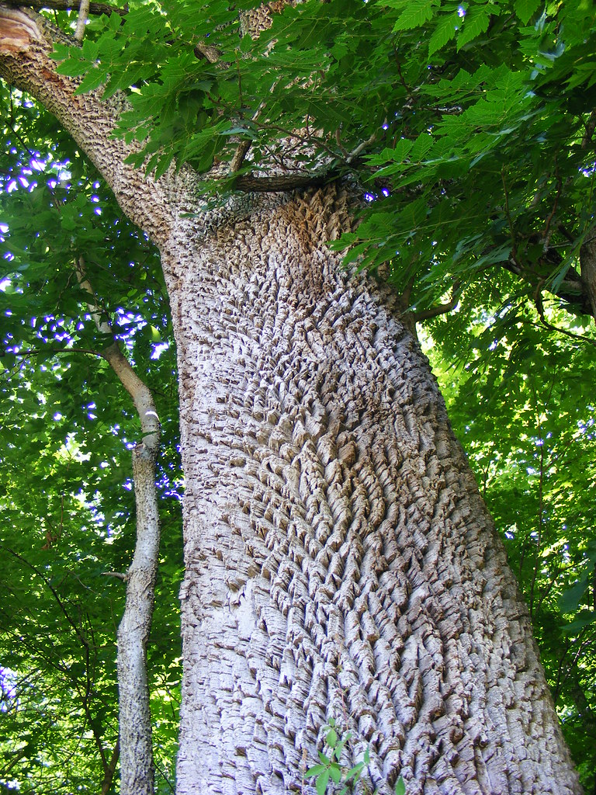
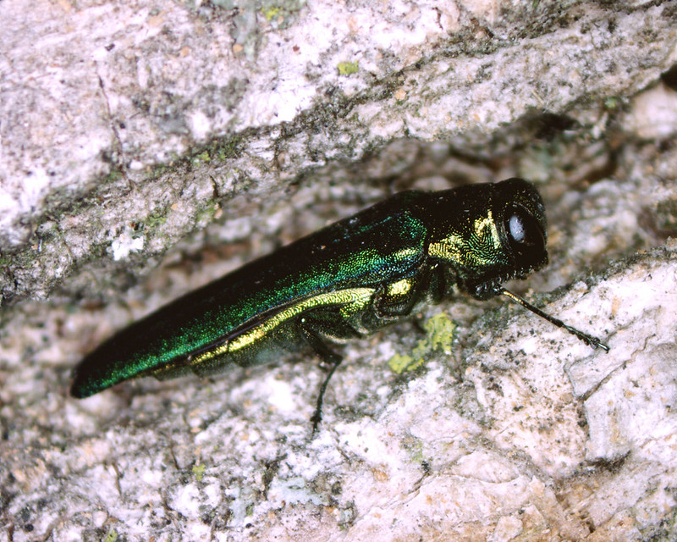
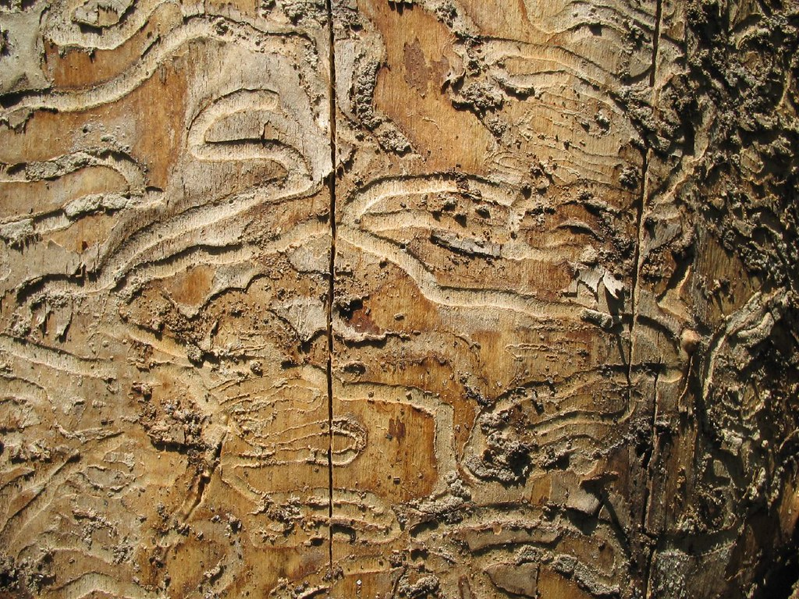
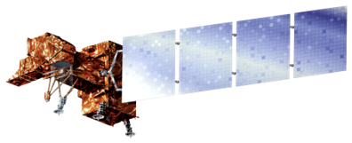
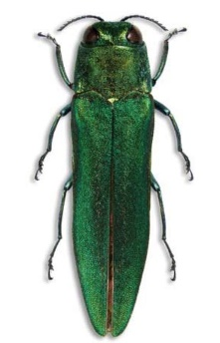
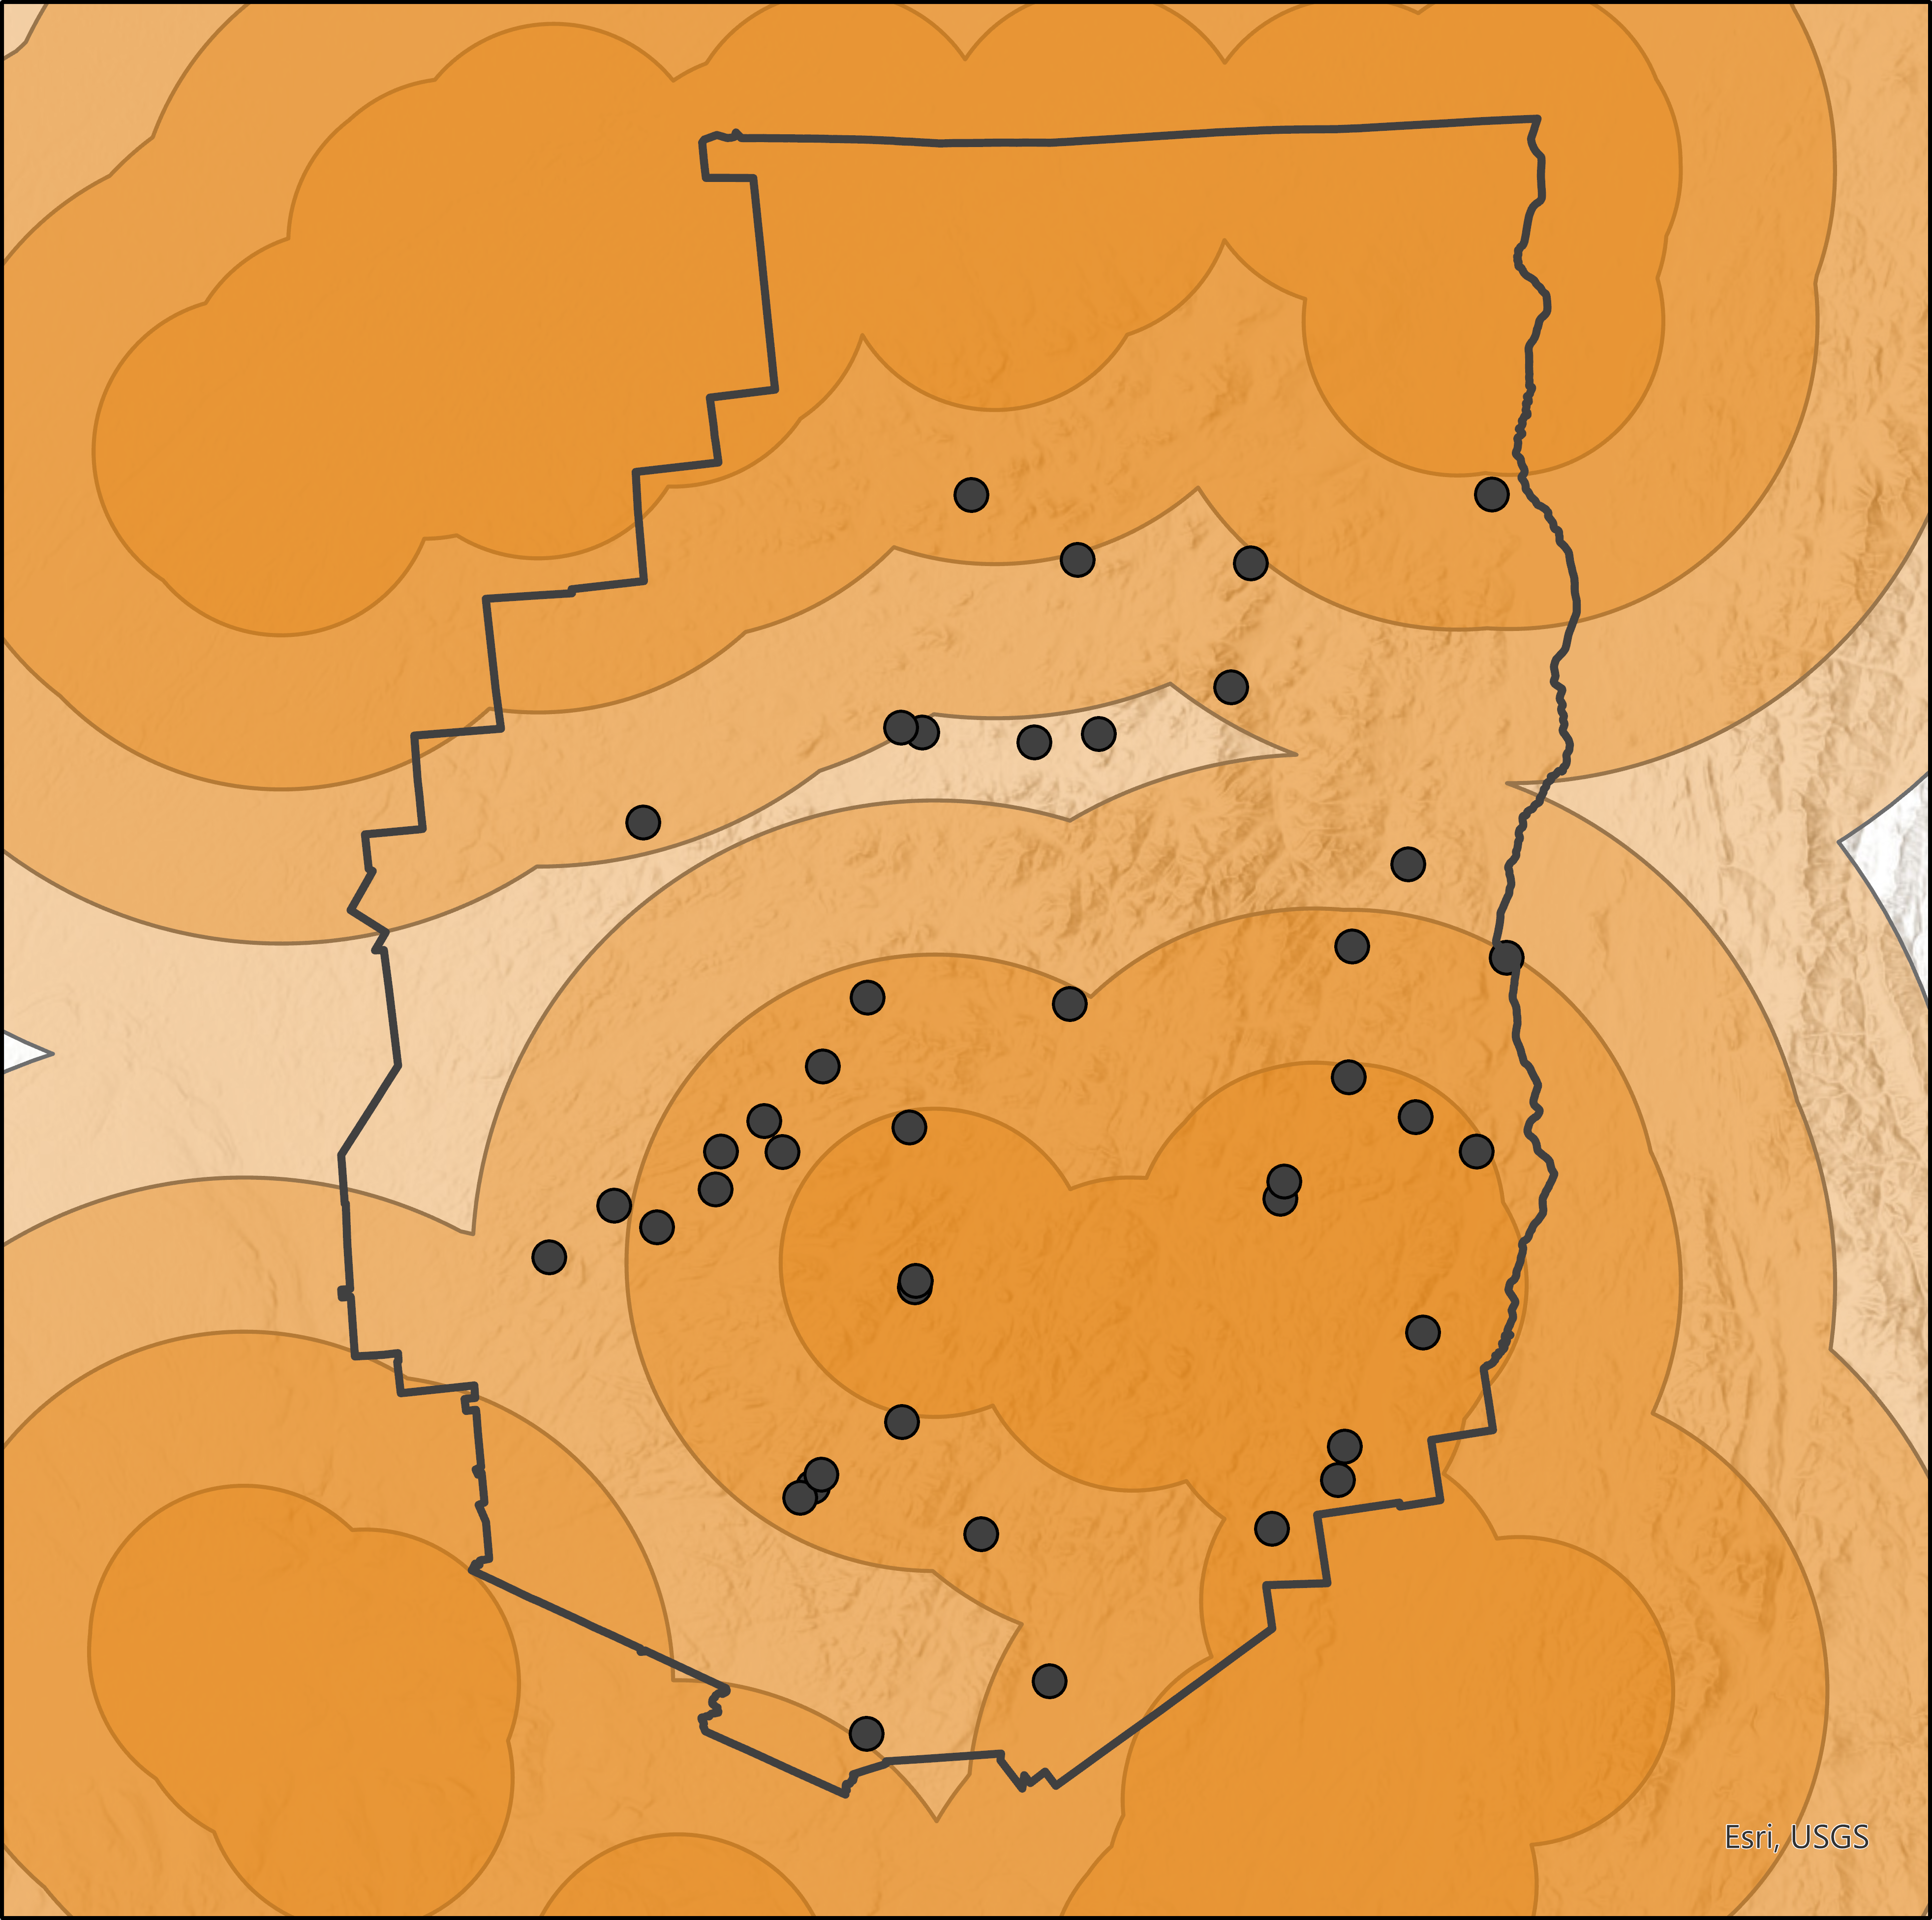
Utilizing NASA Earth Observations to Map Ash Distribution and Inform Emerald Ash Borer Control
Emerald ash borer (EAB):
Kills ash trees
Threatens biodiversity
Costs municipalities
Jeopardizes New York State's timber production
New York Ecological Forecasting
Hyperspectral
Ground Truthing
Classification
Multispectral
Where are the Ash?
N
APIPP
Ash
Ash trees appear to be evenly distributed throughout Adirondack Park
Other Species
Unclassified
Miles
Mapping enables targeted biological control of EAB, to protect the ecosystems & industries that ash trees support
0
25
Esri, CGIAR, USGS
Ash distribution across the Adirondack Park based on classification from hyperspectral imagery
N
Where is EAB going next?
APIPP
Human-mediated up to 50 miles
2023
"Front" of detectable
presence
2024
2025
EAB
present
Insect flight of 12.5 miles annually
2026–2027
Miles
Public Campgrounds
Acknowledgements
0
25
Esri, CGIAR, USGS
Simplified model of maximum potential Emerald Ash Borer risk of spread in the Adirondack Park Invasive Plant Program (APIPP) jurisdiction
Britnay Beaudry (Science Systems & Applications, Inc., NASA Ames Research Center)
Dr. Juan Torres-Pérez (NASA Ames Research Center)
Dr. Mark Friedl (Boston University)
Joseph Spruce (Science Systems & Applications, Inc.)
Image Credits: USDAgov, mightyjoepye, jhritz, Pennsylvania Department of Conservation and Natural Resources
Team Members
Project Partners
Liam Megraw
Stefanie Dimayuga Mendoza
Samantha Kelly
Jesse Carlson
Rebecca Bernacki (New York State Department of Environmental Conservation, Adirondack Park Invasive Plant Program)
California – Ames
Notes:
----------------------Image Information-----------------------------------------------------------------------
https://www.flickr.com/photos/41284017@N08/4878926306
Photo credit : USDAgov (CC BY-ND 2.0)
https://www.flickr.com/photos/41723068@N04/4683427506
Photo credit: mightyjoepye (CC BY 2.0)
https://wordpress.org/openverse/image/18ae8242-9329-4dae-9bde-57aee608ee4a/
Photo credit: jhritz (CC BY 2.0)
Big trail image
Image credit: Pennsylvania Department of Conservation and Natural Resources - Forestry Archive
Image Source: https://upload.wikimedia.org/wikipedia/commons/7/75/Agrilus_planipennis_001.jpg (creative commons CC)

