Slide 1
RWANDA ECOLOGICAL FORECASTING
Utilizing NASA Earth Observations to Classify Wetland Extent in Rwanda in Support of United Nations Sustainable Development Goals
Nicholas McVey
Julia Bayer
Jennifer Gelmis
Dash Cruz
NASA Marshall Space Flight Center
2017 Summer
Notes:
Notes: Image Credit Wanderlust travel magazine http://www.wanderlust.co.uk/planatrip/inspire-me/lists/worlds-greatest-wetlands
We are the Rwanda Ecological Forecasting Team here at Marshall Space Flight Center. We will be using NASA earth observations to classify Wetland Extend in Rwanda. This classification will be incorporated into a time series study of wetland extent over the previous decade. The object is to better understand the fluctuation of wetland extent historically, as well as map impact of development in the wetlands.
My name is Nicholas McVey and I am the team lead and this is my third term at DEVELOP.
My name is Dash Cruz and I am the ACL and Impact Analysis Fellow.
My name is Jennifer Gelmis and this is my first term at DEVELOP.
My name is Julia Bayer and this is my first term at DEVELOP.

Slide 2
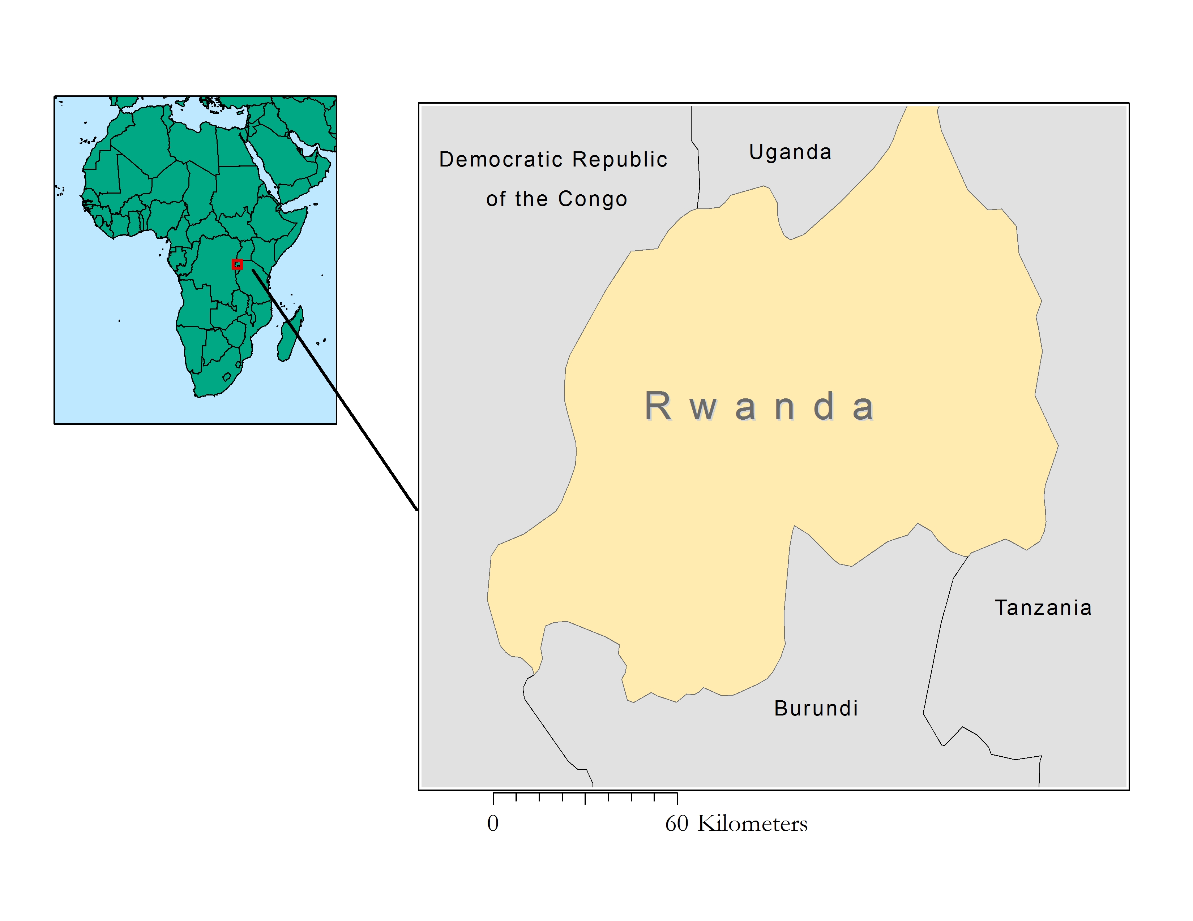
Study Area
Study Location:
Rwanda
Study Period:
2007-2017; Forecasting to 2030
Fast Facts:
Two major drainage basins: Nile and Congo
860 Marshlands: 278,536 hectares
101 Lakes: 149,487 hectares
861 Rivers: 6,462km in Lakes
Notes:
Wetlands make up 10.6% of the land in the East African nation of Rwanda and are commonly found surrounding lakes and rivers. Our project will map the wetlands in Rwanda from 2007-2017. A third of the country’s wetlands are found in the western side of the country in the province of Kinyarwanda. These wetlands are found in the Congo River Basin in the area surrounding Lake Kivu. The rest of the country’s wetlands are found on the east side in the Nile River Basin. One of the most notable wetlands is the Rugezi Marsh in Buberuka highlands in the Northern Province as the marsh serves as the headwaters of the Nile River (REMA, 2009).

Slide 3
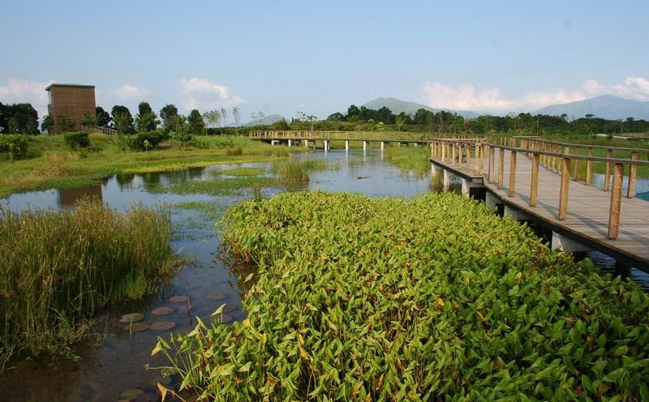
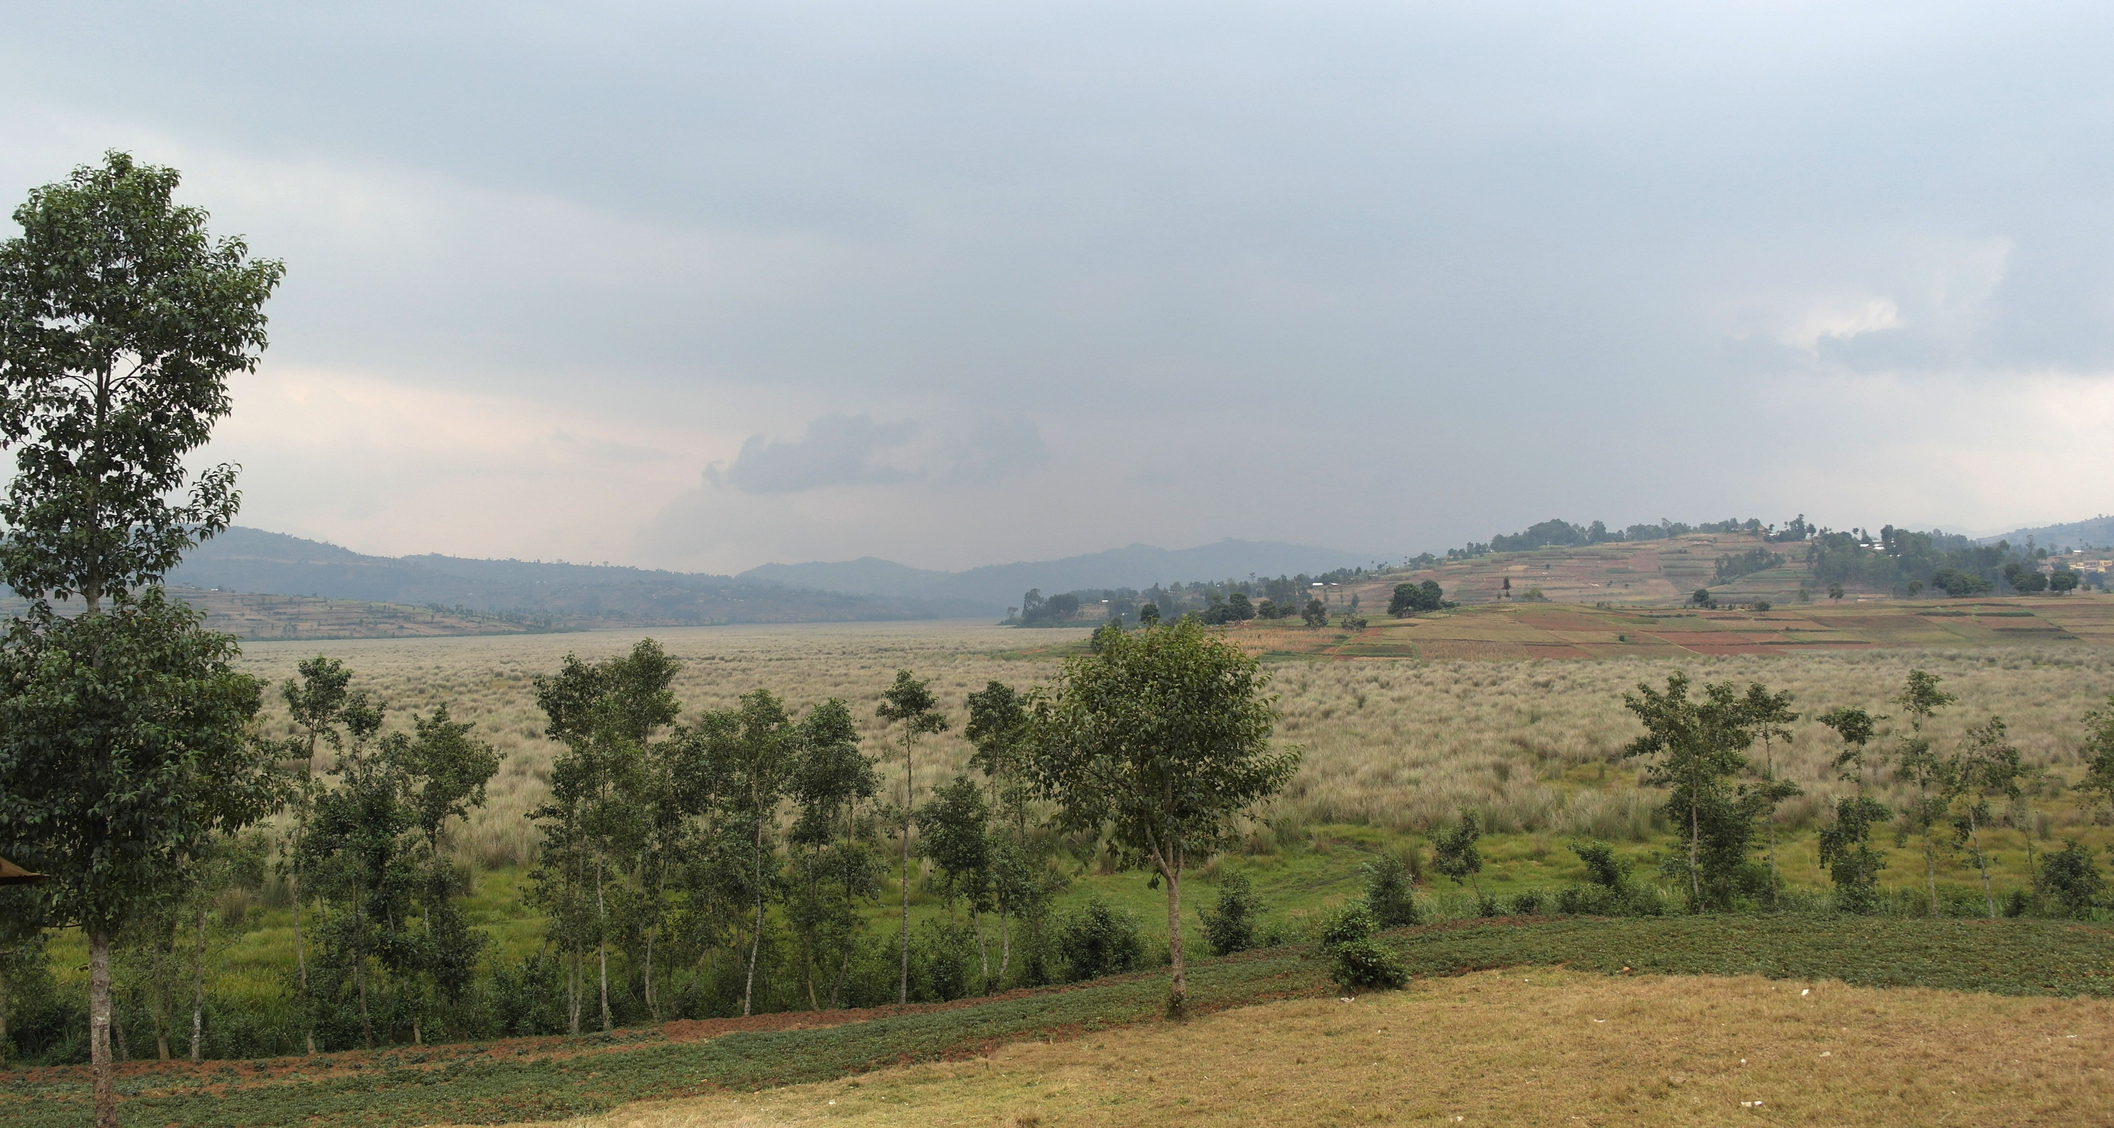
Community Concerns
Enhanced flood control
Impede soil erosion
Reduction of pollutants
Safeguard local biodiversity
Image Credit: Lonely Planet
Image Credit: Adrian Strauch
Notes:
Wetlands are a critical part of the environment providing a range of functions that directly benefit human settlements.
Increasing population pressure, large-scale deforestation and poor management practices have left Rwanda, a country whose economy is based largely on agricultural production with severe environmental problems which can be mitigated through the conservation of wetlands.
Moderate to severe erosion on 50% of its arable farmland. Wetlands slow water flow by acting as a sponge—accumulating, storing, and slowly releasing flood water after rainfall or storm surges. Helps to protect surrounding infrastructure and prevent erosion
Act as a filter to toxic substances and nutrient by breaking them down to less harmful substances, protect groundwater quality**
Unique areas of thriving diversity which is vital to the survival of migrant birds, a myriad of plants and insects, and
Image Source: http://ilovehongkong.org/wp-content/uploads/2012/09/Hong-Kong-Wetland-Park-7.jpg

Slide 4
Partners
Rwanda Environmental Management Authority
(REMA)
Group on Earth Observations-Wetlands Initiative
NASA SERVIR Coordination Office MSFC
Regional Centre for Mapping of Resources for Development
Notes:
Throughout this project we worked with four partners, they are:
The Rwanda Environment Management Authority (REMA) and our POC Marie-Laetitia Busokeye. REMA uses Earth observational data for planning purposes and in general manages environmental affairs in Rwanda and served as one of our end users.
Africa Flores and Emily Adams at NASA SERVIR Coordination Office at MSFC served as one of our collaborators. The SERVIIR Eastern and Southern Africa hub uses geospatial tools to work on environmental decision making in developing countries such as Rwanda. The data collected by SERVIR is primarily used in estimating the effects of flooding and better develop flood relief protocol.
Dr. Robinson Mugo, earth observations lead at the Regional Center for Mapping of Resources for Development (RCMRD), our second end user. RCMRD is an inter-governmental organization based out of Nairobi with 20 contracting member states in Eastern and Southern Africa and the organization aims to promote sustainable development using remote sensing and geographic techniques
Adrian Strauch (Univ. of Bonn), Lammert Hilarides (Wetlands International) and Ania Grobicki (Ramsar Convention Secretariat) at Geo-Wetlands Initiative were our second colloborator. GEO-Wetlands is a global partnership coordinated by the University of Bonn, Wetlands International and the Ramsar Convention Secretariat. GEO Wetlands develops products on wetland delineation and characterization and is currently working on a parallel project in Rwanda.

Slide 5
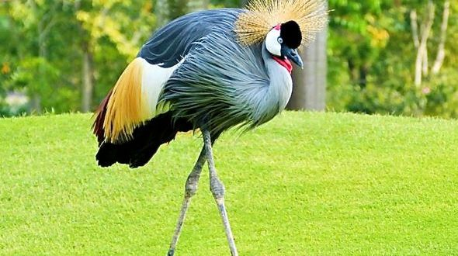
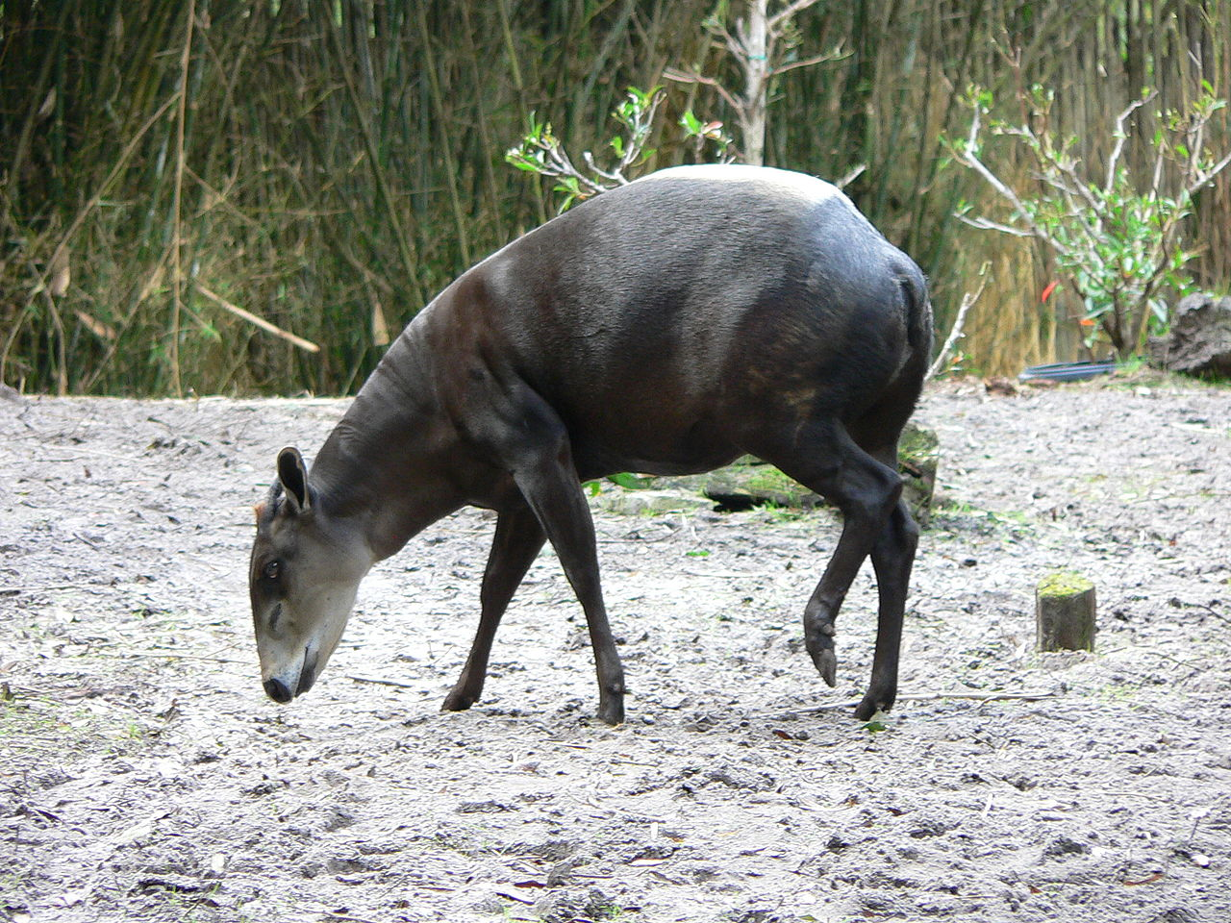
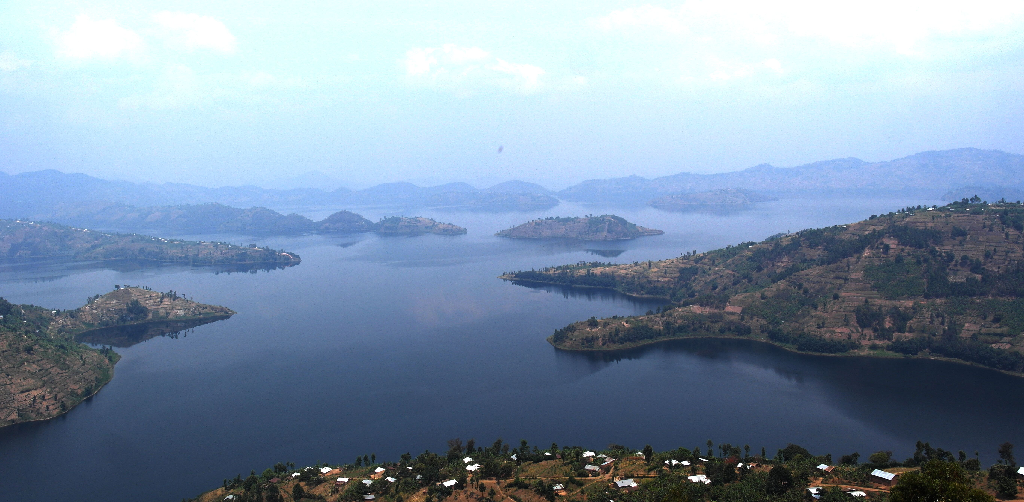
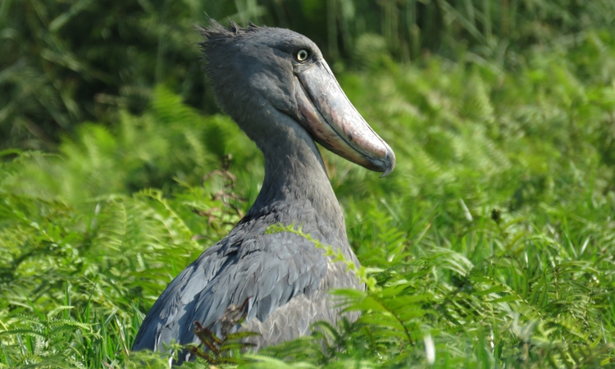
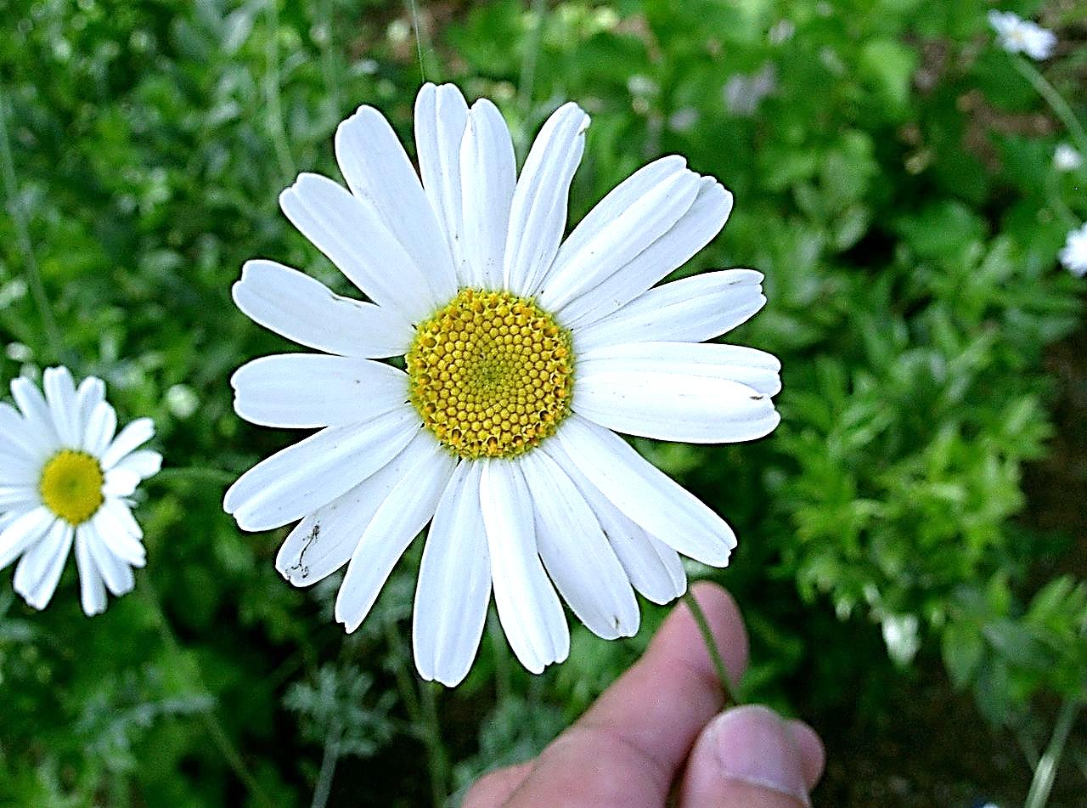
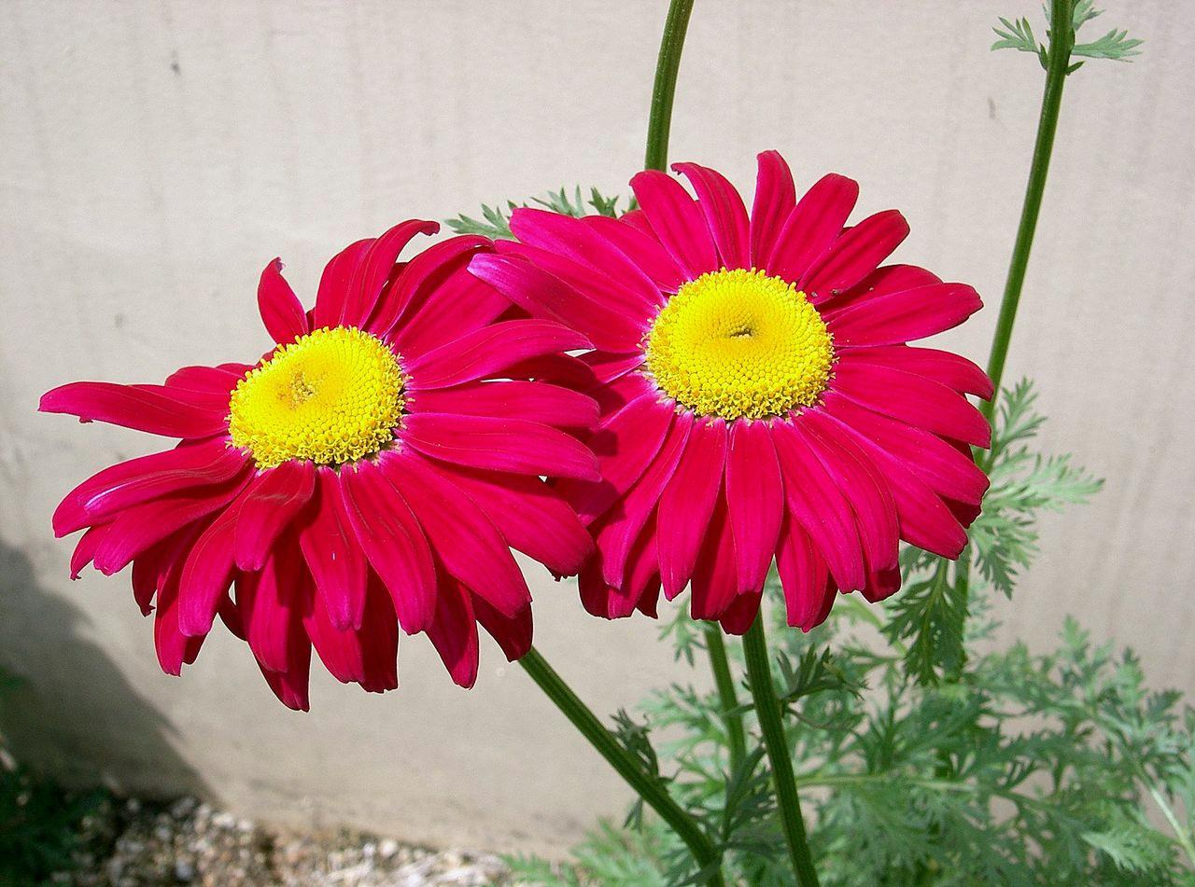
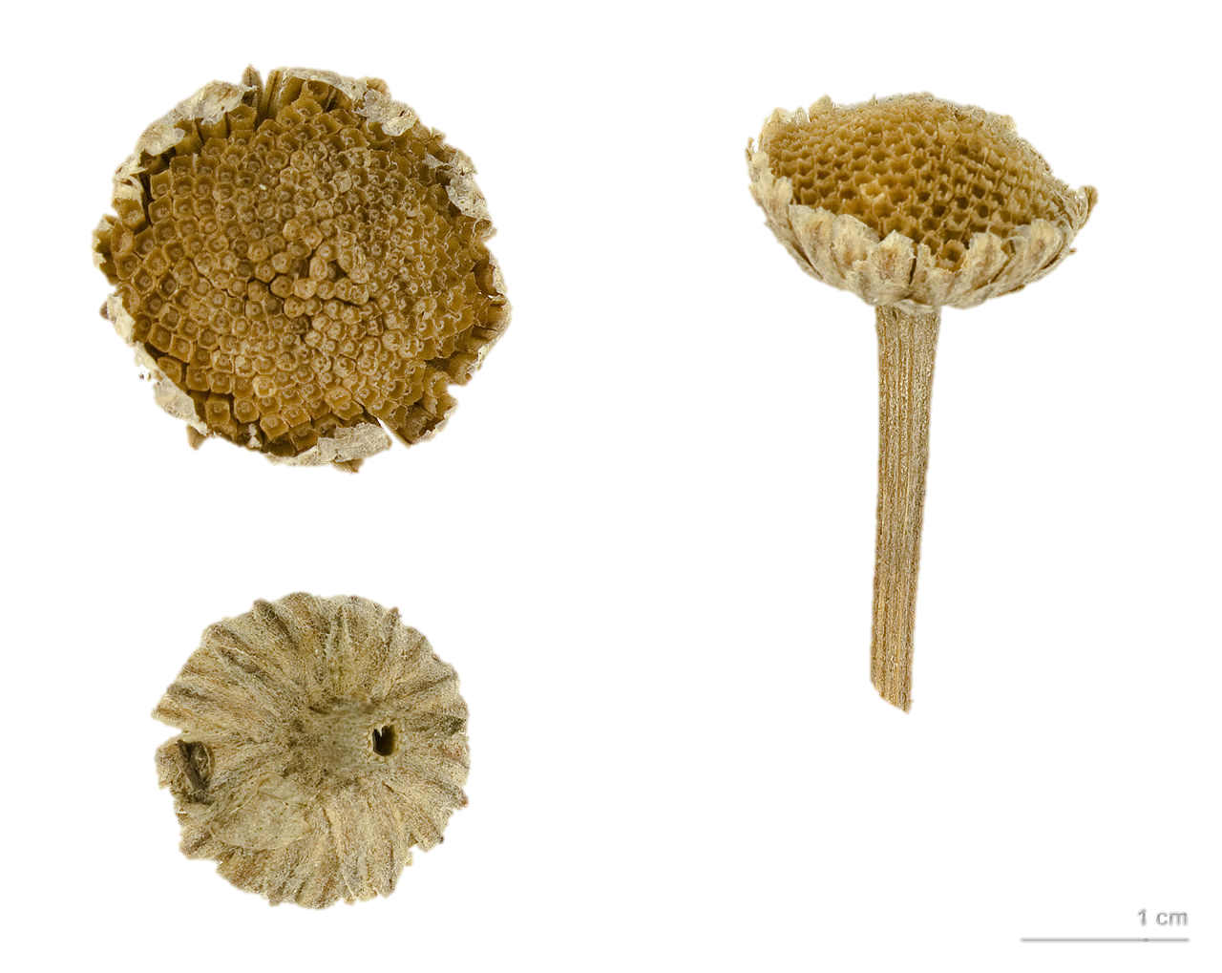
Objectives
Identify wetlands in Rwanda
Enhance protective efforts of critical wetland areas
Generate an accurate classification methodology
Image Credit: BESG
Image Credit: Disney
Image Credit: UNEP
Image Credit: KENPEI
Image Credit: Adrian Strauch
Notes:
The United Nations Sustainable Development Goals are an initiative aimed to be completed by 2030 that looks to provide food security, end poverty and protect the environment across the globe. UN SDG 15.2 is specifically aimed at the protection of diverse ecosystems and prevention of land degradation.
Creatures Fauna/Flora (from Top to Bottom): Grey Crowned Crane, Yellow Back Duiker, Shoebill Stork, Pyrethrum.
There are three objectives that we would like to accomplish during this research.
1st – identify wetlands in Rwanda utilizing NASA Earth observations
2nd – assist with protective efforts of critical wetland areas by producing land-change and ecological forecasting models.
3rd and finally – generate an accurate, well-documented classification methodology to ensure that our results are easily replicated.
*From 1990 to 1994, Rwanda’s Volcanoes' National Park (undisturbed from 1920’s to 1960) was used as a base for Rwanda Patriot soldiers and served as a theatre for military conflict during the Rwandan Civil War. The preserve had been decreased by 47% (from 34,000 ha to 16,000 ha) during the 60’s & 70’s to accommodate human settlement & pyrethrum, a plant used for ornamentation purposes and insecticide production.
*Repatriation of refugees after the Rwandan Civil War effected some of the following National reserves:
Akagera National Park, reduced from 250,000 ha to 150,000 ha
Mutara Game Reserve, which originally had a surface area of 335,000 ha to being non-existent.
*In 2003, Akager’s park boundaries were redrawn to its current standing area of 108,500 ha.
Source: http://postconflict.unep.ch/publications/UNEP_Rwanda.pdf (pg. 205)

Slide 6
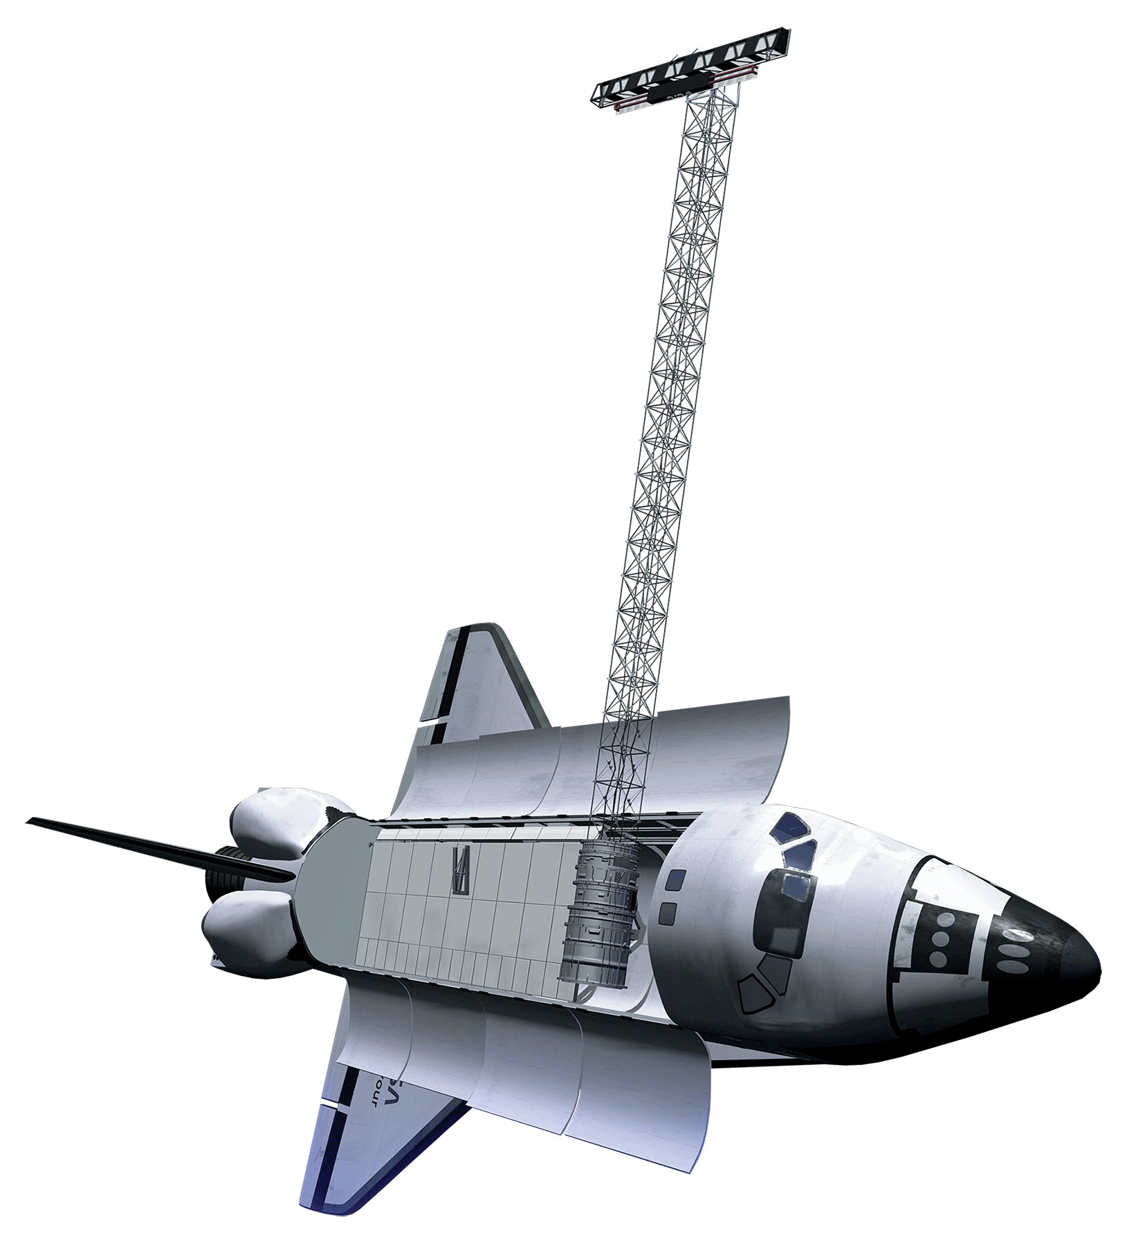
Satellites and Sensors
Landsat 8 Operational Land Imager
Shuttle Radar Topography Mission, Version 3
Landsat 5 Thematic Mapper
Image Credit: NASA DEVELOP Program
Notes:
Throughout this project we worked with three satellites and sensors. They are:
Landsat 8 OLI--launched in 2013, 30 m and was used to classify wetlands in Rwanda.
SRTM--launched in 2000, 11 day mission, mapped 80% of the world’s topography, texture mapping
Landsat5: launched in 1984, TR 16 days, SR 30m was also used to classify wetlands in Rwanda before 2013.
Top of Atmosphere correction values were obtained from the digital number of United States Geological Service data.
Image Source: http://www.devpedia.developexchange.com/dp/index.php?title=List_of_Satellite_Pictures

Slide 7
Methodology - Data Processing
Data Acquisition
Data Analysis
End Products
Supervised classification
Wetland Extent Time Series
Download Landsat 5 TM
Imagery
Historical trace of wetlands
Wetland Change Map
Download Landsat 8 OLI Imagery
Land change analysis using TerrSet
Wetland Prediction Map
Notes:
Landsat 5 TM and Landsat 8 OLI data was imported to the application program interface for Google Earth Engine. The supervised classification package was used to collect training data about the five major interest area properties: land, forest, water, urban, and wetland. The geometry tool was used to draw 150 polygons per property, and the classification scheme was run on 7 different years over a 10 year study period to produce wetland extent maps.

Slide 8
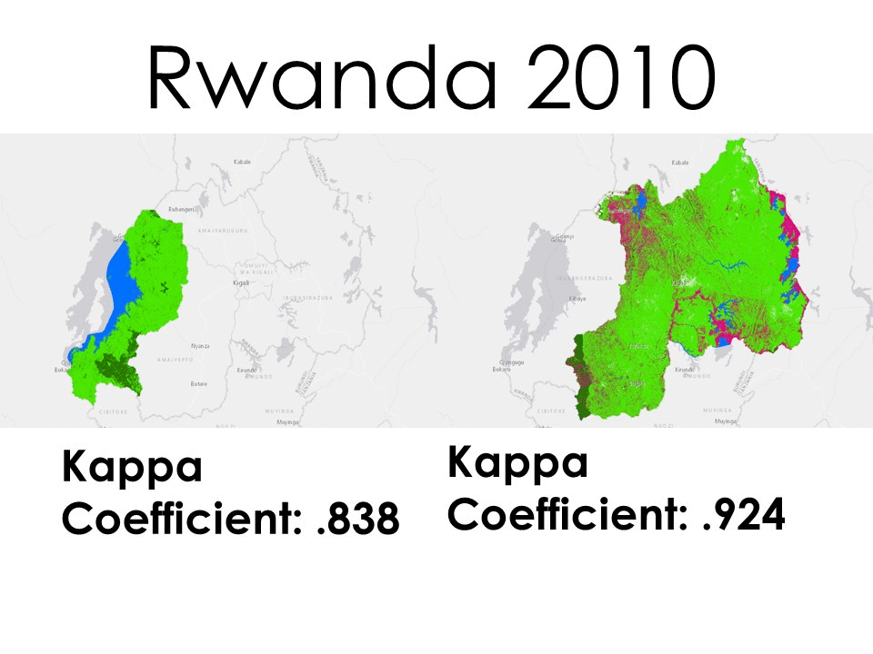
Methodology - Time Series
Google Earth Engine
Landsat 5 – TM and Landsat 8 – OLI
TOA conversion
Land Cover Classifications
Water
Land
Forest
Wetland
Developed
Classification
Land
Water
Developed
Forest
Wetland
Notes:
The time series was generated by running the classifier index over a ten year span for datasets from Eastern and Western Rwanda. These predictors were used to denote historical trends so that future changes may be predicted. This time series was used to generate forecast models through the year 2030.

Slide 9
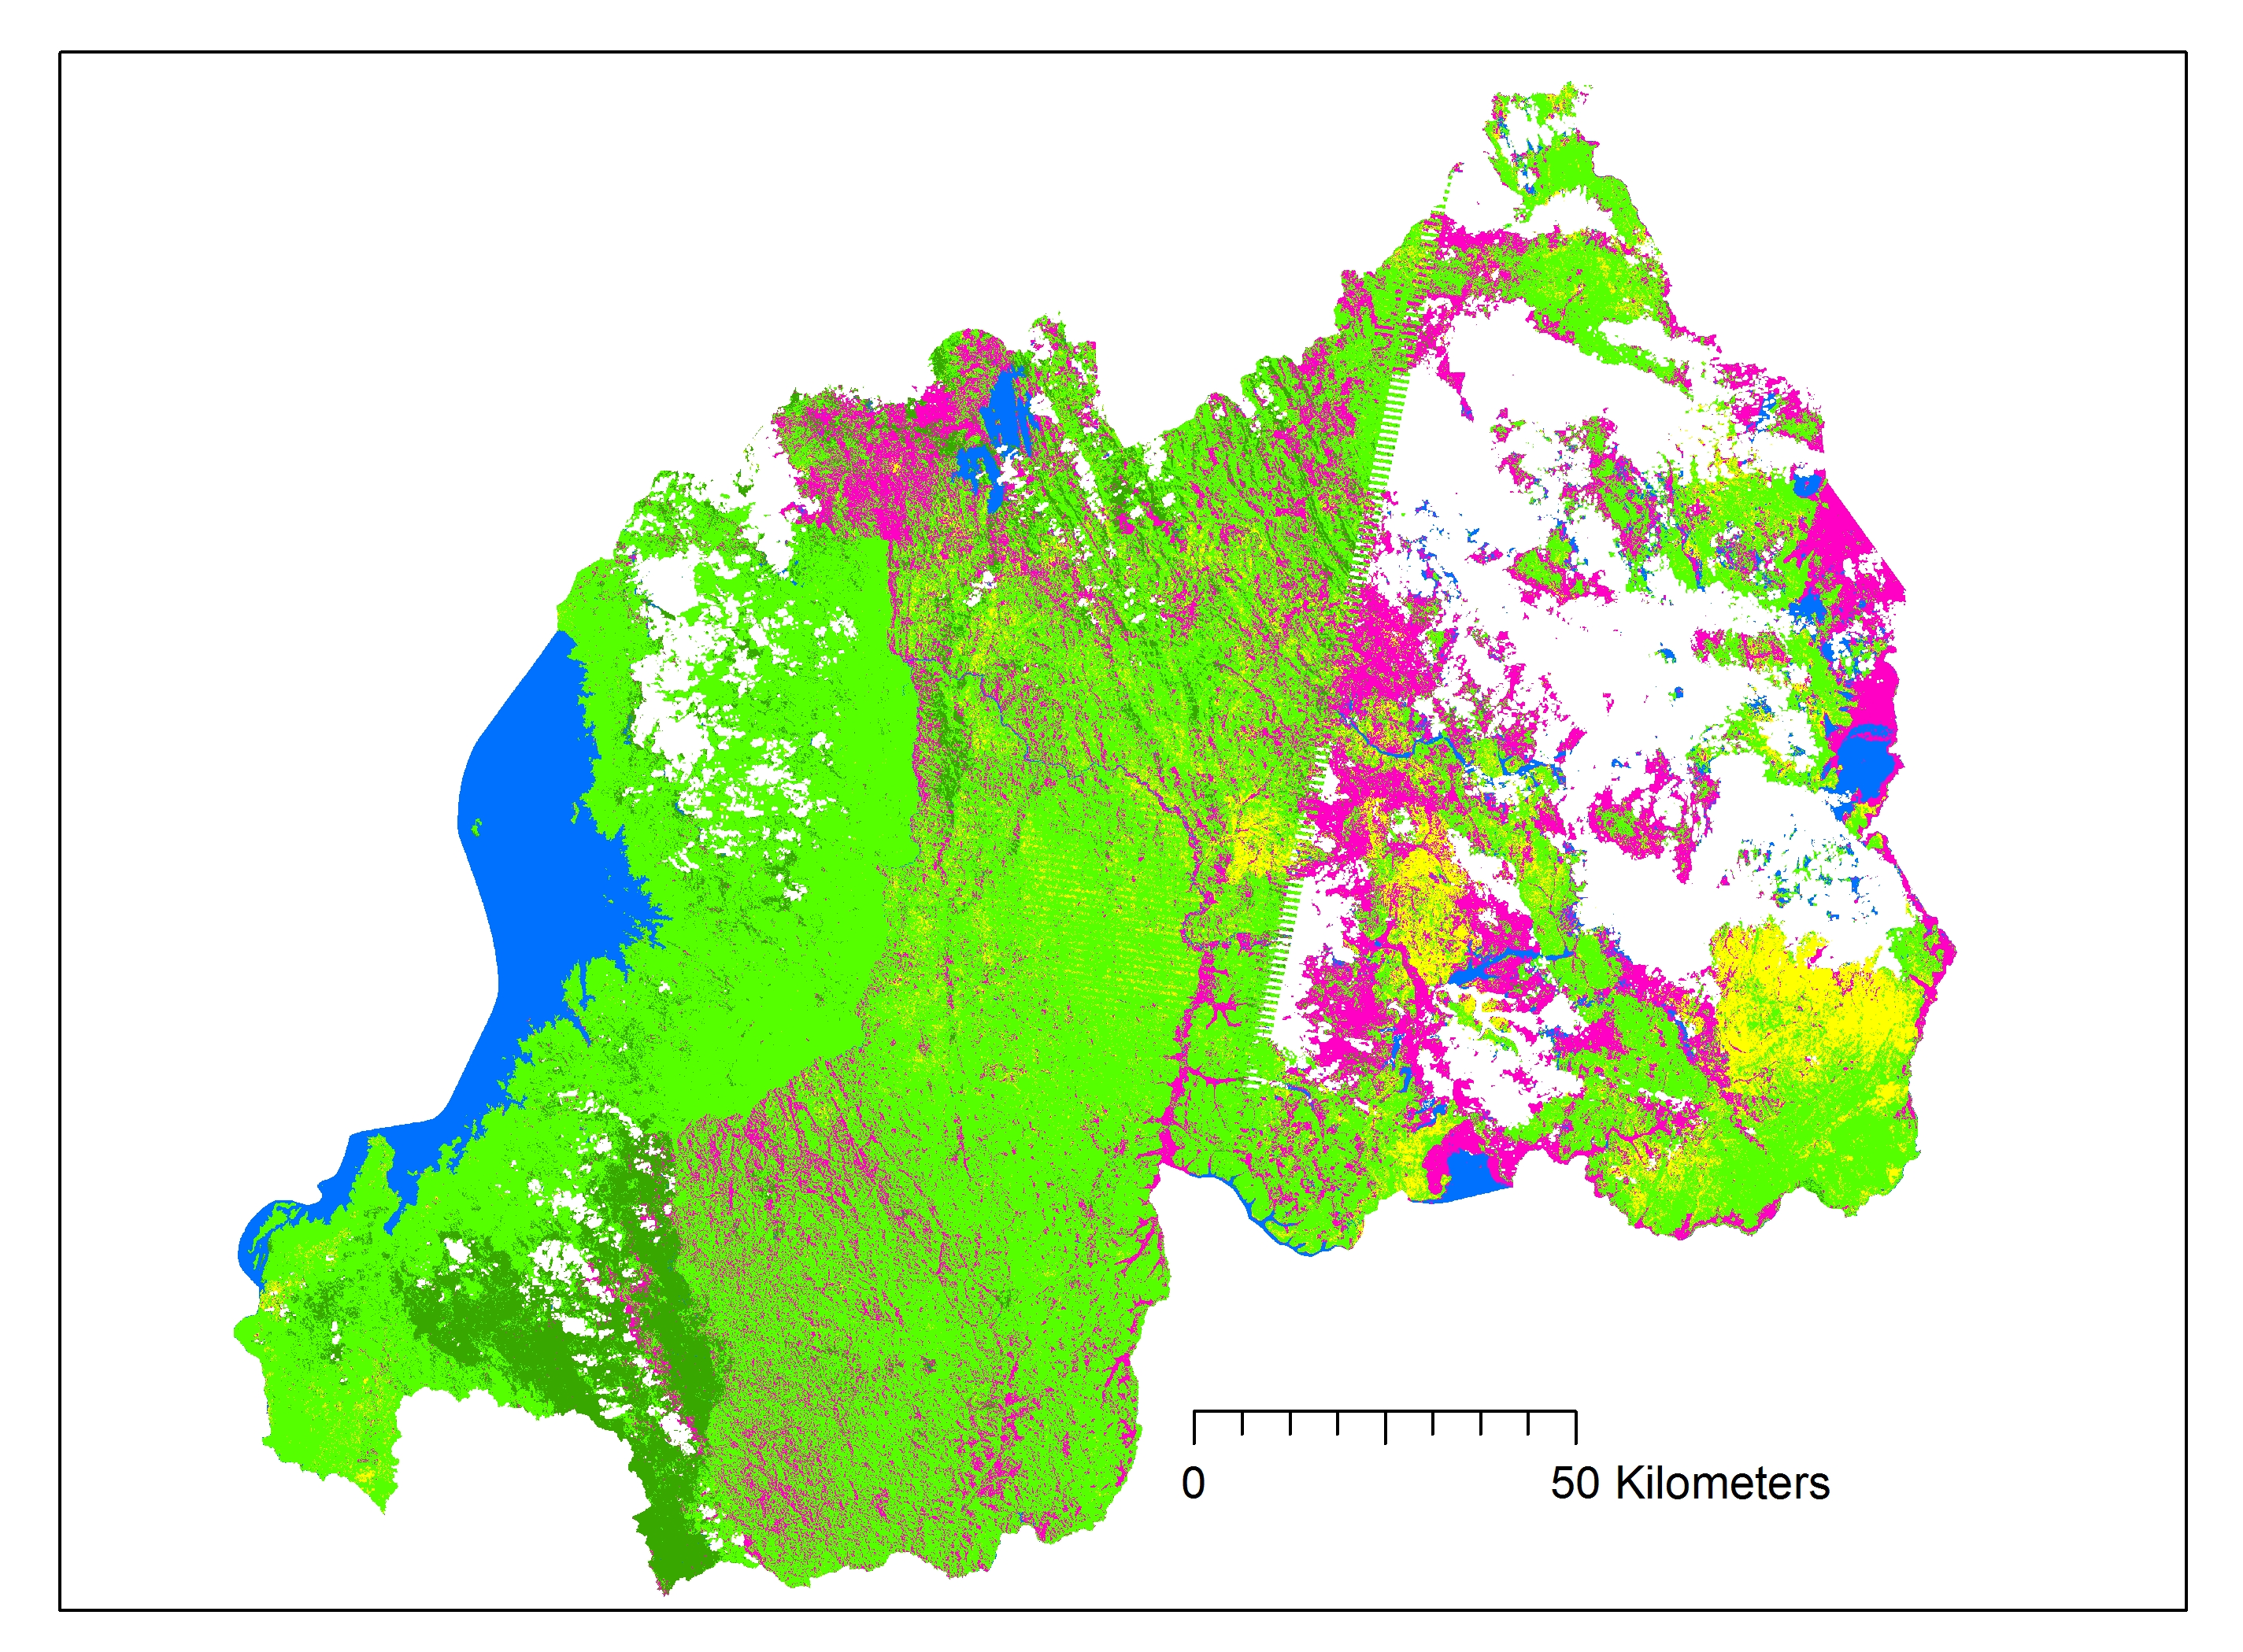
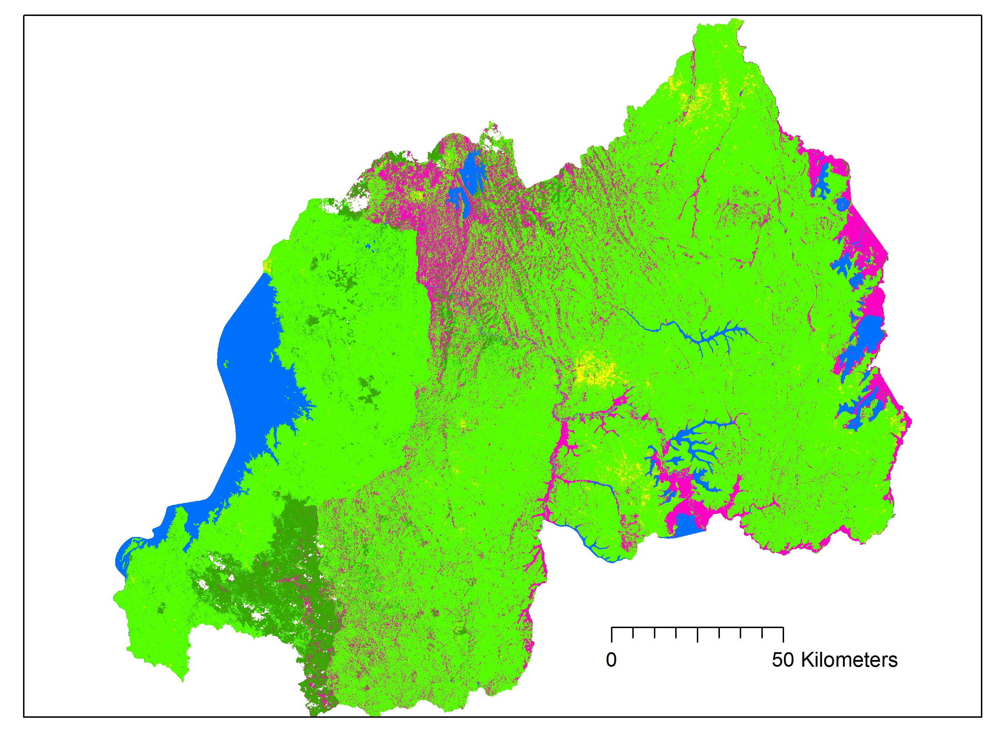
Methodology - Land Change
2008
2014
TerrSet
Land Cover Change Analysis
Land Cover Prediction-2030
Determination of High-Risk Areas
Classification
Land
Water
Developed
Forest
Wetland
Notes:
After creating the Time Series map that illustrates the extent of the wetlands over the course of a decade, we used the TerrSet program to conduct land change analysis of the wetland extent from year to year. This map allowed us to identify areas that are facing critical conversion or destruction. The final product is a land cover forecast projected through 2030, where we identified wetland areas facing extreme risk of degradation for our project partners. The objective here being to highlight areas that are in danger and require aid and protection in order to prevent destruction.
In order to create this map, we used the wetland extent time series from 2015-2016 to represent the current land cover. To create a forecast we used variables relating to development: distance to roads and population density as influencing factors in our model. This allowed us to create a forecast model that will predict land cover, in particular wetland extent, for the year 2030.

Slide 10
Results
2014
2015
2016
¯
¯
¯
Classification
Land
Water
Developed
Forest
Wetland
Notes:
Over the course of our 10 year study, the most prominent change in wetlands that was observed was in Eastern Rwanda between 2014 and 2016. The land cover maps show a decrease in wetlands particularly in the north, inland near Lake Burrea and Lake Ruhondo. However, caution must be taken in interpretation of these results as a decline over three years is not necessarily an indicator of a trend. Much of these wetlands were converted to land, specifically cropland. This goes back to our community concern in that with food insecurity within the country much of the wetlands are converted for agriculture uses to provide more food for the country.
In the maps of the western part of the country, the results were more inconclusive and hard to yield results from. This is for a variety of reasons; there are significantly less wetlands in the western part of the country and as many of these are seasonal it was difficult to obtain data. In addition, during the wetlands peak, the rainy season, they were frequently cloud covered.

Slide 11
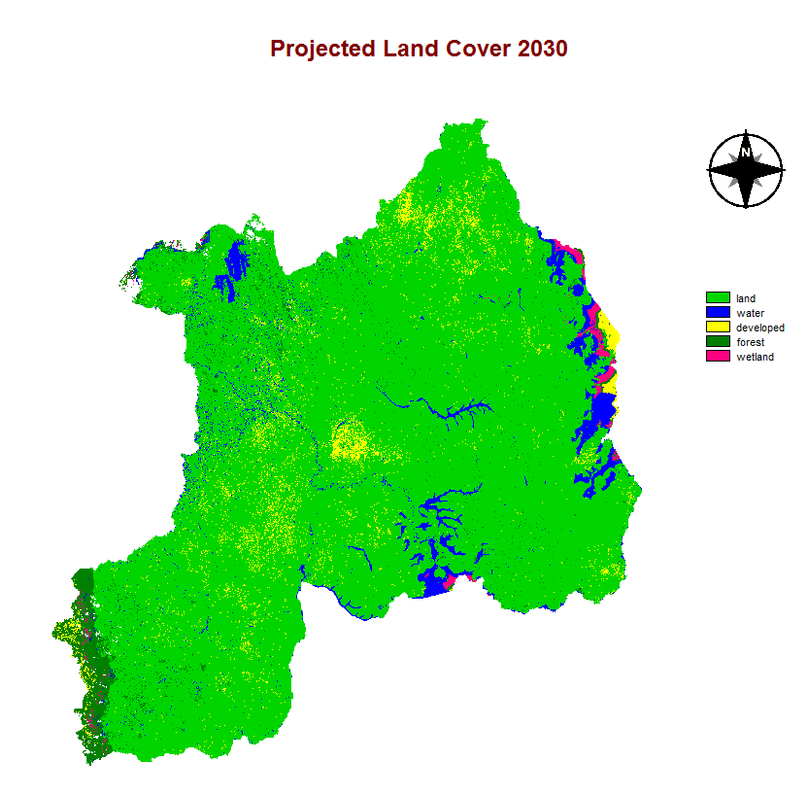
Results
Net loss of wetland extent
15,000 hectares remaining from 200,000 hectares in 2016
Causation
Population growth
Conversion from wetland to agriculture
Notes:
Our Land Cover change forecast map showed a significant decrease of wetlands specifically in the eastern edge of the country and in inland areas such as near Lake Burrea and Lake Ruhondo. The model predicated a net loss in wetland extent with only 15,000 hectares remaining from the 200,000 hectares in 2016. Currently the population growth rate is estimated to be 2.4% thus causing an increase in population by 2030. The model showed increasing urbanization in many areas where there are currently wetlands as population growth within the country would further accelerating urban development. Just as we have observed within recent years the map shows a prediction of increasing conversion to agriculture areas.

Slide 12
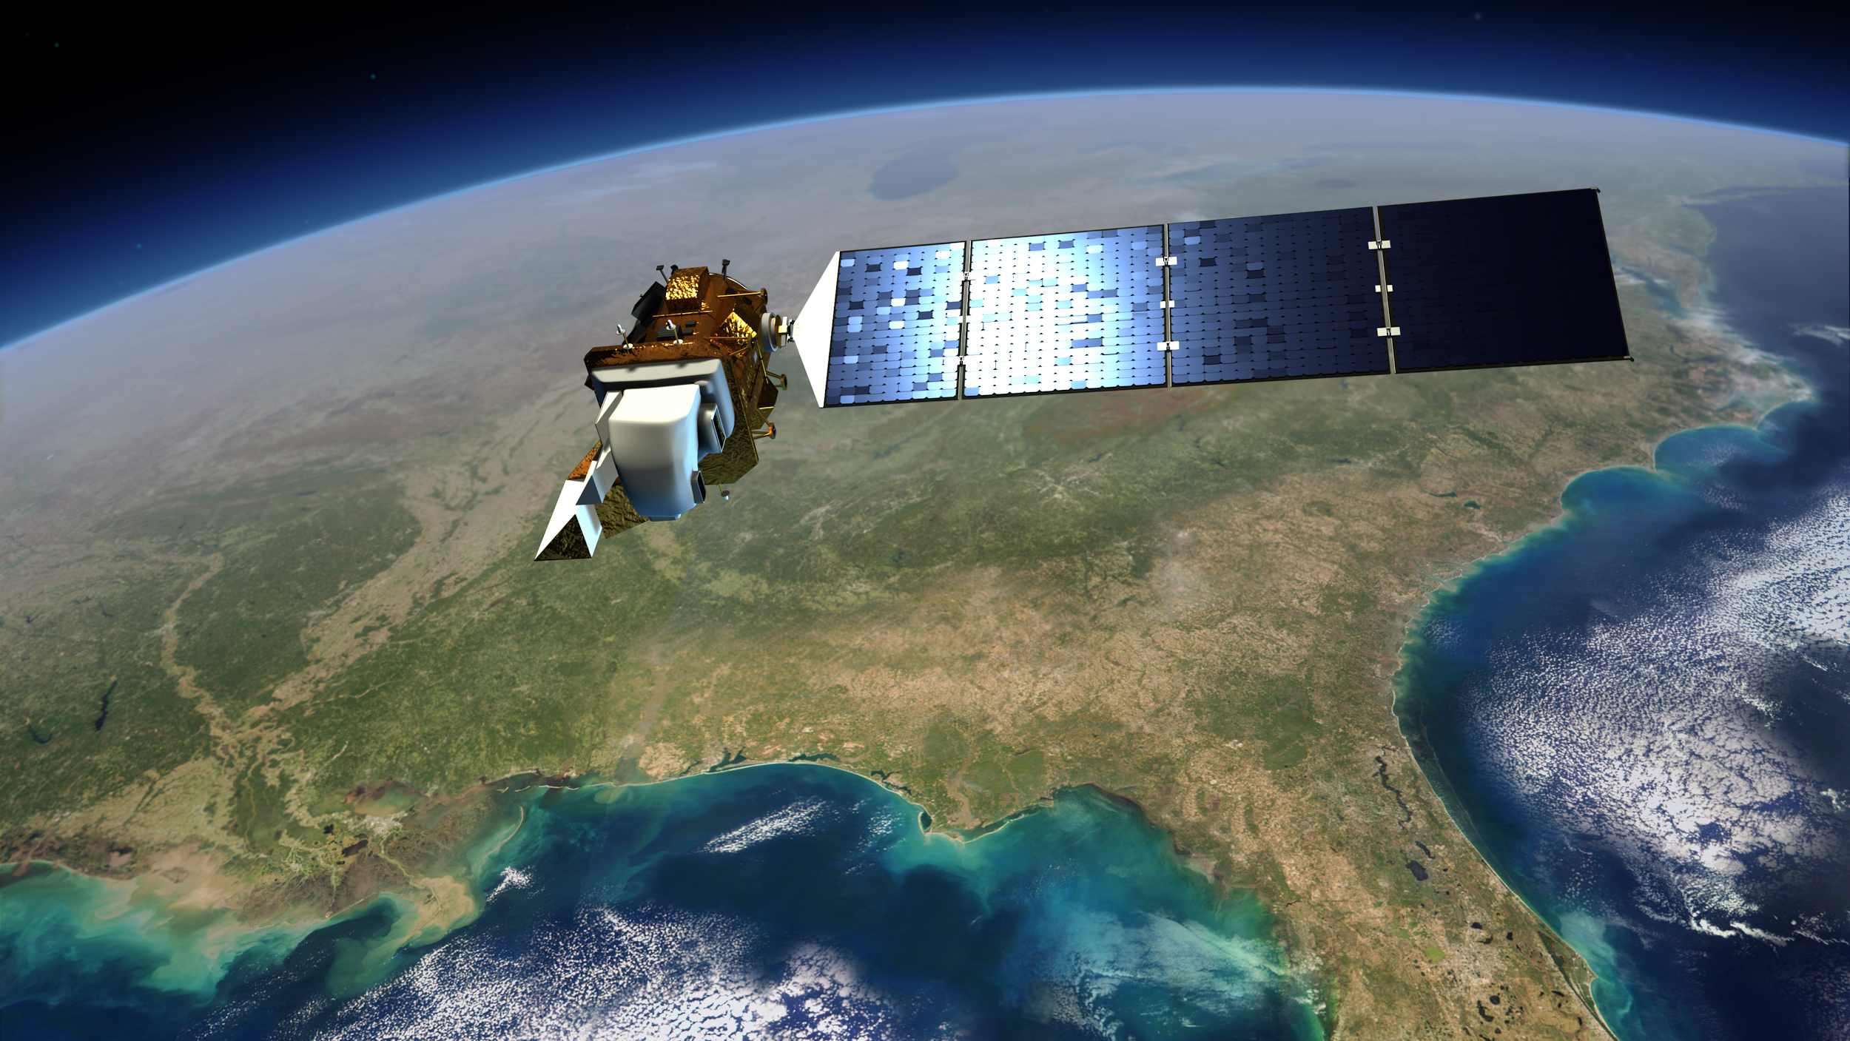
Errors and Uncertainties
Temporal/Spatial Resolution
Landsat
16 day cycle/30m
Masking clouds
Variability of signatures
Prediction Model
Image Credit: Wildtech
Notes:
Landsat 5 and 8 both have temporal resolutions of 16 day return periods. This can make it challenging to obtain a cloud free image for a given area in a study period. Clouds pose an obvious problem to our approach in that when the area is covered in clouds, we cannot draw any conclusions about the surface buried beneath. Particularly when studying wetlands because the time period that would be most useful for the wetland mapping is during the rainy season, and with that rainy season comes significant cloud cover.
Variability in signatures is significant, in fact the variability in just the two halves of the country caused both analyses to be done independently. What looks like wetlands and what appears as open land can vary immensely depending on time of year, location, and timing of recent weather events.
The projection model itself is an uncertainty, as any model would be, influencing factors could act much quicker or significantly slower than what is anticipated. Population growth in Rwanda is high, but recently has shown trends of slowing, demands for food security will likely continue to be significant throughout the near future, which does provide a threat to wetlands as they are ample sources for agricultural production. Increase aid and scientific discovery in the region could also slow the degradation of wetlands and policy is enacted protecting this valuable resources.
Image Credit: http://d1jqu7g1y74ds1.cloudfront.net/wp-content/uploads/2013/05/landsat_8.jpg

Slide 13
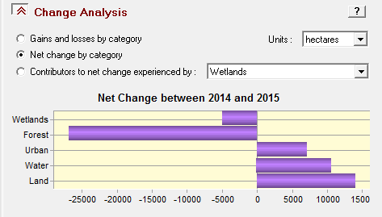
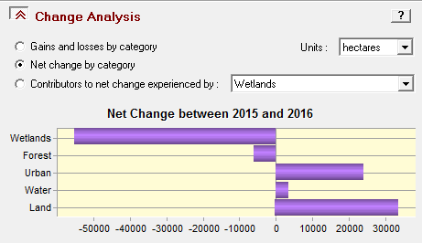
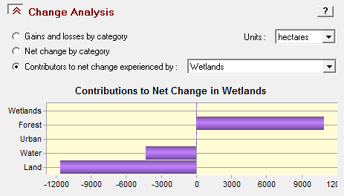
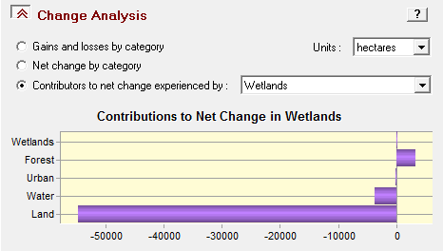
Conclusion
Trend of decreasing wetland extent
Most common conversion was to cropland
Visual classification is difficult
Cloud Cover
Temporal Resolution
Wetlands were most prominent in eastern Rwanda
Forecast indicates that wetlands most resistant to change in close proximately to large bodies of water
Notes:
Primary conclusions illustrate a noticeable trend for declining wetland extent throughout Rwanda over the course of the past 3 years, 2014-2016 in Eastern Rwanda. This is enlightening as the most common influencing factor in the degradation of wetlands was a conversion to the “land” classification. Important to note that our “land” classification includes agricultural fields and uses. This likely points to the conversion from wetlands to agricultural use as one of the primary factors for the reduction in wetland extent.
Interestingly, we also notice a decreasing trend in the “forest” classification as well. While not something we set out to discover or observe, the noticeable decline could also point to increased deforestation efforts as the population continues to grow. The conversion from “forest” to “land” was the second most common influencing factor.
Ultimately we validate the use of remote sensing as valuable methodologies for the preliminary study of wetland extent in Rwanda, but we do have cautions. Significant cloud cover during times most critical for the study is extremely detrimental. Ideally Signature Aperture Radar would be utilized to eliminate the biggest barrier to the most accurate study of the region.

Slide 14
Future Work
Utilizing SAR to more accurately map wetlands
Improving the classifier method
Incorporating a robust decision tree
Digital Elevation
Soil Moisture
Image Credit: Sevgi Ceyda
Notes:
The continuation of this project will focus on using Synthetic Aperture Radar (SAR) to more accurately map wetlands in Rwanda. During this term one of the major challenges was working with the cloud cover found over much of the wetlands in imagery acquired from the Landsat series. This was especially prominent during the rainy season. However, with SAR this will be mitigated as the SAR sensor can acquire data without regard to cloud cover.
Improved methodology for the classification would include adding factors to a decision tree that could help differentiate different kinds of wetlands and forest from the simple classification. The inclusion of DEM or Soil Moisture data could help improve these classifications immensely and provide a much more accurate current extent map for our partners with the GEO Wetlands Initiative.
Image Credit: https://sevgisairoglu.wordpress.com/2013/09/22/ngoma-eastern-province-rwanda/

Slide 15
Acknowledgements
Dr. Jeffrey Luvall – NASA Marshall Space Flight Center at NSSTC
Dr. Robert Griffin – University of Alabama in Huntsville
Emily Adams – NASA SERVIR Coordination Office
Adrian Strauch – GEO-Wetlands Initiative
Konrad Hentze – GEO-Wetlands Initiative
Jonas Franke – GEO-Wetlands Initiative
Robinson Mugo – Regional Centre for Resource Mapping for Development
Marie-Laetitia Busokeye – Rwanda Environmental Management Authority
Leigh Sinclair – University of Alabama in Huntsville/Information Technology and Systems Center
Maggi Klug – NASA DEVELOP MSFC Center Lead

