Slide 1
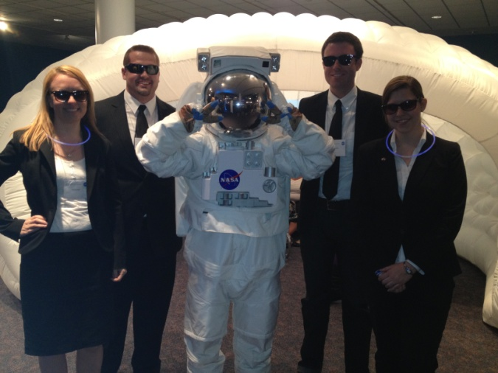
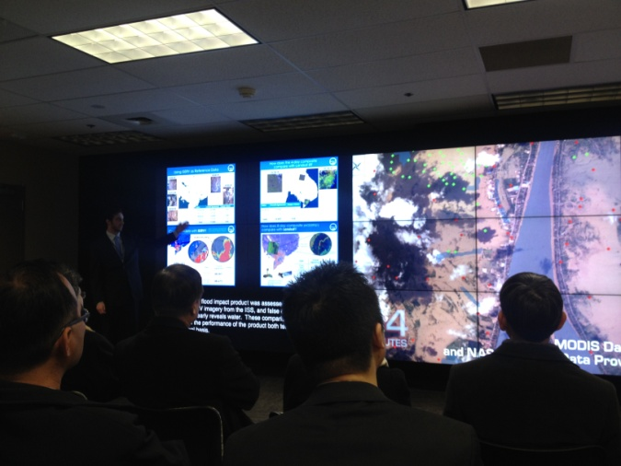
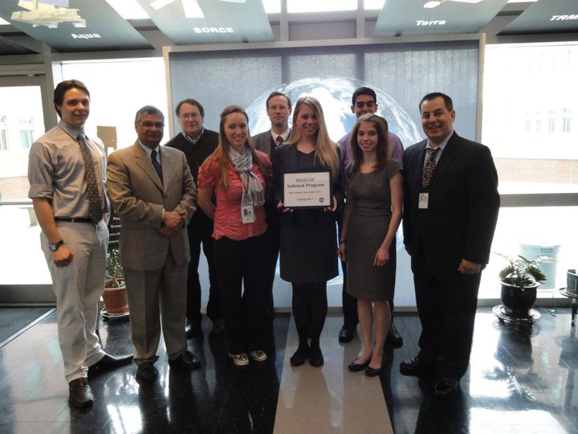
DEVELOP National Program
Participant Expectations :
General Guidelines & Best Practices

Slide 2
Handbook
Provides participants with the policies and procedures of DEVELOP, as well as an overview of NASA’s Applied Sciences & Capacity Building elements, rules of conduct, operational guidelines, information about deliverables and resources available.
Read the handbook and fill out and sign the signature pages your first day in the office. Your Center Lead will collect and return the following forms to NPO:
Statement of Understanding & Agreement
Media Release
Drug Free Work Place and Sexual Harassment
Non-disclosure Agreement
Patent, Copyright & Intellectual Property Agreement
Travelers’ Responsibility Agreement
Emergency Contact Information
The handbook is the best resource for information,
if you have a question - check there first!

Slide 3
General Guidelines & Expectations
Be on time for work!
Attend meetings and lectures as directed.
DEVELOP is a drug-free workplace.
Harassment of any type will not be tolerated.
Have an open mind. Do not discriminate; learn from people who differ from you.
Be mindful of those around you, your actions and other’s property - you represent the DEVELOP Program and your team’s location.
ALL research is the property of DEVELOP.
You must have permission from your Center Lead and NPO BEFORE submitting or presenting your project anywhere.
Be flexible, changes will occur! Learn to expect the unexpected!

Slide 4
Individual Responsibilities
DEVELOP participants are expected to follow rules and regulations of their team’s location, their sponsoring grant organization, and DEVELOP.
Respect yourself, everyone else, and property belonging to other people. Do not steal or damage materials.
Demonstrate integrity. Never plagiarize; it is punishable by law.
Act fairly and promote harmony in the work place by showing common courtesy to other participants.
Encourage a positive working environment; profanity and lewdness are not permitted.
The nature of the DEVELOP Program necessitates that each participant be willing to accept tasks that arise unexpectedly.
Maintain a positive attitude. A person’s productivity is directly affected by the attitudes of the people around them, so striving for a positive outlook in the work place is of the utmost importance.
Abide by the dress code
Have fun and learn! ☺

Slide 5
Expectations
DEVELOPers embody the DEVELOP core values: collaboration, innovation, passion and discovery
Be strategic – identify objectives, help where you are needed, identify potential solutions and paths forward
Collaboration is key – each team will work together cohesively and support each other
Flexibility– be able to adapt, accept that change will happen, be nimble & open-minded
Innovation – look for innovative solutions and ideas, try new things, make positive changes, envision future achievement
Pay attention to detail – strive for the highest quality
Don’t give up! Keep at it. DEVELOPers never say die.

Slide 6
Professionalism
DEVELOP’s signature is based on professionalism & collaboration
Professionalism: “the conduct, aims, or qualities that characterize or mark a profession or a professional person”
DEVELOP is an opportunity for all participants to improve in their professionalism!
Appearance
Demeanor
Reliability
Competence
Ethics
Poise
Organizational Skills
Written Correspondence
Phone Etiquette
Accountability

Slide 7
Professionalism & Dress Code
Business Casual:
Pants: Khakis or slacks
Skirts: Appropriate business skirts at/near knee length
Dresses: Appropriate length (at/near knee) dresses, no spaghetti straps
Shirt: Collared shirts, polo shirts, blouses, sweaters
Shoes: Dress shoes (no sandals, no sneakers, no flip flops)
Accessories & Make Up: Be conservative
Formal Presentations:
Formal Suits (Dark Colored - Black, Navy, Gray) & Dress Shoes
Dress Code Don’ts:
Jeans, tennis/running shoes (except on designated days)
Pants that droop and display underwear
Shorts
Shirks shorter than 3 inches above the knee when seated
Halter tops or exposed midriffs
Revealing, too tight clothing
Shirt straps narrower than 2 inches wide
Sweat pants, sweatshirts, T-shirts
Attire with vulgar, violent or explicit language or images
Multiple body piercings, hats, bandanas, etc.
No flip-flops of any kind
Unkempt attire

Slide 8
Travel
Any travel funded by the DEVELOP Program will be coordinated and originate through the DEVELOP NPO.
Travel is a privilege and the program does it’s best to provide opportunities to present DEVELOP work and engage with partners when appropriate and resources and timing allow.
Travel Process:
DEVELEOPer identifies a conference or meeting they are interested in attending
Talk to the Center Lead about the opportunity, if they approve of the opportunity then they will work with you to submit a request to NPO (includes description, attendee info, justification for travel, cost estimate – if applicable)
NPO will assess merit of the event and funds available
If NPO approves the travel, NPO will input the traveler and event into the NASA Conference Tracking System to gain agency approval
Once agency approvals are received, travel requests must be submitted for the travel to be approved by the funding contract
Once funding organizations approve, travel arrangements (if needed) will be made by NPO and reimbursements will be processed upon the travelers’ return

Slide 9
Reapplication & Eligibility
Participants:
Term: 10-weeks
Classifications: 1) Currently enrolled, 2) Recent Graduate, 3) Early or Transitioning Career Professional
Eligibility Requirements: 18+, able to provide personal transportation to and from DEVELOP location, strong interest in Earth science and remote sensing, U.S. citizenship is required to apply to DEVELOP locations at NASA Centers
Reapplication Eligibility:
Currently Enrolled: as long as enrolled
Recent Graduates: within two years of graduation
Early/Transitioning Career Professionals: not a current student or within 2 years of previous graduation
Center Leads & Fellows:
Term: One year award (renewable for up to two years) for Center Lead, One year award for Fellow (not renewable)
Eligibility Requirements: minimum 3.0 GPA, participation in at least one term with DEVELOP (two or more terms preferable), US Citizenship, ability to begin in September (Fellows)
Reapplication Eligibility: Fellow positions are a one time opportunity, but Fellows & Center Leads can apply for Center Lead or Senior Fellow position, or reapply as a participant
Senior Fellows:
Term: One year award (renewable for up to three years)
Eligibility Requirements: college graduate, previous DEVELOP Fellow or Center Leadership, U.S. citizenship required
Reapplication Eligibility: up to three years reapplying as a Senior Fellow

Slide 10
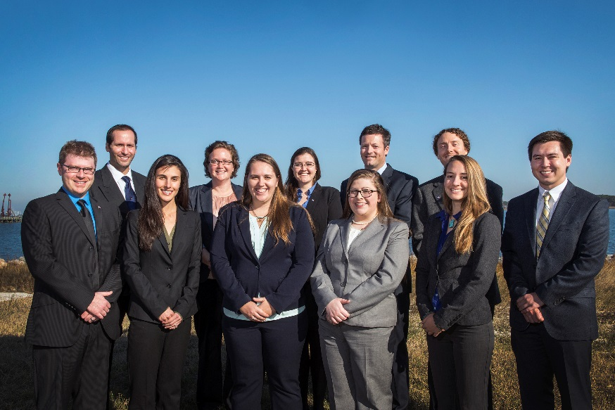
Center Leads
What is a DEVELOP Center Lead?
The Center Lead (CL) is an integral piece of the leadership team in the DEVELOP model. The people who assume this role are responsible for managing the majority of the day-to-day operations at their individual nodes, providing guidance and direction to their teams, and supporting strategic planning for their node and the program as a whole.
Center Lead Term: One year
Eligibility Requirements:
Minimum 3.0 GPA, cumulative or most recent semester
Participation in at least one term with DEVELOP (two or more terms preferable)
Ability to work 20-40 hours per week
U.S. Citizenship
Limited to two terms

Slide 11
Cell Phone Usage
Ringers should be set to silent or vibrate during work hours
Cell phone usage should be kept to a minimum, including texting
Personal phone calls should be made during lunch or before/after work

Slide 12
Use of Government Equipment (@NASA)
US Government computers are for authorized users only
It is NASA's policy to permit limited personal use of Government office equipment, including information technology (IT)
The limited personal use of Government office equipment by NASA employees and contractors shall not interfere with official business, violate existing laws, and should involve only minimal additional expense to the Government
Unauthorized use of the computer accounts and computer resources to which you are granted access is a violation of Federal Law; constitutes theft; and is punishable by law
Misuse of assigned accounts and accessing others' accounts without authorization is strictly forbidden
Failure to abide by these provisions may constitute grounds for termination of access privileges, administrative action, as well as civil or criminal prosecution
NASA 2540.1G & NPR 2810.1A: http://insidenasa.nasa.gov/ocio/policy/policy_direct/index.html

Slide 13
Privacy
Expect NO privacy when using a government computer.
Strict computer use policy in effect - every keystroke is stored, every NASA email is public domain.
NASA Policy:
NASA employees and contractors do not have a right to expect privacy while using Government office equipment at any time, including accessing the Internet and using email.
The Government maintains call details and network access records to monitor telephone activity and Internet access.
The Government also employs monitoring tools to track system performance and improper usage.
This applies to those emailing a NASA email as well.
NASA 2540.1G & NPR 2810.1A: http://insidenasa.nasa.gov/ocio/policy/policy_direct/index.html

Slide 14
Computer Usage
Online Policies:
Used for official purposes only, meaning absolutely no games, commercial radio or music/video downloads.
No Facebook, Twitter, etc. unless it’s for DEVELOP purposes!
Due to center-wide bandwidth considerations, streaming audio and video are prohibited unless for official business (project related is ok).
Limited personal emails are acceptable as long as they do not interfere with work.
Be mindful of the websites you visit and links you click on.
Be aware and careful of phishing attempts.
Software:
Installation of legally licensed software is permitted if the software is necessary to complete your project - but you must have approval from your Center Lead.
Do not make copies of proprietary software.
If you have questions regarding permissibility of software, please contact your Center Lead or IT Fellow.

Slide 15
Social Media
DEVELOP National Program: features projects, node highlights & accomplishments, VPS announcements www.facebook.com/developnationalprogram
Once a DEVELOPer, Always a DEVELOPer: job posts
https://www.facebook.com/groups/387243741376125/
Articles & Important Events: Tweet @NASA_DEVELOP or #NASADEVELOP
http://twitter.com/#!/nasa_develop
NASA DEVELOP National Program:
VPS and promotional videos www.youtube.com/user/NASADEVELOP
NASA DEVELOP National Program: features projects, node highlights & accomplishments, and VPS announcements
https://plus.google.com/+NASADEVELOP
NASA DEVELOP National Program: job posts, job skills & tips, and important events. This is a private group! Follow the link to join!
www.linkedin.com/groups/4343498
Watch time spent on social media. If you are going to be on there you
should probably be on the DEVELOP pages writing nice things!

Slide 16
Communication
The Project Lead is the main point of contact to science advisors and project end-users/contacts
Emails
Telephone calls
Meetings
Each team has access to a phone. If the phone rings, answer it with something like “DEVELOP Program, this is <name>. How may I help you?”
Emails relating to DEVELOP business or to NASA personnel must be approved by your Center Lead or DEVELOP NPO before they are sent outside of DEVELOP
CC the Center Leads when sending project related emails
Take advantage of - and seek out - opportunities!
Remember, your experience is what YOU make of it!

Slide 17
Payments & Taxes
Participants are paid on a step scale based on education level
In order for a participant to qualify for the next step pay rate, the individual must be currently taking classes or graduated at that grade level
Example, a participant who finishes their sophomore year in the spring is only eligible to move to the next pay step in the fall once he/she begins taking junior level classes
Taxes are NOT withheld from participants’ consulting checks
It is the participant’s responsibility to pay any taxes if and when they are due, so it is wise to familiarize yourself with IRS and state specific guidelines regarding independent consultants and consult a tax specialist regarding your tax situation.
One exception: Foreign nationals who are from countries that do not have a tax treaty with the United States will see an automatic 30% of their payment withheld by their funding organization and sent to the IRS.
To see which countries have tax treaties with the US visit this website - www.irs.gov/publications/p519/ar02.html#en_US_2013_publink1000222821.

Slide 18
Dealing w/Personnel Issues
Things will arise!
#1 – don’t put anything in writing. Should a personnel issue arise, immediately and verbally communicate the situation up the chain
Do not send emails about the situation - remember that NASA emails are NOT private
Maintain a positive work environment where participants feel comfortable coming to you with issues they are having with other DEVELOPers
If someone up the chain is the issue, skip that link in the chain
If you need counseling for how to respond to a specific situation talk to NPO
SSAI Rep: Karen Allsbrook
Wise Rep:
Lauren Childs-Gleason
NPO
Center Lead
Project Lead
Team Member

Slide 19
Participant Reporting
Participant Info Sheet
This is a spreadsheet used to maintain accurate participant records & report demographic stats about program (e.g. diversity, education).
Personal Growth Assessments
These are two online assessments (entrance & exit) that collect information relating to participant skill levels and expectations, which help to gather the impact of DEVELOP, and provide valuable feedback to nodes and the program.
Entrance Assessment - week 1
Exit Assessment - week 9
Exit Survey
This is an anonymous online survey that we ask all participants to take. It is DEVELOP’s performance review and allows for a national perspective on the program, leadership, and advisors. It helps DEVELOP evolve and improve, and we value your input greatly!
Link emailed - week 10
Performance Reviews
DEVELOP’s main objective is to assist participants in developing both professionally and personally. Part of this process is giving feedback in performance reviews at the middle and end of the term. Please consider this process constructive and take any feedback as goals for improvement.
Midterm Review - typically weeks 5 or 6
End of Term Review - typically weeks 9 or 10

Slide 20
Annual Alumni Survey
A recent development for the program has been the establishment of an annual survey to assess the impact of DEVELOP, enhance the network of alumni engaged with the program, and assess the career fields that participants progress into. DEVELOP looks forward to surveying you in the near future!
Before you leave this term, please make sure that DEVELOP has the best email address to reach you. The survey goes out every June.
The Alumni Survey Provides:
Metrics for reporting to NASA HQ
Indicators for DEVELOP’s Results Framework
“Success Stories” for newsletters and other highlight activities
Method for signing up to receive The DEVELOPer Newsletter
Information to invite alumni to special events

Slide 21
Tips For Success
Be flexible
Stay organized
Have an open mind and a positive attitude
Know when things are due
Keep track of files
Be ready to present what you are doing at the drop of a hat
Two heads are always better than one - collaborate!
Go above and beyond
Get to know your team
Network Network Network - it’s all about who you know
Use this opportunity to build up your resume with new skills
“Whether you think you can or whether you think you can't, you're right.”
-- Henry Ford --

Slide 22
Important Things To Note
Earth observations and Earth science data are objective, transparent, and policy-neutral. NASA Earth Science doesn’t develop or prescribe policy. Other agencies and organizations use the data and scientific results in their policy analysis and development.
DEVELOP IS part of NASA’s Applied Sciences Program. DEVELOP is NOT part of NASA’s Office of Education
NASA’s internships and educational activities have been consolidated or eliminated – DEVELOP is not part of that consolidation.
DEVELOP is very different from NASA’s internship opportunities in the way we approach projects, focus on teamwork, the level of responsibility and authority given to participants, the opportunities we provide, and the individuals and organizations we network with. Enjoy it while you are here!
NASA restricted travel under sequestration, meaning that new guidelines are in place to gain approval for travel. Travel is a privilege!

Slide 23
THANK YOU!
Have a Great Term!

