Slide 1
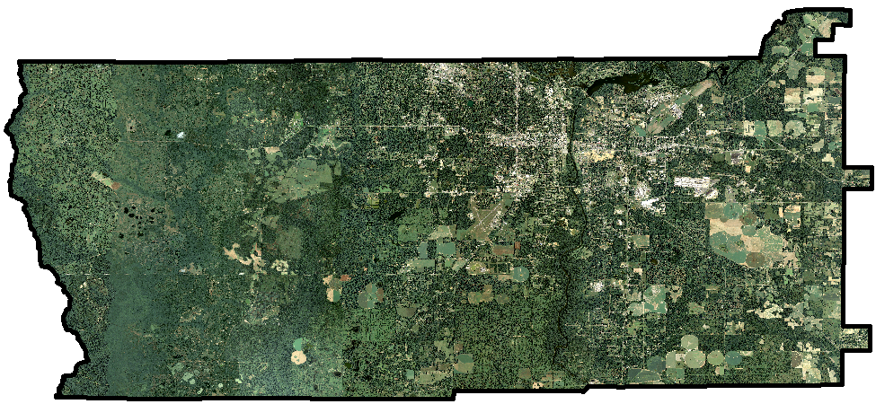
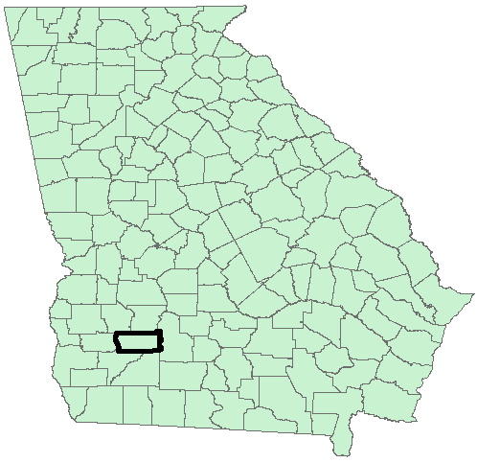
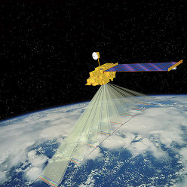
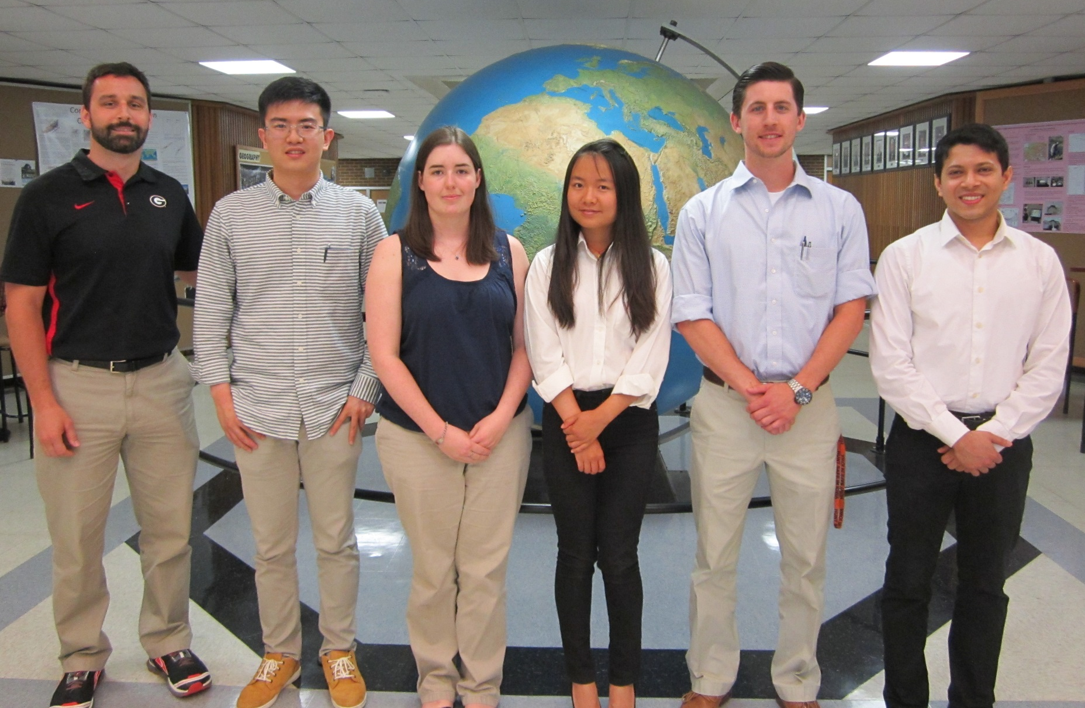
Georgia Disasters and Water Resources
Utilizing NASA Earth Observations to Monitor Sinkhole Development and Identify Risk Areas in Dougherty County, GA
Matthew Cahalan (Project Lead), Kimberly Berry, Wenjing Xu, Tunan Hu, Mohamed Amin, and Dr. Adam Milewski (Science Advisor)
NASA DEVELOP University of Georgia
Abstract
Objectives
Generate sinkhole inventory maps between 1999 – 2011 for Dougherty County, Georgia using an automated sinkhole detection algorithm developed by the team
Produce a sinkhole susceptibility map to aid in land use decisions, infrastructure development, and water resource management
Analyze the factors influencing the spatiotemporal distribution of sinkholes to improve the predictive capabilities for future sinkhole development
Methodology
Study Area
DEM Data download
Sinkhole Mapping
Sinkhole Formation Factor Analysis
Independent Variables:
Overburden thickness
Land use type
Land use change
Distance to fractures
Distance to streams
Distance to wetlands
Distance to ponds
Distance to roads
Elevation
Slope
Aspect
Aquifer fluctuations
Albany
NASA SRTM NASA ASTER
ERS-1 and 2
ArcGIS ModelBuilder Algorithm
Geographically Weighted Regression
Validation
Earth Observations
Temporal Difference Maps
Sinkhole Density Maps
Sinkhole Susceptibility Map
Terra ASTER 2011 DEM
SRTM 2000 DEM
Results
Conclusions
Use images.
Make sure that it has some sort of flow, that it makes sense. Show your results in a logical order.
No bullets.
Use bullets.
Use complete sentences with periods.
Team Members
Project Partners
Acknowledgements
City of Albany and Dougherty County Planning and Development Services
Southwest Georgia Water Resources Task Force
We would like to extend our appreciation to the NASA DEVELOP National Program Office and the entire DEVELOP community for supporting this project.
We would like to acknowledge our main contacts from our partner organizations, Paul Forgey and Randy Weathersby.
We would like to thank Jim Stolze for allowing us access to the Albany Municipalities’ well field to survey sinkholes, enhance our validation techniques, and gather footage for the team’s VPS.
From left to right: Dr. Adam Milewski (Science Advisor), Tunan Hu, Kimberly Berry, Wenjing Xu, Matthew Cahalan, and Mohamed Amin
University of Georgia

