Slide 1
Virginia Water Resources
Utilizing NASA Earth Observations to Monitor Extent of Harmful Algal Blooms in Virginia Rivers
Cassandra Morgan (Project Lead)
Sara Lubkin

Slide 2
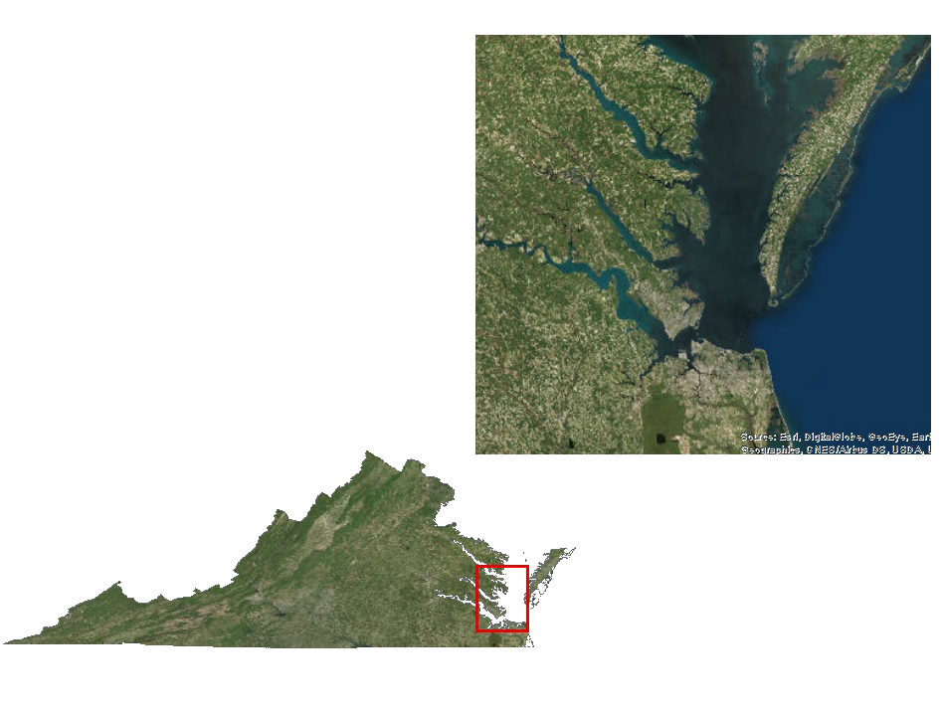
Study Area & Period
May - October
2011 - 2015
Notes:
Our study area included the Lower Chesapeake Bay in Virginia, including the Lower James River, Lower York River, Elizabeth River, Mobjack Bay, Chesapeake Bay
Imagery: ESRI Aerial

Slide 3
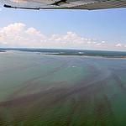
Objectives
Create tools that will allow partners to easily process Landsat 8 OLI/TIRS data to show chlorophyll estimates at 30 meter resolution
Identify potential sampling locations based on estimated chlorophyll concentrations
Provide a more comprehensive overview of Harmful Algal Bloom activity in the Chesapeake Bay Watershed
Photos by: Dr. Kim Reece, VIMS
Notes:
The objective of this project is to provide imagery that indicate probable locations of harmful algal blooms (HABs) in Virginia rivers (James, York, Elizabeth), the Mobjack Bay (Mathews, Va), and the Chesapeake Bay. Maps that combine historical in-situ data collected by VIMS and ODU with MODIS and Landsat satellite data will provide a more complete overview of HAB activity that will benefit our partner organizations both in terms of immediate tracking and monitoring of HABs and in the long term protection of water quality in the Chesapeake Bay watershed.
https://www.flickr.com/photos/vims_photos/7691291198/in/album-72157630853932606/
https://www.flickr.com/photos/vims_photos/7692285188/in/album-72157630853932606/
https://www.flickr.com/photos/vims_photos/7691292052/in/album-72157630853932606/
Guinea Marshes

Slide 4
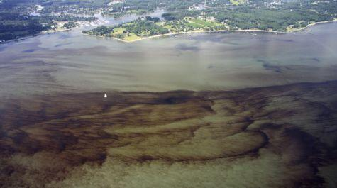
Community Concern
HABs (Cochlodinium polykrikoides and Alexandrium monilatum):
aAre becoming increasingly common in Virginia Rivers
r Reduce oxygen in water and produce toxins, which kill fish and may cause human illness
hHave negative economic impact on Virginia fisheries, as well as the tourist industry
York River, August 2013 Photo by Dr. Wolfgang Vogelbein
Notes:
HABs are becoming increasingly common in Virginia Rivers. Blooms of Alexandrium monilatum, a dinoflagellate not found north of Florida in the past, are now a regular occurrence.
HABs reduce oxygen in water and produce toxins, which kill fish and may cause human illness.
HABs have a negative economic impact on Virginia fisheries, as well as the tourist industry
Photo: http://www.vims.edu/newsandevents/_photosets/hab_2013/york_river_475.jpg

Slide 5
NASA Satellite/Sensors
Landsat 8
Operational Land Imager (OLI)
Aqua (MODIS)
Moderate Resolution Imaging Spectroradiometer
Notes:
http://landsat.gsfc.nasa.gov/wp-content/uploads/2013/01/ldcm_2012_COL-300x168.png
http://earthobservatory.nasa.gov/Features/Water/images/aqua_satellite_render.jpg

Slide 6
Methodology
Acquisition
Processing
Processing
Landsat 8
USGS Earth Explorer
Remove land and clouds from image
Focal statistics
1.4 km Smoothed Landsat image
ArcGIS
ArcGIS
MODIS, Chlorophyll
NOAA CoastWatch
MODIS, Chlorophyll Pointfile
ArcGIS
ArcGIS
ArcGIS
VECOS Water Quality Data
Extract Landsat band values to MODIS points
Analysis
Product
Regression Equation
R software
Notes:
Too busy?

Slide 7
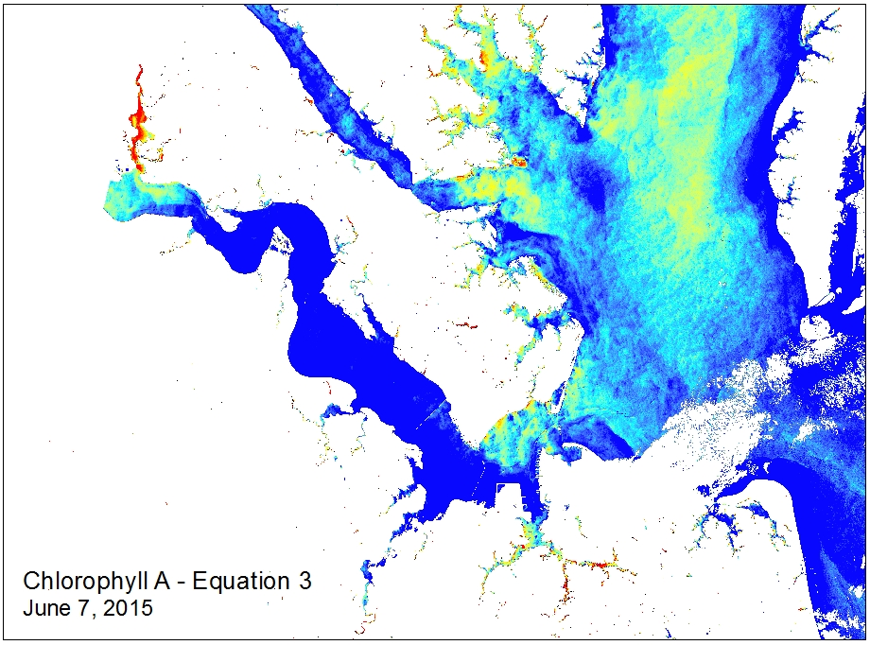
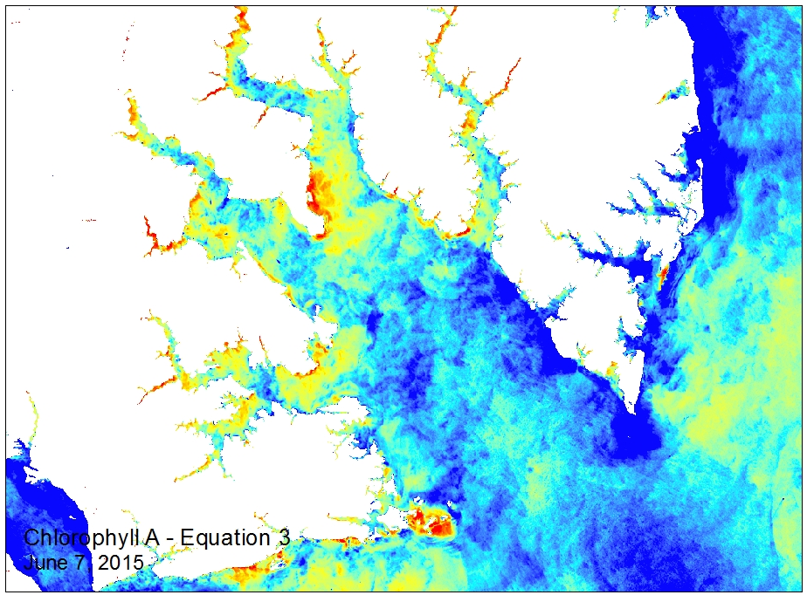
Conclusions
$$[Successful Regression will go here ∗fingers crossed∗]$$
Beautiful maps of successful regression will go here, below are placeholders – images from a model from a paper we utilized before beginning the process to create our own.
Possible graphs of chlorophyll/temperature/ sediment, etc in comparison to in situ data collected by the Hampton Roads Sanitation District.. Depends on success with regression.
Also will include final thoughts (possible 2 slides)

Slide 8
Errors & Uncertainties
To include notes about future work – depending on how far we get

Slide 9
Advisors
NASA DEVELOP National Science Advisor
Dr. Kenton Ross
Partners
Virginia Institute of Marine Science
Kim Reece, Jian Shian, Wolf Vogelbein
Virginia Department of Environmental Quality
John Kennedy, Tish Robertson, Anne Schlegal
Others
Virginia Deputy Secretary of Natural Resources for the Chesapeake Bay
Russ Baxter
Dept. of Biological Sciences, Old Dominion University
Todd Egerton
Hampton Roads Sanitation District
Will Hunley

