Slide 1
California Disasters II
A New Method for Providing Near-Real-Time Active-Fire Support to Fire Responders Using NASA’s Uninhabited Aerial Vehicle Synthetic Aperture Radar (UAVSAR)
Jerry Heo (Project Lead)
Mark Barker
Erika Higa
Christine Rains

Slide 2
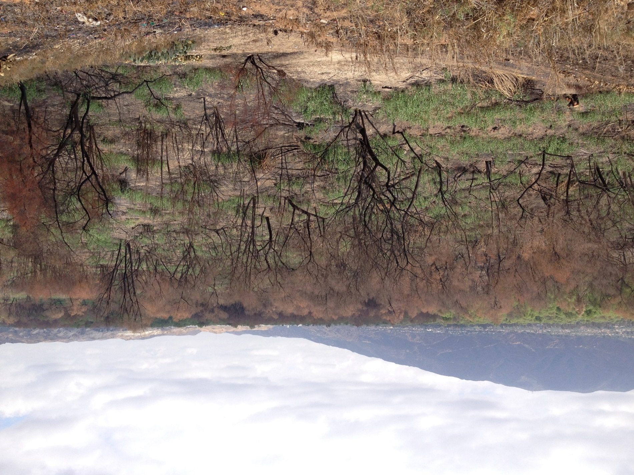
Introduction
Wildfires a familiar threat to California
Increasing in size and severity
Severe drought conditions exacerbate risk
Image Source: Jerry Heo
Notes:
Californians have always lived with the threat of wildfires, but in the past few decades, wildfires have been growing in size and severity in California due to a number of factors such as changing climate patterns, an increasing expansion of human habitats into previously wild areas, and recently the severe drought. Traditional firefighting techniques for fire suppression have also affect the vulnerability of the land to the effects of severe fires because of the buildup of dead vegetation and undergrowth which would normally be cleared out be regular fires. This is an image of the Highway fire, which occurred in Chino Hills in April 2015. [We will be talking about this fire later…maybe]

Slide 3
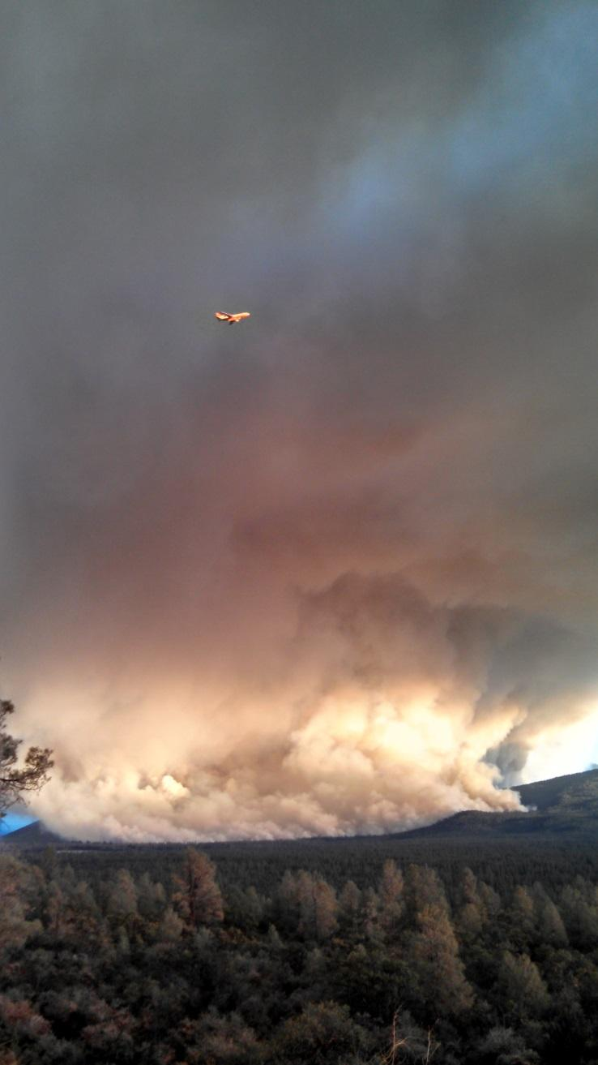
Remote Sensing and Fire Response
Obscured by clouds and smoke
Low temporal and spatial resolution (Landsat, MODIS)
Nighttime support best due to thermal infrared analyses
UAV technology poses dangers
Credit: CAL FIRE Battalion Chief Chris Waters
Notes:
Remote sensing has the capability of adding to fire responders’ ability to monitor active fires, but there have been many difficulties implementing different technologies successfully. Visual remote sensing products have are limited by the presence of clouds or smoke. The most useful remote sensing takes advantage of infrared sensors, but these can be obscured by hot smoke as well. Finding a useful platform for this kind of sensor has been difficult. Landsat has useful resolution, but is limited temporaly to 16-day intervals. MODIS products are available daily, but have resolution too coarse to be useful. The best infrared remote sensing support is the airborne NIROPs operation, but there is only one center for the entire West and the planes are limited to night. Within the fire community there is discussion of the use of UAVs, however, the regulation atmosphere makes the implementation of remote cameras (“drones”) not likely in the foreseeable future. The use of drones around active fires in prohibited because they are dangerous for tankers and other airborne support.

Slide 4
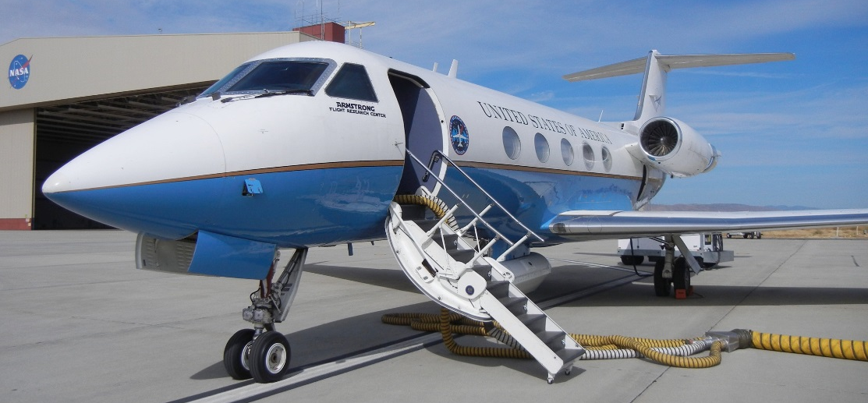
UAVSAR
Active Sensor
Day or night flights possible
High spatial resolution (5m)
Penetrates cloud and smoke
Image Source: Jerry Heo
Notes:
The Uninhabited Aerial Vehicle Synthetic Aperture Radar is perfect to help fill in the gaps in fire remote sensing. The name “UAVSAR” is somewhat of a misnomer, as the radar sensor is currently adapted for a plane—NASA’s C20-A, which flies out of Armstrong Flight Research Center. The benefits of the UAVSAR are many [read slide points]. IT also flies at a very high altitude of 40,000 ft—far above other fire-responding aircraft and even most commercial airlines.

Slide 5
Study Area
& Project Partners
U.S. Forest Service
California Department of Forestry and Fire Protection (CAL FIRE)
Notes:
This project examined wildfire case studies from 2009 to the present. We studied wildfires that burned over 300 acres throughout California. The fires were identified by seeing whether the UAVSAR flew over the wildfire’s location both before and after the fire.

Slide 6
Image Credit: Monet
Image Source: Jerry Heo
Project Objectives
Process all fire case studies from 2009 to present and provide a comprehensive list of these fires in comparison with Landsat-derived dNBR products
Capture data of fire in progress for data during a wildfire occurrence
Analyze field data and correlate it with our UAVSAR product
Provide a list of case studies to project partners and other end users as a means of using our data for future research.
Notes:
[These notes should be thorough enough for someone not familiar with the project to clearly present the material.]
Image Source: Jerry Heo

Slide 7
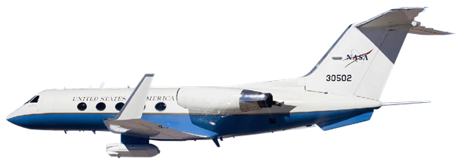
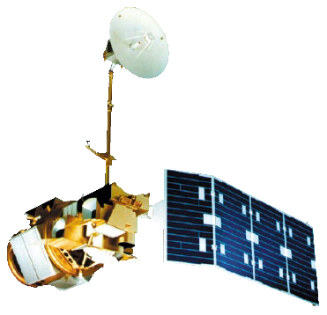
NASA Satellites & Sensors
UAVSAR on Gulfstream III
Landsat 8 OLI
Landsat 5 TM
Notes:
We used cross-polarized products from the UAVSAR instrument to generate images of fire scars, which we compared with “differenced Normalized Burn Ratio” products that we created from Landsat 5 and 8. (Landsat 7 was avoided because of the striping issue). The UAVSAR sensor and the Landsat sensor measure different quantities, but both of these can be correlated with changes in vegetation due to fire.

Slide 8
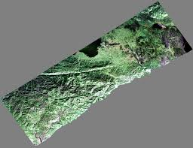
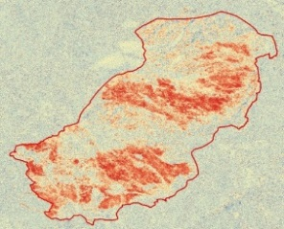
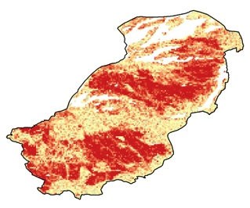
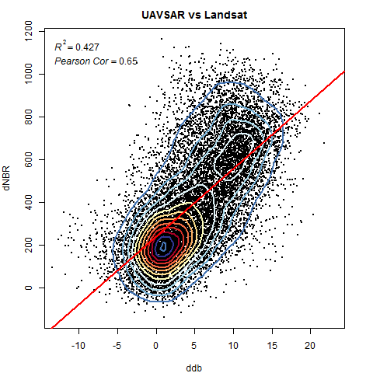
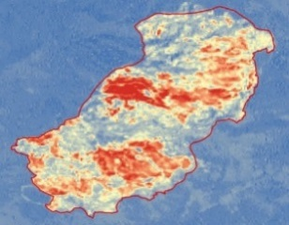
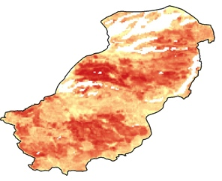
Methodology
UAVSAR
BEFORE
AFTER
dCBB Map
Slope Mask
Landsat 5 & 8
BEFORE
AFTER
dNBR Map
Slope Mask
Notes:
We developed a consistent methodology for our project last term. Once we had located fires with UAVSAR data, we also located the corresponding Landsat scenes. We downloaded both sets of data and processed them. Then we differenced them to highlight changes due to the fire. We also used some additional processing, including slope masking to get rid of slopes where the radar did not work as well, and masking to a smaller study area; [Still working on analysis: other processing includes pixel estimate tool] We then compared the two products.

Slide 9
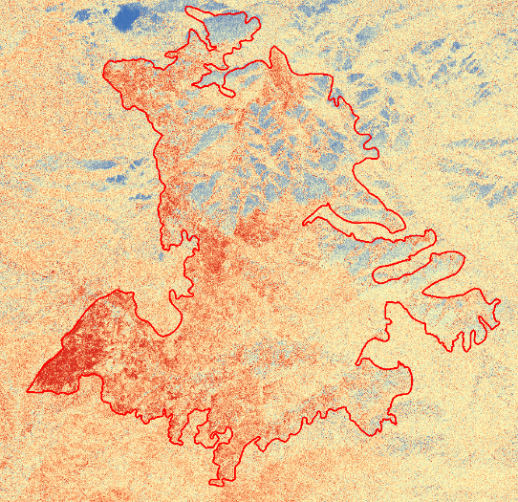
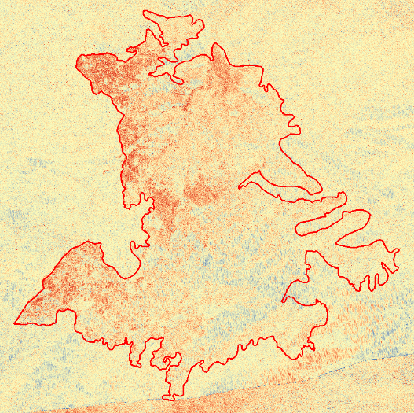
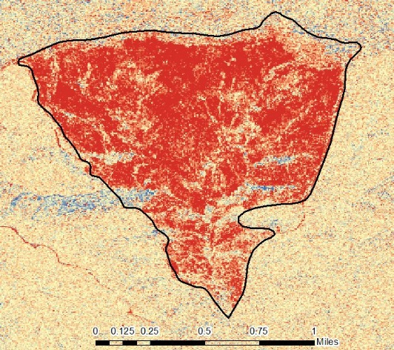
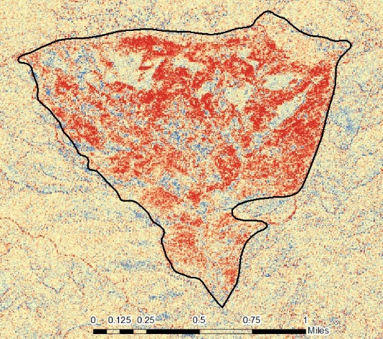
Results
*show dCBB and dNBR of few case studies
*correlation graphs
*Vegetation cover
Notes:
Note—these image are placeholders.

Slide 10
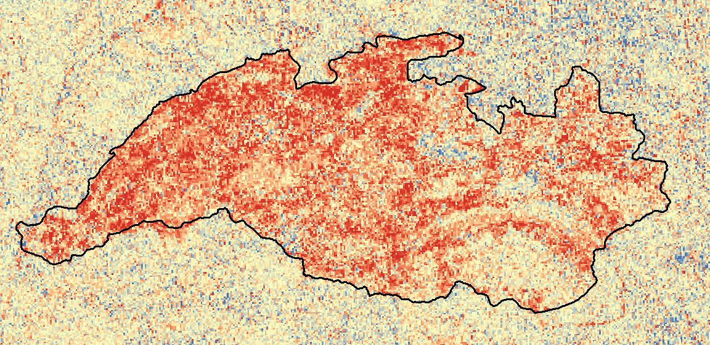
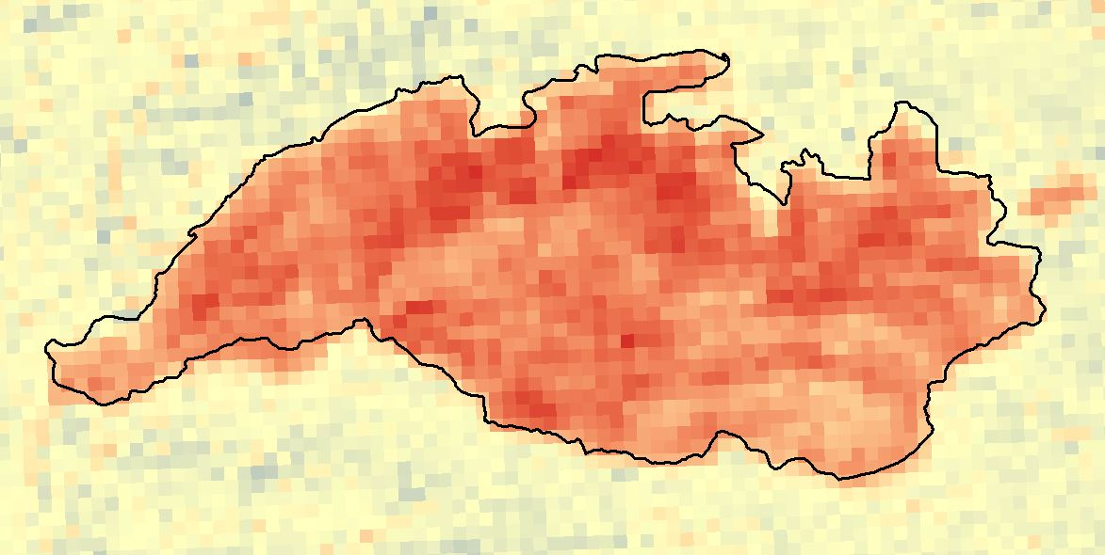
Results
*show dCBB and dNBR of few case studies
*correlation graphs
*Vegetation cover
Notes:
placeholders

Slide 11
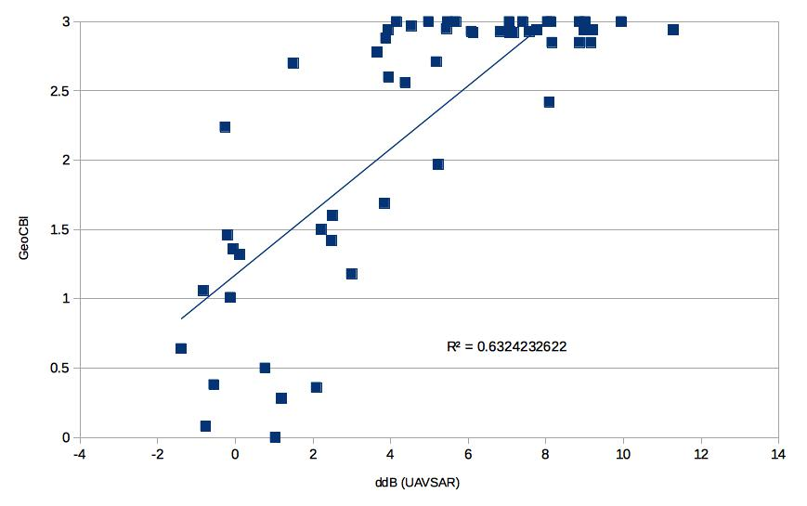
Results
*Canyon Fire
*compare to GeoCBI data
Notes:
We were able to obtain geo-located field data for one of our fires (the Canyon Fire). This graph shows the correlation between the severity measured in the field and the severity measured by the radar.

Slide 12
Conclusions
Future Work
Found that the field data acquired correlated well with the UAVSAR dCBB
Lake fire…
Community concerns
Conclusions
Errors & uncertainties
Future work
Acknowledgements
Backup slides???
Required Statement

Slide 13
Advisors
Dr. Sang-ho Yun (Jet Propulsion Laboratory)
Dr. Mark Simons (California Institute of Technology)
Brent Minchew (California Institute of Technology
Partners
Chief Chris Starnes and Chief Jana Luis, California Department of Forestry and Fire Protection (CAL FIRE)
Brad Quayle, US Forest Service Remote Sensing Activities Center
Others
Carl Albury & Lorri Peltz-Lewis (US Forest Service)
Yunling Lou, Naiara Pinto, Natasha Stavros, Tim Miller (Jet Propulsion Laboratory)
Sander Veraverbeke (UC Irvine)
Scott Nygren and Chris Wilson (Orange County Water District)
Corry Rung, Paul Viscuglia, Tim Williams, Stuart Broce, Todd Renfro (NASA Armstrong Flight Research Center)
Ben Holt and Gwen Miller (DEVELOP)

Slide 14
General Guidelines II
Header text point size should be between 40 and 60 on most slides.
Body text point size should be at least 20.
Use Century Gothic.
Keep text to a minimum.
Try to use a consistent font size between slides.
Image Credit: Monet
Notes:
Image Source: http://commons.wikimedia.org/wiki/File:Claude_Monet_-_The_Magpie_-_Google_Art_Project.jpg

Slide 15
General Guidelines I
Things that are typically included in a presentation:
The slides provided in the template are just a starting point for teams. Feel free to expand upon these topics, alter the headings, and change the order of the slides to fit your needs.
Community concerns
Errors & uncertainties
Acknowledgements
Backup slides???
Required Statement

Slide 16
Maps & Logos
Maps
Import the legend separately.
Make sure all text is legible and editable.
Cite base layer source in speaker notes.
Logos
US Federal logos only.
No state, NGO, local and or international government logos, or software logos.

Slide 17
Photos & Figures I
You may only use images taken by your team, provided by your partners (as long as you have permission from them), from a Federal Agency, from the new DEVELOP stock imagery collection on DEVELOP’s Flickr page, or Creative Commons images.
Obtain a media release form from all people in photos that your team has taken — no children!
All image sources should be cited using a consistent format and should be visible on the slide.

Slide 18
Photos & Figures II
Please do not include the image URL in the source text box but rather place it in the notes section below.
If you use a border for your images include it on all photographs to keep your presentation consistent.
Keep all images and text boxes editable, including individual elements of flowcharts.
Background images are discouraged. If you use one, make sure that your text remains clear and legible.

Slide 19
Acknowledgements
List advisors, partners, and others who have contributed in any way to the project.
If your project is a multi-term one, acknowledge past contributors.
Choose one of the two following slides as an acknowledgements page. Feel free to modify them as needed to fit your content.
Image Credit: Monet
Notes:
Image Source: http://commons.wikimedia.org/wiki/File:Claude_Monet_-_The_Magpie_-_Google_Art_Project.jpg

