Slide 1
Southern Rockies Ecological Forecasting
Using NASA Earth Observations to Identify and Predict Suitable Mule Deer Habitats
Ross Reahard (Project Lead)
Teresa Fenn
Jeri Wisman
Notes:
We are the Southern Rockies Ecological Forecasting team at John C. Stennis Space Center and our project utilized NASA Earth Observations to identify and predict suitable mule deer habitats.

Slide 2
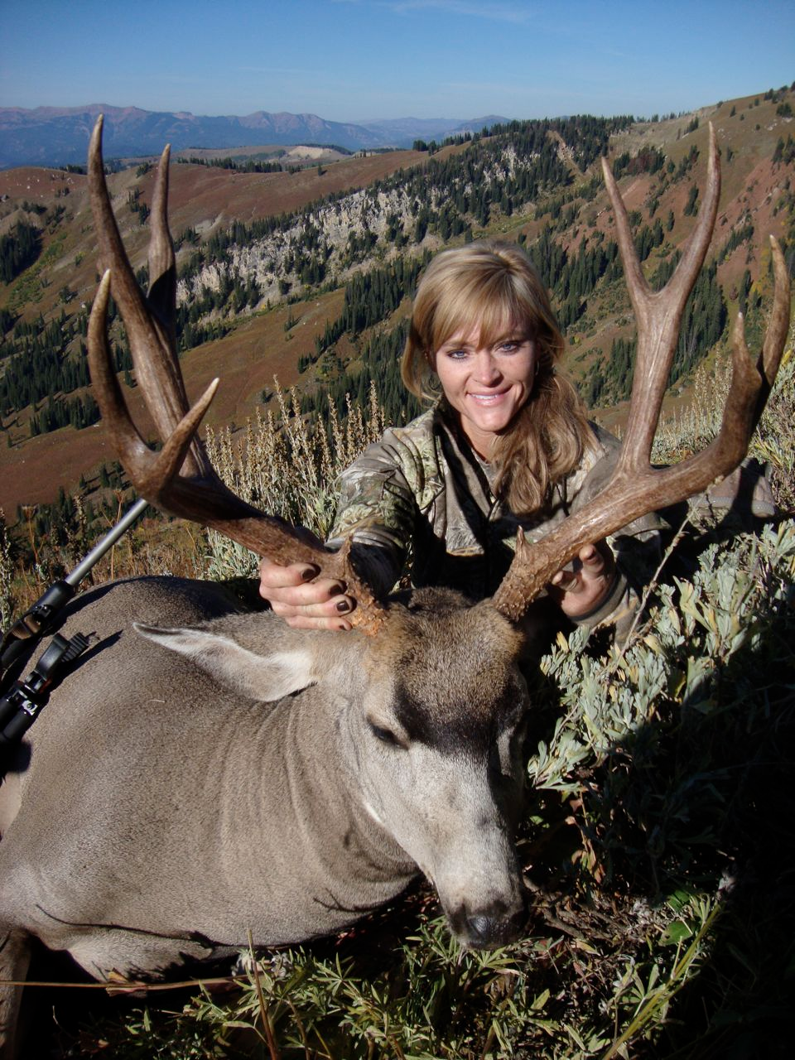
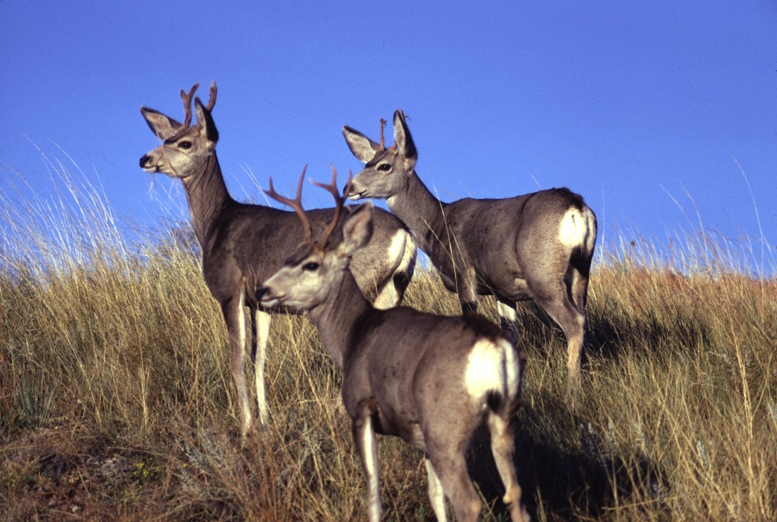
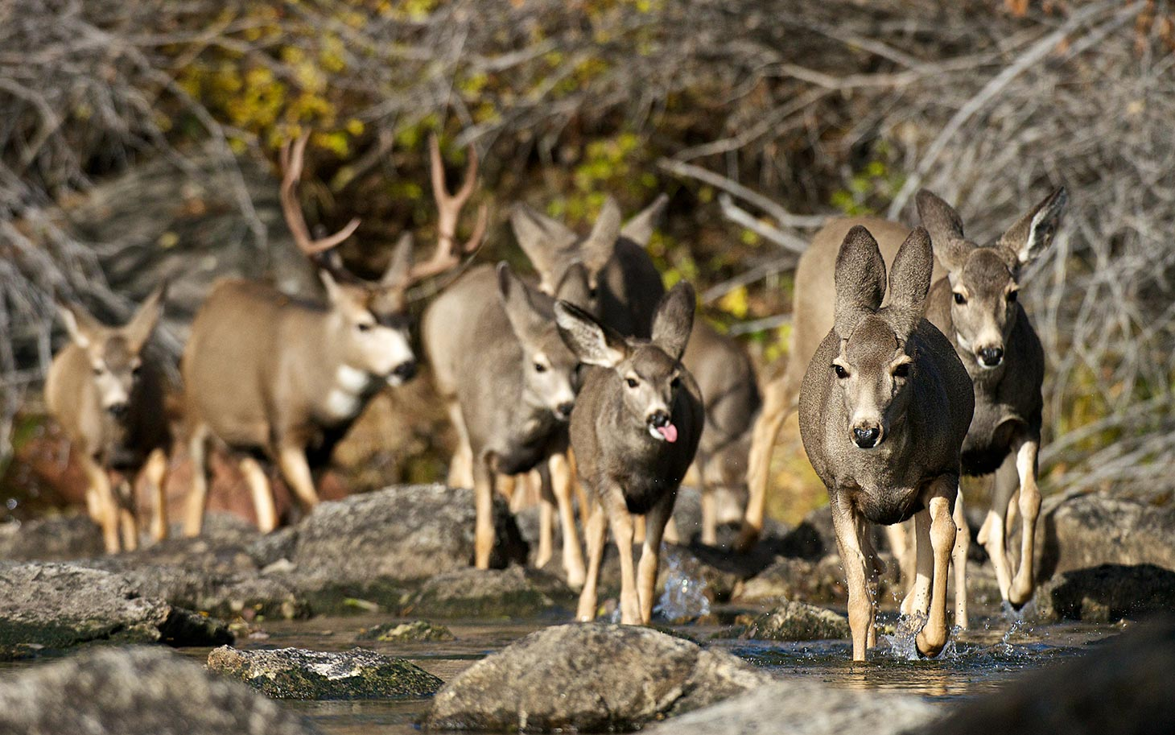
Community Concerns
Economically important species
Ecologically important species
Image credit: NPS.gov
Image credit: Rebecca Francis
Notes:
Mule deer are an economically and ecologically important species in North America. Many western states experience economic growth from tourists seeking to find these animals. They are popular find for wildlife viewers because of their large size. They are also a very popular trophy for hunters. It was estimated that in 2006 alone, mule deer hunting contributed over 100 million dollars to Idaho’s economy.
They also play a large role in their ecosystems’ processes and serve as an ecological indicator for habitat quality. Typically, if the habitat is suitable for mule deer it is suitable for many other animals in their food web. Mule deer can have a major impact on vegetation composition and nutrient cycling. They are considered keystone species and their ecosystems would be dramatically different or not exist without them.
___________________________________________
Image Credits:
Deer hunter: http://rebeccafrancis.com/2010/10/2010-wyoming-deer-hunt/
Deer migration: http://america.aljazeera.com/features/2014/4/mule-deer-longestmigration.html

Slide 3
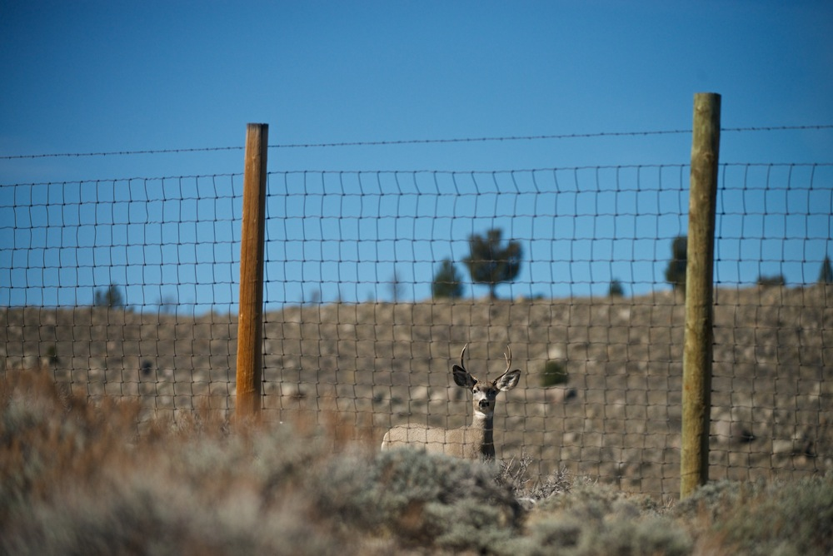
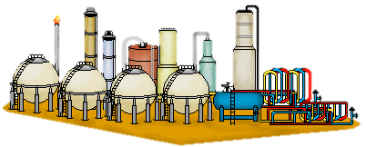

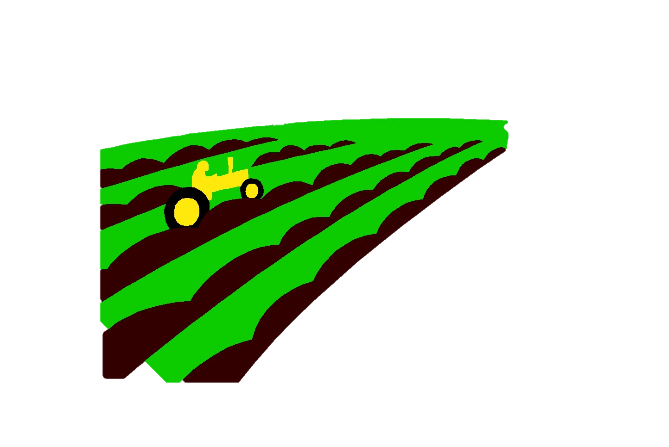
Community Concerns
Facing land loss due to human development
Image credit: Joe Riis
Notes:
The mule deer population, however, faces the risk of losing their habit due to anthropogenic effects. In our study area, land is being lost due to energy-, agricultural-, and housing-development. In general, 50% of areas disturbed by construction can be reclaimed in 3 to 5 years. However, a fully productive habitat can take up to 20 years to rebuild. Sagebrush communities, which are very important to mule deer, are exceptionally difficult to rebuild.
With human-development also comes habitat fragmentation, isolation, vegetation changes, water contamination, air pollution, and erosion.
___________________________________________
Image Credits:
Deer: http://www.wyofile.com/americas-longest-mule-deer-migration-discovered-in-wyoming/
Clipart

Slide 4
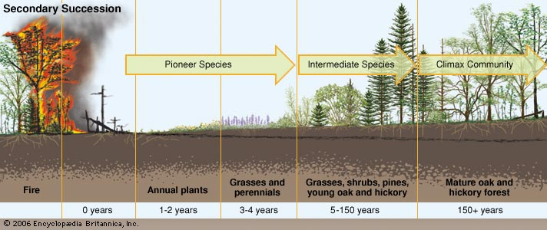
Fire’s Impact
Areas recently disturbed by fires may serve as good habitat
Encourages browse plant growth
Potential increase in amount of forage and thermal cover
Image Credit: Britannica
*however, fires can also negatively impact deer habitat
Notes:
Our partners were also interested in understanding the impact of fire disturbances and their potential to create high quality habitats for mule deer. There are few factors more important than fires in regards to mule deer habitat condition and health. Some have suggested that patchy burns in mountain shrublands have the greatest value to mule deer. Mule deer benefit most from the early successional habitats. Fires can rejuvenate browse plants, which are important to mule deer. Increases in plants such as true mountain mahogany, chokecherry, service berry, etc., can provide more winter forage and thermal cover.
However, wildfires can negatively impact mule deer habitats. If the fire is too hot it will kill important forage types and will put communities at risk. This is important for end-users to keep in mind for management plans.
___________________________________________
Image Credits:
Secondary succession: http://www.britannica.com/science/ecological-succession

Slide 5
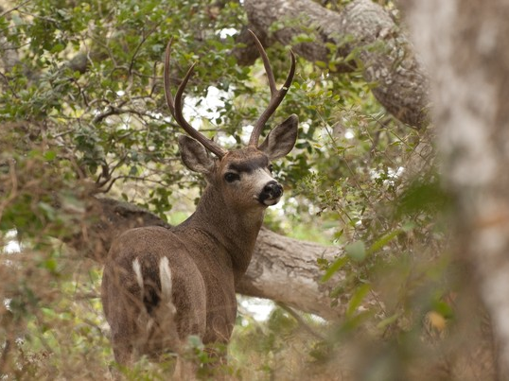
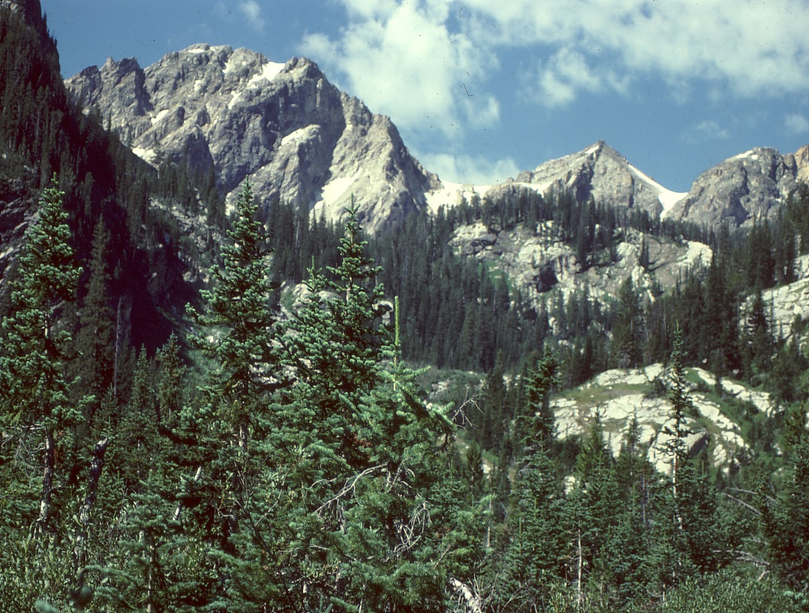
Objectives
Assess and compare: NDVI, vegetation phenology, landcover, and climate data for known mule deer habitat types
Identify: characteristics of suitable habitats
Help End-users: assess habitat management priorities
Image credit: National Geographic
Image credit: Vanderbilt University
Notes:
The objective of this project was to correlate NDVI, phenology, landcover, and climate data with known mule deer habitat ranges to determine the characteristics of suitable habitats. This information will be used to predict future mule deer habitats, allowing the end-users to prioritize areas for conservation and restoration.
___________________________________________
Image Credits:
Deer: http://ngm.nationalgeographic.com/ngm/photo-contest/2011/entries/78208/view/
Rocky mountains: http://www.cas.vanderbilt.edu/bioimages/biohires/ecoregions/h50528tetons5jb207.jpg

Slide 6
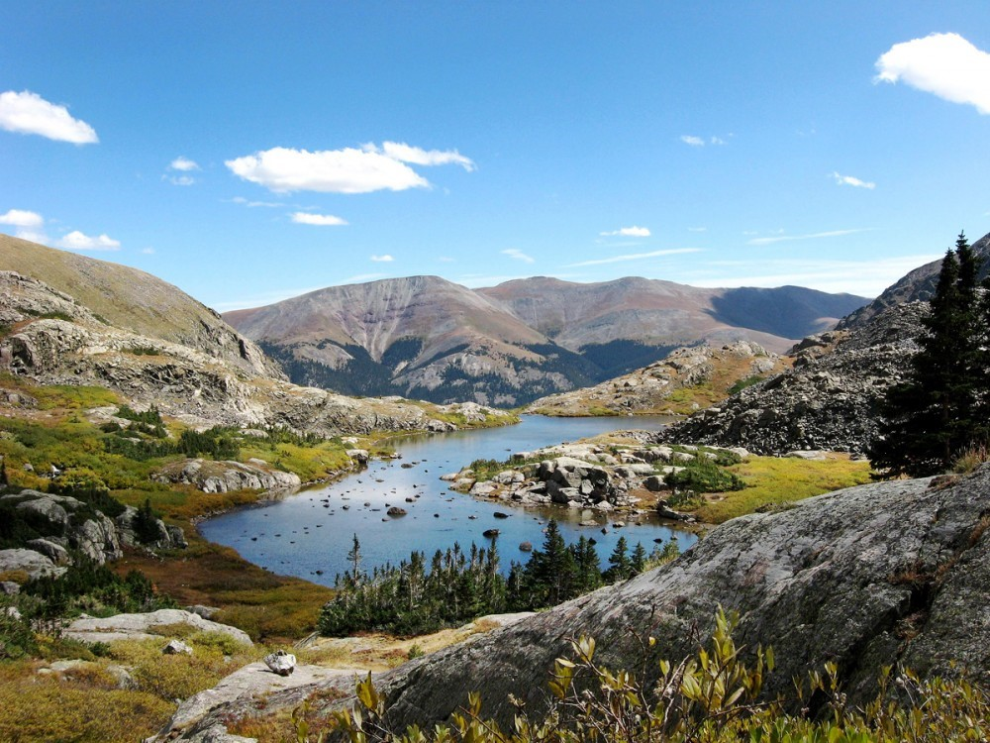
Partners
End-users
Southern Rockies Landscape Conservation Cooperative (SRLCC)
John Rice, Science Coordinator
Western Association of Fish & Wildlife Agencies (WAFWA) Mule Deer Working Group
Jim Heffelfinger, Chair
Image Credit: Summit Voice
Image Credit: Summit County Citizens Voice
Notes:
Our End-users and Partners for this project were the Southern Rockies Landscape Conservation Cooperative (SRLCC) and the Western Association of Fish and Wildlife Agencies’ Mule Deer Working Group.
___________________________________________
Image Credits:
Rocky mountains: http://summitcountyvoice.com/tag/hidden-gems-wilderness/

Slide 7
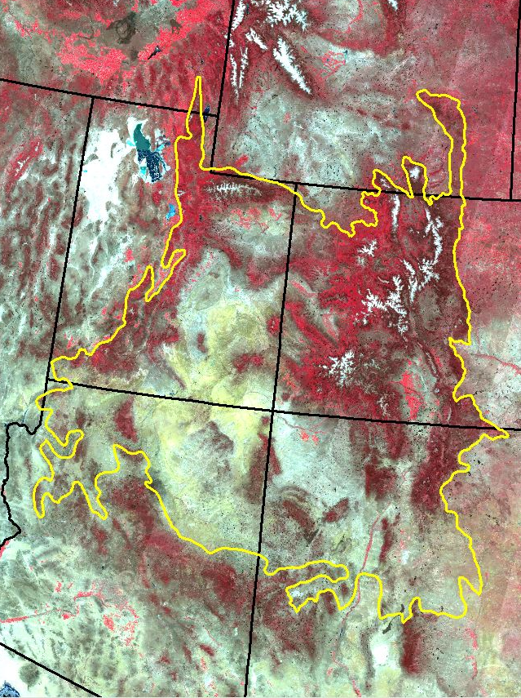
Study Area
SRLCC Boundary
Mule Deer Winter Range
Idaho
Idaho
Wyoming
Wyoming
Utah
Utah
Colorado
Colorado
Arizona
New Mexico
Arizona
New Mexico
Background image: MODIS false color
composite 6/17/14
Winter range shapefile from USU
Notes:
Our study area for this project was the SRLCC boundary and the mule deer winter range. The six states we studied were Idaho, Wyoming, Utah, Colorado, Arizona, and New Mexico. The SRLCC boundary is located within these six states and its area is roughly 200,000 sq. miles (199520). Our partners expressed interest in studying the winter range because not much research has been done on this critical area.
Our study period was from January 2005 to December 2014 to provide up-to-date characteristics of mule deer habitats.

Slide 8

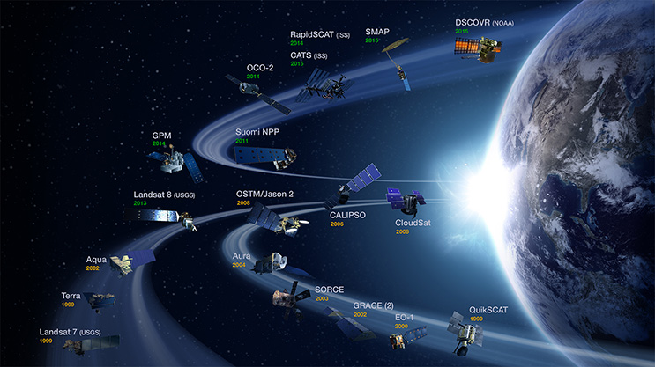
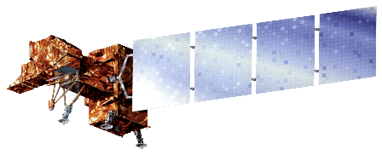
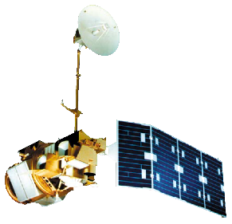
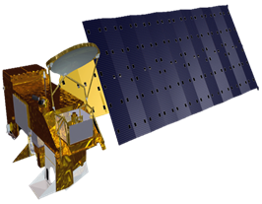
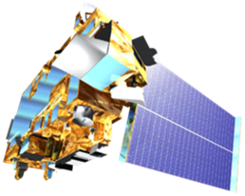
NASA Satellites/ Sensors Used
Landsat 8
Landsat 7
Landsat 5
Terra
Aqua
Image Credit: NASA.gov
Notes:
Aqua and Terra MODIS was used for Day of Year phenology data.
Terra ASTER data was used for Digital Elevation Models.
Landsat 5 TM, Landsat 7 ETM+, and Landsat 8 OLI was used for USGS GAP and NLCD landcover and to derive fire perimeter shapefiles.
___________________________________________
Image Credits:
NASA: http://eospso.nasa.gov/
Satellites: DEVELOPedia

Slide 9
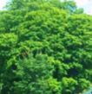

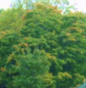

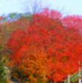



NDVI
Season Max NDVI
Left 80% Max
Right 80% Max
Left 20% Max
Right 20% Max
Left Minimum
Right Minimum
Spring
Growing Season
Fall
Image Credit: USFS
Notes:
MODIS data processed to produce NDVI curve that has 14 layers at 231m resolution. These 14 layer images contain seven NDVI and corresponding day of year values. Left 20% is the beginning of season, left 80% is the onset of maximum greenness aka greenup, MAX is the peak of the growing season, right 80% is the beginning of brown down and right 20% is the end of season.

Slide 10
Methodology – Habitat Suitability Model
Data was clipped to winter range within each state
Statistics from some layers were taken
Layers were weighted using mean ± SD
Layers were overlaid depending on importance
Vegetation Phenology
Elevation
Unsuited
Suitable
Winter Forage
Good
Excellent
Thermal Cover
Good
Excellent
Notes:
Elevation, landcover, and phenology data were clipped to the winter range within each of the six states.
The mean ± SD was recorded for the elevation and climate data.
All values within this range were weighted with a 1 and the values that were outside the range were weighted with a 0. The literature provided the characteristics used to weight the landcover data. They were split into two categories: winter forage and thermal cover. If they were listed as excellent for either one, they were weighted with a 2. If they were listed as good for either one, they were weighted with a 1. All others were considered no data. When the layers were overlaid, those plants that serve as forage and cover would be weighted as a 3.
When layers were overlaid, phenology was the most important then elevation then landcover then climate data.

Slide 11
Methodology – Impact of Fires
Fire perimeters were downloaded and processed
Color-coded based on area
Phenology before and after data compared
Within
winter range
Within
winter range and SRLCC
Within
SRLCC
SRLCC
boundary
Notes:
Perimeters from all fires which occurred from 2005 to 2014 that were larger than 5000 acres were downloaded from USGS and the US Forest Service’s Monitoring Trends in Burn Severity (MTBS) project. If they occurred within the SRLCC boundary they were added to the map. Each fire was color-coded to indicate whether it occurred in the SRLCC, the mule deer winter range, or both.
Large-integral NDVI was added to the map to describe the phenology before the fire and the changes that occurred after the disturbance.

Slide 12
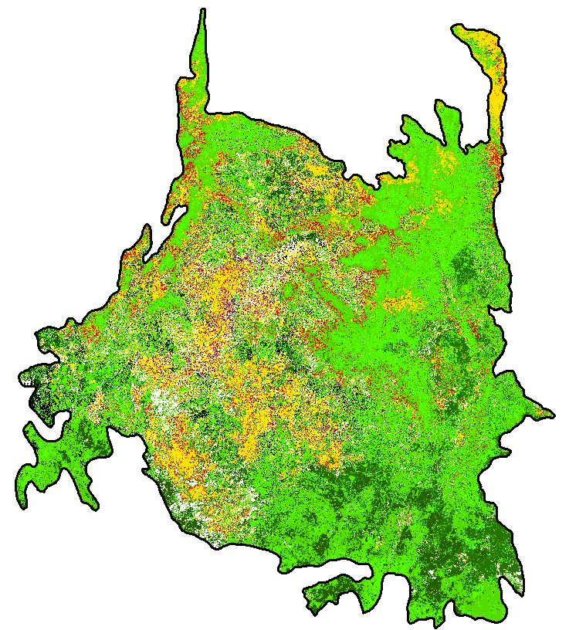
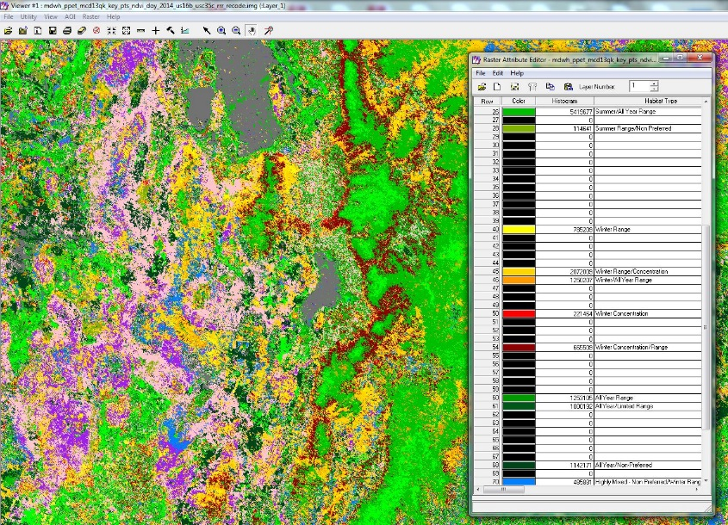
Methodology – Habitat Maps
MODIS based vegetation phenology products were acquired from USFS ForWarn system
7 key points of the growing season NDVI Day of Year data was stacked for 2014 and was classified into 30 classes
Habitat type for each class determined using data from Utah State University’s Mule Deer Habitat Map
Classes recoded and colorized in ERDAS Imagine to produce final product
Notes:
Perimeters from all fires which occurred from 2005 to 2014 that were larger than 5000 acres were downloaded from USGS and the US Forest Service’s Monitoring Trends in Burn Severity (MTBS) project. If they occurred within the SRLCC boundary they were added to the map. Each fire was color-coded to indicate whether it occurred in the SRLCC, the mule deer winter range, or both.
Large-integral NDVI was added to the map to describe the phenology before the fire and the changes that occurred after the disturbance.

Slide 13
Results – Fire’s Impact
*year fires occurred
MODIS Cumulative Integral NDVI
2011
2012
High
Low
2011
2013
2014
Notes:
By looking at the large-integral NDVI, we can see the amount of “greenness” that occurs throughout the entire year. Two fires that occurred within our study in Wyoming demonstrate the positive impacts that wildfires can have on vegetation. These fires occurred in 2012 in areas that displayed lower amounts of “greenness.” Two years after the fires, there is noticeable increase in “greenness” within the area impacted by wildfires.

Slide 14
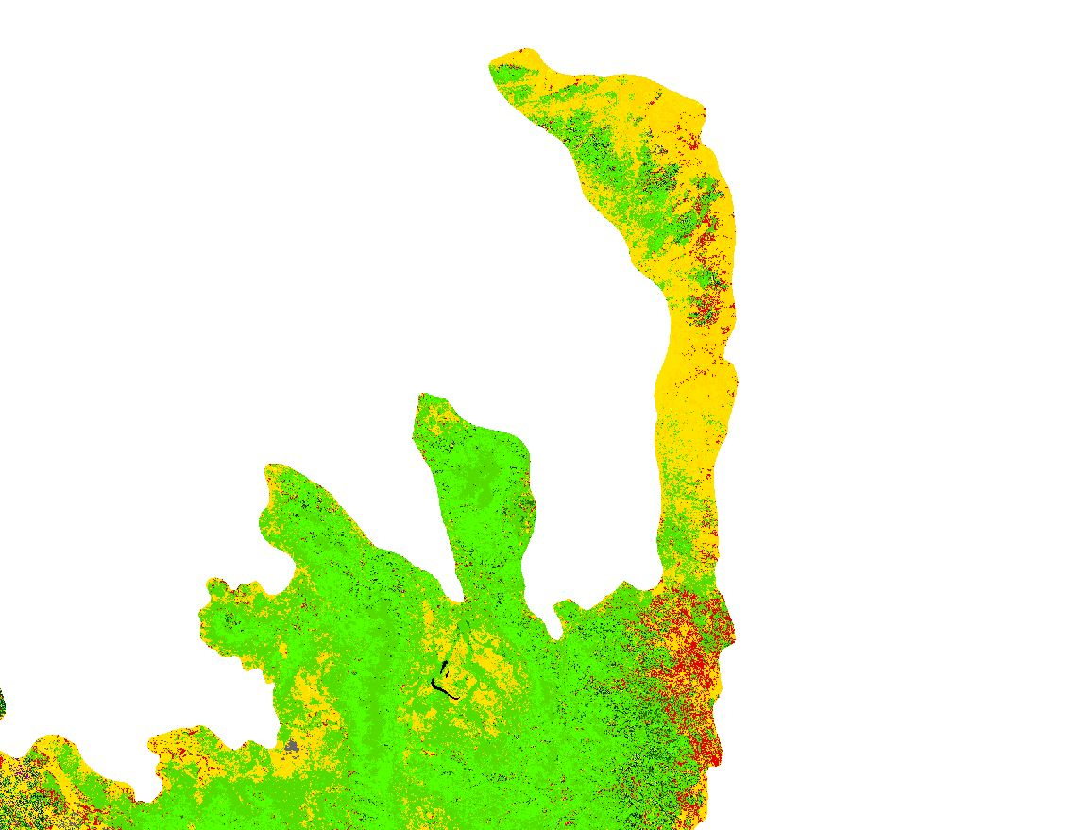
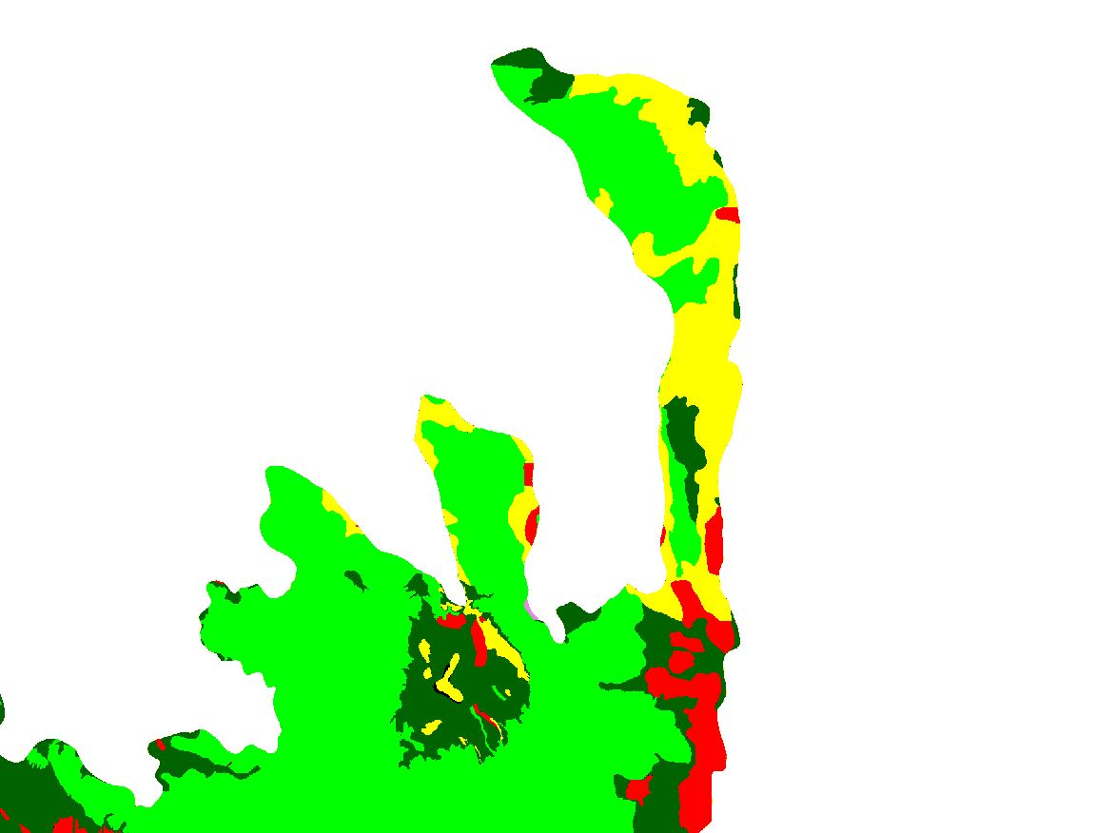
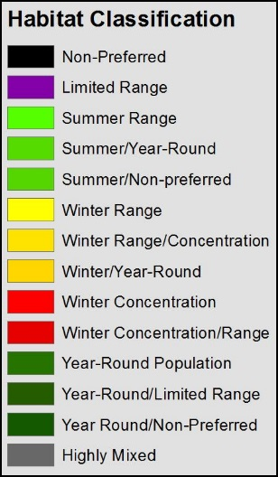
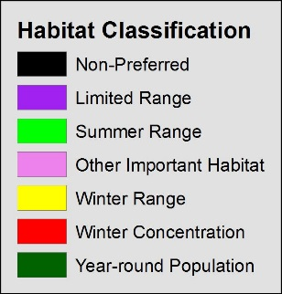
Results – Mule Deer Habitat Maps
MODIS Day of Year Phenology Based
Habitat Classification
Utah State University Habitat Classification

Slide 15
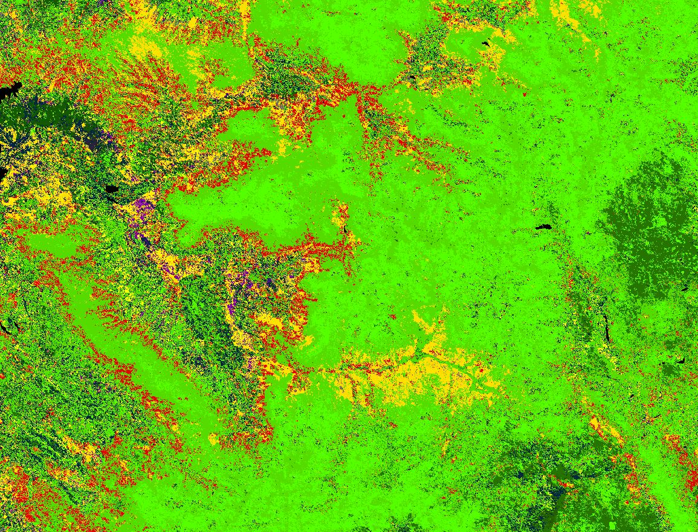
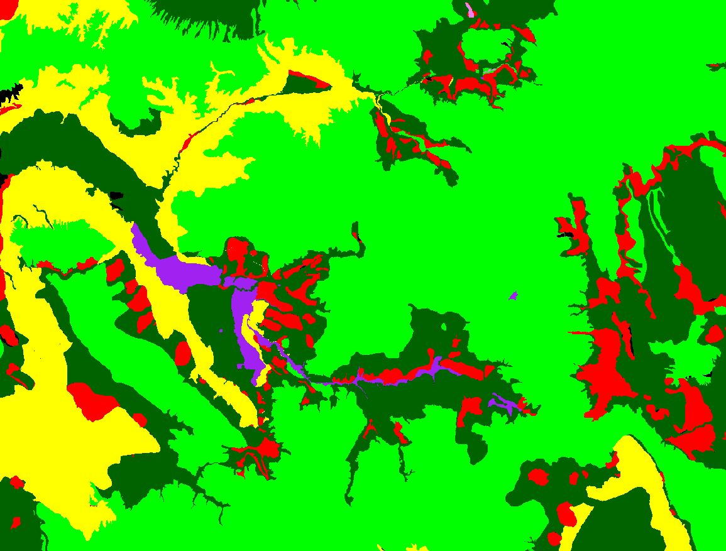
Results – Mule Deer Habitat Maps
MODIS Day of Year Phenology Based
Habitat Classification
Utah State University Habitat Classification

Slide 16
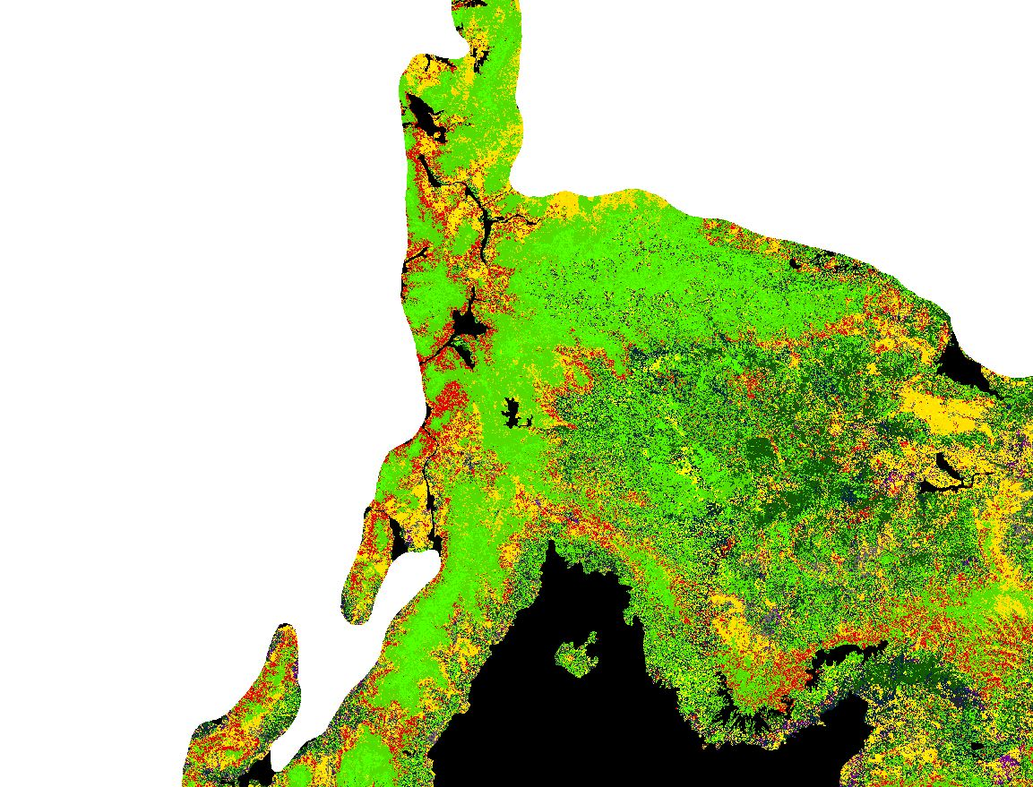
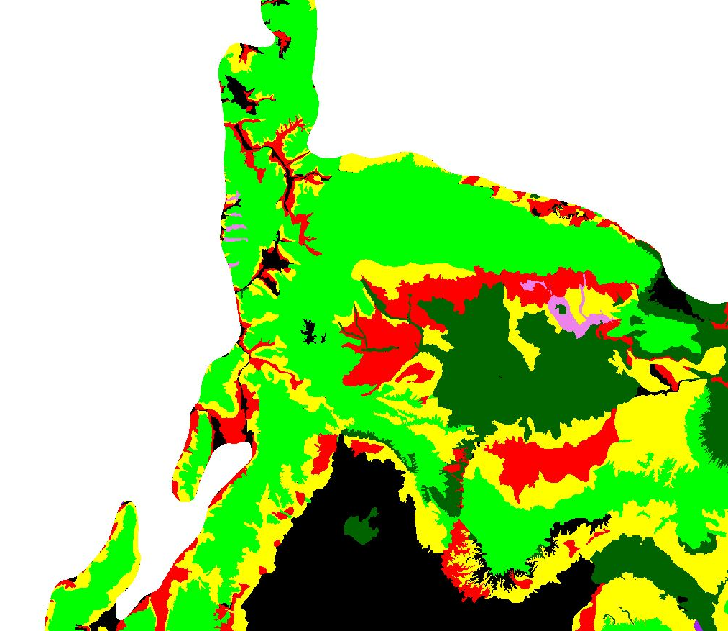
Results – Mule Deer Habitat Maps
MODIS Day of Year Phenology Based
Habitat Classification
Utah State University Habitat Classification

Slide 17
Conclusions
NASA Earth Observation data provides a means to assess vegetation condition and phenology at the landscape scale.
MODIS NDVI integral products were useful for aiding assessment of post burn vegetation changes that may improve habitat quality. Results indicate use of prescribed burns may be beneficial to mule deer habitat management plans.
MODIS phenology data was successfully processed to create habitat type classification maps, though more work is needed to further refine these maps.
Project results showed potential for aiding end users in assessing mule deer habitat quality and habitat type at the landscape scale.

Slide 18
Errors & Limitations
Limited source of pre-existing high quality mule deer habitat data
Coarse spatial resolution of climatological data
Limited information on types of preferred habitat and forage
Unable to acquire GPS collar mule deer tracking data
Time and resource constraints

Slide 19
Future work
Further analysis of additional MOIDS derived vegetation phenology parameters
Further analysis of climatological parameters
Inclusion of MODIS based habitat types into overall habitat suitability model
Inclusion of exclusionary factors (e.g. anthropogenic activities) into habitat suitability model
Incorporation of GPS collar tracking data

Slide 20
References
Utah State University’s RS/ GIS Laboratory’s Mule Deer Habitat Mapping Project - http://www.gis.usu.edu/current_proj/ muledeer.html
USGS and US Forest Service’s Monitoring Trends in Burn Severity Project - http://www.mtbs.gov/data/customquery.html
Idaho’s Mule Deer Management Plan 2008-2017 https://fishandgame.idaho.gov/public/wildlife/planMuleDeer .pdf
Kie, J., Bowyer, R., Nicholson, M., Boroski, B., & Loft, E. (2002). Landscape heterogeneity at differing scales: Effects on spatial distribution of mule deer. Ecology, 83(2), 530-544.
Innes, R. (2013). Odocoileus hemionus. In: Fire Effects Information System. U.S. Department of Agriculture, Forest Service, Rocky Mountain Research Station, Fire Sciences Laboratory. http://www.fs.fed.us/database/feis/
Sawyer, H., Kauffman, M., Middleton, A., Morrison, T., Nielson, R., & Wyckoff, T. (2013). A framework for understanding semi- permeable barrier effects on migratory ungulates. Journal of Applied Ecology, 50, 68-78.

Slide 21
Joseph Spruce, NASA Stennis Space Center
Dr. Kenton Ross, NASA Langley Research Center
Advisors
John Rice, Southern Rockies LCC
Jim Heffelfinger, WAFWA Mule Deer Working Group
William Hargrove, USDA Forest Service
Partners

Slide 22

Questions?

