Slide 1
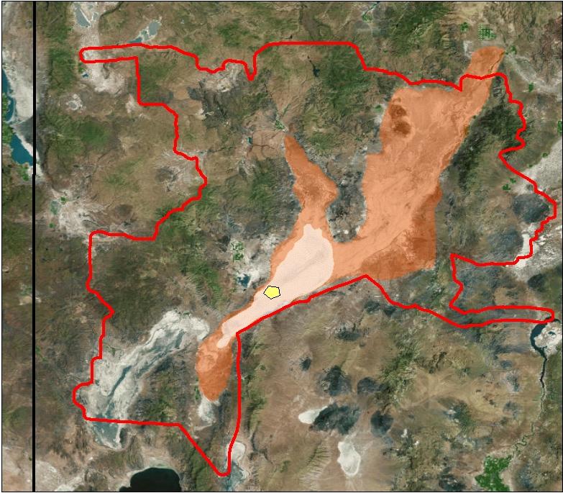
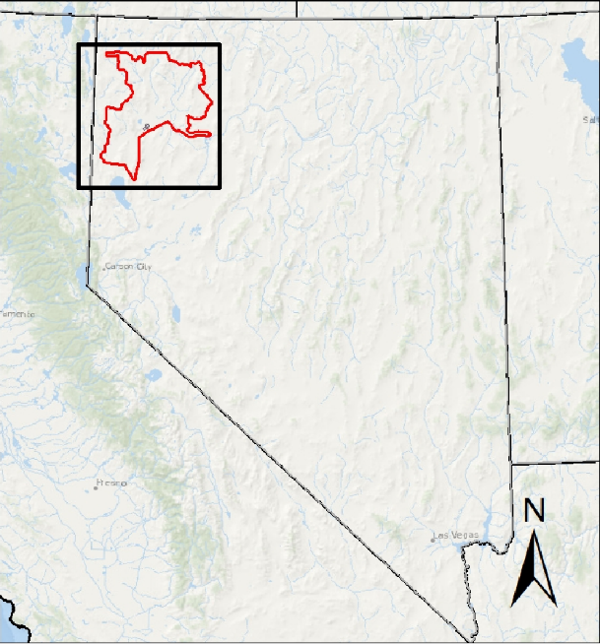
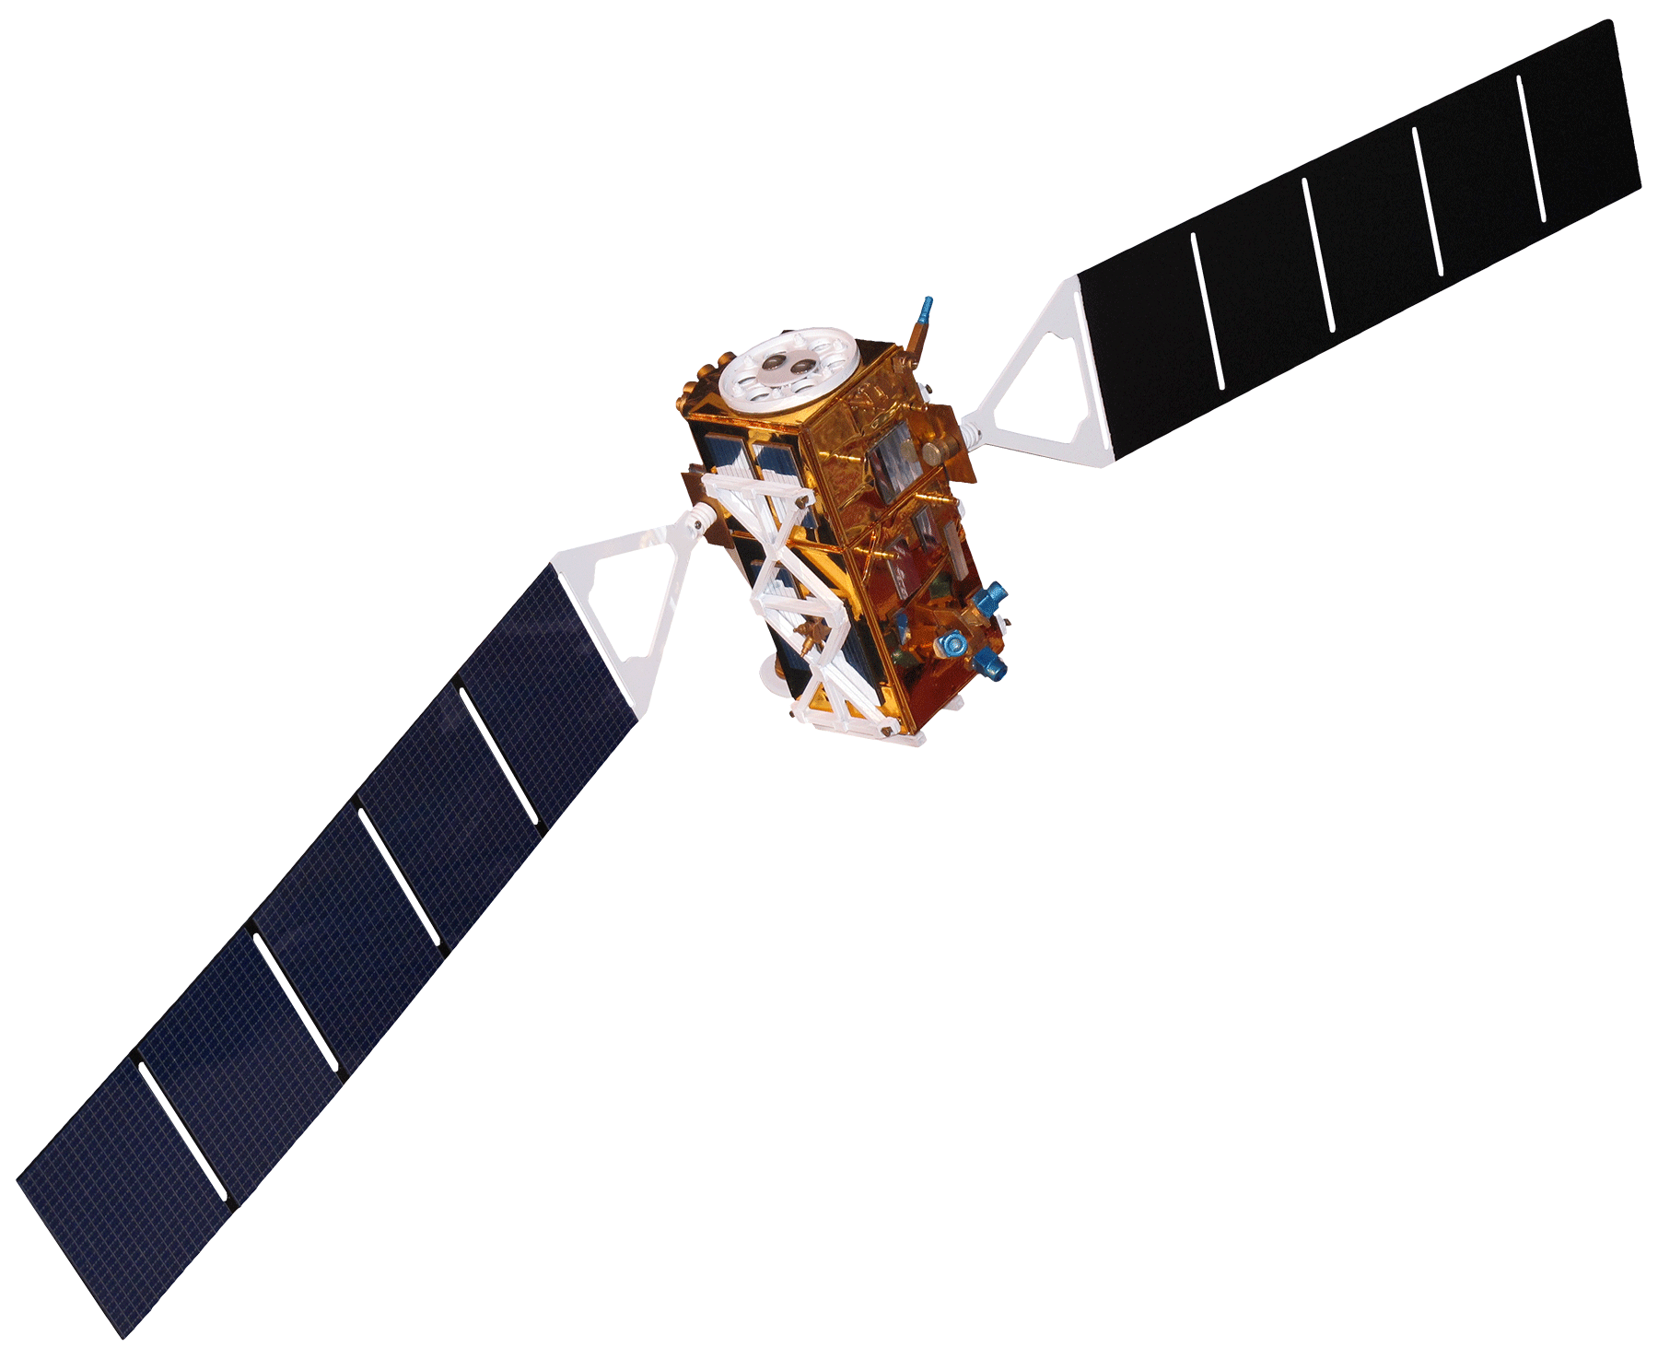
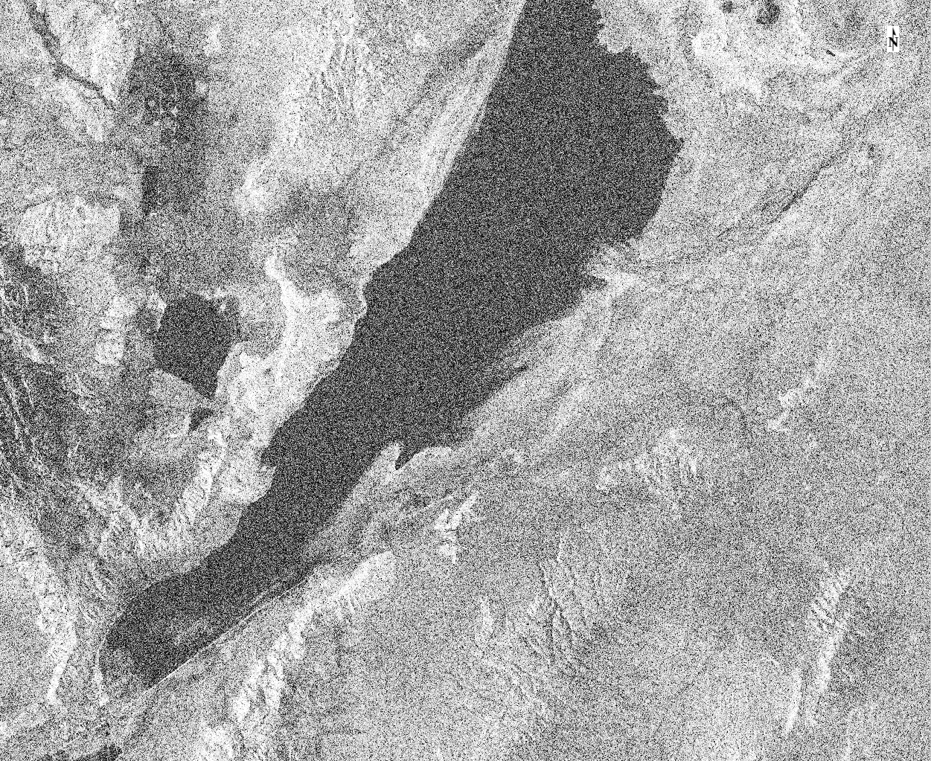
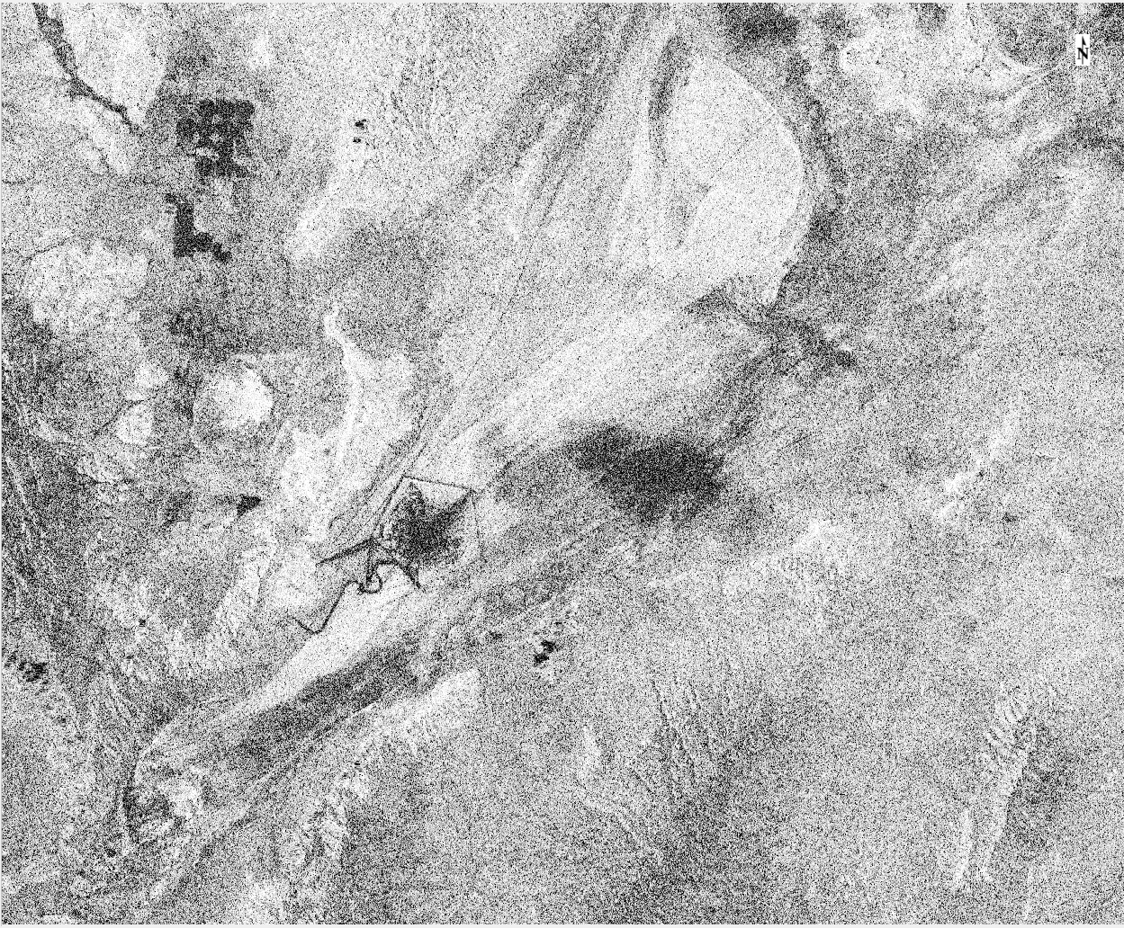
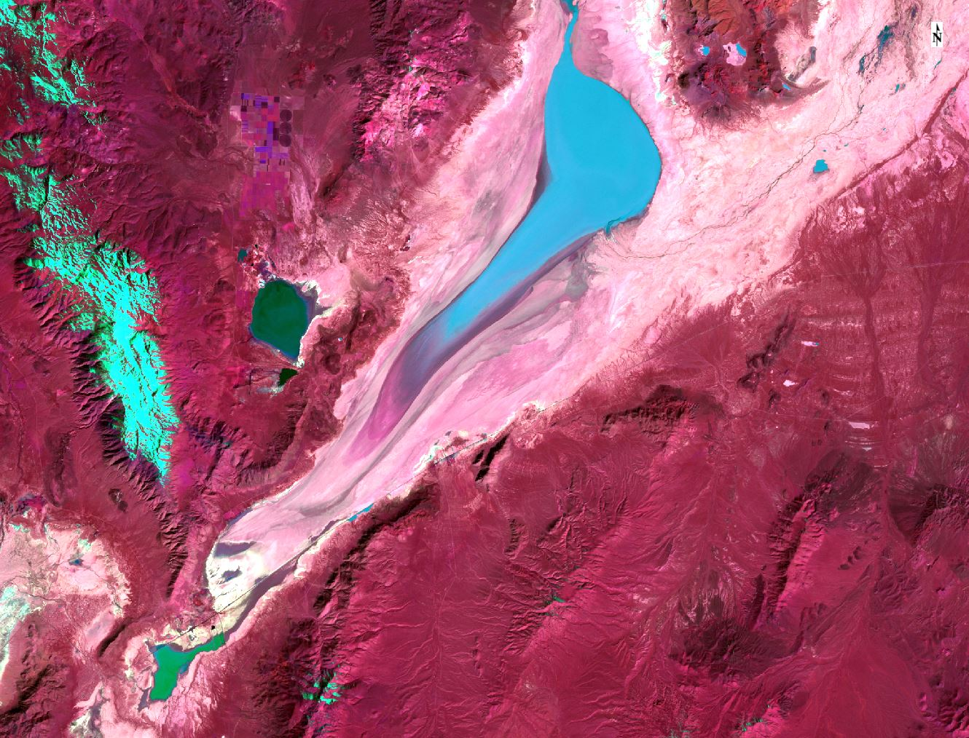
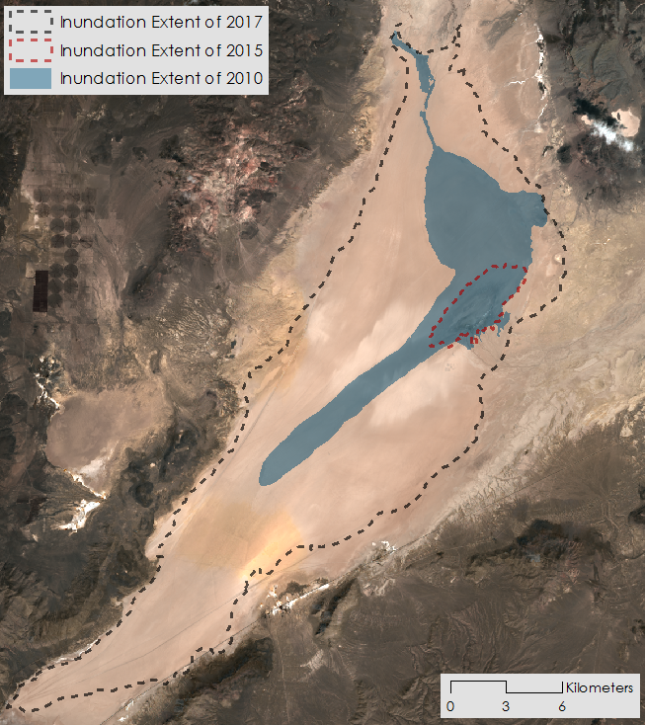
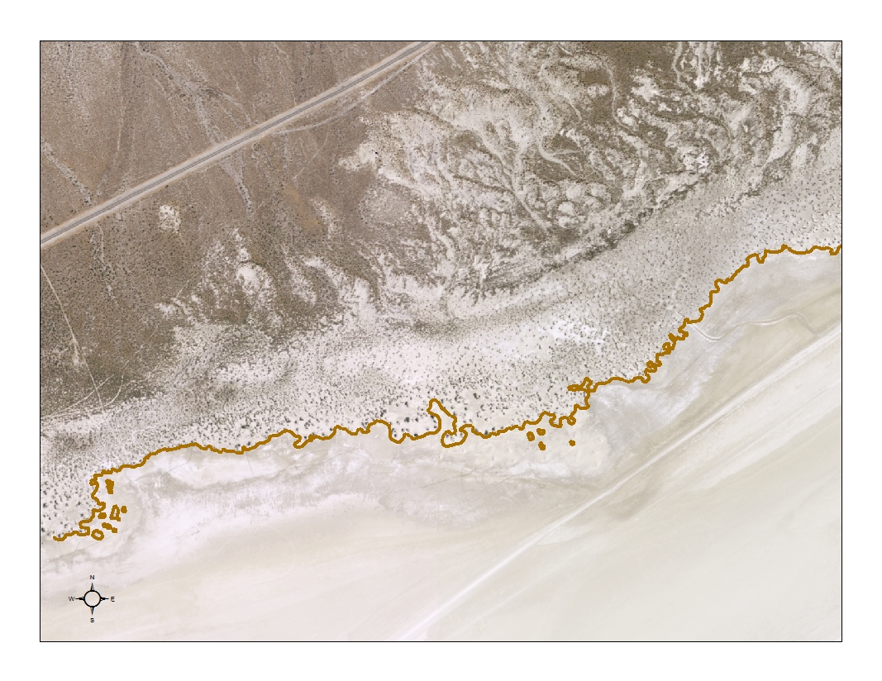
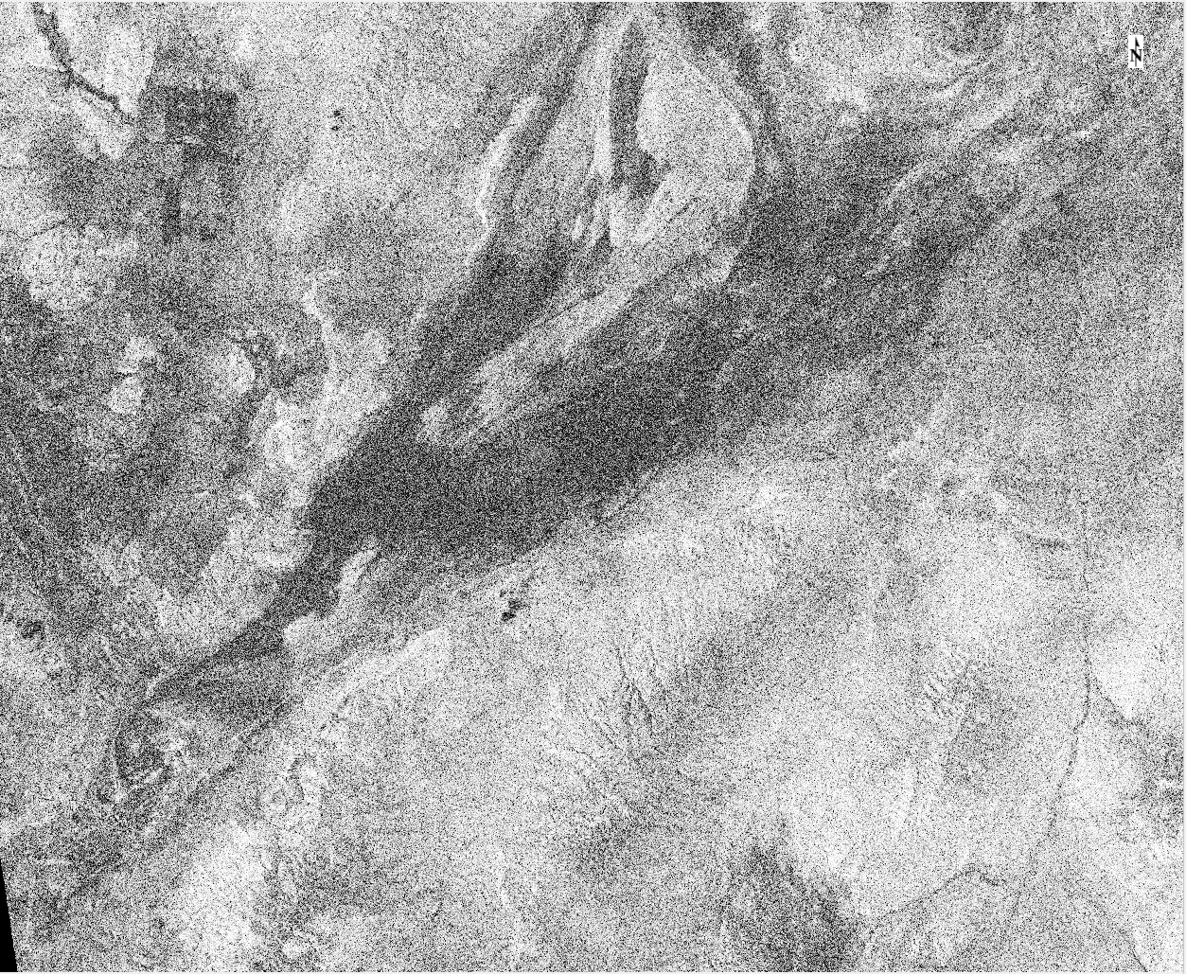
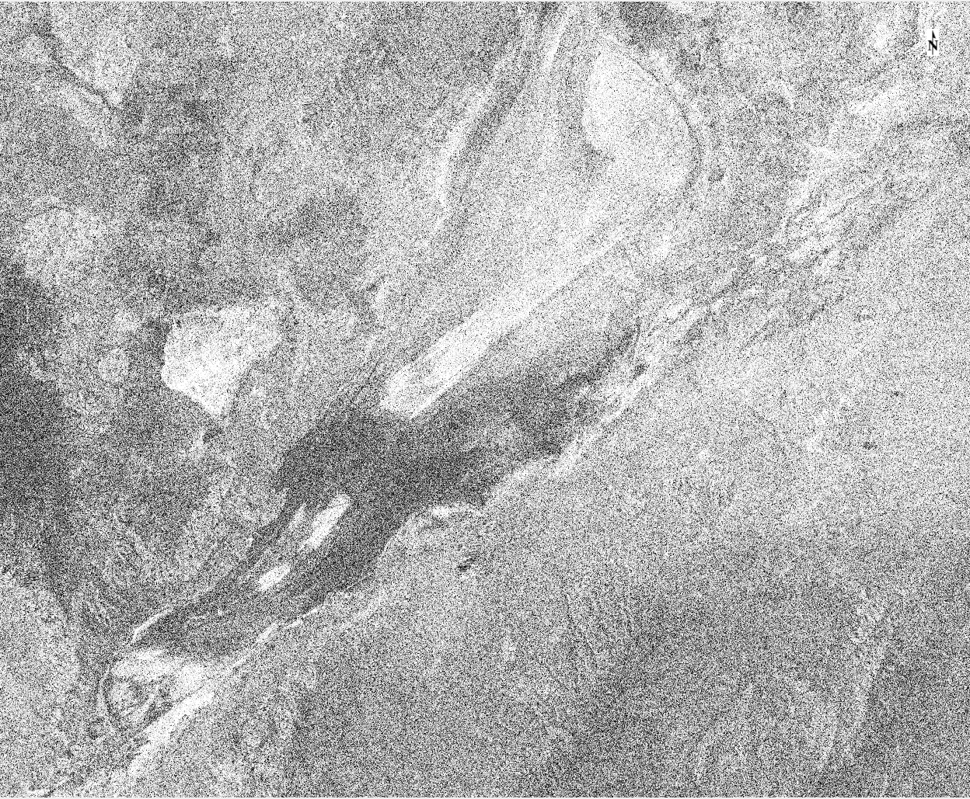
A Multi-Sensor Approach to Determine the Impacts of Human Activity and Natural Surface Deformation on the Black Rock Playa, Nevada
Study Area
Abstract
Study Period 1997 - 2017
Since the early 2000s, wind-deposited sediment mounds have been growing and encroaching onto the Black Rock Playa of the Black Rock Desert-High Rock Canyon Emigrant Trails National Conservation Area. These sedimentary structures along the edge of the playa alter the natural landscape, limit recreational activities such as land sailing and high-speed racing, and potentially indicate increased dust emission. Possible sources of increased sediment input for the mounds are drought, natural processes, or anthropogenic activity. Some members of the community believe that Burning Man, a festival hosted annually on the playa, may be the primary culprit. With Burning Man’s recent request to increase its population capacity, the Bureau of Land Management (BLM) must evaluate the event’s environmental impact through submission of an Environmental Impact Statement. To better understand contributing factors to mound growth and migration, the DEVELOP team assessed landscape changes from 1997 to 2017. Surface deformation maps were generated from Synthetic Aperture Radar (SAR) Earth observations from Sentinel-1, in conjunction with optical Earth observations from Landsat 5 Thematic Mapper (TM), Landsat 8 Operational Land Manager (OLI), and the National Agriculture Imagery Program. Historic weather data from Black Rock Playa and nearby weather stations were used to place surface geomorphology observations in the context of typical drought years, flooding events, and wind patterns. Results will help constrain the mechanism behind mound growth and migration and will assist BLM’s Winnemucca District, Black Rock Field Office in determining if recreational activities should continue to be permitted on the playa.
NEVADA
CALIFORNIA
NEVADA
CALIFORNIA
Study Area
Black Rock Desert-HRC NCA
Burning Man Event 2017
Earth Observations
Methodology
Black Rock Playa
Black Rock Desert
(1) Download Sentinel-1 C-SAR data from 2017
Compare pre- and post-Burning Man images
Objectives
Create correlation images
Normalize images to remove vegetation effect
Identify areas with most change
Generate surface deformation maps of Black Rock Playa from optical SAR imagery
Analyze the relationship between temporal changes in mound formation and recreational activities, drought conditions, flooding events, and other weather patterns
Assess the respective influence of anthropogenic activity, drought, and natural processes on playa surface deformation
Radar
Landsat 5 TM
Landsat 8 OLI
(2) Download Landsat 5 & 8 and NAIP data from 1997-2017
Compare radar and optical results
Optical
Create false color composites
Digitize mound & inundation features
Identify years and areas with most change
Make inferences
Results
Sentinel-1
A&B C-SAR
Change from
May 9 to May 21
Change from
August 13 to August 25
Inundation Extent of 2017
Inundation Extent of 2015
Inundation Extent of 2010
Burning Man
Change from
September 6 to September 18
Change from
November 17 to November 29
Landsat 5 false color composite highlighting flooded areas in the Black Rock Playa.
Extent Mound Encroachment
Coregistered and processed Sentinel-1 C-SAR image pairs showing surface deformation throughout 2017. Darker areas reflect pixels with high decorrelation (low correlation) and indicate regions experiencing significant surface disturbance between the associated image acquisition dates.
Image showing maximum inundation extent for years 2010, 2015, and 2017. These inundation polygons represent the region of the playa whose surface soil experienced wetting and drying in a given year, resulting in a smooth, durable, protective crust. Rectangular cutout highlights a dense region of mounds along the edge of the playa. The brown line indicates the unchanging extent of mound encroachment that persisted from 2006 to 2017 in NAIP imagery.
Conclusions
Project Partner
Team Members
Morphology and presence of vegetation suggests that the unnatural “dunes” are actually vegetation mounds.
The extent of annual inundation could potentially be responsible for mitigating mound encroachment.
SAR data visualizes and confirms surface deformation resulting from Burning Man, other recreational activities, and natural processes such as dust storms, flooding, and precipitation.
Direct correlation between mound growth and a possible cause could not be found.
No observable mound boundary encroachment in the NAIP imagery between 2006 and 2017.
SAR and optical processing used in this study provides the BLM with a sound methodology for assessing surface deformation on the playa from various activities and natural events.
Black Rock Field Office,
Winnemucca District
Acknowledgements
Neda Kasraee
Project Lead
Dara Laczniak
Dr. Bruce Chapman and Dr. Tom Farr – NASA Jet Propulsion Laboratory, California Institute of Technology
Dr. Mark Hall – Bureau of Land Management, Winnemucca District, Black Rock Field Office
EXAMPLE
Marcella Rose
Nick Rousseau
Black Rock Playa Urban Development
California - JPL | Spring 2018

