Slide 1
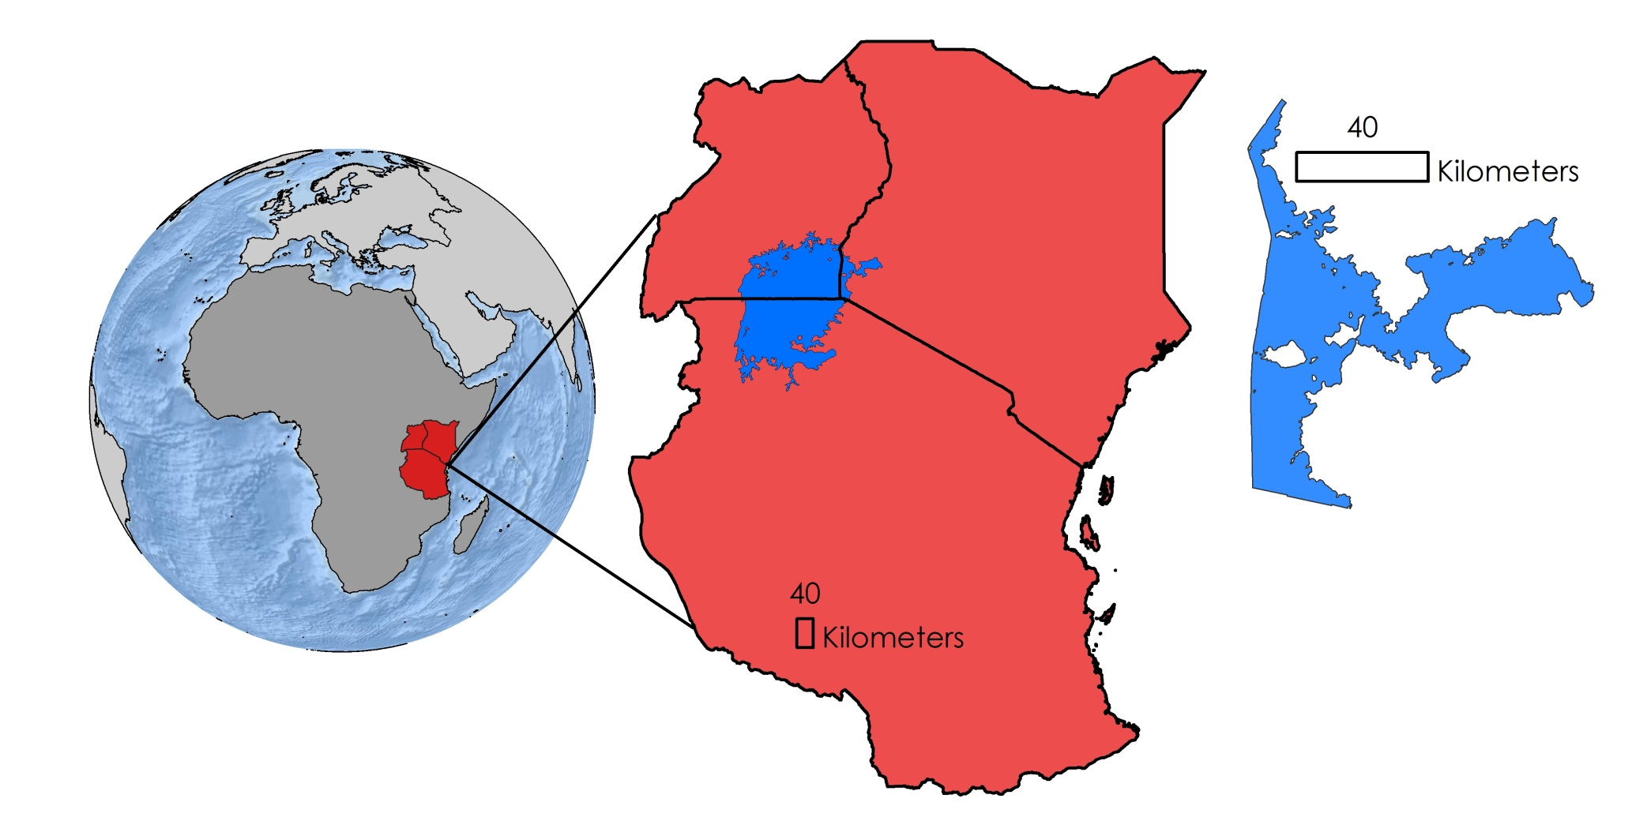


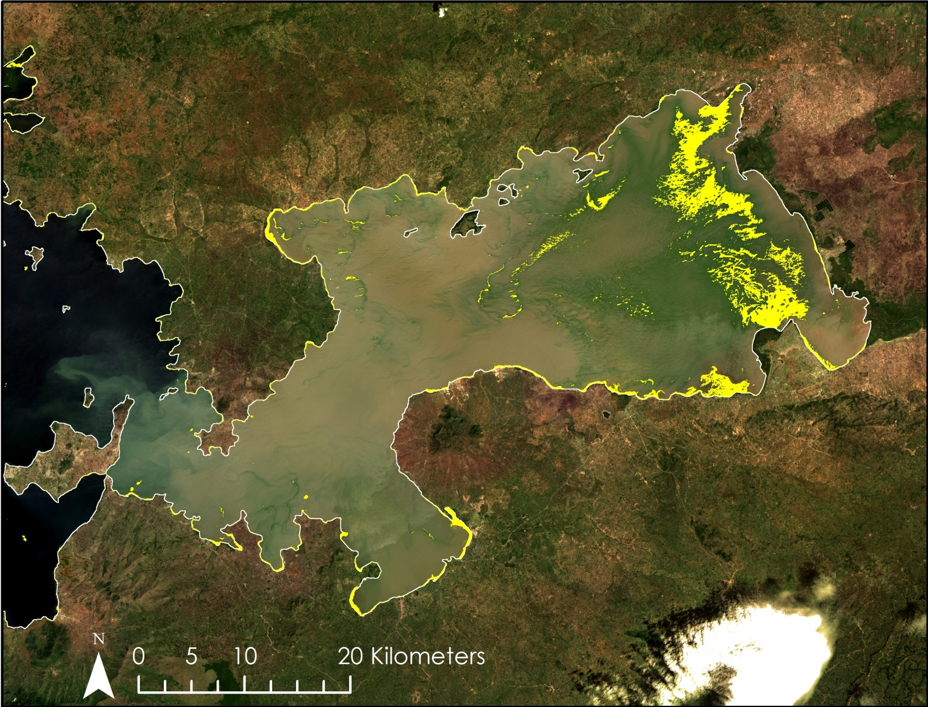
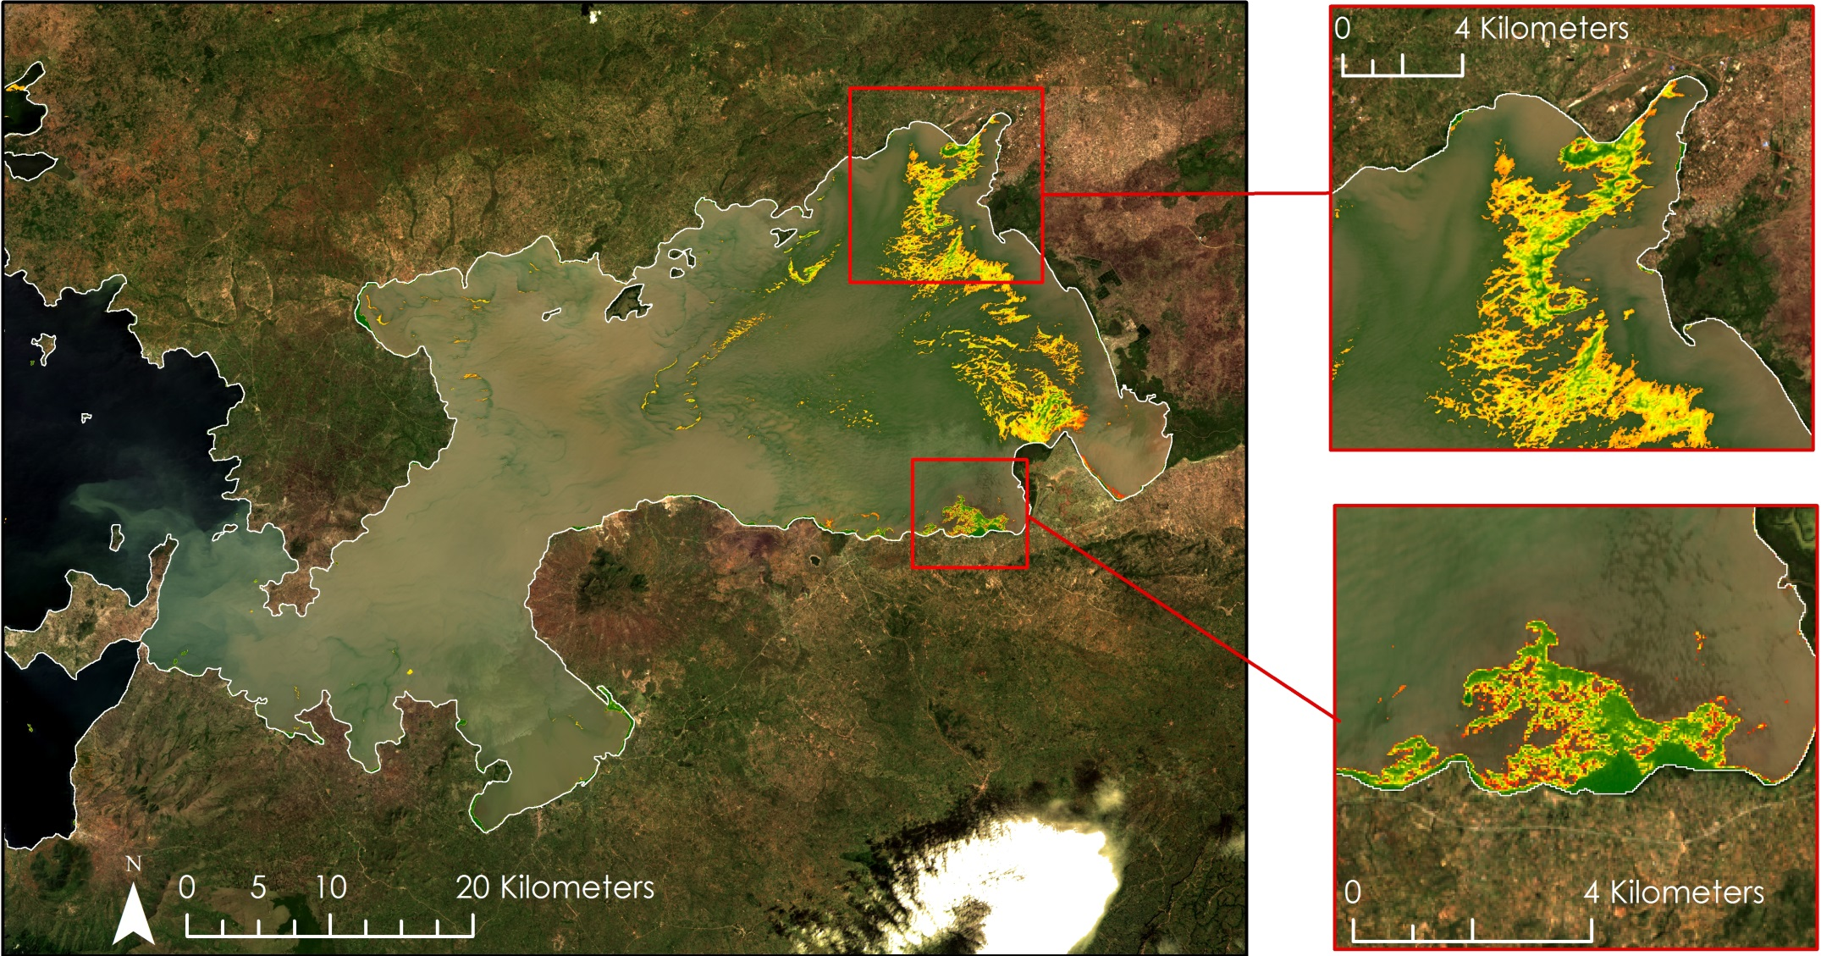
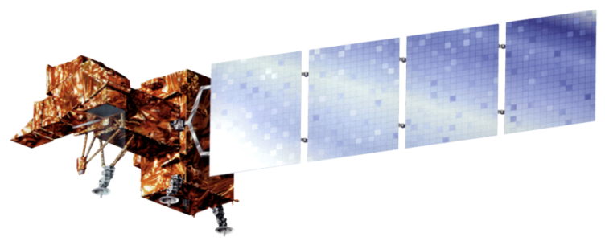
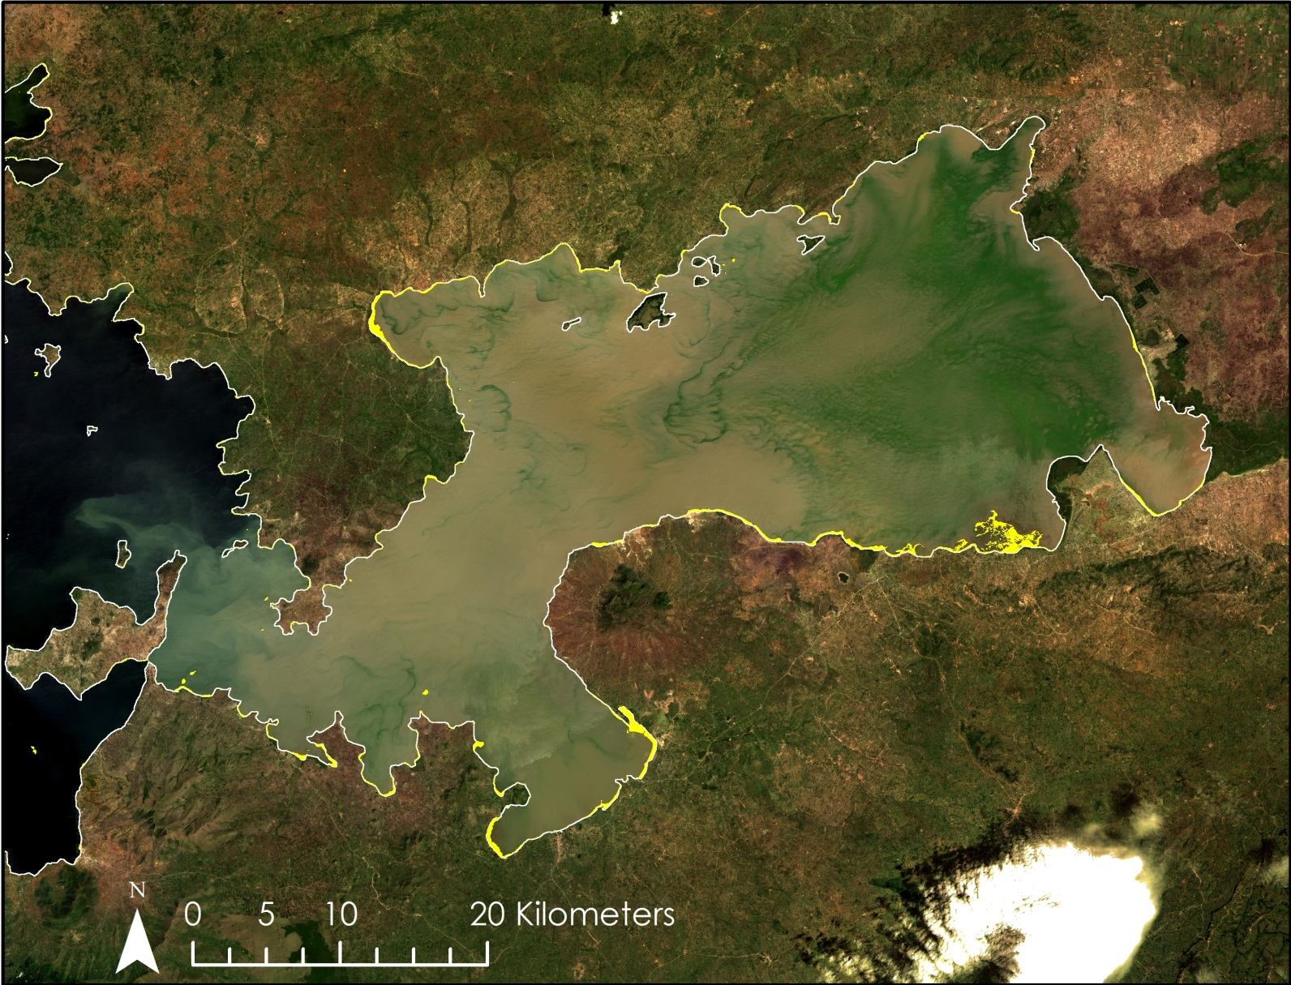
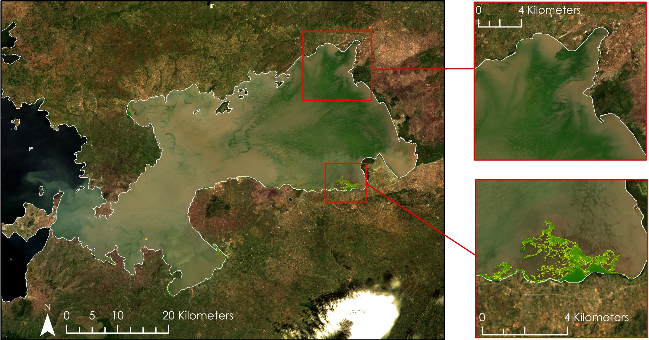
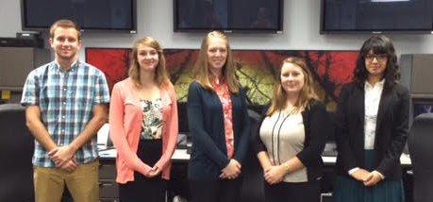

Lake Victoria Water Resources
Spatio-Temporal Analysis of Lake Victoria Water Hyacinth and Algal Blooms Using NASA Earth Observations for Improved Water Management
Jeanné le Roux (Project Lead), Daryl Ann Winstead, Christina Fischer, Sara Amirazodi, Austin Vacek
NASA DEVELOP National Program at NASA Marshall Space Flight Center
Abstract
Objectives
Lake Victoria, with a surface area of 68,800 ${\text{km}}^{2}$, is the largest lake in Africa. The lake is surrounded by Kenya, Tanzania, and Uganda and is home to more than 30 million people, making it one of the most densely populated rural areas in the world. These people rely on the lake for all aspects of their lives, including fishing, agriculture, and industrial applications. However, the increasing population has negatively impacted water quality through agricultural and industrial run-off and sewage. Furthermore, the invasive water hyacinth (Eichhornia crassipes) is blocking fishing access and providing breeding grounds for disease carrying mosquitoes and snails. Ongoing efforts between SERVIR Africa and the Regional Centre for Mapping of Resources for Development (RCMRD) have been assessing and monitoring water quality parameters such as chlorophyll concentration, temperature, and turbidity for Lake Victoria using the Moderate Resolution Imaging Spectrometer (MODIS) sensor on the Aqua satellite. This project seeks to include the use of Landsat 5,7,8 and Earth Observing-1 (EO-1) to assess surface reflectance, chlorophyll-a, and water hyacinth presence. The study will focus on the Winam Gulf region of Lake Victoria in Kenya, since this area experiences abundant water hyacinth activity and has been identified by RCMRD as an area of focus. The data collected will be used to create a preliminary algorithm to detect water hyacinth. This algorithm will then be applied on imagery ranging from August 2000 to October 2015 to provide a historical context of the range of water Hyacinth in the Winam Gulf.
Develop an empirical method to distinguish water hyacinth from other algal growth in the Winam Gulf of Lake Victoria, Kenya
Identify the extent of water hyacinth in the Winam Gulf to enhance RCMRD methodologies
Create a time series map of aquatic vegetation
Study Area
Uganda
Kenya
Tanzania
Winam Gulf, Kenya
Methodology
Lake Victoria
Data Acquisition
Data Processing
Data Analysis
  Landsat 5
  Landsat 7
  Landsat 8
  WorldView
  Extract vegetation using NDWI and MNDWI methods
  Time Series Maps
  Confusion Matrix for both methods
Earth Observations
Landsat 5 TM
Landsat 8 OLI & TIRS
Results
Image: Landsat 8
November 29, 2013
NDWI Method
NDVI Clipped to Non-Water Features Shapefile
Landsat 7 ETM+
Non-Water Features
Low: -0.72
High: 0.93
62% Accuracy
Conclusions
Image: Landsat 8
November 29, 2013
NDWI method extracts water hyacinth, other macrophytes, and surface algal blooms, with 62% accuracy.
MNDWI method extracts only water hyacinth and other macrophytes with 87% accuracy.
MNDWI method is more accurate and more suitable for the needs of the project partners.
These methodologies will serve as a baseline for RCMRD and SERVIR to develop a water hyacinth monitoring system.
A study area shapefile derived from high resolution WorldView imagery rather than Landsat imagery will produce less misclassifications and yield more accurate results.
MNDWI Method
NDVI Clipped to Non-Water Features Shapefile
Non-Water Features
Low: -0.72
High: 0.93
87% Accuracy
Team Members
Project Partners
Acknowledgements
NASA SERVIR Coordination Office
NASA SERVIR - Eastern and Southern Africa
Regional Centre for Mapping of Resources for Development (RCMRD)
We would like to thank our collaborator, Africa Flores, for her guidance on this project.
We also would like to thank our science advisor, Dr. Jeffrey Luvall, our science mentor, Dr. Robert Griffin, Dan Irwin, Timothy Klug, and our Center Lead, Leigh Sinclair.
Furthermore, we would like to thank Dr. Robinson Mugo and James Wanjohi Nyaga of RCMRD for providing us with critical data and information.
Austin Vacek, Jeanné le Roux, Christina Fischer, Daryl Ann Winstead, Sara Amirazodi
NASA Marshall Space Flight Center

