Slide 1
Peru Climate
Monitoring and Forecasting Shifting Climate and Land Use Change Impacts in Peru’s Parque de la Papa for Enhanced Agricultural Management
Rebekke Muench (Project Lead)
Michael Sclater
Kayla McDonald
Richard Rose
Ryan Murphy
Dajon Begin
Notes:
Good Morning, we are the Peru Climate team. My name is Rebekke Muench, I am a recent graduate of Christopher Newport University, my name is Kayla McDonald I am a current student at Christopher Newport University, my name is Ryan Murphy I am a recent graduate of the University of California – Davis, and my name is Michael Sclater and I am a recent graduate of Virginia Polytechnic Institute and State University.

Slide 2
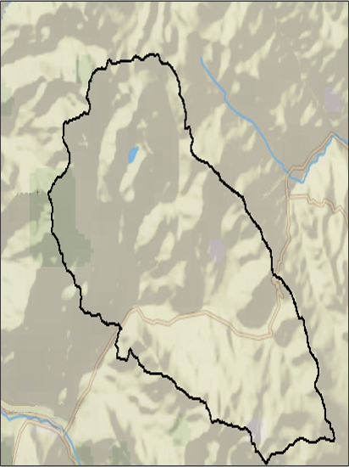
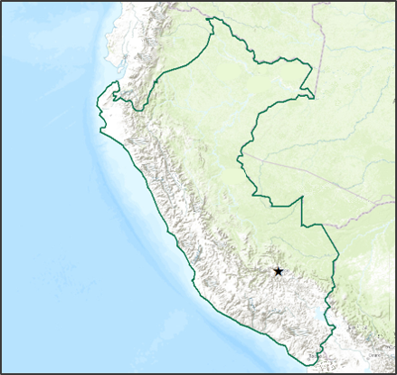
Study Area
Study Period
Temperature (MODIS)
July, 2002 – June 2015
Precipitation
November, 1997 – April, 2015
Land use
Current and historic
Legend
Parque de
la Papa
Peru
Notes:
The focus for our project was the Parque de la Papa, or Potato Park (as indicated by the black line), which is located approximately 40 km from Cusco, Peru.
The time period varied depending on each data source, going as far back as 1990 until present day.

Slide 3
Community Concerns
The Parque de la Papa strives to conserve traditional potato varieties and agricultural practices.
Potato biodiversity is threatened by multiple environmental factors
Image Credit: Leonora Enking
Notes:
The Parque de la Papa strives to protect and preserve it’s indigenous bicultural heritage; however,
Potato biodiversity is threatened by
An increase in temperature,
A change in precipitation patterns, and
Increased damage from pests. Harvesting has relocated to higher elevations to allow farmers to maintain traditional agricultural practices and indigenous potato varieties.
https://www.flickr.com/photos/33037982@N04/3593110456/in/photolist-6tvCyh-Aj1vMr-6tvCyG-aS6k6R-8oaa4M-6ErDi-cdpAKW-6tvCyu-9XQNXH-345cMX-fCvwgk-5cDdZ1-cUkNRd-7QV5qS-66tAdT-5cDTZz-p2rgRS-7DsXXH-emeJVG-rQG45i-mSTcf-axyKHV-dHZBhc-cGosKW-vsPjpM-rF5dQJ-bhZX5a-2brRkw-6bswdb-6bsv7d-6bojKi-9ii4K1-6bswd9-6bsv79-6bsx9w-6bojKn-6Dacp-8o8NFw-5P2siN-85gTRk-n9LLW-8o5kn2-8nYSdL-37LyNE-fgckrn-jzur5Y-6Rz3VM-fgrDds-dxPDW9-8XU3J2

Slide 4
Objectives
Create factor maps
Determine potato crop movement
Develop a repeatable methodology
Image Credit: McKay Savage
Notes:
Create growing degree days, elevation, slope, and precipitation.
Use Landsat imagery to determine how potato crop locations have changed over the past 30 years
Develop a methodology that can be applied throughout Peru to determine potato suitability
https://www.flickr.com/photos/mckaysavage/10943327295/in/photolist-8nYSdL-37LyNE-fgckrn-jzur5Y-6Rz3VM-fgrDds-dxPDW9-8XU3J2-biWKoH-6bsv77-5Q5RRe-do3EyN-rU595x-emeKbm-em8YAB-emeJFW-em8YKD-cynjDY-emeK5G-5uiMQ3-2rhnPA-Kzbc9-c5Ar8E-8QgbiE-dHZCPr-8o8Nf1-6DQMV-72Lw9y-in7EUJ-7kFC1g-cZf7cN-nNsC8-hF2H9L-hF3NJi-hF2pWP-9dSMFt-tJigx-as7wfh-eiCHz4-eiCHNr-eiCHmD-7SVtZ8-9Ft3my-hGbx8j-fpizsf-5NHUEB-oaGR4R-7Gtiod-b81h4c-nev6yZ

Slide 5
Methodology
Acquisition
Notes:
The first step of our project was data acquisition.

Slide 6
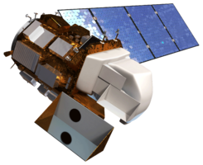
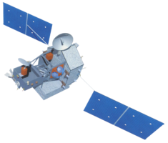
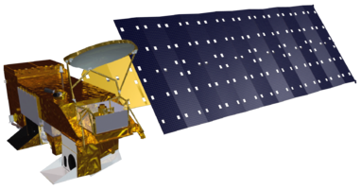
Data Acquisition
Landsat
SRTM
TRMM
Aqua
30 m
28 km
1 km
30 m
Image Credit: NASA
Notes:
Data was downloaded from Aqua MODIS for land surface temperature, Landsat for land cover, TRMM for precipitation, and SRTM for a digital elevation model.

Slide 7
Methodology
Acquisition
Processing
Notes:
The next step was data processing.

Slide 8
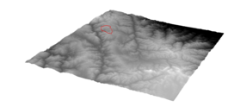
Data Processing
Use Python to process MODIS and TRMM
Use the SRTM DEM and slope tool in ArcGIS to create slope
Create composite bands of the Landsat imagery using Arc Toolbox
Notes:
Python was used to convert MODIS data from Kelvin to Celsius and the to clip the TRMM data to a smaller study area.
To process the Landsat imagery and the DEM or digital elevation model, Arc Toolbox was used to create the composite bands for the Landsat and the slope tool was used to create the slope from the DEM.

Slide 9
Methodology
Acquisition
Processing
Analysis
Notes:
The final part of the project was to analyze the data.

Slide 10
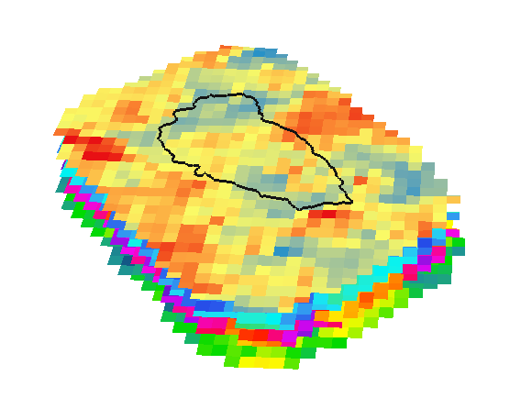
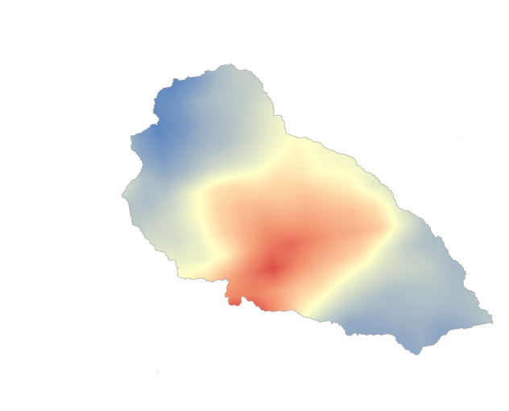
Data Analysis
Create growing degree days (GDD)
Interpolate TRMM data
Create polygons of agricultural area
Notes:
Growing degree days were created using reconstructed MODIS data. Growing Degree days are calculated by subtracting a base temperature from the average daily temperature
GDD are helpful in determining the rate of plant development, time to flowering, and yield potential over a given period.
TRMM was stacked so a value could be given to each pixel for every day during their given study periods
TRMM data was interpolated

Slide 11
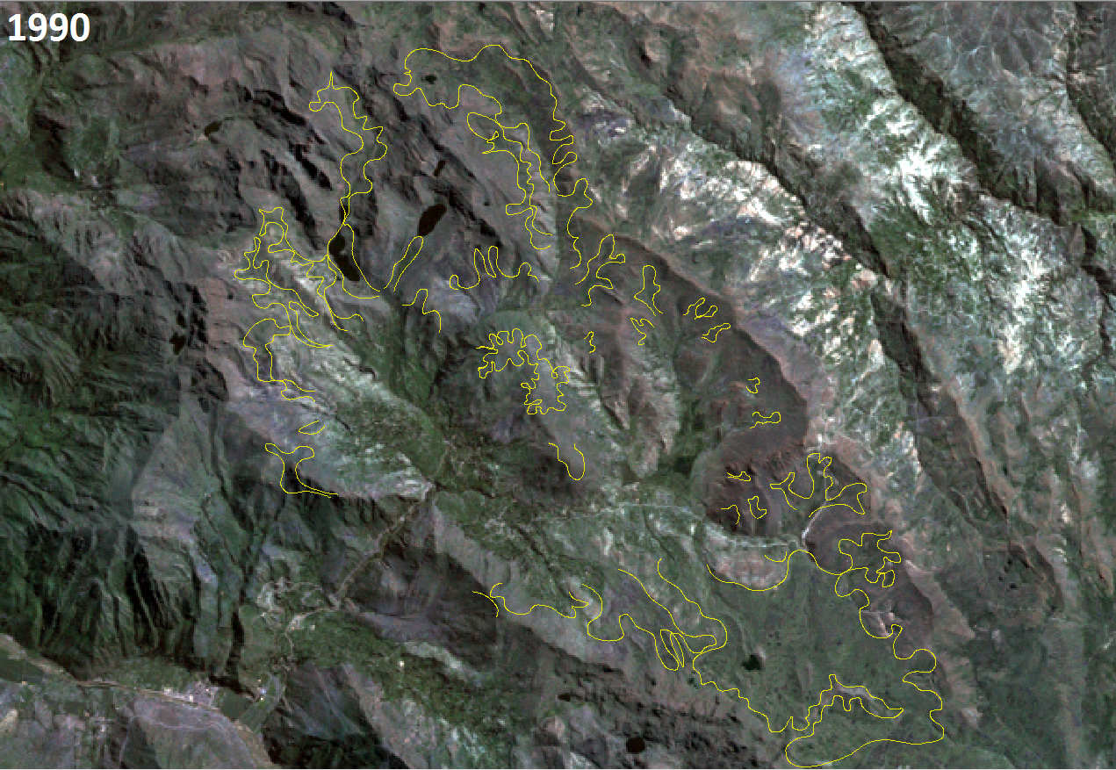
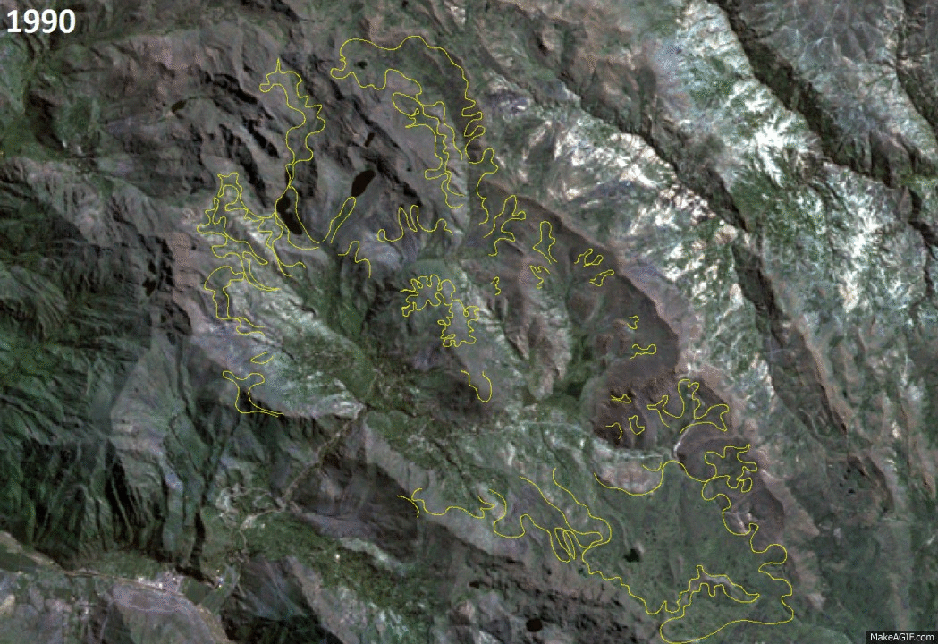
Results: Landsat
Notes:
From 1990 to 2007, the potato crops moved up the mountain to higher elevations by around 200 meters. This change can be seen particularly well in the area indicated by the orange circle In this area, the elevation change is from around 4,100 to 4,350 meters.

Slide 12
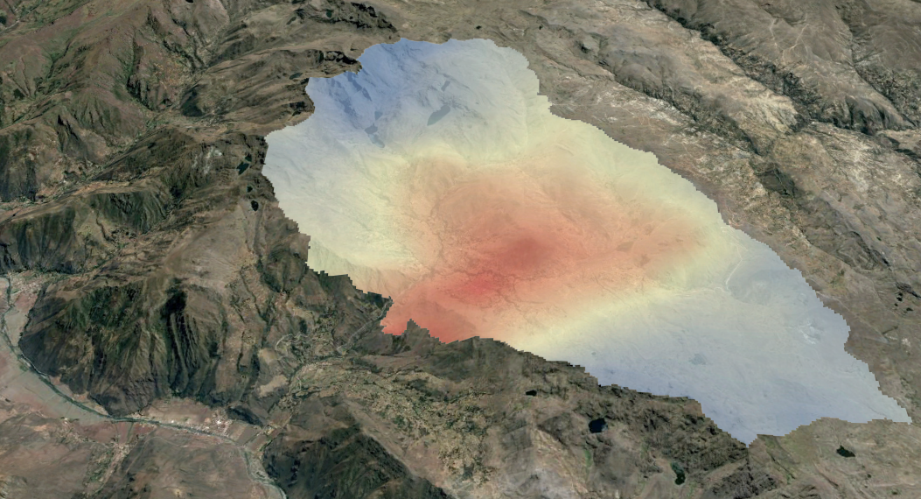
Results: Accumulated GDD
Legends
Legend
> 2000
1200 - 1999
< 1200
Notes:
This map shows accumulated growing degree days, which represent a sum of growing degree days over the cropping period of Nov. to May. The lower value, 1200 growing degree days, represents the minimum amount needed for optimal potato development. Higher elevations in the northern and southern ends of the park have lower accumulated growing degree days, indicating that a longer period of time would be needed in these areas to produce potatoes.

Slide 13
Results: TRMM
Notes:
This graph shows the average amount of precipitation that fell according to the TRMM satellite. Values were calculated by first taking all years from day one, day two etc., and adding them all up and taking the average of them all. Then once the values were calculated, a rolling average was then calculated so it would smooth out any potential outliers since the TRMM data only was available for 17 years, where typically 30 years is the standard for climatic averages.

Slide 14
Conclusions
Agricultural activity shifted 200 m between 1990 and 2007
Average accumulated precipitation was higher than expected
Temperature was higher than expected
Growing degree days suggested shorter growing seasons at higher elevations
Image Credit: Jofre Carneiro
Notes:
Our work confirmed farmers observations that agricultural activity had shifted to higher elevations over time. Temperature and precipitation time-series calculated from the satellite data used here did not match exactly the criteria for optimal potato growth, indicating a need for additional, site-specific information on the optimal conditions for potato cultivation in this region. This study represents a first step towards characterizing the growing conditions found within the Parque de la Papa, and assessing change in cultivation area over time. Future DEVELOP terms will rely on the information presented here to assess the impact of climate on potato production in this region, and predict how future changes in climate may affect the ability of local people here to conserve the rich agricultural biodiversity that is found within this park.
https://www.flickr.com/photos/ismynik/16556332686/in/photolist-re2wTQ-7wVwpq-dq1koj-7wTv65-y19Nez-qLE2Nf-7xUtYW-nTDqcV-csFvUq-7wRKat-7wRH7K-7wVyDf-8Kik9-wZDh1-HKmDT-j1S3ay-bCmVJ7-7wXYJX-7wYGFV-7x2Vh5-7rNG4m-d4kPH3-e7hnT-9dLt9-7wPHcV-7wPFf8-7xUF89-7wPFZt-7wPEsR-hi6CK7-7x2FiJ-7x2Av9-58gpGF-7wYuUk-7wYrpR-7wWwXX-e7hQN-8UfbJ1-wZDgV-4HrmR3-e7hDr-c4nsk-cDcXis-i1RHhj-7LJ1Cb-8VT8yi-8EzNB-HKmCX-77PS28-onQDNm

Slide 15
Errors & Uncertainties
Small plot size of potato crops
Cloudy mountainous regions
Few available ground measurements
Future Work
Locate weather station data to validate temperature and precipitation work
Locate further information on location of potato agriculture
Create potato crop suitability maps
Image Credit: United Soybean Board of the Soybean Checkoff
Notes:
As with much analysis of satellite data, pixel resolution and cloudiness were the two primary potential sources of error. In addition, in the rural, mountainous area of the park there were few sources of reliable weather data available to validate satellite-based temperature and precipitation measurements. If weather station data can be obtained, models could be developed to correct for some error, and so to downscale predictions to a higher spatial resolution. Higher resolution satellite imagery and further ground observations on the location of potato cultivation could help to refine suitability
https://www.flickr.com/photos/unitedsoybean/9622271807/in/photolist-fEhEb4-7n96uQ-9dTv9-4gwYUV-6G7ALM-ajsYEG-6F6zVA-nkBrLd-sCkQf-91wUAT-sMaB6-heF1z9-8xS7Ai-7uh4cr-h1BGPG-8KxjDR-dRCSeX-7SKiQH-8YZVt-76mwaP-ak6YqW-anR191-8jUY4J-oedafk-xfQUE-6tvCyh-8Jfp4k-7m5j95-5ysvUN-4hptah-6GbJ3G-65Eg16-8JCqvs-oEuXgU-5SUGkG-w1DzYw-skfUW-6Uhx77-abWba7-w9yixB-9cR6av-5GZBuy-8qUBid-dus9XA-cxSpCL-7n96ts-85AqT6-a3szKg-am9qFV-5h9LsM

Slide 16
Advisors
Dr. Kenton Ross, DEVELOP National Program
Noel Baker, NASA Post Doc Program
Partners
International Potato Center (CIP)
POC: Dr. David Ellis
POC: Noelle Barker
POC: Rene Gomez
Other
Emily Adams, NASA DEVELOP National Program

