Slide 1
ST. JOSEPH PENINSULA
Disasters
Investigating Land Cover, Shoreline Change, and Sediment Transport Utilizing NASA Earth Observations
Erica Kriner, Paige Aldenberg, James Byrne, Brianne Kendall, & Nicholas Roberge
Alabama – Marshall
Notes:
Good afternoon everyone, and welcome to the St. Joseph Peninsula Disasters presentation. Thank you all for joining us today. My name is Erica Kriner and I am the Team Lead for this project. We’ll get to introductions but first, let’s show you an overview of this presentation.

Slide 2
OUTLINE
METHODS
Incorporating NASA EO and other data & exploring analyses
THE BASICS
THE METHODS
THE FINALE
THE BASICS
CONCLUSION
Future work & acknowledgments
Introducing the team, the partners, and the study site
THE OBJECTIVES
THE RESULTS
OBJECTIVES
RESULTS
Translating community concerns to project goals
Our findings & conclusions, as well as errors or uncertainties
Notes:
We’ll begin by introducing our team, our partners, and the area we were working with for this project. From there, we’ll move on to explaining why this area is important and the community concerns that our work will help address. Then, we’ll discuss how we addressed those concerns by delving into our project’s methodology. We’ll show you what these methods yielded as well as address any potential errors or other uncertainties we may have regarding our data. Finally, we’ll close by showing how one could expand upon our work, and of course by thanking those who helped make this project successful.
** the banners on the top left corner of each slide tell you which part of the presentation you are at based on the above outline. For example, any slides that say "basics" are going to include "introducing the team, the partners, and the study site."

Slide 3
BASICS
The Team
From Left to Right: Erica Kriner (team lead), Brianne Kendall, Nicholas Roberge, James Byrne, Paige Aldenberg
Notes:
[Team Introductions]
------------------------------Image Information Below ------------------------------
•Image Source: Provided by the respective DEVELOPers

Slide 4
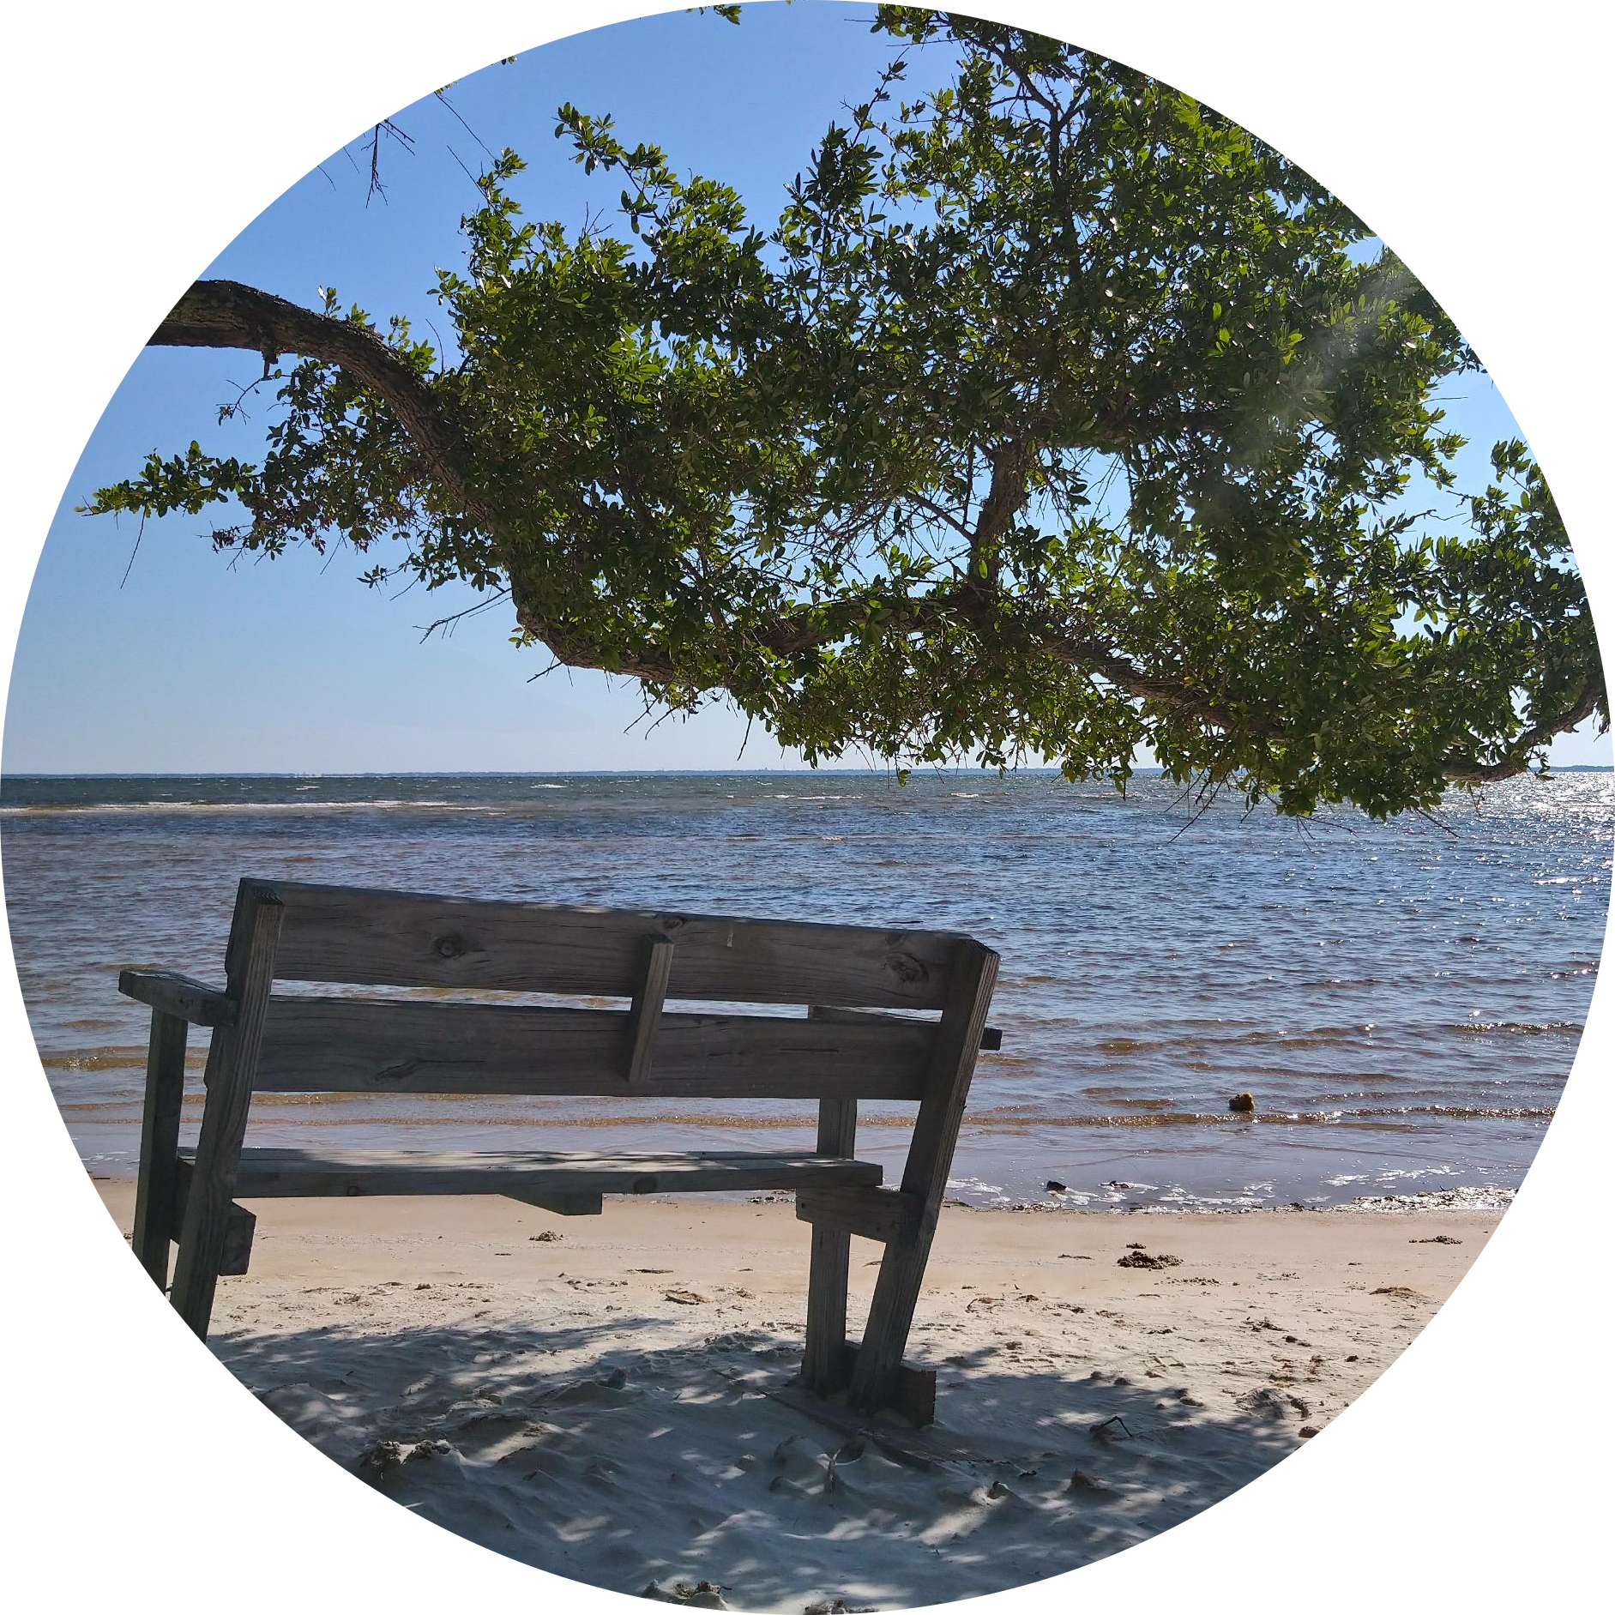
BASICS
The Partners
Florida Department of Environmental Protection
Environmental management and stewardship
Safeguard natural resources and enhance ecosystems
Works closely with other organizations and local governments
Can disseminate research to help with planning and decision-making
Credit: Florida Department of Environmental Protection
Notes:
This project partnered with the Florida Department of Environmental Protection, who focuses on environmental management and stewardship. This includes safeguarding natural resources and enhancing ecosystems, working closely with other organizations and local governments, and disseminating research to help with planning and decision making. Prior to our work with them, they were not utilizing NASA Earth observations in their work and only sparingly used GIS technology. Our partnership aimed in part to build their capacity for using these technologies in the future by illustrating ways in which they can use satellite imagery and remote sensing to manage Florida's wild places.
------------------------------Image Information Below ------------------------------
•Image Credit: Florida Department of Environmental Protection
•Image Source: https://www.floridastateparks.org/learn/managers-message-153
Provided by the Florida Department of Environmental Protection

Slide 5
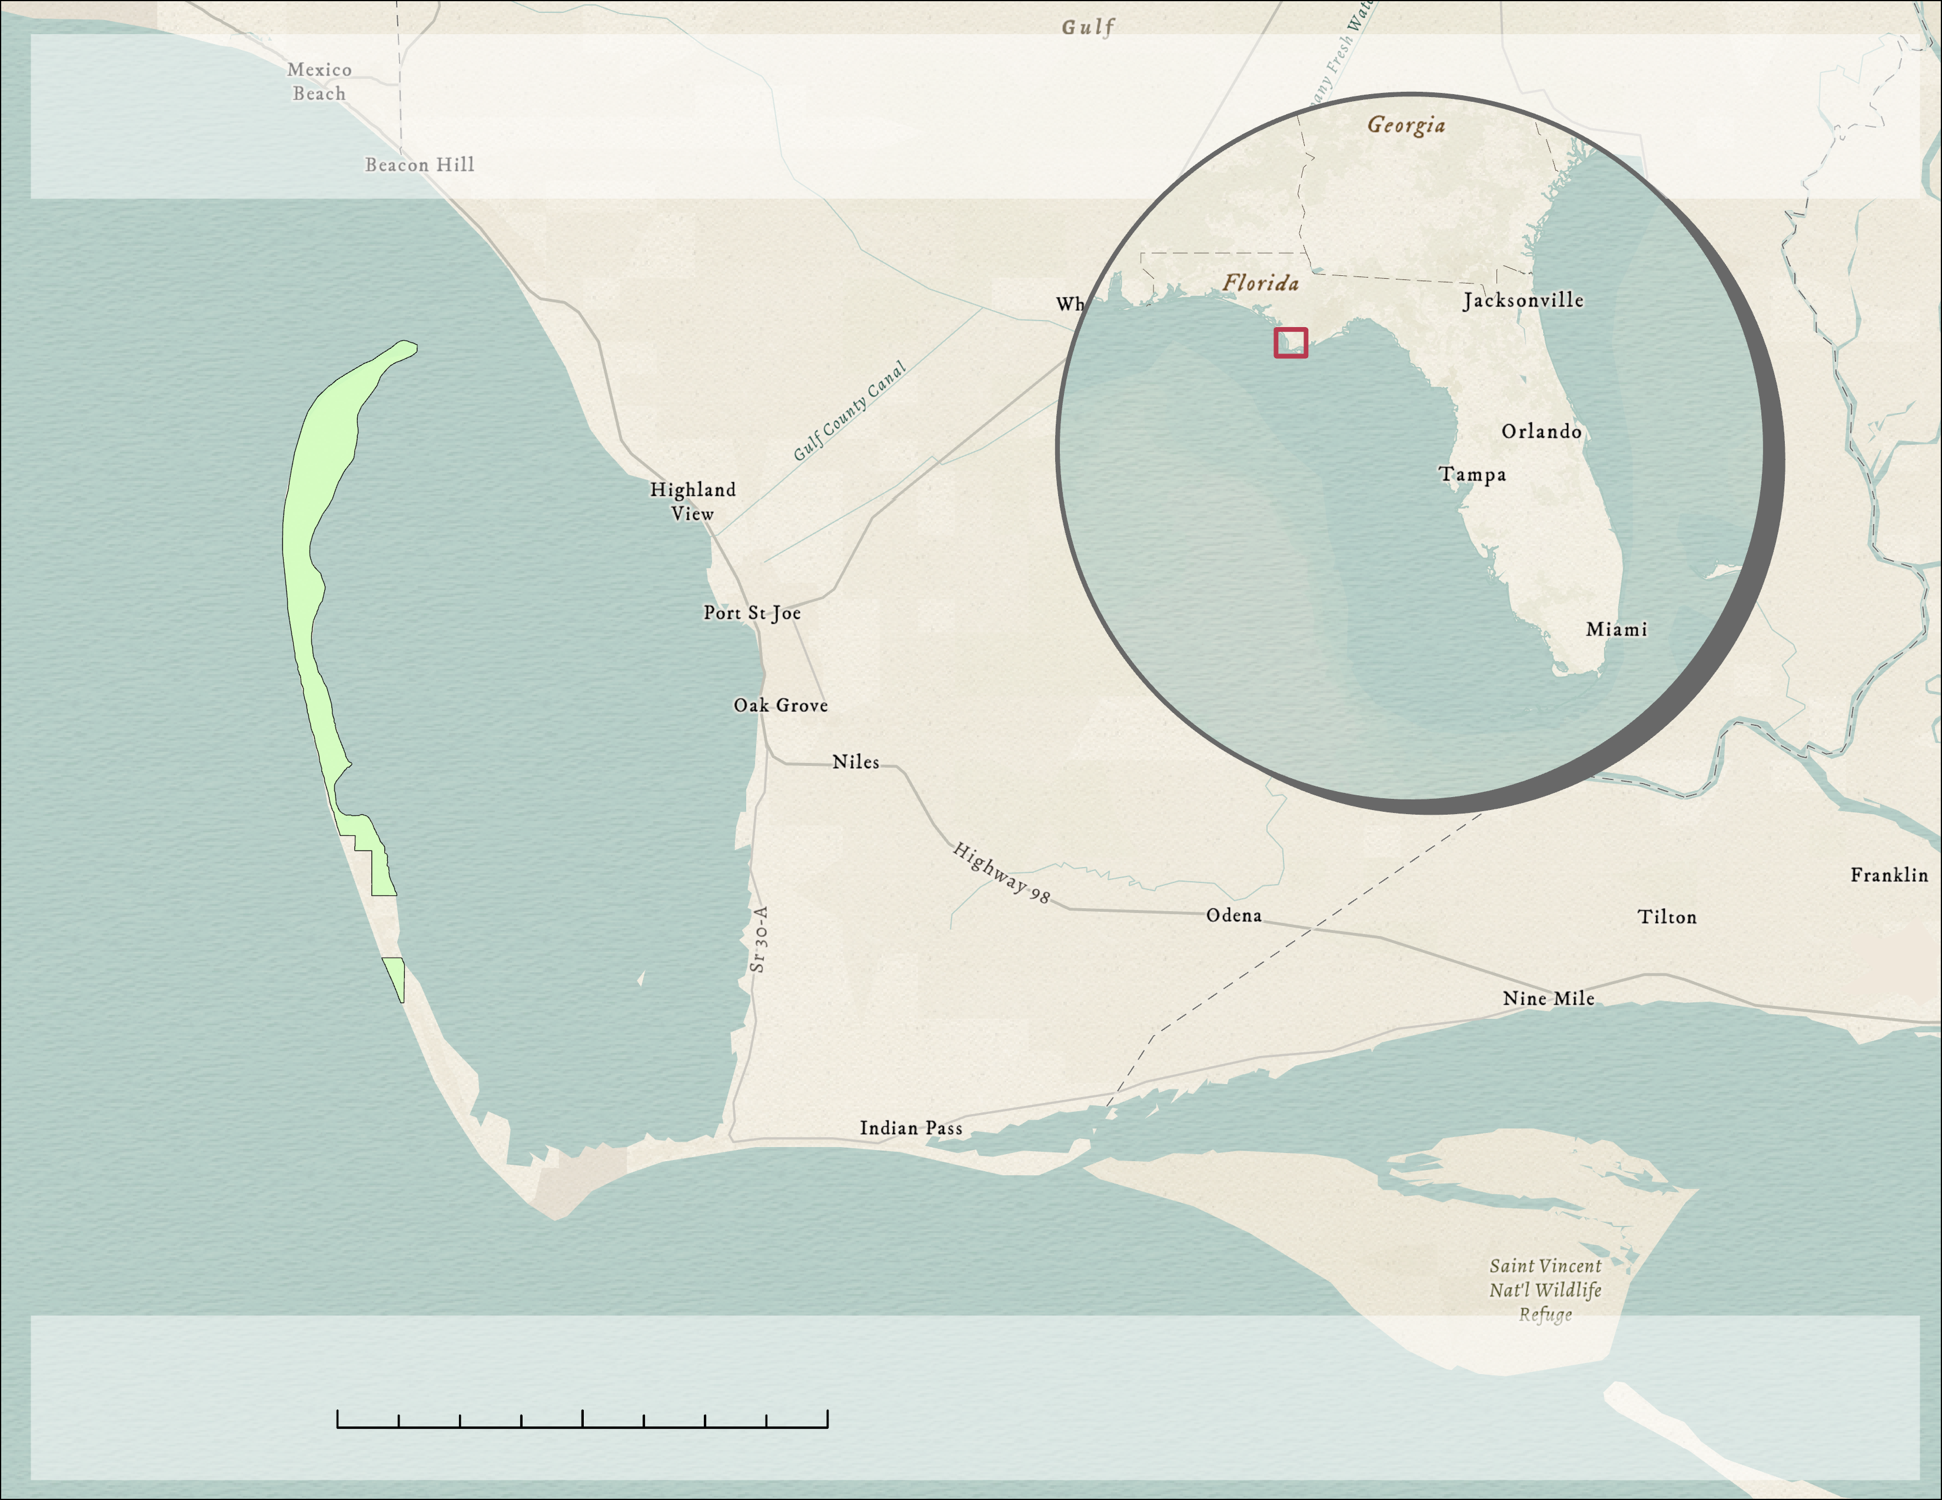
BASICS
ST. JOSEPH PENINSULA
Barrier Island off the coast of Northwestern Florida
7.1 km of recreation, wildlife, and sand dunes
Site of major hurricane damage
Tip of the Peninsula
Cape San Blas
The Breach
N
0 3 7 13 km
T.H. Stone Memorial St. Joseph Peninsula State Park
Notes:
The study area for our project was T.H. Stone Memorial St. Joseph Peninsula State Park. This peninsula is a barrier island that spans twenty miles into the Gulf of Mexico off the Florida panhandle. The peninsula connects to the mainland at Gulf County. The park provides about 7 kilometers of popular recreation sites, vulnerable wildlife habitat, and sand dunes that the local community and tourists enjoy. St. Joseph Peninsula was also a site of major damage from Hurricane Michael in October 2018. This project aimed to address the extent of the damages to aid in future mitigation plans.​
- Click for animation
Here are the main points of focus of the peninsula. The entirety of the peninsula area and surrounding community is Cape San Blas. The park's official boundaries begin halfway up the peninsula, with the tip of the peninsula on the north end, and St. Joseph Bay nestled between the peninsula and the mainland. Most notably, one mile from the park's entrance at a spot called Eagle’s Point is where Hurricane Michael cut a breach through the middle of the peninsula, splitting the park in two and effectively turning the Northern half into an island.
------------------------------Image Information Below ------------------------------
•Base map Credit: ”Modern Antique” - Esri, HERE, Garmin, FAO, NOAA, USGS, © OpenStreetMap contributors, and the GIS User Community
All images and figures created by the DEVELOP team

Slide 6
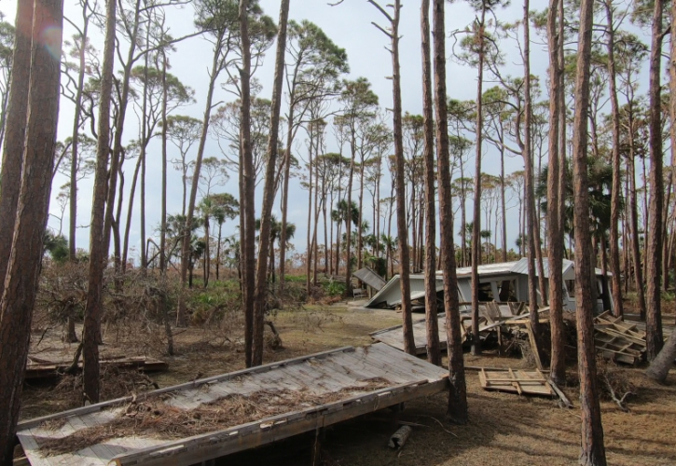
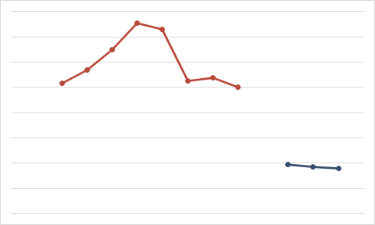
BASICS
Community Concerns
Visitation Before and After Hurricane Michael
400000
350000
300000
Number of Visitors
250000
200000
150000
100000
50000
Pre-Hurricane
Post-Hurricane
Credit: Florida Department of Environmental Protection
2010
2011
2012
2013
2014
2015
2016
2017
2019
2020
2021
Year
Notes:
Hurricane Michael wrought devastation upon St. Joseph Peninsula. Everything recreational was destroyed, from camping spots to cabin sites. The highest storm surges were estimated at close to 14 feet and cut a breach through the middle of the peninsula that was 1,000 feet across and 31-feet deep at its deepest point. The only area that did not sustain any damage was the one-mile strip from the park entrance to the breach site. By cutting the peninsula into islands, sensitive wildlife habitats were disturbed, nesting sites were ruined, and foraging grounds were isolated. The hurricane damage was equally devastating to the local community that levied their economy off the park's annual visitation. Before Hurricane Michael, more than 250,000 people visited the park every year. Since the park reopened in 2019, the visitation rate dropped 69%. In total, Hurricane Michael incurred damages that closed over half the park area, drastically reduced park visitation, and destroyed habitats for vulnerable wildlife.
------------------------------Image Information Below ------------------------------
•Image Credit: Florida Department of Environmental Protection
•Image Source: https://www.floridastateparks.org/learn/hurricane-recovery-t-h-stone-memorial-st-joseph-peninsula-state-park
Provided by the Florida Department of Environmental Protection

Slide 7
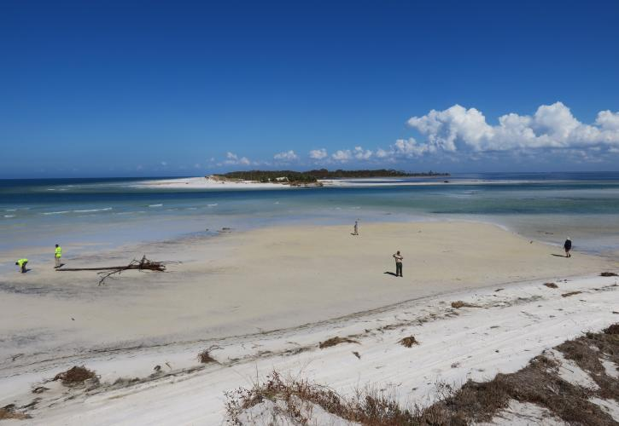
BASICS
Community Concerns
Hurricane damage threatens local habitats and species
Recreation and tourism impacts from park closure
A changing climate affects the safety of the park and surrounding communities
Credit: Florida Department of Environmental Protection
Notes:
Hurricane Michael wreaked havoc on the local communities, and many of those threats still linger today. Vital habitat spaces and foraging grounds were damaged in the storm, and sensitive species like shorebirds are still trying to find safe spaces to bread and nest. The park had to close once the breach cut the peninsula in two, and popular recreational sites have only recently re-opened to the public. Because of this, local tourism continues to suffer. The hurricane had devastating impacts on people and wildlife alike, and the rapidly changing climate only increase the likelihood of more Category 5 storms like Hurricane Michael. These community concerns are what fueled the analysis portion of this project.
------------------------------Image Information Below ------------------------------
•Image Credit: Florida Department of Environmental Protection
•Image Source: https://www.floridastateparks.org/learn/hurricane-recovery-t-h-stone-memorial-st-joseph-peninsula-state-park
Provided by the Florida Department of Environmental Protection

Slide 8
OBJECTIVES
Shoreline
Change Analysis
Sediment
Transport Timeseries
Landcover
Change Analysis
Climatology
Timeseries
Protected & Recreational Areas
Future Mitigation Planning
Tourism & Park Attendance
Safety Beyond the Barrier
Notes:
Based on these community concerns, we created four analysis objectives. With landcover change analysis, we focused on addressing the visitation and tourism of the park and the effects of how park's area changed. We wanted to understand how hurricane damage may have shifted areas designated for wildlife versus those designated for tourism. We used shoreline change analysis to look at erosion and land accretion trends across the park. Identifying these trends help us pinpoint areas of vulnerability along the peninsula. Due to the peninsula's role as a barrier island, it protects communities like Port St. Joe from additional hurricane damage, so we looked to see how climate has affected the barrier island effect over time. We also conducted a sediment transport timeseries to forecast how the landcover and shoreline will continue to change over time, hopefully aiding our partners in creating mitigation plans for future storm events.

Slide 9
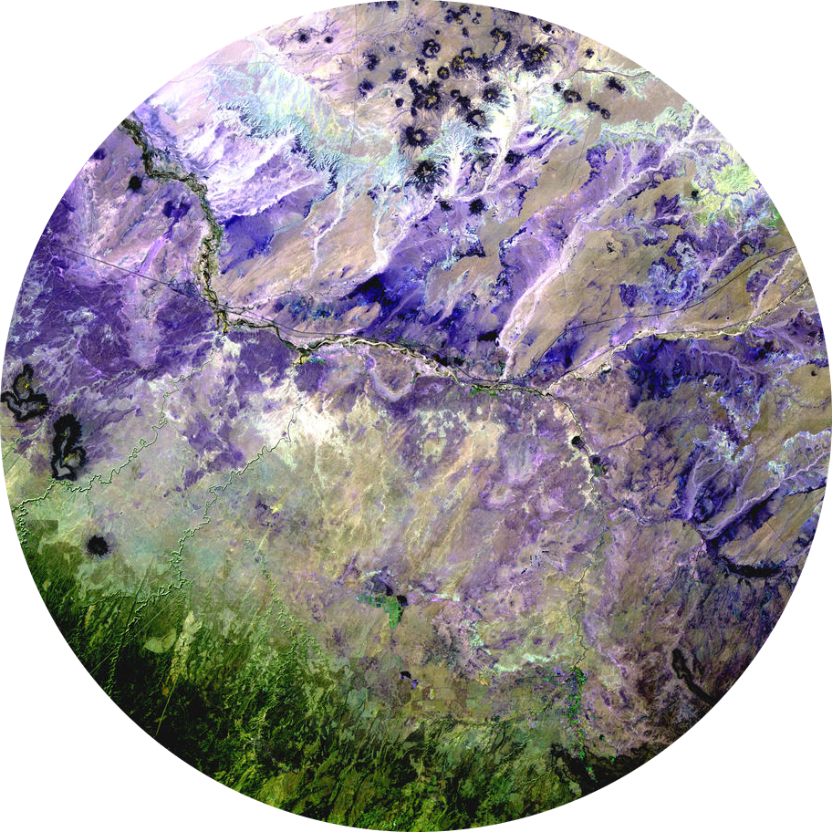
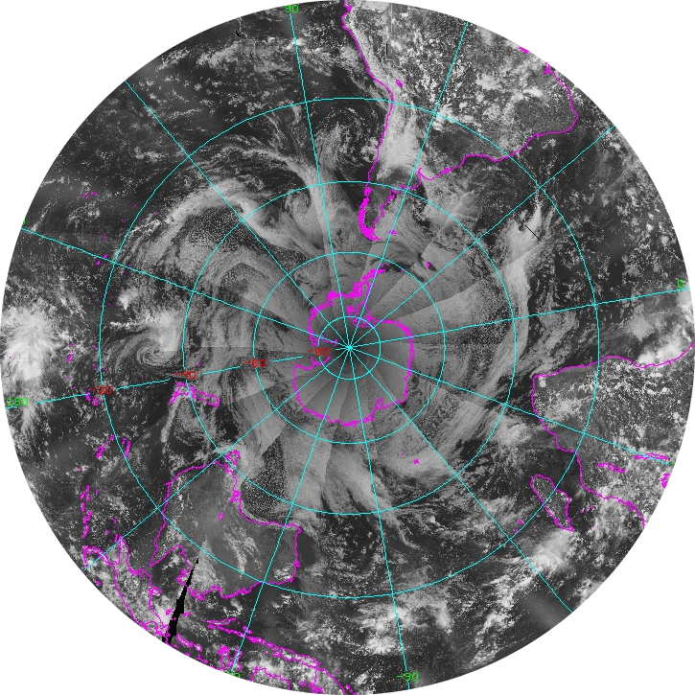
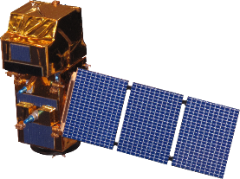
METHODS
Landsat 5 TM
Landsat 7 ETM+
Landsat 8 OLI
NOAA-19
Aqua MODIS
Sentinel-2 MSI
Imagery Credit: USGS,NOAA, ESA
Notes:
In our analyses, we used data from multiple NASA earth observations. The satellites we used were Landsat 5 Thematic Mapper, which collected images from 1984-2013, Landsat 7 Enhanced Thematic Mapper Plus, which has been collecting images since 1999, Landsat 8 Operational Land Imager, which launched in 2013, Sentinel-2 Multispectral Imager, which launched in 2015, Aqua Moderate Resolution Imaging Spectroradiometer, which is an earth observation that collects information on Earth's water cycles, and NOAA 19 weather satellite, which launched in 2009. These satellites collect daily images of Earth's surfaces, and are used to analyze surface features like vegetation, water, and ice. For our objectives, we specifically used: Landsat 5, 7, and 8 for shoreline change analysis and sea grass abundance, Landsat 7 and 8 for land cover change, Landsat 8 for chlorophyll abundance, Sentinel-2 for turbidity analysis, and Aqua MODIS and NOAA 19 for precipitation and sea surface temperature analysis within our climatology time series. [Jimmy]
**FADE IN NEXT SLIDE**
…land cover, Normalized Difference Vegetation Index, aquatic reflectance, ocean color, and sediment in the water.
------------------------------Image Information Below ------------------------------​
•Credits for satellite images of Landsat 5,7,8, and Aqua MODIS: USGS
•Credit for satellite image of Sentinel-2 MSI: ESA
Credit for satellite image of NOAA-19: NOAA
Image sources for satellite images
Landsat 5 TM: https://www.usgs.gov/media/images/desert-forest (public domain)
Landsat 7 ETM+: https://eros.usgs.gov/image-gallery/earth-as-art-2/bogda-mountains (public domain)
Landsat 8 OLI: https://eros.usgs.gov/image-gallery/earth-as-art-4/australian-iron-ore (public domain)
Sentinel-2 MSI: https://www.esa.int/Applications/Observing_the_Earth/Glacier_avalanches_more_common_than_thought (public domain)
Aqua MODIS: https://oceancolor.gsfc.nasa.gov/gallery/feature/images/A2015249174000.SouthwestAtlantic.icon.png (public domain)
NOAA-19: https://www.ssd.noaa.gov/POES/COMP/images/NOAA19_SH_CH1_DDC.jpg (public domain)

Slide 10
Google Earth Engine
Sediment Transport
Climatology
Comprehensive Google Earth Engine Analysis
Shoreline Change
Shoreline Change
Normalized Difference Water Index (NDWI)
Sediment Transport
Normalized Difference Aquatic Vegetation Index (NDAVI)
Normalized Difference Turbidity Index (NDTI)
Climatology
Normalized Difference Chlorophyll Index (NDCI)
Sea Surface Temperature & Precipitation
Notes:
Most of our analyses began in Google Earth Engine, which is a cloud-based catalog of various remote-sensing datasets.
For the shoreline change analysis, we ran a Normalized Difference Water Index on 22 cloud masked images from 1999-2021. This index applies values to certain pixels within the satellite images. Any positive value is identified as water and any negative to zero value is identified as land. This index is found by comparing the Near Infrared spectral band with the green spectral band within an image. We also ran a Modified Normalized Difference Water Index (MNDWI), which uses the short-wave infrared band instead of the near-infrared band. We did this because MNDWI has shown to more accurately remove background land noise.
For sediment transport, we used the Normalized Difference Aquatic Vegetation Index to compare seagrass abundance before/after the hurricane. We then used Hurricane Opal data from 1995 to validate results, as that was the last hurricane to have direct impacts on the peninsula. We also used Normalized Difference Turbidity Index, using Landsat imagery from 1999 – 2021 and Sentinel imagery from 2017 - 2021 to estimate turbidity levels. Select timeframes were exported to ArcGIS Pro in order to conduct change analysis.
For the Climatology analyses, we used the Index to observe the chlorophyll-a concentrations from 1984 to 2021, and sea surface temperature and precipitation from 2002-2021. For sea surface temperature, we analyzed data from NOAA Climate Data Records (CDR) Optimum Interpolation Sea Surface Temperature (OISST). For precipitation, we analyzed data from Climate Hazards Group Infrared Precipitation with Station Data (CHIRPS). We observed increasing values from all these variables. For sea surface temperature, and to a smaller extent with precipitation and chlorophyll-a, we observed an increase of variability with all values in recent years.

Slide 11
ArcGIS Pro
Final Year
ArcGIS Analysis: Landsat 7, 8
Sediment Transport: Shoreline Change
Raster Calculator
1999-2021
Increased water indicates erosion
Increased land indicates sediment transport
Initial Year
Change
Notes:
We used ArcGIS pro to finalize all of our maps, but we specifically used its analyses tools during our shoreline change and land cover change analyses.
For shoreline change, we conducted an annual change analysis using the Raster Calculator (spatial analyst) tool from 1999 to 2021. After we downloaded the water index data from Google Earth Engine, we used the following equation to find the change in water indices each year: Change = Final year - Initial year. With our values, positive 1 showed an increase in water and –1 showed an increase in land over that year. If increased water was detected, then we concluded that the area experienced erosion, and if increased land was detected, then it was likely caused by sediment transport. We used the Mosaics to New Raster (data management) tool to merge the yearly datasets into a single 22-year analysis of shoreline change as well as shoreline change in the years right before and right after Hurricane Michael. These new rasters indicate overall water and land change from 1999-2021, and these results were compared to Aerial imagery of St. Joseph Peninsula from 2009-2018.

Slide 12
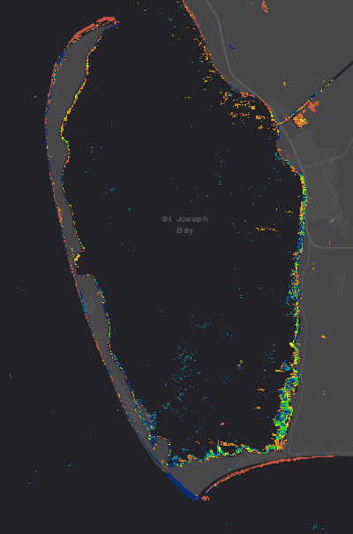
N
Shoreline Change
RESULTS
22 Year Analysis
Greatest erosion occurs inland within the bay
Most land accretion occurs oceanside along the peninsula
Dynamic nature of a barrier island
Water
Land
0
3
Miles
Landsat 7 & 8 1999-2021
Notes:
We conducted change analysis for each individual year; however, there was not enough annual change to make a noticeable difference on the graphs. Because of this, we decided to conduct a full 22-year analysis so we could better see erosion and accretion trends over time. Although 22 years is a short span of time on the geological scale, it is important to see how the shoreline is changing in the face of modern dangers like hurricanes, climate change, and anthropogenic change. We chose to use a multiple color gradient for the 22-year analysis, because we can better understand the gradual changes that occurred over time. Yellow to brown indicates an overall increase of land accretion over time, which is likely an indicator of sediment transport and vegetation growth. Green to blue indicates an overall increase in water over time, which likely indicates long-term erosion along the coast. This multi-color gradient is important, because we can see the dynamic nature of a barrier island, where sediment is constantly being deposited and eroded by waves and storm surges. Almost every inch of the peninsula has been touched by both land gain and land loss, which is to be expected from coastal areas that experience constant sediment buildup and erosion from waves, storms, and tides. However, there are a few areas that show a more definitive trend. The Northern and Southern tip of the peninsula have largely experienced land accretion, while the length of the peninsula and the inland bay area have largely eroded over time. The aerial images that we compared our results indicated beach filling from 2009-2014 and beach erosion from 2014-2018 which were cohesive with our own results. That being said, we decided to take a closer look at how the peninsula was affected by massive storms like Hurricane Michael.
------------------------------Image Information Below ------------------------------
Base map credit: Esri, HERE, Garmin, FAO, NOAA, USGS,
All images and figures created by the DEVELOP team

Slide 13
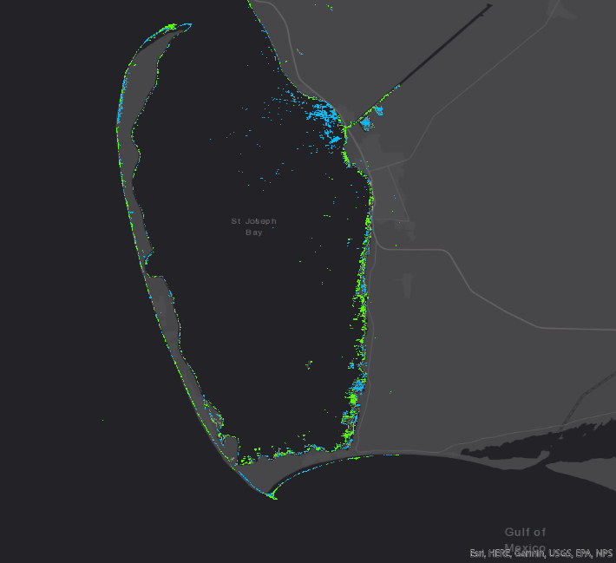
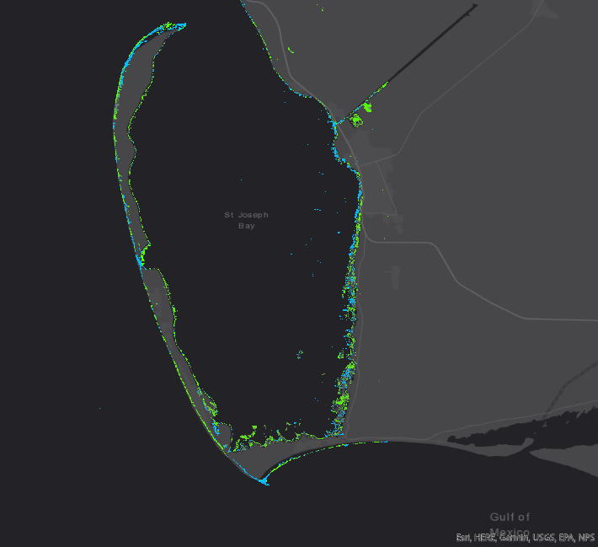
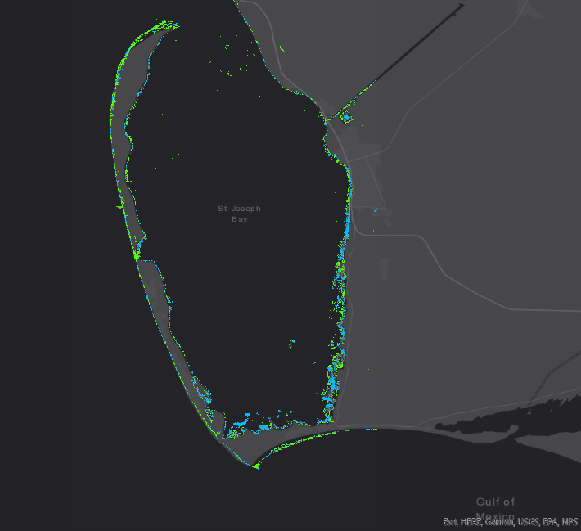
RESULTS
Shoreline Change – Hurricane Michael
N
N
N
Breach
Breach
Breach
Water
Land
0
3
0
3
0
3
Landsat 8 2017-2018
Landsat 8 2018-2019
Landsat 8 2019-2020
Miles
Miles
Miles
Notes:
The Category 5 storm made landfall in October 2018, and we know that the storm surge cut a massive breach into the peninsula, effectively cutting the area in half. I used this information to test the accuracy of these shoreline maps. I used the 2017-2018 map as the control map because the majority of the data from that year was collected before the Hurricane. There is no significant accretion or erosion at the area where the breach occurred. However, the following year shows significant erosion, and the year after shows significant land accretion. This aligns with information from our partners – the breach was present for half of 2018 (which means the entire area was eroded and under water) until it was finally filled in by natural sediment transportation (which means the area experience significant land accretion). This why all the erosion from 2018 transitions to land accretion by 2020. We also used these maps as an indicator of vulnerability across the peninsula. Every storm is different but understanding how the peninsula is affected by one as severe as Hurricane Michael will help our partners prepare for future severe storm events. The 2018-2019 map shows direct impacts the year after the storm. The Northern and Southern tips experienced the greatest erosion, while the greatest land accretion occurred within the bay. This makes sense, because the peninsula acted as a barrier island and most of the storm surge was absorbed by the peninsula. This means that we should see greatest erosion occurring along the ocean-facing side of the park. All the sediment that was washed away was then transported to the bay. Interestingly, the shoreline that hugs the mainland experienced a mix of erosion and accretion. This might be a result of human development like beach houses and restaurants that had already weakened and disturbed the sands along the mainland. Disturbed coastline can easily be eroded by the same waves that are depositing more sand along the shore. The 2019-2020 map indicates recovery almost two years after Hurricane Michael, and it is almost a reverse image of the map before. The Northern and Southern tips have filled back in with sediment, and the excess land accretion within the bay has receded back to the ocean. Our partners were unable to perform extensive restoration work during this time, so most recovery occurred as result of natural forces like tidal waves and ocean currents. It is impressive to see how well the barrier island can recover on its own. Similar trends were seen when these maps were compared with shoreline change maps of pre-and post-Hurricane Opal, which was the last major storm to directly impact St. Joseph Peninsula in 1995.
------------------------------Image Information Below ------------------------------
Base map credit for all images: Esri, HERE, Garmin, FAO, NOAA, USGS,
All images and figures created by the DEVELOP team

Slide 14
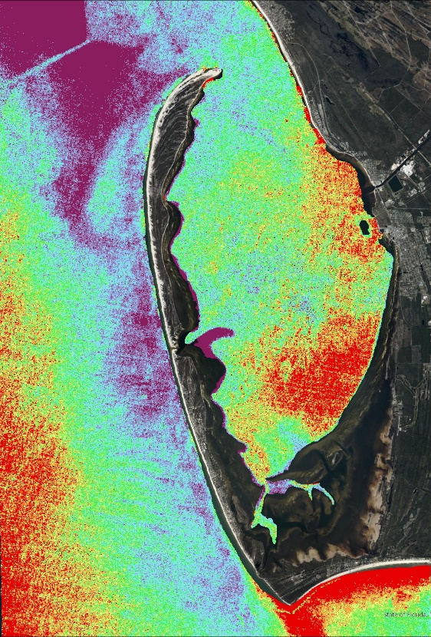
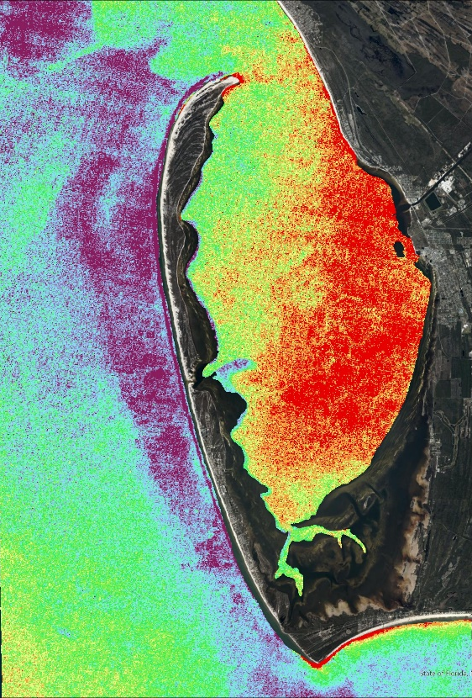
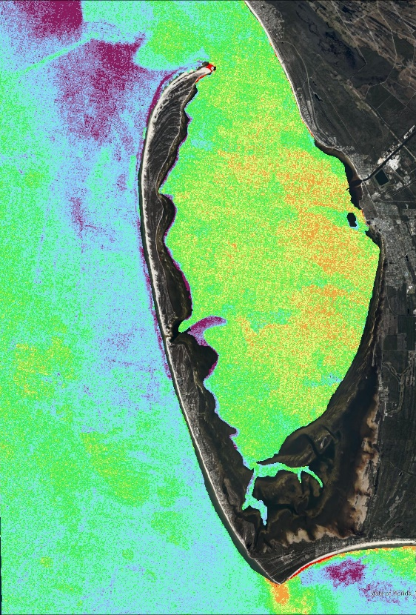
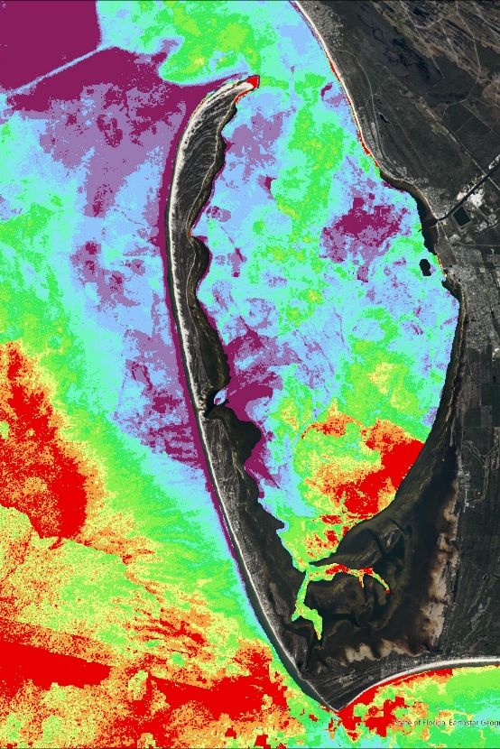
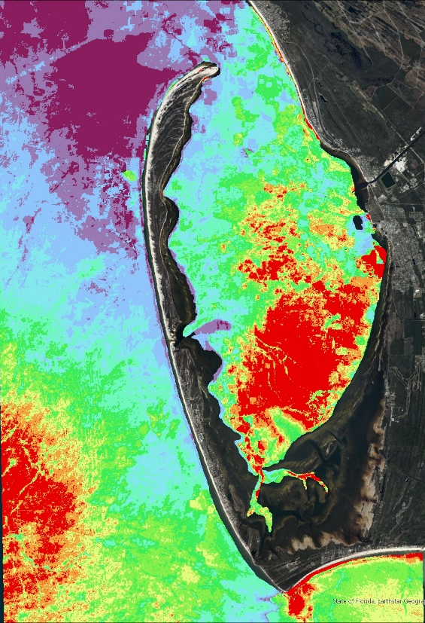
RESULTS
Sediment Transport: Turbidity
2000
2005
2010
2015
2021
N
0
3
NDTI Percentile:
0–10%
11–20%
21–30%
31–40%
41–50%
51–60%
61–70%
71–80%
81–90%
91–100%
Miles
Landsat 7 & 8 April-September
Notes:
These are seasonal Landsat images taken between April and September showing normalized difference turbidity index (NDTI). NDTI uses the ratio of the red and green bands of imagery to detect suspended particles. Turbidity increases as suspended particles in the water increases. An increase in rainfall and/or high winds are the greatest influences on spikes in turbidity. Due to the bottom reflectance of shallow water occasionally being detected as suspended particles, water shallower than 1.8 meters was masked from our analyses. In this time series, imagery for 2015 was cloudy, leaving some gaps in coverage. Turbidity throughout the timeframe has been higher between April and September, and specifically at the southern shore of the cape and at the northern tip of the peninsula, coinciding with shoreline change. Turbidity can also be seen increasing around the mouth of the Gulf County Canal after periods of heavy rain.
------------------------------Image Information Below ------------------------------
Base Map Credit: “World Imagery” - Esri, Maxar, GeoEye, Earthstar Geographics, CNES/Airbus DS, USDA, USGS, AeroGRID, IGN, and the GIS User Community
All images and figures created by the DEVELOP team

Slide 15
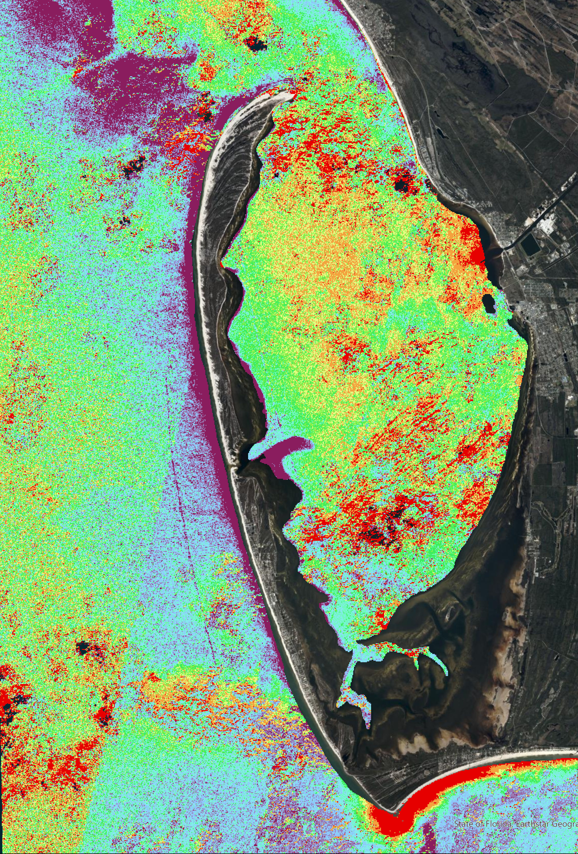
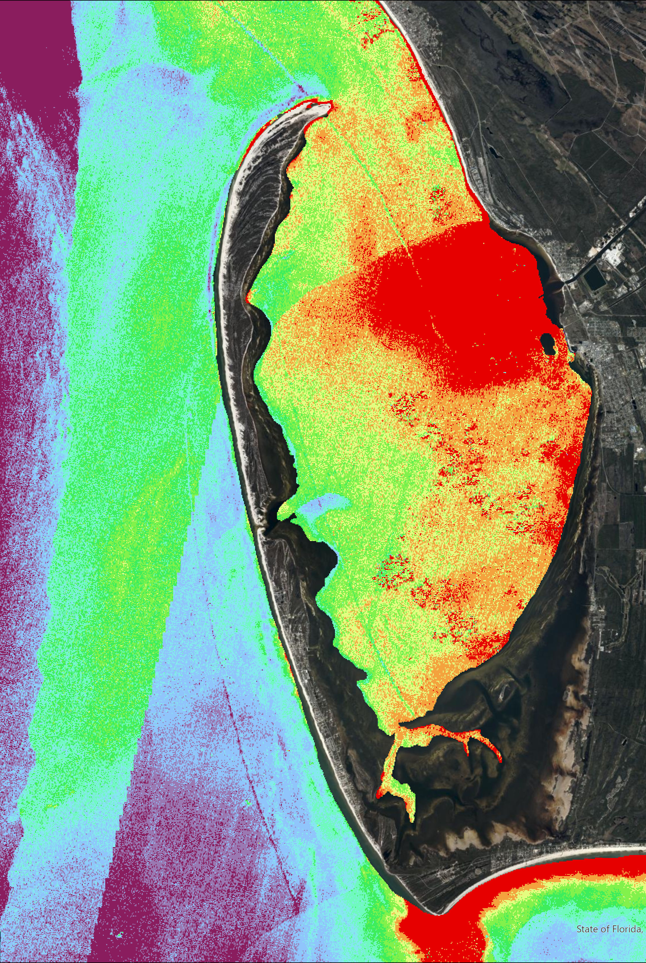
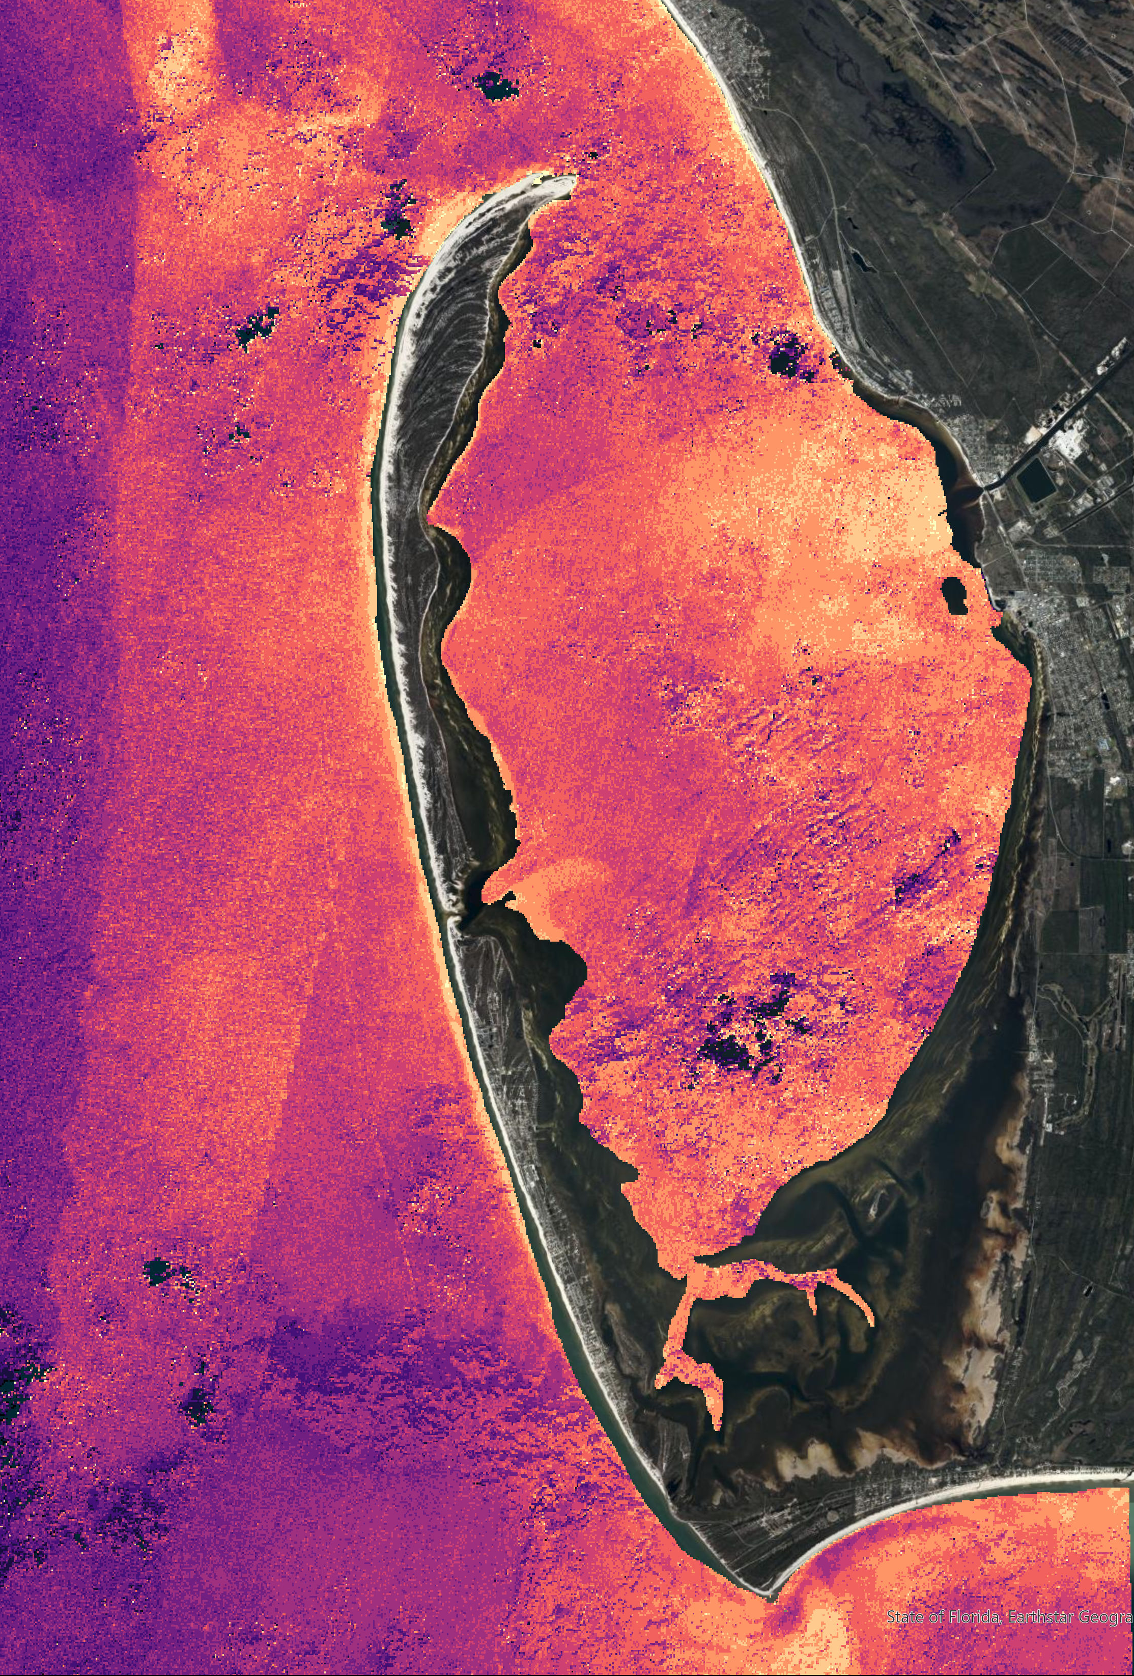
RESULTS
Turbidity: Before and After
Change in NDTI
10 days before
10 days after
-
+
NDTI
0
-0.2
-0.4
Oct. 4
Oct. 9
Oct. 17
N
0
3
NDTI Percentile:
0–10%
11–20%
21–30%
31–40%
41–50%
51–60%
61–70%
71–80%
81–90%
91–100%
Miles
October 2018 Sentinel-2
Notes:
These are Sentinel-2 images of the turbidity 10 days before and after Hurricane Michael as well as an image showing the difference between the two. Sentinel imagery was used for this study due to the temporal availability of Landsat imagery for this timeframe. The imagery prior to the hurricane had some cloud cover that affected the turbidity readings. The chart shows the spike in NDTI on October 9th, the day before the hurricane landed. The images show the median NDTI calculated for the days leading to the spike and afterwards. The positive change in NDTI is shown in yellow on the far-right image and shows an increase in turbidity on the Gulf side of the tip of the peninsula as well as at the mouth of the Gulf County Canal, likely due to heavy rainfall.
------------------------------Image Information Below ------------------------------
Base Map Credit: “World Imagery” - Esri, Maxar, GeoEye, Earthstar Geographics, CNES/Airbus DS, USDA, USGS, AeroGRID, IGN, and the GIS User Community
All images and figures created by the DEVELOP team

Slide 16
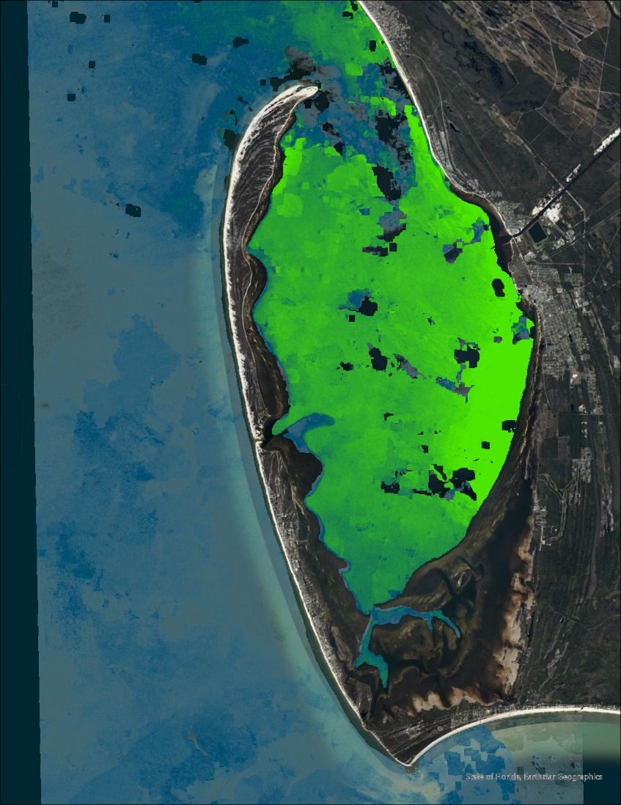
RESULTS
Sediment Transport: Seagrass
Seagrass abundance decreases the most during the winter following a hurricane, which increases sediment transport.
Anthropogenic impacts affect seagrass similarly in years where the peninsula did not experience a hurricane.
Oil spills, propeller scarring, stormwater runoff from increased precipitation, sea urchins.
N
Summer 2018 Submerged Aquatic Vegetation (Landsat 8)
0
3
Miles
Notes:
Through our analyses we noted a decrease in seagrass abundance the winters after a hurricane. Seagrass abundance decreases every winter, but stronger declines happen after a hurricane. As seagrass holds sediment down, a decrease in this abundance will lead to an increase in sediment transport. This image shows the seagrass abundance in the summer of 2018...
(CONTINUE TO NEXT SLIDE)
… and this image shows the abundance of seagrass in the summer of 2019. Although the abundance of seagrass increases back to normal levels the following seasons after the winter decline, the location of the seagrass growth exemplifies the barrier island effect. It should be noted that seagrass abundance has been decreasing over time and this "barrier island effect" is seen in years where the peninsula did not experience a hurricane, most likely due to human-caused impacts like oil spills, propeller scarring, stormwater runoff, or sea urchin grazing. The imagery shown was compared to ariel imagery of St. Joseph Bay, and seagrass concentrations are more so on the perimeters on the coast. The detection in the middle of the bay is more likely to be turbidity, but the trends shown in this imagery compared to the ariel imagery still align with seagrass decline.
------------------------------Image Information Below ------------------------------
Base Map Credit: “World Imagery” - Esri, Maxar, GeoEye, Earthstar Geographics, CNES/Airbus DS, USDA, USGS, AeroGRID, IGN, and the GIS User Community
All images and figures created by the DEVELOP team

Slide 17
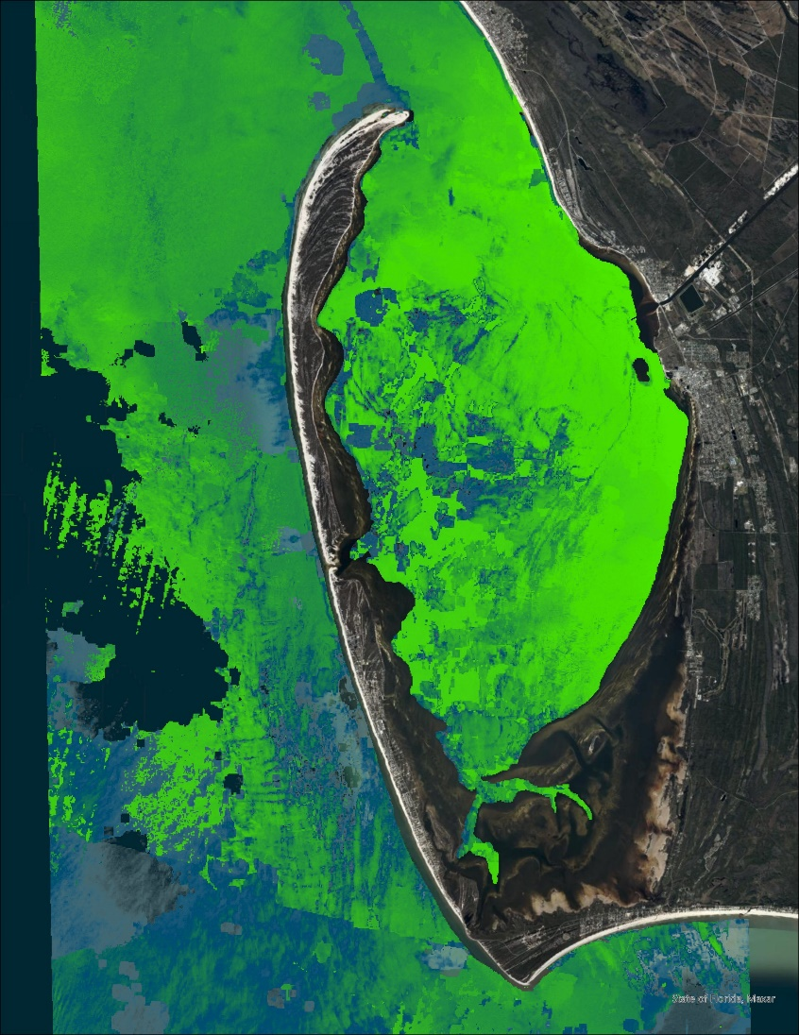
RESULTS
Sediment Transport: Seagrass
Seagrass abundance decreases the most during the winter following a hurricane, which increases sediment transport.
Anthropogenic impacts affect seagrass similarly in years where the peninsula did not experience a hurricane.
Oil spills, propeller scarring, stormwater runoff from increased precipitation, sea urchins.
N
Summer 2019 Submerged Aquatic Vegetation (Landsat 8)
0
3
Miles
Notes:
… and this image shows the abundance of seagrass in the summer of 2019. Although the abundance of seagrass increases back to normal levels the following seasons after the winter decline, the location of the seagrass growth exemplifies the "barrier island effect. It should be noted that seagrass abundance has been decreasing over time and this "barrier island effect" is seen in years where the peninsula did not experience a hurricane, most likely due to human-caused impacts like oil spills, propeller scarring, stormwater runoff, or sea urchin grazing. The imagery shown was compared to ariel imagery of St. Joseph Bay, and seagrass concentrations are more so on the perimeters on the coast. The detection in the middle of the bay is more likely to be turbidity, but the trends shown in this imagery compared to the ariel imagery still align with seagrass decline.
------------------------------Image Information Below ------------------------------
Base Map Credit: “World Imagery” - Esri, Maxar, GeoEye, Earthstar Geographics, CNES/Airbus DS, USDA, USGS, AeroGRID, IGN, and the GIS User Community
All images and figures created by the DEVELOP team

Slide 18
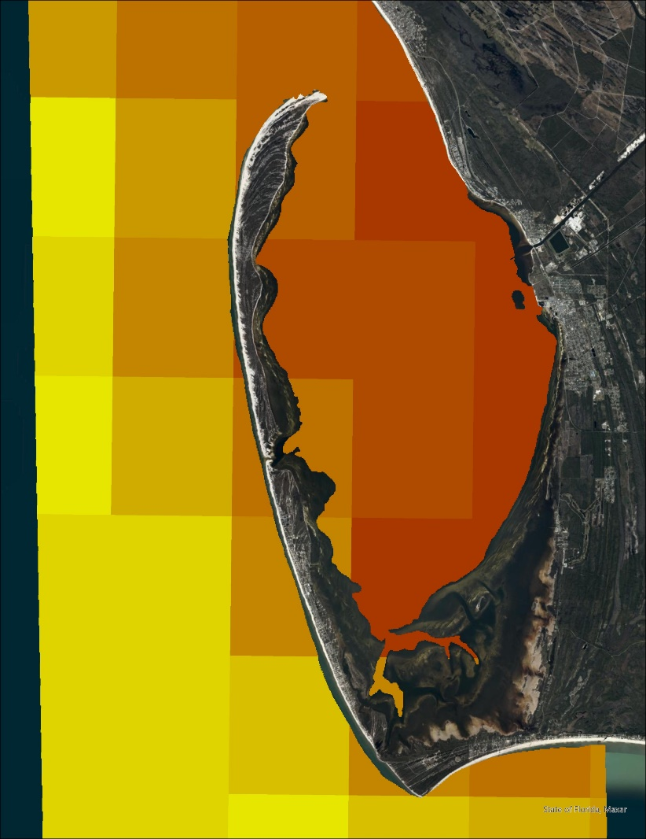
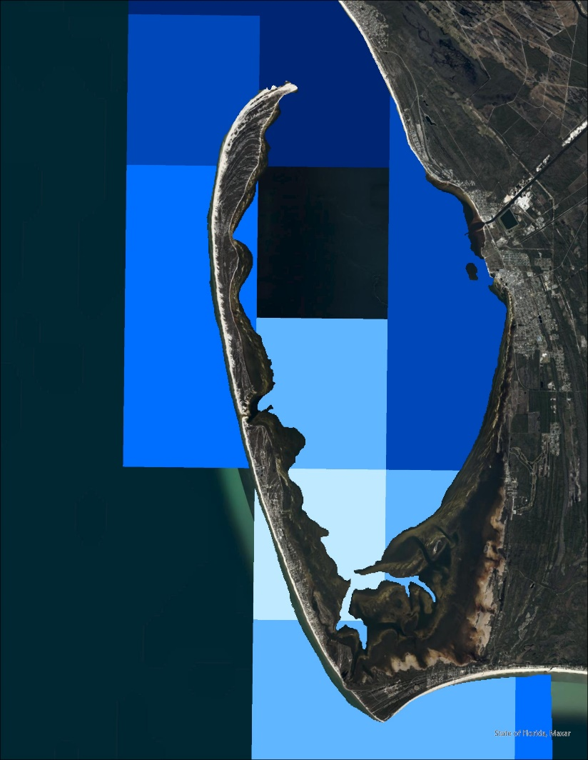
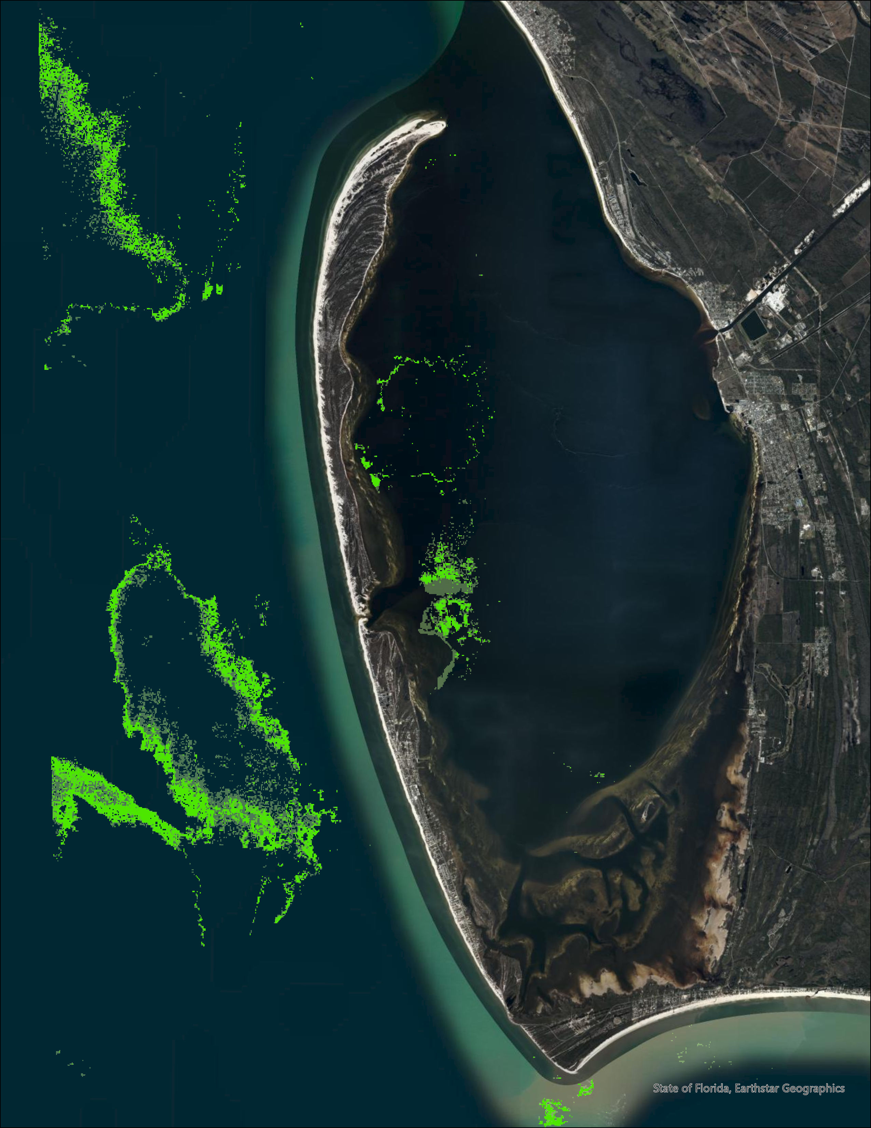
RESULTS
Climatology
Summer 2018 (Jun 1 – Aug 31)
Sea Surface Temperature (Aqua MODIS)
Precipitation (CHIRPS)
Chlorophyll-a Concentration (Landsat 8)
29.5 C
30.9 C
4.2 mm
5.5 mm
0
3
N
Miles
Notes:
Our climatology analysis included looking at sea surface temperature, chlorophyll-a concentrations, and precipitation. The results indicated that there has been an increase in sea surface temperature, chlorophyll-a, and precipitation. We looked at data from when these values were first being recorded to now. For sea surface temperature and precipitation, the data began in 2002, and for chlorophyll-a, the data began in 1984. Here we see each variable before Hurricane Michael...
(CONTINUE TO NEXT SLIDE)
Said on next slide:
...and these are the variables after Hurricane Michael. As we can see from these images, all three values increased. The chlorophyll-a concentrations tended to be where seagrass concentrations were not detected. Continuous increase of sea surface temperature and precipitation lead to higher levels of chlorophyll-a, and too many algae blooms lead to oxygen depletion in the water. Without any big winter low temperatures, these trends can also lead to tropicalization, where non-native species that come in from hurricanes will stay and reproduce rather than dying in the winter, and the surrounding climate changes to be more tropical.
------------------------------Image Information Below ------------------------------
Base Map Credit: “World Imagery” - Esri, Maxar, GeoEye, Earthstar Geographics, CNES/Airbus DS, USDA, USGS, AeroGRID, IGN, and the GIS User Community
All images and figures created by the DEVELOP team

Slide 19
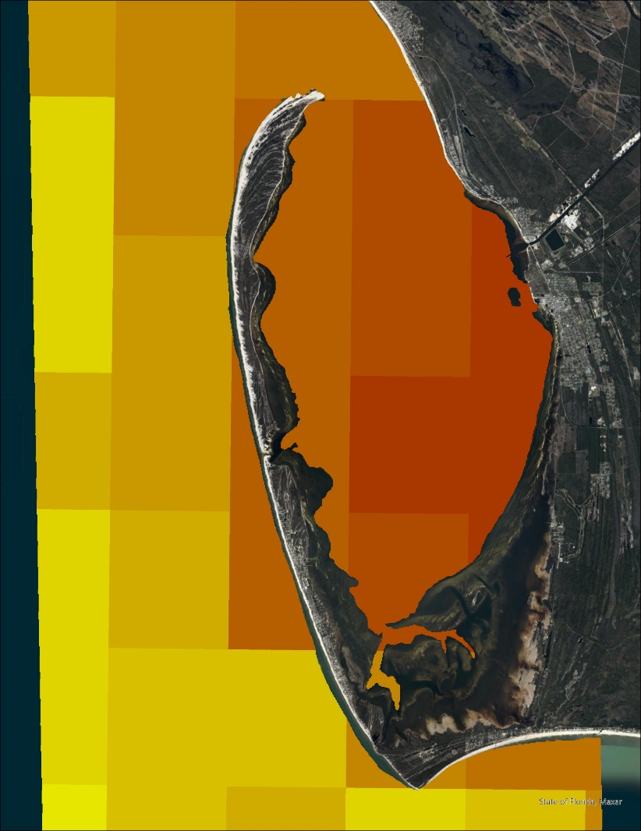
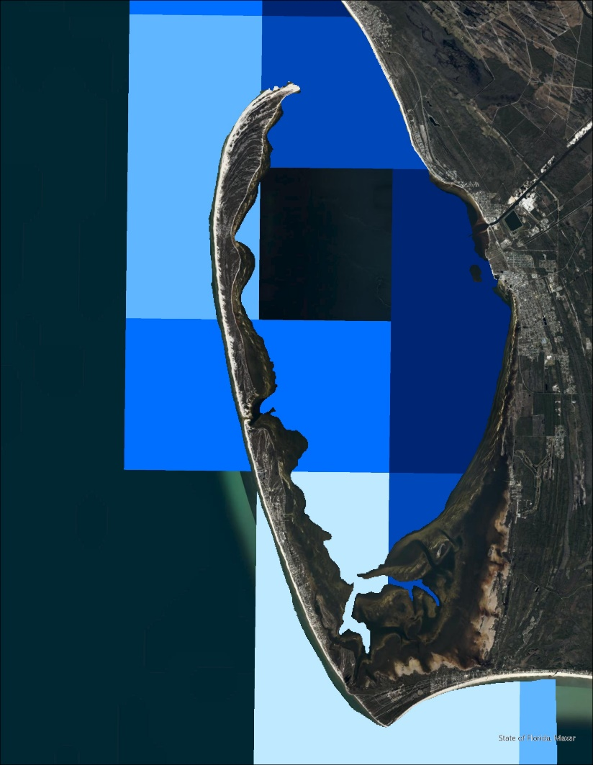
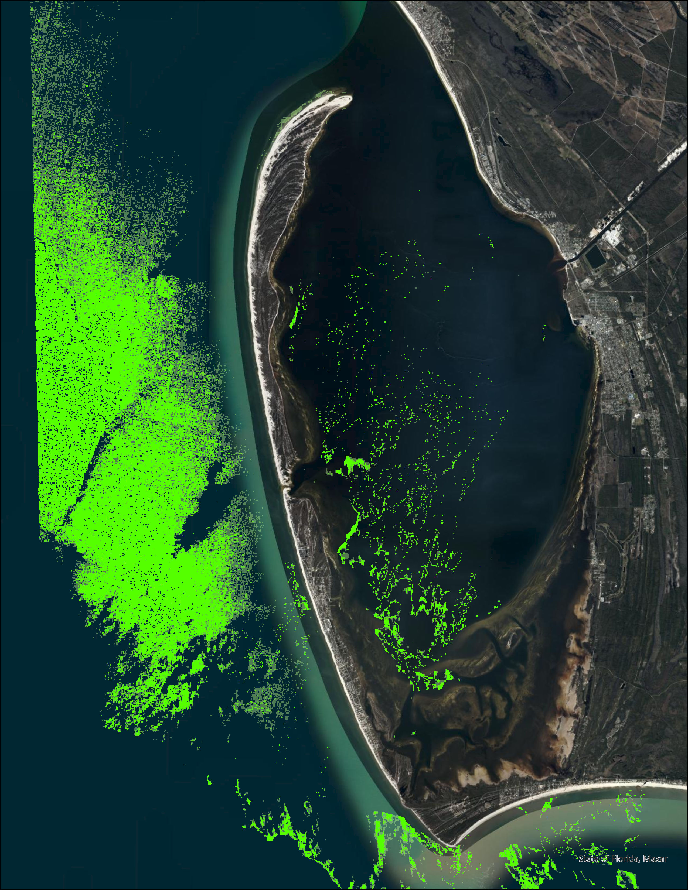
RESULTS
Climatology
Summer 2019 (Jun 1 – Aug 31)
Sea Surface Temperature (Aqua MODIS)
Precipitation (CHIRPS)
Chlorophyll-a Concentration (Landsat 8)
29.5 C
30.9 C
4.2 mm
5.5 mm
0
3
N
Miles
Notes:
...and these are the variables after Hurricane Michael. As we can see from these images, all three values increased. The chlorophyll-a concentrations tended to be where seagrass concentrations were not detected. Continuous increase of sea surface temperature and precipitation lead to higher levels of chlorophyll-a, and too many algae blooms lead to oxygen depletion in the water. Without any big winter low temperatures, these trends can also lead to tropicalization, where non-native species that come in from hurricanes will stay and reproduce rather than dying in the winter, and the surrounding climate changes to be more tropical.
------------------------------Image Information Below ------------------------------
Base Map Credit: “World Imagery” - Esri, Maxar, GeoEye, Earthstar Geographics, CNES/Airbus DS, USDA, USGS, AeroGRID, IGN, and the GIS User Community
All images and figures created by the DEVELOP team

Slide 20
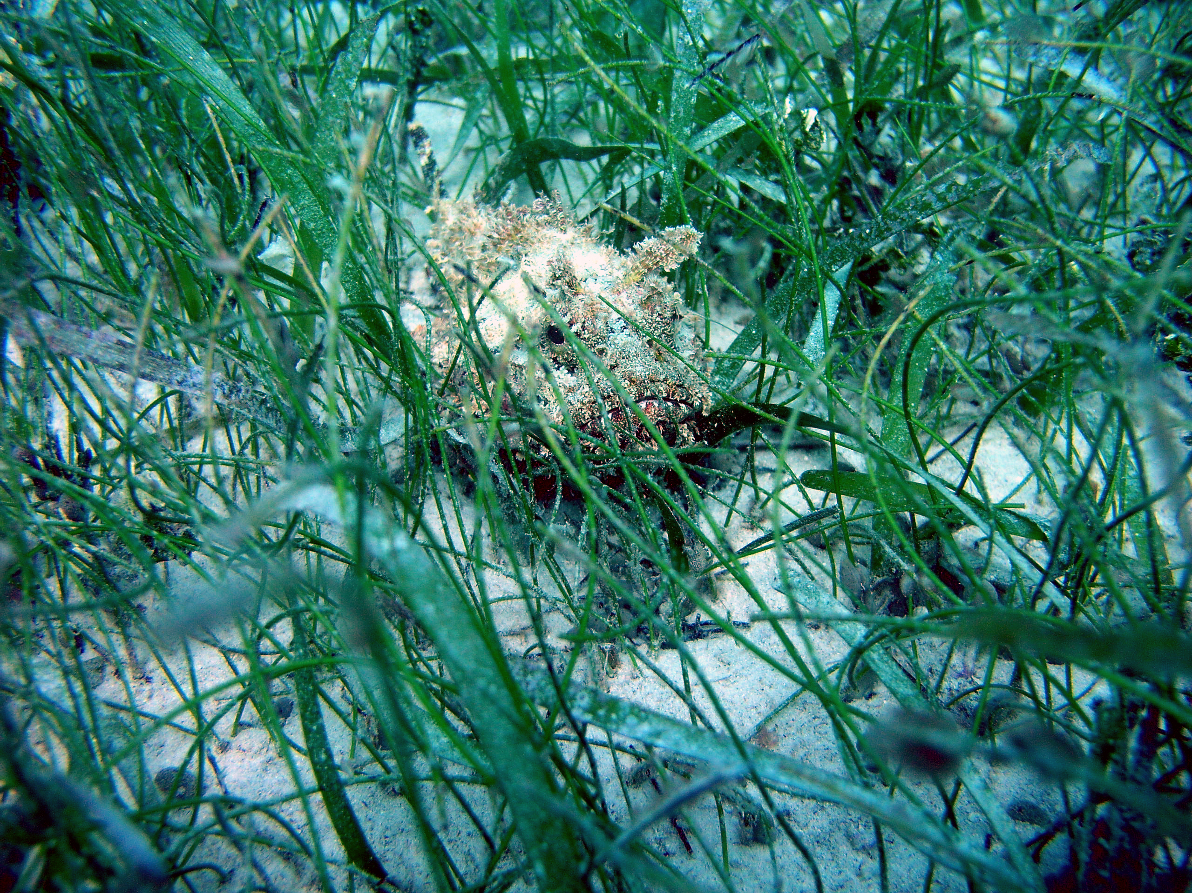
RESULTS
Errors and Uncertainties
Differences in Landsat 5 and Landsat 8 technologies may have affected seagrass concentration readings
Depth of study area may have impacted turbidity and seagrass readings
Cloud masking can leave behind pixels that produce false readings, leaving gaps in coverage
Lack of in situ data for validation
Credit: National Marine Sanctuaries
Notes:
During the analyses, the team faced a few uncertainties with the methodologies and results. When looking at seagrass data, the Landsat readings showed an increase in seagrass abundance, but this was due to the difference in satellite technologies. With more time, we would have made a tool to calculate the abundance that takes this difference into consideration.
The depth of the study area also impacted the turbidity and seagrass results as the bay was too shallow, so this posed some difficulty in deciphering what was seagrass and what was turbidity.
Cloud masking had the potential to produce false readings and left gaps in coverage in our imagery and data. There was also a lack of in situ data to validate our results. We were able to find some aerial images of St. Joseph Bay to compare data with, but we could not compare our overall results to any robust catalog of in situ data.
------------------------------Image Information Below ------------------------------
•Image Credit: National Marine Sanctuaries
•Image Source: Wikimedia Commons https://commons.wikimedia.org/wiki/File:Scorpionfish_In_Seagrass_(29904628858).jpg
(Public Domain)

Slide 21
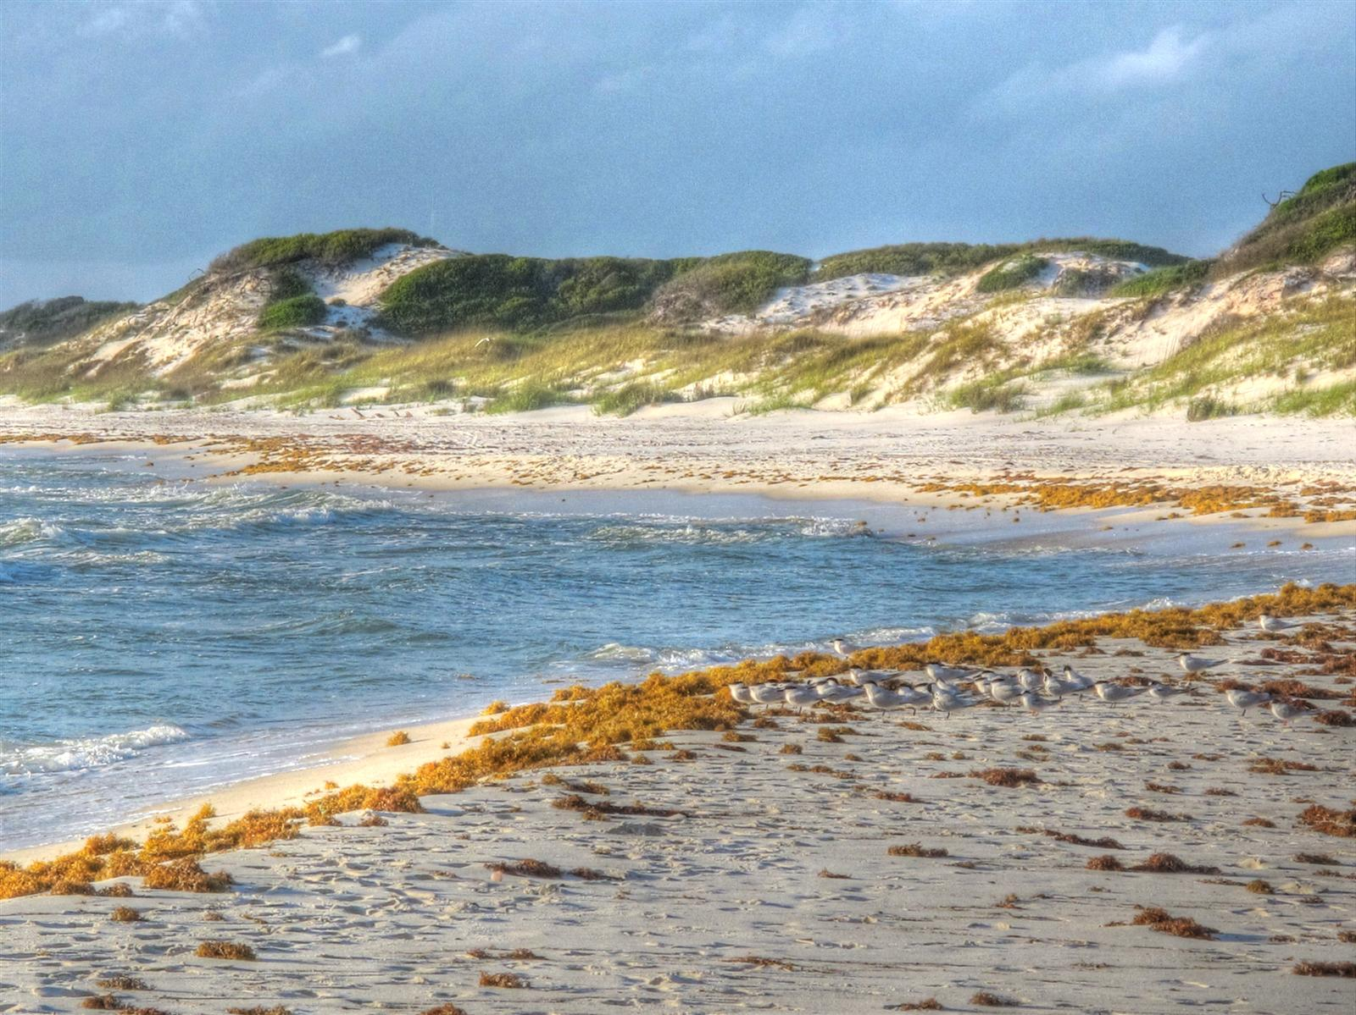
FINALE
Future Work
Consider additional analyses exacerbating environmental damages
Conduct shoreline analysis over longer period and compare with historical shoreline data
In-depth analyses for Hurricane Opal for variable comparisons
Implement analyses for other critical shorelines in the Florida Panhandle
Credit: Mike Tilley
Notes:
While the analyses we conducted told us a lot about St Joseph Peninsula, there is always room for growth. With local wildfires leading to drastic environmental impacts, we would've liked to do analyses on how those fires impacted vegetative species distribution, which would have an effect on sediment transport. We also understand that a 22-year study of shoreline change is only a blip on the geological time scale. To better understand shoreline change over time, a longer study needs to be conducted and compared to any historical in situ data that exists. To confirm our results, comparing in-depth analyses to Hurricane Opal would provide more details and trends of how hurricane damages impact the peninsula. These analyses would be helpful when studying other shorelines across the Florida Panhandle that are prone to hurricane damage as well.
------------------------------Image Information Below ------------------------------
•Image Credit: Mike Tilley
•Image Source: Wikimedia Commons https://commons.wikimedia.org/wiki/File:Dunes_-_St_Joseph_Pennsula_-_panoramio_(1).jpg
(Creative Commons Attribution 3.0 Unported license)

Slide 22
Fellow
Paxton LaJoie
Partners
Christopher Whittle, Florida Department of Environmental Protection
Mark Wimberly, Florida Department of Environmental Protection
Jonathan Dillard, Florida Department of Environmental Protection
Aaron Miller, Florida Department of Environmental Protection
Science Advisors
Dr. Robert Griffin, The University of Alabama Huntsville
Dr. Jeffrey Luvall, NASA Marshall Space Flight Center
Other
Sophia Skoglund, Project Coordination
Hayley Pippin, Geoinformatics
Dr. Kenton Ross, NASA Langley Research Center
Dr. Juan Torres-Perez, NASA Ames Research Center
Michael Enz, Ames Node Summer ‘21
Louisiana Water Resources, Ames Node Summer ‘21
This material contains modified Copernicus Sentinel data (2017-2021), processed by ESA.
Notes:
Once again, thank you so much for attending our presentation. Before we close, our team would like to give a huge thanks to our Fellow, Paxton LaJoie, as well as our partners at the Florida Department of Environmental Protection, Christopher Whittle, Mark Wimberly, Jonathan Dillard, and Aaron Miller, who really encouraged us to take this project in whatever direction we found most helpful. We also want to specifically thank our science advisors, Dr. Robert Griffin and Dr. Jeffrey Luvall, whose inputs on the scientific and technical aspects of our project were invaluable. Finally, we have some miscellaneous thanks to give for others who significantly impacted our work, including Sophia Skoglund, Hayley Pippin, Dr. Kenton Ross, Dr. Juan Torres-Perez, and the entirety of the Louisiana Water Resources team. Thank you all for your contributions, and with that, we will open the floor for any questions.

