Slide 1
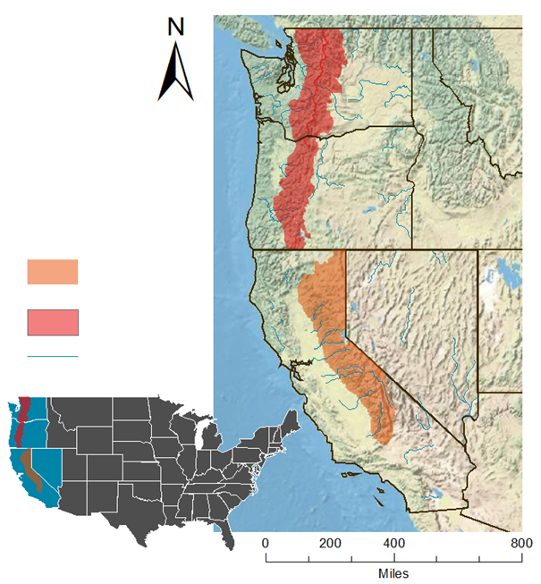
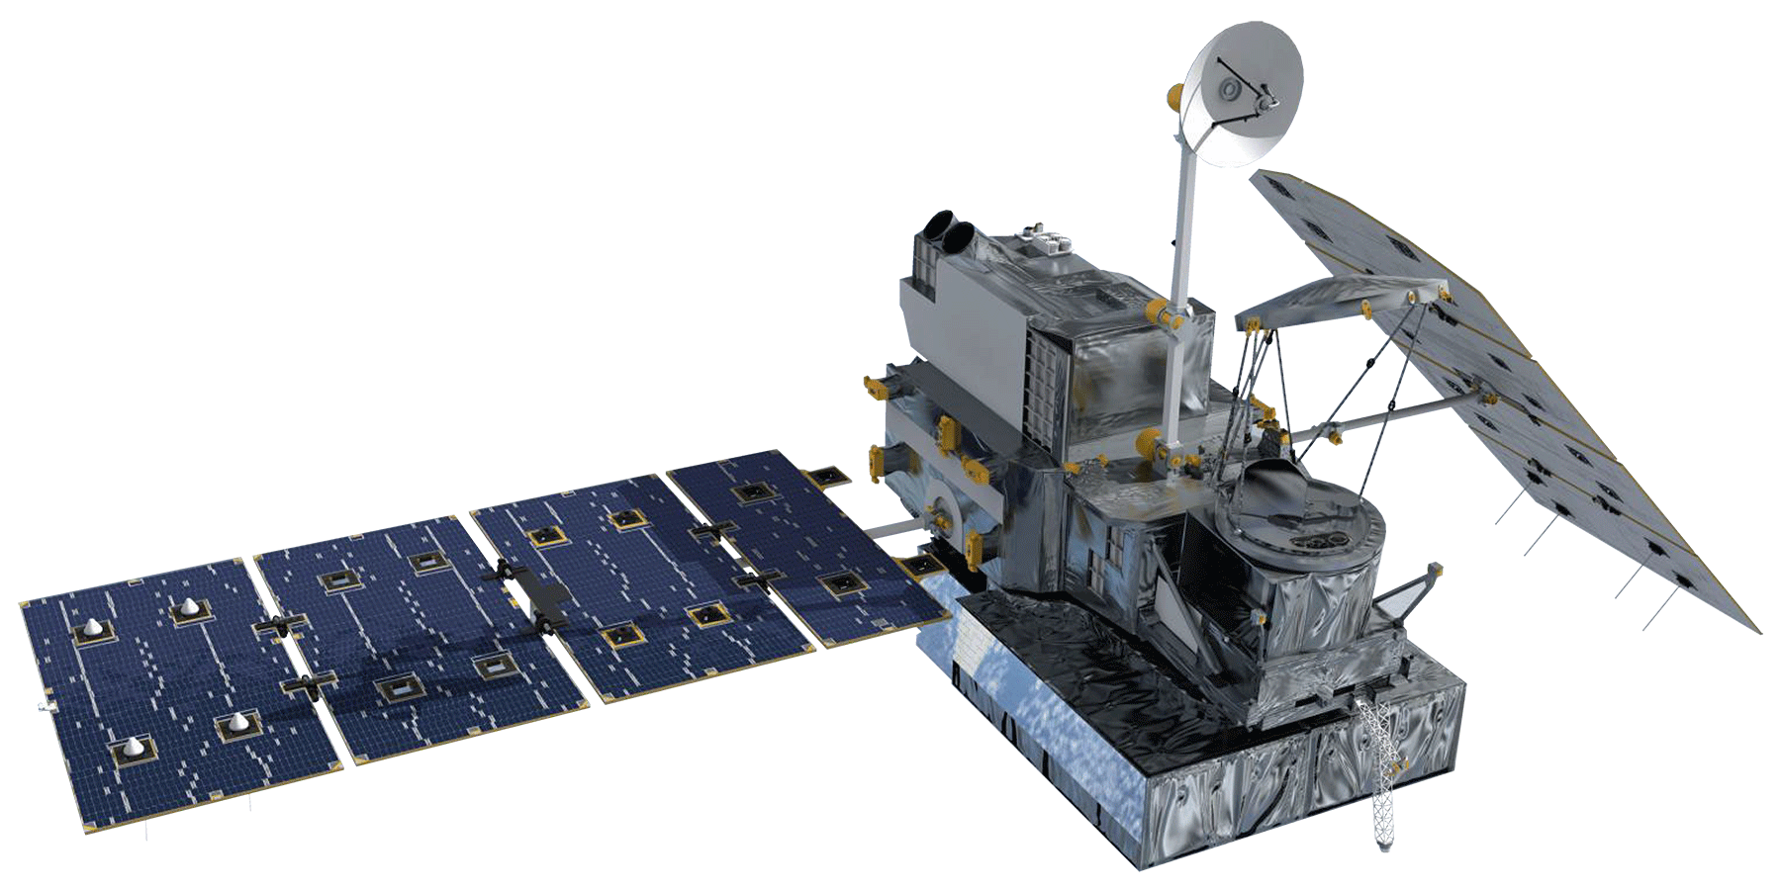
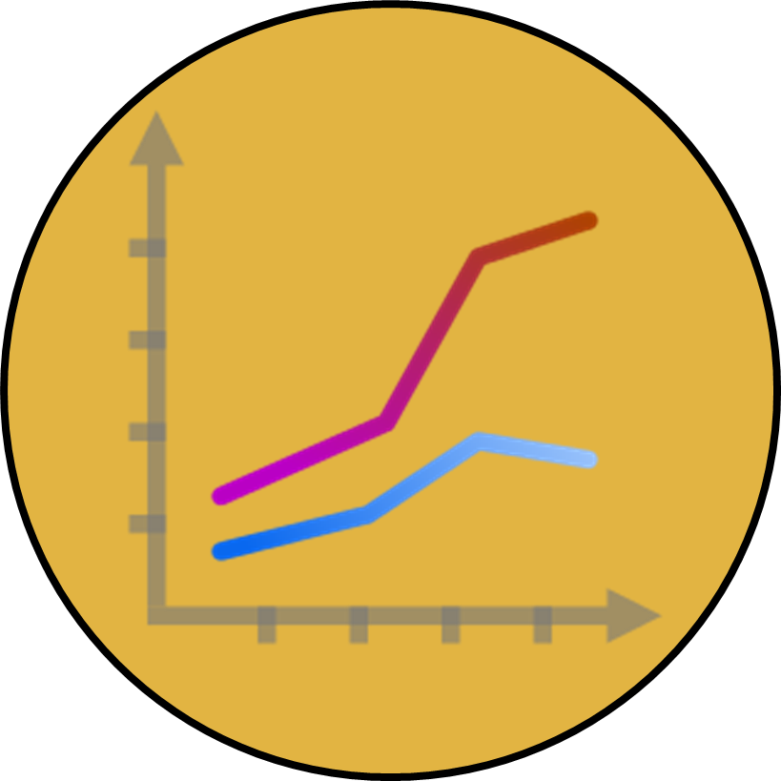
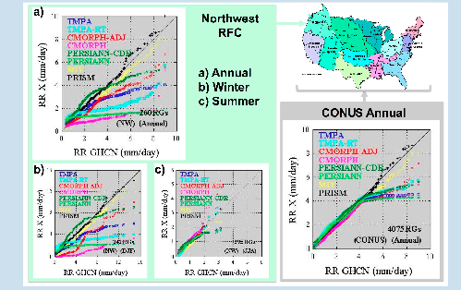
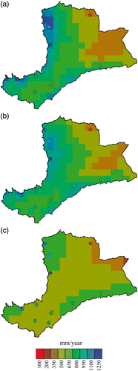
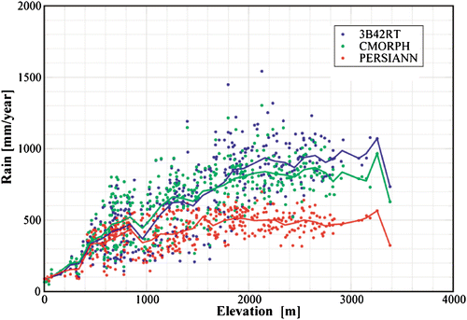
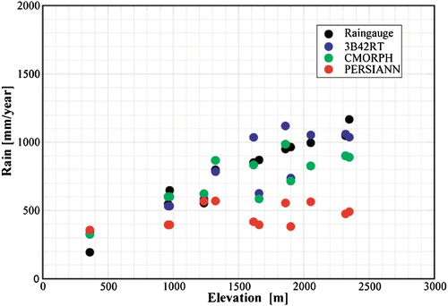
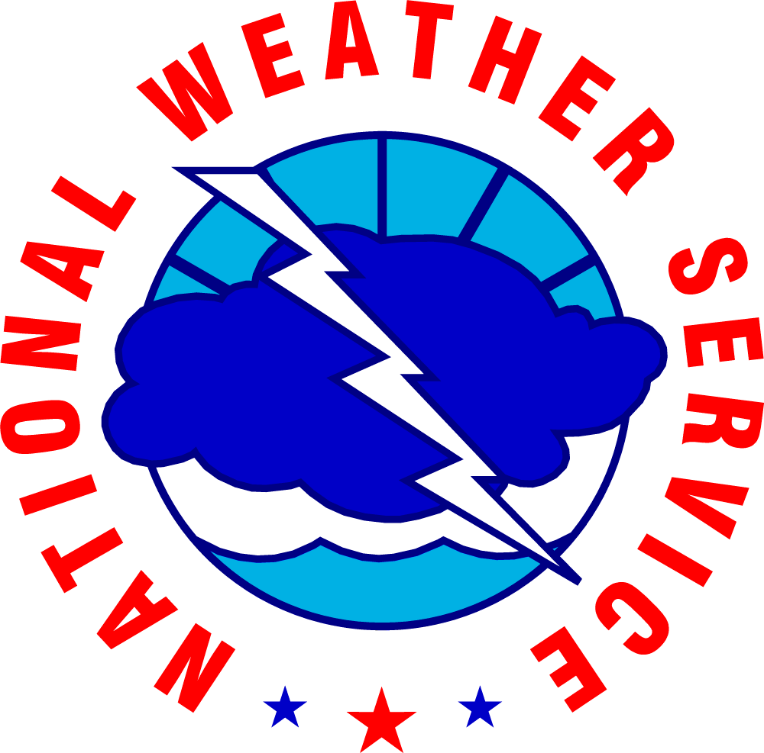
Cascade and Sierra Nevada Mountains
Water Resources
A comparison of remotely-sensed Climate Data Records (CDRs) for improved climate monitoring by the Western Regional Climate Center (WRCC), and National Weather Service River Forecast Centers (NWS RFCs)
Sam Swanson (Team Lead), Kevin Rapa
National Centers for Environmental Information (NCEI), Asheville, NC
Abstract
Study Area
Objectives
1
2
3
WA
To determine if satellite data are useful in measuring orographic precipitation by comparing satellite climate data records (CDRs) to currently-used ground-station data
To create a suite of map products to enhance the understanding of precipitation by the WRCC and NWS RFCs
To further understand snow water equivalent (SWE) in the study area by performing similar analyses on NOHRSC satellite data and ground observations from SNOTEL and the California Snow Survey
OR
Legend
Sierra Nevada
NV
Earth Observations
Cascades
Shown: GPM Microwave
Imager (GMI)
Spatial resolution:
0.1° (~11 km²)
Temporal resolution:
30 minute
Additionally,
SSM/I, AMSU-B,
AMSR-E, and TMI provide passive microwave data to the NOAA CMORPH dataset
0.073° (~8 km²), 30 minute
Major Rivers
CA
Figure 5. Out study area encompasses two
orographic , or mountainous, regions of the West, the Cascades and Sierra Nevada.
Methodology
Acquisition:
Download data
GHCN, CMORPH,
PRISM, and GPM
Subset if possible
Decompress files
Processing:
Satellite-derived
Convert to rasters
Clip to study area
Aggregate to daily
Ground-based
Assign station names
Average by raster pixel
Compilation:
Extract raster values
Append raster values to
GHCN data
Synchronize units
Visualization:
Scatter plots
Difference maps
Anomaly maps
Benefits maps
SWE maps
Results
Conclusions
Figures 3 and 4. Precipitation measurements by various products as compared to elevation. Because mountainous regions vary so drastically in elevation over short spaces, it is important to note a satellite’s power in measuring precipitation at certain elevations. Our study will present similar results by drawing elevation data from the GHCN sites, then comparing across GPM, CMORPH, and PRISM. Source: Herpa et al 2010.
Conclusions are not currently applicable in the poster rough draft.
Figure 1. Scatterplots comparing CMORPH estimates of precipitation via ground-stations (GHCN) to remotely-sensed and gridded datasets. Satellite measurements of the Northwest RFC underestimate precipitation. Source: Prat et al 2015.
Figure 2. Comparative maps showing 5-year averages of precipitation from different satellite products: a) TRMM, b) CMORPH, and c) PERSIANN. Overlayed on top of these rasters are points of Ethiopian ground station measurements with the same color scheme for comparison. Source: Herpa et al 2010.
Team Members
Project Partners
Acknowledgements
We would like to thank our Center Lead Jessica Sutton and our science advisor Michael Kruk for all of their help and guidance throughout this project.
We would also like to acknowledge:
The employees at NCEI | Nina Oakley
Emma Baghel | Andrea Bair
Dr. Olivier Prat | Jonathan Brannock
Team members Sam Swanson and Kevin Rapa
NOAA National Centers for Environmental Information

