Slide 1
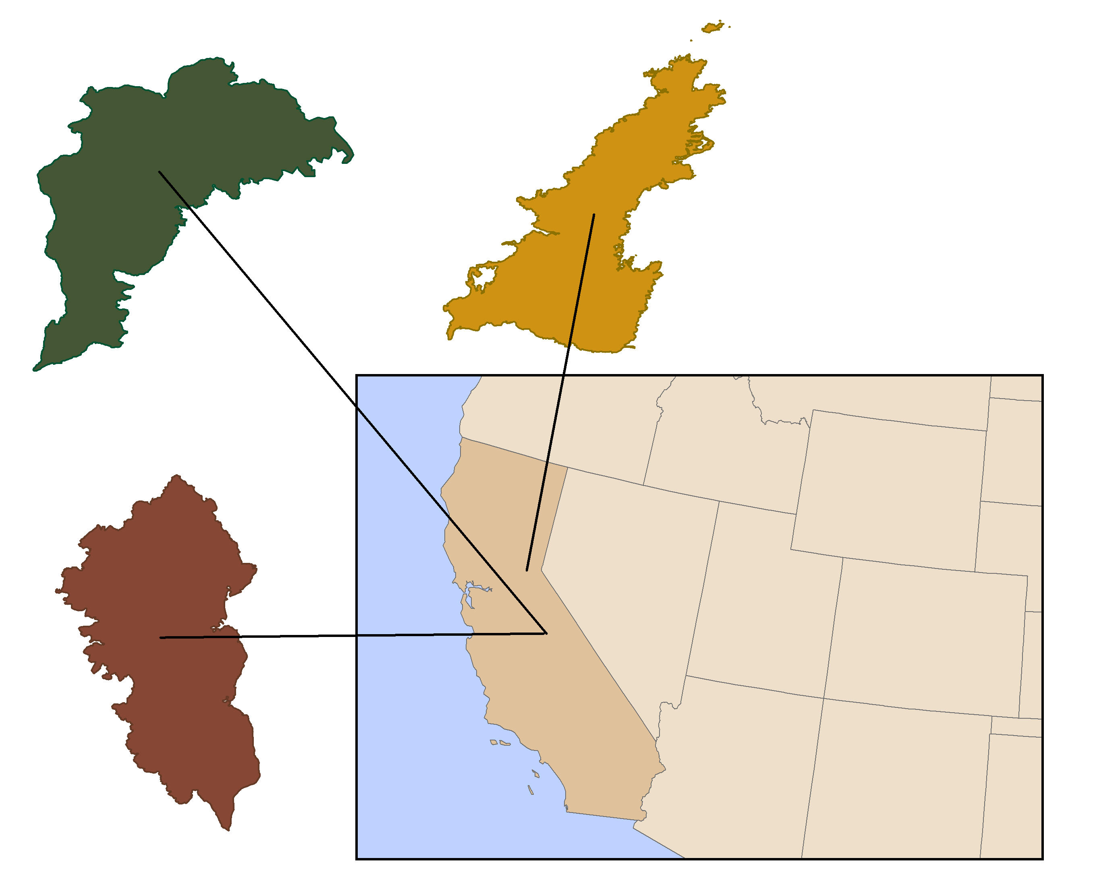
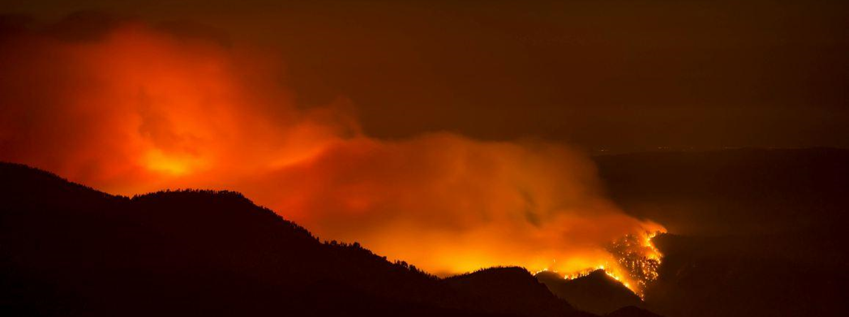
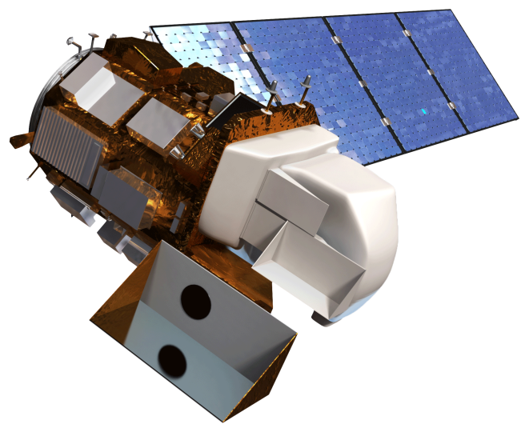
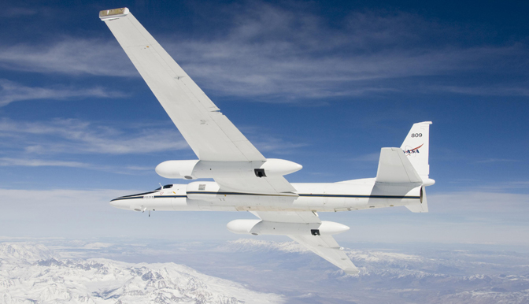
Southern California Disasters II
Assessing the Effectiveness of Simulated HyspIRI Data for Use in USDA Forest Service Post-Fire Vegetation Assessment and Decision Support
Heather Nicholson (Project Lead), Madeline LeBoeuf, Amber Todoroff
NASA DEVELOP National Program
Abstract
Objectives
Abstract
Use simulated HyspIRI data to produce wildfire burn severity and vegetation monitoring products, such as dNBR and RdNBR, to aid wildfire mitigation and wildland restoration.
Quantitatively compare the HyspIRI products to similar Landsat based products generated by the USDA Forest Service in order to determine how hyperspectral data can be used to improve current capabilities.
Study Area
Methodology
*Creation and implementation still in progress
Data Analysis
Download Simulated HyspIRI data from AVIRIS and Master websites.
Calculate Indices
Download Forest Service NBR, dNBR, and RdNBR burn severity products computed from Landsat.
NBR
$$\frac{(NIR−LSWIR)}{(NIR+LSWIR)}$$
dNBR
Image Source: inciweb
$${1000(NBR}_{pre}− {NBR}_{post})$$
Geo-reference the data and subset the swaths to the study area.
RdNBR
Normalize both data sets for statistical comparison.
Run a statistical analysis that determines any significant difference between the two data sets.
$$\frac{dNBR}{\begin{aligned}\sqrt{abs\left({NBR}_{pre}\right)} \\ \end{aligned}}$$
Earth Observations
Results
Landsat 8
King Post Fire Image
RAVG USFS Product
King Fire RdNBR
AVIRIS and MASTERL1B Simulated HyspIRI
King Fire RdNBR
Landsat 8 OLI
AVRIS and MASTER Onboard a NASA ER-2
Conclusions
TBD
Team Members
Project Partners
Acknowledgements
USDA Forest Service Remote Sensing Applications Center
(RSAC)
USDA Forest Service Eastern Forest Environmental Threat Assessment Center (EETAC)
USDA Forest Service Missoula Fire Sciences Laboratory
HyspIRI Science Team at Jet Propulsion Laboratory
Joseph Spruce – Science Advisor, CSC, SSC
James Smoot – Science Advisor, CSC, SSC Maria Kalcic – Science Advisor, CSC, SSC
USDA FS, RSAC
Dr. Steve Norman – USDA FS, EFETAC
Ross Reahard – SSC DEVELOP Center Lead
Eric Mack – SSC DEVELOP Former Participant
Caitlin Ruby –SSC DEVELOP Former Participant
Timothy Sutherlin –SSC DEVELOP Former Participant
Luke Wylie – SSC DEVELOP Former Participant
NASA DEVELOP National Program Office
Official Team Photo Coming Soon!
Heather Nicholson, Madeline LeBoeuf, Amber Todoroff
John C. Stennis Space Center

