Slide 1
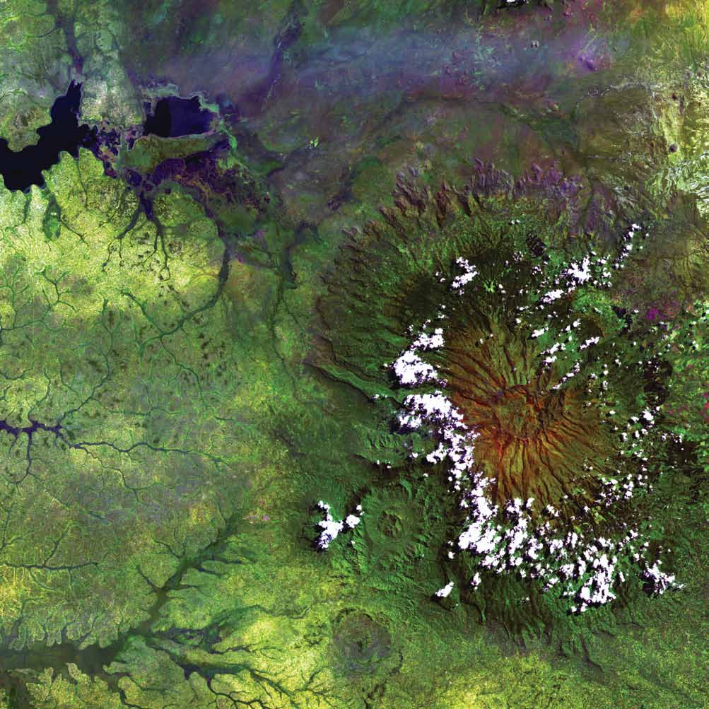
DEVELOP National Orientation (2022)
Module 1. About NASA

Slide 2

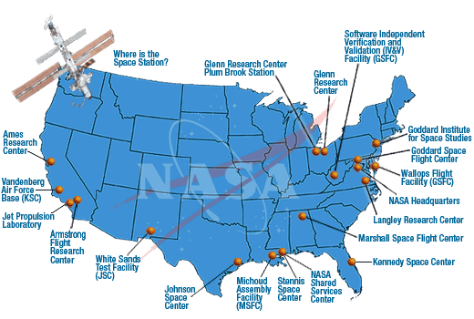
ABOUT NASA
By The Way
NASA celebrated its 60th birthday in 2018!
NASA History
"An Act to provide for research into the problems of flight within and outside the Earth's atmosphere, and for other purposes."
With this simple preamble, the US Congress and President Dwight D. Eisenhower established the National Aeronautics and Space Administration on July 29, 1958.
NASA began operations on October 1, 1958.
It absorbed into itself the earlier National Advisory Committee for Aeronautics (NACA).
Today, NASA has 10 Centers and multiple facilities around the country.

Slide 3
ABOUT NASA
NASA Organization
NASA Administrator
Associate Administrator
Mission Directorates
Human Exploration and Operations
Space Technology
Science
Mission Support
Aeronautics Research
Joint Agency Satellite Div.
Heliophysics Division
Earth Science Division
Planetary Science Div.
Astrophysics Division
Applied Sciences Program
Capacity Building Program
ARSET
DEVELOP
SERVIR
You are here!

Slide 4
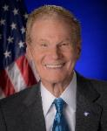
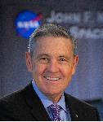
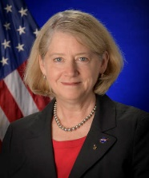

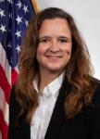
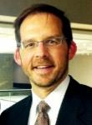
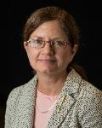

ABOUT NASA
NASA Leadership
Bill
Nelson
Robert Cabana
Col. (USAF, ret) Pam Melroy
NASA Administrator
Sen. Bill Nelson
Deputy Administrator
Colonel (USAF, ret.) Pam Melroy
Associate Administrator
Robert Cabana
Dr. Thomas Zurbuchen
Dr. Karen St. Germain
Lawrence Friedl
Science Mission Directorate
Thomas Zurbuchen, Ph.D.
Earth Science Division
Karen St. Germain, Ph.D.
Applied Sciences Program
Lawrence Friedl
Dr. Nancy Searby
Mike
Ruiz
Capacity Building Program
Nancy Searby, Ph.D.
By The Way
Knowing key NASA leaders is important because you will see these people at conferences and events!
DEVELOP National Program
Mike Ruiz
NASA Organization Chart: http://www.nasa.gov/about/org_index.html#.VBNBWvldWbM

Slide 5
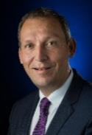
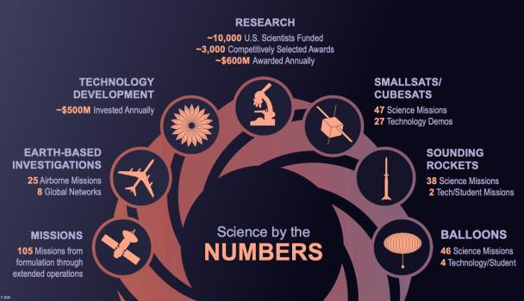
ABOUT NASA
By The Way
Dr. Thomas Zurbuchen, AA for SMD and aka Dr. Z, is often seen at conferences and visiting NASA Centers! Follow him on Twitter!
Science Mission Directorate
Science is interconnected; no important question stands alone.
The Science Mission Directorate (SMD) is an organization where discoveries in one scientific discipline have a direct route to other areas of study. This flow is something extremely valuable and is rare in the scientific world.
SMD seeks to understand the origins, evolution, and destiny of the universe and to understand the nature of the strange phenomena that shape it by…
Engaging the Nation’s science community
Sponsoring scientific research
Developing and deploying satellites and probes in collaboration with NASA’s partners around the world to answer fundamental questions requiring the view from and into space

Slide 6
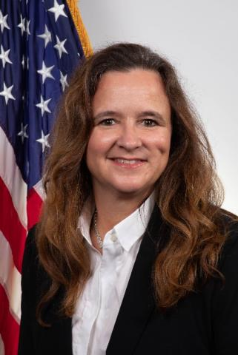
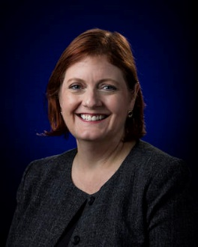




ABOUT NASA
By The Way
Dr. Julie Robinson starts her new position in ESD on June 19th! She previously served as the Chief Scientist of the ISS Program and the Associate Director of NASA’s Human Research program.
Earth Science Division
The Earth Science Division (ESD), conducts scientific studies to understand the Earth as a system on all time scales.
ESD utilizes NASA’s ability to view the Earth from the unique vantage point of space.
ESD provides uniformly high-quality data covering the planet to support the pursuit of answers to fundamental science questions.
There are four lines of business:
Dr. Karen St. Germain, Director
Dr. Julie Robinson,
Deputy Director
Flight
Develops, launches, and operates NASA’s fleet of Earth-observing satellites, instruments, and aircraft. Manages data systems to make the data freely and openly available.
Technology
Tests and demonstrates scientific technologies for future satellite and airborne missions:
Instruments, Information Systems, Components, In-Space Validation.
Research & Analysis
Supports research that advances knowledge of the Earth as a system. Six focus areas plus field campaigns, modeling, and scientific computing.
Applied Sciences
Supports innovative and practical uses of Earth observations and scientific knowledge by private and public sectors to inform their planning, decisions, and actions.

Slide 7


















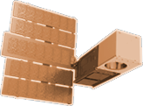




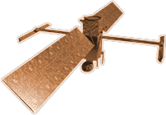








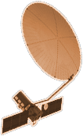


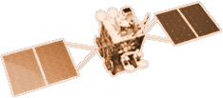


CYGNSS (8)
NISTAR, EPIC
2015
GRACE-FO (2)
SMAP
ICESAT-2
OCO-2
2020
LIS
SAGE III
GPM
SENTINEL-6
MICHAEL FREILICH
TSIS-1
EARTH FLEET
LANDSAT 8
ECOSTRESS
LANDSAT-9
SUOMI NPP
INVEST/CUBESATS
GEDI
CSIM-FD 2023
HARP 2022
CIRIS 2023
CTIM* 2022
HYTI* 2022
SNOOPI* 2022
NACHOS* 2022
NACHOS2* 2022
OCO-3
1995
2010
TROPICS (6)
EMIT
LANDSAT 7
CALIPSO
SWOT
TERRA
CLARREO-PF
AQUA
CLOUDSAT
TEMPO
AURA
2000
JPSS INSTRUMENTS
PREFIRE (2)
2005
OMPS-LIMB 2022
LIBERA 2027
NISAR
MAIA*
ISS INSTRUMENTS
KEY
PACE
INTERNATIONAL PARTNERS
U.S. PARTNER
ISS INSTRUMENT
JPSS INSTRUMENT
CUBESAT
LAUNCH DATE TBD
TSIS-2*
(PRE) FORMULATION
IMPLEMENTATION
OPERATING
EXTENDED
GEOCARB*
SENTINEL-6B
GLIMR*
INCUS*
LANDSAT NEXT*
ESO-1, 2, 3, 4*
MISSIONS
01.20.22
2025
Notes:
Jan 2022

Slide 8
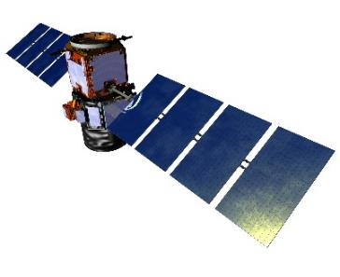
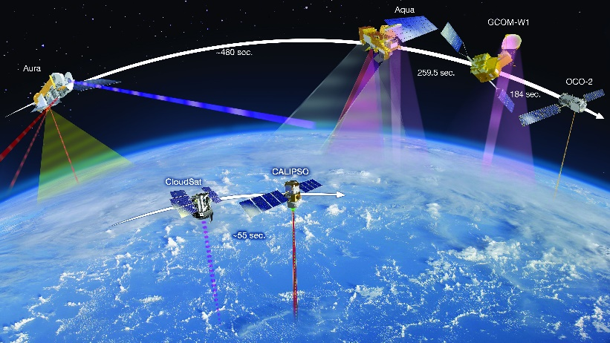
ABOUT NASA
NASA Earth Observations (EO)
NASA Earth observations (EO): Umbrella term used that includes all airborne and flight missions that study the Earth.
Current NASA Spaceborne EO Missions:
Aqua
Aura
CALIPSO
CloudSat
CYGNSS
DISCOVR
ECOSTRESS (on ISS)
GEDI (on ISS)
GPM
GRACE-FO
ICESat-2
Landsat 7
Landsat 8
Landsat 9
LIS (on ISS)
OCO-2
OCO-3 (on ISS)
SAGE III (on ISS)
Sentinel-6 Michael Freilich
SMAP
Suomi NPP
Terra
TSIS-1 (on ISS)
Future Missions:
MAIA, NISAR, CLARREO Pathfinder, PACE, SWOT, TEMPO
By The Way
NASA pursues airborne campaigns in addition to its spaceborne missions. Some DEVELOP projects explore use of airborne data as well!

Slide 9
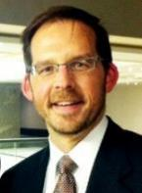

ABOUT NASA
By The Way
Lawrence Friedl, ASP Director, once worked at NASA Mission Control!
Applied Sciences Program
The Applied Sciences Program (AppSci) supports innovative and practical uses of Earth observations and scientific knowledge by private and public sectors to inform their planning, decisions, and actions.
AppSci pursues:
  Partnerships with public and private organizations
  Discovery of innovative NASA Earth Science applications
  Support of environmental decision-making activities
  Demonstration of practical benefits of NASA Earth Science
  Help to improve the quality of life and strengthen the economy
Three lines of business:
Lawrence Friedl,
Director
Emily Sylak-Glassman, Deputy Director
Earth Science Applications
Capacity Building
Mission Planning

Slide 10







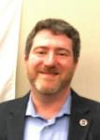
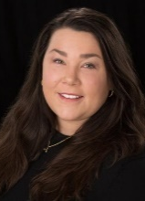
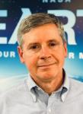
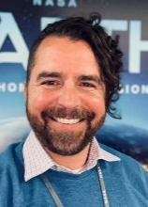

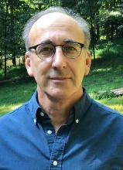



ABOUT NASA
Applied Sciences Programmatic Application Areas
The Applied Sciences Program is structured around thematic application areas that routinely hold solicitations and have active investment portfolios at NASA HQ:
New application areas for 2022!
HEALTH & AIR QUALITY
DISASTERS
ECOLOGICAL FORECASTING
WATER RESOURCES
AGRICULTURE
WILDFIRES
CLIMATE
John Haynes
Dr. Shanna McClain
Woody Turner
Dr. Keith
Gaddis
Dr. Brad Doorn
Dr. David Green
Dr. Allison Leidner
Acting*
Additional two thematic areas:
URBAN DEVELOPMENT
ENERGY

Slide 11




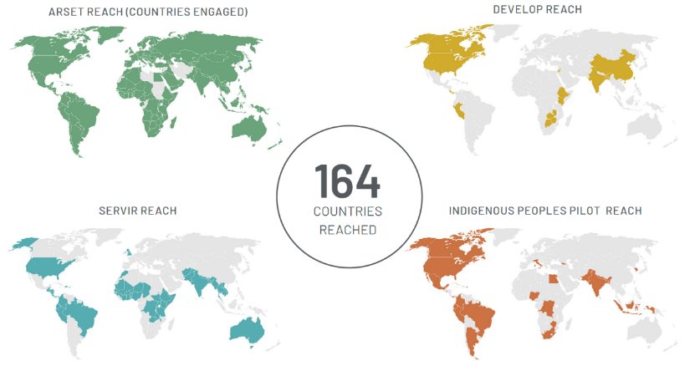
EMPOWERING PEOPLE & COMMUNITIES
Making Earth Data Accessible to All
2020 REACH
The Capacity Building Program provides individuals and institutions with workforce development, training activities, and collaborative projects to strengthen understanding of Earth observations and expand their use around the world.
Through the ARSET, DEVELOP and SERVIR programs and the Indigenous Peoples project, CBP works with everyone at every level — from first-time users to long-time professional users of Earth observation data.
We promote open data access and coordinate capacity building activities focused on users needs.
Capacity Building Program Webpage

Slide 12
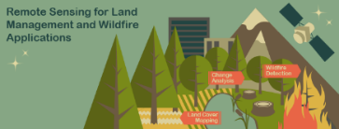

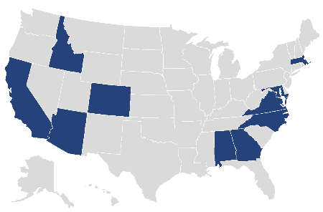
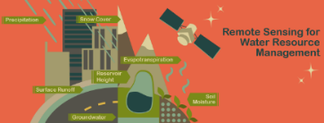

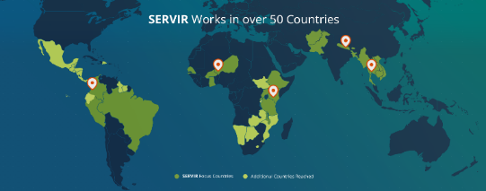
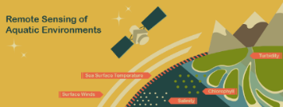

CBP ELEMENTS
ARSET
DEVELOP
SERVIR
ARSET offers satellite remote sensing training that builds the skills to integrate NASA Earth Science data into decision-making activities. Through its decade of trainings, ARSET has reached over 25,000 participants from 160 countries and more than 5,000 organizations worldwide.
DEVELOP addresses decision-makers’ needs through interdisciplinary feasibility studies that apply the lens of NASA Earth observations to environmental issues around the globe.
Projects build capacity to use Earth observations in participants and partner organizations through eight thematic areas during three terms a year.
SERVIR connects space to village by helping developing countries use satellite data to address critical challenges in food security, water resources, weather and climate, land use, natural disasters, and air quality.
A partnership of NASA, USAID, and leading technical organizations around the world, SERVIR develops innovative solutions to improve livelihoods and foster self-reliance in Asia, Africa, and the Americas.
https://appliedsciences.nasa.gov/nasadevelop
https://appliedsciences.nasa.gov/arset
https://servirglobal.net

Slide 13
CBP ELEMENTS
Indigenous Peoples
Environmental Justice
Prizes & Challenges
The Indigenous Peoples Pilot engages with indigenous communities to foster ethical and culturally relevant space for the use of Earth observations in monitoring, mapping, and managing natural and cultural resources. The pillars of this work include community engagement and the co-production of place-based remote sensing trainings specific to Indigenous lands and territories.
NASA‘s ESD is committed to ensuring that the investment the nation has made in NASA satellites and science benefits people across the U.S. and helps them make informed decisions about the very real challenges they face in their communities.
The EJ area builds connections with communities to advance equity and environmental justice, and co-develop uses of Earth and social science. Initial work is engagement, feasibility projects, data fusion activities, and DEVELOP projects.
NASA has a long history with open innovation, inviting the public to participate in the agency’s scientific and technical explorations. Within the Applied Sciences Program, we crowdsource ideas, technologies, scientific advances, and other “solutions” from people around the world through incentivized competitions called prizes and challenges.
https://appliedsciences.nasa.gov/indigenous-peoples-pilot
https://science.nasa.gov/earth-science/equity-and-environmental-justice
https://appliedsciences.nasa.gov/what-we-do/prizes-and-challenges

Slide 14
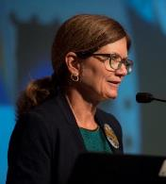
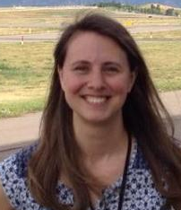

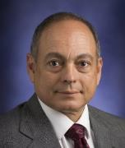
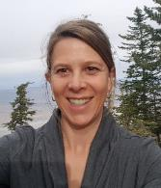
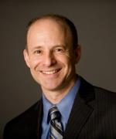
ABOUT NASA
Capacity Building Program: Leadership
Element Leads
Dr. Nancy Searby
CBP Program Manager
Melanie Follette-Cook
ARSET
Acting Project Manager
NASA Goddard Greenbelt, MD
Sydney Neugebauer
CBP Coordination & Analysis Lead
Mike Ruiz
DEVELOP
Program Manager
NASA Langley Hampton, VA
Christine Mataya
CBP Program Support Specialist
Dan Irwin
SERVIR
Program Manager
NASA Marshall Huntsville, AL

Slide 15
ABOUT NASA
Quiz Time
How old is NASA?
Who is Lawrence Friedl?
What are the Applied Sciences’ lines of business?
What are the two newest thematic application areas?
Which of DEVELOP’s “sister” programs focuses on providing trainings and which focuses on international capacity building?

Slide 16
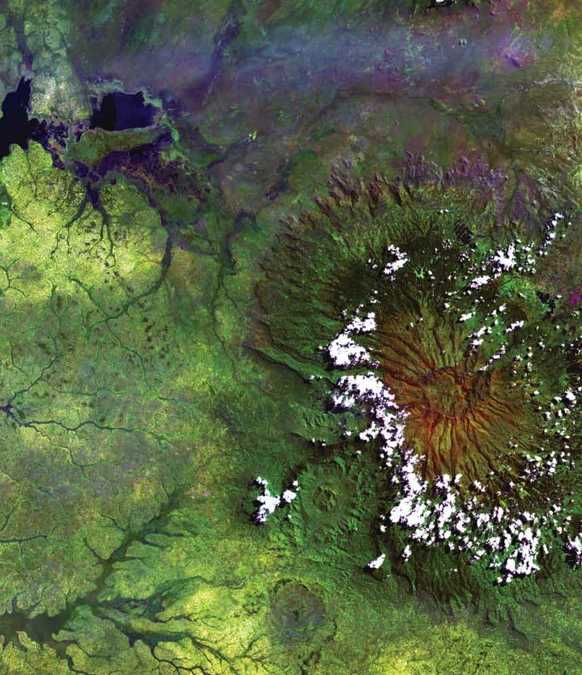
Thank You.
Joining the DEVELOP family means being part of NASA’s Legacy.
Learn it. Know it. Live it.

