Slide 1
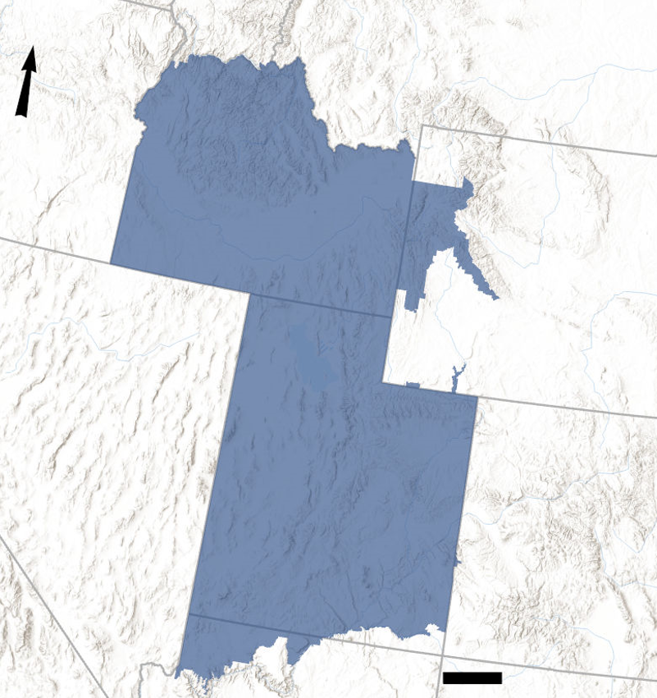
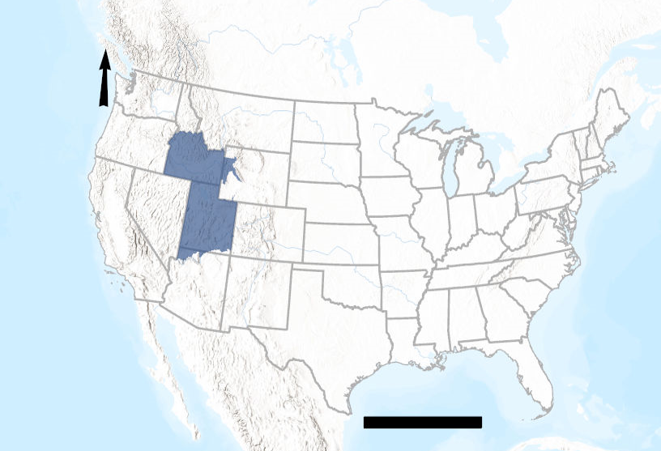
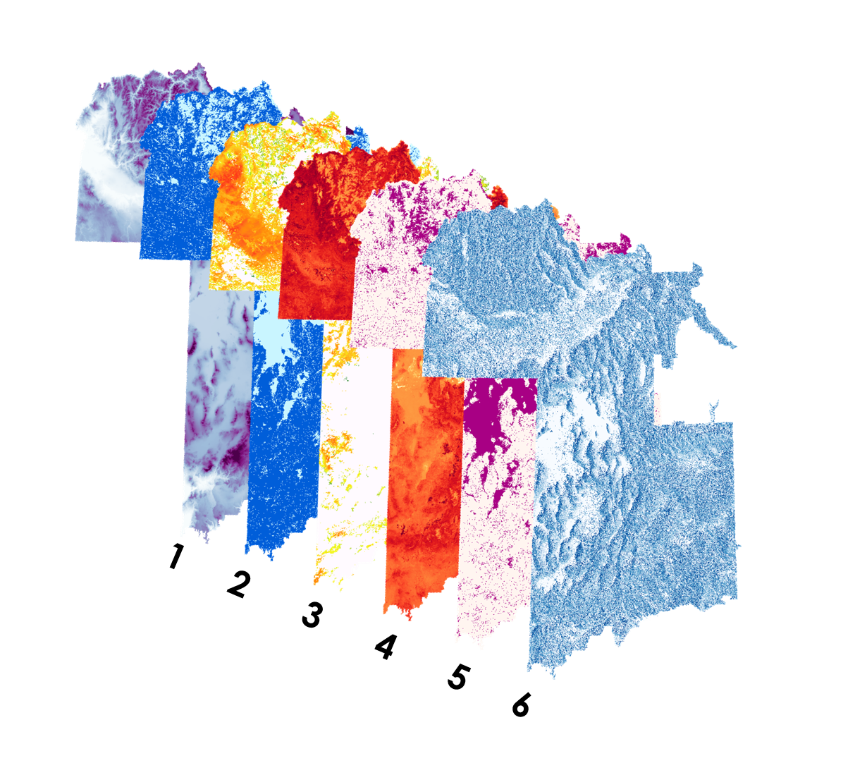
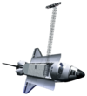
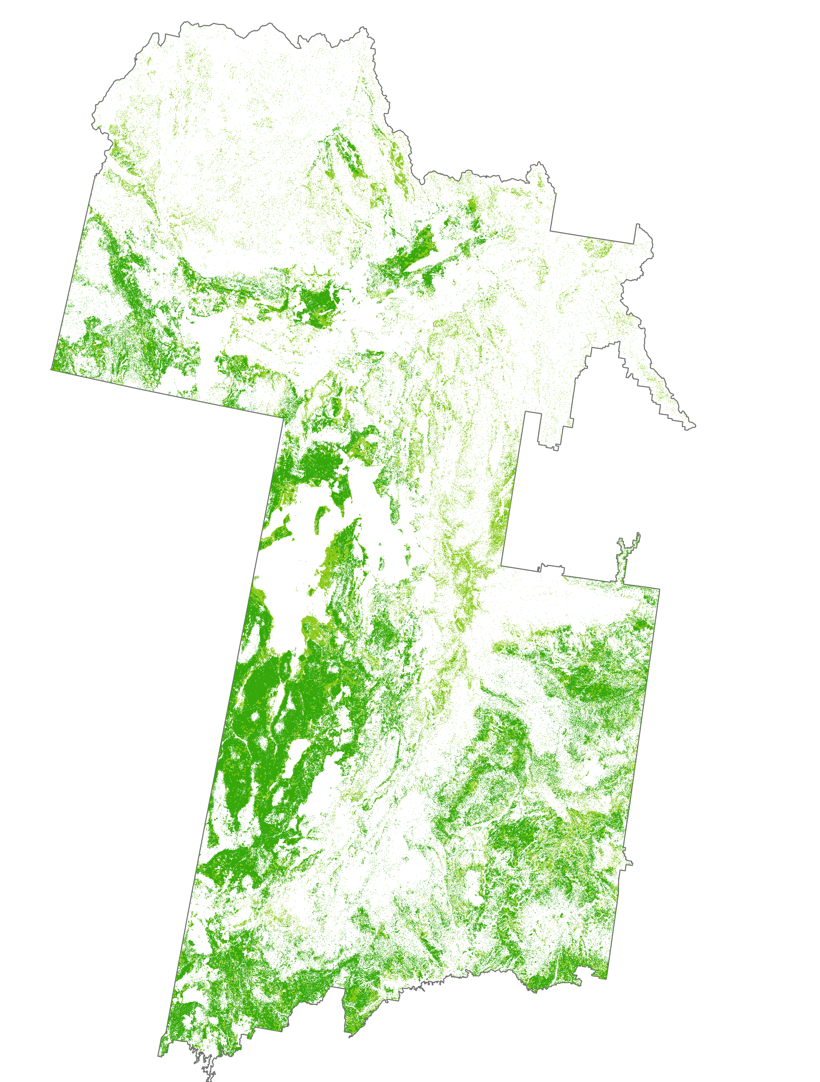
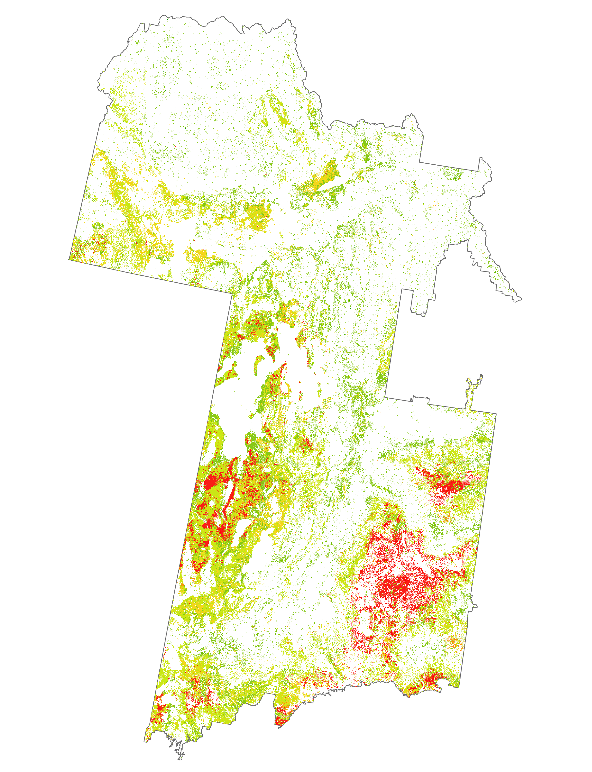
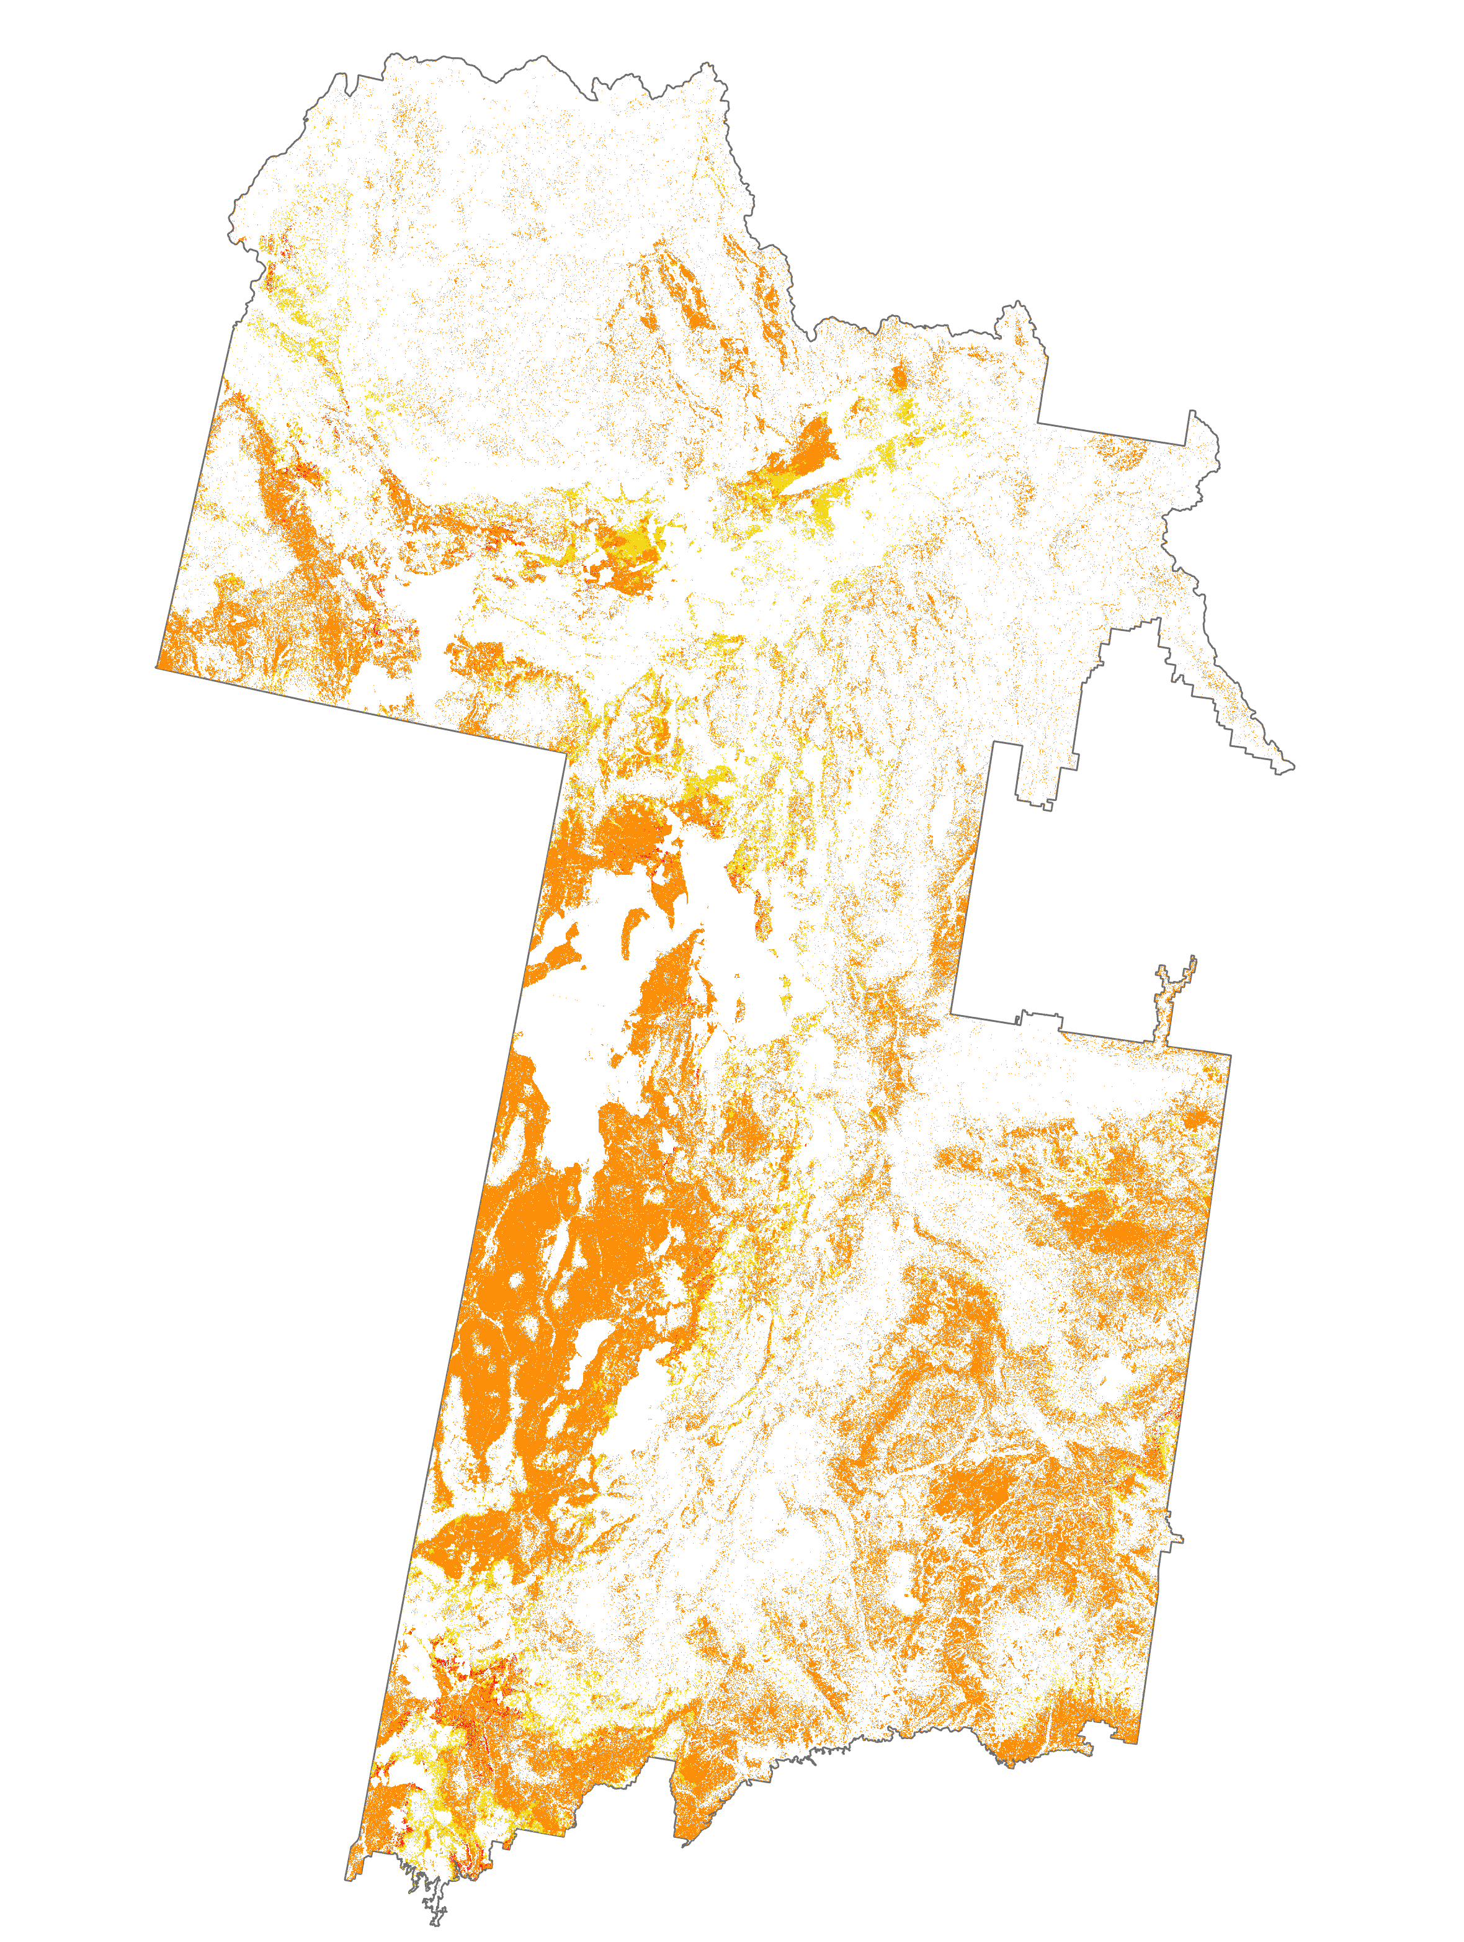
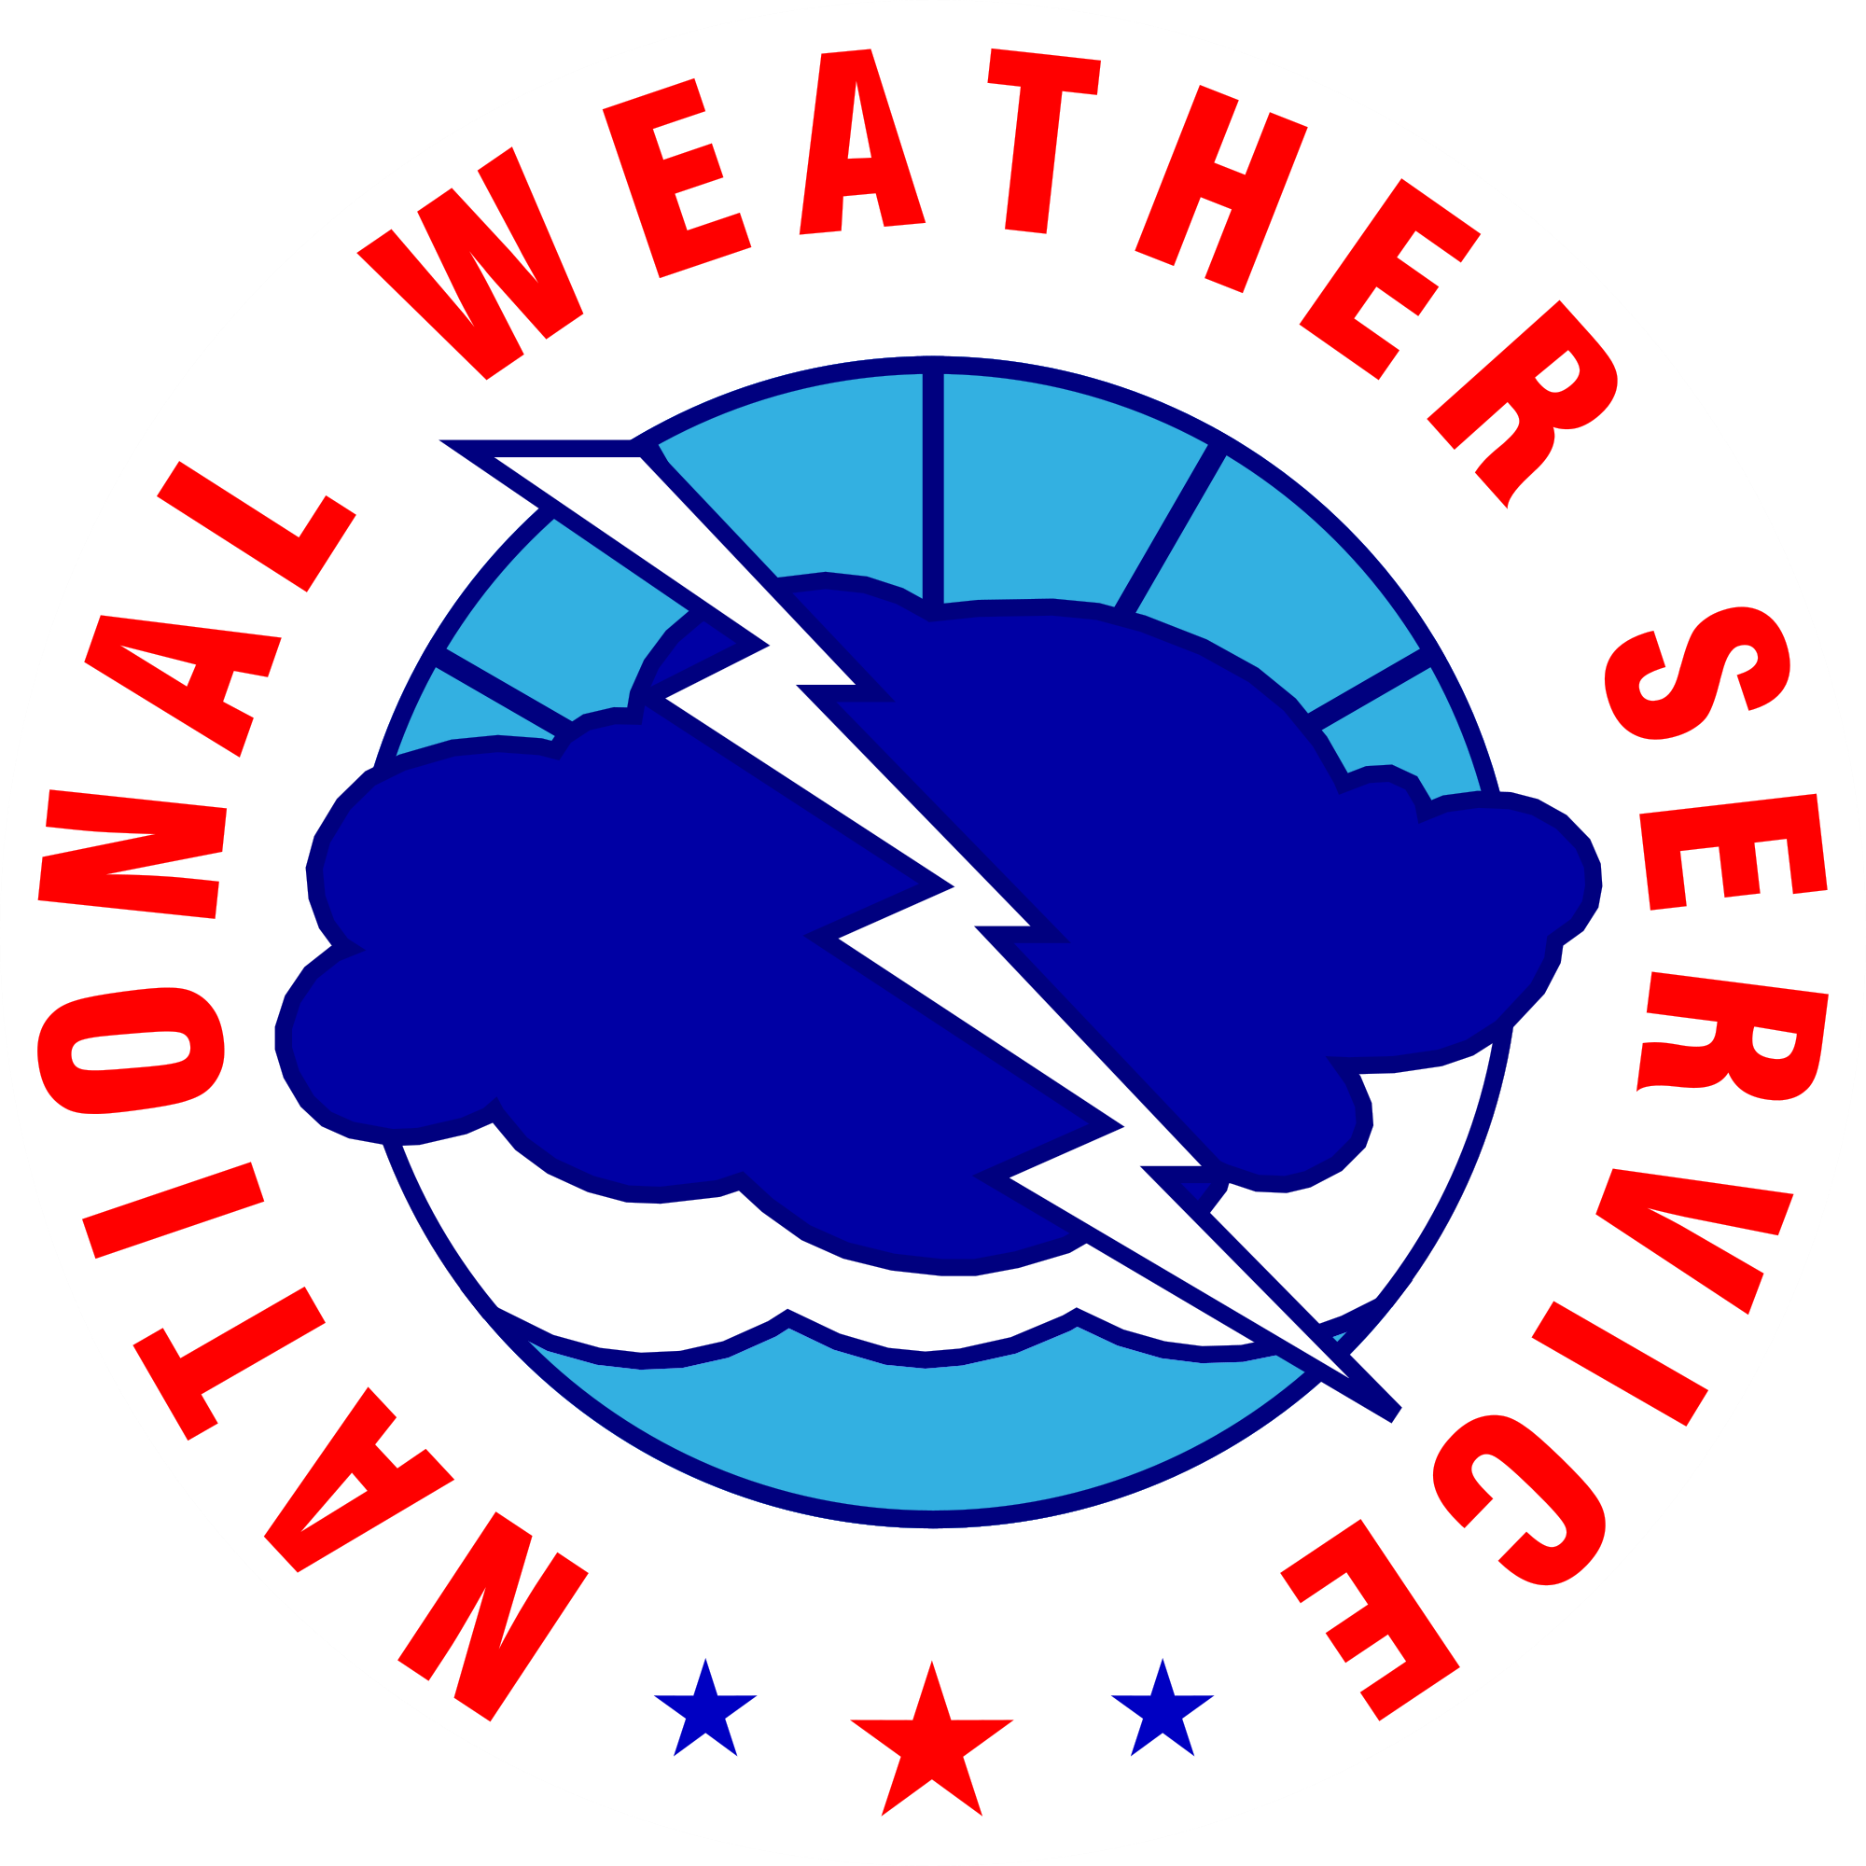
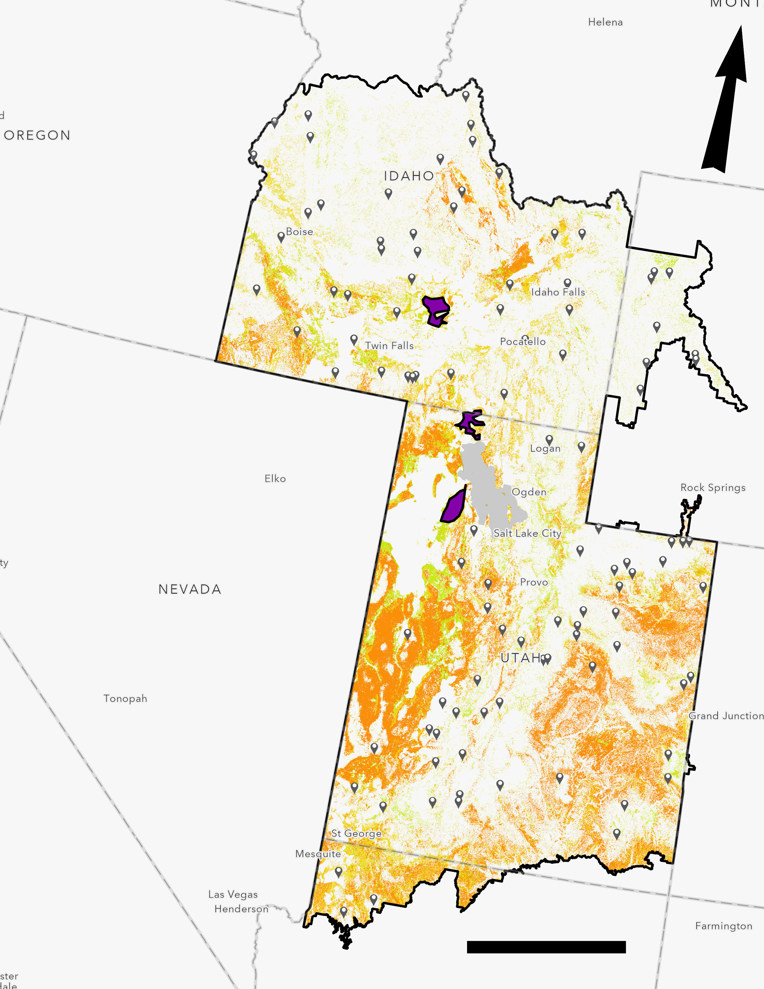
Integrating NASA Earth Observations into Live Fuel Moisture Models to Improve Wildfire Timing and Severity Forecasting in the Eastern Great Basin
Abstract
Study Area
The eastern Great Basin (EGB) covers approximately 411,000 km² within the states of Arizona, Colorado, Idaho, Utah, and Wyoming. Since the 1950s, wildfires have increased in both frequency and size within the EGB and neighboring states. Partners at the Bureau of Land Management (BLM), the Idaho Department of Fish and Game, the National Weather Service, and the Great Basin Coordination Center (GBCC) are particularly concerned with Live Fuel Moisture (LFM). Living vegetation that fuels wildfires, referred to as live fuel, requires greater energy input to combust when wet and less energy input to combust when dry, making LFM a vital measurement for predicting wildfire risk and severity. To increase spatial coverage for the EGB from the 155 in situ observation sites, the NASA DEVELOP team modeled LFM using satellite data from Aqua and Terra Moderate Resolution Imaging Spectroradiometer (MODIS) and Suomi National Polar-orbiting Partnership (NPP) Visible Infrared Imaging Radiometer Suite (VIIRS). The team incorporated remotely sensed data into machine learning modeling techniques, such as the Random Trees Classifier through ArcGIS Pro, to develop a predictive model of LFM. The remotely sensed data included vegetation indices, land surface temperature, evapotranspiration, and topographic variables. Model accuracy was evaluated by testing generated values against historical data obtained from partners at the BLM and the GBCC. The LFM model benefitted partners by improving the spatiotemporal resolution for wildfire forecasts. While model accuracy averaged at 8.2%, the LFM trend developed from model classification was useful for resource allocation and improved emergency response to wildfires within the EGB.
N
N
1,000
kilometers
100
kilometers
Eastern Great Basin
Earth Observations
Methodology
Our model is composed of six different layers. (1) Elevation, (2) Aqua Evapotranspiration (ET), (3) VIIRS Land Surface Temperature (LST), (4) VIIRS Normalized Difference Vegetation Index (NDVI), (5) Terra ET, and (6) Aspect.
Suomi NPP
Terra
Aqua
Results
Live Fuel Moisture Percentages
Landsat 8
Landsat 5
SRTM
< 75
Project Partners
75 - 99
100 - 124
125 - 149
 BLM Upper Snake Field Office
 NOAA National Weather Service
 Idaho Department of Fish and Game Southeast Regional Office
 Great Basin Coordination Center
150 - 199
≥ 200
May 2017
July 2017
September 2017
N
Great Basin Ecological Forecasting
Objectives
Evaluate the feasibility of using existing spatial datasets to determine LFM
Determine which data inputs have the highest correlation strength with in situ datasets from the BLM and GBCC
Generate a LFM model to predict wildfire risk and severity
Produce a tutorial describing the model for partners to replicate processes
In situ sites
Polygons
Eastern Great Basin
Live Fuel Moisture (LFM)
LFM ≤ 75 %
75% ≤ LFM < 100%
125% ≤ LFM < 150%
100% ≤ LFM < 125%
150% ≤ LFM < 200%
200% ≤ LFM
Team Members
Conclusions
200
Kilometers
 Additional in situ measurements for a predictive model would increase the classification accuracy of the eastern Great Basin study area. Accuracy is currently around 8.2% on average.
Graphs displaying the trend lines of the LFM measurements visually displays how the LFM measurement percentages change over time.
Fewer gaps in VIIRS LST data would be helpful for training of the predictive model and increasing model accuracy.
LFM percentages increased in the later spring months (approx. 150%) in comparison to summer months (less than 125%).
There were variations in data in accordance with monthly weather phenomena.
Acknowledgements
We would like to thank our project partners: Scott Bergen, Senior Wildlife Research Biologist ; Ben Dyer, Fire Ecologist; Michelle Mavor, Fire Ecologist; Kurt Buffalo, Meteorologist, Science and Operations; Mike Hutson, Meteorologist; Nanette Hosenfeld, Predictive Services Meteorologist; and node advisors: Keith T. Weber, GIS Director at Idaho State University, GIS Training and Research Center; Mason Bull, NASA DEVELOP National Program Fellow.
Lauren Lad
Project Lead
Helena Bierly
Amber Hobbs
Gavin Pirrie
Idaho – Pocatello | Fall 2019

