Slide 1
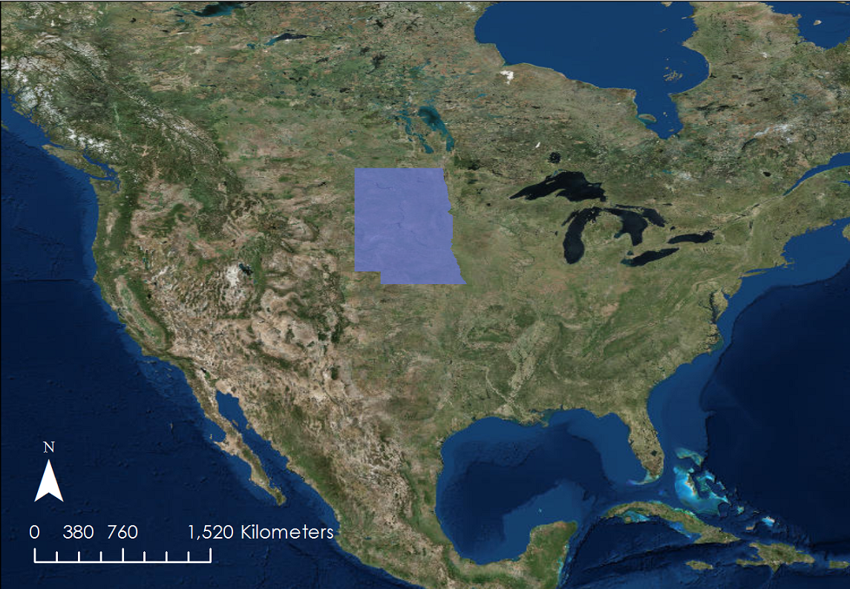
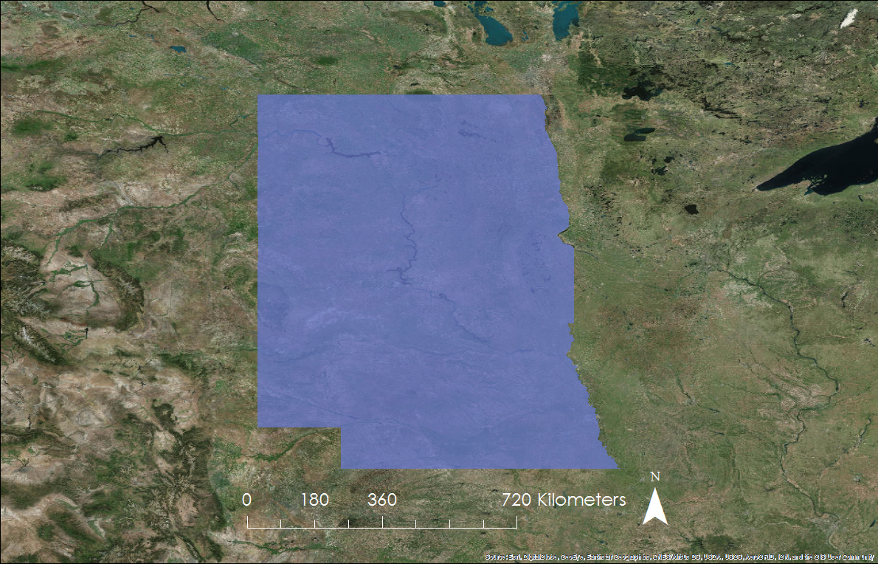
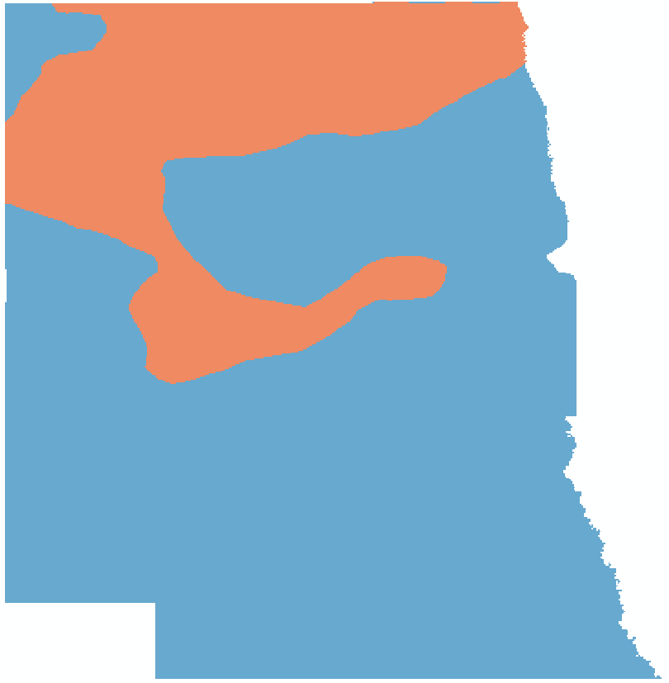
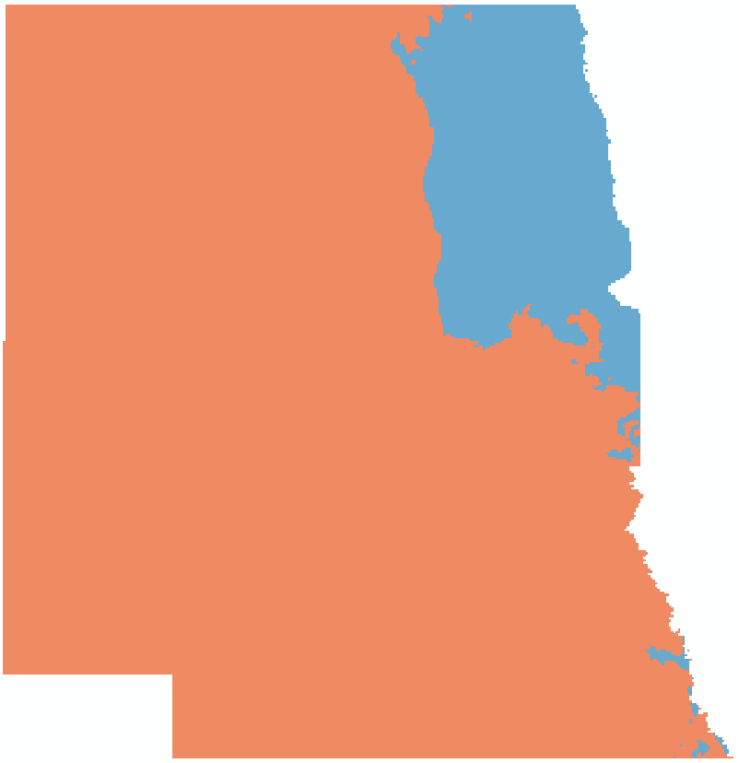
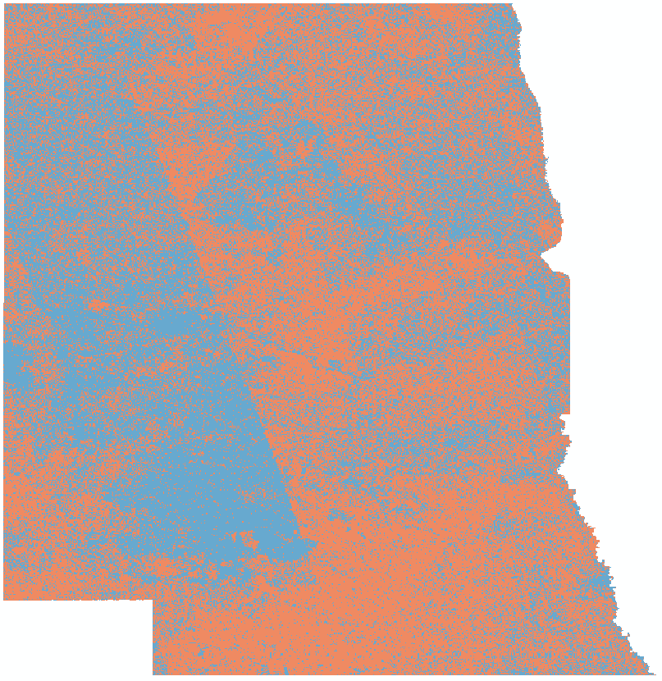
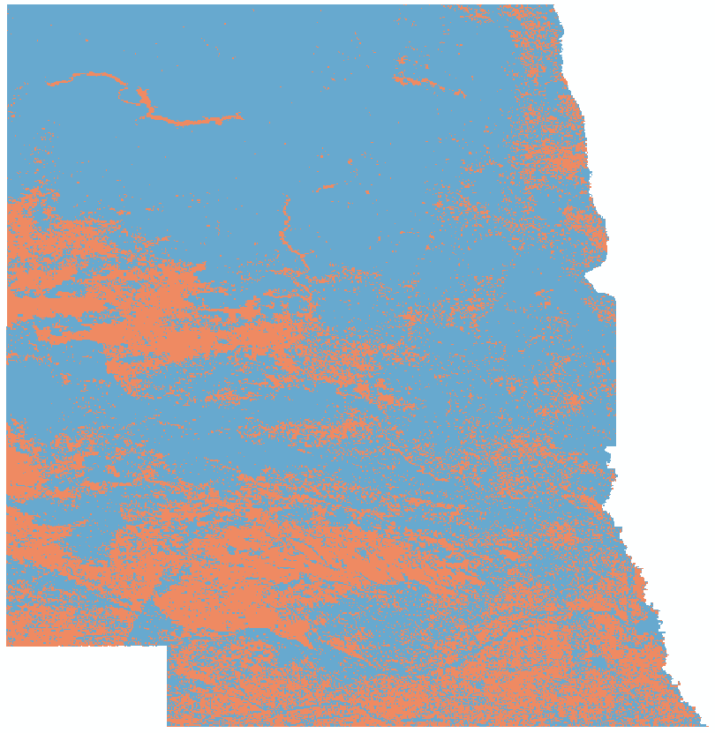
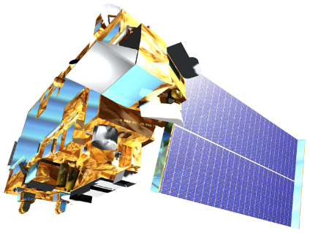
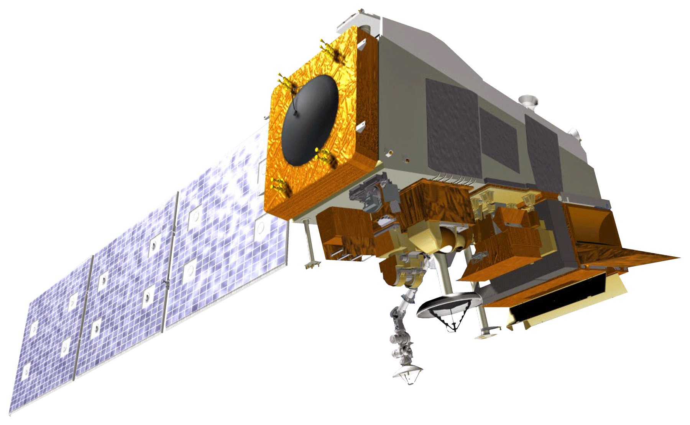
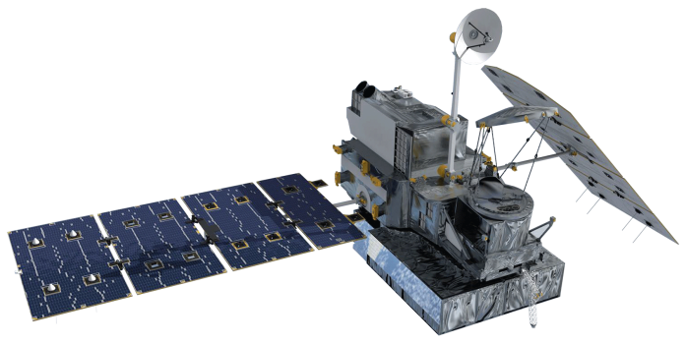
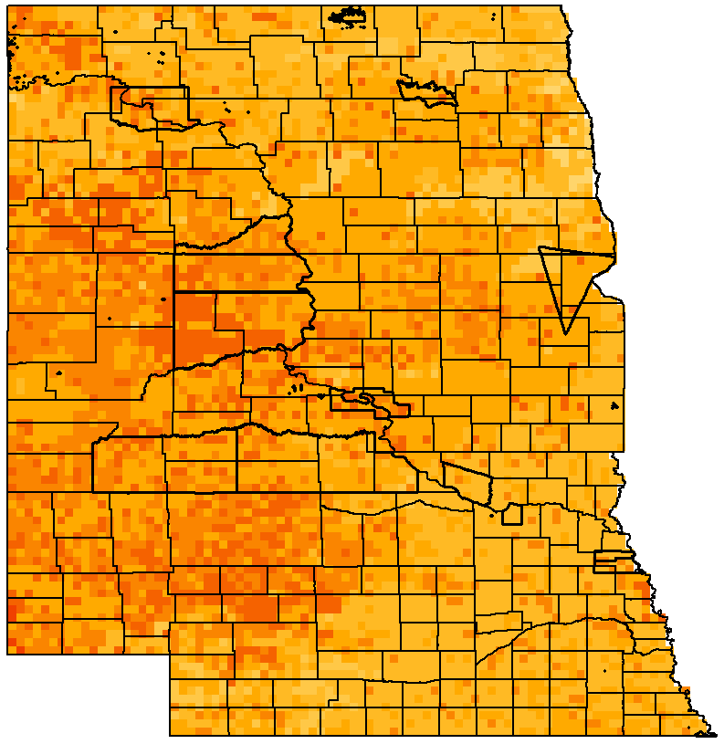
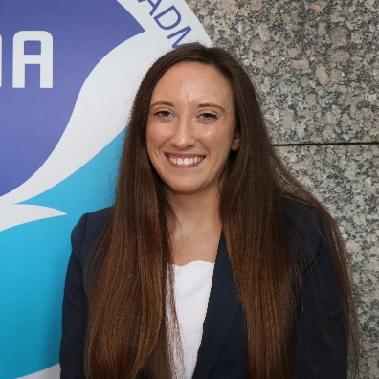
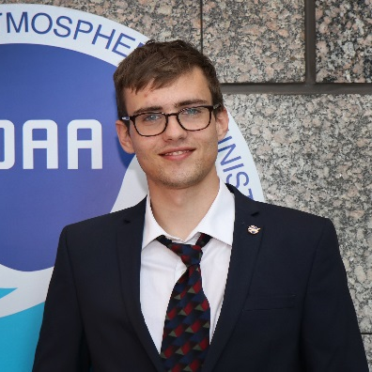
Utilizing NASA Earth Observations and NOAA Climate Data Records to Produce Climate Indicators of Rangeland Health and Wildfire Risk
Abstract
Partners
The grasslands of the Great Plains that span the Dakotas and Nebraska are crucial for the region’s agriculture and livestock grazing. In the face of increased variability in regional climate, their susceptibility to drought conditions, wildfires, and extreme weather events are expected to increase. Building upon an existing fire risk indicator from a previous DEVELOP team, this project worked with the Bureau of Indian Affairs (BIA), the State Fire Meteorologist of South Dakota, the Central Region Climate Services Director of NOAA’s National Centers for Environmental Information (NCEI), and the National Integrated Drought Information System (NIDIS) to enhance the original product. The end product sends a daily map of wildfire risk across the Great Plains to partners. The map compiles Earth observations, including snow cover from NASA’s Moderate Resolution Imaging Spectroradiometer (MODIS) sensor aboard the Terra satellite, fuel moisture content derived from the Suomi National Polar-orbiting Partnership (NPP) Visible Infrared Imaging Radiometer Suite (VIIRS), and precipitation estimates from the Global Precipitation Measurement (GPM) Integrated Multi-satellite Retrievals for GPM (IMERG). Additional modeled datasets in the tool include wind speeds, daily average temperature, and dew point from NOAA’s Real-Time Mesoscale Analysis (RTMA), drought conditions from the US Drought Monitor, daily climatological temperature averages from 1981-2010 from Oregon State University’s Parameter-elevation Regressions on Independent Slopes Model (PRISM) Climate Group, and soil moisture measurements from the North American Land Data Assimilation System (NLDAS). This Fire Risk Estimation (FIRE) 2.0 tool creates a daily fire risk map for the fire management community in the Great Plains to monitor day-to-day changes in climate indicators and help them prepare for when and where the next major fire may strike.
Bureau of Indian Affairs, Wildland Fire Management, Great Plains Region
South Dakota School of Mines and Technology
NOAA NCEI Regional Climate Services, Central Region
NOAA National Integrated Drought and Information System
Objectives
Transition the FIRE tool from Google Earth Engine to an Esri ArcGIS platform
Modify the study area from Missouri River Basin to ND, SD, & NE
Update original data layers, thresholds, & weight matrix
Produce automated daily fire risk maps
Methodology & Results
1. Data Acquisition
Study Area
Earth Observations
Terra MODIS (Fuel Moisture & Snow Cover)
Suomi NPP VIIRS NDII (Fuel Moisture)
GPM IMERG (Precipitation)
NOAA Climate Data & Other Datasets
RTMA (Windspeed, Humidity, Temperature)
U.S. Drought Monitor (Drought)
PRISM (Historical Temperatures)
GPM (Precipitation)
NLDAS (Soil Moisture)
North Dakota
2. Data Processing
South Dakota
Applying Seasonal Threshold & Weighting Criteria for Large Fire Potential
Producing Variable Layers
Nebraska
 |  | Partner-Provided Thresholds
 |  | Spring | Summer | Fall | Winter
VARIABLES | Drought (USDM) | D1 | D1 | D1 | D1
 | Windspeed (m/s) | 8.94 | 8.94 | 8.94 | 8.94
 | Rain – Soaking (mm) | 12.7 | 12.7 | 12.7 | 12.7
 | Rain – Wetting (mm) | 2.54 | 2.54 | 2.54 | 2.54
 | Relative Humidity (%) | 30 | 20 | 30 | 40
 | Temperature Anomaly (ºC) | 10 | 8 | 10 | 15
Earth Observations
3. Results
0
180
360
720
Kilometers
Contribution to Fire Risk
Terra MODIS
Suomi NPP VIIRS
GPM IMERG
Does Not Contribute
Team Members
Legend
Does Contribute
Counties
Reservations
Snow Cover
Fire Risk Potential
0.5 – 0.6
0
0.6 – 0.7
Daily Fire Risk Map: November 6, 2018
0 – 0.1
0.7 – 0.8
Natalie Belew
Project Lead
Tyler Hennessee
Nick Roberts
0.1 – 0.2
0.8 – 0.9
0.2 – 0.3
0.9 – 1
0.3 – 0.4
Acknowledgements
0.4 – 0.5
0
180
360
720
Kilometers
We would like to thank our science advisor Michael Kruk, Center Lead Aaron Mackey, as well as our partners Darren Clabo, David Martin, Britt Parker, and Doug Kluck for their expertise and guidance throughout this project.
Additionally, we would like to acknowledge people within the NOAA NCEI Staff including Rocky Bilotta, Alec Courtright, Karin Gleason, Jared Rennie, Kate Johnson, Jonathan Brannock, and others for help along the way.
Finally, we acknowledge the previous work of the Missouri River Climate II team in originally creating the tool.
Conclusions
NASA Earth observations & NOAA climate data can be used in decision-making in near real-time for fire managers in the Great Plains.
Unlike the original FIRE Tool, the FIRE 2.0 Tool can automatically ingest and send daily fire risk maps every morning to fire managers.
Enhanced data layers, thresholds, and weights make the tool more robust and reliable compared to original product.
Missouri River Basin Disasters
North Carolina – NCEI | Fall 2018

