Slide 1
PERU
Health & Air Quality
Leveraging Earth Observations and Health Data to Map Outbreak Risk and Inform Public Health Interventions for Zoonotic Disease Prevention
Jennifer Rogers, Melanie Cabrera, Gayatri Girirajan, & Julianne Liu
Georgia – Athens
Notes:
Welcome, thank you everyone for being here. My name is _____ and I’m joined today by my teammates: [unmute and say name].
We are the second term of the Peru Health and Air Quality project which is based at the Georgia – Athens DEVELOP node. Our project used NASA Earth observations to analyze the risk of zoonotic disease outbreaks in Madre de Dios, Peru and inform public health and environmental interventions.

Slide 2
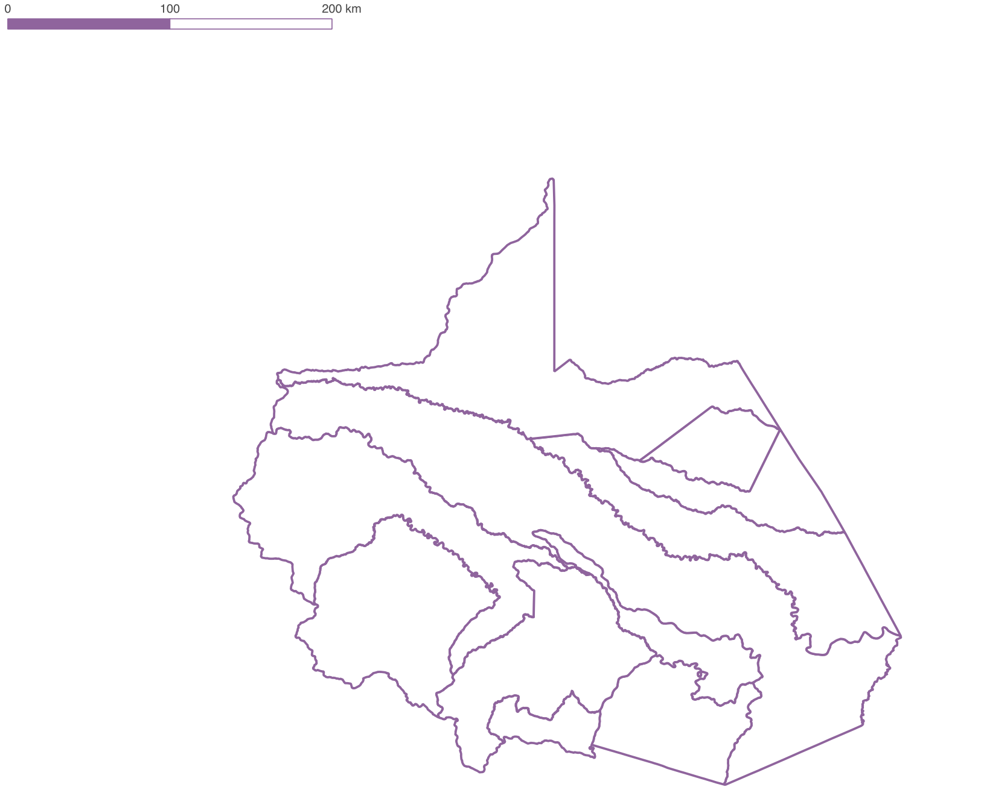
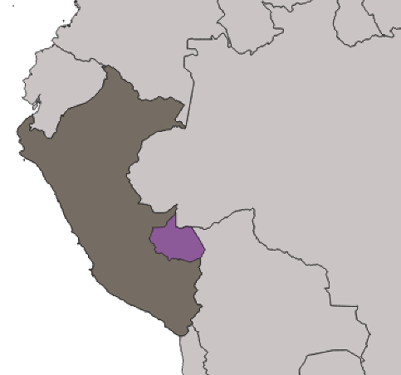

Study Area & Period
Inapari
Country: Peru
Region: Madre de Dios
Area: 11 districts
Years: 2010 – 2020
Iberia
Tambopata
Tahuamanu
Las
Piedras
Fitzcarrald
PERU
MADRE DE DIOS
Manu
Madre de Dios
Huepetuhe
Laberinto
Inambari
N
0
500 km
0
100km
Notes:
Madre de Dios is located in Southeast Peru and situated completely within the Amazon Rainforest, making it a hotspot of biodiversity. The region is divided into 11 districts, shown on the right, and each has a unique combination of land uses. Our research focused on district level disease incidence and the correlation with climatic, topographic, and land use variables in 2010 and 2020.

Slide 3
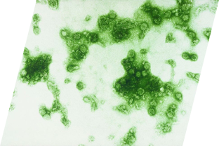
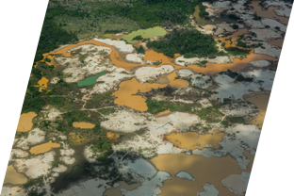
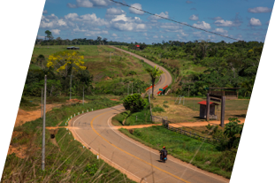
Community Concerns
Endemic
Dengue Fever & Leishmaniasis
Changing Land Use
Expanding
Vector Habitats
Image Credits: Diego Pérez, Sanofi Pasteur
Notes:
Our project was driven by three primary concerns:
First, two zoonotic diseases regularly occur in Madre de Dios and have some of the highest rates in the world. Dengue fever is transmitted by the Aedes aegypti mosquito and can cause severe flu-like symptoms along with lasting joint and muscle pains. Leishmaniasis is transmitted by sandflies of the Psychodidae family and can cause skin lesions and destroy facial membranes, which are culturally stigmatized. Both diseases can result in lower quality of life and even death if untreated, and many cases go unreported and occur in areas without access to healthcare.
*click*
Second, zoonotic diseases are diseases transferred from animals to humans. Outbreaks are more likely to occur with increased and unprecedented interactions among humans, wildlife, and natural spaces. This is highly concerning for Madre de Dios because the region has experienced drastic land use changes in recent decades, including large-scale urbanization and deforestation caused by goldmining and the Interoceanic Highway.
*click*
And third, these changes in land use contribute to expanded habitats for disease vectors. Urbanization is linked with dengue-carrying mosquitoes and forest encroachment is linked with leishmaniasis-carrying sand flies.
---------Image Credit --------
Image 1 – Changing Land Use
Image 1 Credit: Diego Pérez
Image 1 Source: Personal Communication with permission to use
Image 2 – Endemic Dengue Fever & Leishmaniasis
Image 2 Credit: Sanofi Pasteur (Dengue virus)
Image 2 Source: https://flic.kr/p/93T2b2 (CC BY-NC-ND 2.0)
Image 3 – Expanding Vector Habitats
Image 3 Credit: Diego Pérez
Image 3 Source: Personal Communication with permission to use

Slide 4






Partners
Peru Ministry of Health
(MINSA)
Peru Ministry of Environment (MINAM)
The Lab for EcoHealth & Urban Ecology at la Universidad Peruana Cayetano Heredia
El Instituto del Bien Común (IBC)
The National Commission for Aerospace Research and Development (CONIDA)
La Asociación para la Conservación de la Cuenca Amazónica (ACCA)
Notes:
DEVELOP partnered with the Peruvian Ministry of Health and Ministry of Environment to address these concerns and explore how remote sensing data can help inform responses to dengue fever and leishmaniasis outbreaks in Madre de Dios.
We also collaborated with:
The Lab for EcoHealth and Urban Ecology at La Universidad Peruana Cayetano Heredia,
El Instituto del Bien Común,
The National Commission for Aerospace Research and Development, and
La Asociación para La Conservación de La Cuenca Amazónica
---
Icon Credit: all from PowerPoint

Slide 5
Objectives
Term I:
Term II:
MINSA & MINAM:
Land Use
Land Cover Classification
Variable Significance for Disease Incidence
District-Level
Disease Risk Visualization
Informed Decision Making & Advocacy
Risk Matrix
Risk Map
Notes:
In Summer 2021, the first term of this project integrated satellite imagery from Landsat 5 and 8 into a land use land cover classification script in Google Earth Engine. They produced land use land cover maps for 2010, 2015, and 2020, then quantified their land categories by total area and percent of district. They ultimately found a positive correlation between urbanization and total dengue fever and leishmaniasis incidence.
In this second term, we integrated Term I’s land use land cover assessments into our expanded analysis of variables influencing dengue and leishmaniasis in Madre de Dios. To determine districts’ degree of vulnerability, we scripted disease outbreak risk matrices which correlate disease incidence with climatic, topographic, and land use/land cover variables. Then, we visually represented these data through mapping the risk associated with each disease and each relevant variable.
Lastly, these products will inform the decision making processes of both the Peruvian Ministry of Health and of the Environment.

Slide 6


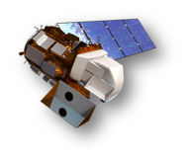
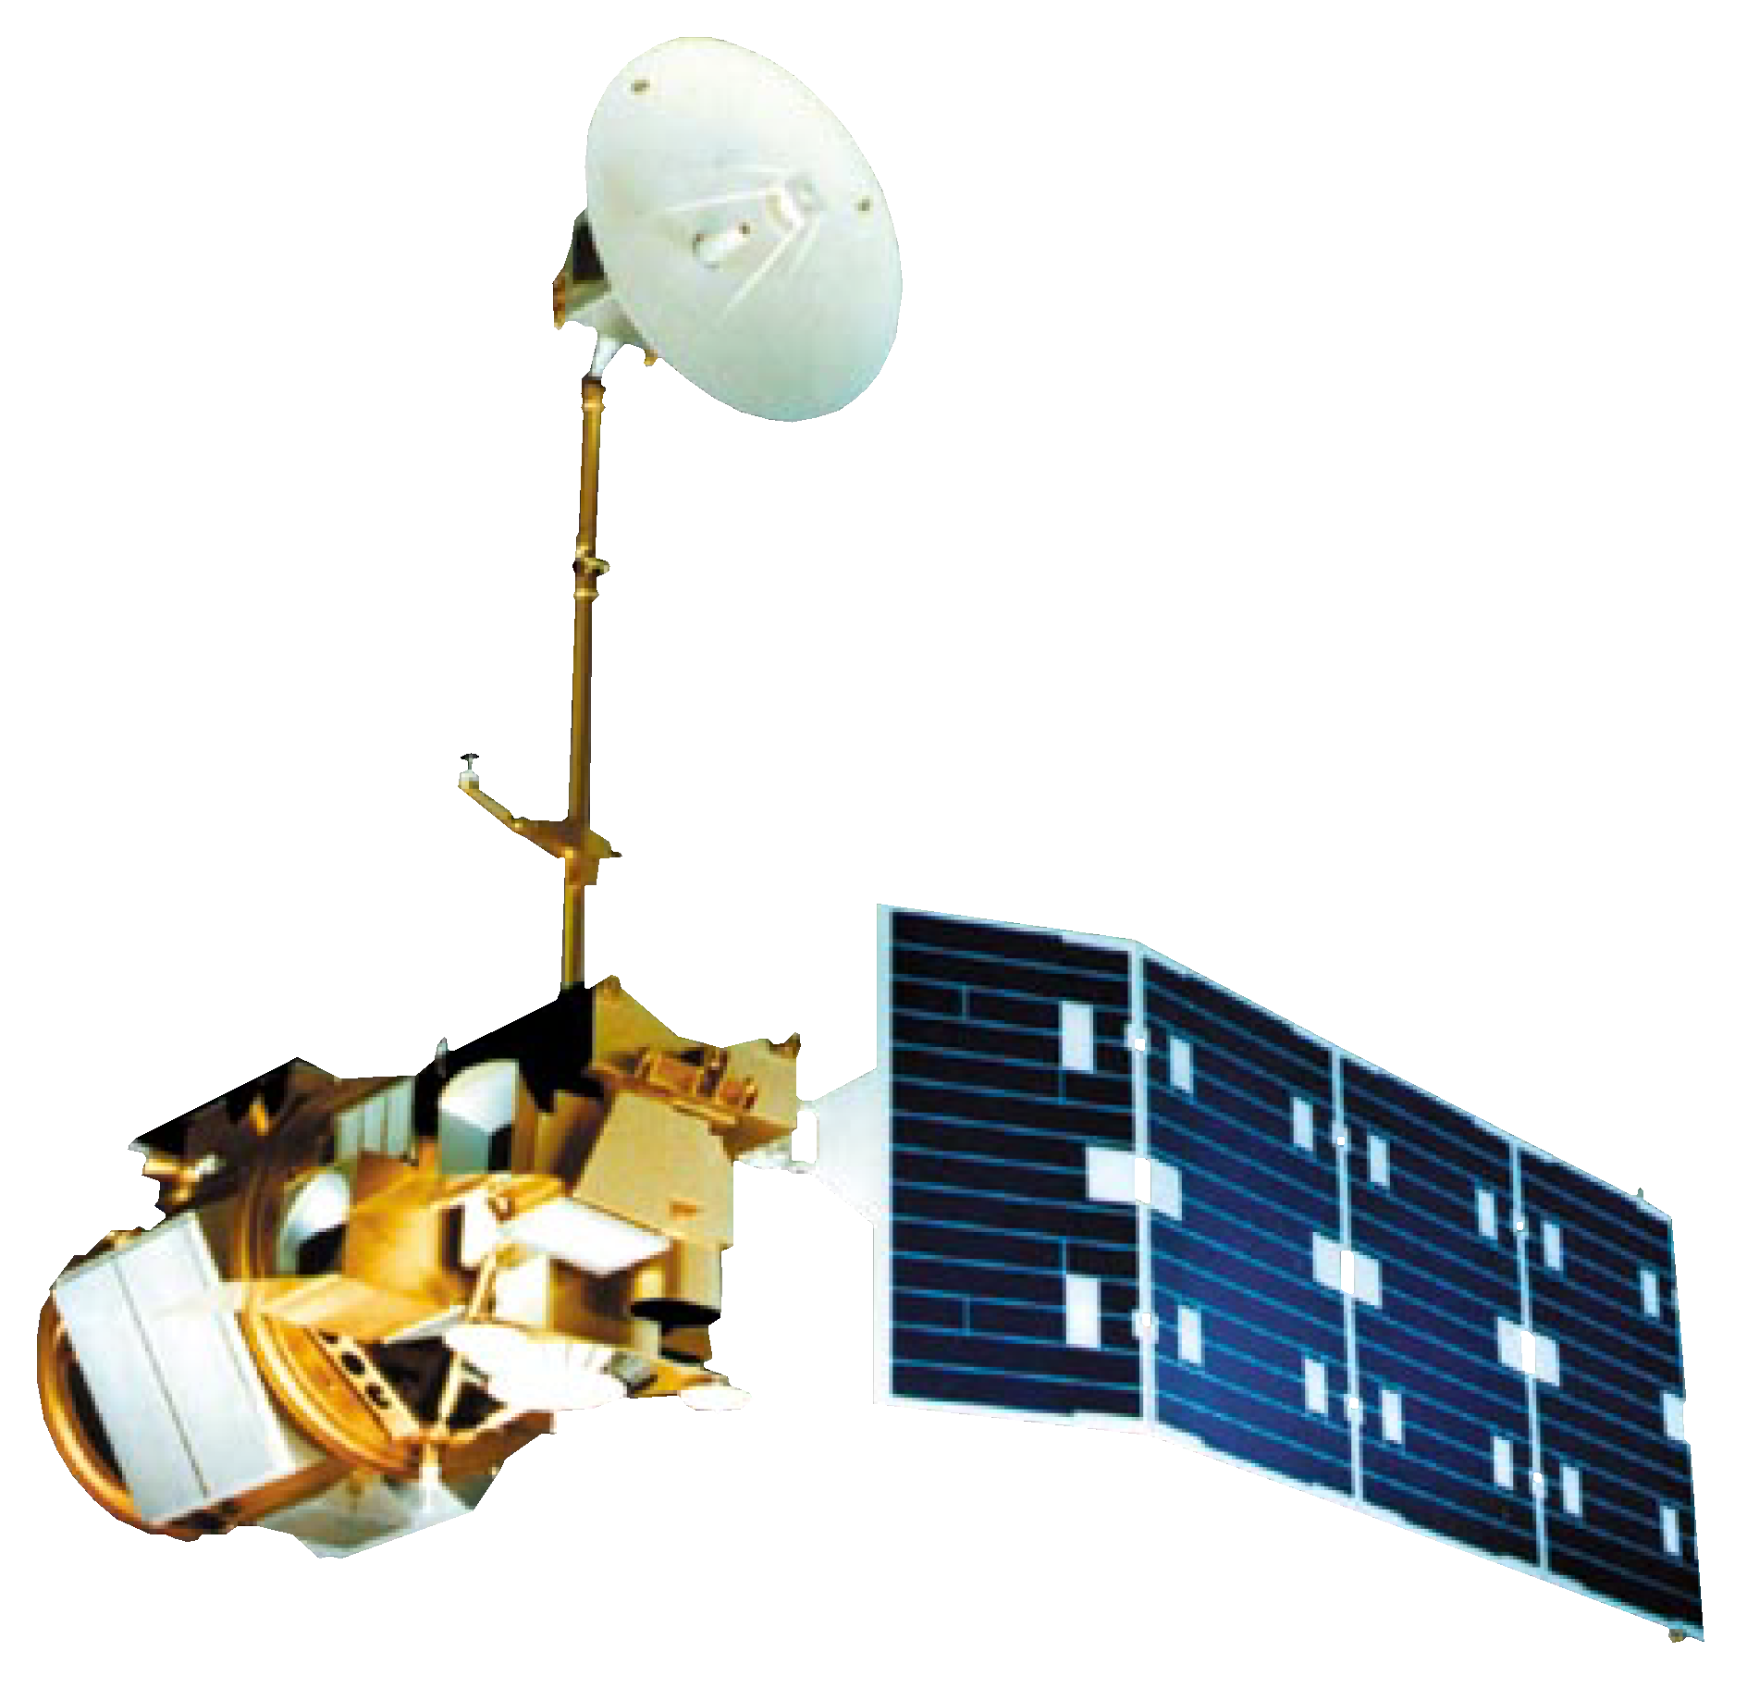
NASA Satellites & Sensors
Satellite & Sensor | Categories | Years
Landsat 5 Thematic Mapper (TM) | Tier 1 | 2010
Landsat 7 Enhanced Thematic Mapper Plus (ETM+) | Tier 2 | 2010 - 2014
Landsat 8 Operational Land Imager (OLI) | Level 2 Collection 2 Tier 1 | 2015 - 2020
Global Precipitation Measurement (GPM) Integrated Multi-satellitE Retrievals for GPM (IMERG) | Version 6 | 2010 - 2020
Shuttle Radar Topography Mission (SRTM) Digital Elevation Data | Version 4 | 2000
Image Credits: NASA
Notes:
To create the risk matrices and risk maps for our partners, we used a variety of Earth observations. Data from Landsat 5 TM and Landsat 8 OLI built Term I’s land use land cover classifications, and we used Landsat 7 ETM+ and Landsat 8 OLI for temperature. For precipitation, we used the GPM IMERG dataset. And for elevation and slope, we used the Shuttle Radar Topography Mission Digital Elevation dataset.
-----Image Credits-------
Image 1 Credit: NASA (Background Image of Earth)
Image 1 Source: https://images.nasa.gov/details-PIA18033
Image 2 Credit: NASA (Landsat 7 Image- upper)
Image 2 Source: https://www.devpedia.developexchange.com/dp/images/3/39/02_Landsat7.png
Image 3 Credit: NASA (Landsat 8 Image- middle)
Image 3 Source: https://www.devpedia.developexchange.com/dp/images/c/c2/03_Landsat8.png
Image 4 Credit: NASA (Landsat 5 Image- lower)
Image 4 Source: https://www.devpedia.developexchange.com/dp/images/6/69/01_Landsat5.png

Slide 7
Methodology Overview
Climatic Variables
Regression Models
Topographic & LULC Variables
Risk Matrices
Risk
Maps
Linear
Stepwise
Health Data
Notes:
With data from those sources organized into these variable categories on the left, we conducted statistical analyses including stepwise and linear regression to identify statistically significant variables, which then informed our creation of risk matrices and risk maps.
We’ll begin by discussing the cleaning our variable data.

Slide 8
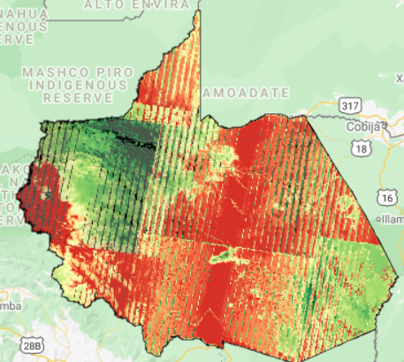

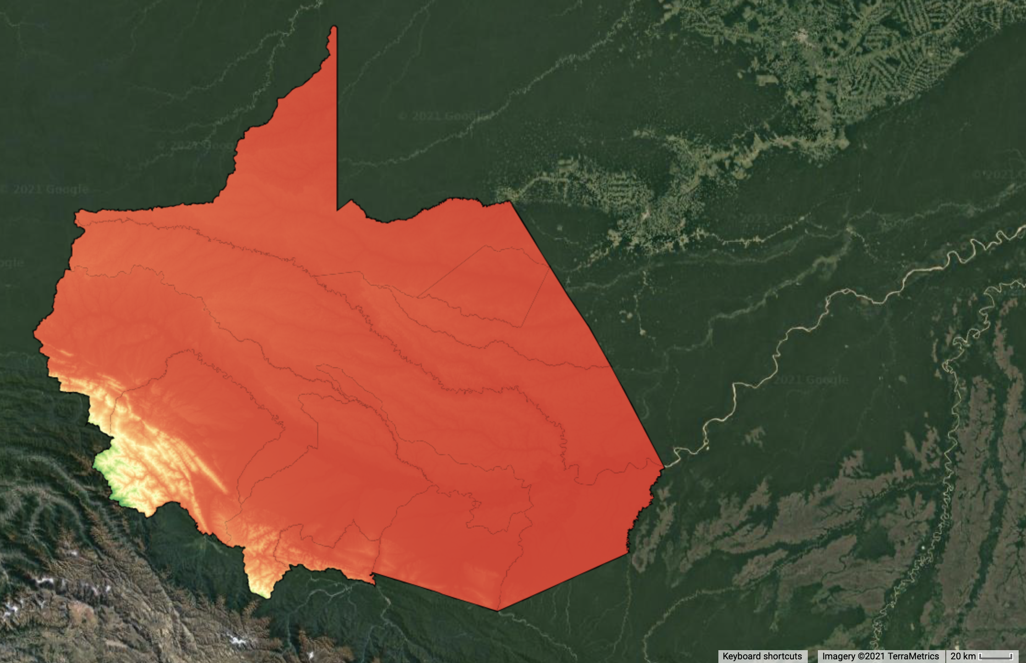

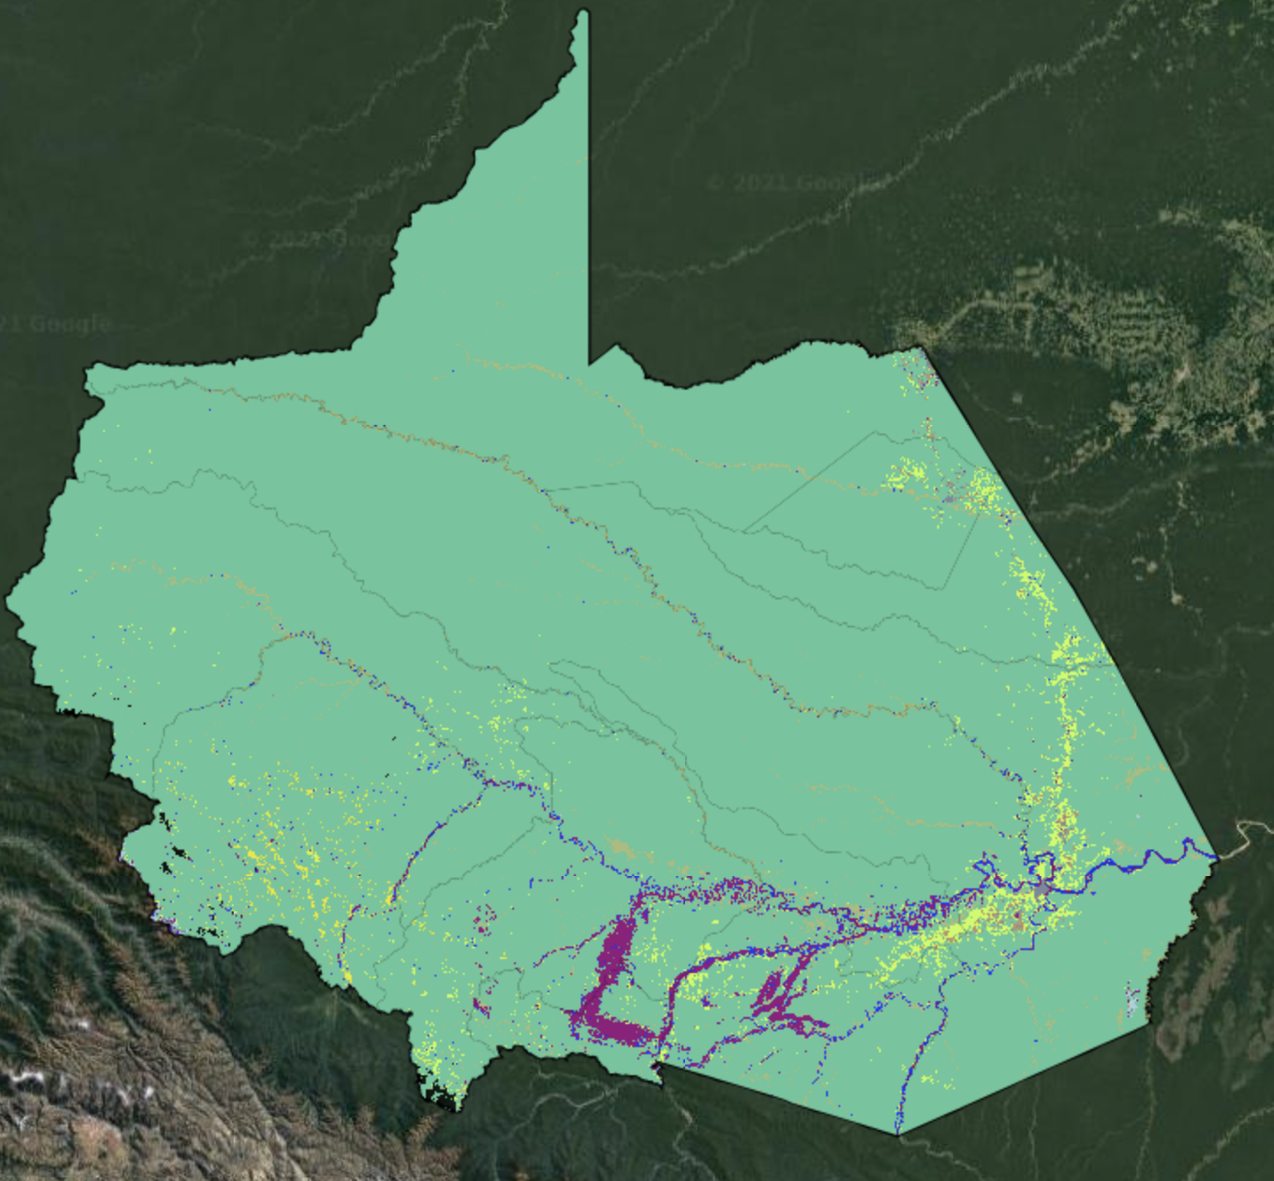



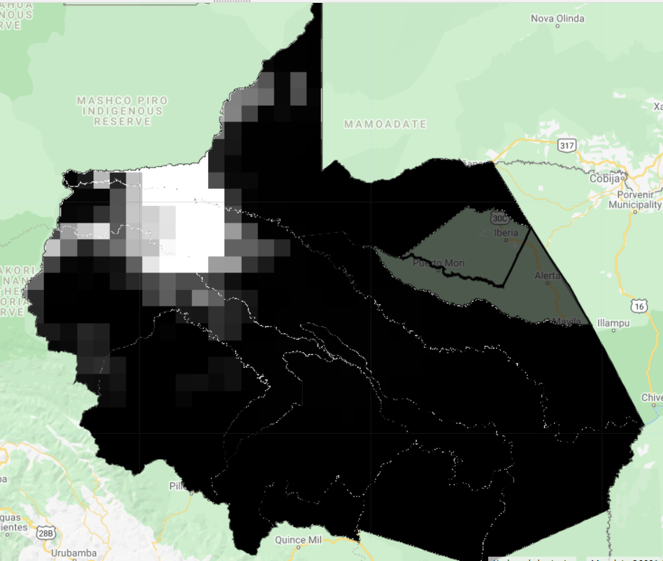

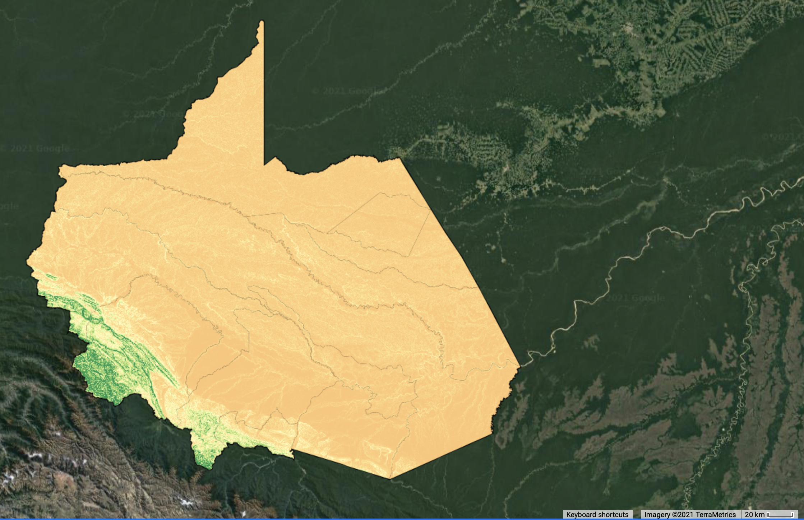

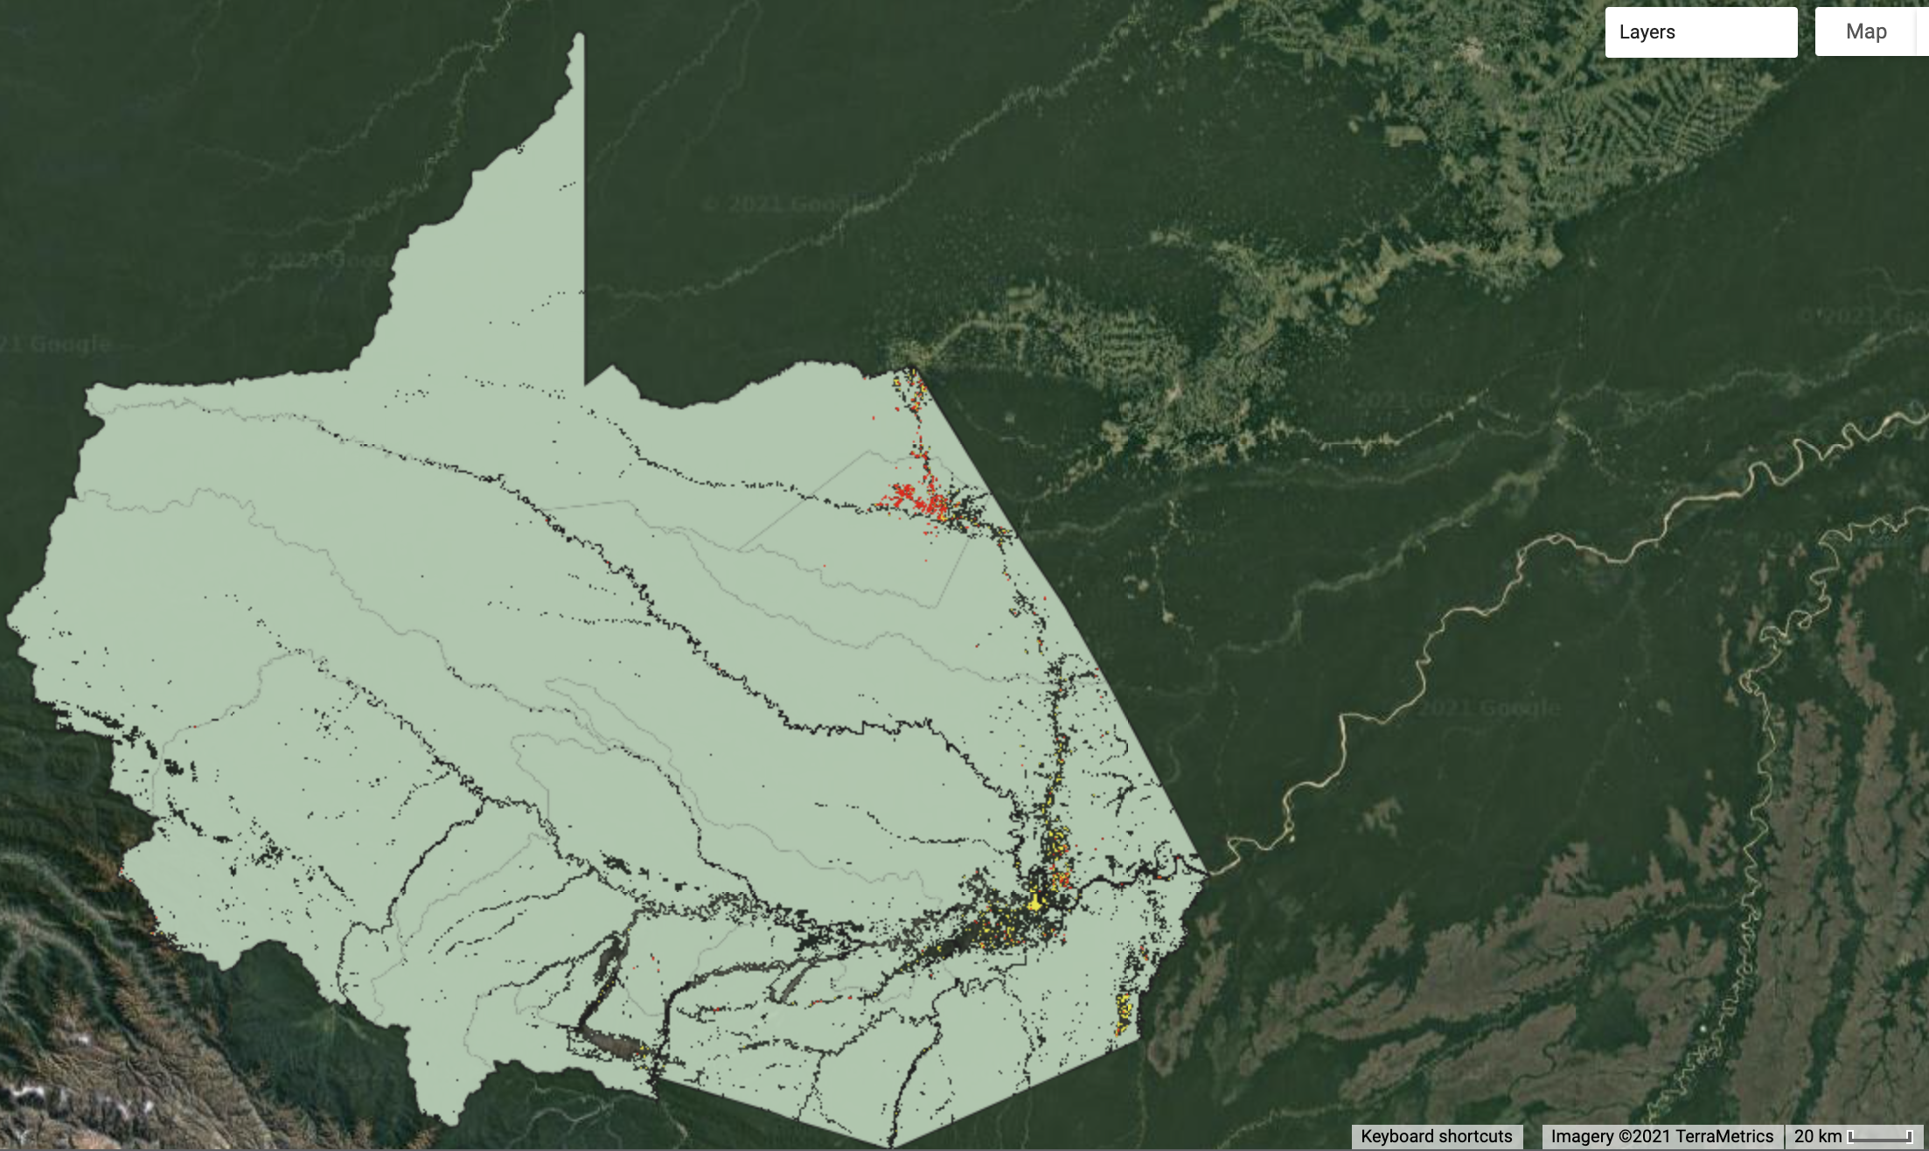


Data Processing
Climatic Variables
Topographic Variables
LULC Variables
High
4000m
Forest
Med
Pasture
Low
150m
Mining
Land Use Land Cover
Water
Elevation
Agriculture
Temperature
High
25°
Precipitation
Forest
Med
Urban
Low
0°
Urban -Forest
Edge
Precipitation
Slope
Urban-Forest Edge
N
20km
Notes:
For our two climatic variables, temperature and precipitation, we first queried and masked clouds from the satellite imagery. We then filtered these data to our districts for both the wet season, November to March, and dry season, April to October. For temperature, we also converted from Kelvin to Celsius. Finally, we aggregated the mean, median, minimum, maximum and range values to the districts.
For topographic data, we queried elevation data and subsequently used it to derive slope. We then clipped these to our districts and aggregated by the same reducers as our climate data.
For our Land Use Land Change variables, we ran Term I’s classification script to extract data about certain land uses and certain combinations, including: urban, forest, water & wetlands, agriculture & pastures, and "human-altered environments” -- which included urban, mining, agriculture, and pastures. Additionally, we built upon the script of a previous DEVELOP project to classify the areas where urban and forest land classes meet, represented by the urban-forest edge variable. All of these LULC variables were analyzed as both the total area in km2 and percent area.
---
All maps generated by the team

Slide 9
Data Processing
Health Data
Dengue Fever Cases
Leishmaniasis Cases
Filter Weekly Health Post Data (2000-2021)
to 2010 and 2020
Filter To Wet/Dry Season & Full Seasonal Year
Normalize Disease Incidence to District Population
Notes:
For health data, the Ministry of Health provided us weekly incidence reports for all diseases from 2000 to 2021. The previous term organized the data to dengue and leishmaniasis, and we further organized the data by wet season, dry season, and full seasonal year for 2010, 2015, and 2020. Then, using interpolated census data from 2007 and 2017, we normalized disease incidence to district population.

Slide 10
Statistical Analysis
Independent Variables
Dependent Variables
Temperature
Precipitation
Dengue Fever​
Incidence
Wet Season
Seasonal Year
Wet Season
Seasonal Year
Wet Season
Seasonal Year
Elevation
Slope
Regression Analysis
Urban
Forest
Agriculture & Pastures
Water & Wetlands
Leishmaniasis
Incidence
Human-Altered Environments
Urban-Edge
Wet Season
Seasonal Year
Urban-Forest Edge
Forest-Edge
Notes:
To inform which variables were included in our risk matrix, we ran stepwise and linear regression for dengue and leishmaniasis incidence in 2010 and 2020, for both the wet season and seasonal year, which includes wet and dry season. The topographic, land use land change, and climatic variables were the independent variables in our regression models. These included metrics for: temperature, precipitation, elevation, slope, urban, forest, agriculture & pastures, water & wetlands, human-altered environments, urban edge, forest edge, and urban-forest edge. All of these variables were tested for correlation and then analyzed against disease incidence for their significance as individual variables and in combinations with one another.

Slide 11







Regression Results
Dengue Fever
Urban-Forest Edge (km²)
Slope Range
Leishmaniasis
Urban (km²)
Temperature Mean
Precipitation Range
Elevation Mean
Notes:
For dengue fever, we found that models including the urban-forest edge and slope range were the most successful, and other important variables across all years included urban area or percent and precipitation mean. These results informed the data feeding into our risk matrices.
For leishmaniasis, we found that elevation mean had high significance across all years and variables, but the other variables didn’t consistently show any significance. Due to these results and supporting literature about the difficulties of modeling leishmaniasis, we moved forward with just dengue for our risk matrices and maps.
---Image Credit---
Icons from PowerPoint

Slide 12
Regression Results
Disease & Date​​ | Variable Combination with the Highest Significance​​ | r2​​ | ρ ​​
Dengue: Wet Season 2010​​​​ | Urban Forest Edge (km²), Temperature Range, Temperature Median, Slope Range​​​​ | 0.91 | 6.4 x 10⁻⁴
Dengue: Seasonal Year 2010 ​​ | Urban Forest Edge (km²), Slope Range, Temperature Mean, Temperature Range, Precipitation Range | 0.62​​ | 6.8 x 10^{-​​2}
Dengue: Wet Season 2020​​ | Urban Forest Edge (km²), Slope Range​​ | 0.48​​ | 3.1 x 10⁻²​​
Dengue: Seasonal Year 2020​​ | ​Urban, Urban Forest Edge(km²), Slope Range, Temperature Mean, Temperature Range, Precipitation Range​ | ​0.73​ | ​6.0 x 10^{-2​}
Leishmaniasis: Wet Season 2010​​ | Human-Altered Environments, Forest Edge(km²), Elevation Mean, Temperature Min​​ | 0.89​​ | 1.1 x 10^{-3​​}
Leishmaniasis: Seasonal Year 2010​​ | Forest Edge (km²), Elevation Mean​​ | 0.80​​ | 6.2 x 10⁻⁴
Leishmaniasis: Wet Season 2020​​ | Water (km²), Forest Edge (km²), Elevation Mean​​ | 0.52​​ | 4.5 x 10⁻²
Leishmaniasis: Seasonal Year 2020​​ | ​Human-Altered Environment, Urban Edge, Elevation Mean, Temperature Max ​ | ​0.43​ | ​1.2 x 10⁻¹​
Notes:
We created models by running multiple combinations of variables and identifying which models then had the highest statistical significance. To orient you, high R-squared values are preferable while low p-values are preferable and indicate a higher statistical significance. Our strongest model was for dengue: wet season 2010, which combined urban forest edge/temperature range/temperature median/slope range.

Slide 13
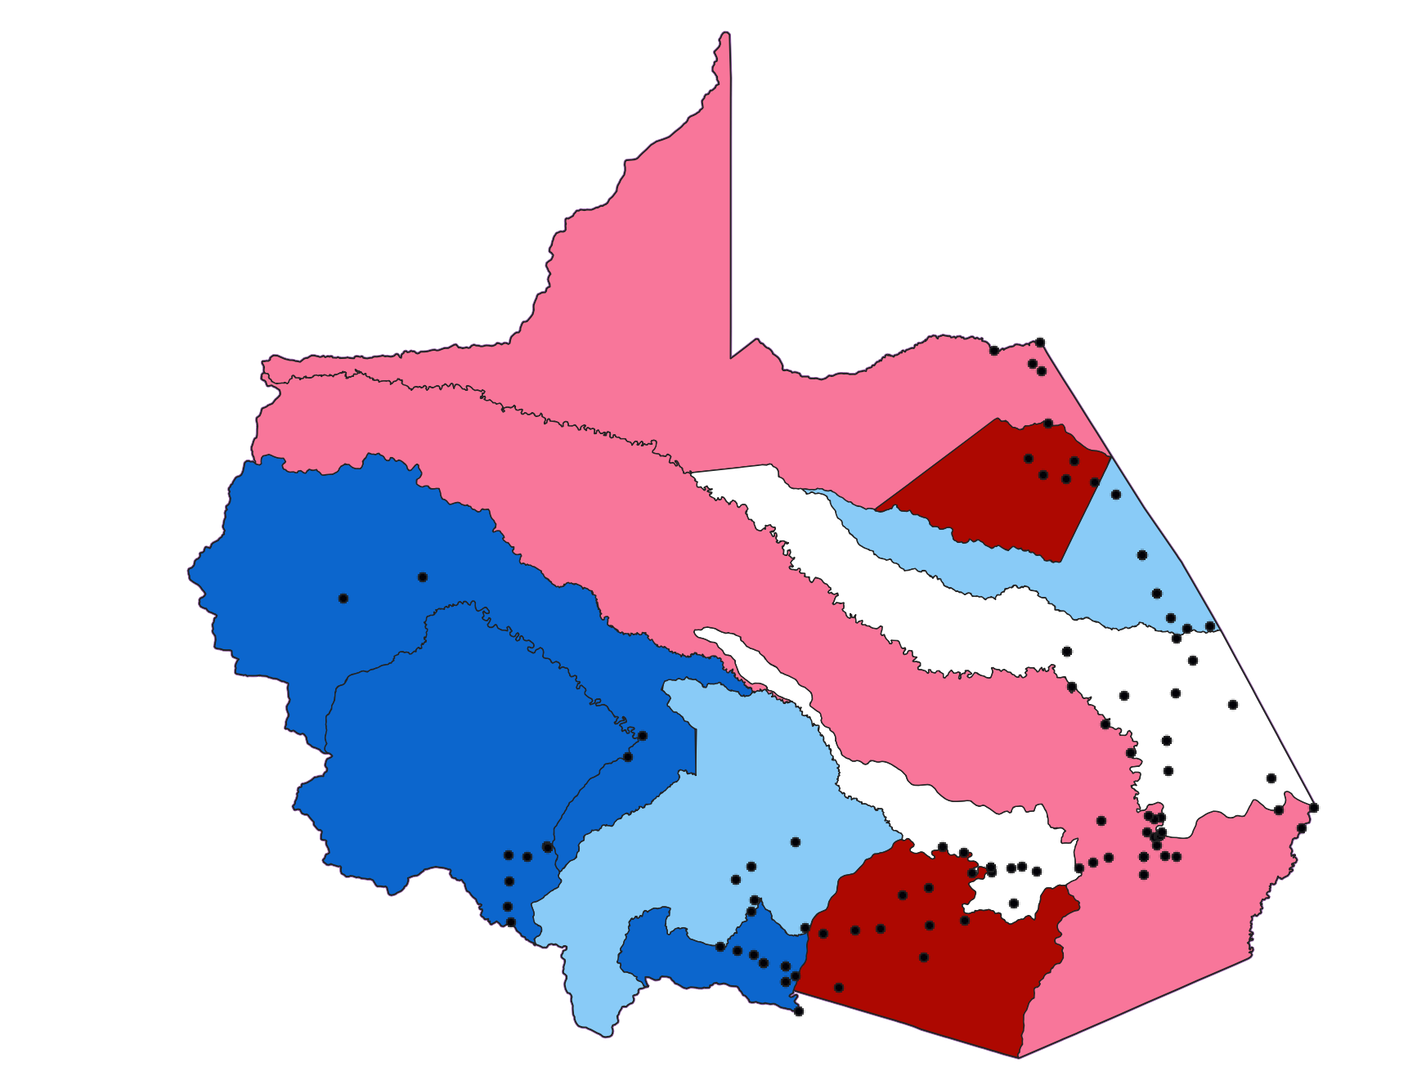
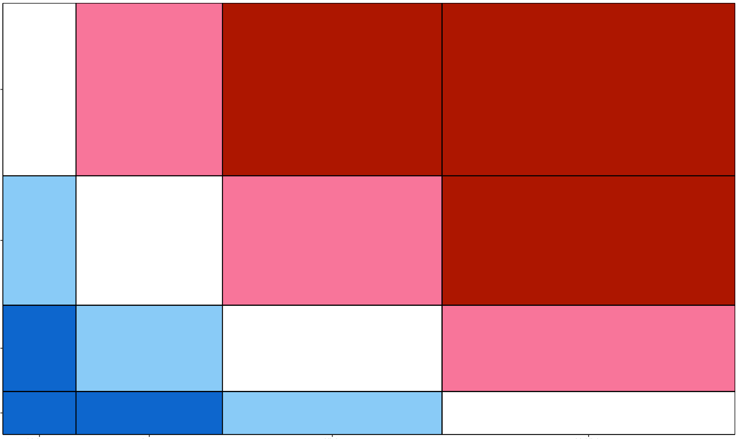
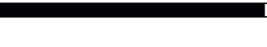
Risk Matrix
Risk Map
Inapari
Tambopata
Iberia
v. high
Tahuamanu
Las
Piedras
Population
Fitzcarrald
high
low
Manu
v. low
v. low
low
high
v. high
Madre de Dios
Huepetuhe
Inambari
Laberinto
Likelihood
0
100km
N
Notes:
For our risk matrices, we incorporated these significant variables as well as others deemed important in the literature to create a likelihood parameter, which is the likelihood of contracting disease. Intervals and weights of risk were determined by expert opinions from our partners, scientific literature, and the distribution of our data.
On the other axis is consequence, which we measured by population. With varying population density across the districts, this parameter helps partners identify which districts have the higher potential for disease spread based on the number of possible people infected.
On the left, you can see an example of our risk matrix. Red is high risk because of higher population and higher likelihood, blue is lower risk because of lower population and lower likelihood, and white is medium risk.
On the right, you can see an example of our risk maps. The colors correlate with risk, and the dots represent health posts, showing the distribution of healthcare resources as compared to risk.

Slide 14
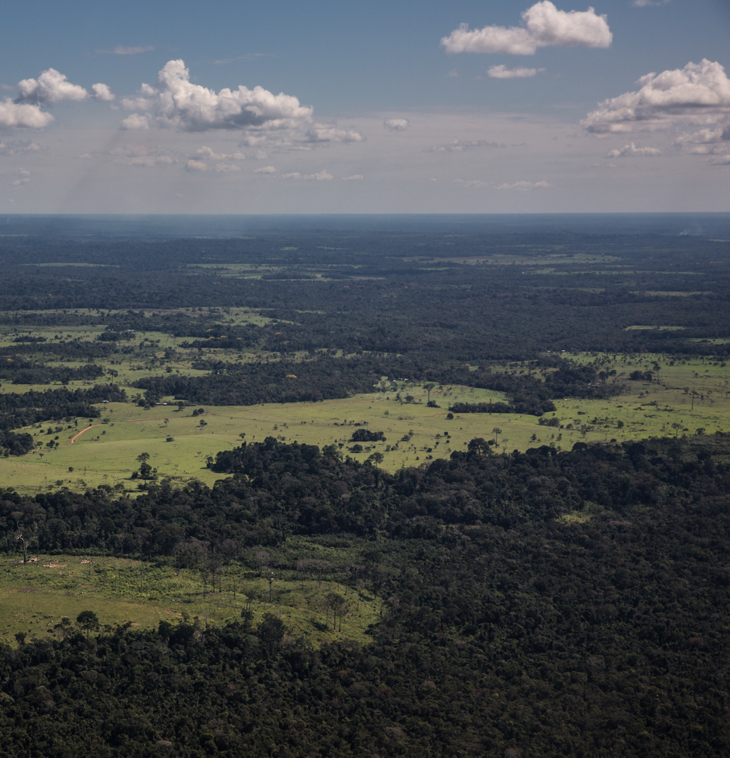
Limitations
Nuance obscured by low resolution
Statistical significance vs. observed transmission patterns
Underreporting and understudied
Image Credits: Diego Pérez
Notes:
Before discussing our conclusions, we’d like to acknowledge some of the limitations surrounding our analysis.
First, low resolution data can obscure nuances. While GPM IMERG is some of the best available precipitation data, its 11 km resolution may not have captured spatial and temporal variation. Similarly, while district level health data is important administratively, it does not convey variation at the community or ecosystem levels and can underrepresent rural areas.
Additionally, statistical significance may not reflect observed transmission patterns, evident in the low correlation between forest area and leishmaniasis. Our small dataset of 11 districts and the lag time from climatic variables to disease contraction may have also obscured significant trends.
Furthermore, due to unknown numbers of individuals with acquired immunity of leishmaniasis along with underreporting and the overall disease being under-researched, it may be difficult to tie environmental factors to new cases of leishmaniasis. This may also serve true for dengue.
--
Image Credit: Diego Pérez
Image Source: Personal Communication with permission to use

Slide 15
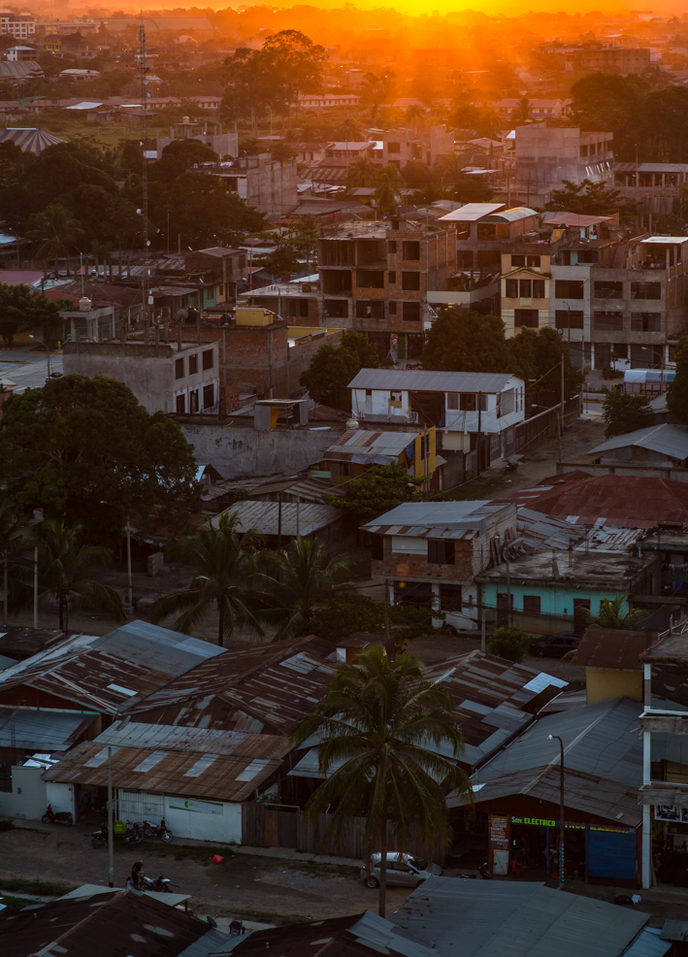
Image
Conclusions
Streamlined process to analyze environmental variables contributing to risk
Implement Effective Public Health and Land Management Strategies
Predictors of Disease Incidence
  Dengue: Urban-Forest Edge & Slope Range
  Leishmaniasis: Forest-Edge & Elevation Mean
Image Credit: Diego Pérez
Notes:
With the risk matrices and maps, we created a streamlined process which allows the Ministries of Health and Environment to analyze the environmental variables contributing to risk and identify the districts most vulnerable to dengue fever outbreaks.
Through our statistical analysis leading to these end products, we isolated variables most predictive of disease incidence. For dengue fever, we found that amount of Urban-Forest Edge and the Slope Range were consistently most important in describing incidence. This is illustrated by Iberia and Inambari having the highest incidence of dengue fever as well as the largest area of urban-forest edge. For leishmaniasis, we found that the amount of Forest Edge and Mean Elevation were important, supported by Tahuamanu and Manu having high incidence rates as well as large amounts of forest-edge.
--
Image Credit: Diego Pérez
Image Source: Personal Communication with permission to use

Slide 16
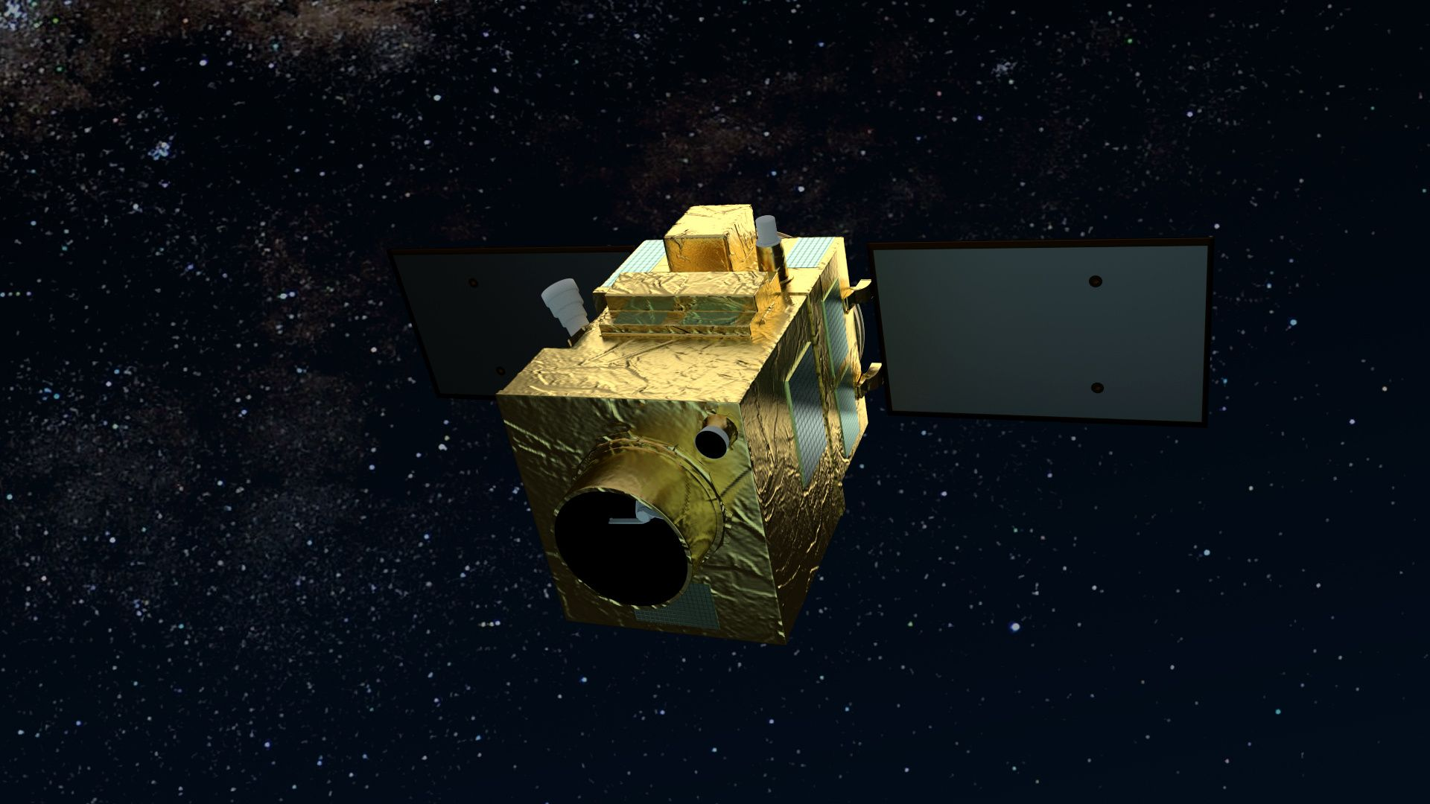
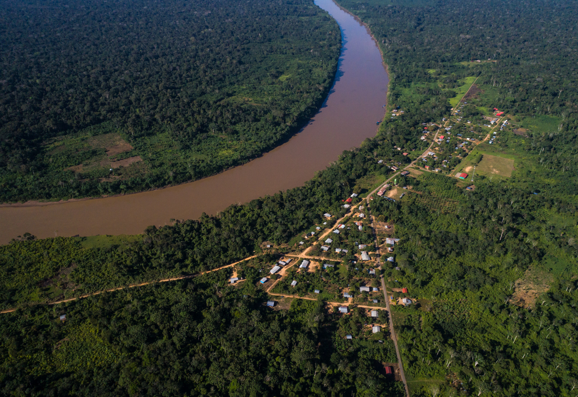
Future Work
High resolution PeruSAT-1 imagery
Address-level health data
Account for population density
Additional zoonotic diseases
Image Credits: AIRBUS, Diego Pérez
Notes:
While we were able to accomplish a lot over these two terms, there is still more work that can be done to further improve the risk matrices and maps.
Incorporating PeruSAT-1 into land use analysis would allow for very high spatial-resolution at less than 3 meters and could be used to isolate areas of interest. In particular, this could be used to differentiate various types of crops and forests for their individual effects. These data would also make it possible to identify smaller bodies of water hosting our vectors of interest.
Acquiring, finer scale, address-level health data would similarly allow for more precise comparisons between disease incidence and climatic and topographic variables, offering additional insight at the community scale. Better accounting for population density is another important variable that would better explain human and environmental interactions.
Future work could also expand our framework to include other zoonotic diseases of interest, such as rabies.
--
Top Image 1 Credit: AIRBUS
Top Image 1 Source: https://www.airbus.com/search.image.html?q=perusat#searchresult-image-all-12 (CC-BY-SA)
Bottom Image 2 Credit: Diego Pérez
Bottom Image 2 Source: Personal Communication with permission to use

Slide 17
Project Partners
Peruvian Ministry of Health (MINSA): Dr. César Munayco
Peruvian Ministry of Environment (MINAM): Dr. Tatiana Pequeño, William Augusto Llactayo Leon, Germán Marchand
Lab for EcoHealth and Urban Ecology at La Universidad Peruana Cayetano Heredia: Dr. Armando Valdes-Vasquez, Ellen Delgado Florian, Vivana Sanchez-Aizcorbe Hennings, Dr. Gabriel Carrasco
El Instituto del Bien Común (IBC): Miguel Macedo, Kathrin Hopfgartner, Andrea Bravo
The National Commission for Aerospace Research (CONIDA): Dr. Jose Pasapera Gonzales
La Asociación para la Conservación de la Cuenca Amazónica (ACCA): Sidney Novoa
Science Advisors
Dr. Marguerite Madden (University of Georgia - Athens)
Dr. Xiao Feng (University of Florida)
DEVELOP Node
Sarah Payne (Athens-GA Node Fellow)
Past Contributors
Elizabeth Stapleton
Ariel Calle
Nataly Chacon
Nelson Huffaker
Oliver Nguyen
Notes:
Our team would like to acknowledge the contributions of the first team who worked on this project, our science advisors and DEVELOP Fellow, and of course our many partners at the Ministry of Health, Ministry of Environment, Lab for EcoHealth and Urban Ecology, Instituto del Bien Común, National Commission for Aerospace Research and Development, and La Asociación para La Conservación de La Cuenca Amazónica. We would also like to thank you all for your attention, and we are happy to answer any questions you may have at the end.

