Slide 1
LOWER OMO VALLEY
Food Security & Agriculture
Mapping Land Cover Change in Unprotected and Protected areas in the Lower Omo River Valley, Ethiopia
Chiara Phillips, Stacy Armbruster, Lauren Lad, Matison Lakstigala
Colorado – Fort Collins
Notes:
Hi all, thank you for joining us today. We are the Lower Omo Valley Food Security & Agriculture Team. My name is Matison Lakstigala, my name is Chiara Phillips, Stacy Armbruster, and Lauren Lad. For our DEVELOP project this spring, we mapped and assessed the extent and rate of land cover change in protected and unprotected areas in the Lower Omo River Valley. ___________________________________________
Note: Any place in speaker notes that has a bracket, “[“ indicates there is an animation/transition at that point.
___________________________________________
Image Credits:
Website image: NASA DEVELOP, made by the team

Slide 2
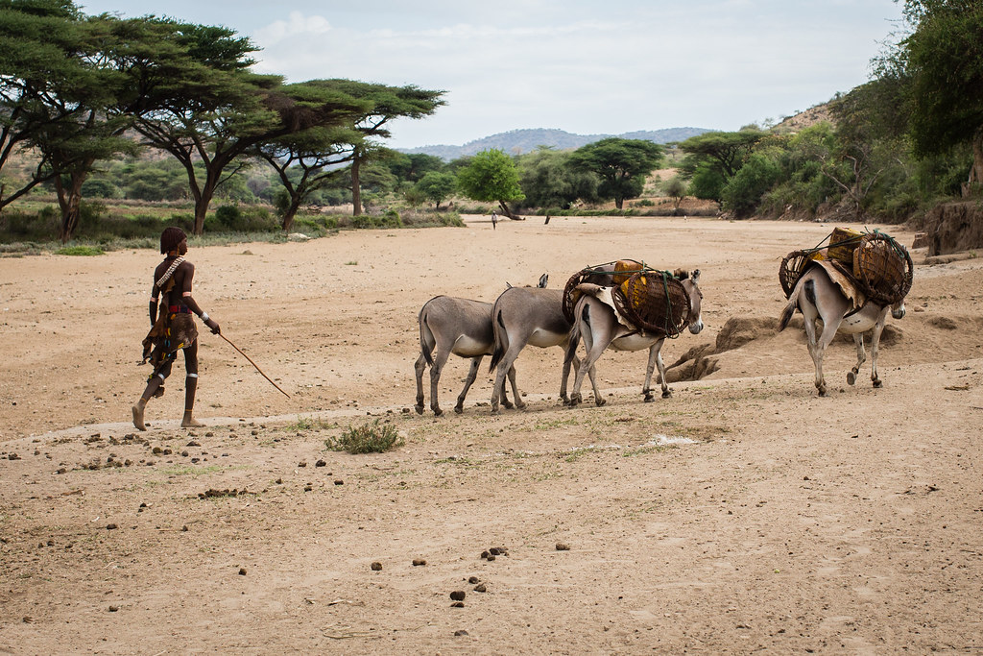
ETHIOPIA: Lower Omo Valley
Semi-arid region of southwestern Ethiopia
Home to ~200,000 indigenous, agro-pastoral and fishing communities
Includes a UNESCO World Heritage Site
Image Credit: Joseph King
Notes:
The Lower Omo River Valley is a [semi-arid and rich ecological and cultural region in Southwestern Ethiopia that is [home to ~200,000 indigenous agro-pastoral and fishing communities as well as unique wildlife such as elephants, zebras, rhinos, lions, giraffes, and gazelles. [It includes a designated UNESCO World Heritage Site due to the discovery of many fossils, which has been of fundamental importance in the study of human evolution.
This area also consists of several national parks and protected areas to conserve and manage these critically biodiverse landscapes and wildlife in collaboration with communities and other stakeholders. Like much of the world, it is undergoing population growth, development, and land use change. Therefore, the region will benefit from reliable land cover change monitoring.
_________________________________________
Image Credits:
Image 1: Donkeys hauling water, Joseph King (CC BY-NC-ND- 2.0) – Creative Commons License https://search.creativecommons.org/photos/cab377c1-bd06-4a88-9764-2011a1bae41f

Slide 3
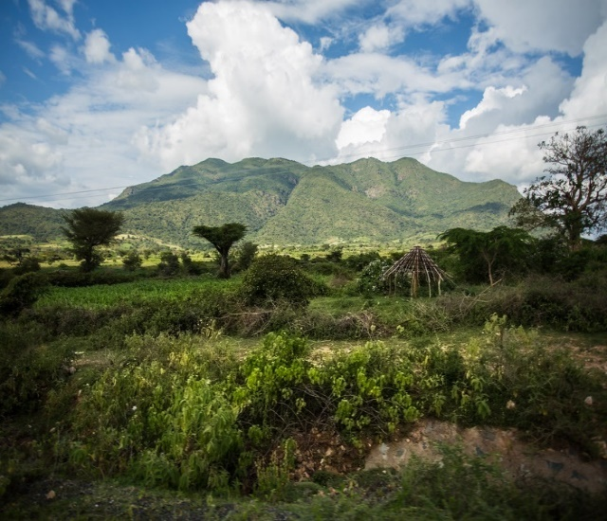
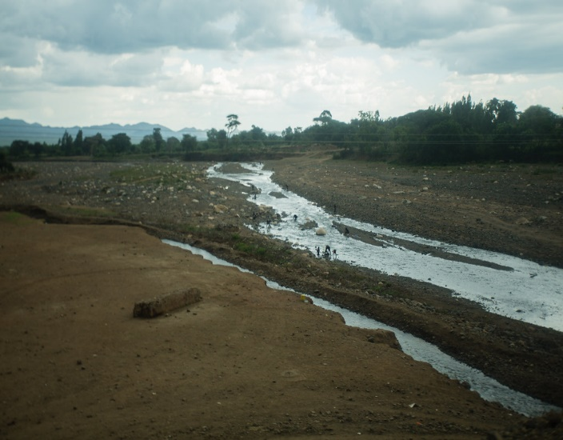
COMMUNITY CONCERNS
Lack of research on:
Land use changes in protected and unprotected areas
Where development is occurring relative to protected areas
Critical habitat for wildlife and biodiversity
Image Credit: Top: Gimli62; Middle, Bottom: Joseph King
Notes:
[Due to increased development and land use change, some biodiverse regions may be at risk of being urbanized, cultivated as agricultural plots, or losing access to water bodies that are essential for maintaining both terrestrial and aquatic life. This includes looking at land changes in protected and unprotected areas, as well as where [development is occurring relative to protected areas. It is important to understand the trend of ecological change in this landscape as these changes may benefit wildlife, while others may not. [With continued land change, conservation leaders are in need of consistent and reliable land cover monitoring in order to assess habitat that is critical for wildlife and biodiversity.
__________________________________________
Image Credits:
Image 1: (Top) Buffalos at the water hole, Gimli62 (CC BY-NC 2.0) Creative Commons License https://search.creativecommons.org/photos/9391acce-4c42-42a5-90b4-1abac5d3a077
Image 3: (Middle) Omo National Park, Joseph King (CC BY-NC-ND- 2.0) – Creative Commons License https://search.creativecommons.org/photos/2e30f1df-536d-4954-b39d-9b410d0f54b1
Image 4: (Bottom) Irrigation channel, Joseph King (CC BY-NC-ND- 2.0) – Creative Commons License https://search.creativecommons.org/photos/41404a72-6a48-48f0-9217-cb532ba4acf5

Slide 4
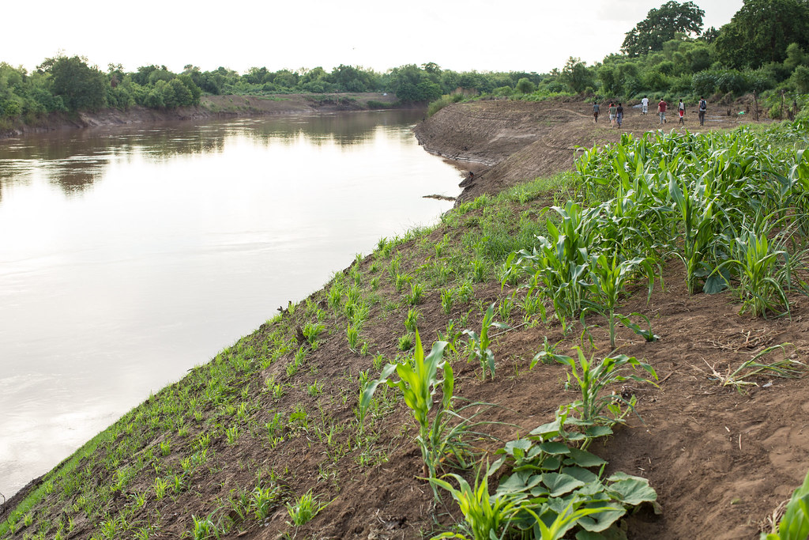
PARTNERS
Ethiopian Wildlife Conservation Authority (EWCA)
Governing agency for all protected areas and wildlife
Collaborates with communities and stakeholders for:
Ecological benefits
Economical benefits
Social benefits
Image Credit: Joseph King
Notes:
[To help address these community concerns, our team partnered with The Ethiopian Wildlife Conservation Authority (EWCA), [a governing agency for all protected lands and wildlife in Ethiopia. [EWCA collaborates with local communities and stakeholders for the [ecological, [economical and [social benefit of the Lower Omo Valley.
The authority also makes decisions related to protected area enforcement and regulations and provides recommendations to policy makers at the national level. They use multiple strategies to assess the status of wildlife species, to evaluate the current condition of protected areas, and to make policy recommendations.
___________________________________________
Image Credits:
Omo River, Joseph King (CC BY-NC-ND- 2.0) – Creative Common License https://search.creativecommons.org/photos/a90659a1-edec-4bda-9a9b-f0ba2499d15c

Slide 5
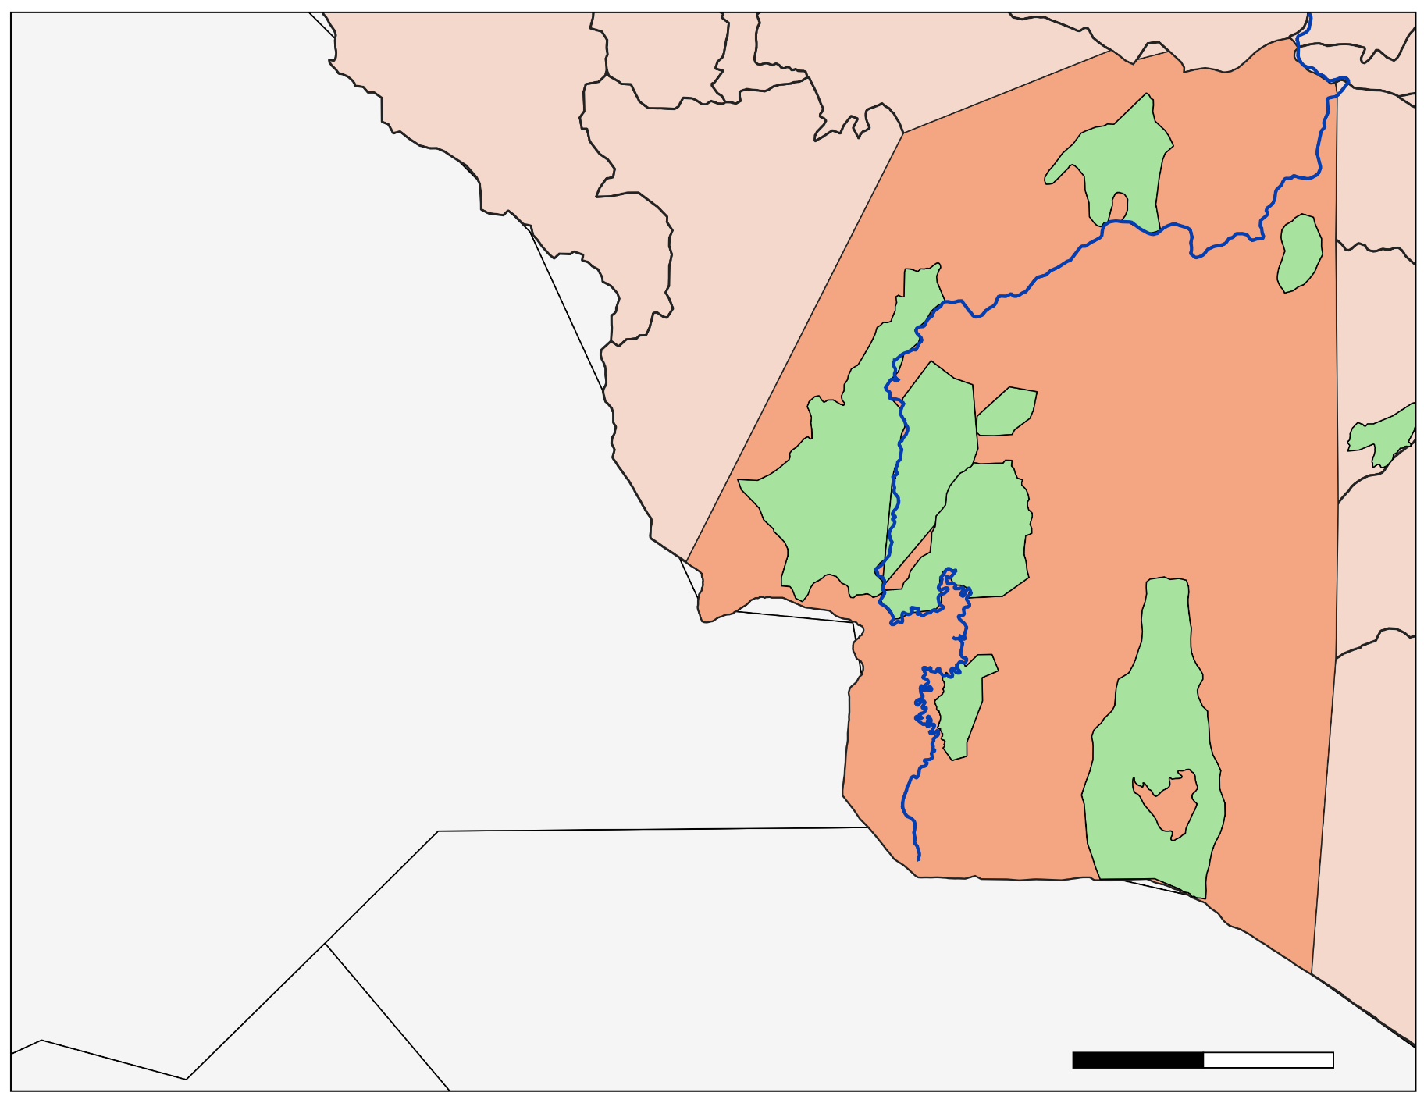
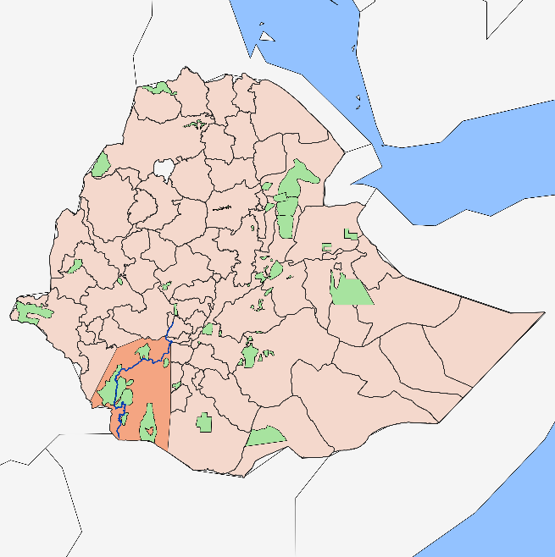
STUDY AREA & PERIOD
C. Churachura
Lower Omo Valley
~62,000 sq. km
January through May; 1994 to 2018
Includes 8 protected areas
C. Churchura
Maze
Tama
W. Sala
Omo
Mago
Chelbi
Lower Omo Study Area
Murulle
Omo River
N
Protected Areas
Study Area
Ethiopian Administrative Zones
0
50
100
km
Notes:
[Our partners identified a region of interest in the Lower Omo Valley that is boxed in red on the inset map (left). This area is characterized by a semi-arid to arid climate. Vegetation in the immediate vicinity of the Omo River banks varies between large forest trees and shrub grassland. Further out from the banks, the vegetation transitions to a dense belt of woody plants or ‘brushland thicket,’ which then gives way to an open wooded grassland.
[Our study area covered ~62,000 km^2 of land from the years [1994-2018 and our study period was from January –May,. This area includes [8 protected areas, two of which are national parks. The seasonal aspect of the study was crucial in differentiating the level of greenness between our land cover classes.

Slide 6
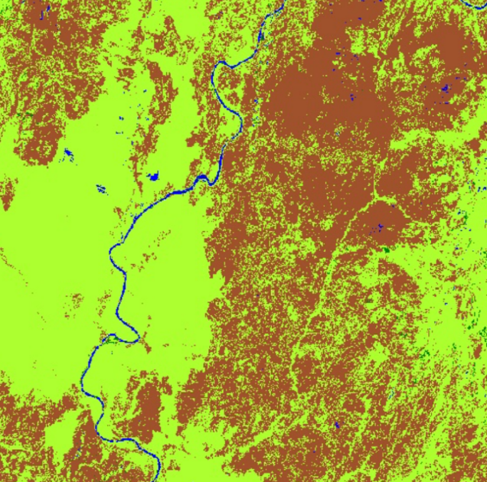
OBJECTIVES
1. Classify
2. Create
3. Analyze
Classify land cover from 1994 to 2018 using Random Forest in Google Earth Engine (GEE)
Create time series analysis to understand rate of change
Analyze acreage of land cover change for protected & unprotected areas
Class | 1994 to 2010 | 2010 to 2018 | 1994 to 2018
Water | 1162% | -3213% | 918%
Natural Veg. | 10% | -17% | -8%
Cultiv. | -11% | 344% | 291%
Bare | -24% | 7% | -18%
Image Credits: NASA DEVELOP
Notes:
This term, we had three primary objectives.
First, we classified land cover between 1994 and 2018. This was done using a Random Forest classifier in Google Earth Engine (GEE).
[Second we created a time series analysis to understand the rate of land cover change.
[Lastly we analyzed the acreage of land cover change for both protected and unprotected areas during our study period.
___________________________________________
Image Credits:
Image 1: Random forest image classification, DEVELOPer, made by the team

Slide 7
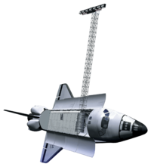
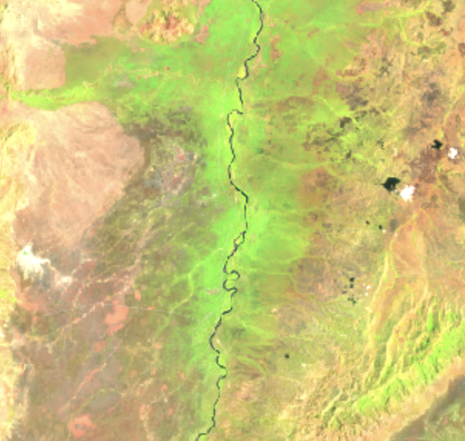
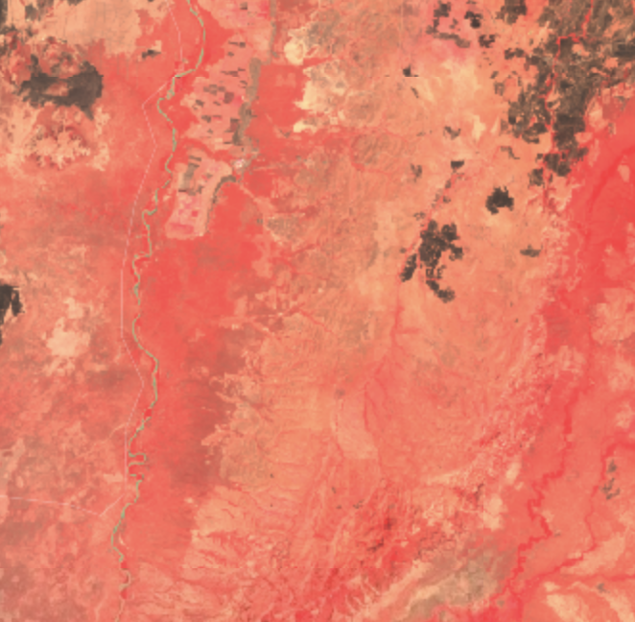
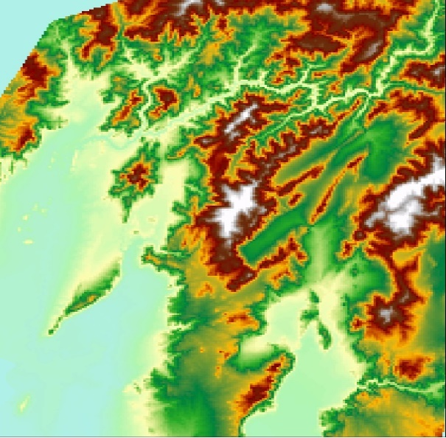
METHODS: Satellites & Sensors
Landsat 5 TM
Landsat 7 ETM+
Landsat 8 OLI
SRTM
Image Credit: NASA DEVELOP, Google Earth Engine
Notes:
For our project, we used data from four NASA Earth observations: [Landsat 5 Thematic Mapper (TM), [Landsat 7 Enhanced Thematic Mapper Plus (ETM+), [Landsat 8 Operational Land Imager (OLI), and the [Shuttle Radar Topography Mission (SRTM). Landsat 5, 7, and 8 were used for our LandTrendr analysis, while Landsat 5, 8 and the SRTM’s digital elevation model were used for our classification model.
Unfortunately, Landsat 5 had missing data from 2003 to 2009 and Landsat 7 had scan line error issues in the imagery. While Landsat 8 had great image availability,we were not able to use it for the earlier classifications due to its launch date in 2013.
___________________________________________
Image Credits:
Image 1: Landsat 5, NASA DEVELOP http://www.devpedia.developexchange.com/dp/index.php?title=List_of_Satellite_Pictures
Image 2: Screenshot of Landsat 5 land cover raster (true color) data from Google Earth Engine
Image 3: Landsat 7 ETM, NASA DEVELOP http://www.devpedia.developexchange.com/dp/index.php?title=List_of_Satellite_Pictures
Image 4: Screenshot of Landsat 7 land cover raster (true color, with stripping) data from Google Earth Engine
Image 5: Landsat 8 OLI, NASA DEVELOP http://www.devpedia.developexchange.com/dp/index.php?title=List_of_Satellite_Pictures
Image 6: Screenshot of Landsat 8 land cover raster (false color) data from Google Earth Engine
Image 7 SRTM, NASA DEVELOP http://www.devpedia.developexchange.com/dp/index.php?title=List_of_Satellite_Pictures
Image 8: Screenshot of SRTM raster from Google Earth Engine

Slide 8
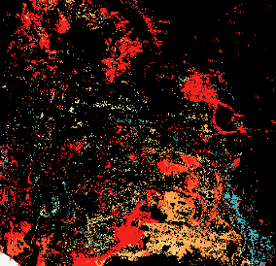
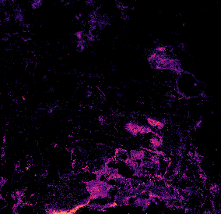
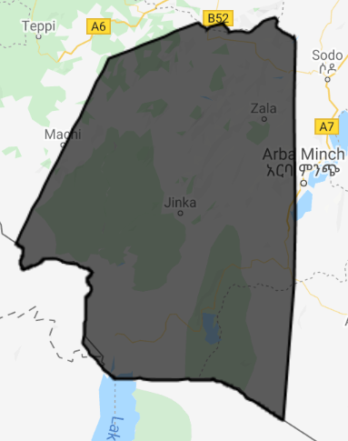
METHODS: Selecting Composite Years
Inputs
Processing
Outputs
Year of Detection Raster
Google Earth Engine (GEE)
LandTrendr algorithm within GEE
Ran 1984-2019 (Jan-May) for best calibration
Satellite Imagery
Vegetation Gain
Magnitude Raster
Year of Detection Raster
Study Area Shapefile
Vegetation Loss
Magnitude Raster
2
5
Image Credit: Google Earth Engine, NASA DEVELOP
Notes:
After selecting the satellites, we needed to select what years to model land cover to show the years of significant change for our partners.
In order to do this, we collected satellite imagery from our sensors and created a study area shapefile that included the 8 protected areas that our partners are interested in.
Next, we ran the Landtrendr algorithm over our entire study area in Google Earth Engine from January 1 to May 1 of 1984 through 2019.
We used 1984 to 2019 instead of our specific study period because LandTrendr is best calibrated with longer periods of time. Once we had our LT outputs we filtered them down to our study period.
LandTrendr lets you assess land cover change in two ways: vegetation gain or vegetation loss. We ran LandTrendr for both vegetation loss and gain using a Normalized Difference Vegetation Index.
Each LT run has two outputs: a magnitude raster and a year of detection raster. The year of detection raster will assign each pixel a year value only if the change in that pixel is greater than the specified magnitude threshold. That year value will be the year that had the greatest amount of change. If the pixel did not experience change above the magnitude threshold, it gets a value of 0. Since the year of detection raster only assigns a value of a year if it goes above the set threshold, it does not quantify the amount of change in each pixel.
For example, let’s say the magnitude was 200. Two pixels could have the year 2004 assigned to it, but one pixel could have a magnitude of 201 and another one could have a magnitude 300. In the year of detection raster they would both still have the same 2004 value. This is where the magnitude raster comes in. The magnitude raster assigns a value of the magnitude of change of the greatest year of change for each pixel.
___________________________________________
Image Credits:
Image 1: Screenshot of Landsat 8 land cover raster (true color) data from Google Earth Engine
Image 2: Shapefile, DEVELOP
Image 3-8: Landtrendr vegetation gain/loss outputs, DEVELOP

Slide 9
METHODS: Selecting Composite Years
Inputs
Processing
Outputs
Class | Percentage
0 | 99.99%
2003 | <0.01%
2001 | <0.01%
2005 | <0.01%
Gain YOD Raster
QGIS
SCP Plug-in
Class | Percentage
0 | 95.92%
2004 | 0.21%
2000 | 0.17%
2005 | 0.07%
Loss YOD Raster
5
Image Credit: NASA DEVELOP
Notes:
[The gain [raster did not have significant change during the study period, but the [loss raster saw its largest changes in the early 2000’s. Because of this, we decided to capture the change before 2000 to classify the landscape before change. Throughout the 1990’s, land cover in Ethiopia was largely the same, as such we looked for the least cloudy year in the 90’s for our first classification year, which was 1994.
We also decided to capture the change after the [largest changes in 2014 and 2017. We did this by classifying during the year 2018. Our third classification year was 2010 because we wanted to do a halfway point between the two dates and this year had the lowest amount of cloud cover.
As a whole, our LandTrendr outputs allowed us to select the years 1994, 2010, and 2018 to create cloud-masked composites for our next step of land cover classification.
___________________________________________
Image Credits:
Image 1: Gain YOD Raster: Made by DEVELOPer
Image 2: Loss YOD Raster: Made by DEVELOPer

Slide 10
RESULTS: LandTrendr
Vegetation Gain
Class | Percentage
0 | 99.99%
2003 | <0.01%
2001 | <0.01%
2005 | <0.01%
2012 | <0.01%
2016 | <0.01%
2010 | <0.01%
2014 | <0.01%
2002 | <0.01%
Vegetation Loss
Class | Percentage
0 | 95.92%
2004 | 0.21%
2000 | 0.17%
2005 | 0.07%
2014 | 0.07%
2008 | 0.07%
2017 | 0.06%
2006 | 0.05%
2018 | 0.03%
5
Notes:
The gain raster did not have significant change during the study period, but the loss raster saw its largest changes in the early 2000’s. As such, we decided to capture the change before 2000 to classify the landscape before change. Throughout the 1990’s, land cover in Ethiopia was largely the same, as such we looked for the least cloudy year in the 90’s for our first composite year, which was 1994.
We also decided to capture the change after the largest changes in 2014 and 2017 by classifying during the year 2018. Our third classification year was 2010 because we wanted to do a halfway point between the two dates.
As a whole, our LandTrendr outputs allowed us to select the years 1994, 2010, and 2018 to create cloud-masked composites for next step of land cover classification.

Slide 11
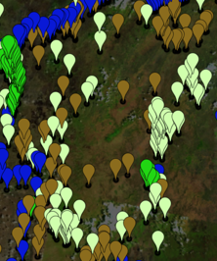
METHODS: Land Cover Classification
Inputs
Processing
Outputs
Land Cover by Class
Satellite Imagery
Google Earth Engine (GEE)
Random Forest classifier within GEE
Classified 1994, 2010, and 2018 composite (Jan-May)
8
160
Training Points by Class
10
Accuracy Metrics
2
5
Image Credit: Google Earth Engine, NASA DEVELOP
Notes:
After selecting what years we wanted to use through our LandTrendr analysis, we could begin our Land Cover Classification. We took those three years, 1994, 2010, and 2018 and collected [satellite imagery from January to May of each year to create three cloud-masked composites. Based on those composites, we created our own ocularly sampled training points in Google Earth Engine (as seen on the bottom) over 4 classes: water, natural vegetation, cultivated land, and bare ground. Our goal was to find around 200 training points in each class if enough of that land cover type was seen in the imagery for a given year. We originally also tried creating a class for man-made infrastructure but we were not able to do that because there just wasn’t enough seen within our satellite imagery to drop sufficient training points. This could be due to either the 30-meter Landsat resolution being too coarse to pick up on these structures, or absence of significant settlements in the area.
Moving on, after creating our training dataset, we calculated predictor variables including raw satellite bands and the indices NDVI, NDWI, NBR, elevation, and tasseled cap brightness, greenness, and wetness.
[After that, we used the Random Forest classifier in Google Earth Engine to create our three land cover classifications. This was done by using the four classes of training points we created for each year and the predictor variables together.
This outputted [three land cover models for 1994, 2010, and 2018. FInally, we also split the training and testing points into 70 and 30%, respectively, to get three different accuracy metrics: overall percent accuracy and producer and user class accuracy.
___________________________________________
Image Credits:
Image 1: Screenshot of Landsat 8 land cover raster (true color) data from Google Earth Engine
Image 2: Training points from Google Earth Engine
Image 3: Land cover classification, DEVELOP

Slide 12
RESULTS: Accuracy Metrics
1994 Overall Accuracy | 2010 Overall Accuracy | 2018 Overall Accuracy
89% | 84% | 83%
Land use/cover categories | 1994 User Accuracy (%) | 1994 Producer Accuracy (%) | 2010 User Accuracy (%) | 2010 Producer Accuracy (%) | 2018 User Accuracy (%) | 2018 Producer Accuracy (%)
Water | 97.4 | 97.4 | 94.8 | 100.0 | 98.6 | 93.4
Natural Vegetation | 80.0 | 85.7 | 77.8 | 83.1 | 77.8 | 76.1
Cultivated Land | 55.6 | 45.5 | 35.7 | 31.5 | 81.5 | 74.6
Bare Ground | 93.4 | 90.5 | 91.8 | 81.8 | 73.8 | 88.9
Notes:
These three accuracy metrics are all slightly different but get to the same idea of evaluating how well your model matches up with what is actually seen on the ground. Overall accuracy essentially tells us out of all of the training points we dropped on the satellite imagery, what percent we mapped correctly across all classes combined. Using the Random Forest classifier with GEE, we achieved overall accuracies of
[89% for 1994,
[84% for 2010,
[and 83% for 2018. The user accuracy is the accuracy from the point of a map user, so this essentially tells us how often the class on the map will actually be present in the ground truth points. On the other hand, the producer accuracy is from the perspective of the map makers, so how often the real features we dropped are correctly shown on the classified map for a given class. For the purposes of this presentation, I am going to mainly focus on the producer's accuracy when evaluating class accuracy.
[So although 1994 and 2010 had the greatest overall accuracy, their producer accuracies for cultivated land were the two lowest of all classifications. This is most likely because there were fewer training points for cultivated land since there were fewer visibly cultivated areas within that composite year.
[Of all of the classes, our most accurate class was water, which was consistently classified at an accuracy greater than or equal to 93.4%.

Slide 13
RESULTS: Unprotected Areas
Land use/cover categories | 1994 to 2010 |  | 2010 to 2018 |  | 1994 to 2018
 | km² | % | km² | % | km² | %
Water | 3,715 | +14 | 2,921 | -73 | 794 | +302
Natural Vegetation | 2,181 | +9 | 4,883 | -18 | 2,701 | -11
Cultivated Land | 662 | -30 | 5,914 | +381 | 5,252 | +237
Bare Ground | 5,234 | -25 | 1,890 | +12 | 3,344 | -16
C. Churchura
Maze
Tama
W. Sala
Omo
Mago
Chelbi
N
Murulle
Water
Natural Vegetation
Cultivated Lands
0
50
100
Bare Ground
km
Notes:
Between 1994 and 2018, unprotected areas experienced the greatest amount of percent change in
[Water, which was up by around 302%.
[Cultivated land had the second largest class percent increase in unprotected areas at an additional 237%., but had the largest acreage increase of 5,252 square km.
The largest acreage and percent decrease within unprotected areas was within the [bare ground class, at a decrease of 16% from 1994 to 2018 and a decrease in 3,344 square kilometers. [Natural vegetation had the second largest decrease of 11% which was 2,701 kilometers total.
_________________________________________
Image Credits:
Image 1: Gif of Classification Outputs, DEVELOPer, made by team

Slide 14
RESULTS: Protected Areas
Land use/cover categories | 1994 to 2010 |  | 2010 to 2018 |  | 1994 to 2018
 | km² | % | km² | % | km² | %
Water | +417 | +452 | -292 | -57 | +125 | +135
Natural Vegetation | +949 | +16 | -1,008 | -15 | -59 | -1
Cultivated Land | +371 | +147 | +1,565 | +251 | +1,936 | +767
Bare Ground | -1,737 | -23 | -264 | -4 | -2,001 | -26
C. Churchura
Maze
Tama
W. Sala
Omo
Mago
Chelbi
N
Murulle
Water
Natural Vegetation
Cultivated Lands
0
50
100
Bare Ground
km
Notes:
Within protected areas as a whole,
[cultivated land had the largest percent and acreage increase of over 700% which was equal to a gain of 1,936 square kilometers.
[water had the second largest percent increase at 135% or 125 square kilometers. Within both unprotected and protected areas, our understanding of why there is this pattern of gain in water and cultivated land is that this might be due to the construction of the Gibe III dam and the associated water availability from it.
[Bare ground again had the largest decrease, which was 26% or 2,001 square kilometers in total. [Natural vegetation only had 1% decrease over all protected areas combined, which summed to 59 square kilometers. _________________________________________
Image Credits:
Image 1: Gif of Classification Outputs, DEVELOPer, made by team

Slide 15
RESULTS: Protected Areas
Percent Change of Protected Areas between 1994 and 2018
17,900
15,900
13,900
11,900
Percent Change
9,900
7,900
5,900
3,900
1,900
-100
C. Churchura
Chelbi
Mago
Maze
Murulle
Omo
Tama
W. Sala
Protected Areas
Water
Natural Vegetation
Cultivated Lands
Bare Ground
Notes:
However, there were differences in land cover change among each protected area both in terms of percent and acreage change. It’s important to keep in mind that high percentage change does not necessarily mean high acreage change. For example, If a protected area had a very small acreage of a certain class to begin with, very large percentages can come out of a percent change calculation with seemingly slight increases or decreases in acreage.
[For example, of the protected areas, Tama Community Conservation area had the largest percent increase of all protected areas within its change in cultivated land at an additional 17,272%. However, in actual acreage, Tama only increased from 1.5 square km to around 259 square km. Omo National Park and Welshet Sala hunting area had the two next largest percent increases in cultivated land at 5,127% and 2,517% respectively. Again though, the acreage change for Omo was 11 square km to 621 square km and Welshet Sala went from less than one square kilometer to 23 square kilometers.

Slide 16
RESULTS: Protected Areas
Percent Change of Protected Areas between 1994 and 2018
700+
600
500
400
Percent Change
300
200
100
0
-100
C. Churchura
Chelbi
Mago
Maze
Murulle
Omo
Tama
W. Sala
Protected Areas
Water
Natural Vegetation
Cultivated Lands
Bare Ground
Notes:
In comparison to other protected areas,
[Chelbi was an outlier in that it had a very large percent increase in water at 1065% compared to the second largest water percent increase in [Mago national park at 63%.

Slide 17
RESULTS: Protected Areas
Change in Area of Protected Areas between 1994 and 2018
8,800
6,800
Kilometers ²
4,800
2,800
800
-1200
C. Churchura
Chelbi
Mago
Maze
Murulle
Omo
Tama
W. Sala
Protected Areas
Water
Natural Vegetation
Cultivated Lands
Bare Ground
Notes:
However, in actual acreage increase, [Chelbi only went from 11 square km of water to 128 square km, and really where Chelbi is the most interesting acreage wise is in its change in bare ground, which decreased by 1,187 square kilometers which was larger than any decrease in all other protected areas.
[In terms of acreage, Chebura Churchura was the outlier in its gain of 8,503 square kilometers of water. Its biggest decrease was in natural vegetation, which decreased by 209 square kilometers.

Slide 18
RESULTS: Protected Areas
Change in Area of Protected Areas between 1994 and 2018
800+
Kilometers ²
300
-200
-700
-1200
C. Churchura
Chelbi
Mago
Maze
Murulle
Omo
Tama
W. Sala
Protected Areas
Water
Natural Vegetation
Cultivated Lands
Bare Ground
Notes:
Other notable areas include
[Omo National Park, which had the largest increase in cultivated area of 621 square kilometers during the study period. It had its largest decrease in natural vegetation, which was 703 square kilometers.
[Chelbi Wildlife preserve had the second largest acreage increase in cultivated land at an additional 600 square km.

Slide 19
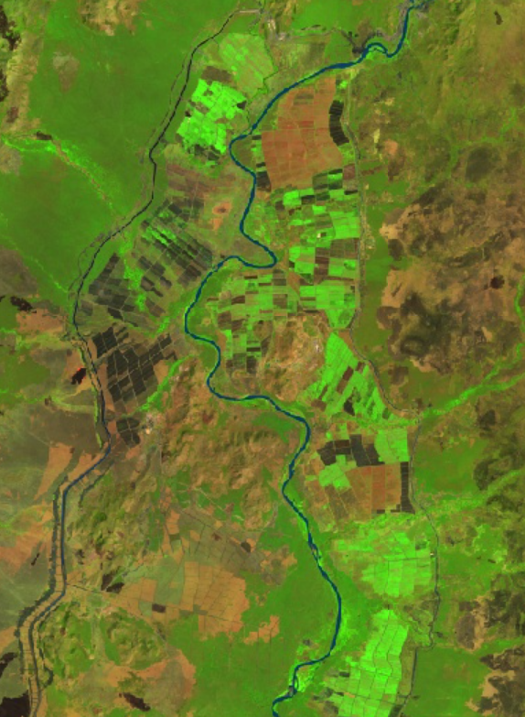
CONCLUSIONS
Unprotected areas within the study area between 1994 and 2018 experienced the largest percent increase in water bodies with the largest percent and area decrease in bare ground.
Protected areas within the study area between 1994 and 2018 saw the largest percent and area increase in cultivated area along with the largest percent and area decrease in bare ground.
km
2
5
Image Credit: Google Earth Engine
Notes:
The main objective of this research was to quantify the acreage and rate of land cover change between 1994 and 2018 within protected and unprotected areas in the Lower Omo Valley.
[Cultivated land saw the largest percent and area increase (767%, which is 1,936 square kilometers respectively in protected areas within the study area between 1994 and 2018. there was a slight decrease (around -1%) in natural vegetation as well a 26% decrease in bare ground.
[Water bodies saw the largest percent increase, which was 302% in unprotected areas within the study area between 1994 and 2018. Cultivated land had the second largest percent increase of 237%, but had the largest area increase of any class. The largest percent and area decrease was seen in bare ground, which was 16%. Natural vegetation had a 11% decrease.
[Protected areas are experiencing more land cover change to cultivated land than unprotected areas.
Of the protected areas, Tama, Omo, and Welshet Sala had the largest percent increase of cultivated areas in protected land, while Omo and Chelbi have the largest acreage increase of cultivated land. Chelbi had the largest percent increase in water while Chebera Churchura had the largest area increase in water. For natural vegetation and bare ground, Maze had the largest percent decrease, while Chelbi had the largest bare ground area decrease and Omo had the largest natural vegetation area decrease. In general, land cover change has been occurring across all the classes within protected and unprotected areas.
Collectively, when we look at our conclusions, it is important to note that Ethiopia is still a developing country and there is a need to balance economic growth by providing food security and reliable sources of food for their nation, while also trying to conserve the unique biodiversity and landscapes they have.
___________________________________________
Image Credit:
- Landsat 8 OLI False Color Google Earth Engine screenshot

Slide 20
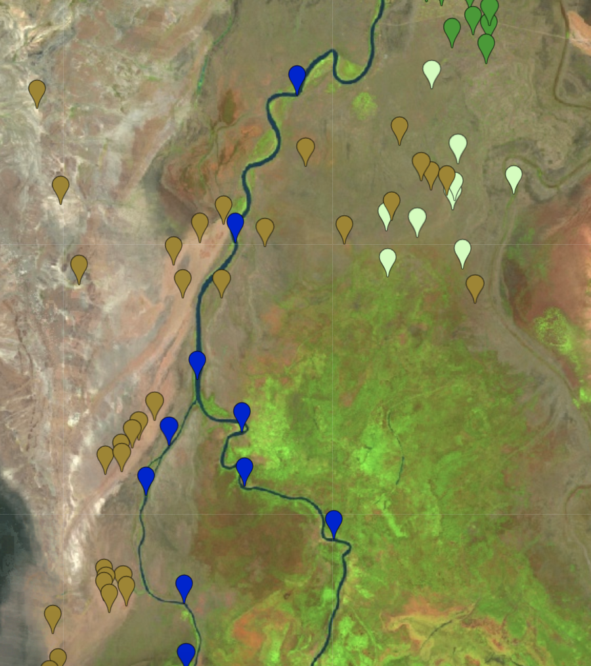
LIMITATIONS & UNCERTAINTIES
Satellite imagery not available spanning several years and multiple sensors
No in situ ground truth points; would allow for identification of additional classes
Ocular collection of training data from satellite imagery can introduce error into the models
1994 and 2010 classifications only had 38 & 39 training points for the cultivated land class compared to ~200 for the other 3 classes
km
2
5
Image Credit: Google Earth Engine
Notes:
There were several limitations throughout the course of this project.
[As mentioned earlier, we had some limitations in the availability of satellite imagery.
[Ideally, we would have access to a ground-truth dataset, but due to the large spatial extent of our study area and several sections of mountainous terrain within the region, this was not feasible for our project.
[As such, ocularly collecting training data from the satellite imagery could introduce error into our models.
[Lastly, because there were fewer areas of visible cultivated land, the 1994 and 2010 classifications only had 38 and 39 training points for that class compared to around 200 points within the rest of the classes. __________________________________________
Image Credit:
- Landsat 5 TM False Color with Training Data Overlaid, Google Earth Engine Screenshot

Slide 21
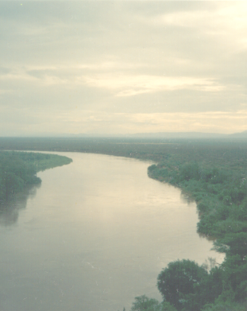
FUTURE WORK
Enhance calibration and validation of the classification models
Incorporate in situ data points
Incorporate different indices with LandTrendr to increase accuracy
NDMI
3 tasseled cap components
Utilize Sentinel-2A imagery to create a classification on a finer scale of 10-meters for research post-2016
Continue monitoring this area and repeat similar methods
Image Credit: NASA DEVELOP
Notes:
Future studies should [involve enhancing the accuracy of the classification models by incorporating in-situ/ground truth points. This would provide more accuracy than what was possible with ocularly sampling satellite imagery. We did try to identify a class of settlements that would have included man-made structures/other urban areas, using training points, however due to the low resolution we were unable to. Having in-situ points could also help add an additional settlement class.
[Furthermore, in terms of the LandTrendr outputs, research moving forward could try altering the parameters to increase classification accuracy. Examples could include using different indices such as the Normalized Difference Moisture Index or the three tasseled cap components.
[Future work could also utilize Sentinel-2A imagery to create a classification on a finer scale of 10-meters as opposed to the 30-meter scale classifications that were created with Landsat imagery for any classifications for 2015 and later.
[Lastly, because the scope of this research was limited to examining land cover changes from 1994 to 2018, it may be necessary to continue monitoring this area and repeat similar methods in the future.
___________________________________________
Image Credits:
- NASA DEVELOP

Slide 22
ADVISORS
Dr. Paul Evangelista (Colorado State University, Natural Resource Ecology Laboratory)
Dr. Catherine Jarnevich (USGS, Fort Collins Science Center)
Peder Engelstad (Colorado State University, Natural Resource Ecology Laboratory)
Nicholas Young (Colorado State University, Natural Resource Ecology Laboratory)
Tony Vorster (Colorado State University, Natural Resource Ecology Laboratory)
PARTNERS
Dr. Fanuel Kebede, Wildlife Research & Monitoring Director, Ethiopian Wildlife Conservation Authority
Thank you!
Notes:
We’d like to thank our advisors, node leadership, and partners for all of their support and guidance throughout the term and we’re happy to take any questions now! Thanks!

