Slide 1
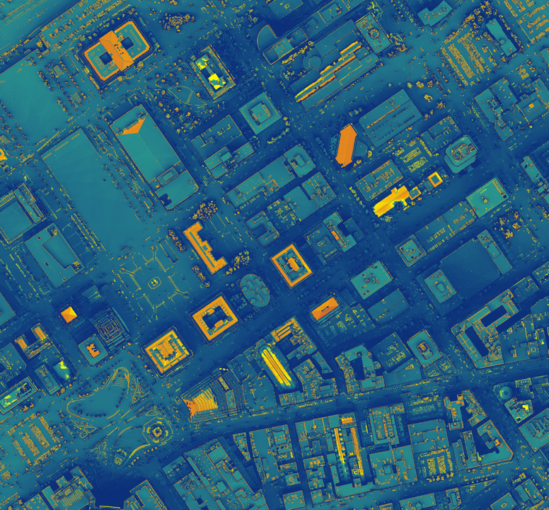
OHIO ENERGY
Restructuring the Energy Balance in Ohio by Quantifying Energy Loss and Solar Potential Using NASA Earth Observations and LiDAR
Hannah Besso
Yiyi He
Crystal Wespestad
Sihang Chen
Arizona – Tempe| Summer 2019
Notes:
Speaker: We are Hannah, Yiyi, Crystal, and Sihang from the NASA DEVELOP Tempe Arizona node. We partnered with government officials at the city of Cleveland and Cuyahoga County to help target solar energy outreach to specific land owners. Currently, the state of Ohio uses only 3% renewable energy, and less than 1% of that is solar. We developed a method to quantify the solar potential in Cuyahoga County and the City of Cleveland using NASA Earth Observations and LiDAR.
------------------------------Image Information Below ------------------------------
Image Source: ArcMap (Created by Team)

Slide 2
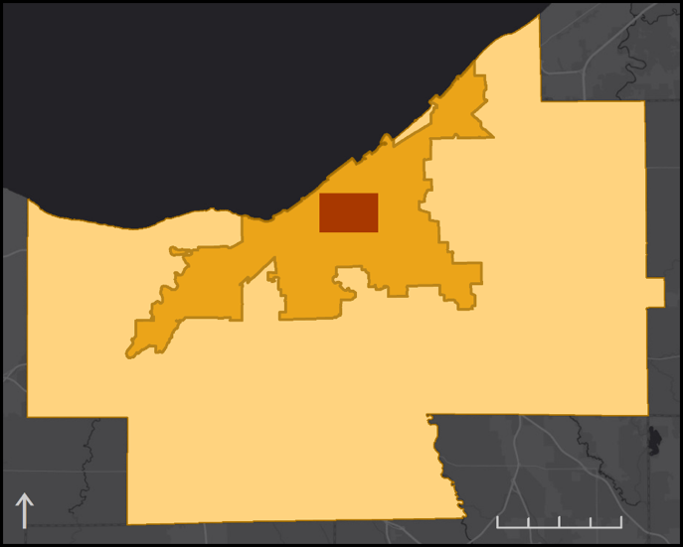
Study Area & Period
Cleveland
Land area: 77 mi²
Population: 383,793
Cuyahoga County
Land area: 457 mi²
Population: 1,248,371
Study Period
2017 to 2018
Lake Erie
Test Area
Cleveland
Cuyahoga County
0
0
2.5
5
7.5
10
3
6
Miles
mi
Notes:
Speaker: Cleveland is located within Cuyahoga County in Ohio. Cuyahoga County is about 457 square miles, with Lake Eerie to the north and small hills to the south. The study period of our project is 2017-2018 and is acquired from LiDAR. To help them increase the utilization of solar energy, we developed a method to model rooftop solar potential, and ran it on a 5 square mile study area within the county.
------------------------------Image Information Below ------------------------------
Image Source: ArcMap (Created by Team)
Cuyahoga County Open Data: Cuyahoga County Boundary (https://data-cuyahoga.opendata.arcgis.com/datasets/cuyahoga-county-boundary)
ArcGIS Hub Open Data: NEORSD Municipal Boundaries (https://hub.arcgis.com/datasets/bd91f77a0b524f75a519bb0c524d0495_0?geometry=-82.893%2C41.204%2C-80.436%2C41.565)
ArcGIS World Imagery Basemap: World Dark Grey Canvas Base ( http://goto.arcgisonline.com/maps/Canvas/World_Dark_Gray_Base)

Slide 3
Objectives
Evaluate the solar potential of rooftops and open areas in Cuyahoga County and the City of Cleveland using LiDAR and NASA Earth observations
Estimate the average energy generation potential for selected rooftop segments in kilowatt hours per year
Identify the socioeconomic and land use attributes for buildings with high solar potential
Notes:
Speaker: The objectives of this project were to first evaluate solar potential of rooftops and open areas in Cuyahoga County as well as the City of Cleveland, Ohio using LiDAR and NASA Earth Observation data; second, to estimate energy generation potential for selected study sites; third, to identify locations within neighborhoods with low socioeconomic status that have high solar potential.
------------------------------Image Information Below ------------------------------
Image Source: PowerPoint Icons (Created by Team)

Slide 4
Partners
Cuyahoga County, Department of Sustainability
City of Cleveland, Office of Sustainability
Image Credit: Cuyahoga County
Notes:
Speaker: We are partnered with the Sustainability Departments of Cuyahoga County and the City of Cleveland. Our project aims to develop a methodology for analyzing the solar potential of rooftops and open spaces throughout the City of Cleveland and Cuyahoga County. The county provided a high resolution Digital Surface Model, parcel data, and building footprints data.
------------------------------Image Information Below ------------------------------
•Image Source: Cuyahoga County (https://www.cuyahoga50.org/ )

Slide 5
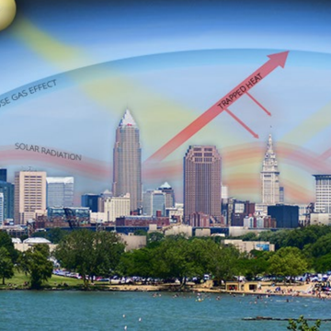
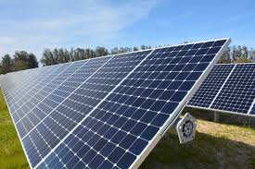
Community Goals
Cuyahoga County Climate Change Action Plan
100% Renewable Energy by 2035 (City) and 2050 (County)
Image Credit: Erik Drost; Cuyahoga County Climate Change Action Plan; J. Brian Garmon; Open Source
Notes:
Speaker: Cuyahoga County is already experiencing the effects of a changing climate at a local scale in the form of increased annual average precipitation and temperature. To mitigate these local and global effects, the Cuyahoga County Climate Change Action Plan details mitigation techniques and county-wide goals for limiting carbon emissions. Our partners have set the goal of using 100% renewable energy by 2050.
------------------------------Image Information Below ------------------------------
•Image (left) Credit: Erik Drost (Permission to use given by Erik Drost)
•Image (left) Source: https://www.countyplanning.us/wp-content/uploads/2019/05/Final_CCCCAP-1.pdf
•Image (right) Credit: J. Brian Garmon (Open Source)
•Image (right) Source: https://www.afcec.af.mil/News/Article-Display/Article/1495158/vandenberg-flips-the-switch-on-new-solar-array-system/

Slide 6
NASA Satellites and Sensors Used
Shuttle Radar Topography Mission (SRTM) version 2
NASA Prediction of Worldwide Energy Resources (NASA POWER)
Image Credit: NASA
Notes:
Speaker: There are two main NASA dataset that we are using for this project – SRTM and NASA POWER. The SRTM provides a digital elevation model that helps to confirm that the topography outside of the county boundary has no significant effect on the annual solar duration within the county. POWER provides an estimate of incoming solar irradiation on a tilted surface by accounting for the light scattering and filtering effects of clouds and aerosols.
------------------------------Image Information Below ------------------------------
Image (SRTM instrument) Source: http://www.devpedia.developexchange.com/dp/images/a/ab/12_SRTM.png (Public Domain)
Image (NASA Logo) Source: NASA (Public Domain)

Slide 7
NASA POWER
Maximum angle: 60º
Clouds, aerosols …
Optimal angle: 34º
Solar Panel
Tilt angle
Flat: 0º
Notes:
Speaker: The POWER data takes satellite top of atmosphere irradiation data, as well as atmospheric and meteorological conditions across a 22 year timespan to create a climatologically averaged dataset. Our model included tilt-specific irradiation data, since the angle of a solar panel will change the angle of solar rays incident on that panel throughout the year and therefore the total energy the panel can produce. Our first goal was to create a solar potential raster of the study area. To do this, we modeled pixel viewshed based on sun angles and shadows.
------------------------------Image Information Below ------------------------------
•Images Source: These two diagrams were created by team

Slide 8
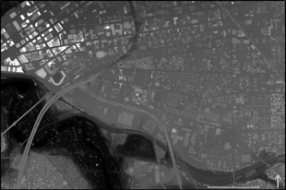
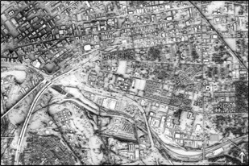
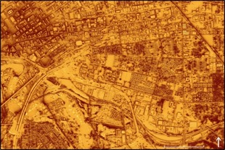
Methodology
Digital Surface Model
1-ft resolution
(LiDAR)
POWER
DSM
0
0.25
0.5
mi
Sun Exposure
Slope
Aspect
Sun Exposure
Duration of Direct Incoming Solar Radiation
(Esri Area Solar Radiation Tool)
Solar Energy
Roof Segments
mi
0
0.25
0.5
mi
Solar Energy per Segment
Building Footprint
Solar Energy
Irradiation on tilted surfaces
(POWER data)
Solar Energy per Building
0
0.25
0.5
mi
Notes:
Speaker: Our first goal was to create a solar potential raster of the study area. To do this, we modeled pixel viewshed based on sun angles and shadows. This gave us a sunlight duration raster with hours of sunlight per year per pixel. We combined this with our NASA POWER irradiation data for a solar potential raster of the study area.
------------------------------Image Information Below ------------------------------
Images Source: ArcMap (Created by Team); clipped to the study area
Image (Digital Surface Model): University of Vermont Spatial Analysis Laboratory
Image (Sun Exposure): University of Vermont Spatial Analysis Laboratory
Image (Solar Energy): The NASA Langley Research Center (LaRC) POWER Project funded through the NASA Earth Science/Applied Science Program

Slide 9
Methodology
POWER
DSM
DSM
Sun Exposure
Slope
Aspect
N
NW
NE
Solar Energy
Roof Segments
S
Max 60◦
Slope
Aspect
Solar Energy per Segment
Building Footprint
Solar Energy per Building
0
0.25
0.5
mi
Viable Roof Segments
Notes:
Speaker: Next we identified roof areas that are viable for solar panel installation. Using slope and aspect Esri tools with our DSM as the input, we created roof segment polygons according to local solar panel installation practices. This included removing north facing roof segments and areas with slope greater than 60 degrees. Finally, we found the total solar potential within each building.
------------------------------Image Information Below ------------------------------
Images Source: ArcMap (Created by Team)
Image (DSM): University of Vermont Spatial Analysis Laboratory
clipped to the study area
Image (Viable Roof Segments): Cuyahoga County GIS Department
Images (Slope and Aspect) Source: PowerPoint Shapes (Created by Team)

Slide 10
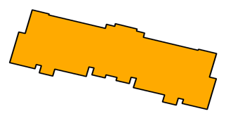
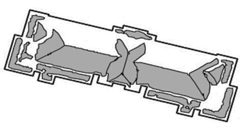
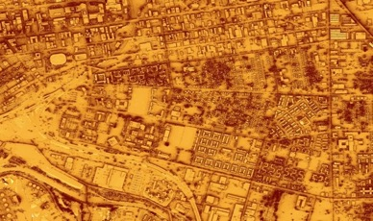
Methodology
POWER
DSM
Aggregate to
building footprints
Sun Exposure
Slope
Aspect
Solar Energy
Roof Segments
Aggregate to
roof segments
Solar Energy per Segment
Building Footprint
Solar Energy per Building
Pixel-based Solar Energy Potential
Notes:
Speaker: To calculate solar potential of each building in the study area, we aggregated pixel based solar energy potential to each individual roof segments and summed the segments into building footprints. We found the total solar potential within each building.
------------------------------Image Information Below ------------------------------
Images Source: ArcMap (Created by Team)
Image (Pixel-based Solar Energy Potential): University of Vermont Spatial Analysis Laboratory; The NASA Langley Research Center (LaRC) POWER Project funded through the NASA Earth Science/Applied Science Program
clipped to the study area
Image (Aggregate to roof segments): Cuyahoga County GIS Department
Image (Aggregate to building footprints): University of Vermont Spatial Analysis Laboratory; The NASA Langley Research Center (LaRC) POWER Project funded through the NASA Earth Science/Applied Science Program; Cuyahoga County GIS Department

Slide 11
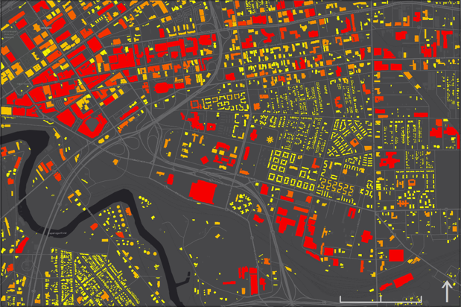
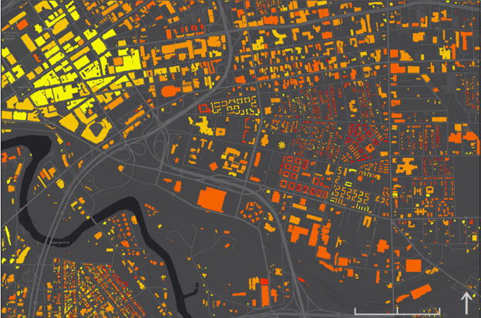
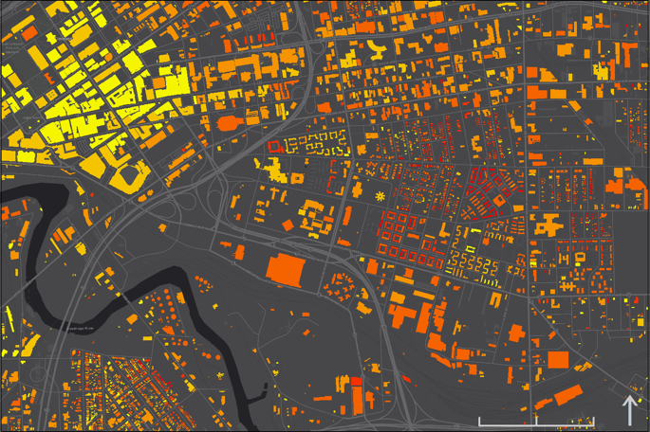
Results
Total Annual Solar Energy Potential by Building
Total Annual Solar Energy Normalized by Surface Area
0-50 50-100 100-150 150-200 200-250 250-3500
0.7-5 5-6 6-7 7-8 8-9 9-10.8
Total Energy (MWh/yr)
Normalized by Area (kWh/yr・ft²)
0
0.25
0.5
0
0.25
0.5
mi
mi
Notes:
Speaker:
The graph on the left shows total annual solar energy potential in MWh/yr of each building. Yellow indicates low solar energy potential and red indicates high solar energy potential.
The graph on the right shows total annual solar energy in kWh/yr/ft² of each individual building divided by its rooftop surface area. We can see that there is a reverse trend due to the big surface area of buildings who have high solar energy potential.
Within the study area there was a total solar potential of around 111,000 MWh per yr. However, we recognize that installing panels on every building in the study area is unlikely.
------------------------------Image Information Below ------------------------------
Images Source: ArcMap (Created by Team); clipped to the study area
Both images: University of Vermont Spatial Analysis Laboratory; The NASA Langley Research Center (LaRC) POWER Project funded through the NASA Earth Science/Applied Science Program; Cuyahoga County GIS Department

Slide 12
Results
85% of solar energy could be generated by 19% of buildings in test area
x10⁵
0.8
94,363 MWh/yr
Cumulative Solar Energy (MWh/yr)
0.4
0.0
0 1000 2000 3000
560
Building Count (Ordered Most to Least Productive)
Notes:
Speaker: So we conducted a cumulative sum assessment by summing the potential energy per building, in order of decreasing solar potential. The elbow point of this curve indicates the point of diminishing returns, and shows that 85% of the 111,000 MWh/yr potential energy could be generated by only 19% of buildings. This 19% is composed of 560 buildings. These buildings are zoned for a variety of land uses.
------------------------------Image Information Below ------------------------------
•Image (plot) Source: Matplotlib
•Image (Solar Panel figure) Source: PowerPoint 3D Models

Slide 13
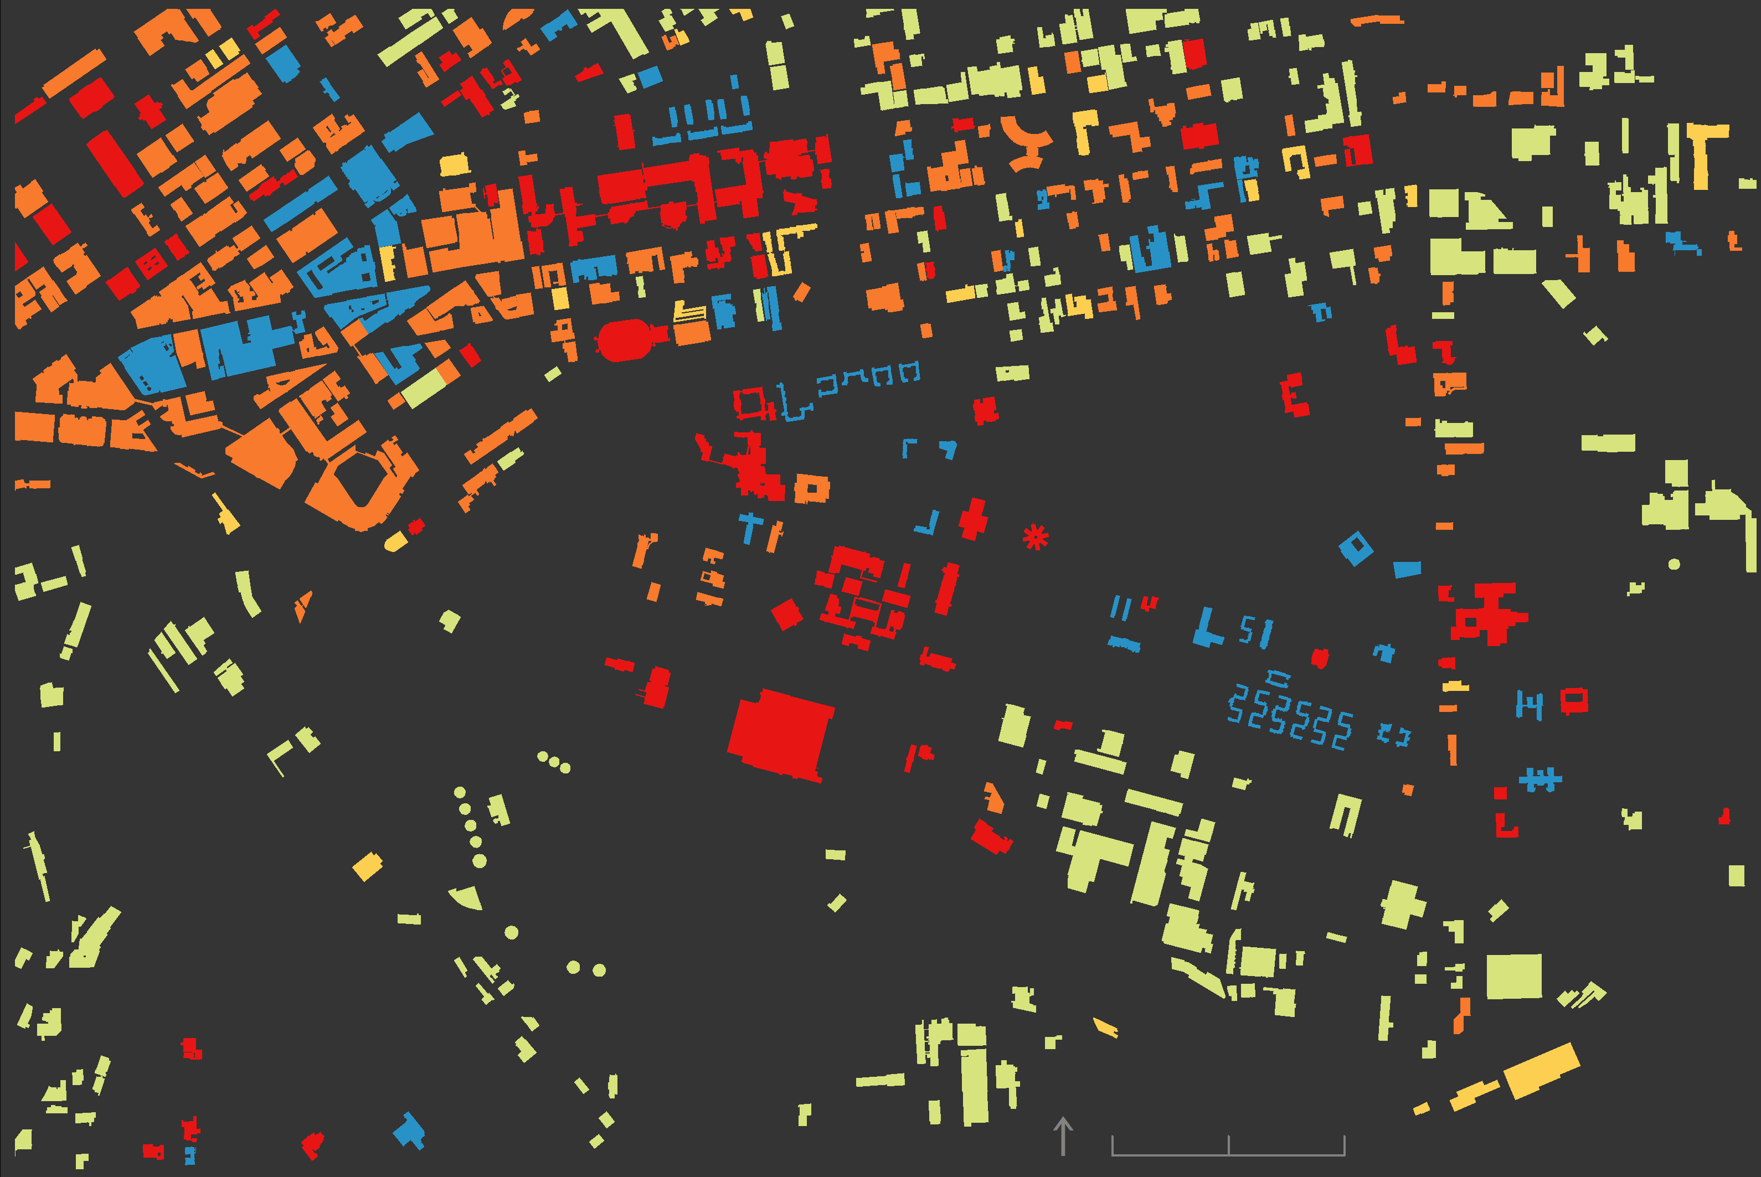
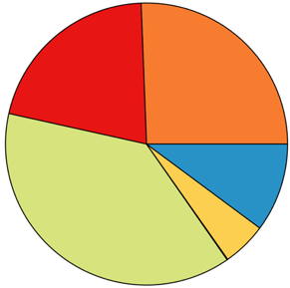
Results
Potential Energy Distribution of the Top 560 Buildings by Land Use
21%
26%
10%
38%
5%
Commercial
Industrial
Institutional
Other
Residential (1-2 Families)
2,000 ft
Residential (Multi-Family)
Top 560 Buildings by Land Use
Notes:
Speaker: This 19% is composed of 560 buildings. These buildings are zoned for a variety of land uses. Land use type is important because it will affect the outreach methods our partners will take in encouraging land owners to invest in solar. The highest solar potential was within the industrial, commercial, and institutional building types, which we determined was mainly due to building size.
------------------------------Image Information Below ------------------------------
Image (Pie Chart) Source: Python (Created by Team)
Image (Map) Source: ArcMap (Created by Team); clipped to the study area
Cuyahoga County Open Data website

Slide 14
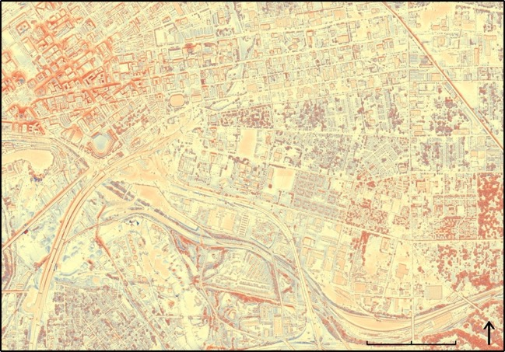
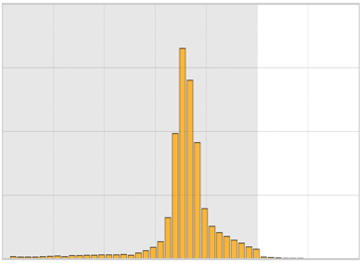
Model Comparison
Solar Energy Difference by Pixel
(Ohio Energy Team Estimate – Esri Area Solar Radiation Estimate)
4
3
Frequency (1e7)
2
1
0
-100
-80
-60
-40
-20
0
20
40
Estimated Energy Difference (kWh/yr)
Difference
(kWh/yr)
Max: 96.32
Min: -105.85
High: 96.4
0
0.25
0.5
mi
Low: -105.8
Notes:
Speaker: To check our work, we compared our results to the output of the Esri Area Solar Radiation tool. This tool used similar methods, but we included additional factors that describe solar insolation and panel tilt. As shown in this difference map and frequency histogram, the majority of our pixel values are lower than the Esri estimate in part due to the inclusion of the NASA POWER data.
------------------------------Image Information Below ------------------------------
Image (Map) Source: ArcMap (Created by Team); clipped to the study area
University of Vermont Spatial Analysis Laboratory; The NASA Langley Research Center (LaRC) POWER Project funded through the NASA Earth Science/Applied Science Program
Image (Histogram) Source: Matplotlib

Slide 15
Conclusions
Installing solar panels on the top 560 buildings would power 9,000 typical homes for one year
Targeting the top 19% of potential rooftops across all land use types would help Cuyahoga and Cleveland reach their 100% renewable energy goals
These methods will be applied to the entirety of Cuyahoga County
Notes:
Speaker: In conclusion, if solar panels were installed on the top producing 560 buildings within our study area, enough energy would be produced to power 9000 typical houses for a year. Targeting the top 19% of potential rooftops across all land use types would help Cuyahoga and Cleveland reach their 100% renewable energy goals. Our method will be utilized by our partners to complete this analysis across the entire county.
------------------------------Image Information Below ------------------------------
Image Source: PowerPoint Icons (Created by Team)

Slide 16
NASA DEVELOP:
Dr. Nicholas B. Rajkovich – Science Advisor, University of Buffalo
Dr. Dave Hondula – Science Advisor, Arizona State University
Erika Higa – Center Lead
Megan Seeley – Geoinformatics Fellow
NASA POWER:
Dr. Paul Stackhouse Jr. – Senior Research Scientist and Principal Investigator
Bradley Macpherson – Geospatial and Technology Developer
Brian Tisdale – Booz-Allen and Hamilton, Inc.
Partners:
Mike Foley – Department of Sustainability Director
Dan Meaney – Cuyahoga County Planning Commission Manager
Anand Natarajan – Mayor’s Office of Sustainability Energy Manager
Elizabeth Lehman – Mayor’s Office of Sustainability Energy Analyst
Solar Panel Experts:
Robert Martens – Better Together Solar President/CEO
Al Frasz – Dovetail Solar and Wind President
Notes:
Speaker: We would like to thank the many people who made our project possible from NASA DEVELOP, NASA POWER, and the governments of Cleveland and Cuyahoga County. (our advisors and leads from NASA DEVELOP, Paul Stackhouse and Brian Tisdale at NASA POWER, our partners from Cleveland and Cuyahoga, and the solar panel experts from Cleveland.)

