Slide 1

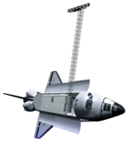




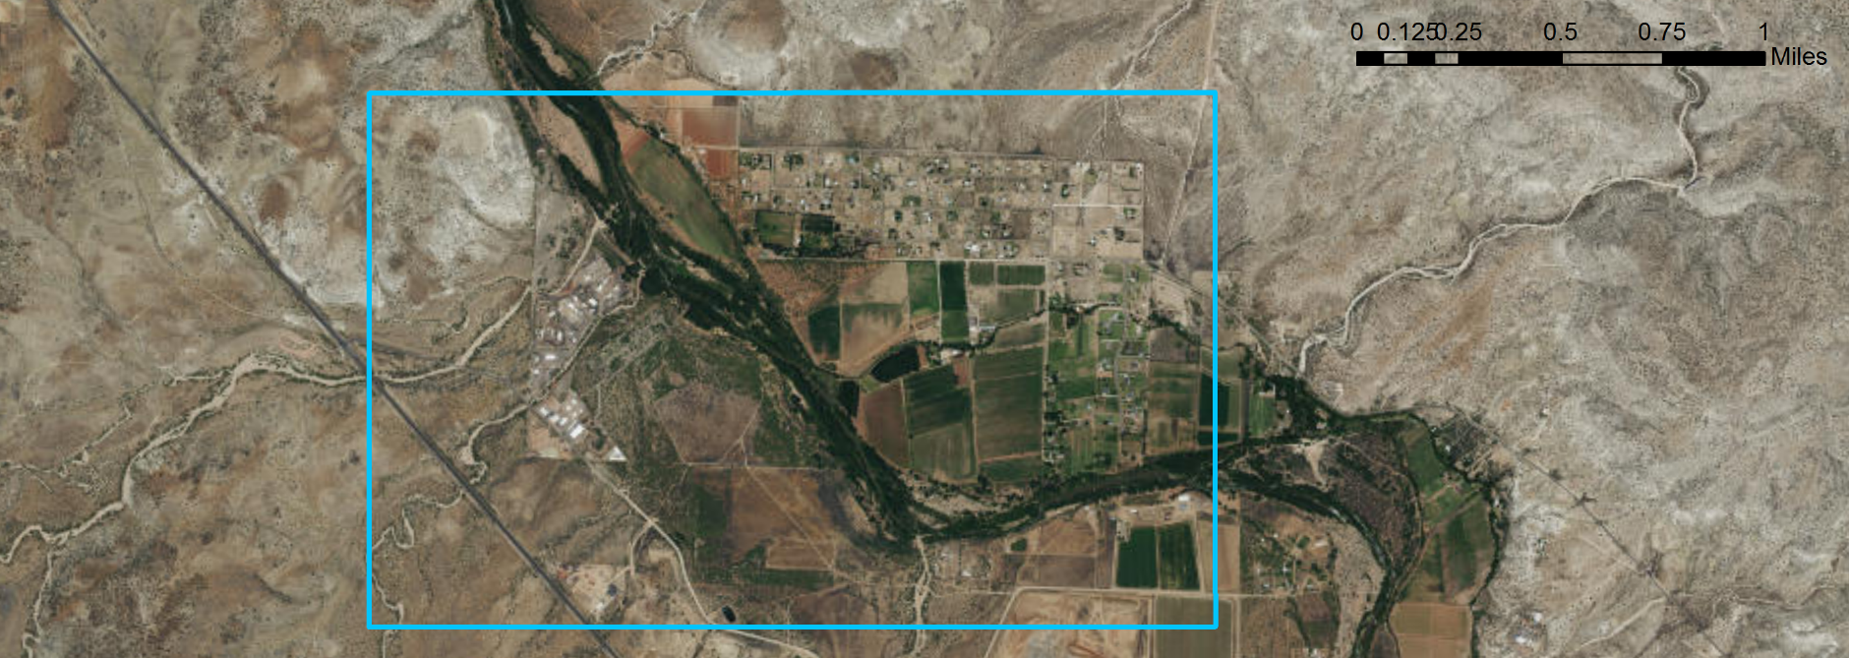
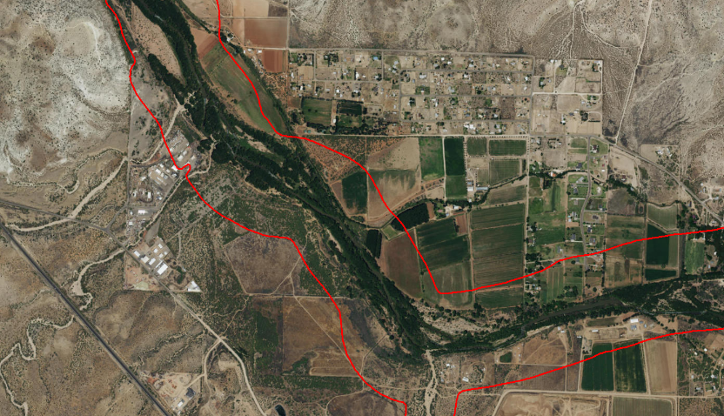
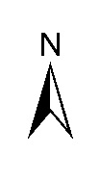
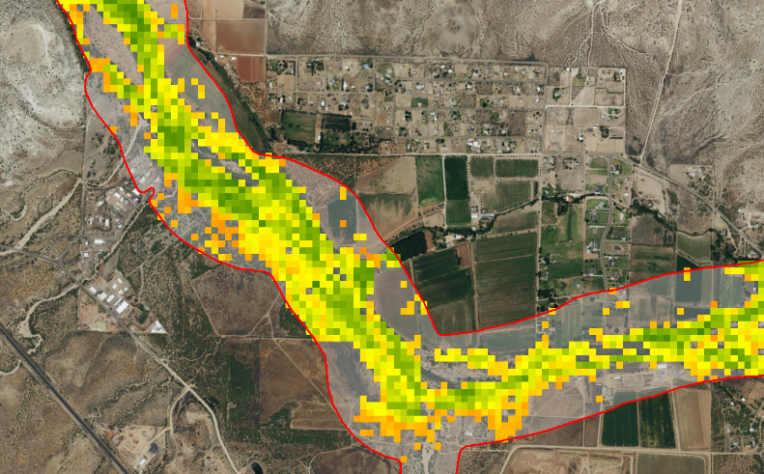
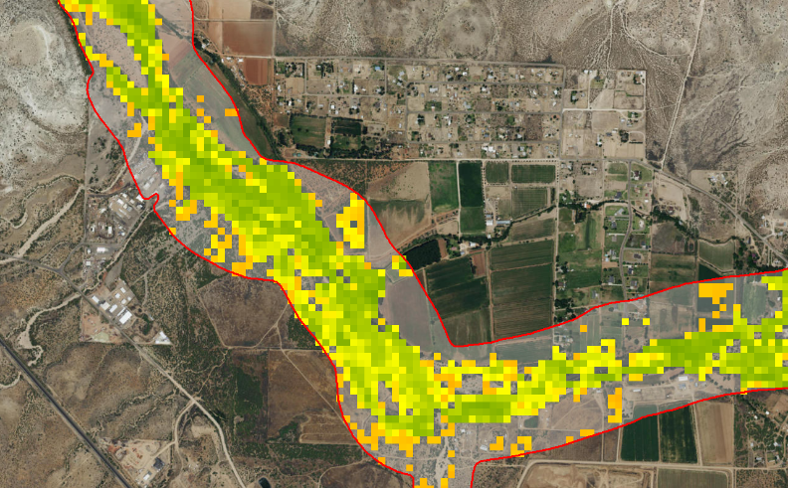
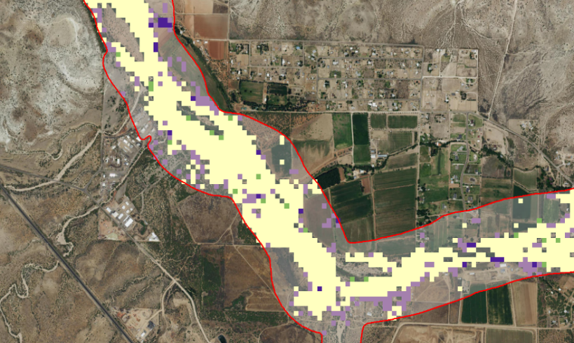
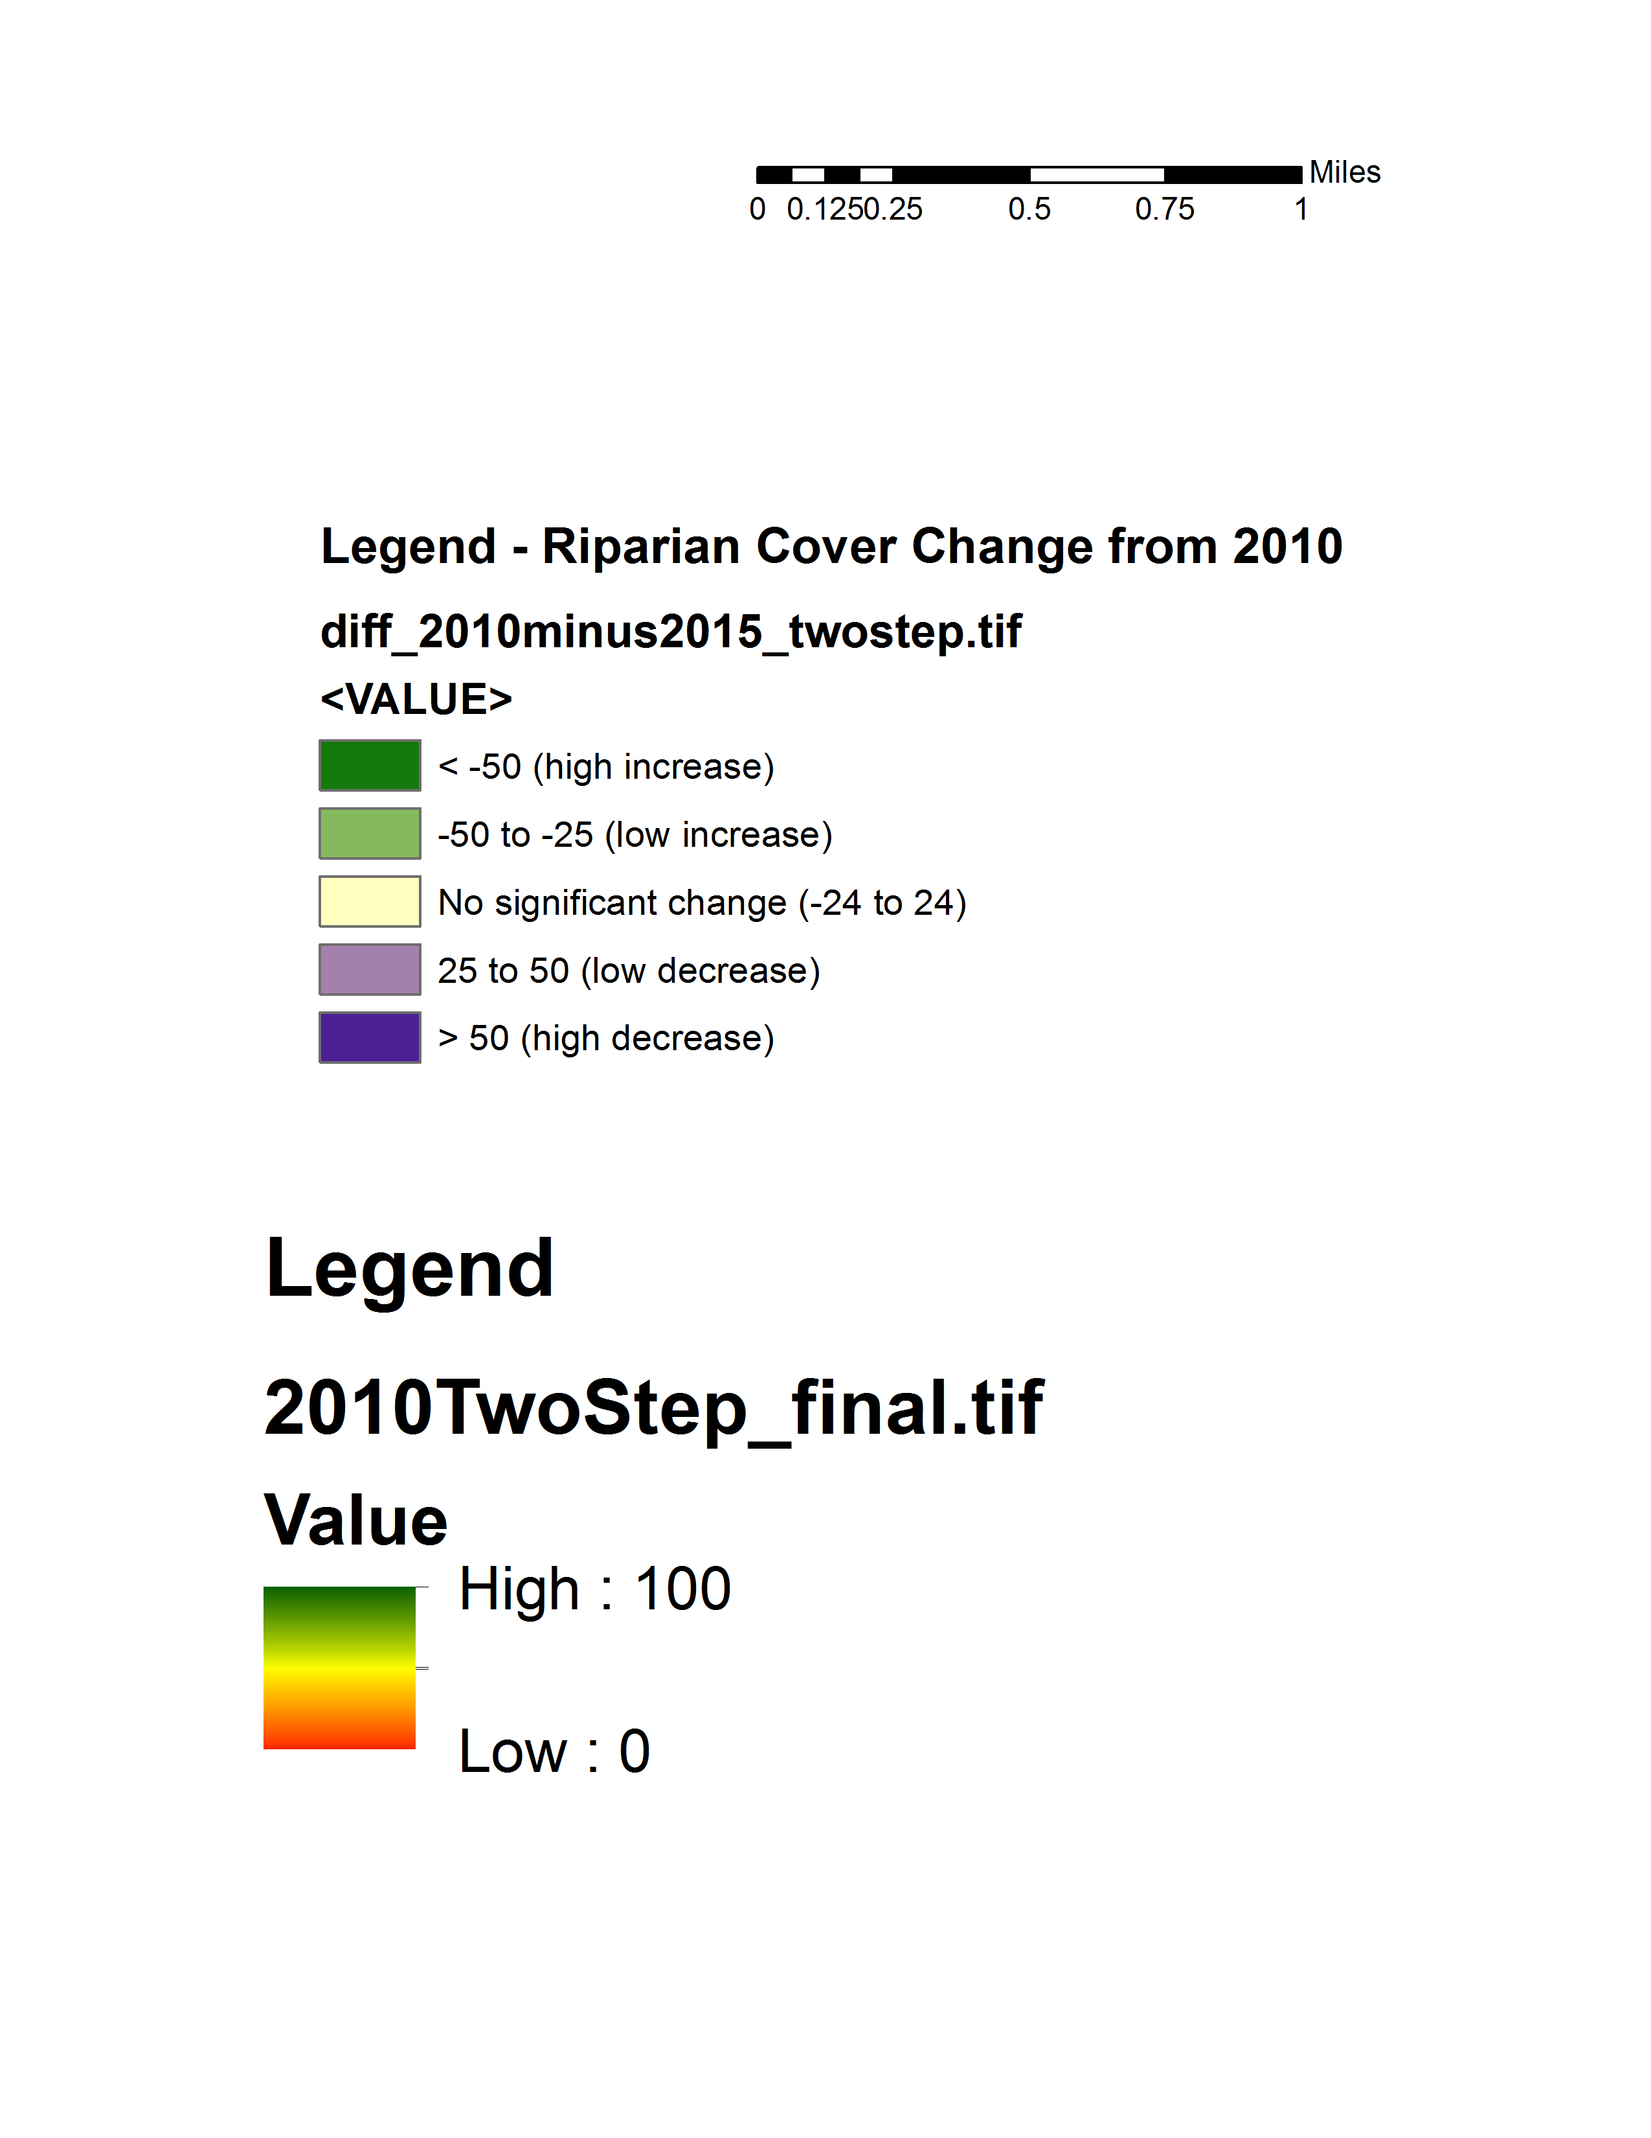

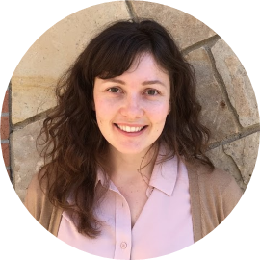

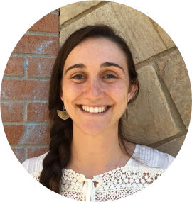

Utilizing NASA Earth Observations to Delineate Riparian Corridors and Evaluate Invasive Species Cover in the Verde River Watershed
Abstract
Objectives
Riparian corridors in the semiarid Colorado River Basin act as an interface between terrestrial and aquatic systems, play an important role in maintaining biodiversity and wildlife habitat, and contribute to controlling erosion and buffering pollutant and nutrient runoff. However, the proliferation of invasive species such as Tamarisk (Tamarix spp.) within these corridors disrupts biodiversity and essential ecological and hydrogeomorphic processes, including water balance and sediment and nutrient loads. This project utilized terrain data from SRTM, spectral and thermal indices derived from NASA’s Landsat 5 and Landsat 8 multispectral imagery to map the current maximum potential riparian corridor area and riparian vegetation cover in the Verde River watershed, which feeds major Colorado river tributaries in the lower Colorado River Basin. Potential riparian corridors and riparian vegetation cover were mapped for both 2015 and 2010 to enable partners at the Walton Family Foundation to prioritize future ecological restoration areas as well as to evaluate the efficacy of previous management efforts in the Verde watershed. In addition, this project methodology can be replicated by partners to support their efforts to manage riparian habitat and invasive species across the entire Colorado River Basin and in future years.
Delineate the maximum potential riparian corridor area of the Verde River Watershed
Map riparian vegetation cover of the Verde River Watershed for the years 2010 and 2015
Create a decision-support tool for partners to prioritize future ecological restoration areas and evaluate the efficacy of previous management efforts
Earth Observations
Landsat 5 TM
SRTM
Landsat 8 OLI & TIRS
Study Area
Methodology
CA
NV
UT
CO
AZ
NM
Mexico
Data Acquisition
Landsat 5 TM and Landsat 8 OLI + TIRS Imagery
Elevation (10m DEM)
Hydrography Data (NHD)
Processing
Derive terrain variables (slope, aspect, drainage area, etc.)
Image analysis & spectral indices derivation
Analysis
Valley Bottom Extraction Tool (V-BET)
Classification modeling
Las
Vegas
Lake Mead
Grand
Canyon
Colorado River
Flagstaff
Legend
Stream/River
USA National Wild & Scenic River
Major Roads and Highways
Pheonix
Study Area
Verde River Watershed
Results
Arizona
Arizona Water Resources
 | Random Forest Regression
 | 2010 |  | 2015
Continuous Classification | R² | RMSE | R² | RMSE
 | 0.50 | 20.26% | 0.54 | 19.2%
Binary Classification | Presence Error | Absence Error | Presence Error | Absence Error
 | 16% | 31% | 15% | 31%
Image Credit: ESRI
Percent Vegetation
Cover
2010
2015
Veg Change
Percent Vegetation
Cover Change
High: 100%
Low: 25%
<-50 (high vegetation gain)
-50 to -25 (low vegetation gain)
No significant change
25 to 50 (low vegetation loss)
>50 (high vegetation loss)
Predicted
Absence
Conclusions
V-BET output
The Valley Bottom Extraction Tool was utilized effectively to delineate current maximum riparian corridor extent in the topographically diverse Verde watershed.
Percent riparian vegetation cover in the Verde River Watershed was successfully mapped utilizing NASA Earth observation data integrated into a two-step Random Forest land cover classification model.
The resulting map products will support riparian habitat management and restoration efforts by project partners at the Walton Family foundation.
This methodology can be utilized in future efforts to map riparian corridor extent and conditions for the entire Colorado River Basin.
Team Members
Project Partners
Peter Skidmore, Program Officer, Walton Family Foundation
Dr. Catherine Jarnevich, Research Ecologist, USGS, Fort Collins Science Center
Dr. Gabriel Senay, Research Physical Scientist, USGS, North Central Climate Science Center
Acknowledgements
Sarah Carroll
(Team Lead)
Amandeep
Vashisht
(Team Lead)
Leana Schwartz
Chanin Tilakamonkul
Dr. Paul Evangelista, Colorado State University, Natural Resource Ecology Lab
Dr. Amanda West, Colorado State University, Natural Resources Ecology Lab
Brian Woodward, Colorado State University, Natural Resources Ecology Lab
USGS at Colorado State University – Spring 2017
This material is based upon work supported by NASA through contract NNL16AA05C and cooperative agreement NNX14AB60A. Any mention of a commercial product, service, or activity in this material does not constitute NASA endorsement. Any opinions, findings, and conclusions or recommendations expressed in this material are those of the author(s) and do not necessarily reflect the views of the National Aeronautics and Space Administration and partner organizations.

