Slide 1
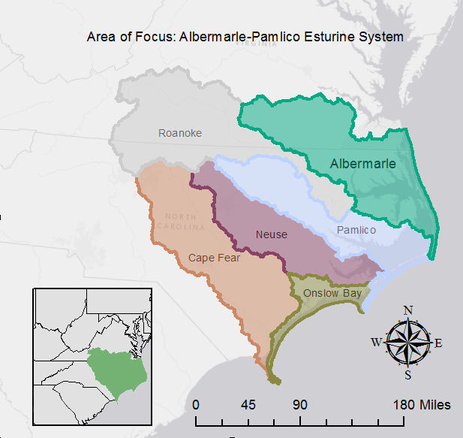
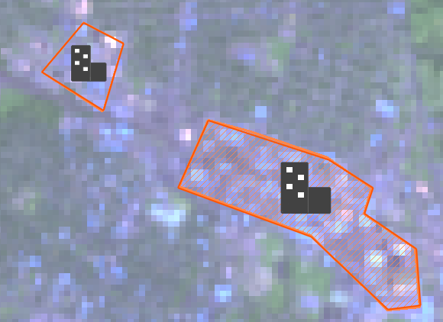
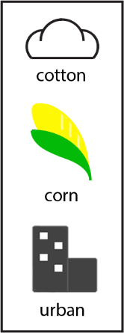
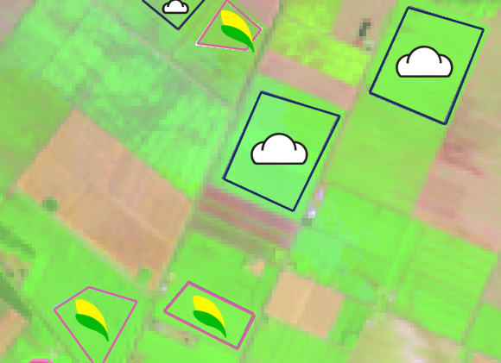
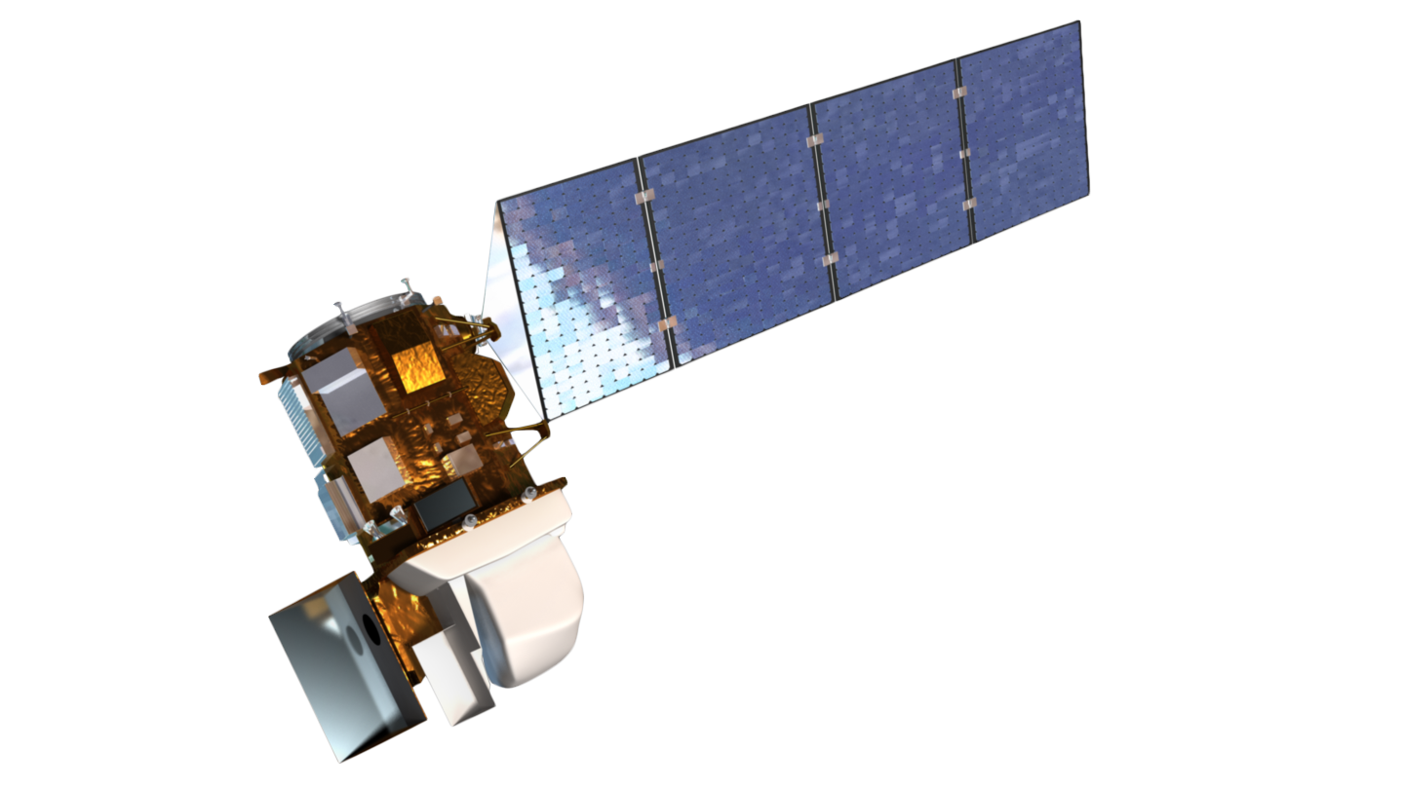
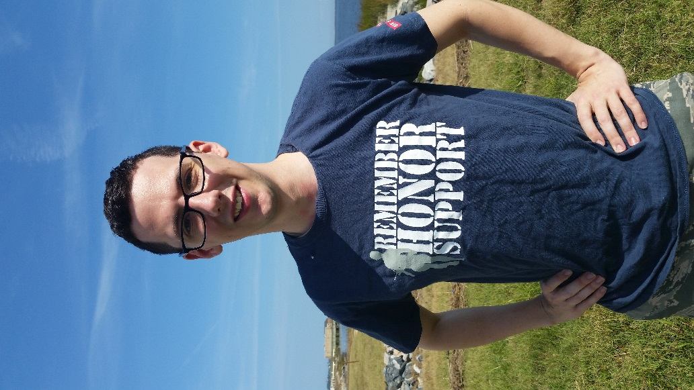
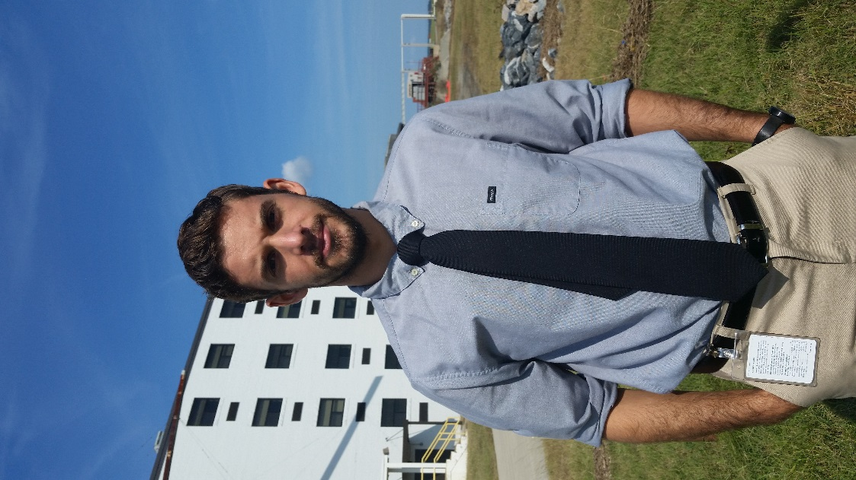
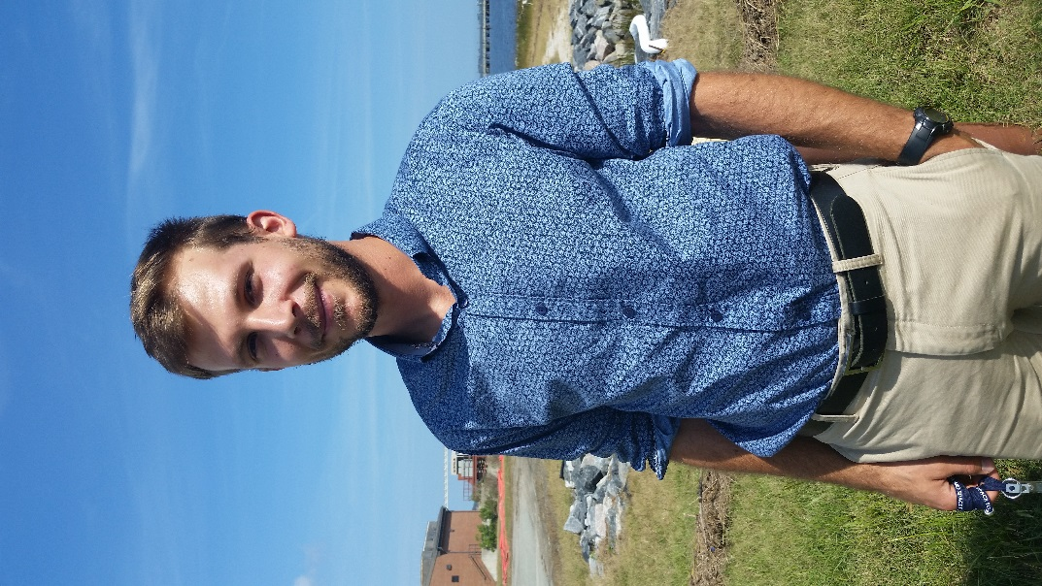
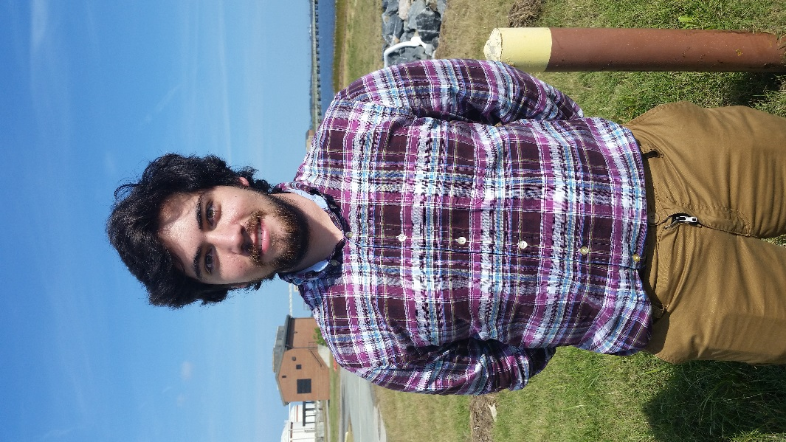
North Carolina Ecological Forecasting
Reassessment of NOAA C-CAP wetland delineation and further disaggregation of land use classes using remote sensing
Ben Roberts-Pierel (Project Lead), Brett Buzzanga, Michelle Pasco, Jake Patrick, Benjamin Charlem, Taylor Sage (USAF)
NASA DEVELOP National Program at NASA Langley Research Center
Abstract
Objectives
Keep this blank for now.
Body text point size should be at least 24.
Caption text point size should be at least 16.
Feel free to rename, move, and resize sections as needed.
Aims to provide an updated classification that is tailored to the Albemarle-Pamlico Estuary with important land classes such as invasive species, Phragmites australis
Create a replicable method so it would be possible for APNEP to update these classifications on a more regular basis than what C-CAP offers
Study Area
Methodology
Study Period: September 2015 to November 2015
Earth Observations
Analyzing Landsat, Soil, NHD, and DEM imagery
Creating maps in GIS to delineate land classifications
Results
Landsat 8 OLI
Use images.
Make sure that it has some sort of flow, that it makes sense. Show your results in a logical order.
No bullets.
Conclusions
Use bullets.
Use complete sentences with periods.
Team Members
Project Partner
Acknowledgements
Emily Adams, Langley Center Lead Rebekke Muench, Langley Assistant Center Lead Dr. Kenton Ross, NASA DEVELOP Science Director
Zand Bakhtiari, Previous Contributor Stephen Zimmerman, Previous Contributor Kayla Patel, Previous Contributor Brag Gregory, Previous Contributor
Pictured (from left to right): Taylor Sage (USAF), Bretty Buzzanga, Ben Roberts-Pierel (Project Lead), Michelle Pasco, Jake Patrick
Not Pictured: Benjamin Charlem
NASA Langley Research Center

