Slide 1
dnppy + GitHub
An Introduction to python programming and
software development for DEVELOP participants

Slide 2
Purpose
Support DEVELOP’s capacity building mission
Basic programming skills are increasingly valuable
Git is an industry best practice for software development
Improve institutional knowledge retention
Tools from past participants can be preserved and built upon
Put more power in the hands of participants
Soften the learning curve for people who want to start coding with GIS
Open the DEVELOP toolkit for public contribution and use
Open source software packages are almost self-marketing
Increase the utility and accessibility of NASA data
Directly supports NASA science directorate level goals

Slide 3
Strategy
Use dnppy as a collection of standardized python tools
Collection of “chain together” style functions and classes for scalability
Make python programming resources more accessible to new programmers
You can access these resources from your future places of work or study
Can avoid excessive software release approval requests
Managed through NASA-DEVELOP GitHub group for high visibility
Put github into tech project workflows
Great collaborative code writing environment
Provides platform for handling NASA Software Release Authorization
Allows code contributions from the public
Persistent access allows more fluid partner handoffs and updates

Slide 4
dnppy
DEVELOP National Program
Python package

Slide 5
About
dnppy is...
A python package, a collection of functions and classes that are useful for manipulation and analysis of geospatial data and NASA satellite data products
A development environment modifier to help the users quickly gain access to a large host of third party libraries
A method for distributing DEVELOP project code that complies with NASA Software Release
Managed from github at https://github.com/NASA-DEVELOP/dnppy
Continously updated documentation pages with much more info at https://nasa-develop.github.io/dnppy/

Slide 6
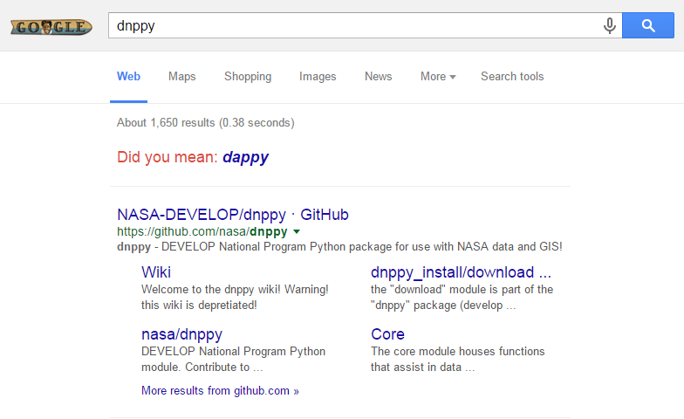
Access
Extremely easy to find
A GitHub account is not required to download and use dnppy
Installs itself and a host of python libraries without admin elevation
This is us!

Slide 7
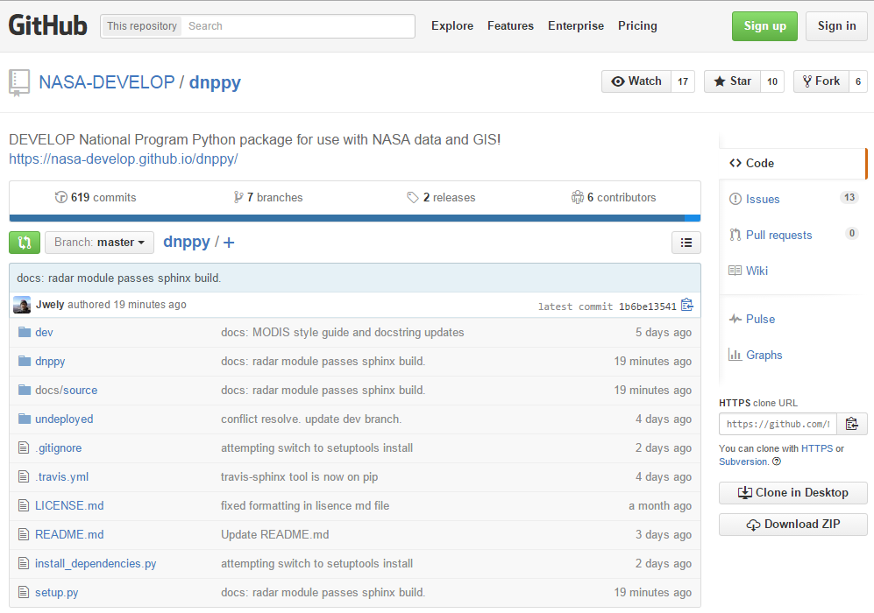
View docs
Get help
Stats
Download

Slide 8
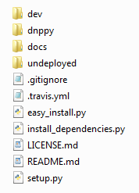
Installation
Grab the master branch from our GitHub by clicking the “Download ZIP” button in the bottom right*
Extract the contents then run “easy_install.py” by double clicking, or opening and executing in your prefered python interpreter
If installation succeeds, you should delete this downloaded folder
* On occasion, the downloaded zip file is empty and fails to extract. If this happens to you, just try downloading again.

Slide 9
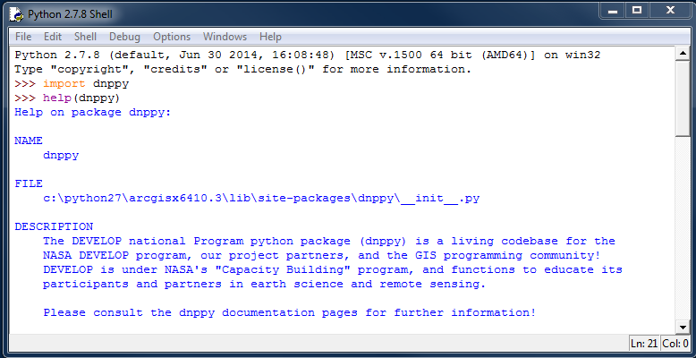
Getting started
Recommended use of Integrated Development Environment (IDE) like PyCharm by Jetbrains to manage your project code
Alternatively search your computer for “IDLE” as the default python interpreter
run ‘import dnppy’
You now have access to
dnppy, gdal, scipy
and more!

Slide 10
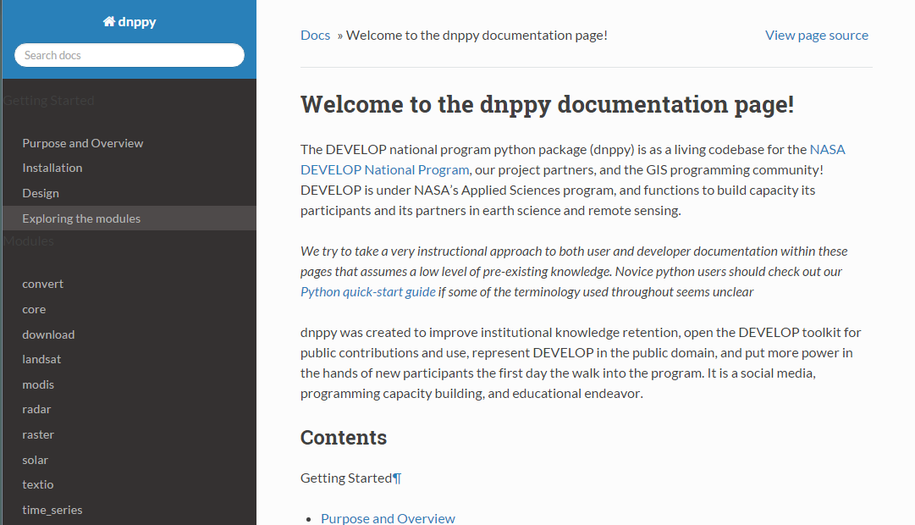
Exploring Modules
Summaries
Details

Slide 11
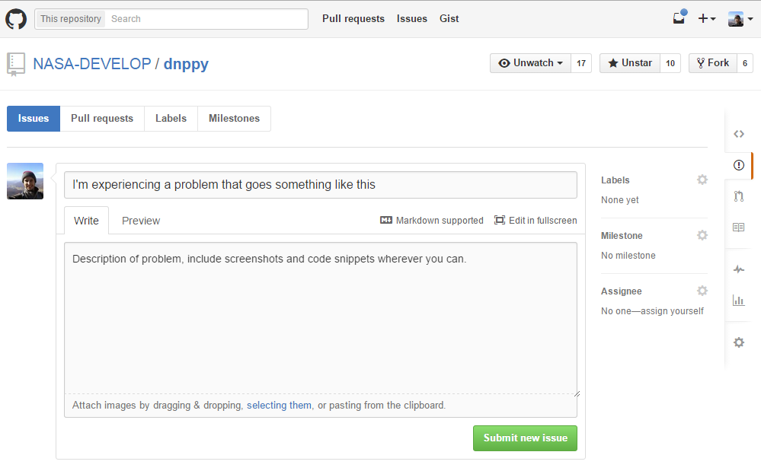
Issues
Help integrated into GitHub issue tracker
Use this issue tracker to report just about anything related to dnppy
Get help

Slide 12
GitHub
Collaborative software
development

Slide 13
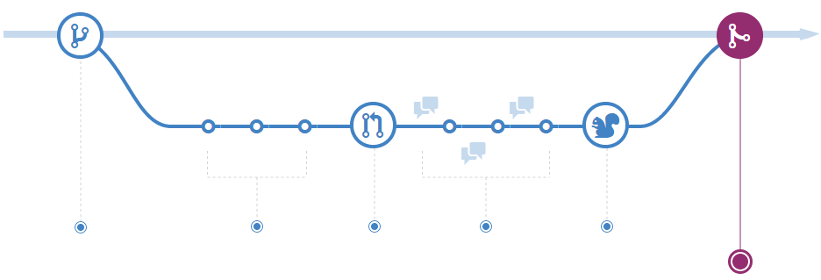
About
Git is a type of version control system that drastically simplifies the process of collaborative code writing
GitHub is a service that integrates the Git workflow into a public facing social environment
Organizes projects into repositories or “repos”

Slide 14
About
The highlights of the Git workflow are as follows:
A repo can have multiple “branches” where different ideas are tested before those changes are applied to the whole code base
Team members create a local “clone” of the repo on GitHub ,replicating the repo on their computer
Collaborators can make changes and add features on a specific branch of their local repo
Contributors then “commit” those changes then “push” to the “origin” repo on GitHub where they become visible and available to others
Collaborators can “pull” those changes to their local repos
Members of the public can “fork” copies of the repo on to their own branches, make changes to those branches, then issue a “pull request” for their changes to be merged into the “origin”.

Slide 15
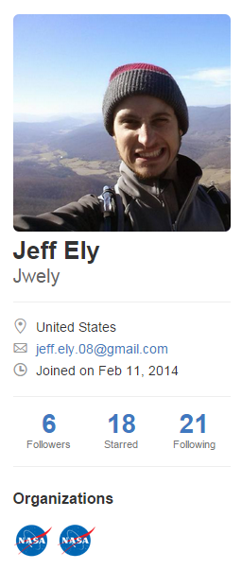
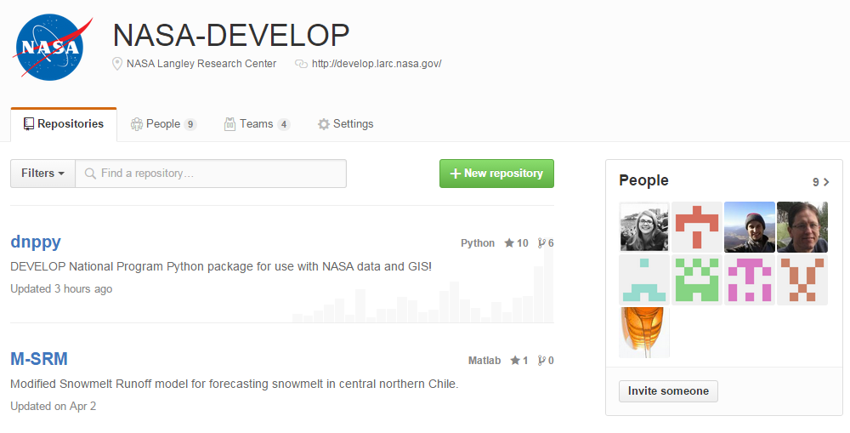
Other Selling points
Publicly referenceable portfolio of code projects
Retain permanent access to NASA-DEVELOP organization
Get that sweet NASA meatball on your profile

Slide 16
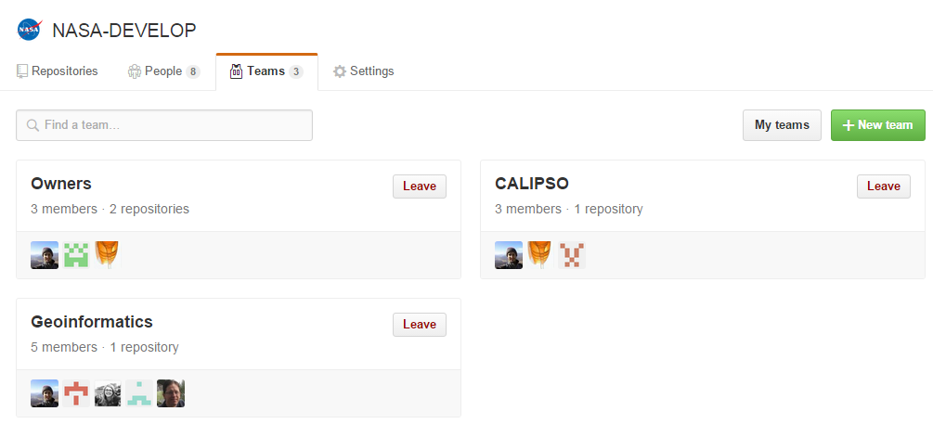
Setting up the team
Each team member creates a GitHub profile
Team lead sends the national technical lead (Mike Bender) an email with the team name and the usernames of each team member
Teams on continuation projects will be added to an existing team

Slide 17
Getting started
You are encouraged to create public repositories on your personal GitHub accounts for learning exercises and getting comfortable with Git or learning python
Your team will be have access to one private repository on the NASA-DEVELOP organization page
Do not put any code directly related to your project anywhere except your teams private repository
These rules help us meet federal requirements on NASA software release

Slide 18
Learning resources
Comprehensive workflow explanation
View the basics of Git
Why should you use a version control system like Git?
Several guides exist to help understand the concept of configuration management and version control systems like Git
Consult this cheat sheet for Git shell commands
Some more advanced resources in the developers section of the dnppy help docs

Slide 19
Should I use it?
Your team should try GitHub if:
You intend to collaborative write code to perform your analysis
You are a programmer or computer scientist who is unfamiliar with it (Version control experience is a “must” for tech industry employers)
Your team must* use GitHub if:
You intend to deliver a polished software tool to your project partner
* software tools produced by develop will all be distributed through github, so you might as well learn a few things along the way.

Slide 20
Questions?

Slide 21
Behind the Curtain
Bureaucratic NASA software release procedures are being streamlined to have minimal possible impact on the teams
We use private repositories to allow teams to develop in the best possible conditions while complying with requirements
Projects fall into four categories for software release, and the teams have a significant degree of control over which category they want to be in, and can change categories in some cases
Categories are loosely assigned at the very beginning of a project

Slide 22
Project Categories
Strictly practical working scripts with very limited reusability, no release of code. Written offline without Git. Results might have been really great, but there is no foreseeable need to re-run the analysis, and even if the code is kept it would require substantial effort. Code is decidedly not held on to.
Scripts are sequentially run to perform analysis, but are mostly function calls to dnppy and/or arcpy. May be developed in private repository. May have some syntactical reference utility in the future or provide easy repetition of steps useful to future projects. Placed in dnppy/undeployed/proj_code folder, without a software release request. Available to partners soon after end of project. While a project may start out in this category, it is reasonable that the right participant could push it to category 3 in later terms.
[private repo required for duration of project]
New software tool that warrants new software release request. Developed with Github in a private repository with the intention of making the repository public.
[private repo required until SRA approval] [SRA required]
Projects building upon category 3 projects. SRA has already been submitted, so the team develops as if the work is in the public domain. SRA may still not have been approved, so the repo may remain private while development occurs. Previous teams work should be kept on a static release branch indefinitely.
[private repo released] [SRA finished]

