Slide 1
Eastern India Ecological Forecasting III
A Multi-Sensor Approach to Enhance the Prediction of Mangrove Biophysical Characteristics in Chilika Lagoon and Bhitarkanika Wildlife Sanctuary, Odisha, India
Abhishek Kumar
Taufiq Rashid
Isabel Miranda
Shanti Shrestha
Maria Luisa Escobar Pardo
University of Georgia
2017 Summer

Slide 2
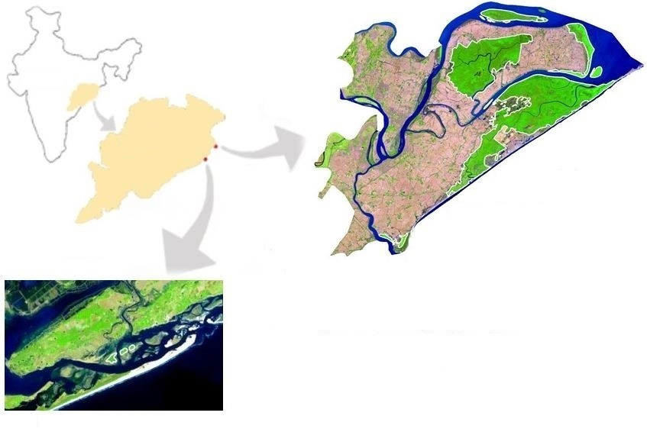
Study Area
Bhitarkanika
Latitude: 20.71ºN
Longitude: 86.86ºE
Mangrove Types: Dense, Closed & Open
Total Mangrove species: 55
Mangrove Area: 145 km²
Chilika
Latitude: 19.84º N
Longitude: 85.47º E
Mangrove Types: Open, small patches
India
Odisha
0
12
kilometers
Chilika
Bhitarkanika Wildlife Sanctuary
Green polygon with white outline represents mangrove area
0
6
kilometers
Notes:
Chilika Lagoon and Bhitarkanika Wildlife Sanctuary are two notable east coast wetland sites recognized by the Ramsar Convention on Wetlands and both situated in the state of Odisha. As the world’s second largest lagoon, Chilika Lagoon holds three small, but distinct mangrove patches near the opening to the Bay of Bengal. Bhitarkanika Wildlife Sanctuary lies north of Chilika Lagoon on a delta formed by Brahmani and Baitarani rivers and has several large and dense patches of mangroves.
Image Source: India Eco Forecasting III Team

Slide 3
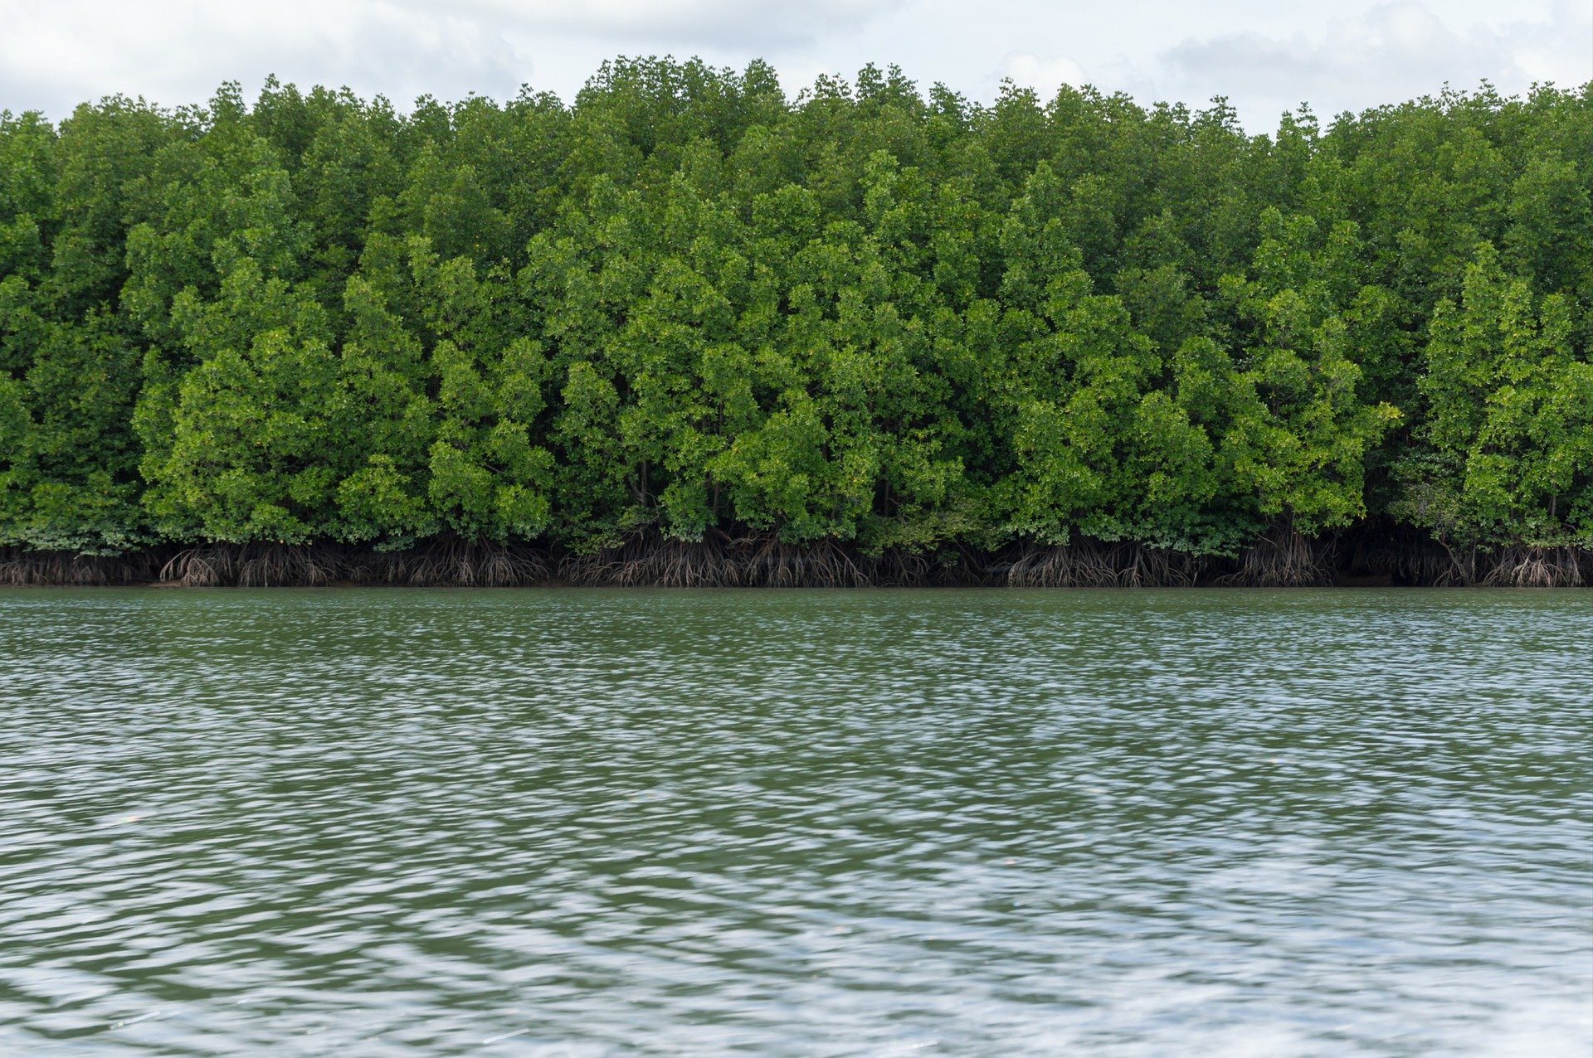
Community Concerns
Residents from 36 nearby villages receive valuable ecosystem services from the mangroves.
Mangroves have been overexploited or converted to other forms of land use.
Encroachment upon forests, unauthorized aquaculture practices, and discharge of effluent place even more pressure on mangrove forests and biodiversity.
Image Credit: dslr99, Pixabay
Notes:
Residents from 36 nearby villages receive valuable resources and services from the mangroves, including food, raw materials, medicinal and ornamental products and vacation/leisure sites.
Mangroves have been overexploited or converted to various other forms of land use, including agriculture, aquaculture, salt ponds, terrestrial forestry, and urban and industrial developments.
Bhitarkanika Wildlife Sanctuary and Chilika Lagoon supports several populations of crocodiles, lizards, migratory birds, and several rare and endangered mammals.
Image Source: http://irade.org/eerc/pdf/WB_FR_RuchiBadola.pdf

Slide 4
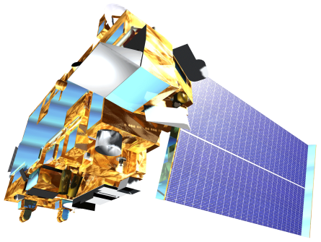
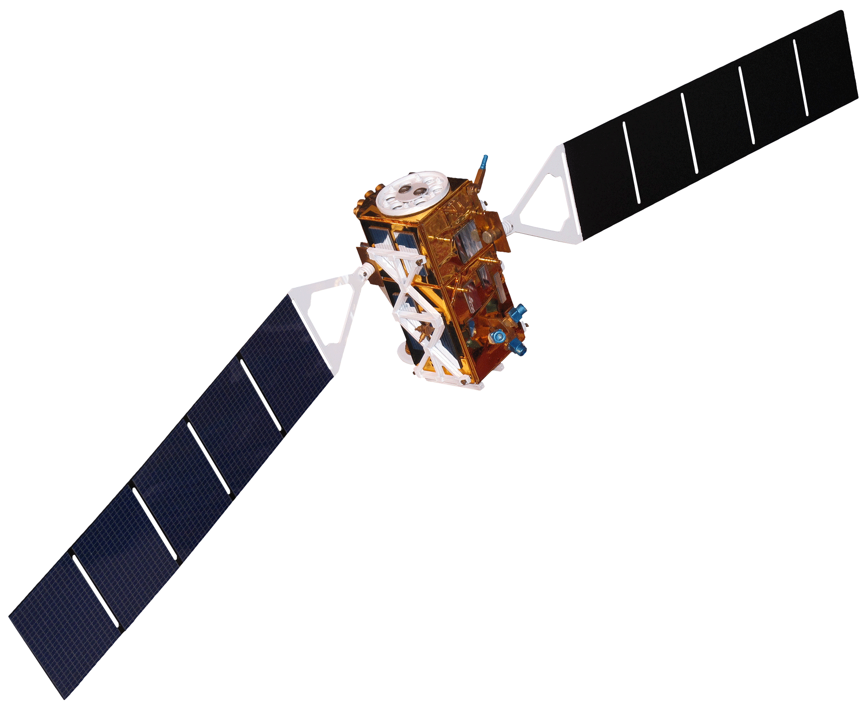
Objectives
Analyze long-term (2000-2016) spatio-temporal variability of biophysical parameters (GPP, LAI, CHL) using MODIS surface reflectance data
Produce a biophysical forecasting tool by utilizing 17 years of time series MODIS derived LAI, CHL, and GPP data and meteorological data derived from NASA’s Giovanni and WorldClim meteorological data
Create a mangrove extent forecasting tool using Landsat 5 TM and Landsat 8 OLI data in Land Change Modeler on TerrSet
Landsat 5 TM
Landsat 8 OLI
Terra MODIS
Sentinel-1 (C-SAR)
Image Credit: NASA
Notes:
The primary objective of the study is to refine previously created MODIS-based LAI and GPP models using 17 years of MODIS 8-day biophysical products. The secondary objective is to produce a biophysical forecasting tool by utilizing 17 years of time series MODIS derived LAI, CHL, and GPP data and meteorological data derived from NASA’s Giovanni and IPCC projected data. Lastly, this project aims to create a land change forecasting tool using Landsat 5 and Landsat 8 OLI data in TerrSet.
The end-products and results will be used by the Ministry of Environment and Forests, Odisha and Chilika Development Authority to improve conservation efforts.
Satellite Image Source: NASA’s Developedia

Slide 5
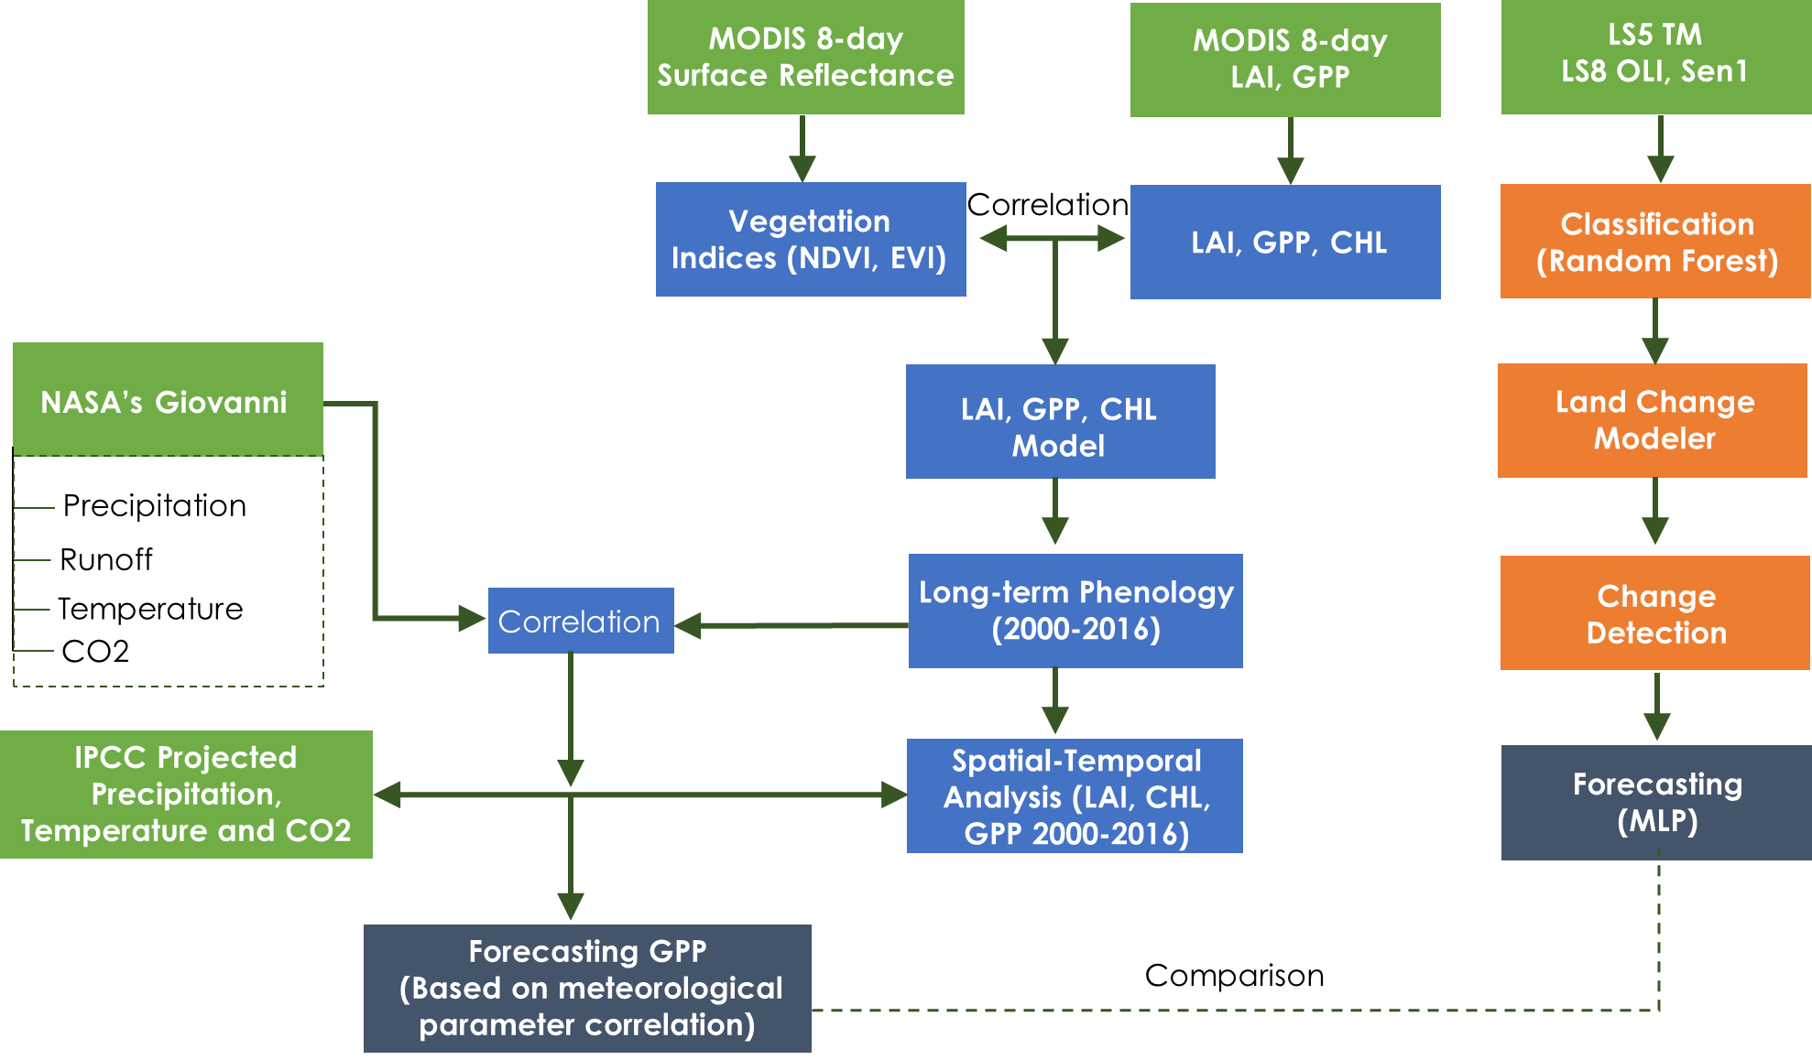
Methods
*MLP –
Multi-Layered Perceptron Neural Network
Notes:
Land Cover Classification
Training site polygons were created for each time period for seven land cover classes: dense mangrove; open mangrove; water; agriculture; mudflat; sand; and plantation. Google Earth Engine Explorer was used to conduct a supervised classification on Landsat 5 and 8 Satellite Imagery for the years 1995, 2004 and 2017. Random Forests was used as the algorithm for the supervised classification for the Bhitarkanika and Chilika study areas. Random Forests is a machine learning technique that is being increasingly used for image classification of percentage tree cover and forest biomass (Horning 2010). Output Land-cover maps were validated visually with stratified sample points using Google Earth satellite imagery at the closest timestamp. In addition, published literature was reference to maximize the accuracy of the Land-cover classification (Reddy et al., 2007; Pattanaik 2008).
Quantifying Land Cover Change and Forecasting
The Land-cover Classification was analyzed in TerrSet to calculate the total area in square kilometers for each Land-cover class. The Land Change Modeler (LCM) suite in TerrSet was run to quantify Land-cover category change in the study area from 1995 to 2004 and from 2004 to 2017.To predict future changes in Land-cover it is necessary to empirically model each of the land cover transitions of interest, in our cast we modeled the transitions Dense Mangrove to Open Mangrove and Open Mangrove to Agriculture because these land cover transitions were the most significant in terms of area (land cover change of 1500 hectares or more). This was done using the Multilayered Perceptron (MLP) Neural Network within the LCM of TerrSet for the year 2050 using a set of driver variables that would cause a land cover class to transition to another land cover class.

Slide 6
Methods
Forecasting GPP/LAI/CHL
MODIS derived current GPP/LAI/CHL
Current year
Temperature
GPP
LAI
CHL
Precipitation
2050
2050 GPP/ LAI/ CHL
Notes:
This flowchart shows how we forecasted annual GPP/LAI/CHL. We developed models to predict GPP/LAI/CHL using climatic variables- temperature and precipitation for each month using multiple linear regression. The model explained 73% of variation in GPP…
These monthly GPP were averaged to get annual GPP/LAI/CHL for current year as well as 2050. The difference between 2 GPP/LAI/CHL were then subtracted from MODIS derived GPP/LAI/CHL for year 2016. This gave us the 2050 GPP/LAI/CHL. Thus we made use of meteorological variables together with MODIS pixel to predict 2050 GPP/LAI/CHL.

Slide 7
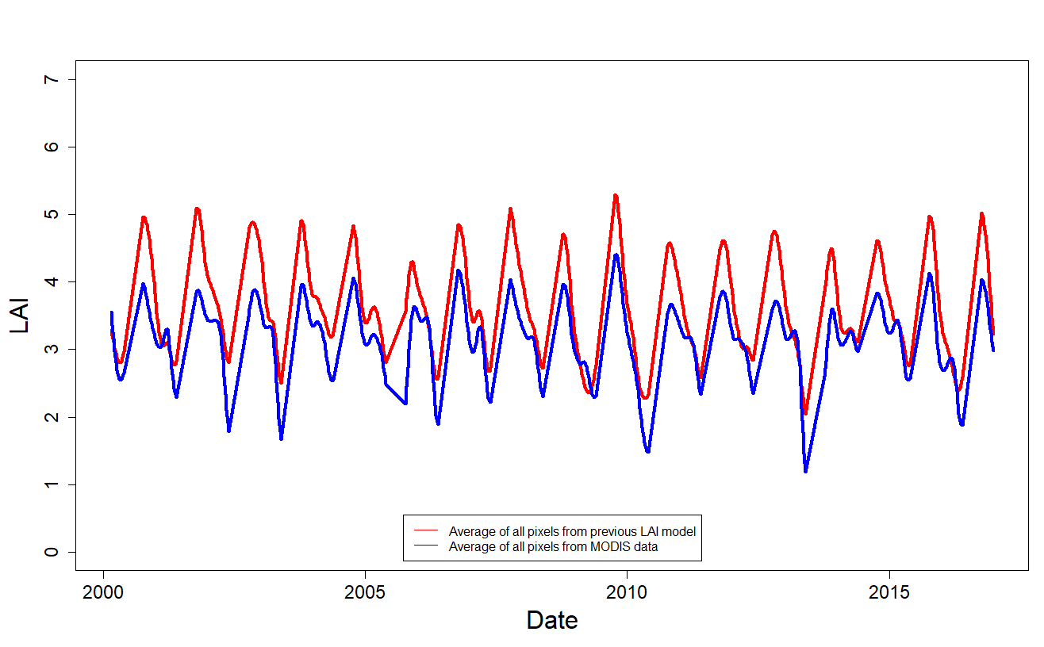
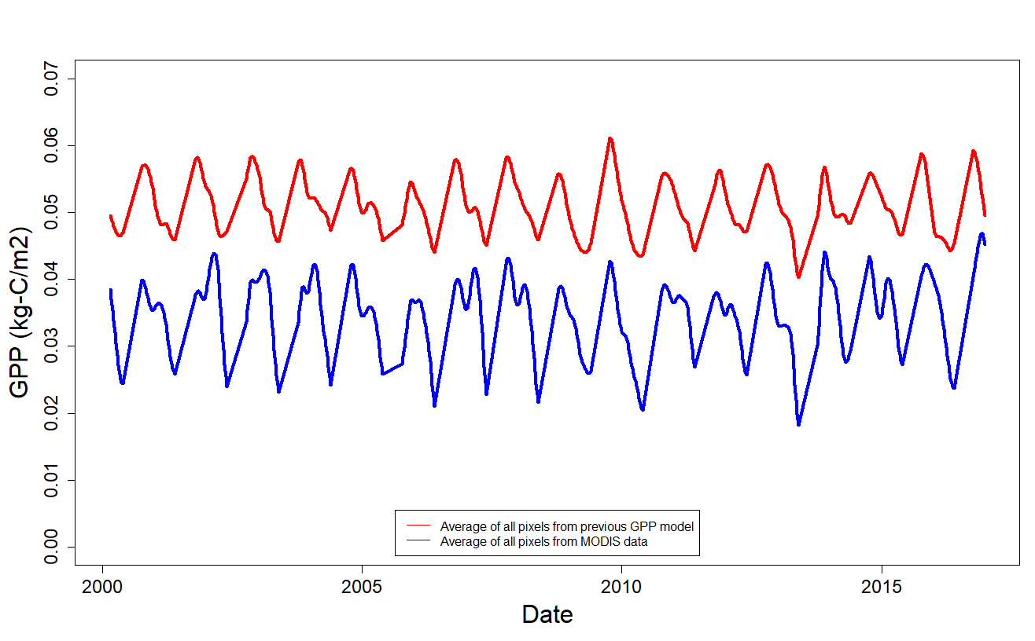
Results
From Previous Model
7
0.06
6
5
4
0.04
3
LAI
GPP (kg-C/m2)
0.02
2
1
Average of all pixels from previous LAI model
Average of all pixels from MODIS data
Average of all pixels from previous GPP model
Average of all pixels from MODIS data
0
0.00
2000
2005
2010
2015
0.01
2000
2005
2010
2015
Date
Date
Notes:
Over-estimation in both LAI and GPP were observed when compared with MODIS LAI and GPP data extracted from MOD15 and MOD17 products.

Slide 8
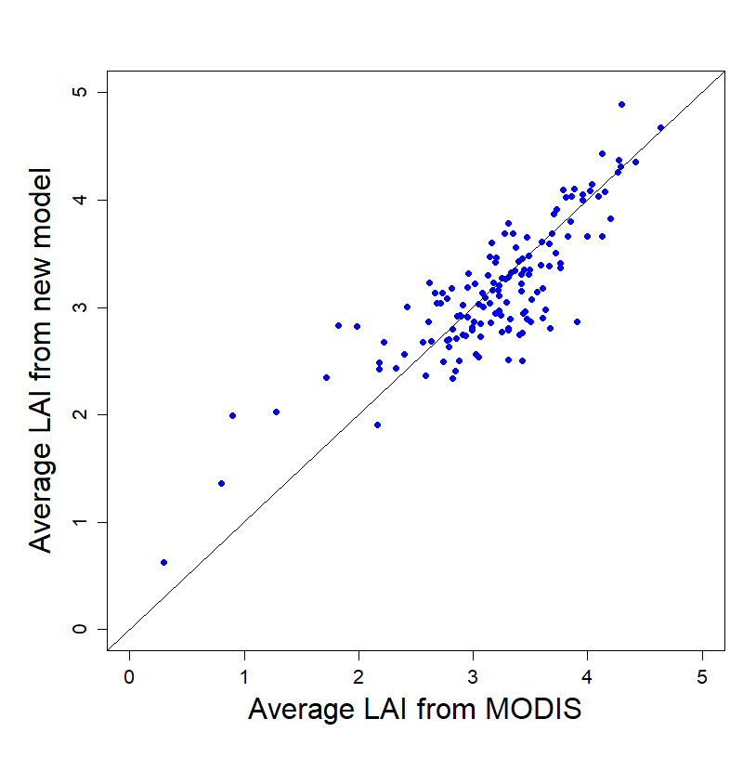
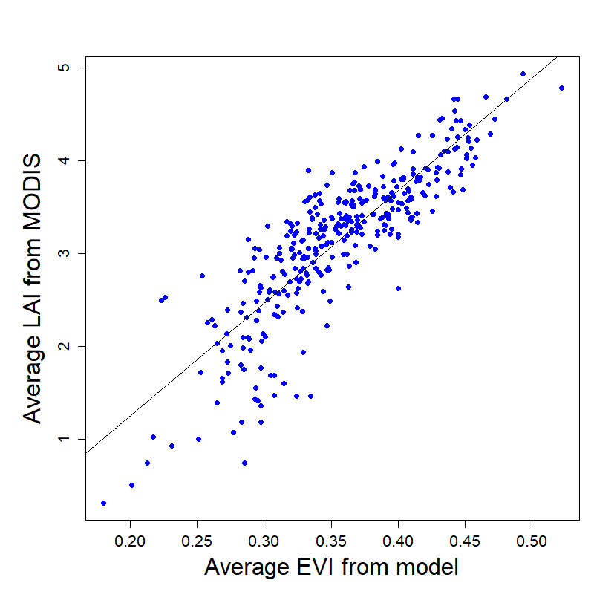
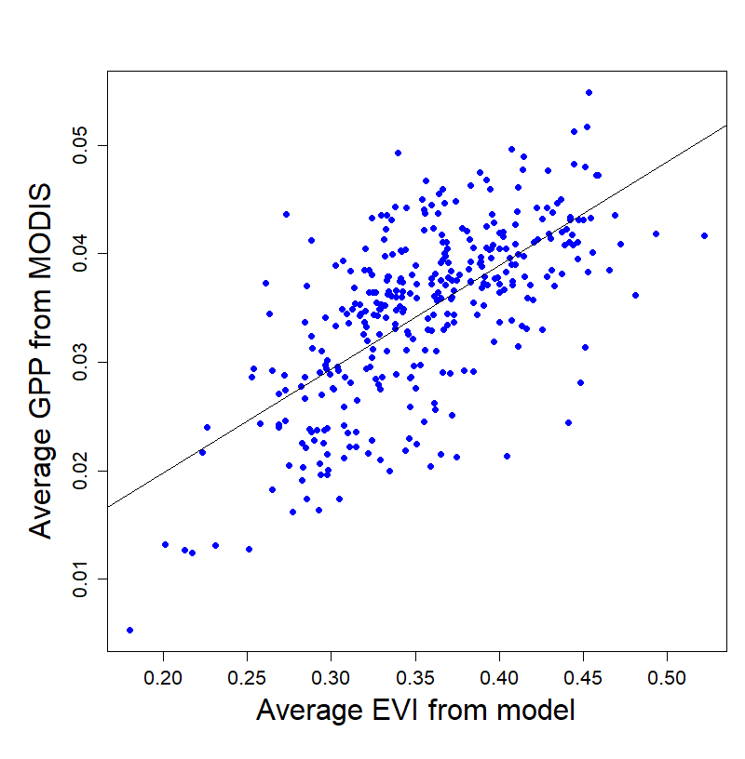
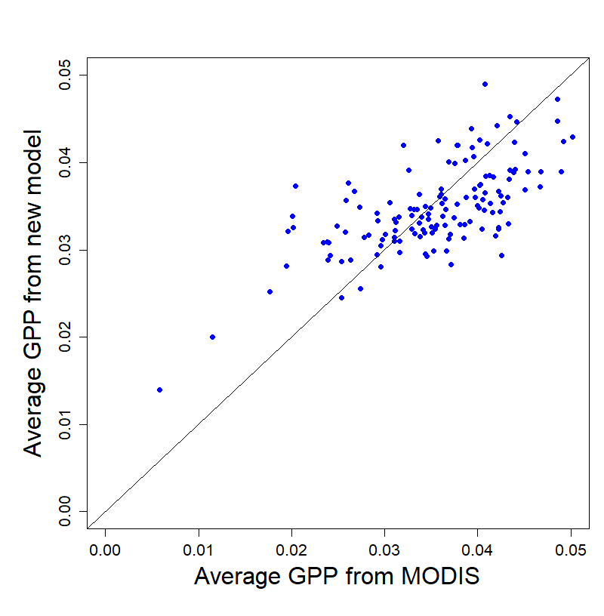
Results
Calibration
New Model
Validation
5
5
LAI = 11.8038*EVI – 1.0419
R² =0.72
RMSE=0.371
NRMSE=8.56%
4
4
3
3
Average LAI from MODIS
Average LAI from New Model
2
2
1
1
0
0.20
0.30
0.35
0.40
0.45
0.50
0
1
2
3
4
5
0.25
Average EVI from Model
Average LAI from MODIS
0.05
0.05
GPP = 0.0969296*EVI + 0.0003819
R² =0.44
RMSE=0.0056
NRMSE=12.73%
0.03
0.03
Average GPP from MODIS
Average GPP from New Model
0.01
0.01
0.20
0.25
0.30
0.35
0.40
0.45
0.50
0.00
0.01
0.02
0.03
0.04
0.05
Average EVI from Model
Average GPP from MODIS
Notes:
Therefore, we refined the LAI and GPP models by using 17 years (2000-2016) of data. We used average value of all pixels to compare between EVI and modis derived GPP/LAI. This showed clear trend of linear relationship and thus we obtained new parameters by using linear regression.
The new model was validated by splitting the data into 12 years of data as calibration dataset and 5 years of data as validation dataset. We looked at the plots of average GPP and LAI from MODIS Vs average GPP and LAI from new models. Calibration and validation results showed improvement in the model with reduced normalized root mean square errors of 8.56% for LAI model and 12.73% for GPP model, compared to previous term NRMSE which was 19.54% for LAI and GPP 18.64% for GPP). Thus we obtained our new model to predict GPP and LAI using EVI2.

Slide 9
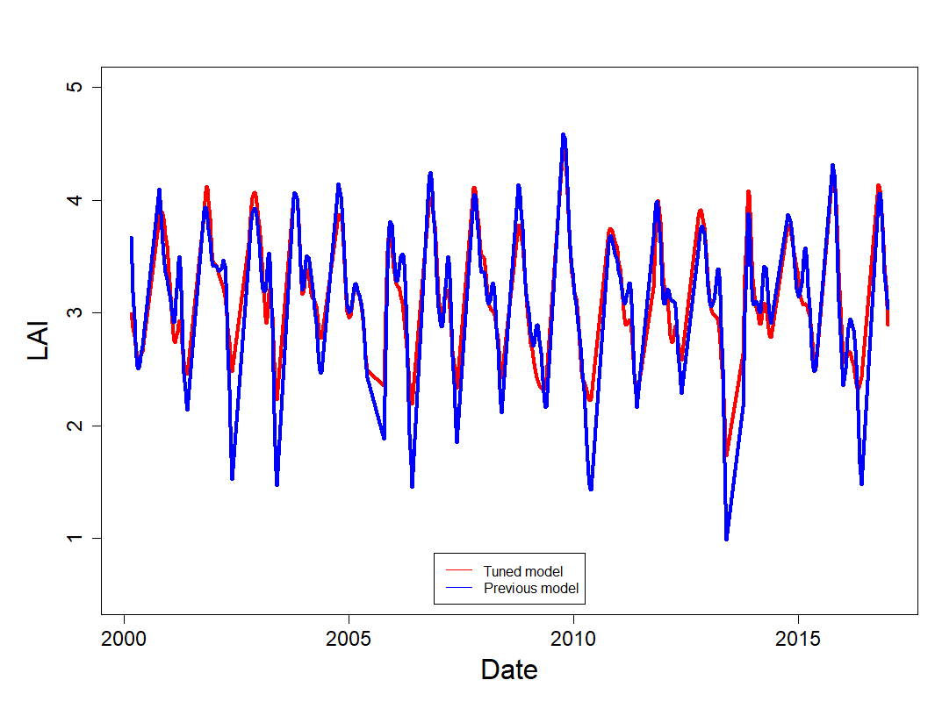
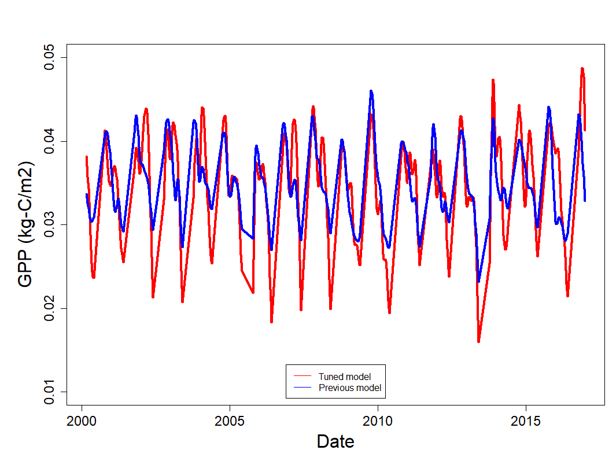
Results
Results from tuned LAI and GPP Models
5
0.05
4
0.04
3
0.03
GPP (kg-C/m2)
LAI
2
0.02
1
Tuned Model
Previous Model
Tuned Model
Previous Model
0.01
2000
2005
2010
2015
2000
2005
2010
2015
Date
Date
Notes:
Here, I am showing how the LAI and GPP derived from our tuned model varied with time. The time series of GPP and LAI from tuned model clearly showed to no-overestimation in prediction which was encountered using previous models.

Slide 10
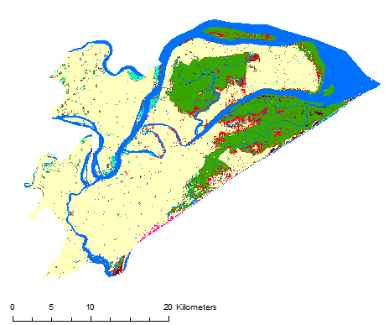
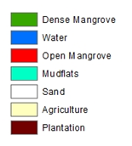
Results
Classification Results
1995
2004
2017
0
20
km
Overall Accuracy: 84%
Dense Mangrove
Water
Open Mangrove
Mudflats
Sand
Agriculture
Plantation
Overall Accuracy: 82%
Overall Accuracy: 86%
Notes:
The land-cover maps were made using GEE explorer with a random forest algorithm. These are the classification results with an overall accuracy of 84% for 1995, 82% for 2004 and 86% for 2017. An accuracy assessment was calculated in TerrSet to create an Error Matrix indicating the overall accuracy. Visually we can note significant fragmentation of dense mangrove and increases in agriculture and open mangrove land cover.

Slide 11
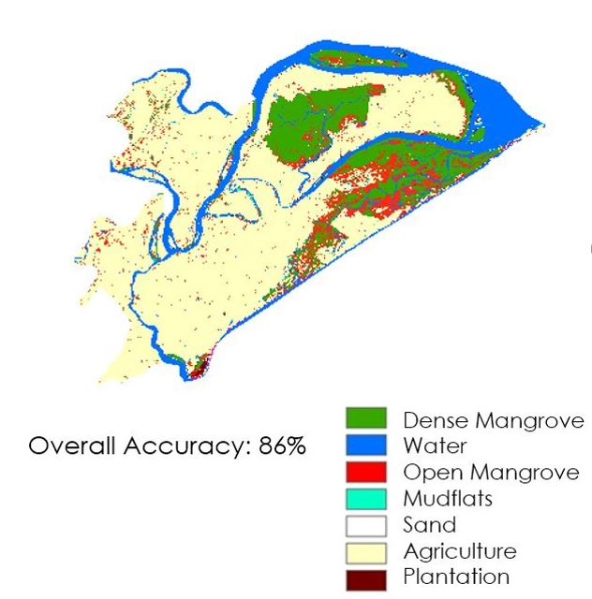
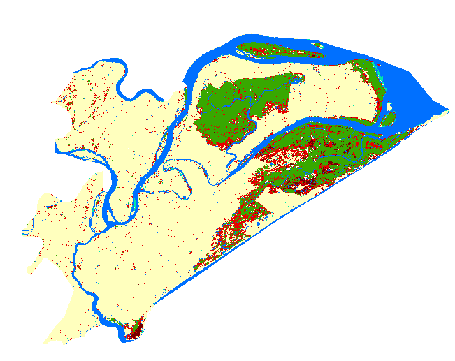
Landsat 8 2017
Radar (Sentinel 1) 2017
Overall Accuracy: 84.8%
Notes:
Since, radar data has higher resolution compared to landsat data, we also conducted the classification using Radar data to compare accuracy and found them to be performing very similarly. The overall accuracy for landsat 8 was 86% and the overall accuracy for Radar (Sentinel 1) was of 84.8%

Slide 12
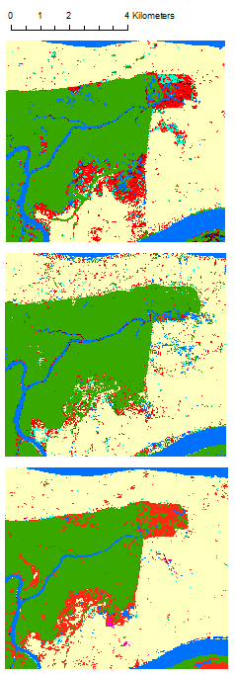
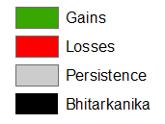
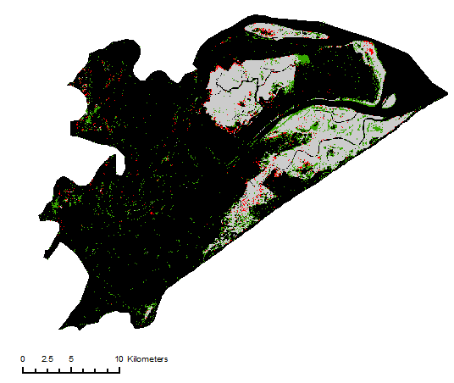
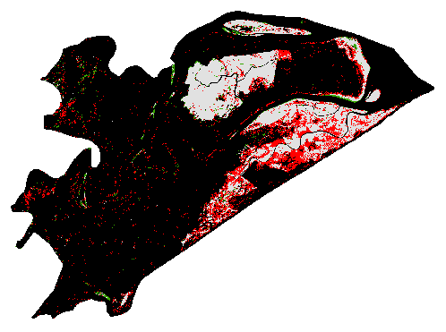
Results
0
4
km
1995
Dense Mangrove Change
Gains
Losses
Persistence
Bhitarkanika
2004 - 2017
1995 – 2004
2004
2017
Dense Mangrove
Water
Open Mangrove
Mudflats
Sand
Agriculture
Plantation
0
20
km
Notes:
Focusing on the land cover class dense mangrove we used the Land Change Modeler in TerrSet to map areas of gain, loss and persistence in Bhitarkanika. The total amount of loss of dense mangrove is 9.28 square km from 1995 to 2004 and the total amount loss from 2004 to 2017 is 21.44 square km, indicating more loss occurred from 2004 to 2017. Focusing on a particular part of our study area we can note than in 1995 areas of open mangrove (red) in 2004 were replaced by dense mangrove. In 2017 we can note that locations of dense mangrove were again lost becoming open mangrove. In addition 70% of the total dense mangrove that was lost from 2004 and 2017 changed to open mangrove. There was also a 24.4% gain in dense mangrove from 1995 to 2004.
ADD WHY THERE WAS GAIN IN DENSE MANGROVE?

Slide 13
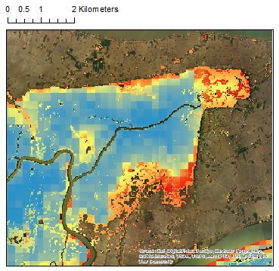
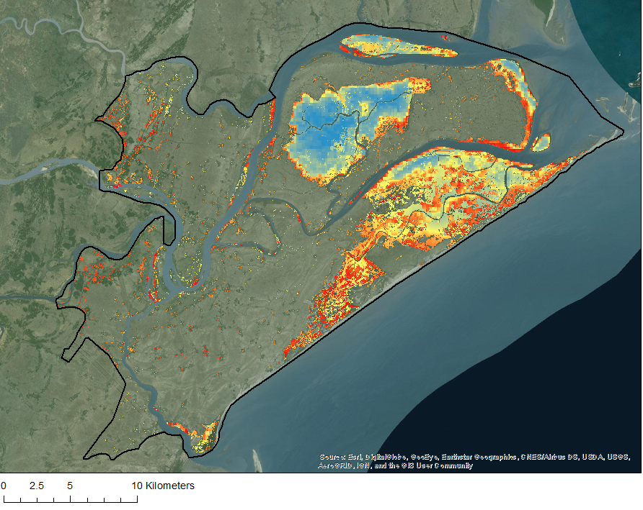
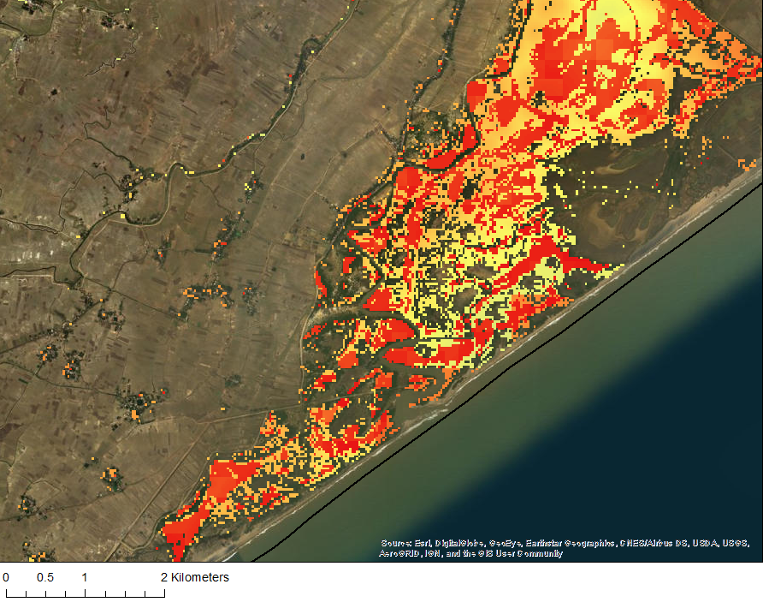
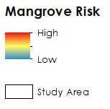
Results
2050 Forecasted Mangrove Risk to Disturbance
Driver Variables
0
2
km
Dense Mangrove to Open Mangrove
A
Distance from Roads
Distance from Towns
Distance from Channels
Elevation
Distance from disturbance
MLP
Open Mangrove to Agriculture
B
Distance from roads
Annual precipitation
Distance from disturbance
Distance from channels
Mangrove Risk
0
10
km
High
Low
Study Area
Notes:
Predicting Future Mangrove Extent
To predict future land-cover transitions we used the Transition Potential tab in the Land Change Modeler.
Only land cover transitions that were more than 1,500 hectares were included in our forecast, these land cover transition were Dense Mangrove to Open Mangrove and Open Mangrove to Agriculture. These are the main transition occurring within our study area from 2004 to 2017. To predict future changes in mangrove extent it is necessary to empirically model each of these transitions, this was done using the Multilayered Perceptron (MLP) Neural Network.
The MLP is creating a multivariate function that can predict the potential for a pixel to transition based on the values of the driver variables for that pixel. The driver variables we used were different for each transition and were selected based on the strength for the variable to predict change for each transition. For example, pixels that are transitioning from dense mangrove to open mangrove are most influenced by distance to roads, towns channels, previous disturbance and elevation.
The MLP produces a transition potential image that describes the probability that a transition will occur in the landscape and is used to predict future land-cover change for 2050. Finally using the Change Prediction Tab in the LCM allowed us to specify the date 2050 and use the Markov Chain Analysis to model our transitions in land cover.
One of the two models of change is a soft prediction map that indicates a scale of vulnerability that shows the risk of mangroves to disturbance in the future and the area’s potential to change to another land cover. Red/orange locations indicate medium to high vulnerability and locations of yellow and blue indicate lower vulnerability.
Results
A: Lower mangrove risk locations, seen in blue, are around the north western part of our study area which is the Bhitarkanika National Park. However the edges of the national park show increased mangrove risk indicated in yellow and red. Mangroves in the north east of the national park also face higher risk than further in the park and are also located closer to the town areas.
B: Much of the medium to high Risk areas , seen in red and yellow, are located in the south eastern part of the study area by the Rajnagar-Pattamundai Road and along the river right below the road. Mangrove high risk locations also appear to be fragmented along the river.

Slide 14
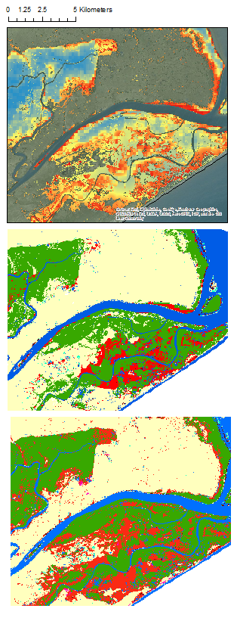
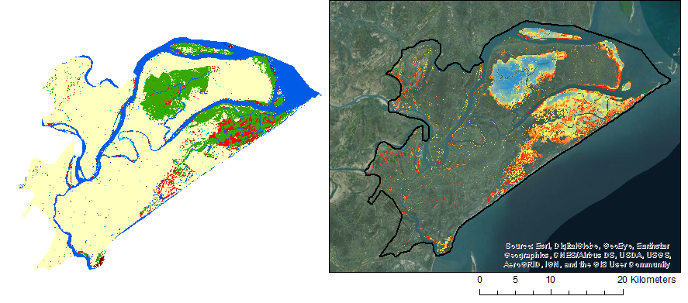
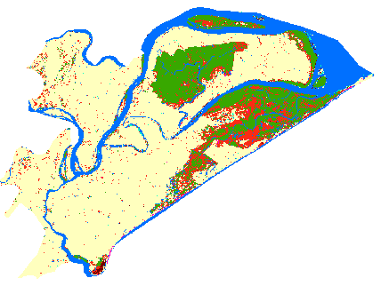
Results
0
5
kilometers
A
2050 Soft Prediction
2050 Hard Prediction
2050 Soft Prediction
Mangrove Risk
High
Low
Study Area
B
2050 Hard Prediction
0
20
2017 Classification
km
C
2017 Classification
Dense Mangrove
Water
Open Mangrove
Mudflats
Sand
Agriculture
Plantation
Notes:
Another model that the Markov Chain analysis outputs is the hard prediction model, the hard prediction model is a “best guess” of the many plausible scenarios that land cover could have in the future. Therefore the chances of hard prediction to match the future conditions are slim and should be interpreted with caution. Therefore the soft prediction model provides a better indication for risks to habitat and biodiversity.
We decided to compare the hard and soft prediction with our 2017 classification. In figure A we can note a portion of the study area along the river and outer edges of mangrove patches that is experiencing future mangrove degradation. Locations with high mangrove risk in the soft prediction coincide with locations of agriculture and open mangrove (red) in the 2050 hard prediction (figure B). The hard prediction compared to the 2017 classification shows greater increase in agriculture that was previously open mangrove. In addition the soft prediction locates areas of high mangrove risk that coincide with open mangrove areas in the 2017 classification.
Therefore park managers* should focus on further monitoring open mangroves within the study area as well as the outer edges of dense mangrove patches.

Slide 15
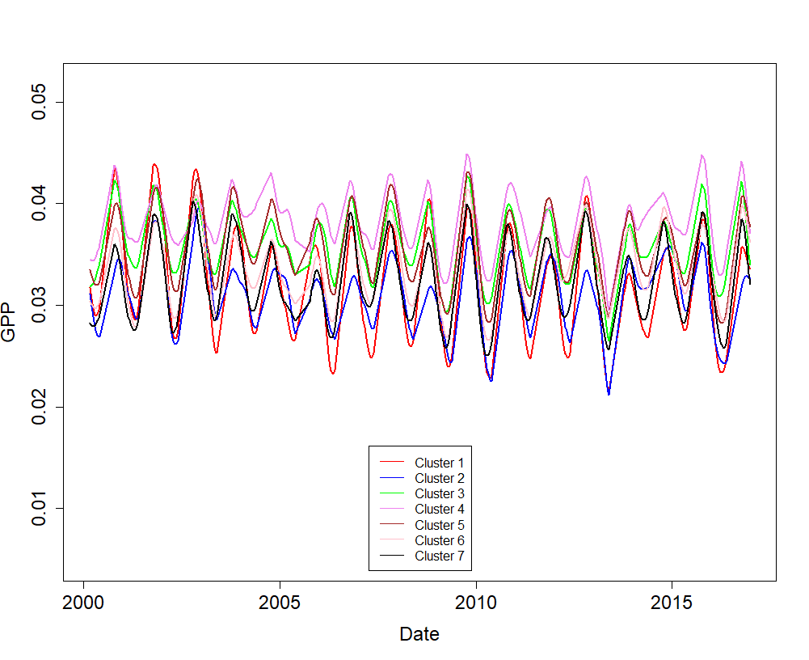
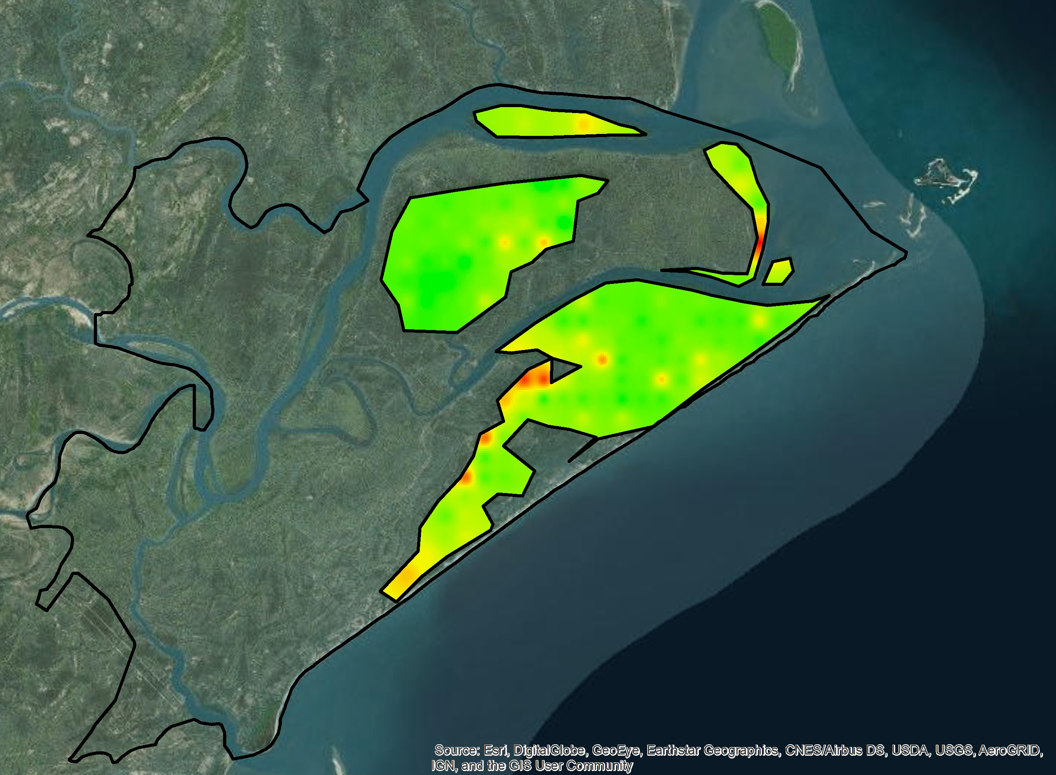
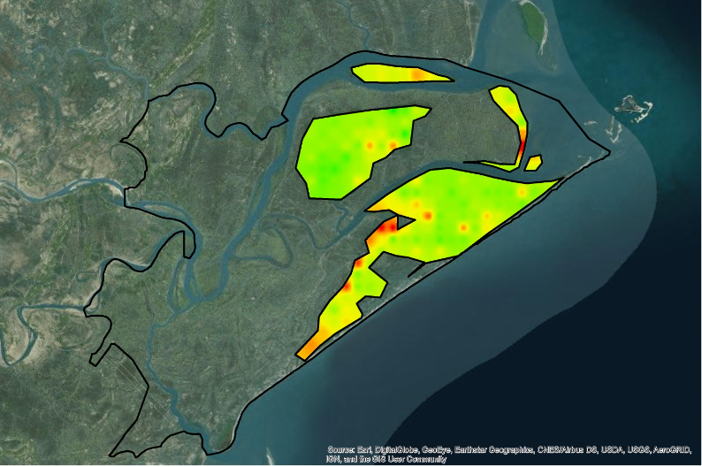
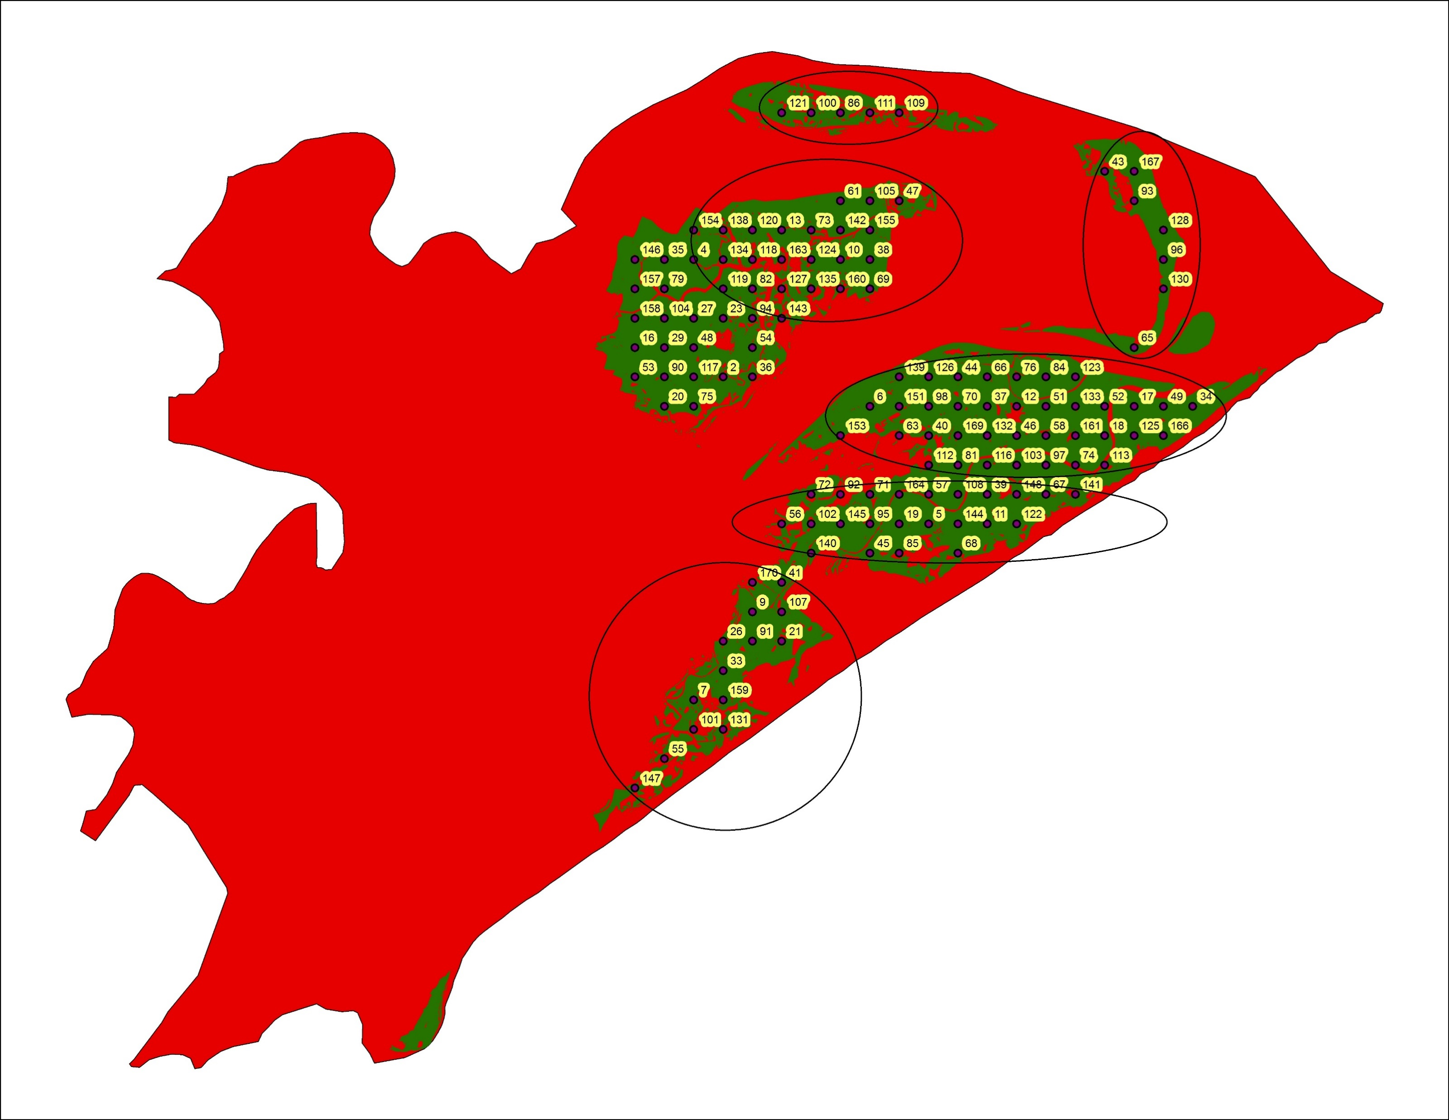
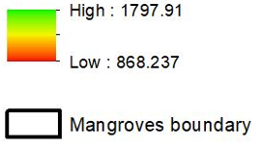
Results
Spatio-temporal Variability in GPP
Mean Annual GPP (2016)
Forecasted Mean Annual GPP (2050)
2
3
1
4
5
6
7
Kilometers
GPP (gm-C/m2/yr)
0
2
4
8
12
16
High: 1797.91
Low: 868.237
Source: Eastern India Eco Forecasting III
Mangrove Boundary
Notes:
We divided the mangroves within Bhitarkanika into 7 clusters as some clusters were dense and some were open and some were isolated. We thought to look at cluster-wise changes in GPP and LAI. The graph of temporal variability of GPP is shown. This graph helped us to identify that the cluster 4 was having the highest GPP and cluster 1,2 and 7 had relatively lowest GPP and these happened to be the isolated mangroves. This also helped us identify any outlier pixels that were behaving abnormally in terms of GPP.
Next, we are showing the mean annual GPP of year 2016 and the map showing forecasted mean annual GPP for year 2050. As can be seen, the GPP has reduced in year 2050. The area that were initially high GPP areas, the greener areas tended to show hints of yellow and red colors showing reduction in GPP. Parts of cluster 1, 7 and 6 will noticeably be facing reduction in GPP in year 2050. The reduction in GPP was 7.7% compared to mean annual GPP of year 2016.

Slide 16
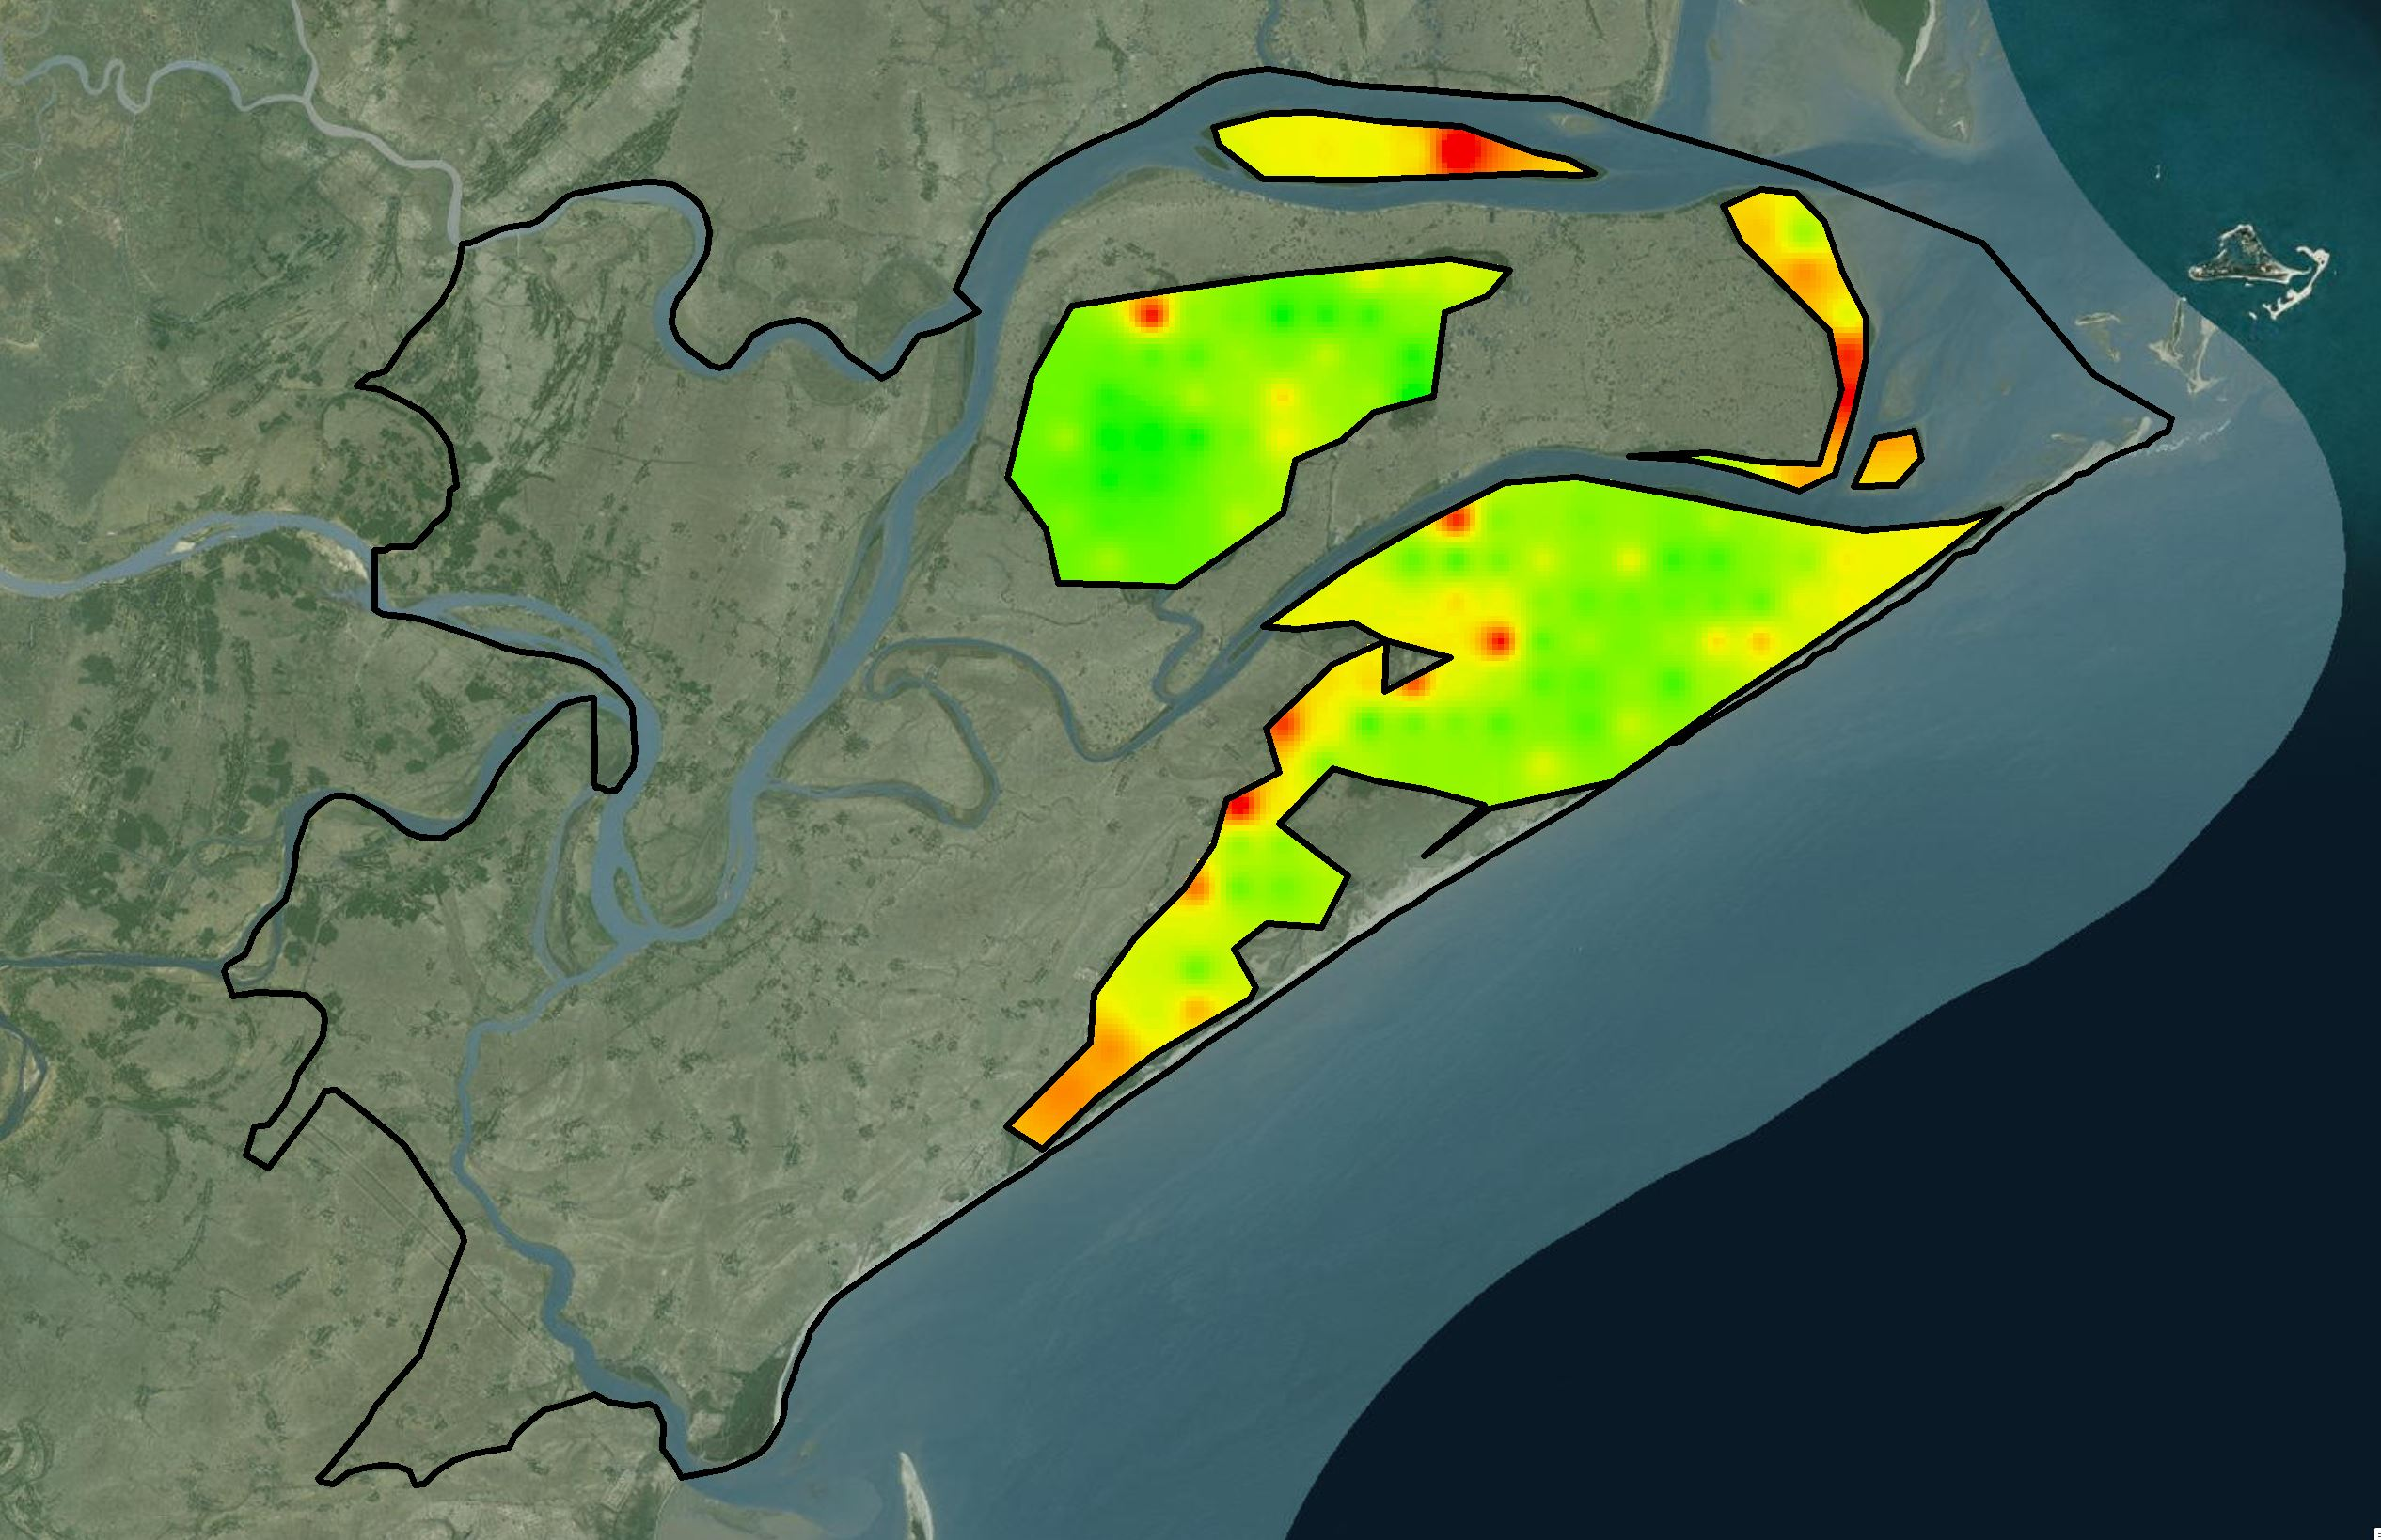
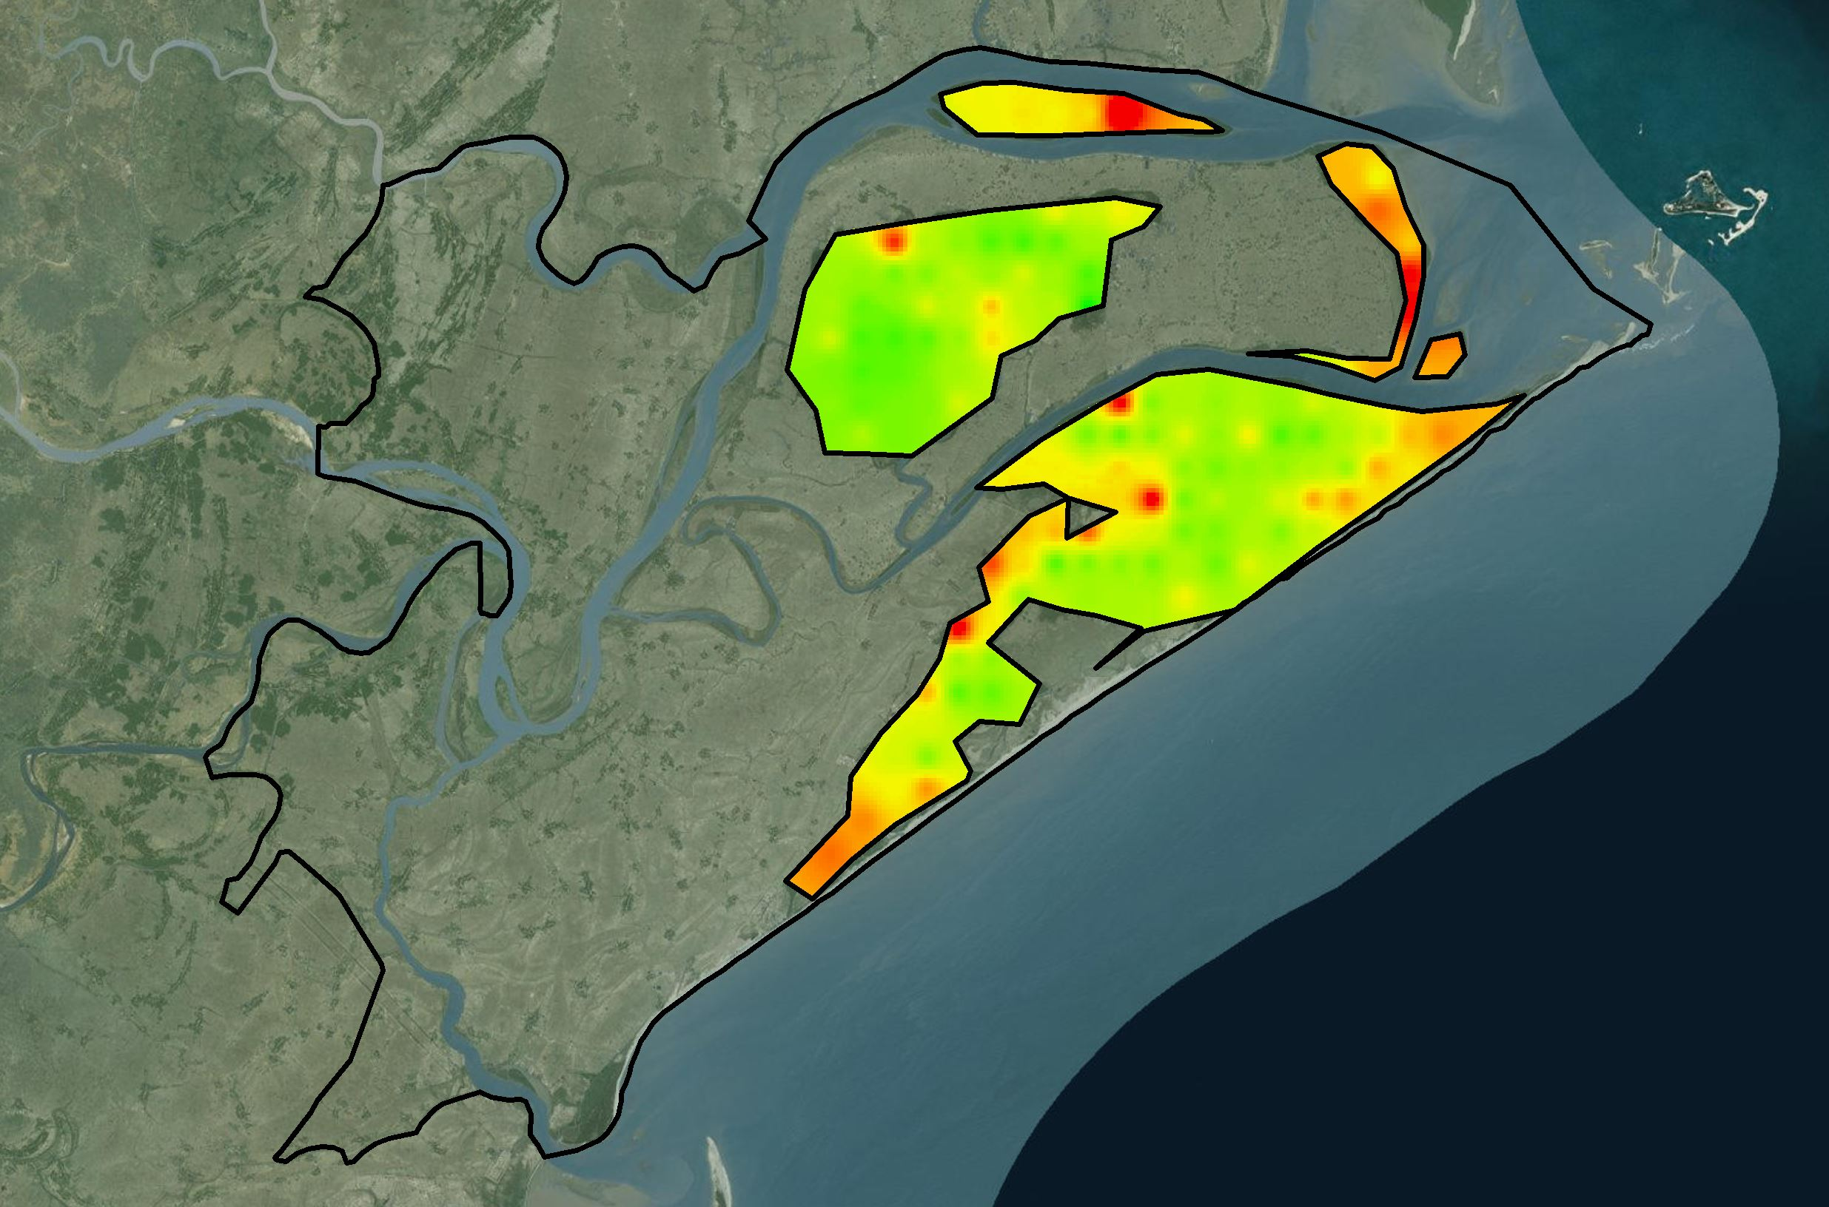
Results
Mean Annual LAI (2016)
Forecasted Mean Annual LAI (2050)
Kilometers
2
4
8
12
16
High: 3.06251
Low: 1.43122
Source: Eastern India Eco Forecasting III
Mangrove Boundary
Notes:
Here, we are showing the mean annual LAI of year 2016 and the map showing forecasted mean annual LAI for year 2050. As can be seen, the LAI has reduced in year 2050. The area that were initially high LAI areas, the greener areas tended to show hints of yellow and red colors showing reduction in LAI. Parts of cluster 1, 7 and 6 will noticeably be facing reduction in LAI in year 2050. The reduction in LAI was 20.83 % compared to mean annual LAI of year 2016.

Slide 17
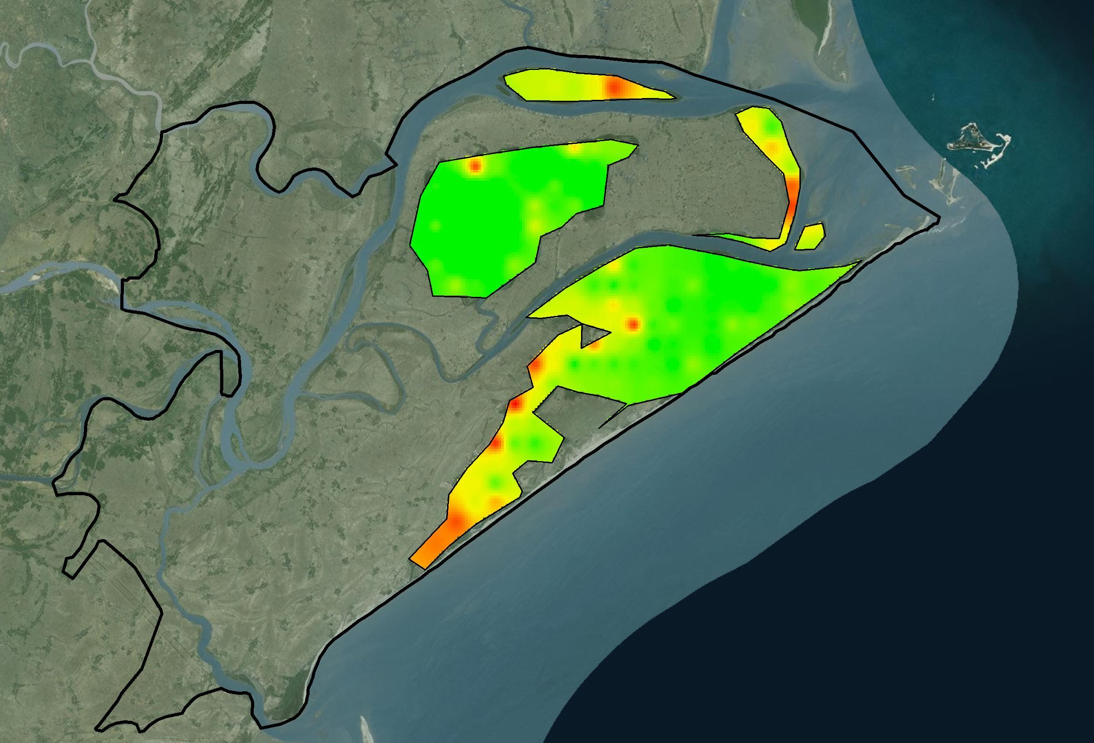
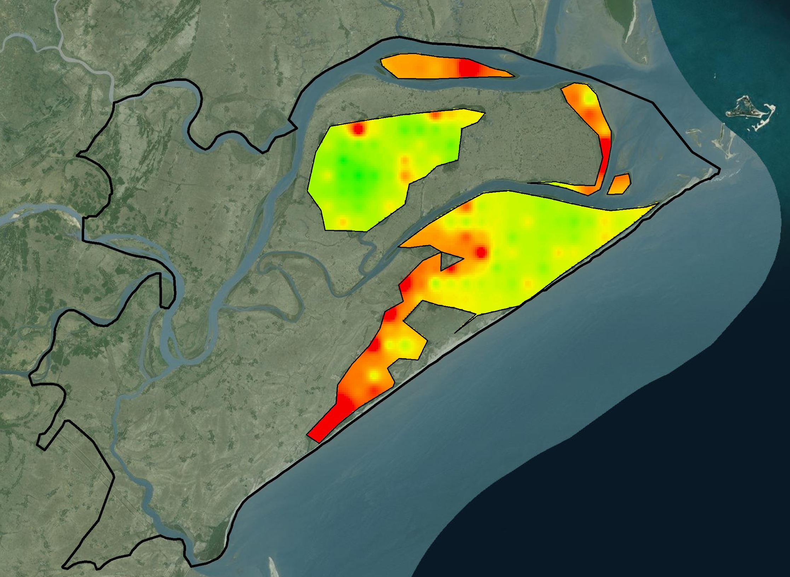
Results
Mean Annual CHL (2016)
Forecasted Mean Annual CHL (2050) (2050)
Kilometers
2
4
8
12
16
High: 39.6875
Low: 15.6421
Source: Eastern India Eco Forecasting III
Mangrove Boundary
Notes:
Here, we are showing the mean annual CHL of year 2016 and the map showing forecasted mean annual CHL for year 2050. As can be seen, the CHL has reduced in year 2050. The area that were initially high CHL areas, the greener areas tended to show hints of yellow and red colors showing reduction in CHL. Parts of cluster 1, 7 and 6 will noticeably be facing reduction in CHL in year 2050. The reduction in CHL was 25.96 % compared to mean annual GPP of year 2016.

Slide 18
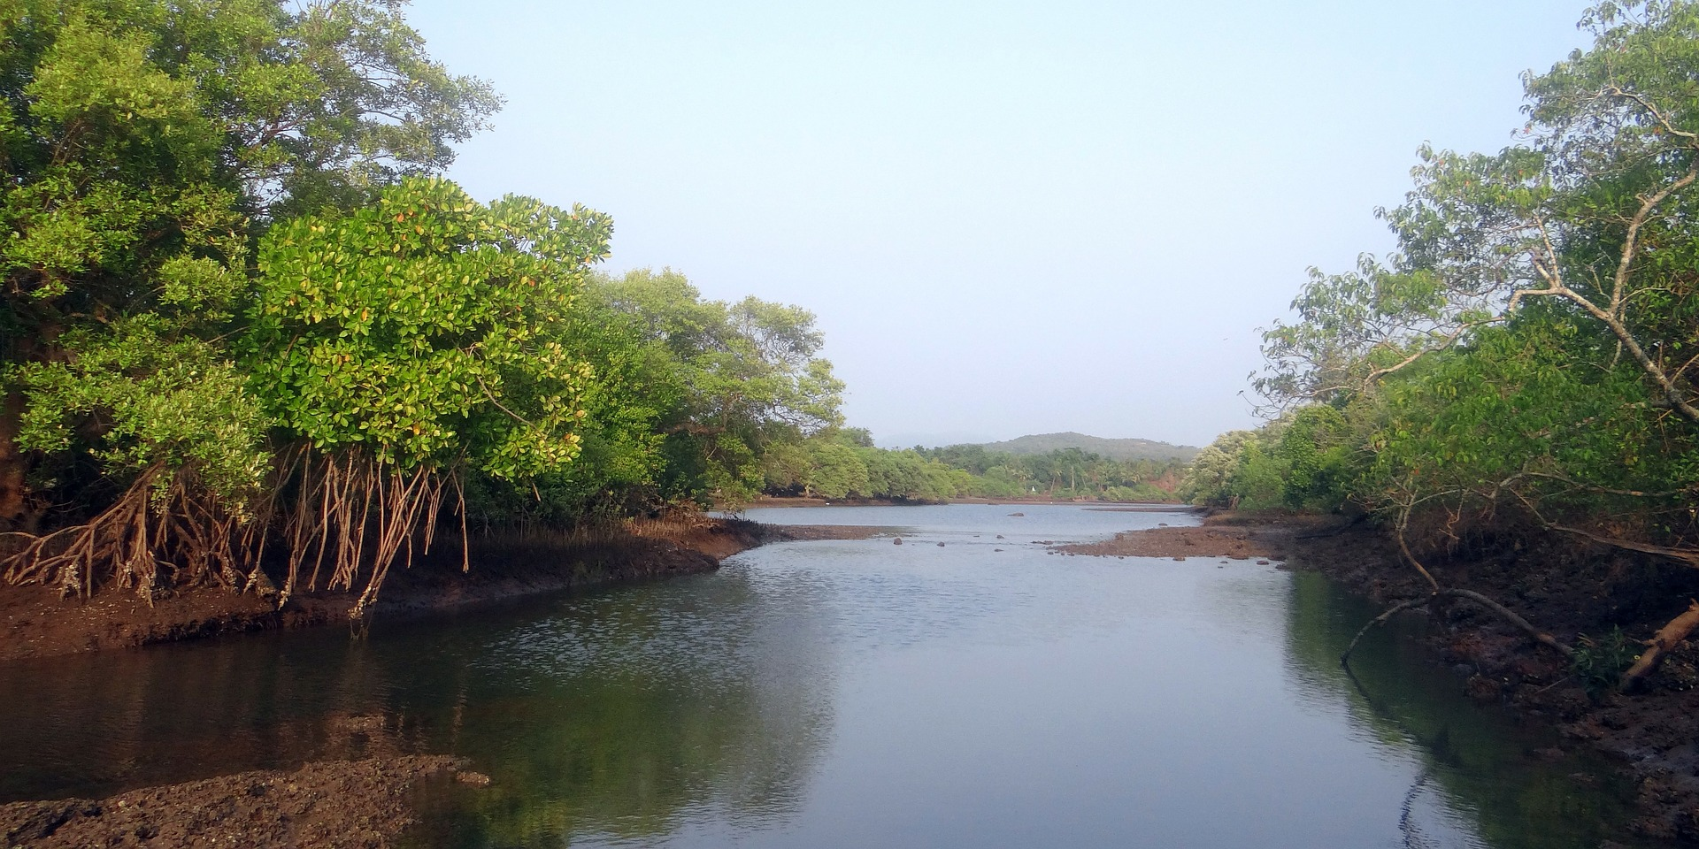
Conclusions
Despite conservation efforts, the current extent of dense mangrove in Bhitarkanika Wildlife Sanctuary is projected to decrease up to 10% by the year 2050.
A comparison between the classification for 1995, 2004, 2017 and the projected classification for 2050 indicates that dense mangrove extent decreased while open mangrove and agriculture extents increased.
The forecasted GPP, LAI and CHL values for year 2050 was 7.7%, 20.83% and 25.96% less respectively compared to the mean annual value for 2016.
By 2050, patches of mangrove along the south-west and northern coast of Bhitarkanika Wildlife Sanctuary are projected to decrease; and corresponding area are projected to decrease in GPP, LAI and CHL as well.
Image Credit: Sarangib, Pixabay

Slide 19
Acknowledgements
Advisors
Dr. Deepak Mishra, University of Georgia Department of Geography
Partners
Dr. Gurdeep Rastogi, Senior Scientist, Wetland Research and Training Center
Others
Dr. Marguerite Madden, UGA Lead Science Advisor

Slide 20
Additional Slides
What is Random Forests algorithm?
Random Forests is a machine learning technique that is being increasingly used for image classification of percentage tree cover and forest biomass (Horning 2010).
The Random Forests algorithm is good for dealing with outliers in training data.
It calculates classification error using one third of the training data (out-of-the-bag samples) while the remaining two thirds of the data is used to build the Random Forests Model (Horning 2010).
Random Forests provides and fast and higher accuracy compared to other well-known classifiers for remotely sensed data (Gislason et al., 2006).
For more information see paper: Horning, N. (2010). Random Forests: An algorithm for image classification and generation of continuous fields data sets. New York.

Slide 21
Additional Slides
What is MLP?
Multilayered Perceptron (MLP) Neural Network is used to empirically model each of the land cover transitions, Dense Mangrove to Open Mangrove and Open Mangrove to Agriculture that will be used to predict future mangrove extent
The MLP Neural Network selects random samples of pixels that went through each transition you are modeling and pixels that could have gone through each transition but did not
Half of the sample pixels are used to train the model and the other half will be used to test how well the model is doing at predicting change
The MLP is creating a multivariate function that can predict the potential for a pixel to transition based on the values of the driver variables for that pixel. The model produces an accuracy of how well the driver variables can predict change
The MLP produces a transition potential image that describes the probability that a transition will occur in the landscape and is used to predict future Land-cover change
For more information: Eastman, J. Ronald. "TerrSet manual." Accessed in TerrSet version 18 (2015): 1-390.

Slide 22
Additional Slides
Land Cover Gains and Losses

