Slide 1
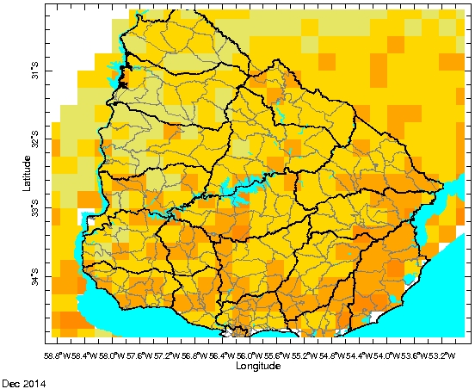
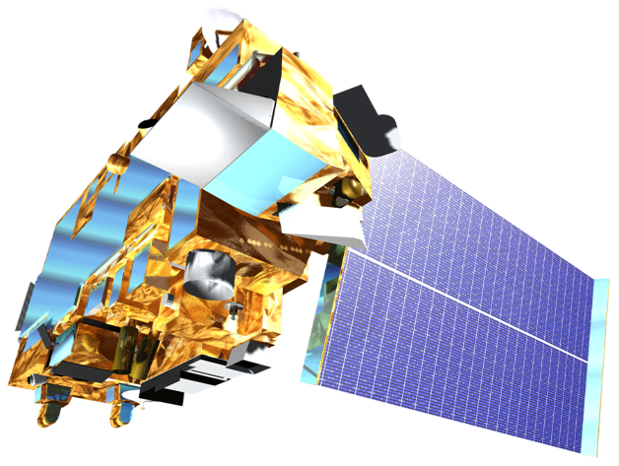
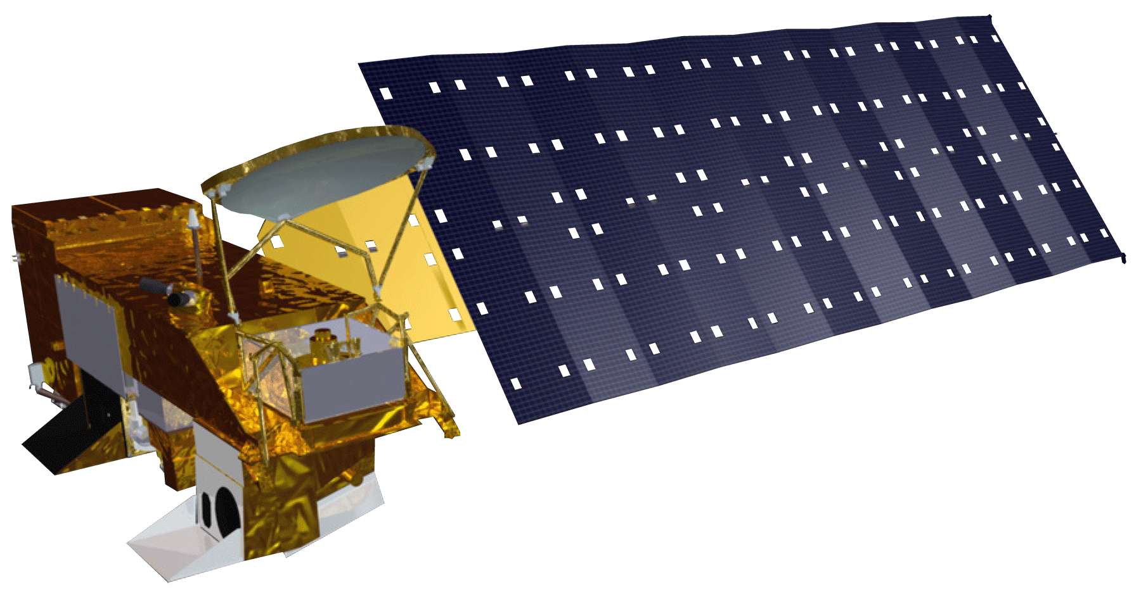
Uruguay Agriculture III
Deconstructing a drought severity index based on NASA earth observations into its principle components for better end-user assessment of the driving factors behind local scale drought
Jerrod Lessel (Project Lead), Andrew Kruczkiewicz
International Research Institute for Climate and Society
Abstract
Objectives
Keep this blank for now.
Body text point size should be at least 24.
Caption text point size should be at least 16.
Test whether a different scaling method would resolve the end-user described issue of over estimating the degree of drought severity from the drought severity index (DSI)
Create ternary diagrams for the principle components of the DSI in order to better understand the driver of the drought
Study the relationship of the DSI components displayed within the ternary diagrams to help understanding of the drivers of specific drought types
Study Area
Methodology
Test
Change scaling method in the DSI from (CMORPH-CMORPH_{min})/(CMORPH_{max}+CMORPH_{min}) to (CMORPH-CMORPH_{min})/(-CMORPH_{min}+CMORPH_{min})
Create
Present ternary diagrams of the principle components of the DSI in order to see how the three variables of the DSI impact drought in the region of interest
Study
Research the outputs of the ternary diagrams in order to better understand how to read the diagrams to help end-users use the results for better decision making
Study Period: January 2003 through December 2014
Earth Observations
Terra
Aqua
Conclusions
Results
Forthcoming in final draft
Use bullets.
Use complete sentences with periods.
Forthcoming in final draft
Use images.
Make sure that it has some sort of flow, that it makes sense. Show your results in a logical order.
No bullets.
Team Members
Project Partners
Acknowledgements
Jerrod Lessel
Andrew Kruczkiewicz
INIA
Instituto Nacional de Investigacion Agropecuaria
Photo Forthcoming
We wish to give special thanks to our outstanding science advisor Dr. Pietro Ceccato for his counseling and insights throughout the term. We also wish to thank Walter Beathgen and Guadalupe Tiscornia for all of their extensive help throughout the term.
International Research Institute for Climate and Society

