Slide 1
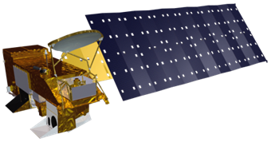
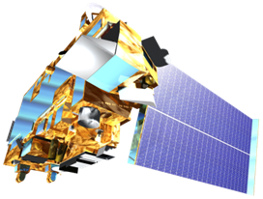
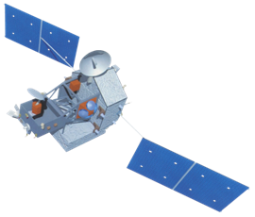
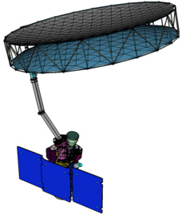
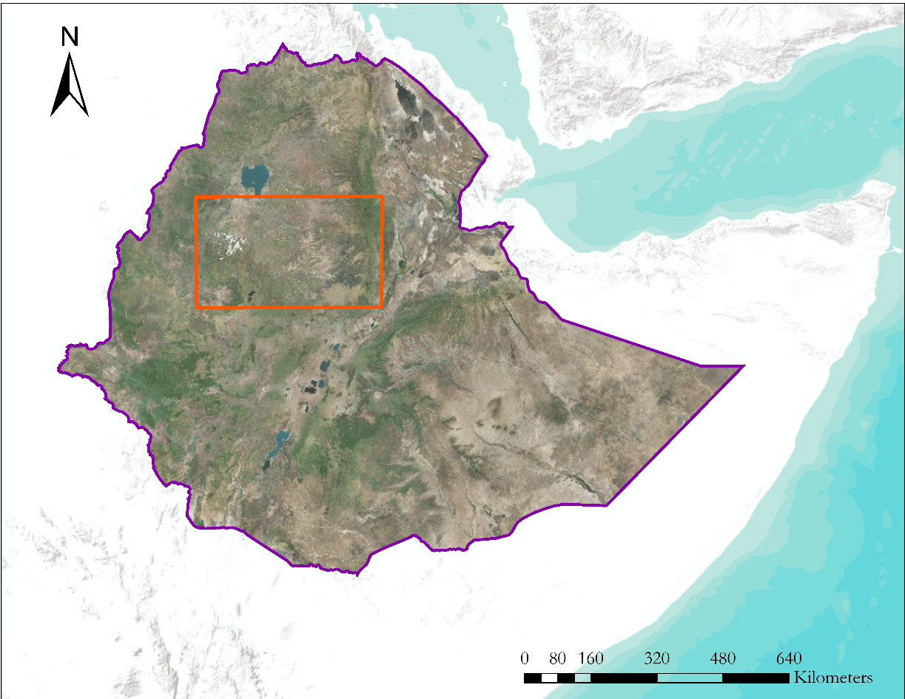
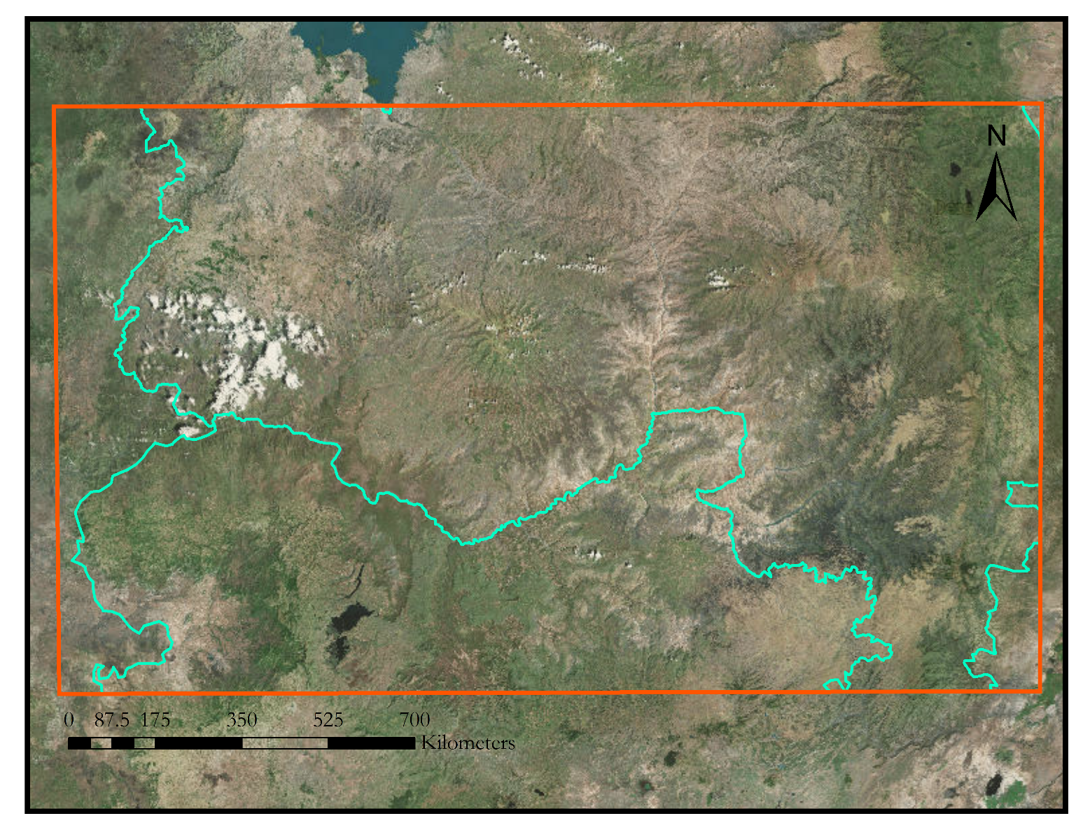
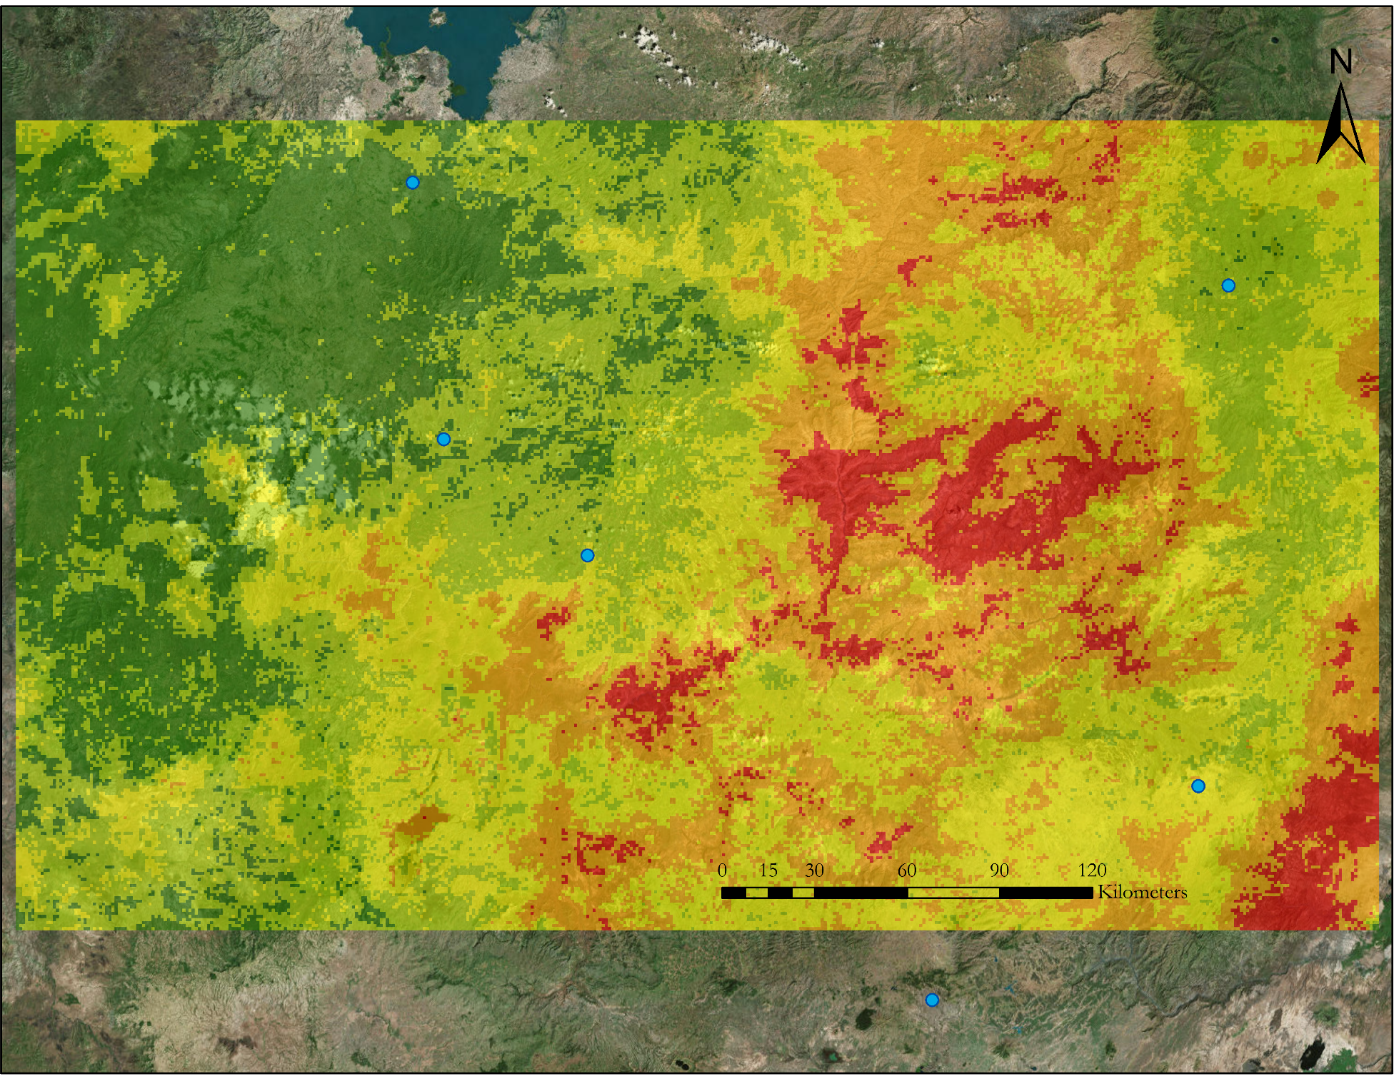
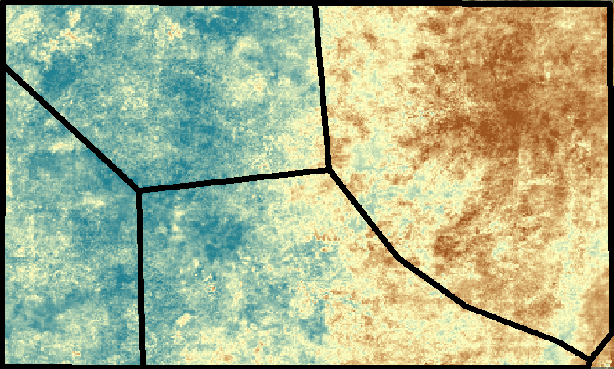
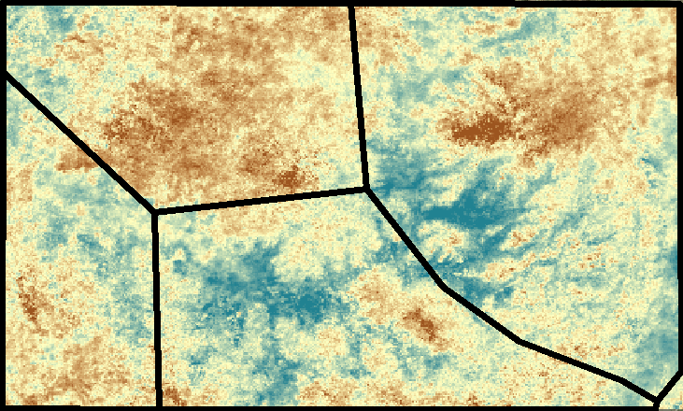
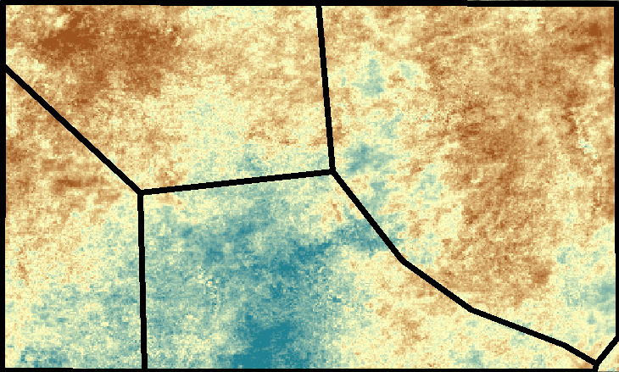
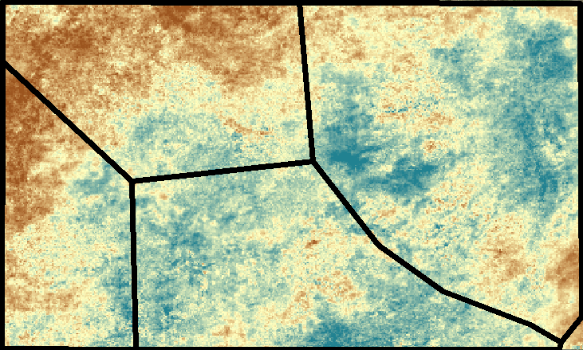
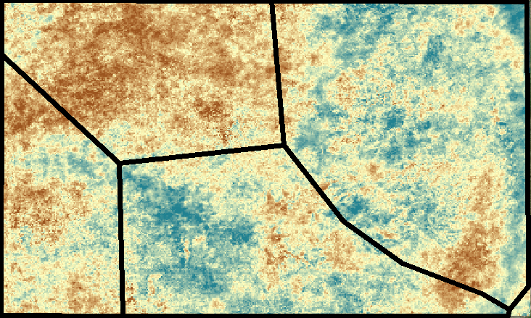
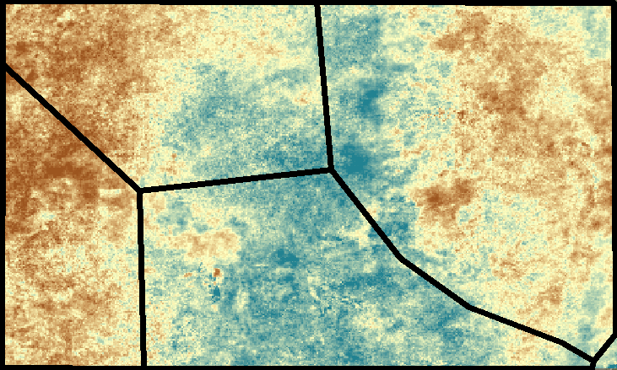
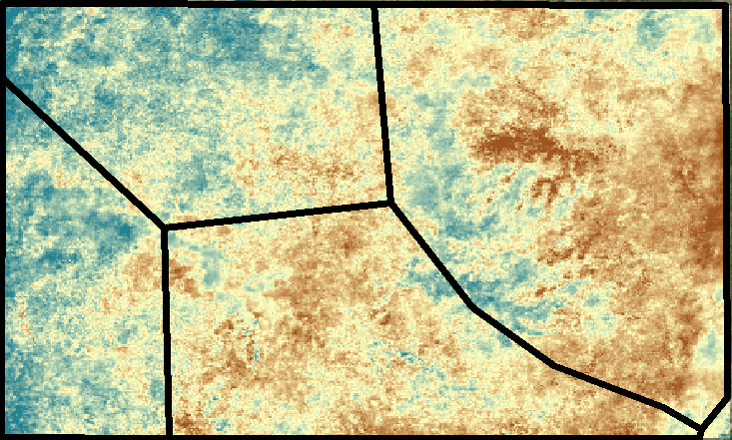
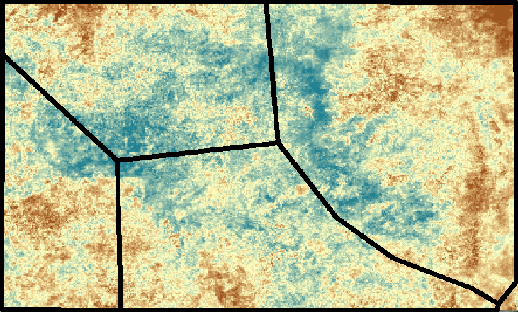
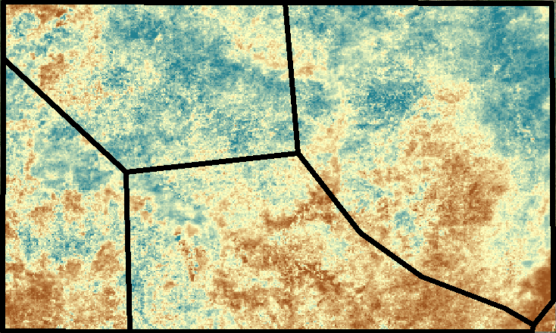
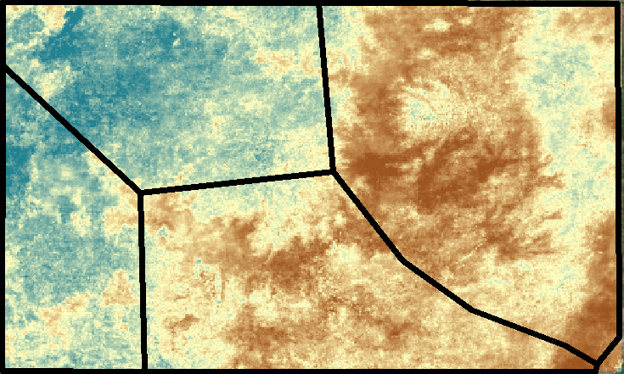
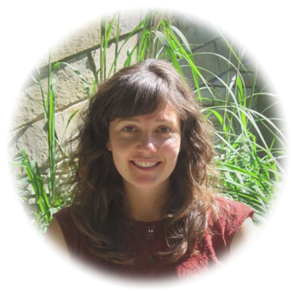
Utilizing NASA Earth Observations to Assess Agricultural Drought Severity in Ethiopia and Provide a Tool for Monitoring Drought at the Regional Level
Abstract
Ethiopia has recently been affected by several droughts, with the latest 2015 drought being the worst in half a century. Agriculture, being the predominant sector of the country’s economy, is rain-fed and is therefore most susceptible to droughts. Developing a reliable remotely sensed tool that incorporates a combination of drought-related parameters can help in better detection of drought events with respect to their spatiotemporal extent, duration and severity. This project implemented a scaled drought index utilizing NASA’s Terra Moderate Resolution Imaging Spectroradiometer (MODIS), Tropical Rainfall Measuring Mission (TRMM) and Global Precipitation Measurement (GPM) Integrated Multi-satellite Retrievals for GPM (IMERG) data to assess drought at a regional scale over the last 10 years. The index maps and decision support tools were provided to the project partners to supply timely information for humanitarian aid, and to build their capacity to monitor droughts in the future.
Objectives
Earth Observations
Develop a scaled drought index to characterize drought conditions
Analyze drought severity and spatiotemporal variation across the study area
Create tutorials for partner organizations to build their capacity to monitor drought in the future
Terra Moderate Resolution
Imaging Spectroradiometer
(Terra MODIS)
Aqua Moderate Resolution Imaging Spectroradiometer
( Aqua MODIS)
Tropical Rainfall
Measuring Mission
(TRMM)
Soil Moisture Active Passive
(SMAP)
Study Area
Yemen
Ethiopia Boundary
Methodology
Study Area Boundary
Data Acquisition
Vegetation index and land temperature from MODIS
Rainfall from TRMM
Soil moisture from SMAP
Data Processing
Resample data
Aggregate to monthly values
Scale values
Weight drought parameters
Combine parameters
Data
Analysis
Create drought index
Analyze spatial variation across climate zones
Compare results to soil moisture trends
ETHIOPIA
Regional Boundary
Somalia
Benishangul -
Gumuz
Kenya
Amhara
Oromia
Addis Ababa
ETHIOPIA DISASTERS
Results
2015 Drought Classification Map
Drought Index Time Series Across Climatic Zones
Bahir Dar
2006
2007
2008
2009
Area Under Extreme - Severe Drought
total area: 120,000 km²
Dese
III
I
II
IV
2011
Finote Selam
2010
2012
2013
Debre Mark’os
2014
2015
Climatic Zones:
I. North West Highlands
II. North East Highlands
III. South West Rainforest
IV. Central Highlands
Debre Birhan
Drought Index and Soil Moisture Comparison
Drought Index
Extreme drought
Moderate drought
Addis Ababa
High: 1 (wettest)
North-West Highlands
Severe drought
Abnormally dry
No drought
Low: 0 (driest)
South-West Rainforest
Cities
Central Highlands
Conclusions
North-East Highlands
The drought index captured the severity and extent of drought from 2006-2015 across the study area.
In 2009 the NW Highlands and SW Rainforest experienced severe drought whereas in 2015 the NW Highlands and central Highlands experienced severe drought.
The drought index and SMAP soil moisture values showed similar trends for the 2015 growing season.
June
July
Aug
Sep
Oct
Nov
Project Partners
US Department of State Office of Space and Advanced Technology (OES/SAT) and Humanitarian Information Unit (HIU)
Institute of Geo-Information and Earth Observation Sciences (I-GEOS)
USGS North Central Climate Science Center
Team Members
Acknowledgements
We would like to thank Dr. Paul Evangelista, Dr. Amanda West, Ryan Anderson, and Brian Woodward of Colorado State University.
This material is based upon work supported by NASA through contract NNL11AA00B and cooperative agreement NNX14AB60A. Any mention of a commercial product, service, or
activity in this material does not constitute NASA endorsement. Any opinions, findings, and conclusions or recommendations expressed in this material are those of the author(s) and do not necessarily
reflect the views of the National Aeronautics and Space Administration and partner organizations.
.
Amandeep Vashisht (Team Lead)
Sarah Carroll
Rebecca Girma
Bethlehem Astella
Cara Steger
USGS at Colorado State University – Fall 2016

