Slide 1
Texas and Arizona Ecological Forecasting
Utilizing NASA Earth Observations to Monitor and Manage Ocelot Habitat Loss
Daryl Ann Winstead (Project Lead)
Christina Fischer
Amberle Keith
Kaushik Narasimhan
Notes:
Hello, my name is Daryl Ann Winstead.
I’m Christina Fischer.
I’m Kaushik Narasimhan.
And I’m Amberle Keith.
Our project is the Texas & Arizona Ecological Forecasting looking at Ocelot habitat. (Or something like this).

Slide 2
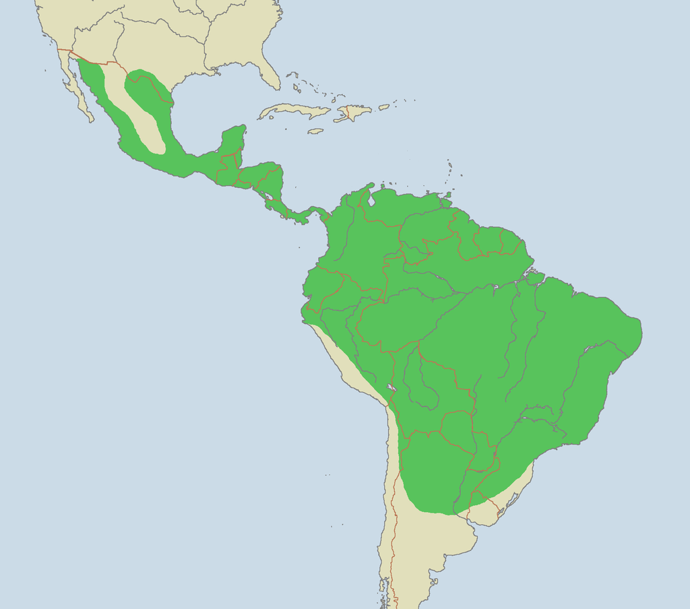
Background
Large historical range
Fewer than 100 ocelots in the United States
Largest remaining populations exist in refuges & in private ranches in southern Texas
Source: Brion Vibber, Wikimedia Commons
Notes:
The original range for ocelots extended from Argentina into Arizona, Texas, Louisiana, and Arkansas. The map here displays current range for ocelots in green. It is estimated that there are fewer than 100 ocelots left in the United States. Most of the remaining populations primarily exist on refuges and private ranches in southern Texas.
"Ocelot range". Licensed under CC BY-SA 3.0 via Wikimedia Commons - https://commons.wikimedia.org/wiki/File:Ocelot_range.png#/media/File:Ocelot_range.png
Laguna Atascosa National Wildlife Refuge (LANWR), surrounding wilderness refuge areas, and private ranchers are primarily responsible for conservation of remaining populations.

Slide 3
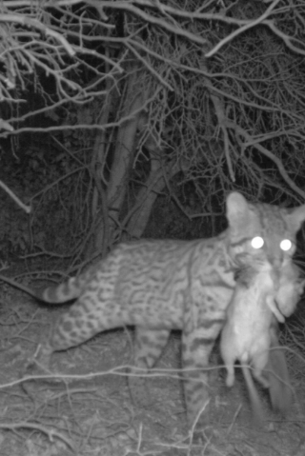
Background
Prefer dense, closed canopy thornscrub communities
Solitary & territorial
Small, yearly litters with long gestation period
Two subspecies: L.p. albescens in Texas & L.p. sonoriensis in Arizona
Source: USFWS
Notes:
There are two subspecies of ocelots in the United States: (INSERT FULL NAMES HERE!). The subspecies are related to congeners in different Mexican populations. These cats are prefer dense, closed canopy that is over 90% canopy cover, dense thornscrub communities that consist of species like honey mesquite. Ocelots, like many species of cats, are solitary and territorial. They are also elusive and nocturnal. Males maintain larger territories encompassing smaller female territories. Their litter sizes tend to be small of 1-2 kittens(?) have a long gestation period. The reproductive strategy for the ocelot makes them vulnerable to outside pressures.
Image from the USFWS.

Slide 4
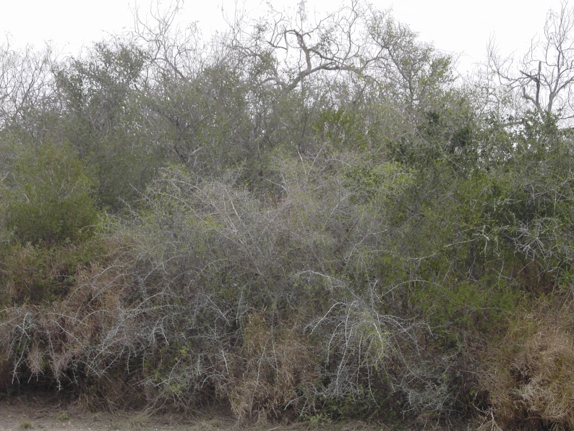
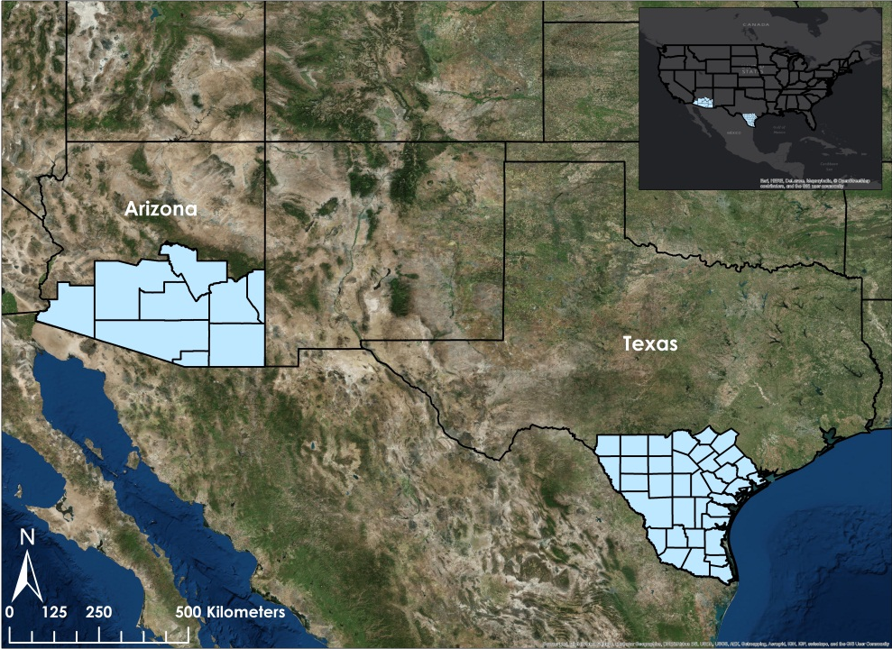
Study Area & Period
South Texas and Arizona
January-March encompasses the dry season for these regions
Years: 1996-2014
Thornscrub
Source: USDA
Source: ArcGIS Online Baselayers
Notes:
The study area for this project was south Texas and south Arizona. Data were collected from 1996, 2005, and 2014 in Jan-Mar, +/- a month for cloud cover. The months of January to March were selected so as to encompass the dry season for both regions. The dry season was chosen for a number of reasons. 1) It reduced the amount of cloud cover when collecting the data 2) The dry season is a difficult time period for the ocelot. The team wanted to assess the habitat conditions when the preferred vegetation was at its least extent. The years of 1996, 2005, and 2014 were select so as to have records how landcover has changed during this time. The time period also coincides with when Landsat data collection was consistent and when the regions were not in El Nino years.
The desired ocelot habitat in the United States is desert scrub, thornscrub, and dense canopy cover. The image on the left shows an example of thornscrub http://www.fsa.usda.gov/. (Image from the USDA).
Baselayer for the map is from ArcGIS Online base layers.

Slide 5
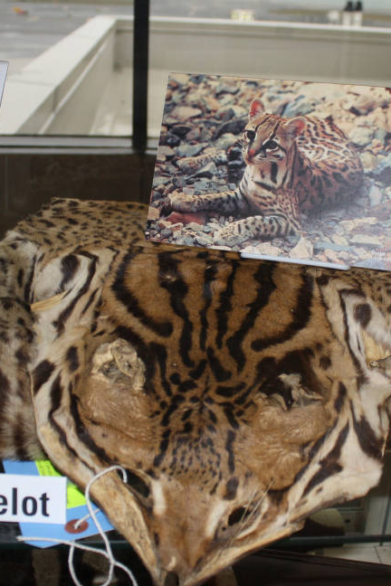
Community Concerns
Fastest growing counties in Texas contain ocelot habitat
95% of ocelot habitat has been destroyed
Remaining populations remain small & isolated
Road collisions significant threat
Privately-owned lands and partnerships with stakeholders vital to conservation
Source: USFWS
Notes:
There are 16 counties in southern Texas that represent the majority of ocelot habitat. These counties are among the fastest growing counties in Texas, specifically Cameron and Willacy counties, which are expected to grow by more than 80% in population (SOURCE?). Human encroachment and land conversion are the greatest pressures on ocelot habitat. It is estimated that 95% of the ocelot habitat has been destroyed.
Due to the reduced habitat, remaining populations are small and isolated. This has caused inbreeding depression, reduced reproductive success, and increasing competition from other mesopredators to have become bigger problems for the species. Inbreeding depression leads to a host of genetic issues, including lack of disease resistance, infertility, and expression of harmful genes.
The bobcat has an overlapping niche, but is much more of a generalist. Competition for food sources and territories may be overwhelming for an already taxed ocelot population.
One of the direct main threats to the cat are animal/vehicle collisions along roads. There have been an increased number of incidents in south Texas due to an increase in traffic in the region.
Currently, private lands on large ranches with prime ocelot habitat are a focus of conservation efforts and are vital for conservation efforts.
Image from the USFWS.

Slide 6
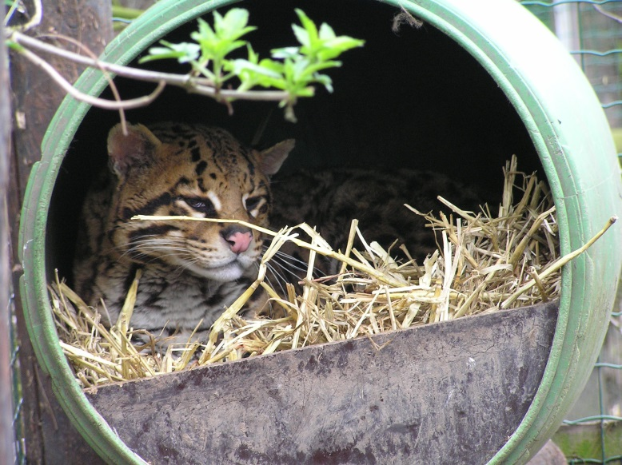
Project Partners
The Denver Zoo
South Texas Refuge Complex
Texas Department of Transportation
Pittsburg Zoo & PPG Aquarium
East Wildlife Foundation
Secretaria de Medio Ambiente y Rescusos Naturales (SEMARNAT)
Caesar Kleberg Wildlife Wildlife Research Institute at Texas A&M University-Kingsville
Source: Chordata-cmmonswiki, Wikimedia Commons
Notes:
For this project, we had a number of partners which included the Pittsburg Zoo & PPG Aquarium, the Caesar Kleberg Wildlife Research Institute at Texas A7M University-Kingsville, The Denver Zoo, the South Texas Refuge Complex, the Texas Department of Transportation, the Secretaria de Medio Ambiente y Rescusos Naturales (SEMARNAT), and the East Wildlife Foundation.
Photo from Wikimedia Commons: https://commons.wikimedia.org/wiki/File:Ocelot_in_Uilen-_en_Dierenpark_De_Paay.JPG

Slide 7
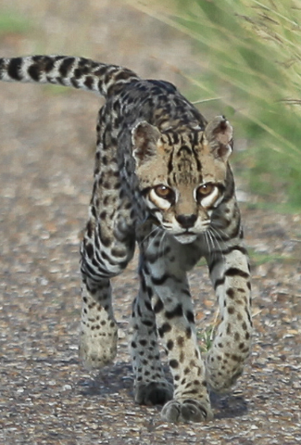
Objectives
Identify areas of potential ocelot habitat for conservation purposes
Study impact of urban and agricultural growth on ocelot habitat
Analyze impact of road development on ocelot populations
Source: USFWS
Notes:
The objectives for this project were to:
•Identify areas of potential ocelot habitat for conservation purposes
•Study impact of urban and agricultural growth on ocelot habitat
•Analyze impact of road development on ocelot populations
Image from the USFWS.

Slide 8

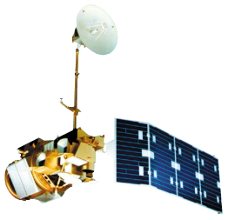

NASA Satellites & Sensors
Landsat 8
Operational Land Imager
Land Cover Classification
Landsat 5
Thematic Mapper
Land Cover Classification
Terra
MODIS & ASTER
NDVI & Stream Network
Notes:
Landsat 8 Operational Land Imager and Landsat 5 Thematic Mapper data were downloaded from USGS GloVis and used in ArcMap 10.2.1 to derive land cover classifications. Terra MODIS data were downloaded using a python package provided by the DEVELOP program and used to derive Normalized Difference in Vegetation Index. Terra Aster-based Global Digital Elevation Model data were downloaded from USGS Earth Explorer and used to derive stream networks within the study area.

Slide 9
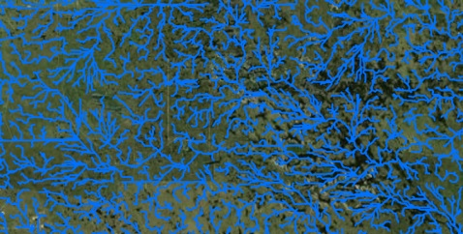
Methodology
NDVI
Percent Cover
Suitable Habitat
Landcover Classification
Road Hazards
Road Network
Stream Network
Notes:
Land cover classifications were derived during 1996, 2005, and 2014. Normalized Difference in Vegetation Indices (NDVI) were derived using Terra MODIS data and used to error check the areas of vegetation for the land cover classification in years 2005 and 2014. The land cover classification layers were used in a time series in order to assess land use and land cover change – which aided in producing the Habitat Percent Cover Map. The land cover classification layer for 2014, along with in situ data, was used in Princeton Maximum Entropy model in R software which derived outputs which aided in the use of Fuzzy Logic in ArcMap 10.2.1 which then created the Habitat Probability Map. The Proximity Risk Map was then created by using multiband buffers which were then used to analyze at-risk roads.

Slide 10
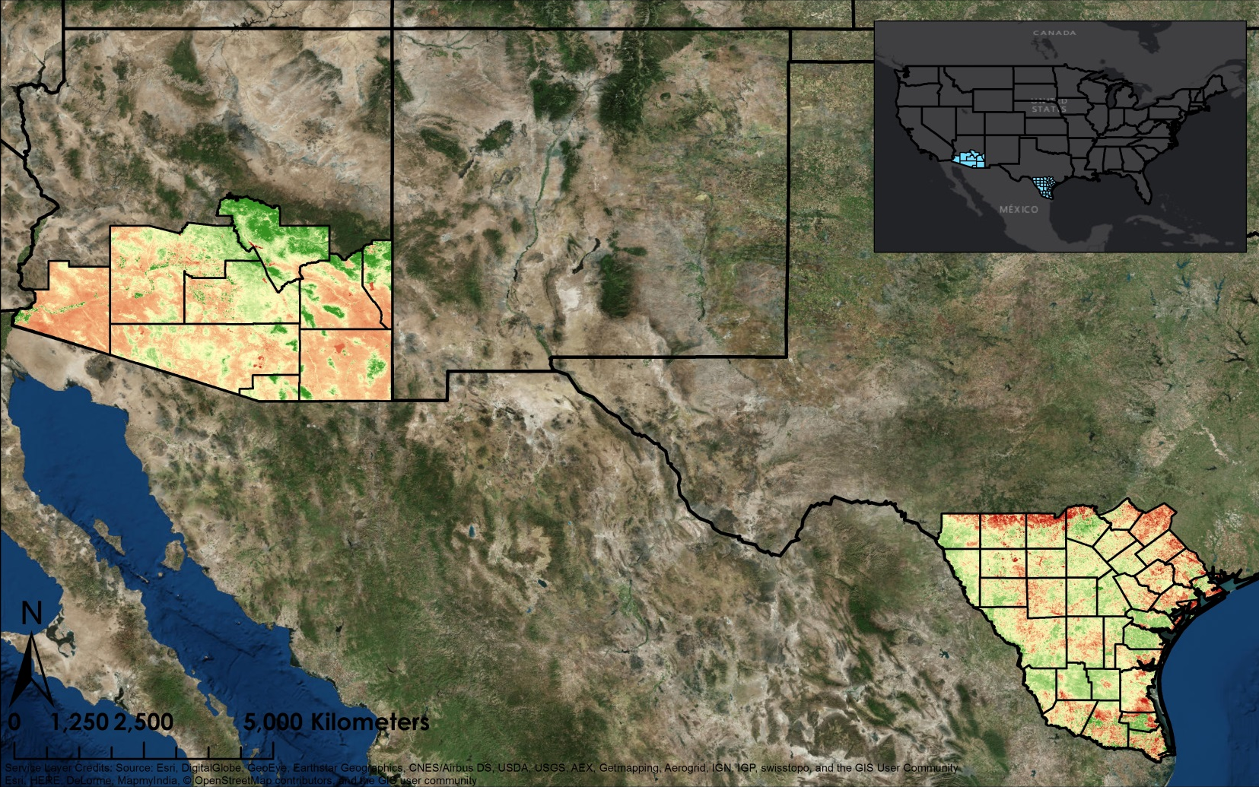

NDVI
Notes:
The first layer derived in order to perform the fuzzy logic and Maximum Entropy model was a Normalized Difference in Vegetation Index. This was created in ArcMap using the traditional (IR – Red)/(IR + Red) equation.

Slide 11
Hydrological Analysis
Stream Networks
Notes:
Another layer used in the fuzzy logic model was the hydrological analysis. Stream networks were derived from DEM data using the spatial analyst toolbox in ArcMap.

Slide 12
Land Cover Classification - 1996
Notes:
This show the land cover classification for 1996. The tan color is the scrub/shrub/grassland class that was focused on due to the ocelot preferring it. For each land cover classification layer, a minimum of 100 regions of interest were derived using polygons and then verified in google street view. A signature file was created from these regions of interest and used to run a Maximum Likelihood Classification in ArcMap 10.2.1.

Slide 13
Land Cover Classification - 2005
Notes:
This shows the land cover classification for 2005

Slide 14
Land Cover Classification - 2014
Notes:
Here is the land cover classification for 2014. This layer was used in the fuzzy membership tool in arcmap where it was scaled from 0 to 1.

Slide 15
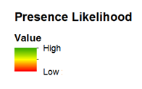
Maximum Entropy
Notes:
Here is the presence likelihood that was created in R Studio using the 2014 land cover classification and NDVI. Green depicts areas that a highly likely to have ocelots present and red depicts to have no ocelots present.

Slide 16
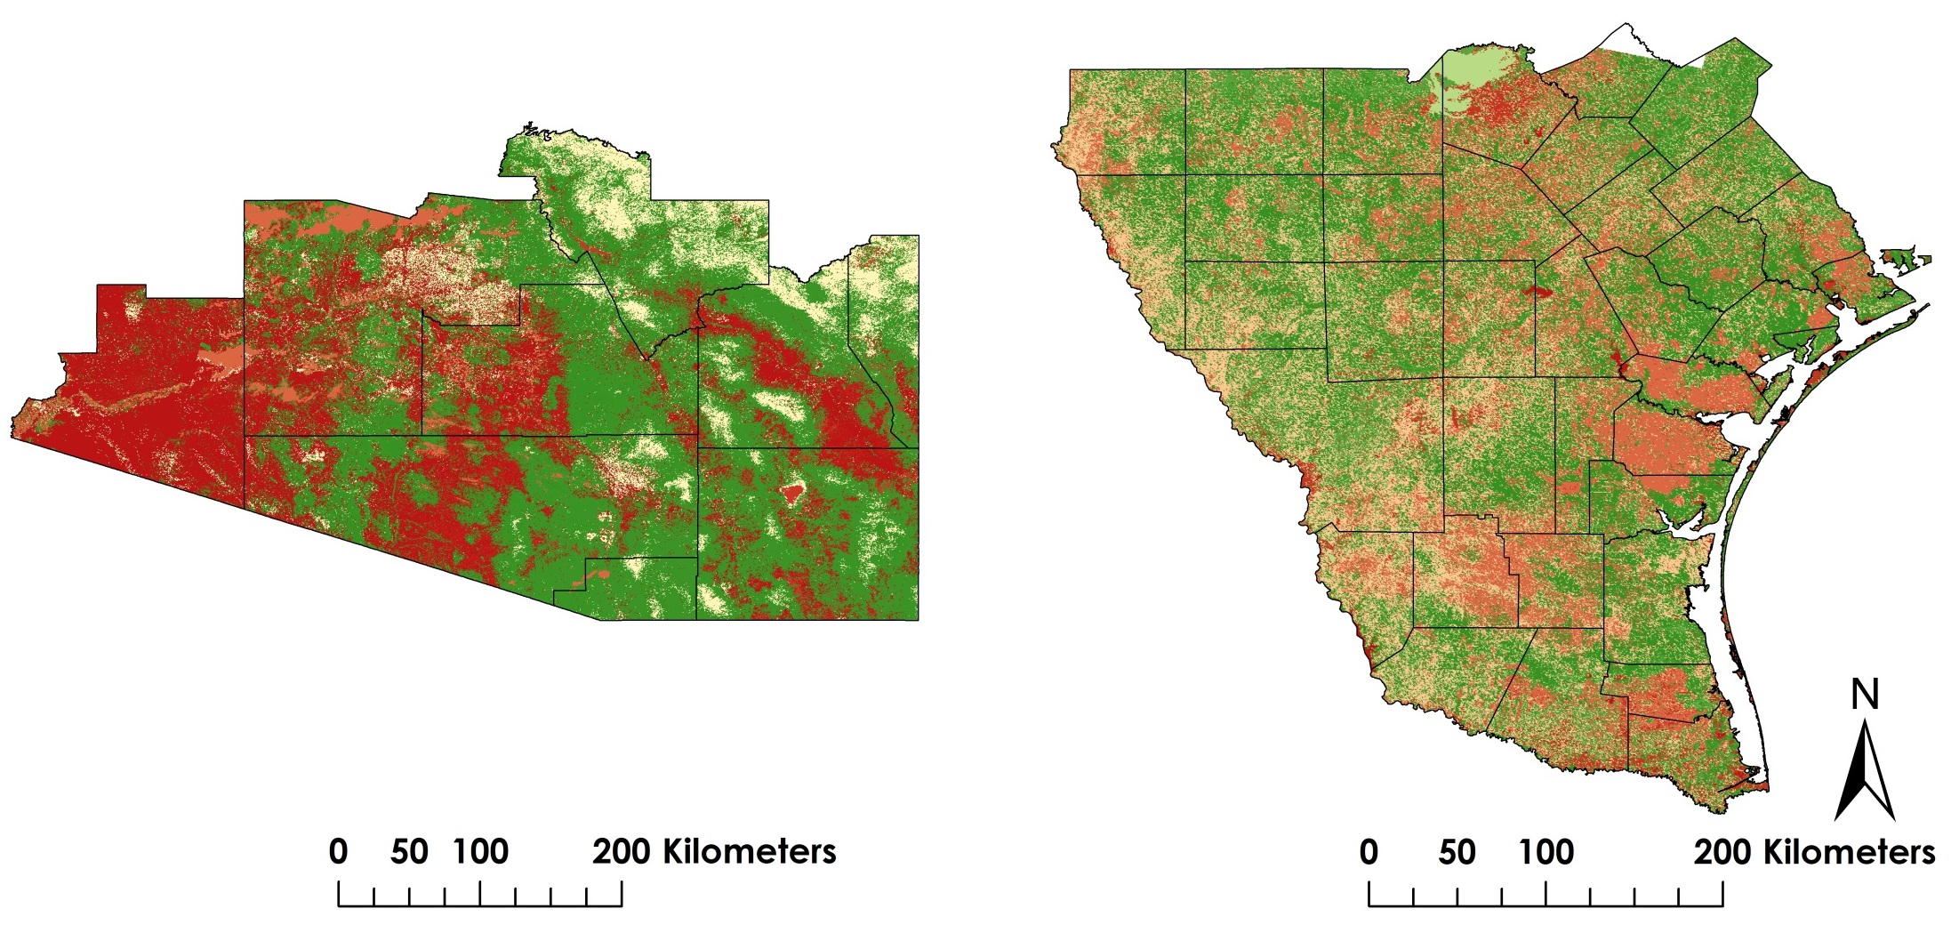
Results
Suitable Habitat Map
Most Suitable : 1
Least Suitable : 0
Notes:
After the Land Cover Classification and NDVI layers were scaled using the Fuzzy Membership Tool in ArcMap, they were then used in the Fuzzy Overlay Tool. This produced the Suitable Habitat Map where the most suitable areas for the ocelot are shown in green and the least suitable areas are shown in red.

Slide 17

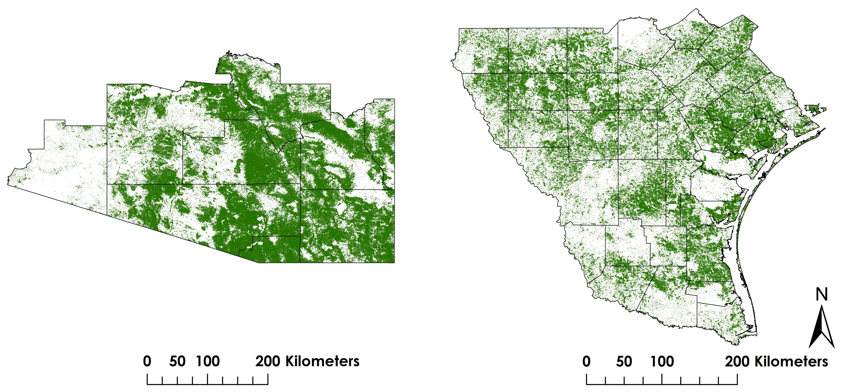
Results
Habitat Percent Cover Map
Suitable Habitat Area (km²) |  | Percent Cover
Texas | 38,772.6 | 36.2%
Arizona | 63,952.1 | 49.7%
Notes:
From that layer, the team pulled out the most suitable areas and accessed the current percent cover of habitat for the ocelot. The current percentages are 36.2 in Texas and 49.7 in Arizona.

Slide 18
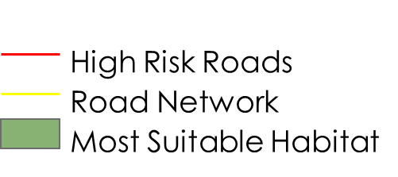
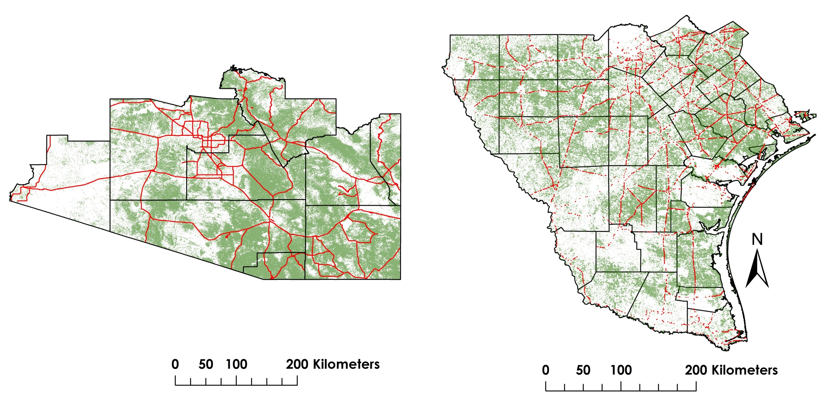
Results
Proximity Risk Map
Notes:
The intersect tool was then ran with the most suitable habitat layer and the road network layer which pulled out the high risk areas where road intersects with current or potential ocelot habitat.

Slide 19
Conclusions
Change in Habitat Coverage Over Time
Suitable Habitat Area (km²) |  | Total Area in Study Area (km²) | Percent Cover
2014
Texas | 38,772.6 | 107,226.8 | 36.2%
Arizona | 63,952.1 | 128,651.2 | 49.7%
2005
Texas | 54,511.3 | 107,226.8 | 50.8%
Arizona | 81,811.9 | 128,651.2 | 63.6%
1996
Texas | 47,745.7 | 107,226.8 | 44.5%
Arizona | 73,208.4 | 128,651.2 | 56.9%
Notes:
We concluded that ocelot habitat has decreased from 1996 to 2014 in both Texas and Arizona, with the largest decrease occurring from 2005 to 2014. Overall, Texas saw a decrease of 15% from 2005 to 2014 and Arizona had a 14% decrease in the same period.

Slide 20
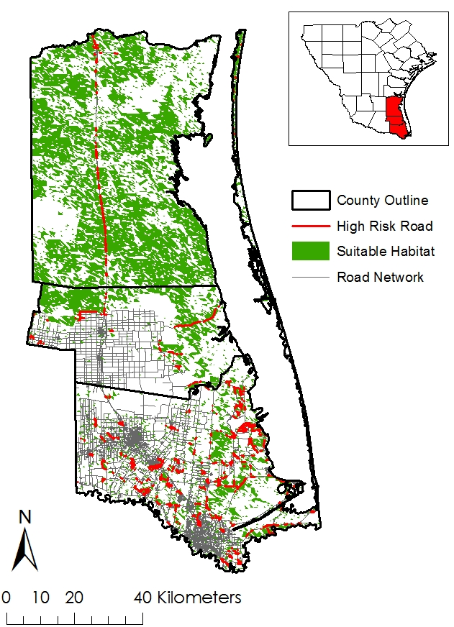
Conclusions
County | Road Risk (km)
Cameron | 335.6
Kenedy | 105.4
Willacy | 50. 1
Total Study Area | 2948.9
Notes:
The total length of road we determined to be at a high risk for ocelots amounted to almost 2950 km of road for the entire study area. A more detailed analysis of road risk was performed on 3 Texas counties. These counties were chosen because of their known ocelot populations. Cameron County (on the bottom) contains 335 km of road that intersects with ocelot habitat, Willacy County (above it) contains 50 km, and Kenedy County (on top) contains 105 km. These are the counties roads that the TX DOT should focus their efforts on for ocelot underpasses.

Slide 21
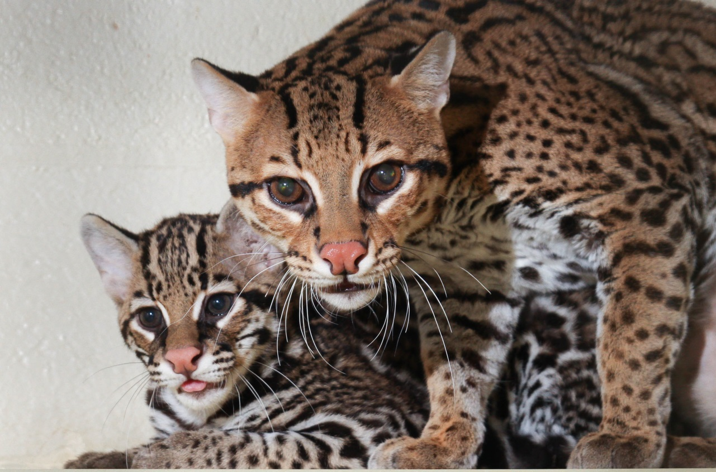
Source: Mark Dumont, Wikimedia Commons
Errors & Uncertainties
Limited point data
Ground verification
Land cover classification
Cloud cover
Spatial resolution
Habitat increase from 1996-2005
Notes:
Point data on exact ocelot locations was very limited to the team due to the information being sensitive. Ground-truthing will be needed to validate the results from this project. Land cover classification kept misidentifying unimproved roads in Arizona and marsh areas in Texas. Cloud cover in the landsat data posed a problem. The spatial resolution for Landsat and Terra were different and the Landsat had to be resampled to the same resolution as Terra to be used in our models. Habitat increases from 1996 – 2005.
Image from Mark Dumont, Wikimedia Commons

Slide 22
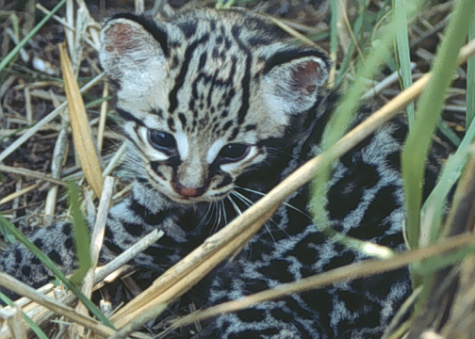
Source: USDA
Future Work
Expanding study area
Other endangered species
Ocelot subspecies
Notes:
Some future work for the project would be to expand the study area into the north coastal areas of Mexico and then through Central America and eventually into South America. Using similar methods to look into suitable habitat for other endangered species. Look into specific subspecies.

Slide 23
Advisors
Dr. Jeffrey Luvall, NASA at NSSTC
Dr. Robert Griffin, University of Alabama in Huntsville
Partners
Ken Kaemmerer & Dr. Joseph Gaspard, Pittsburg Zoo & PPG Aquarium
Dr. Michael Tewes & Dr. Humberto Perotto, Caesar Kleberg Wildlife Research Institute at Texas A&M University-Kingsville
Nanette Bragin, The Denver Zoo
Mitch Sternberg, South Texas Refuge Complex
Dr. John Young Jr., Texas Department of Transportation
Dr. Arturo Caso, SEMARNAT
Dr. Tyler Campbell, East Wildlife Foundation
Others
Timothy Klug, NASA DEVELOP
Notes:
The team would like to thank Drs. Jeffry Luvall and Robert Griffin for all of the support and guidance on the project. They would also like to thank all of their project partners for their support and expertise, especially Dr. Tewes for his assistance with the point data and Ken Kaemmerer for putting the team in touch with many of the partners for this project. Finally, the team would like to thank Timothy Klug for his assistance with python coding.

Slide 24
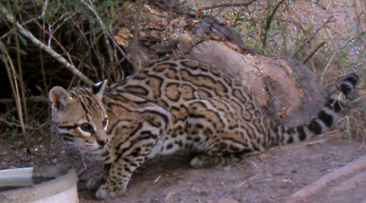
Questions?
Source: USFWS
Notes:
Are there any questions at this time?
Image from the USFWS.

