Slide 1
ASHEVILLE URBAN DEVELOPMENT II
Mapping Urban Heat to Support Cooling Initiatives and Climate Resilience Planning in the Greater Asheville Area
Kimberly S. Becerril
Sarah L. McMullen
Caleb V. Kluchman
Caroline M. Tintinger
North Carolina – NCEI Summer 2024
Notes:
Good afternoon! We are the NASA DEVELOP North Carolina NCEI urban development group. Our project is titled "Mapping Urban Heat to Support Cooling Initiatives and Climate Resilience Planning in the Greater Asheville Area". My name is Kim, the project lead, and this is Caleb, Sarah, and Caroline.

Slide 2
Background – Urban Heat Islands (UHI)
Causes for UHIs
Lack of vegetation
Anthropogenic activities
Urban landscape and design
Urban
Temperature
Suburban
Rural
Notes:
Urban heat islands (UHI) are urbanized areas or cities that experience higher temperatures than adjacent rural areas (EPA, n.d.). The variation between urban and rural land surface temperatures (LST) is caused by four principal factors: cities’ low albedo, lack of vegetation, anthropogenic activities, and urban design (Nuruzzaman et al., 2015; Stache et al., 2022). First a lack of vegetation increases heat. Evapotranspiration from vegetation and soil further lower temperatures (Qiu et al., 2013). Therefore, in cities with minimal natural, vegetative cover, temperatures rise. Heat also increases in urban areas due to anthropogenic activities including transport and industry emissions, lighting, and air conditioning (Tong et al., 2021). City design can augment heat by blocking wind flow and trapping reemitted insolation (Phelan et al.). These factors create UHIs that increase temperatures by 0.5°C to 4°C during the daytime than in surrounding rural areas (EPA, n.d.).
----------Image Information Below----------
[Image displaying temperature in different types of regions]
Image Credit: Image created by project author, Caroline Tintinger, in Canva

Slide 3
Background – Effects of UHIs
Environmental and human health implications
Implications are uneven: hotspots
Spatial environmental injustice
Visualization of Land Surface Temperature in Asheville, NC
Image Credit: Darcy Gray, Amiya Kalra, and Amy Kennedy
Notes:
UHIs result in copious environmental, health, and economic consequences. Environmentally, temperatures increase, water quality and quantity decline, and air pollution increases (Phelan et al., 2015). Increased temperatures, and the associated decline in environmental quality, threaten human health causing increases in heat stress, heat-related illnesses, and morbidity (Tong et al., 2021). Although these adverse effects occur ubiquitously across UHIs, the severity of these effects is uneven. Hotspots are areas where severe land surface temperature (LST) is compounded by low albedo and the lack of evapotranspiration (Tong et al., 2021).
Socially vulnerable populations are significantly more likely to live in hotspots. These are heat-vulnerable communities (Mitchell & Chakraborty, 2015; Tong et al., 2021). Discriminatory government practices and urban planning, such as redlining, promote the spatial correlation between vulnerability and heat resulting in neighborhoods lacking vegetation or heat-resistant infrastructure (Swope et al., 2022). In UHI hot spots, these heat-vulnerable communities have high heat exposure, limited capacity to adapt to high temperatures, and notable heat-related health risks caused by socioeconomic and demographic factors (Reid et al., 2009; Bao et al., 2015; Shahmohamadia et al., 2015).
----------Image Information Below----------
Image Credit: Gray, D., Kalra, A., & Kennedy, A., members of the NASA DEVELOP 2019 Fall Asheville Urban Development I project
Image Source: https://develop.larc.nasa.gov/2019/fall/AshevilleUrban.html

Slide 4
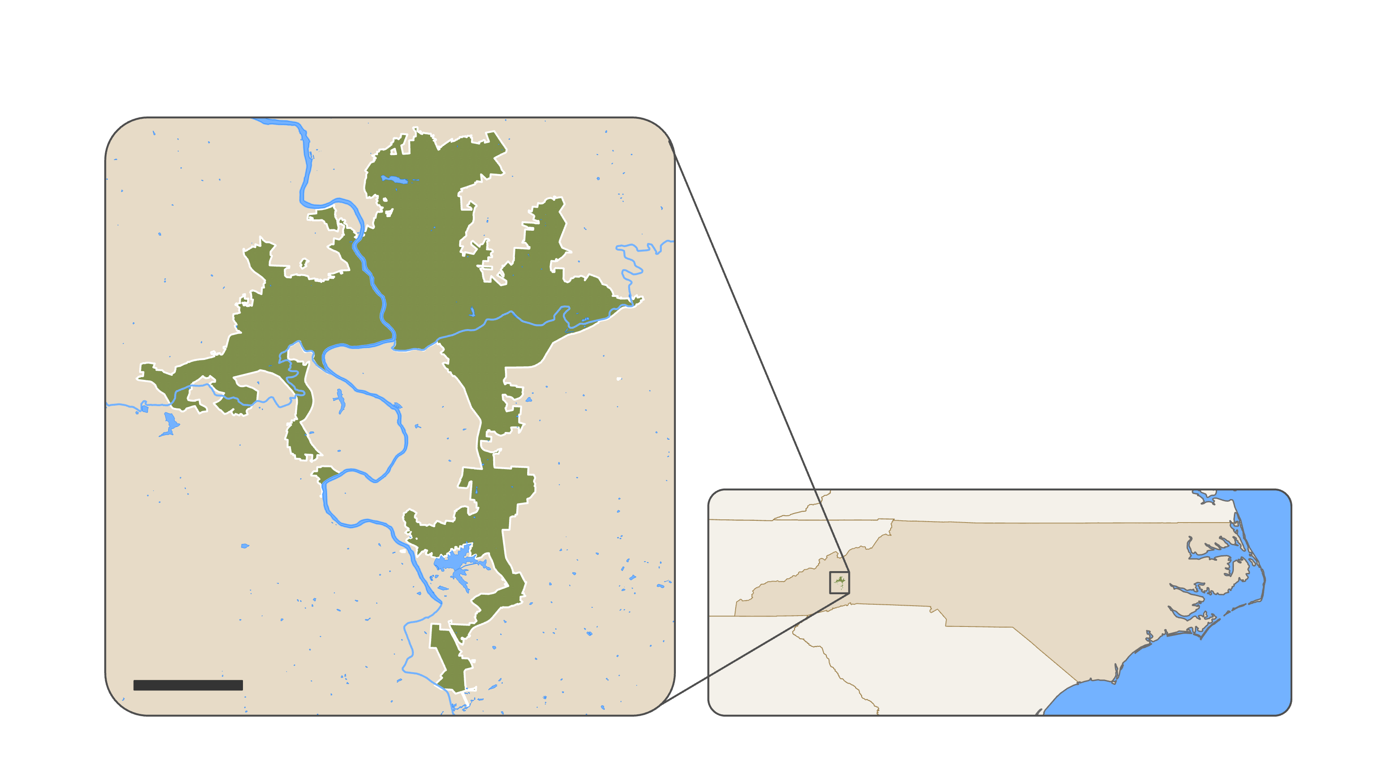
Study Area and Period
Study Area Asheville, NC
Study Period 2019 - 2023
Asheville - Study Area
North Carolina
Bodies of Water
Asheville
NORTH CAROLINA
NORTH CAROLINA
5 km
Basemap Credit: State of NC, U.S. Census
Notes:
The study area of Asheville, North Carolina.
Asheville is in western North Carolina within the southern Appalachian Mountains in a humid temperate climate. This midsized city has an area of 117.2 km, and a population of 95,000 as of 2023, and is the most populous city in WNC (U.S. Census Bureau, n.d.).
The project's study period is between 2019 and 2023.
----------Image Information Below----------
[Map displaying Asheville, NC]
Image Credit: Image created by project authors in ArcGIS Pro

Slide 5
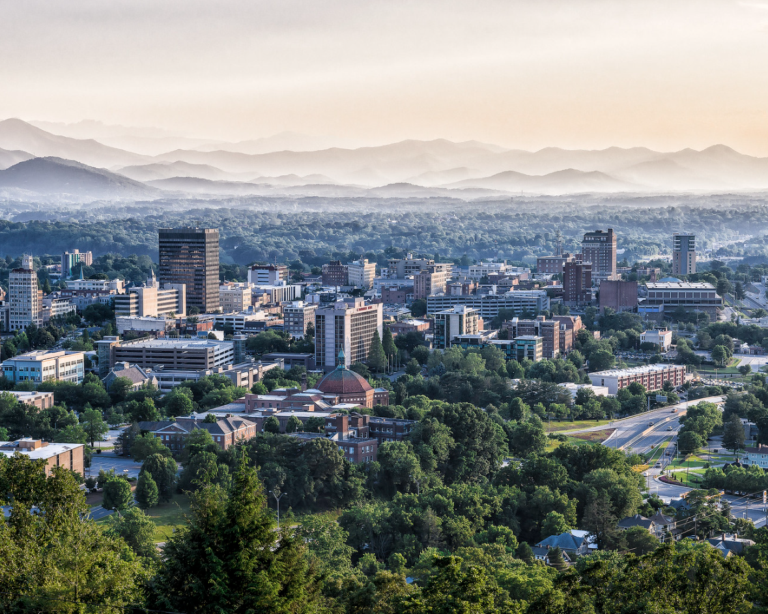
Asheville Community Concerns
Population Increase
Tree cover decline
Infrastructure expansion
Climate change intensification
Asheville UHI Consequences
Environmental degradation
Social vulnerability to heat
Asheville UHI Influences
Image of Asheville, NC
Image Credit: Ken Lane
Notes:
Why do this project?
Asheville saw a population increase of over 40% in the last 35 years (U.S. Census Bureau, n.d.). With the city’s population increase, tree cover has declined by an estimated 6.4% since 2008, indicating a loss in the city’s cooling ability (The City of Asheville, 2019). Increased population, reduced tree cover, infrastructure expansion, and climate change intensification prompted further temperature increases, making Asheville an apt city of study.
As a result of this, Asheville's urban temperature rose, which can result in environmental degradation and increased stress for vulnerable populations/communities.
Add info here
----------Image Information Below----------
Image Credit: Ken Lane
Image Source: https://www.flickr.com/photos/kenlane/11109519276/in/photolist-hVHc2N-dCSrEb-8U33RA-Suip3g-5qCSno-8AbYSr-8APygD-8Afdry-9t7m2E-8CNBB3-awoKd9-QHo9uh-a7TUCx-edzdqg-66GnpH-9fp9UB-edzdBV-7J8jNn-edEVbj-bjNtWy-Sysxsg-23SvCJN-awm3x4-edz9vz-7J7hi4-7JPD9v-9fqWfv-23SvC6J-2sCFTF-SGacnC-A4Ue5W-6JEn6a-Sysw3n-Uhhyeq-9BiHcu-82Neac-deJMd1-5TJGzR-oswrEq-TGaEwK-TQ1BiA-7wVfPm-qjgkwn-ekziyN-biUnKZ-pcPE1q-2WxVNF-bwi629-TDJCss-5yR3X6 licensed under CC BY-NC-SA 2.0

Slide 6
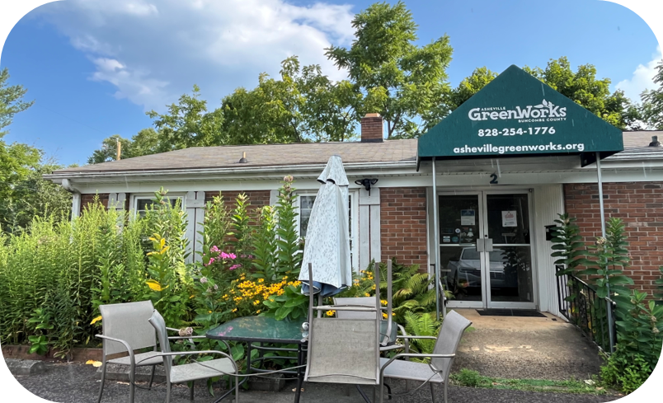
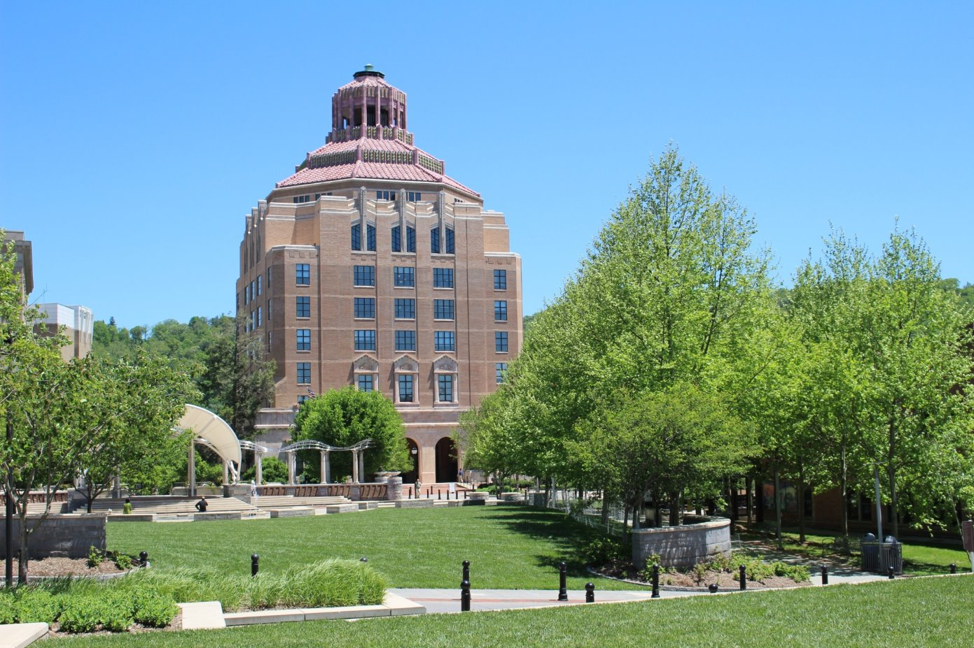
Partners
Asheville GreenWorks
City of Asheville Sustainability Department
Image of Asheville GreenWorks​
Image Credit: Sarah McMullen​
Image of Asheville City Hall
Image Credit: Dan Phairas
Notes:
We partnered with Asheville GreenWorks and the City of Asheville (CoA) Sustainability Department, to carry out the project.
Greenworks
GreenWorks is committed to building equitable climate resiliency in Asheville through planting trees, cleaning rivers, organizing recycling initiatives, and educating the local community (Asheville GreenWorks, 2022).
On July 24, 2023, the projected hottest day of the year, GreenWorks mapped the UHI effect across all Buncombe County, N.C. neighborhoods using the National Oceanic and Atmospheric Administration (NOAA) data to identify neighborhoods most in need of tree planting.
City of Asheville Sustainability Department
Committed to sustainable practices, infrastructure and city design.
On January 28, 2020, the City of Asheville signed a climate emergency proclamation through Resolution 20-25 (The City of Asheville, 2020), committing the CoA to implement sustainable practices and city design, focusing on supporting vulnerable communities in Asheville. This resolution resulted in the Climate Justice Initiative (The City of Asheville, n.d.), a collaboration with community leaders of Black, Indigenous, and People of Color (BIPOC) groups, which created the Climate Justice Index and the interactive Asheville Climate Justice Map (The City of Asheville, n.d.-a), including data collected by the 2019 NASA DEVELOP Asheville Urban Development I team (AUD1). The CoA is also building an Urban Forest Master Plan, including heat mitigation strategies for climate resilience in Asheville, such as strategic tree planting (The City of Asheville Urban Forestry Commission, 2023).
----------Image Information Below----------
[Image 1 displaying Asheville GreenWorks Building in Asheville, NC]
Image 1 Credit: Sarah McMullen, author
[Image 2 displaying the City Hall in Asheville, NC]
Image 2 Credit: Dan Phairas, City of Asheville Employee

Slide 7
Project Objectives
UHI Hot Spots
Identify hot spot areas
Social Vulnerability
Identify socially vulnerable areas
Heat Vulnerability
Identify heat-vulnerable areas
UHI Mitigation and Adaption
Assess the spatial suitability of mitigation and adaption measures based on cooling capacity
Expand on and update the 2019 NASA DEVELOP Asheville Urban Development I project,
to support cooling initiatives and climate-resilient urban planning.
Notes:
Our project objectives are a continuation of a previous develop project called Asheville Urban Development I from a team in 2019.
The AUD1 project, led by Gray et al. (2019), mapped Asheville's Land Surface Temperature (LST) changes from 1984 to 2018, and tree cover and 2 socioeconomic factors influencing social vulnerability. Building on this, the Asheville Urban Development II team extended the AUD1 project by mapping urban heat in the greater Asheville area from 2019 to 2023. Their objectives included investigating Urban Heat Island (UHI) impacts using environmental and social vulnerability data. They assessed the feasibility of using remote sensing to identify areas for heat mitigation and produced an urban heat map analyzing hot spots using LST, evapotranspiration, and albedo data (Moss et al., 2019). Incorporating evapotranspiration, originally used for tree cover mapping in AUD1, they expanded their research scope. They evaluated spatial correlations between UHI hot spots and social vulnerability by integrating the CDC's Social Vulnerability Index (SVI) into the urban heat map, creating a heat vulnerability map (Center for Disease Control, n.d.). Using the InVEST Urban City Cooling Model, they developed a map of UHI mitigation and adaptation measures, guiding initiatives by the City of Asheville (CoA) and Asheville GreenWorks. Strategies considered included tree planting, cool pavement, and green and white roofs (Phelan et al., 2015; Knight et al., 2021). Their work also updated the Asheville Climate Justice Index through the Asheville Climate Justice Map, reflecting data up to 2023.

Slide 8
Methodology
LST Data
from Landsat 8 and 9
Albedo Data
from Landsat 8 and 9
Evapotranspiration Data
from ECOSTRESS
Demographic Data
from U.S. Census ACS
Urban Heat
Index
Social Vulnerability Index
Urban Heat Map
Heat Vulnerability Index
Social Vulnerability Map
Land Use and Cover Data
from Sentinel-1 and 2
Heat Vulnerability Map
Data Source
Canopy Cover Data
from the CoA
InVEST Urban Cooling Model
Index
Map
Cooling Capacity Map and Adaptive Capacity Map
Model
Notes:
This flowchart is an overview of the project methodology.
Color Key:
Blue = datasets
Purple = indices
Green = maps
Orange = models
To create our Urban heat index and map we used LST, albedo, and evapotranspiration data. These three factors indicate the presence of hotspots.
To create our social vulnerability index and map we used demographic and socioeconomic data collected by the American Community Survey as part of the U.S. Census database and processed by the CDC/ASTDR to create their social vulnerability index (SVI). We then combined the urban heat and social vulnerability indices to create the heat vulnerability index and map. We then input the processed data in the heat vulnerability index into the InVEST urban cooling model. We also uploaded data on land use, cover, and canopy cover. The InVEST urban cooling model produced a cooling capacity map showing the ability of areas to adapt to and mitigate urban heat.
More information on how we processed the data will be discussed later in the presentation.

Slide 9
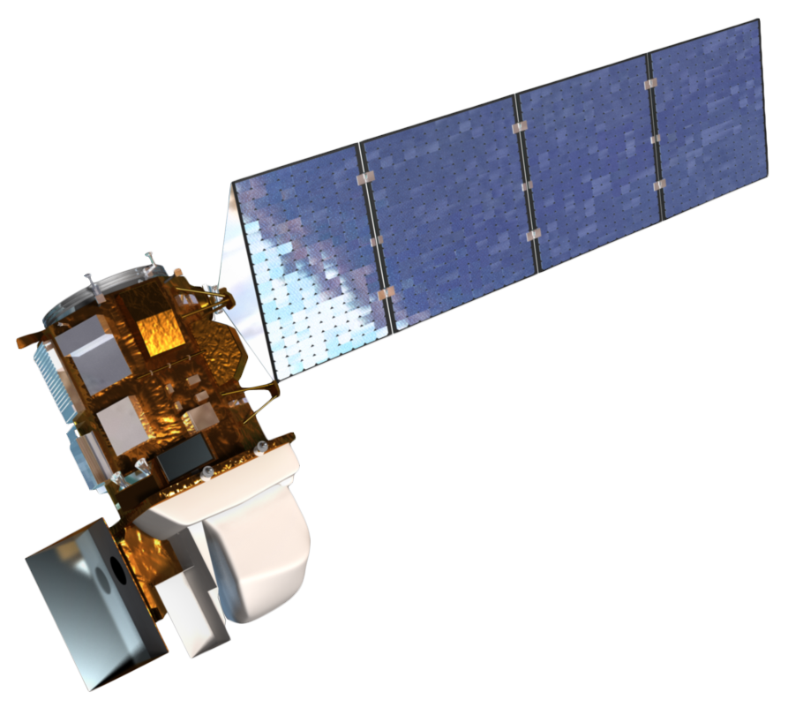
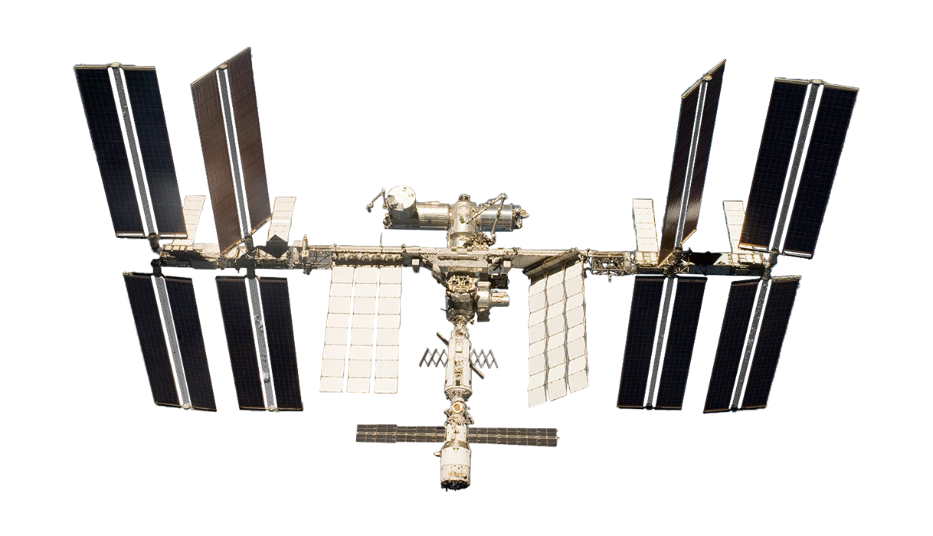
Earth Observations
Landsat 8
OLI and TIRS
Landsat 9
OLI-2 and TIRS-2
ECOSTRESS
PHyTIR
Landsat 8
Landsat 9
ECOSTRESS
Image Credit: NASA, Northrop Grumman
Notes:
We used 5 satellites for our earth observations. The first three we used were Landsat 8 and 9, which we used for LST and albedo data, and ISS ECOSTRESS, which we used for Evapotranspiration data.
Landsat is equipped with the Operational Land Imager (OLI) and Thermal Infrared Sensor (TIRS). ISS ECOSTRESS is equipped with the Prototype Hyperspectral Infrared Imager Thermal Infrared Radiometer.
Landsat 8 and 9 have a combined revisit time of 8 days, and the scenes for our study area are taken at 11:05 am. ECOSTRESS had either daily or nearly daily visit times, so we centered the data we used around cloud-free Landsat scenes.
Landsat 8 and 9 had mixed spatial resolutions with 30 meters for optical data (like visible and near infrared) and 100 meters for thermal. ECOSTRESS had a pixel resolution of 70 meters.
We will give more information on data acquisition later in the presentation.
----------Image Information Below----------
Landsat 8 Image: https://landsat.gsfc.nasa.gov/satellites/landsat-8/
Landsat 9 Image: Northrop Grumman, https://landsat.gsfc.nasa.gov/satellites/landsat-9/landsat-9-overview/
ECOSTRESS image: https://www.jpl.nasa.gov/missions/ecosystem-spaceborne-thermal-radiometer-experiment-on-space-station-ecostress

Slide 10
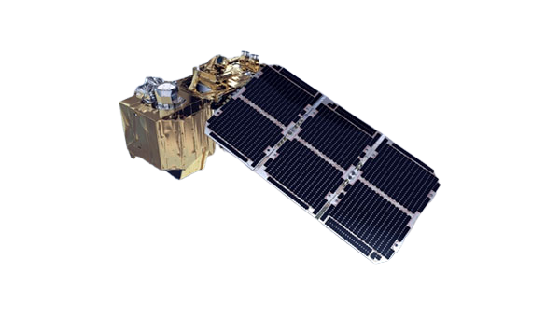
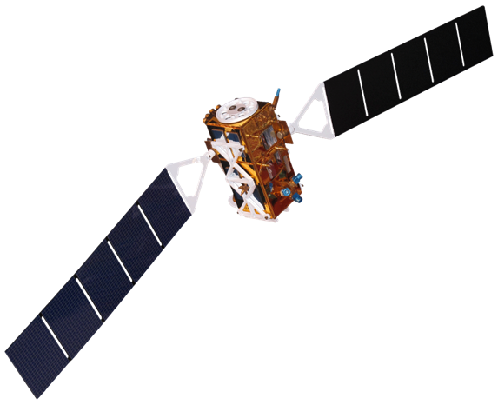
Earth Observations
Sentinel-1
C-SAR
Sentinel-2
MSI
Landsat 8
Landsat 9
Image Credit: European Space Agency
Notes:
Sentinel-1 and Sentinel-2 were used through the European Space Agency WorldCover product as input for the Land Use Land Cover requirements for the InVEST model. We did not access the raw Sentinel data, we just used the final product from ESA. Sentinel and the WorldCover product both have 10 meter pixel resolution.
----------Image Information Below----------
Sentinel-1 Image: European Space Agency
Sentinel-2 Image: European Space Agency, https://sentinels.copernicus.eu/web/sentinel/user-guides/sentinel-2-msi/overview

Slide 11
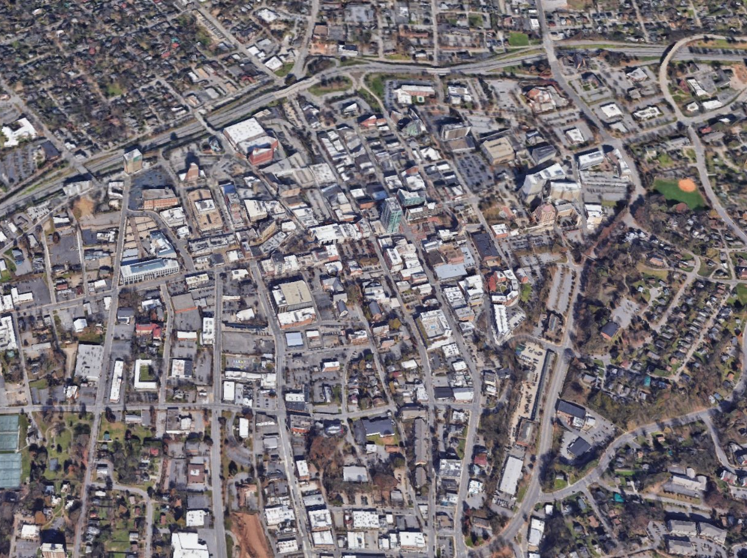
Urban Heat
Aerial Image of Downtown Asheville, NC
Image Credit: Google Earth
Notes:
Now, we will begin our analysis of urban heat.
----------Image Information Below----------
[Image displaying downtown Asheville, NC]
Image Credit: Google Earth screenshot (over downtown Asheville, NC)
Image Source: https://www.google.com/maps/@35.5808478,-82.5573589,1830a,35y,38.88t/data=!3m1!1e3!5m1!1e4?entry=ttu

Slide 12
Urban Heat
LST Data
from Landsat 8 and 9
Albedo Data
from Landsat 8 and 9
Evapotranspiration Data
from ECOSTRESS
Urban Heat
Index
Urban Heat Map
Notes:
METHODOLOGY
Data Aquisition:
LST
We acquired Land Surface Temperature (LST) data from Landsat 8 (Level 2, Collection 2, Tier 1) and Landsat 9 (Level 2, Collection 2, Tier 1) in Google Earth Engine (GEE). Landsat 8 and 9 satellites feature the Operational Land Imager (OLI and OLI-2, respectively) and Thermal Infrared Sensor (TIRS and TIRS-2, respectively) instruments. We used Landsat 8 imagery to measure LST from 2019 to 2023 and incorporated Landsat 9 data for 2022 and 2023, post its deployment in 2021. We filtered both collections to include data only for warm months: May 1st to September 30th, optimizing analysis of the Asheville Urban Heat Island (UHI). Both Landsat 8 and 9 provide high-resolution data at 30-by-30m, ensuring detailed and suitable sources for LST analysis.
Albedo
Same as LST
Evapotranspiration
We acquired ECOSTRESS Evapotranspiration data (PT-JPL Daily L3 Global 70m) from the Land Processes Distributed Active Archive Center. We used ECOSTRESS Geolocation Daily L1B Global 70m data to process the level 3 evapotranspiration data. We created a median composite for warm months (May to September) from 2019 to 2022 due to data availability up to February 2023.
Data Processing:
LST
We processed LST data using Dr. Ross’s Heat Script JavaScript code from NASA DEVELOP's Urban Heat Island Toolkit in Google Earth Engine (GEE) as a template. Initially, we set temperature parameter limits from 10-40°C to adjust the LST display, aligning with typical summer temperatures in Western NC and ensuring data accuracy without outliers. Spatially defining the study area around Asheville, NC (33.7471°N, 84.3901°W), we retrieved 7 image collections—6 from Landsat 8 covering 2019-2023 and 2 from Landsat 9 for 2022-2023—to form the Landsat surface temperature dataset. Merging these collections into a single layer, we converted Kelvin to Celsius, masked cloudy pixels, and used mosaic-by-date to consolidate images into a single mosaic for 2019-2023. Visualizing median LST values with a temperature palette in GEE, we exported the visualization as a TIFF file to Google Drive.
Next, in ArcGIS Pro 3.1.2, we uploaded the TIFF file's raster band ST_B10 for further processing. Using the Raster Calculator, we multiplied float numbers by 100,000 and applied the Int tool to maintain precision by converting them into integers. Building a raster attribute table facilitated the conversion of the raster to a vector dataset. Utilizing the Raster to Polygon tool without simplification, we converted the raster into vector polygons for enhanced analysis with Census data. Reverting integer values back to floats, we created a new field named Celsius, dividing values by 100,000. Finally, employing the Spatial Join tool between the LST vector dataset and Census Block Groups, we computed mean LST values per group, resulting in a choropleth map visualizing Asheville's Census Block Groups' mean LST from 2019 to 2023.
Albedo
We processed the albedo data, utilizing Dr. Ross’s Heat Script JavaScript code from the Urban Heat Island Toolkit in the NASA DEVELOP Google Earth Engine (GEE) repository as a template. We modified the script to process albedo data, rather than LST. As done to process the LST data, we defined our study area to Asheville, NC and called in 7 image collection datasets from Landsat 8 and 9. We then calculated albedo using bands 1 (Coastal/Aerosol), 3 (Green), 4 (Red), 5 (Near Infrared), and 7 (Short Wave Infrared (SWIR) – 2).
We excluded bands 2, 6, 8, 9, 10, and 11 from processing as they do not contribute to albedo measurements. We used the merge function to aggregate the albedo data image collections into one layer. Using the mosaic by date function, we generated a list of unique dates and merged and separated each unique date into image sets. We removed all unrelated bands from the image to reduce processing time. The albedo code visualization was exported into Google Drive as a TIFF file.
The TIFF file was imported into ArcGIS Pro 3.1.2 for further processing. We used the raster calculator tool to covert the data into integers with minimal decimals. Using the Int tool, we truncated the integers, to exclude negligible data. Next, we used the Raster to Polygon tool, without selecting the Simplify Polygons setting, to convert the raster dataset into a vector or polygon dataset. We then spatially joined the spatial census block data, which we then spatially joined into block groups. The result was a choropleth map of Asheville displaying census block groups’ albedo values for 2019-2023.
Evapotranspiration
ECOSTRESS level 3 data in raw h5 file format lacks geographic data, requiring either a swath to grid Python script from LP DAAC or an 'Extract Area Sample' request via AppEEARS for usability. After testing both options, AppEEARS was chosen for its efficiency and streamlined process. We uploaded study area vector file for data request, specifying May 1st to September 30th recurring annually from 2019 to 2022. We selected ECO3ETPTJPL 001, 70m product. We downloaded "ETdaily" and "ETinstUncertainty" layers from the 7 available, noting potential for broader project utilization.
The layers were imported into ArcGIS Pro. In Arc we merged "ETdaily" and "ETinstUncertainty" raster layers using "Mosaic to New Raster" tool. We applied mean operator due to lack of median option; recommended future tool development for median calculation consistency. We converted mosaic into polygons using "Raster to Polygon" tool without simplification. We clipped polygons to study area. We spatially joined polygons to census block spatial data, then to block groups for analysis. These points summarize the process of acquiring, processing, and integrating ECOSTRESS level 3 data into ArcGIS Pro for spatial analysis and visualization within the study area.
Urban Heat Index
We Utilized min-max normalization method to standardize datasets for creating urban heat and heat vulnerability indices. This transformation ensures minimum value converts to 0 and maximum value to 1, with all others scaled proportionally between 0 and 1. We processed raw raster data by calculating mean values for LST, albedo, and evapotranspiration within each census block group vector. We standardized LST, albedo, and evapotranspiration datasets using min-max normalization. We weighted data to emphasize LST (heat exposure) due to its direct impact on urban heat formation. We used this formula (equation 3): urban heat = heat exposure * (1-adaptive capacity). Urban heat index reflects relative influences of LST, albedo, and evapotranspiration in hot spot formation. From the processed data we created urban heat map using standardized, weighted urban heat values at the census block group level.
Urban Heat Map
With the standardized, weighted urban heat values at the census block group level, we created the urban heat map. We then imported the data into ArcGIS Pro. We processed it using the same methodology for the LST, albedo, and evapotranspiration datasets but tailored some processing steps for the urban heat index specifications. The result was an urban heat map for Asheville, NC with data from 2109-2023.

Slide 13
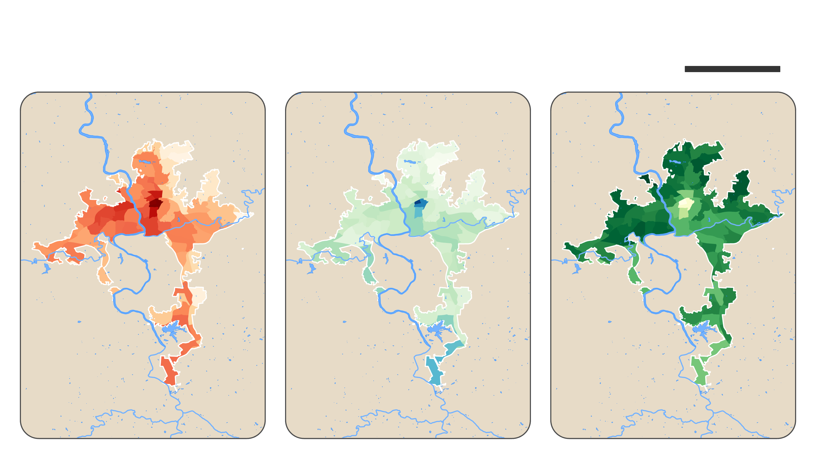
Urban Heat
10 km
Land Surface Temperature
Albedo
Evapotranspiration
HIGH
LOW
HIGH
LOW
HIGH
LOW
Median
2019-2023
Median
2019-2023
Mean
2019-2022
Basemap Credit: State of NC
Notes:
RESULTS
The urban heat map (Figure 2D) displays heat exposure in the CoA and the three contributing factors: LST (Figure 2A), albedo (Figure 2B), and evapotranspiration (Figure 2C). LST was highest in downtown Asheville and decreased radially outward from the city center (Figure 2A). However, West and South Asheville had irregularities to this pattern with moderately high LST which we attribute to the higher population densities and urban build-up in these areas. Northeast Asheville had the lowest LST, due to greater vegetation cover in this area (Figure 2A) (Gray et al., 2019).
Albedo was highest in the city center in downtown Asheville (Figure 2B). This was followed by South Asheville in Arden and at the Asheville Regional Airport (Figure 2B). The remainder of the city had low albedo, with the peripheral areas having the lowest albedo (Figure 2B). This is consistent with the amount of vegetative cover, as vegetation can have low albedo rates (Gray et al., 2019). Albedo is a complex variable that does not always correlate with urban heat.
Evapotranspiration was highest in the census block groups near or adjacent to the edge of the CoA’s boundaries and lowest in the inner city (Figure 2C). Arden and the airport area were incongruent with this pattern, having moderate evapotranspiration levels, due to their urban buildup and lack of vegetation (Gray et al., 2019). The city center in and around downtown Asheville had the lowest evapotranspiration levels, consistent with the dense urban landscape. The radial pattern of evapotranspiration demonstrates the correlation between evapotranspiration and vegetation; the more vegetation, the more evapotranspiration, and vice versa.
The data shows that there is a distinct relation between these three variables. Generally, where there was low LST, albedo was also low, and evapotranspiration was high. Vegetation typically has a relatively low albedo and results in high evapotranspiration, indicating the importance of vegetation in reducing LST. This cooling effect is evident in the periphery of each map (Figures 2A, B and C), where a greater proportion of the land cover is more densely vegetated with trees (Gray et al., 2019). Alternatively, in the city center, where unnatural landcovers dominate the landscape and tree cover is sparse, LST is high, albedo is moderate, and evapotranspiration is low.
----------Image Information Below----------
[Maps displaying LST, albedo, and evapotranspiration in Asheville, NC]
Image Credit: Map created by project authors in ArcGIS Pro

Slide 14
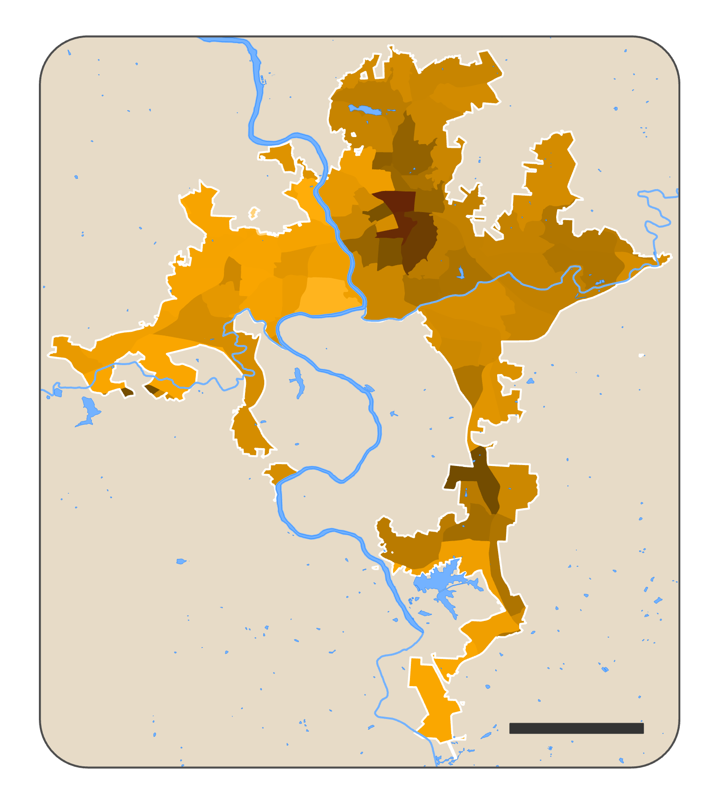
Urban Heat
Data LST | Albedo | Evapotranspiration
Geometry U.S. Census Block Groups
Asheville
HIGH
LOW
URBAN HEAT
NORTH
CAROLINA
5 km
Basemap Credit: State of NC
Notes:
RESULTS
These three map layers were combined to create the urban heat map (Figure 3). The urban heat map shows that the city center was the CoA’s most severe hot spot, closely followed the areas directly surrounding downtown, and the area south of Shiloh and north of Arden. Overall, urban heat manifested in a pattern of spatial decay: the periphery had relatively low urban heat compared to the city center (Figure 3). Areas with the highest urban heat had high LST compounded by low albedo and low evapotranspiration, and vice versa (Figure 3). The area south of Shiloh and to the north of Arden was an exception to this spatial pattern, with relatively high urban heat levels despite its distance from the city center, however, this is consistent with the level of urban buildup in this area.
----------Image Information Below----------
[Map displaying Urban Heat in Asheville, NC]
Image Credit: Map created by project authors in ArcGIS Pro

Slide 15
Urban Heat
Data LST | Albedo | Evapotranspiration
Geometry U.S. Census Block Groups
Asheville
HIGH
MEDIUM
LOW
URBAN HEAT
NORTH
CAROLINA
5 km
Basemap Credit: State of NC
Notes:
RESULTS
Alternative map with three classes for partners.
Symbolization method is Natural Breaks (Jenks). "With natural breaks classification (Jenks) Natural Breaks Jenks, classes are based on natural groupings inherent in the data. Class breaks are created in a way that best groups similar values together and maximizes the differences between classes. The features are divided into classes whose boundaries are set where there are relatively big differences in the data values (Esri)."
----------Image Information Below----------
[Map displaying Urban Heat Asheville, NC]
Image Credit: Map created by project authors in ArcGIS Pro

Slide 16
Social Vulnerability
Image of Asheville Citizens
Image Credit: Will Thomas
Notes:
Now, we will transition to our social vulnerability analysis.
----------Image Information Below----------
[Image displaying Asheville Citizen congregated at Pack Square in downtown Asheville, NC]
Image Credit: Will Thomas
Image Source: https://commons.wikimedia.org/wiki/File:Mountain_Moral_Monday_-_North_Carolina-202.jpg licensed under CC 4.0

Slide 17
Social Vulnerability
Demographic Data
from U.S. Census ACS
Social Vulnerability
Index
Social Vulnerability Map
Notes:
METHODOLOGY
Data Acquisition:
We obtained social vulnerability data from the CDC and ATSDR Social Vulnerability Index (SVI), utilizing the latest U.S. Census Bureau data from 2022. We used the CDC/ASTDR SVI because the CoA used this index in the existing Climate Justice Map, and it is a standard national measure of social vulnerability. The SVI consists of four main themes: socioeconomic status, household characteristics, racial and ethnic minority status, and housing type and transportation. Each theme includes variables to comprehensively assess demographic vulnerability at the census tract scale:
Socioeconomic Status includes demographic data such as percentage of individuals below 150% poverty, unemployed, burdened with housing costs, without a high school diploma, and lacking health insurance.
Household Characteristics encompasses variables like percentage of population aged 65 and older, aged 17 and younger, civilians with disabilities, single-parent households, and those with limited English proficiency.
Racial and Ethnic Minority Status includes individuals who identify as Hispanic or Latino (of any race), Black and African American, American Indian and Alaska Native, Asian, Native Hawaiian and other Pacific Islander, two or more races, and other races.
Housing Type and Transportation encompasses variables such as percentage of population in multi-unit structures, mobile homes, crowded housing conditions, without access to a vehicle, and living in group quarters.
Data Processing:
SVI
Social vulnerability data from the U.S. Census American Community Survey (ACS) was processed by the CDC/ATSDR to create the SVI at the census tract scale. The CDC calculated and summed percentile rankings of ACS demographic variables into four SVI themes at the census tract level. Values of these themes were then summed and normalized on a 0-1 scale to generate an SVI ranking ("RPL_THEMES") for each census tract. We isolated the final SVI ranking ("RPL_THEMES") from the CDC/ATSDR SVI CSV file. We spatially rescaled the data to align with other datasets (LST, albedo, evapotranspiration) by assigning the tract-level SVI value to all census blocks within the same census tract.
Social Vulnerability Map
We uploaded processed census block SVI data into ArcGIS Pro. We used spatial join tool to connect census block groups with SVI data. We applied one-to-one join operation, retaining all target features. We then used intersect match option and mean merge rule to integrate CDC SVI data into Asheville census block groups. From this we generated choropleth map displaying SVI values at the census block scale for Asheville.

Slide 18
Social Vulnerability
Data SVI from 2022
Geometry U.S. Census Block Groups
Asheville
HIGH
LOW
SOCIAL VULNERABILITY
NORTH
CAROLINA
5 km
Basemap Credit: State of NC
Notes:
RESULTS
The social vulnerability map (Figure 4) shows the relative vulnerability of Asheville communities based on the CDC/ASTDR SVI. The most socially vulnerable areas were downtown, Emma, and in South Asheville to the east of Shiloh and in Biltmore Park. Broadly, the communities of West and South Asheville were moderately vulnerable. The stretch of West Asheville extending south towards Bent Creek displays the lowest social vulnerability, however, there are few citizens residing in this area, as it is an industrial sector, resulting in little to no SVI data. Altogether, the region of North Asheville has the lowest social vulnerability. Morningside/West Asheville Estates have low social vulnerability, making it an outlier to the wider adjacent communities.
What is Social Vulnerability?
Every community must prepare for and respond to hazardous events, whether a natural disaster like a tornado or a disease outbreak, or an anthropogenic event such as a harmful chemical spill. The degree to which a community exhibits certain social conditions, including high poverty, low percentage of vehicle access, or crowded households, among others, may affect that community’s ability to prevent human suffering and financial loss in the event of a disaster. These factors describe a community’s social vulnerability.
SVI maps the communities that will most likely need support before, during, and after a hazardous event
----------Image Information Below----------
[Map displaying SV in Asheville, NC]
Image Credit: Map created by project authors in ArcGIS Pro

Slide 19
Social Vulnerability
Data SVI from 2022
Geometry U.S. Census Block Groups
Asheville
HIGH
MEDIUM
LOW
SOCIAL VULNERABILITY
NORTH
CAROLINA
5 km
Basemap Credit: State of NC
Notes:
RESULTS
Alternative map with three classes for partners.
Symbolization method is Natural Breaks (Jenks). "With natural breaks classification (Jenks) Natural Breaks Jenks, classes are based on natural groupings inherent in the data. Class breaks are created in a way that best groups similar values together and maximizes the differences between classes. The features are divided into classes whose boundaries are set where there are relatively big differences in the data values (Esri)."
----------Image Information Below----------
[Map displaying SV Asheville, NC]
Image Credit: Map created by project authors in ArcGIS Pro

Slide 20
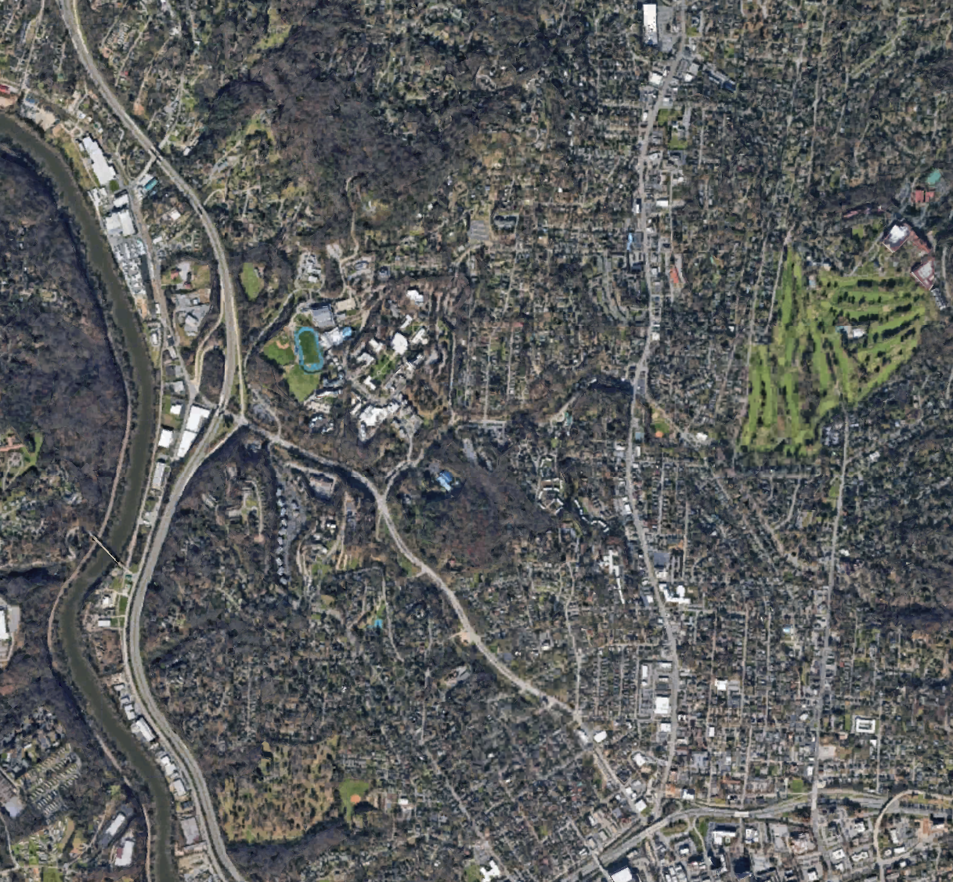
Heat Vulnerability
Aerial Image of Neighborhoods in North Asheville, NC
Image Credit: Google Earth
Notes:
Combining our analysis of socially vulnerability and urban heat, we will combine these factors together to assess heat vulnerability.
----------Image Information Below----------
[Image displaying North Asheville, NC]
Image Credit: Google Earth screenshot (over North Asheville, NC)
Image Source: https://www.google.com/maps/place/Asheville,+NC/@35.6118806,-82.5724243,4416m/data=!3m1!1e3!4m6!3m5!1s0x88598ca93c0f6f09:0x94ef31c106343a5d!8m2!3d35.5950581!4d-82.5514869!16zL20vMHlkcGQ?entry=ttu

Slide 21
Heat Vulnerability
Urban Heat
Index
Social Vulnerability Index
Heat Vulnerability Index
Urban Heat Map
Social Vulnerability Map
Heat Vulnerability Map
Notes:
METHODOLOGY
Details of normalization on slide 11 (in urban heat index section)
Heat Vulnerability Index
We combined the urban heat and SVI indices. In accordance with the weighting of the urban heat formula, adaptive capacity was given less weight. This process is delineated in the following formula: heat vulnerability = heat exposure * social vulnerability (1-adaptive capacity). With the heat vulnerability scores for Asheville’s census block groups, we created the heat vulnerability map.
Heat Vulnerability Map
With the heat vulnerability scores for Asheville’s census block groups, we created the heat vulnerability map. We imported the heat vulnerability index data into ArcGIS Pro and processed it using the same data processing methodology for the urban heat map. The result was a heat vulnerability map for Asheville, NC for data from 2019-2023. This map combined the variables of heat exposure (LST), social vulnerability (demographic and socioeconomic composition of communities), and adaptive capacity (albedo and evapotranspiration).

Slide 22
Heat Vulnerability
Data LST | Albedo | Evapotranspiration | SVI
Geometry U.S. Census Block Groups
Asheville
HIGH
LOW
HEAT
VULNERABILITY
NORTH
CAROLINA
5 km
Basemap Credit: State of NC
Notes:
RESULTS
The heat vulnerability map (Figure 5) combines the urban heat and social vulnerability indices, to display heat-vulnerable areas in Asheville, NC. The area with the highest heat vulnerability was in the city center and surrounding downtown Asheville. The areas with the lowest heat vulnerability were generally located towards or adjacent to the CoA’s periphery. One area inconsistent with this radial pattern was the census block group south of Shiloh and north of Arden, with relatively high heat vulnerability, influenced by high urban heat and moderate social vulnerability. Overall, there was a pronounced pattern of decreasing heat vulnerability further away from downtown.
----------Image Information Below----------
[Map displaying Heat Vulnerability in Asheville, NC]
Image Credit: Map created by project authors in ArcGIS Pro

Slide 23
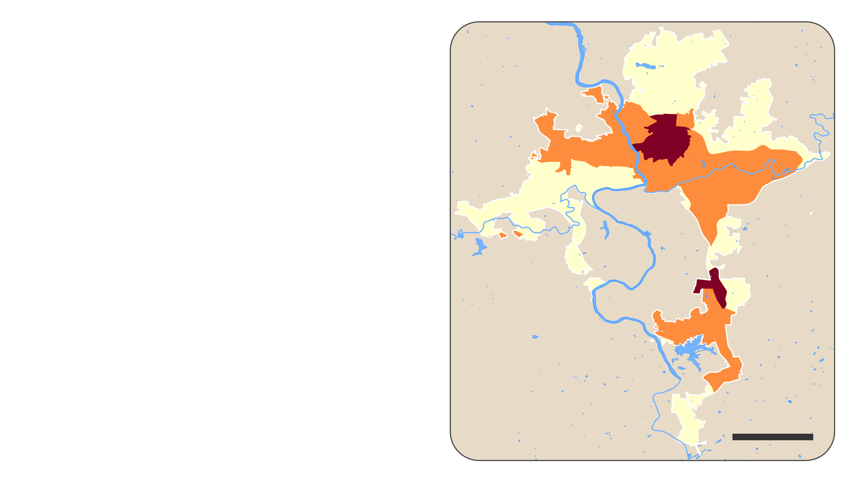
Heat Vulnerability
Data LST | Albedo | Evapotranspiration | SVI
Geometry U.S. Census Block Groups
Asheville
HIGH
MEDIUM
LOW
HEAT
VULNERABILITY
NORTH
CAROLINA
5 km
Basemap Credit: State of NC
Notes:
RESULTS
Alternative map with three classes for partners.
Symbolization method is Natural Breaks (Jenks). "With natural breaks classification (Jenks) Natural Breaks Jenks, classes are based on natural groupings inherent in the data. Class breaks are created in a way that best groups similar values together and maximizes the differences between classes. The features are divided into classes whose boundaries are set where there are relatively big differences in the data values (Esri)."
----------Image Information Below----------
[Map displaying Heat Vulnerability in Asheville, NC]
Image Credit: Map created by project authors in ArcGIS Pro

Slide 24
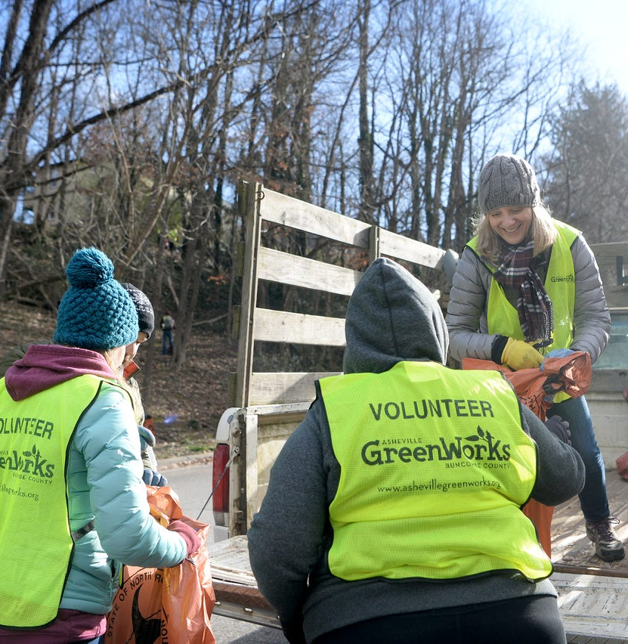
UHI Mitigation and Adaptation
Image of Asheville GreenWorks Volunteers
Image Credit: Asheville GreenWorks
Notes:
Having assess the spatial pattern of heat vulnerability, we will look at the city's spatial cooling capacity, to identify areas most in need of implementing UHI mitigation and adaptation strategies.
----------Image Information Below----------
Image credit: Asheville GreenWorks, obtained from project partner

Slide 25
Cooling and Adaptive Capacity
Heat Vulnerability Index
Land Use and Cover Data
from Sentinel-1 and 2
Heat Vulnerability Map
Canopy Cover Data
from CoA
InVEST Urban Cooling Model
Cooling and Adaptive Capacity Maps
Notes:
METHODOLOGY
The InVEST Urban cooling model was used to inform UHI Mitigation and Adaptation Strategies.
Per the data input needs, we incorporated ESA WorldCover Land Use Land Cover data created from sentinel 1 and 2 products, as well as a 2018 Canopy Cover layer used to inform shade cover per land cover class.

Slide 26
Cooling Capacity
Data LULC | Albedo | Evapotranspiration | Canopy Cover
Geometry U.S. Census Block Groups
Asheville
HIGH
Cooling Capacity
NORTH
CAROLINA
LOW
5 km
Basemap Credit: State of NC
Notes:
RESULTS
The Cooling Capacity map displays the present cooling capacity (the ability to mitigate or adapt to high urban heat) of census block groups. Canopy cover, evapotranspiration rates, and albedo all contribute to adaptation and mitigation capacity in this model. Broadly, North and East Asheville have the greatest cooling capacity. The Oak Forest neighborhood in South Asheville stands out due to its relatively high capacity to mitigate and adapt to heat compared to surrounding census block groups. West Asheville has a moderately high cooling capacity. The area with the lowest cooling capacity was downtown Asheville. This is followed by areas surrounding the downtown, such as the South Slope, the River Arts District, North Downtown, and those in the southern extent of the city, such as Arden and the airport area. Generally, the areas in the CoA with dense canopy cover and less urban build up or sprawl had higher cooling capacity.
----------Image Information Below----------
[Map displaying InVEST model output for Asheville, NC]
Image Credit: Map created by project authors in ArcGIS Pro

Slide 27
Adaptive Capacity
Data Cooling Capacity | Heat Vulnerability
Geometry U.S. Census Block Groups
Asheville
Asheville
Asheville
HIGH
Cooling Capacity
LOW
HIGH
NORTH
CAROLINA
NORTH
CAROLINA
NORTH
CAROLINA
Heat Vulnerability
5 km
5 km
5 km
Basemap Credit: State of NC
Notes:
This map combines the Heat Vulnerability index and the output from the InVEST model. Bright green areas signify high cooling capacity and low heat vulnerability. An example neighborhood is Lake View Park in North Asheville, which is vegetation. These areas do not require immediate attention from a heat vulnerability perspective. Bright red areas signify low cooling capacity and high heat vulnerability, with downtown Asheville as an example, seen in the center of the map. A dark green/brown signifies high values in both of these indexes. This map is another tool that could be used by our partners to identify communities that could benefit from cooling measures.
- talk about specifics of the map
----------Image Information Below----------
[Map displaying Bivariate Map with HVI and Cooling Capacity for Asheville, NC]
Image Credit: Map created by project authors in ArcGIS Pro

Slide 28
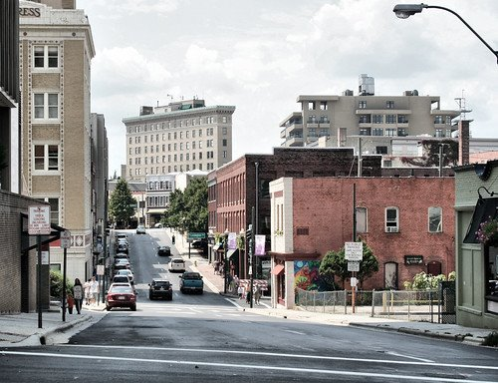
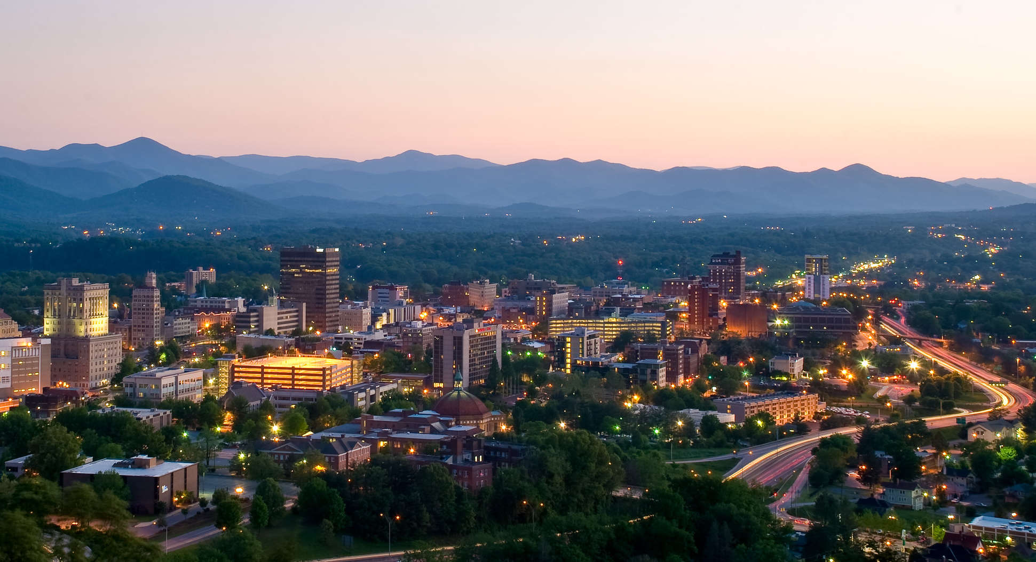
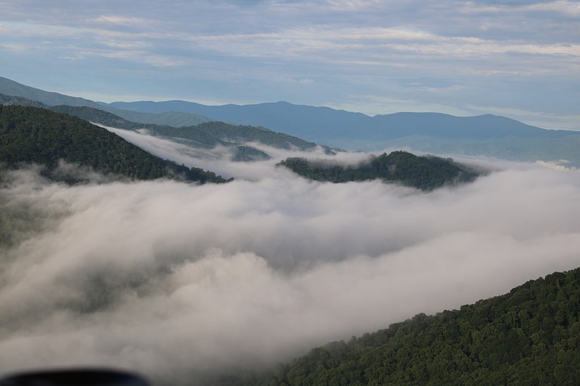
Errors and Uncertainties
Scale and Data Sources
LST ≠ Ambient Air Temperature
Image of Downtown Asheville, NC
Image Credit: Nick Ledford
Albedo Complexity
Evapotranspiration Parameters/Calculation
Image of Asheville, NC
Image Credit: Michael Trace
Notes:
One limitation of the methodology of our study was the scale used for our analysis. Census block groups aggregate the data into larger spatial areas, obscuring data details and variability within block groups. Depiction of the data at a more granular level, such as at the census block scale could highlight UHIs and other spatial patterns of heat vulnerability more accurately than block groups. Additionally, the SVI data from the CDC/ASTDR was on the census tract scale; these larger areas diminish the data’s detail and its spatial pattern (Center for Disease Control and Prevention, n.d.).
Additionally, the Land Use Land Cover data from the European Space Agency, the WorldCover product, was less accurate than we had hoped. They claim an accuracy of 76.7% (Esa WorldCover Documentation), and the missing percentages were certainly noticeable. This inaccuracy was made clear in the shade input of the InVEST model, where we matched up our 2018 canopy cover data to the 'Tree Cover' class of the LULC map. Only around 62.5% of the tree cover class was actually tree cover, with the WorldCover data overestimating the amount of canopy cover. Although the tree canopy data is slightly outdated, being from 2018, as it is specialized to Asheville I am inclined to trust it more.
There were also limitations and possible points of uncertainty in our LST, albedo, and evapotranspiration methodologies. First, LST differs from ambient air temperature. LST is the temperature of the surface, while the air temperature is above the surface. The air temperature is what people feel, not LST. LST is generally hotter than the air temperature, making Asheville appear hotter on our maps than what people experience. Despite this, we used LST as an indicator of urban heat because satellite remote sensors provide more spatial resolution than weather stations (Li et al., 2023). Second, the relationship between albedo and LST is complex, creating a point of uncertainty in our study. In general, low albedo is correlated with increased LST, however, other environmental factors can modify how albedo is absorbed or reflected. Vegetation has a relatively low albedo, absorbing more heat than reflective surfaces such as buildings, however, plants convert the absorbed energy into latent heat, which does not increase the environmental temperature. Furthermore, plants also reduce temperature through evapotranspiration and absorption of carbon dioxide. In contrast, while highly built-up areas in downtown Asheville have relatively high albedo, the proportion of absorbed insolation is instead converted to conventional heat, leading to pronounced increases in temperature (Nuruzzaman et al., 2015; Stache et al., 2022). Third, our evapotranspiration measurements were an indirect indicator of vegetation, potentially resulting in uncertainties. While evapotranspiration provides valuable information, we did not directly analyze vegetation cover for our urban heat index and map. Furthermore, we used mean evapotranspiration calculations, rather than median, as done with our other variables. In more extensive studies, we would create a tool to calculate the median value for consistency with the LST and albedo data.
----------Image Information Below----------
[Image 1 displaying Downtown Asheville, NC]
Image 1 Credit: Michael Tracey
Image 1 Source: https://openverse.org/image/e0311127-dbf7-4e75-812b-025a69f04cc1?q=asheville licensed under CCO 1.0
[Image 2 displaying Downtown Asheville, NC from Sunset Mountain]
Image 3 Credit: Nick Ledford
Image 3 Source: https://www.flickr.com/photos/ledford/3912443462/ licensed under CC BY 2.0

Slide 29
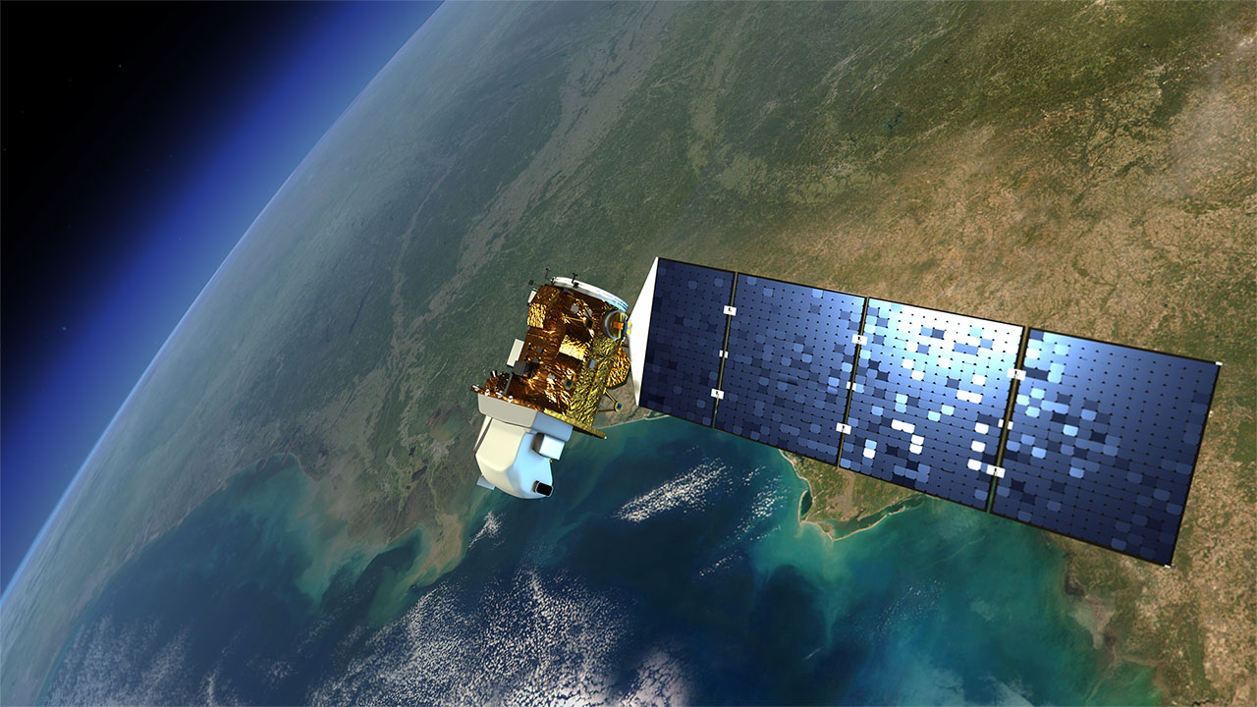
Errors and Uncertainties
Social Vulnerability
Cloud Masking
Image of Cloudy Blue Ridge Mountains
Image Credit: Unknown
Time and Aspect of Satellites
Data Processing and No Statistical Analysis
Image Rendition of Landsat Satellite
Image Credit: NASA
Notes:
Our social vulnerability methodology had limitations. We used the CDC/ASTDR SVI because this index is the national standard for evaluating social vulnerability due to its large scope and data reliability. However, the demographic and socioeconomic variables measured in the SVI are not heat-specific (Center for Disease Control and Prevention, n.d.). It does not include specific contributing elements to heat vulnerability such as access to reliable home air-conditioning or air-conditioned spaces, home cooling energy burden, or specific health factors that make an individual more prone to heat-related health effects (Center for Disease Control and Prevention, n.d.). At the time of this study, there were no standardized, reliable heat vulnerability indices.
Our data processing method of data exclusion based on cloud cover limited our analysis. Depending on their height and structure, clouds can either cool or warm LST by reflecting isolation or trapping heat, impacting LST (NASA, n.d.). Therefore, our LST results may be slightly imprecise due to the exclusion of cloudy-day measurements, but the margin of error is minimal since clouds can both warm and cool LST, preventing significant bias in one direction.
The time and aspect that the Landsat satellites pass over Asheville, NC affect the measurements recorded. The Landsat satellites pass over at roughly 11 am EST so temperatures are not yet at the daily maximum (as they are during the mid-afternoon) (U.S. Geological Survey, 2023). Additionally, the aspect can impact LST. The eastern side of the mountains is hotter than the western face when the satellite LST measurements are taken in the morning, as they were exposed to the sun for a longer duration.
Our calculations and analysis also had limitations. The min-max normalization we used to standardize our data, does not process outliers well, which could have skewed the data. We also did not conduct statistical analyses. Including statistical analyses would make our evaluation of the correlation between variables (e.g. our heat vulnerability analysis between hot spots and socially vulnerable areas) robust. Furthermore, there were possible errors from our data processing. For instance, there were three census block groups with abnormally high albedo, possibly indicating errors that arose from the data processing, potentially from the cloud masking.
----------Image Information Below----------
[Image 1 displaying clouds over the Blue Ridge Mountains outside Asheville, NC]
Image 1 Credit: Unknown
Image 1 Source: https://commons.wikimedia.org/wiki/File:Blue_Ridge_Mountains_-_Asheville.jpg licensed under CC BY-SA 4.0
[Image 2 displaying Landsat satellite]
Image 2 Credit: NASA
Image 2 Source: https://www.flickr.com/photos/gsfc/7630269434 licensed under CC BY 2.0

Slide 30
Conclusion
Asheville's UHI was characterized by a radial pattern of decreasing urban heat from downtown to more rural areas
Socially vulnerable communities were disproportionately located in urban heat hotspots, indicating environmental inequity
Implementing cooling measures in hotspots can mitigate urban heat effects
Need for targeted interventions to reduce heat impacts, address environmental injustices, and enhance urban climate resilience
Notes:
Our analysis shows how urban heat, heat vulnerability, and cooling capacity interact spatially. Asheville's urban heat island effect is characterized by a radial pattern of decreasing urban heat from downtown to more rural areas, driven by the correlation between high LST and dense urban development with minimal vegetation and evapotranspiration.
Socially vulnerable communities are disproportionately located in urban heat hotspots, indicating environmental inequity. Implementing cooling measures in hotspots such as urban greening and adding green or high albedo roofs, based on the urban landscape, can mitigate urban heat effects. For instance, green roofs are a potential alternative cooling measure for areas like downtown Asheville where additional tree planting is not possible, and there already is high albedo.
Our project emphasizes the need for targeted interventions to reduce heat impacts, address environmental injustices, and enhance urban climate resilience. This data will update Asheville’s Climate Justice Map and inform the City of Asheville and Asheville GreenWorks’ future heat mitigation strategies including strategic tree planting, installation of cooling pavements and green or white roofs.

Slide 31
NASA DEVELOP Program
Tallis L. Monteiro – Center Lead, North Carolina – NCEI
Project Partners
Chris Defiore – Asheville GreenWorks
Chris Clarke – Sustainability Department, The City of Asheville
Science Advisors
Douglas Rao – NOAA National Centers for Environmental Information
Edward Macie – Asheville GreenWorks, City of Asheville Urban Forestry Commission
Molly Woloszyn – NOAA National Integrated Drought Information System
Past Contributors
Darcy Gray (Project Lead)
Amiya Kalra
Amy Kennedy
Special Thanks
Kathryn Caruso – Prior Center Lead for the NCEI Node
Jared Rennie – NOAA National Centers for Environmental Information
Dr. Kenton W. Ross – NASA Langley Research Center
This material contains modified Copernicus Sentinel data (2024), processed by ESA.
Notes:
We thank Tallis Monteiro, the NASA Develop North Carolina NCEI Node Center Lead, for her leadership throughout this project. Thank you to our science advisors, Douglas Rao (NOAA National Centers for Environmental Information), Edward Macie (Asheville GreenWorks, CoA Urban Forestry Commission), and Molly Woloszyn (NOAA National Integrated Drought Information System) for their mentorship, guidance, and assistance. Eric Bradford, Chris Defiore, and Sara Millar from Asheville GreenWorks and Kiera Bulan, Chris Clarke, and Bridget Herring from the City of Asheville Sustainability Department deserve thanks for their partnership and collaboration. We would like to extend their appreciation to Kathryn Caruso (prior Center Lead for the NCEI NASA DEVELOP Node), Jared Rennie (NOAA National Centers for Environmental Information) and Kenton Ross (NASA Langley Research Center) for their guidance with data acquisition and processing. Representatives from NASA and the National Oceanic and Atmospheric Administration’s National Center for Environmental Information deserve acknowledgment and thanks for their instruction and guidance.

