Slide 1
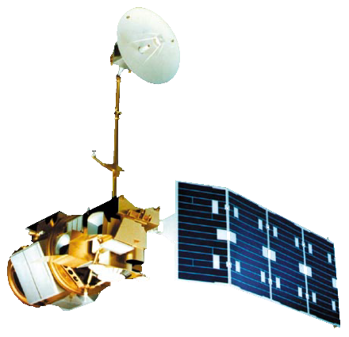
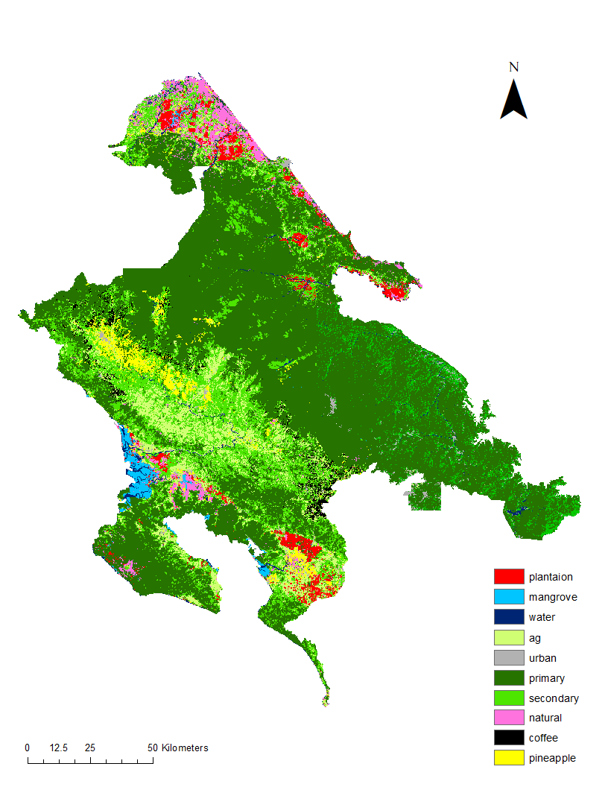
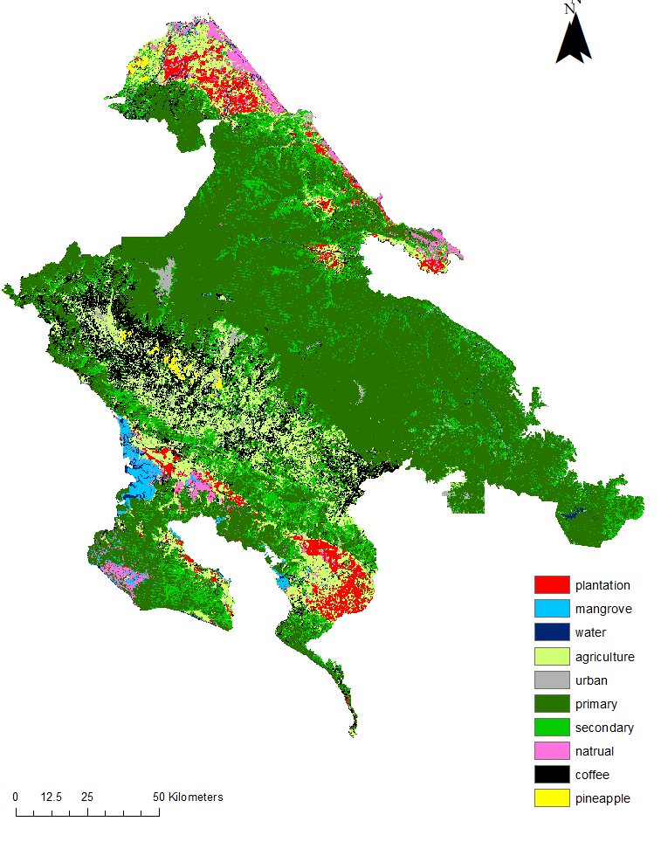
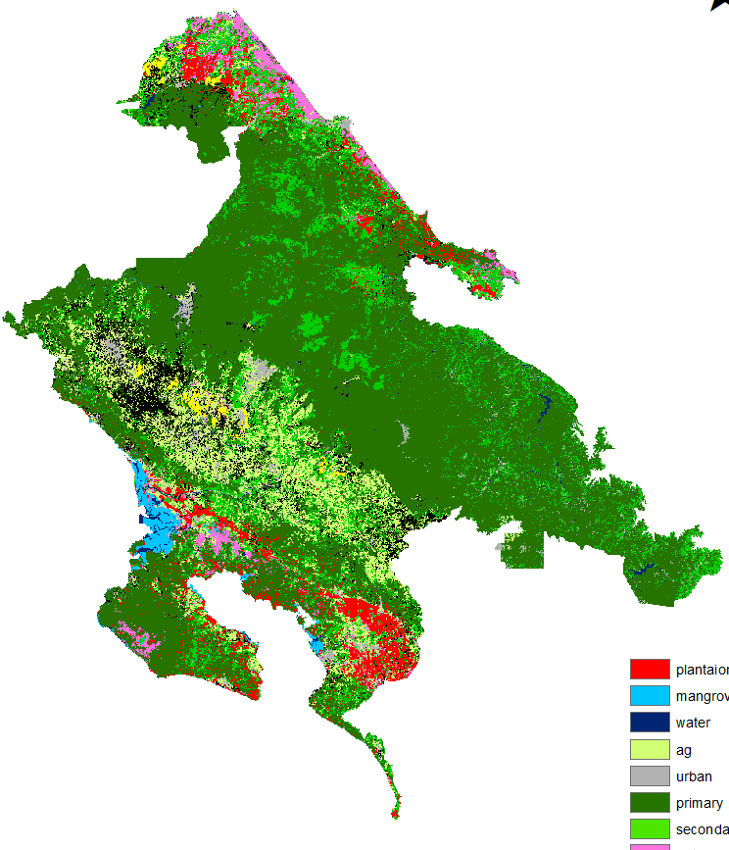
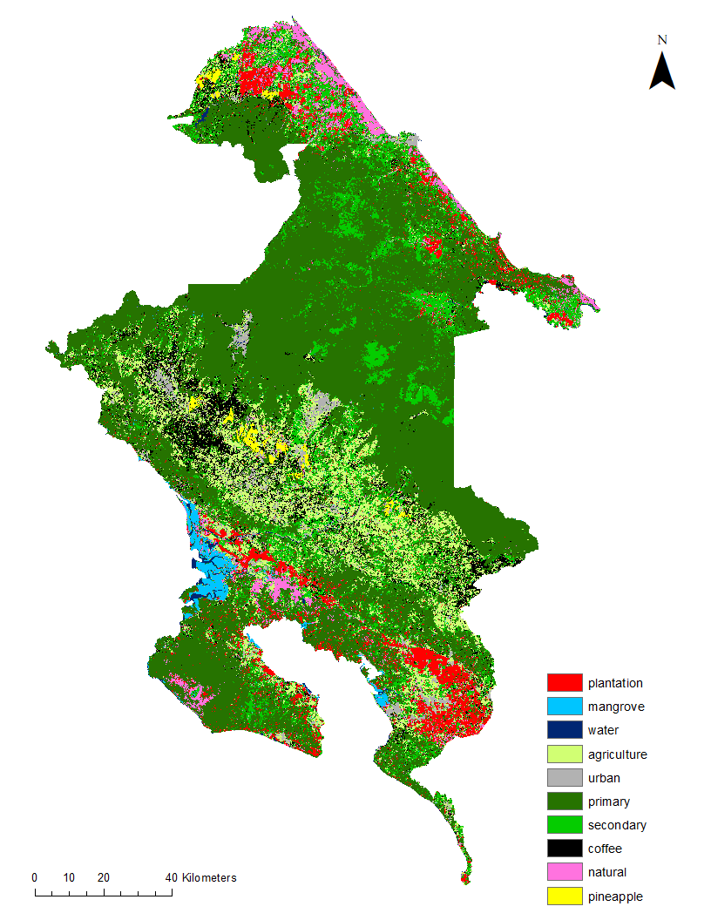
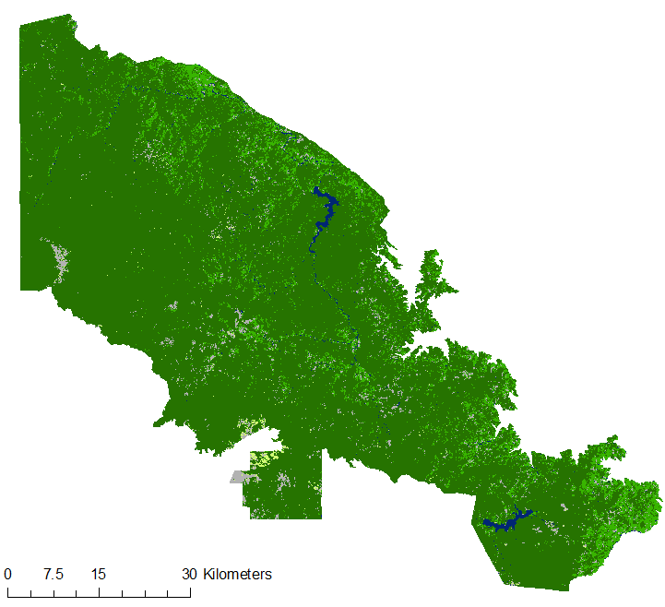
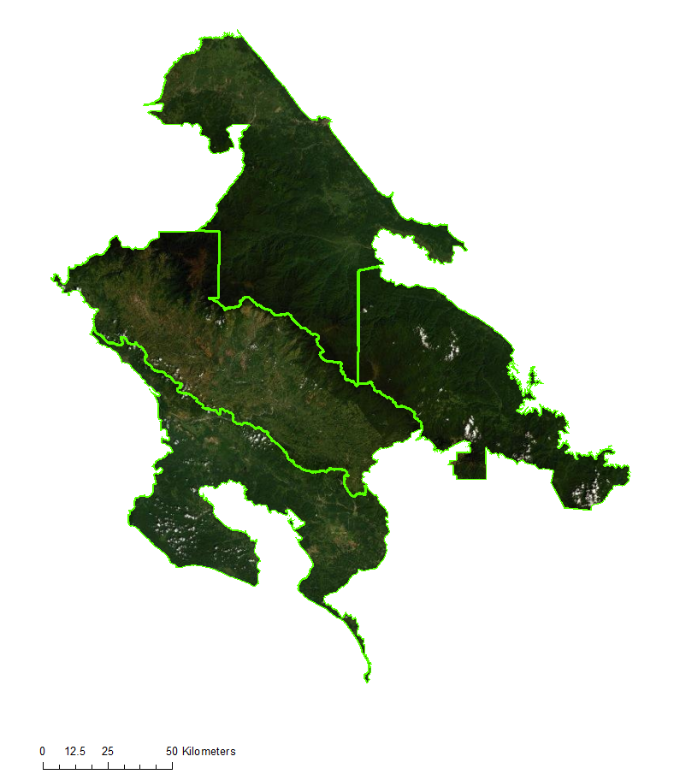
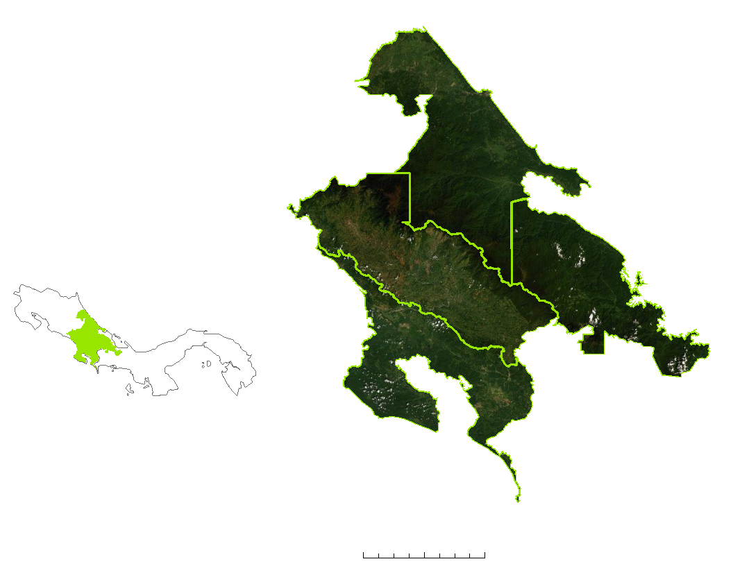
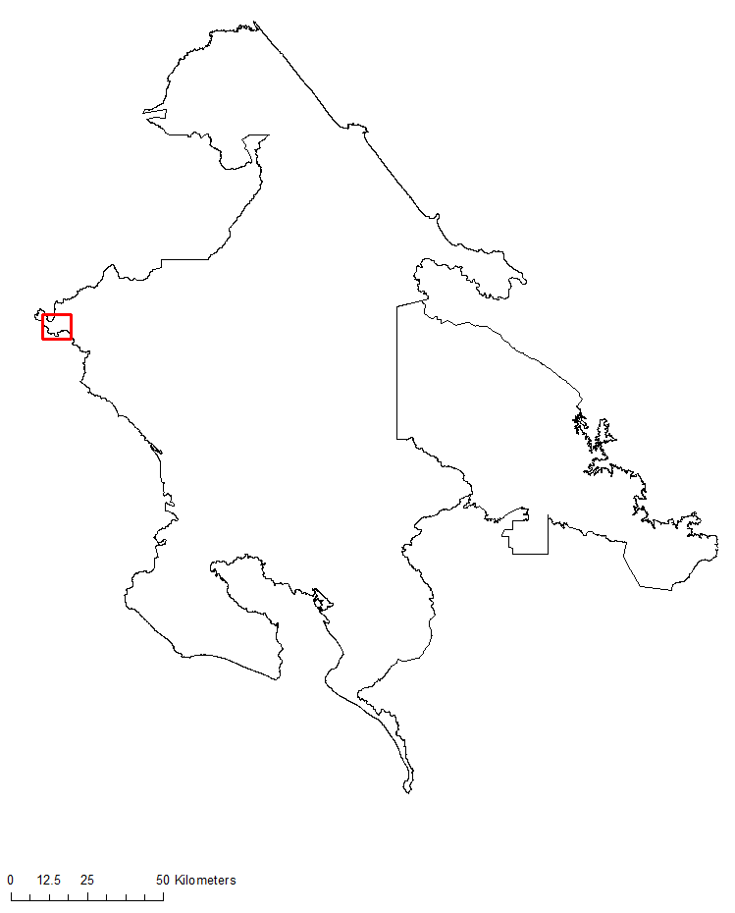
Detecting Land Change Along the Mesoamerican Biological Corridor in Costa Rica and Panama for Targeted Resource Management
Abstract
Objectives
Costa Rica & Panama Ecological Forecasting
La Amistad International Park connects southern Costa Rica and northern Panama as part of the Mesoamerican Biological Corridor. Despite the existence of conservation programs within this region, human-induced and natural ecological disturbances threaten native species and alter forest ecosystems. To assess these threats, the NASA DEVELOP Costa Rica & Panama Ecological Forecasting team partnered with the Ministry of Environment and Energy in Costa Rica and the National Environmental Authority in Panama to create products that monitor land use and land cover (LULC) change in La Amistad and surrounding areas. The team mapped LULC changes from 1999 to 2019 using Landsat 5 Thematic Mapper (TM), Landsat 7 Enhanced Thematic Mapper (ETM+), and Landsat 8 Operational Land Imager (OLI). The time series maps were then used in QGIS to forecast LULC in 2029. The 2029 forecast map projected major LULC conversions and highlighted regions of significant change over time. To map short-term forest changes, the project team created a Forest Change Detection Tool (FCDT) developed in Google Earth Engine’s API. The tool used the aforementioned Earth observations and Sentinel-2 Multispectral Instrument (MSI) to ensure that any month of interest can be observed by partners. Analyses of the LULC maps and the development of the FCDT helped partners involved in protecting the corridor to identify areas in need of attention and conservation resources.
Map land cover in protected areas for 1999, 2009, and 2019
Forecast land use in the year 2029 to predict areas with the greatest change
Develop an accurate method of detecting short-term forest change
Earth Observations
Landsat 5 TM
Landsat 7 ETM+
Landsat 8 OLI
Sentinel-2 MSI*
*Used as supplementary data in the Forest Change Detection Tool 2.0
Results
Land Cover Classifications for Study Area 1999 to 2019, Forecasted in 2029
Methodology
2019
1999
2009
2019
Data Collection
Landsat 5 TM
Landsat 7 ETM+
Landsat 8 OLI
Advanced Land Observing Satellite
Google Earth Pro & Ancillary Data
1999
2009
2019
Digital Elevation Model and
Slope Maps
N
Cloud Masking
Cloud Free Surface Reflectance Images
Classification
0
25
50
Km
Study Area in Costa Rica, 2029
Study Area in Panama, 2029
Plantation
1999 Classification Map
2009 Classification Map
2019 Classification Map
Mangrove
Water
Agriculture & Grass
QGIS Modules for Land Use Change Simulations
QGIS Modules for Land Use Change Simulations
Bare Soil & Urban
Primary Forest
Secondary Forest
Natural Palm
Accuracy Assessment
2019 Forecast Map
2029 Forecast Map
N
Coffee
N
40
Km
0
15
30
Km
Pineapple
Study Area
0
20
N
Priority Maps and Layers from FCDT 2.0
Priority Map
La Amistad Caribe
NDVI
La Amistad Pacífico
La Amistad Pacífico
La Amistad Panama
Priority Scale
Low
Medium
High
Costa Rica
La Amistad Caribe
La Amistad Panama
Priority Map
Osa
Panama
Osa
EVI2
N
Conclusions
0
25
50
Km
Study area
N
In the Costa Rica study area, plantation and bare soil & urban land cover had an expected increase from 1999 to 2019. Primary forest decreased by 2.83% and can be correlated to the .58% increase in agriculture & grass.
In the Panama area of interest, primary forest land cover decreased from 1999 to 2019 by -1.46% and can be corelated to a .53% increase in bare soil and urban land cover and a 1.9% increase in secondary forest land cover.
Historical LULC maps can be used to monitor and forecast the spatial and temporal dynamic of changes.
Study area boundaries
0
32
65
Km
0
25
50
Kilometers (Km)
Project Partners
0
25
50
Km
Ministry of Environment and Energy, National Center for Geoenvironmental Information (Costa Rica)
National Environmental Authority (Panama)
Acknowledgements
Team Members
Dr. Rafael Monge Vargas | Ministry of Environment and Energy, Costa Rica
Roney Samaniego | National Environmental Authority of Panama
Dr. Marguerite Madden | University of Georgia’s Center for Geospatial Research
Dr. Sergio Bernardes | University of Georgia’s Center for Geospatial Research
Shelby Ingram | NASA DEVELOP Georgia – Athens Node
Emil Cherrington | NASA SERVIR Alabama – Marshall
Sean McCartney | NASA ARSET Maryland – Goddard
Dr. Steve Padgett-Vasquez | NASA DEVELOP National Program
Estefanía Palacios | University of Georgia Department of Geography
Ryan Slapikas | Florida State University
This material contains modified Copernicus Sentinel data (2019) processed by ESA.
Molly Azami
Kara Bissonnette
Mahsa Khodaee
Zachary Leslie
Georgia – Athens | Fall 2019

