Slide 1
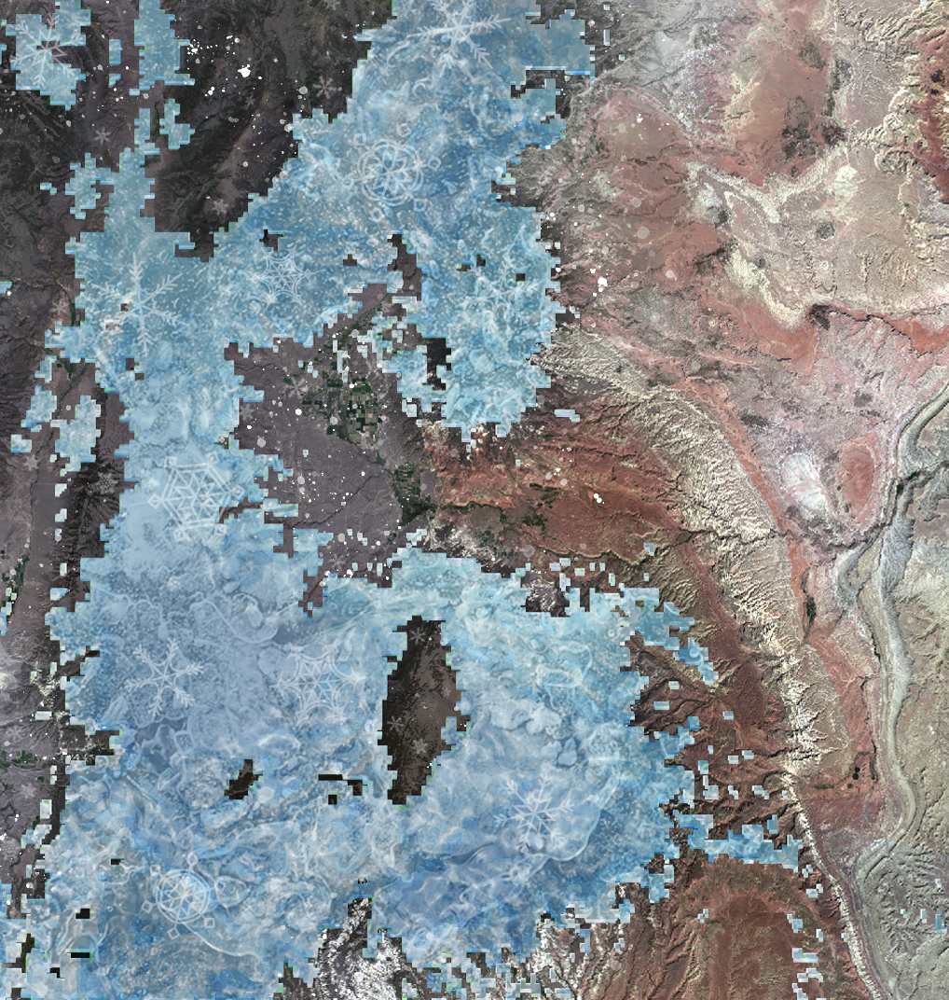
Fremont River Basin Water Resources
Water Availability Assessment from Annual Snowpack in the Fremont River Basin Based on NASA Earth Observations and In Situ Data
Margaret Mulhern
Manda Au
Nolan Barrette
Austin Counts
Notes:
Script:
Hello! My name is Margaret Mulhern and I am the Project Lead.
I am Manda Au.
I am Nolan Barrette.
I am Austin Counts.
We are the Fremont River Basin Water Resources team. We studied the water availability from annual snowpack in the Fremont River Basin based on NASA Earth observations and in situ data.
Image Source:
Fremont River Basin Water Resources Team

Slide 2
Community Concerns
The Fremont River water flow is dependent on snowmelt
Water flow is currently predicted utilizing USDA Snowpack Telemetry (SNOTEL) in situ data
Observed water flow has not matched the predicted water flow
Image Credit: National Park Service
Notes:
Script:
For the Fremont River, snowmelt is a primary source of water throughout the year.
The predicted water flow from USDA Snowpack Telemetry (SNOTEL) monitoring station data has not aligned with the observed water flow from stream gauge data in the basin. During the 2016 to 2017 season, the measured snow pack at the two SNOTEL stations, both at the same elevation, showed the year’s snow pack to be 100% to 110%. Thus, a normal water year was expected for irrigation purposes.
Image Source:
National Park Service. Sent directly to the team by the project partners.

Slide 3
Community Concerns
The Utah Division of Water Rights requested reductions in irrigation water from the Fremont River
Image Credit: Terry Fisk, National Park Service
Notes:
Script:
Instead, by mid-summer 2017, the Utah Division of Water Rights requested reductions in irrigation water allotment from the Fremont River. The park needed to reduce their irrigation to 70% of their allotted amount. The Utah Division of Water Rights does not partition water for the Fremont River, but instead requires a certain volume of water reaches the Dirty Devil River down stream. During years of lower water flow, they can request reductions in irrigation to be sure the required volume is met.
Image Source:
Terry Fisk, National Park Service. Sent directly to the team by the project partners.

Slide 4
Community Concerns
Capitol Reef National Park manages historic orchards and pastures, which rely on irrigation water from the Fremont River
Image Credit: National Park Service
Notes:
Script:
The Fremont River irrigates approximately 16,000 acres of agricultural land in Southern Utah, including the irrigation of historic orchards and pastures managed by Capitol Reef National Park. In this semi-arid environment, “Water is life” (Terry Fisk), and the Fremont River is the primary source of water in the basin for irrigation.
Image Source:
National Park Service. Sent directly to the team by the project partners.

Slide 5
Community Concerns
The Natural Resources Conservation Service (NRCS) of the USDA creates forecasts for the Dirty Devil River
The NRCS does not forecast for the Fremont River
Image Credit: Monet
Image Credit: National Park Service
Notes:
Script:
The Natural Resources Conservation Service of the USDA creates forecasts for the Dirty Devil River downstream of Capitol Reef National Park, but it does not partition out flows for the Fremont River. As a result, those in the Fremont River Basin currently only rely on the data from the SNOTEL stations. Our project can provide tools for Capitol Reef National Park to better predict water availability each year from snow melt using NASA Earth Observations.
Image Source:
National Park Service. Sent directly to the team by the project partners.

Slide 6
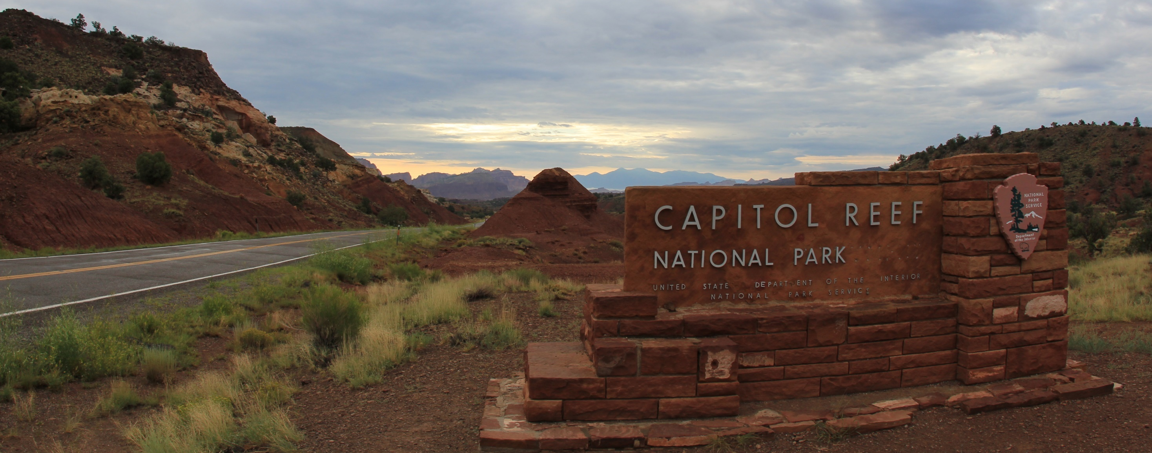
Project Partners
Northern Colorado Plateau Network, National Park Service
Capitol Reef National Park, National Park Service
Image Credit: daveynin
Notes:
Script:
For this project, we had two partners. Our partners were the Northern Colorado Plateau Network and Capitol Reef National Park, both a part of the National Park Service.
Image Source:
https://flic.kr/p/adXTcc

Slide 7
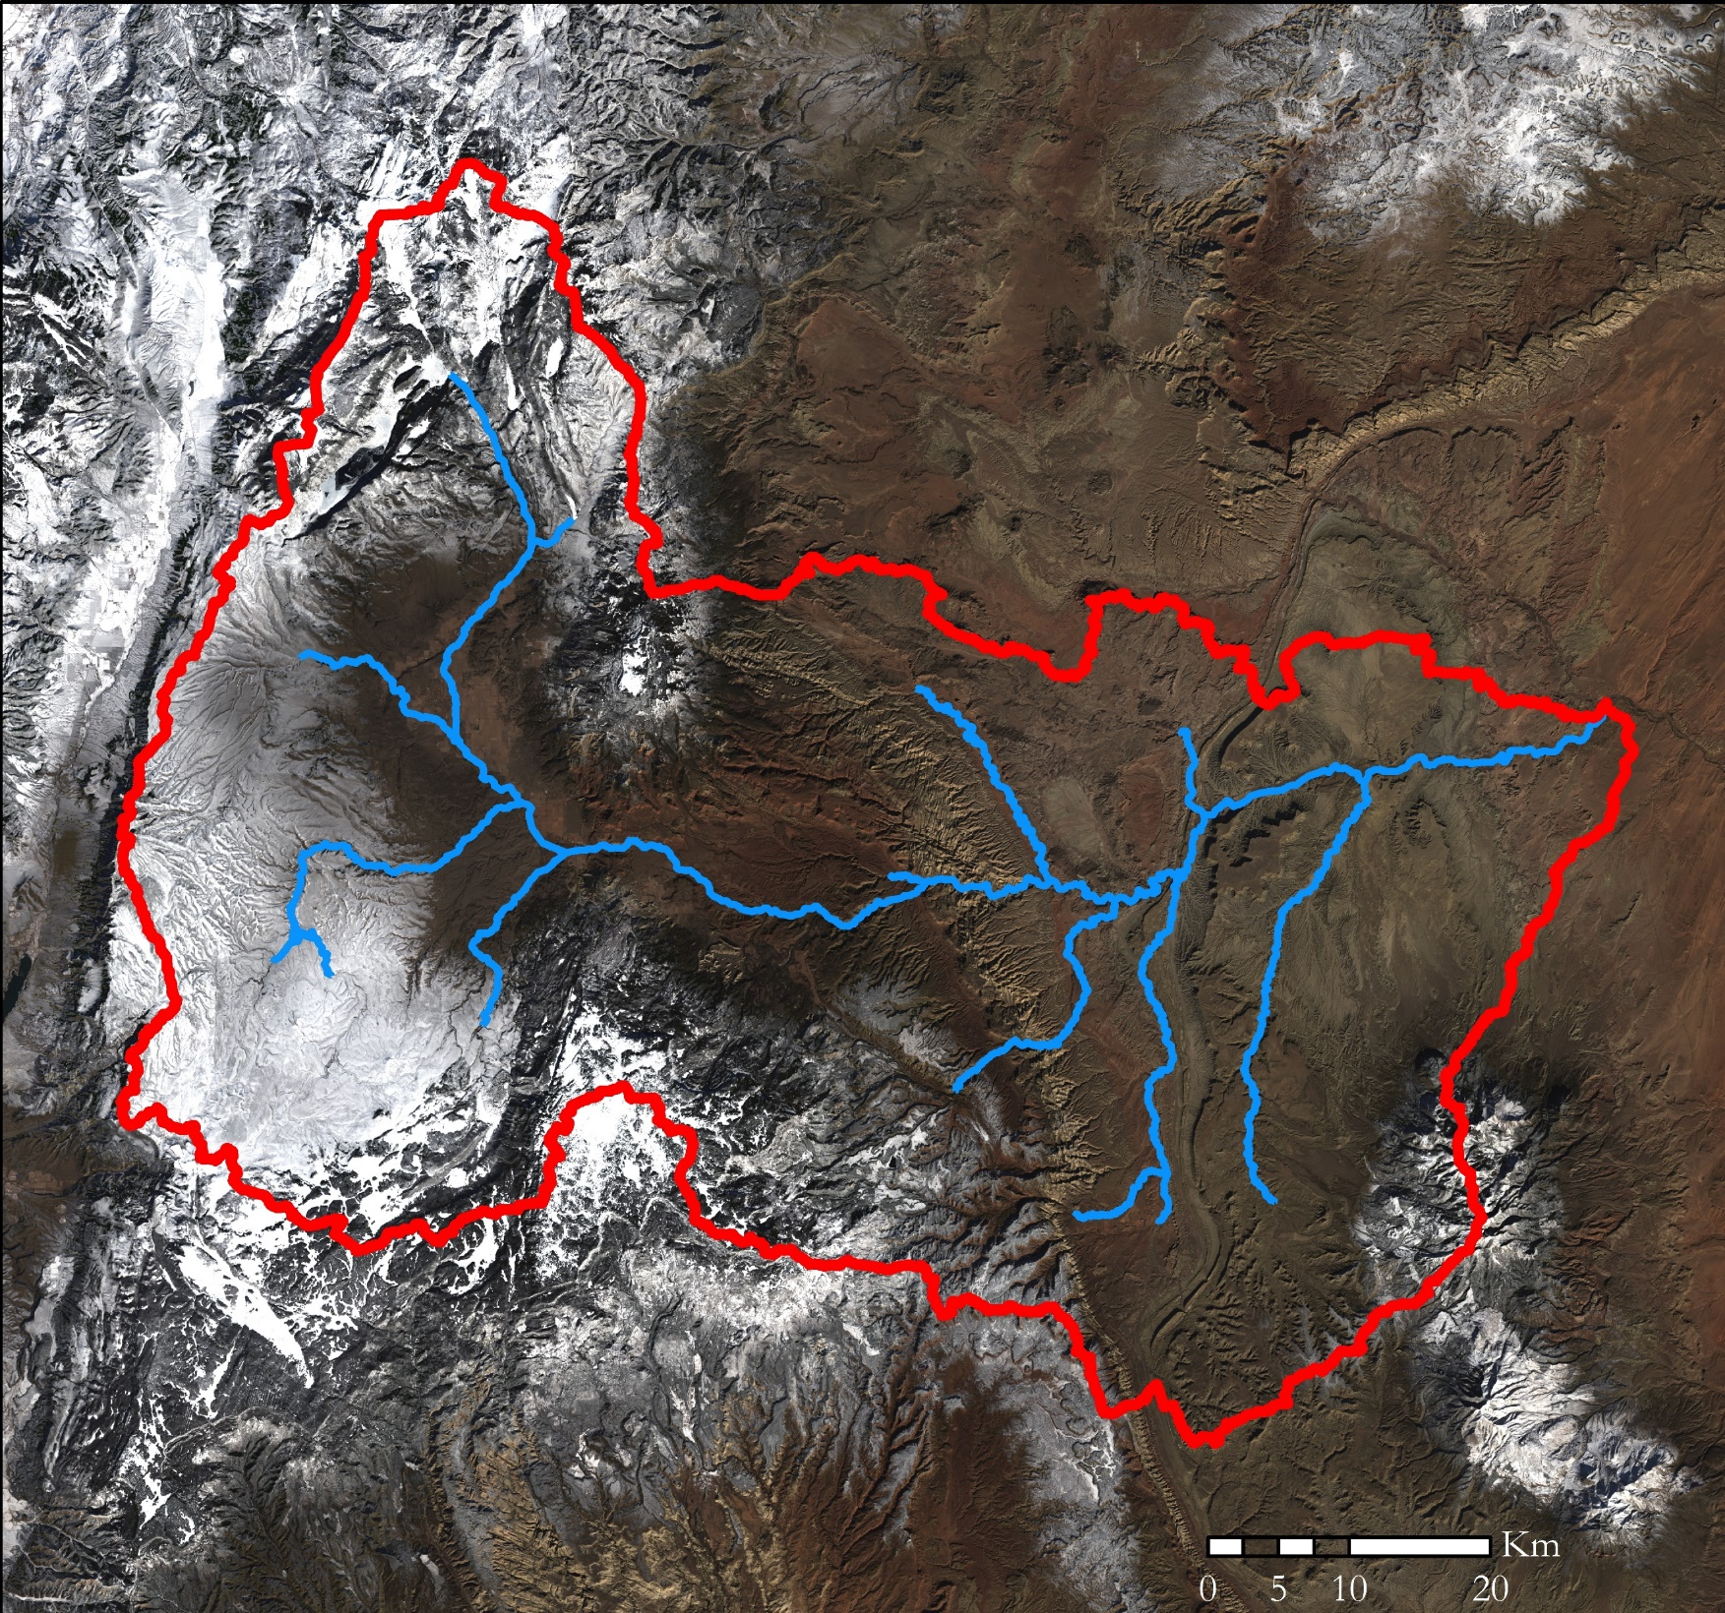
Study Area
ID
WY
Utah
NV
CO
AZ
NM
CA
Fremont River Watershed
Fremont River & Tributaries
Landsat 8 OLI Natural Color Imagery
Notes:
Script:
Our study area is located in southern Utah and includes Capitol Reef National Park.
Image Source:
Study Area Map created by the Fremont River Basin Water Resources Team.
Base Layer is USGS and NASA Landsat 8 OLI Natural Color Imagery

Slide 8
Objectives
Derive a viable runoff model for the Fremont River Basin
Detect snow cover from NASA Earth observations
Model and Predict water flow
Image Credit: Terry Fisk, National Park Service
Notes:
Script:
During the Fall 2013 and Spring 2014 NASA DEVELOP terms, the Chile Water Resources team created the Modified – Snowmelt Runoff Model, or M-SRM, that accomplished what we are trying to do in our project. However, since the creation of this code 4 years ago, it has not been updated.
We set out to update the M-SRM for use in the Fremont River Basin, and to be used in conjunction with current software. We have named the new updated version the Snowmelt Observational Watershed Model, or SNOW-M,.
Our objectives were also:
- To derive snow maps from Terra MODIS snow indices to detect accumulation and snow cover in the Fremont River Basin, including Capitol Reef National Park.
To model water flow into the Fremont River from 2000 to 2017, using SNOW-M
And, to predict water flow for up to 3 months, which can be useful for our partners to plan their irrigation for the coming season.
Image Source:
Terry Fisk, National Park Service. Sent directly to the team by the project partners.

Slide 9
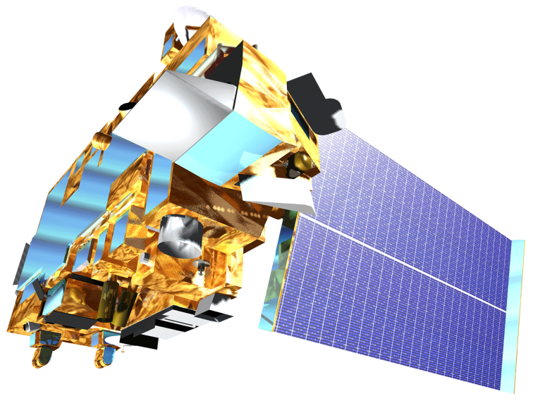
NASA Earth Observations
Terra Moderate Resolution Spectroradiometer (MODIS)
Landsat 8 Operational Land Imager (OLI)
(USGS & NASA)
Image Credit: DEVELOPedia
Notes:
Script:
We acquired Level 3 Terra MODIS snow indices and temperature data. We utilized Landsat 8 Operational Land Imager (OLI) for validation of the MODIS snow indices. While Landsat 8 provides better spatial resolution, Terra MODIS has daily acquisitions which allows for higher accuracy for SNOW-M.
Image Source:
http://www.devpedia.developexchange.com/dp/index.php?title=List_of_Satellite_Pictures

Slide 10
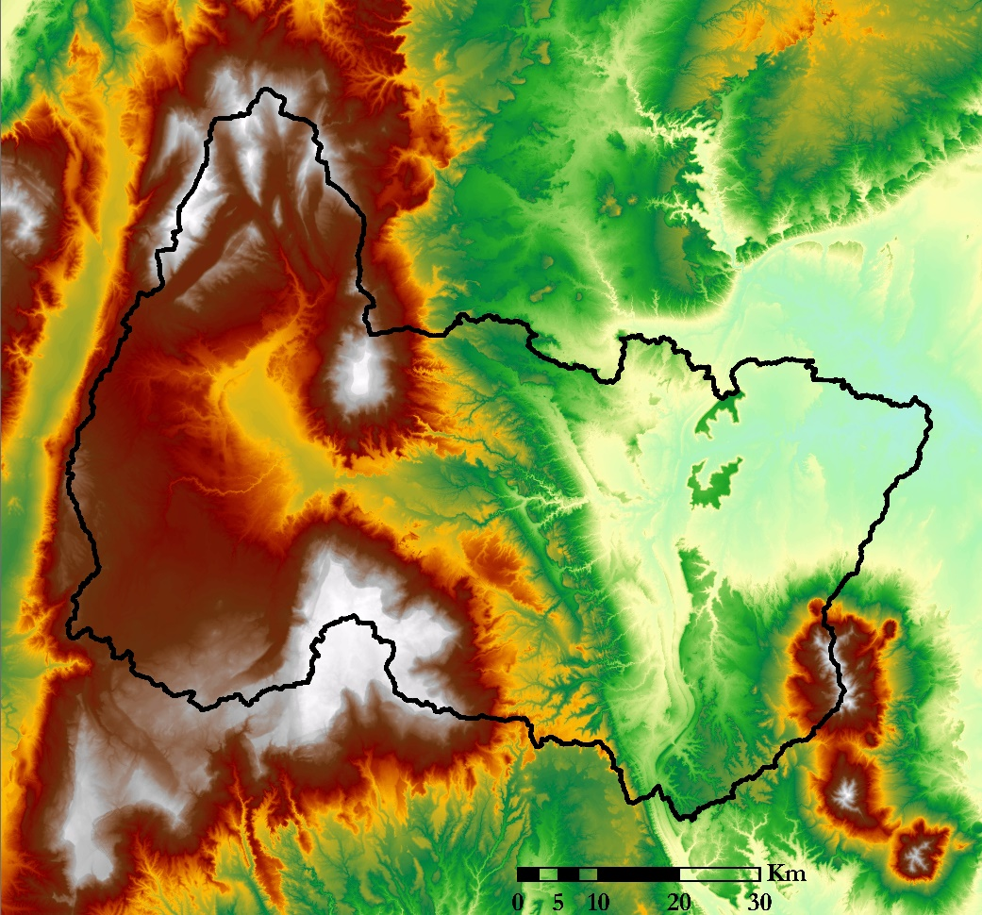
Additional Data
Elevation (m)
Precipitation
⅓ Arc Second
LiDAR DEM
NOAA PERSIANN-CDR
High : 3544.38
High : 145.03
Low : 1270.82
Low : 0
Image Credit: Fremont River Basin Water Resources Team
Notes:
Script:
We also incorporated a 1/3 Arc Second LiDAR DEM from the National Land Cover Database and precipitation data from PERSIANN-CDR. The DEM was used for its high spatial resolution for determining the watershed boundary and elevation zones within the basin. The M-SRM used TRMM data with the model, however we updated SNOW-M to use PERSIANN. PERSIANN has shown greater accuracy over TRMM for our study region, and they both have the same spatial resolution.
Image Source:
Fremont River Basin Water Resources Team

Slide 11
Ancillary Data
USDA Snowpack Telemetry (SNOTEL) Snow Water Equivalent (SWE) data
USGS stream gauge data
Image Credit: Terry Fisk, National Park Service
Notes:
Script:
For in situ data, we utilized USDA Snowpack Telemetry Snow Water Equivalent data from two different SNOTEL monitoring stations, and USGS stream gauge data. The stream gauge measurements along with the precipitation and temperature measurements from SNOTEL sites are used to assess the accuracy of the model.
Image Source:
Terry Fisk, National Park Service. Sent directly to the team by the project partners

Slide 12
Models
Soil and Water Assessment Tool (ArcSWAT)
Modified Snowmelt-Runoff Model (M-SRM)
SNowmelt Observational Watershed Model (SNOW-M)
Image Credit: National Park Service
Notes:
Script:
We used Soil and Water Assessment Tool, or ArcSWAT, to determine the boundary of the Fremont River Watershed. The tool utilizes the differences in slope profiles to pinpoint where watershed boundaries are located.
The Modified Snowmelt-Runoff Model was originally created for the Chile Water Resources Project from Fall 2013 and Spring 2014. We needed to update the code for this model to work for our study area and data sets. The original code was written specifically for their study area in Chile, and we have been making updates with the long term goal of having a more dynamic model. We used M-SRM as the base code and structure for the SNowmelt Observational Watershed Model tool, which is the primary model for our project.
Citation:
SNowmelt Observational Watershed Model (SNOW-M) (NASA DEVELOP)
Modified Snowmelt-Runoff Model (M-SRM) (NASA DEVELOP)
Soil and Water Assessment Tool (ArcSWAT) (USDA and Texas A&M)
Image Source:
National Park Service. Sent directly to the team by the project partners

Slide 13
Methodology
DEM
ArcSWAT Watershed Delineation
Modified Snowmelt Runoff Model
(M-SRM)
Snowmelt Observational Watershed Model
(SNOW-M)
In situ SNOTEL Data
In situ Stream Gauge Data
Landsat 8 OLI
MODIS NDSI
MODIS
LST
PERSIANN Precipitation
Elevation Zones
Validate Snow Cover
SNOW-M
Actual vs Simulated Flow Plot
Snow Cover Area Plot
Snow Maps
Validation Table
Notes:
Script:
Here is a quick overview of our methodology before we dive into each individual component.
--click for animation--
We spent the majority of our time during the term taking the previously made Modified Snowmelt Runoff Model and updating it into the SNowmelt Observational Watershed Model (SNOW-M). Initially, it was believed the original model could undergo minor adjustments to be used for our project, however, we determined the code needed significant updates and changes.

Slide 14
Methodology
Delineate Watershed within ArcSWAT
Create Elevation Zones
Elevation (m)
1296-1966
1967-2601
2602-3544
Notes:
Script:
We used the ArcSWAT plug-in within ArcGIS to delineate our watershed. Within our watershed boundary, we created elevation zones, which is a required input for SNOW-M. We chose three elevation zones, which closely resemble the change in precipitation and vegetation by elevation within our study area. We compared our elevation zones with previous research to determine if the divisions were reasonable.
Source:
https://www.cbrfc.noaa.gov/papers/snow_rs_op_streamflow_prediction_2014WSC.8.pdf
Image Source:
Fremont River Basin Water Resources Team

Slide 15
Snow Extent
Fractional Snow Cover (%)
0 - 20
Snow Cover comparison between MODIS Normalized Difference Snow Index (NDSI) and Landsat 8 OLI
21 - 30
31 - 40
41 - 50
51 - 60
61 - 70
71 - 80
No Decision
Cloud
Landsat 8 OLI False Color Imagery
Notes:
Script:
Before moving forward, we used Landsat 8 OLI imagery to visually compare the snow cover determined by Normalized Difference Snow Index, or NDSI in the MODIS Snow Indices. After indicating the areas of snow cover were not under estimated, we chose to move forward with the model.
Images: (Both From January 23, 2018)
LANDSAT 8 OLI False Color Image (6,5,3)(SWIR1,NIR,Green)
MOD10A1 NDSI Fractional Snow Cover Image

Slide 16
SNOW-M Inputs
In situ SNOTEL Data
In situ Stream Gauge Data
MODIS NDSI
MODIS
LST
PERSIANN Precipitation
Elevation Zones
SNOW-M
Notes:
Script:
The SNowmelt Observational Watershed Model (SNOW-M) takes MODIS NDSI, MODIS LST, PERSIANN Precipitation, in situ SNOTEL Data, in situ Stream Gauge Data, and the Elevation zones file we previously described. Each of the inputs went through preprocessing prior to being run through the GUI for SNOW-M.
SNOW-M is currently going through the NASA Software Release Process.

Slide 17
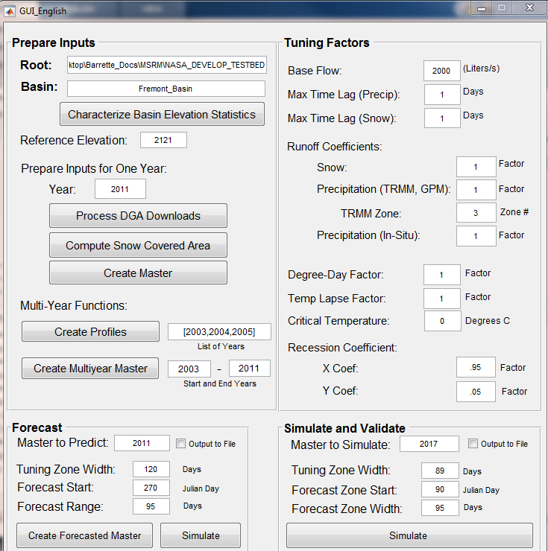
SNOW-M GUI
Notes:
Script:
The GUI also allows for tuning factors such as Base Flow, Runoff Coefficients, and Degree Day Factor. These allow the model to predict what percentage of precipitation is available as runoff within the basin.

Slide 18
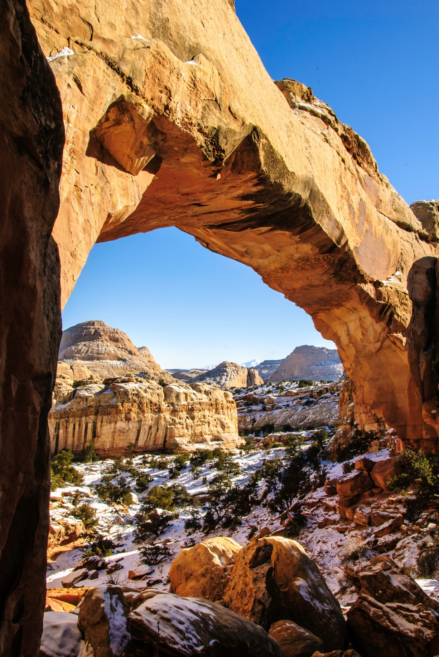
Outputs
SNOW-M Outputs:
Validation Table
Actual Flow vs. Simulated Flow Plot
Snow Cover Area Plot
Snow Maps
Image Credit: Terry Fisk, National Park Service
Notes:
Script:
The model outputs include a validation table, an Actual Flow versus Simulated Flow Plot, and a Snow Cover Area Plot.
We also created Snow Maps from monthly MODIS NDSI imagery. And conducted additional snow cover change analysis between the rasters.
Image Source:
Terry Fisk, National Park Service. Sent directly to the team by the project partners

Slide 19
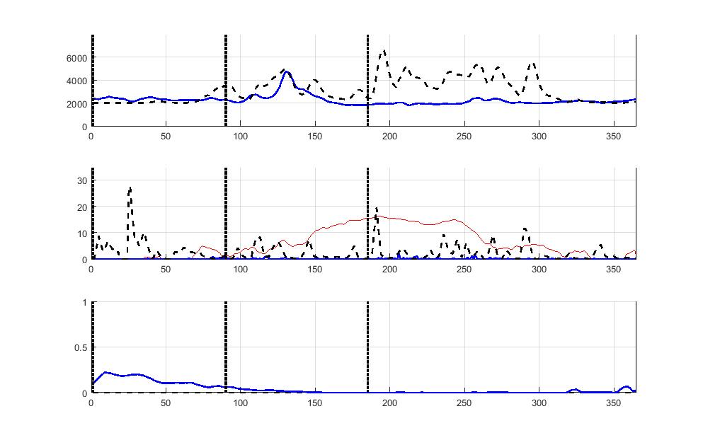
Model Results
In-Situ Flow vs. Simulated Flow: 2017
Tuning Zone
Projection Zone
Flow (L/s)
In-Situ
Simulated
Precipitation vs. Temperature: 2017
Tuning Zone
Projection Zone
Temperature
Precipitation (cm/day)
Temperature (C)
Precipitation (in-situ)
Precipitation (PERSIANN)
Snow Covered Area: 2017
Tuning Zone
Projection Zone
Fractional Area
Low Elevations
High Elevations
Notes:
Script:
This simulation is set with a base flow of 2000 L/s and all other variables at default. The Actual vs. Simulated Flow graph shows a 25% error in the simulated value compared to the actual value within the projection zone. In addition the Precipitation vs. Temperature graph shows that the PERSIANN data is recording larger precipitation values compared to the in-situ SNOTEL stations. The last graph shows the fractional snow covered area within the basin.
Image Source:
Fremont River Basin Water Resources Team

Slide 20
Snow Cover Change
% Difference
4.7 - 6.3
3.2 - 4.7
1.6 - 3.2
0 - 1.6
-2.5 - 0
-5.1 - -2.5
-7.6 - -5.1
-9.6 - -7.6
Image Credit: Fremont River Basin Water Resources Team
Landsat 8 OLI Natural Color Imagery
Notes:
Script:
For the 2016 to 2017 water year, there was less snow cover than the average observed from 2000 to 2010. This may account for the change in the irrigation water allotment experienced during that year. This is not suggesting an overall trend in the area, only showing a possible explanation why less water was seen during the 2016 to 2017 water year. We utilized monthly Terra MODIS NDSI imagery to determine the change detection.
Image Source:
Fremont River Basin Water Resources Team

Slide 21
In Conclusion
Preliminary snow cover change map for the 2016 to 2017 water year show less snow cover
The SNOW-Model was written and adapted from M-SRM to fit the Fremont River Basin.
The project resulted in the development of the SNOW-Model.
Image Credit: Terry Fisk, National Park Service
Notes:
Script:
Comparing 2016-2017 snow cover with the average for 2000-2010 we see less snow cover at higher elevations in our preliminary analysis, and next term will further analyze this through the model. The Snow-Model was written and adapted for the Fremont River Basin from the previously made M-SRM. We now have a running model for snow runoff, however, there are improvements that can be made in the model during the second term of this project.
Image Source:
Terry Fisk, National Park Service. Sent directly to the team by the project partners

Slide 22
Further Model Development
Model for a water year instead of a calendar year
Convert the model code to R
Update the SNOW-M in situ data inputs
Continue to tune the model for our current study area
Image Credit: Terry Fisk, National Park Service
Notes:
Script:
Currently, the model is written to analyze each calendar year. This was appropriate when the study region was in the southern hemisphere, however, for studying basins in the United States, the model will be updated to follow the USGS prescribed water year, which is from October 1st to September 30th. This time period would capture the total snow fall during the winter season, which contributes to the snow melt the following spring.
Our partners primarily use R and no longer use MATLAB. For the model to be a long term tool for our partners, it should be updated to be in R. Also, since R is an open source software, this update will make the model more accessible to future end users.
Currently, the model is still utilizing the Chilean format for temperature data. The model could be updated to allow for a more user-friendly file input system which tolerates variations between data. The CSV formats should be updated to align more seamlessly with USGS stream gauge data and USDA SNOTEL monitoring station data.
Further tuning is needed for simulating water flow, as previously discussed.
Finally, the second term should continue to update the code for further water basin flexibility. This model can be more easily adaptable from basin to basin.
Image Source:
Terry Fisk, National Park Service. Sent directly to the team by the project partners

Slide 23
Future Work
Utilize irrigation logs
Integrate snow indices from Suomi NPP VIIRS
Incorporate precipitation data from GPM
Image Credit: Terry Fisk, National Park Service
Notes:
Script:
The model would benefit from the addition of irrigation logs, showing the amount of water being pulled for irrigation purposes.
As the MODIS sensors will eventually be phased out, the second term of this project should adjust the SNOW-Model to use the snow indices from Suomi NPP VIIRS for the longevity of this tool for our partners.
We have also suggested the second term incorporate the precipitation data from GPM, because it has a better spatial resolution than the current precipitations data set from PERSIANN. The data for the VIIRS snow indices and the GPM precipitation data both began collection in 2014, and we think the switch to both is a natural collaboration.
Image Source:
Terry Fisk, National Park Service. Sent directly to the team by the project partners

Slide 24
Acknowledgements
Joseph Spruce, Lead Science Advisor for NASA DEVELOP VA – Wise County
Dr. L. DeWayne Cecil, Chief Climatologist at NOAA National Centers for Environmental Information and Program Manager of Global Science & Technology, Inc.
Annette Hollingshead, Senior Scientist of Global Science & Technology, Inc.
Bob VanGundy, Geology Instructor at The University of Virginia’s College at Wise
Dr. Kenton Ross, Lead Science Advisor for NASA DEVELOP National Program
Katherine Cavanaugh, Geoinformatics Fellow at NASA DEVELOP, Jet Propulsion Laboratory
Eric White, Center Lead at NASA DEVELOP Wise County Clerk of Circuit Court’s Office
Brooke Colley, Assistant Center Lead at NASA DEVELOP Wise County Clerk of Circuit Court’s Office
Notes:
Script:
The Fremont River Basin Water Resources team would like to thank their team of support, including science advisors, our node leadership at the Wise County Clerk of Circuit Court’s Office, and Kate, our Geoinformatics fellow at JPL.

Slide 25
Acknowledgements
Rebecca Weissinger, National Park Service, Northern Colorado Plateau Network Ecologist
Terry Fisk, Chief of Resource Management and Science at Capitol Reef National Park
Notes:
Script:
Additionally, the team appreciates the enthusiasm and assistance from the Fremont River Basin Water Resources project partners, who made this project possible:
Rebecca Weissinger, National Park Service, Northern Colorado Plateau Network Ecologist; and
Terry Fisk, Chief of Resource Management and Science at Capitol Reef National Park.

Slide 26
Acknowledgements
Jeffry Ely, Project Lead, Chile Water Resources, Langley Research Center, Spring 2014
Joshua Kelly, Team Member, Chile Water Resources, Langley Research Center, Spring 2014; and Project Lead, Chile Water Resources and Agriculture, Fall 2013
Joseph Novak, Team Member, Chile Water Resources, Langley Research Center, Spring 2014
Laura Macaluso, Team Member, Chile Water Resources, Langley Research Center, Spring 2014
Lyndia Cuker, Team Member, Chile Water Resources, Langley Research Center, Spring 2014
Bethany Burress, Team Member, Chile Water Resources and Agriculture, Fall 2013
Jeffry Ely, Team Member, Chile Water Resources and Agriculture, Fall 2013
Amberle Keith, Team Member, Chile Water Resources and Agriculture, Fall 2013
Ajoke Williams, Team Member, Chile Water Resources and Agriculture, Fall 2013
Notes:
Script:
The team would also like the acknowledge the previous two DEVELOP teams whom created the original Modified Snowmelt-Runoff Model (M-SRM) utilized in our project:

Slide 27
Thank You
Margaret Mulhern
Project Lead
Manda Au
Nolan Barrette
Austin Counts
Notes:
Script:
Thank you for taking the time to listen to our presentation. We can take any questions that you may have at this time.

Slide 28
Methodology
1/3 Arc Sec LiDAR DEM
ArcSWAT Watershed Delineation
Landsat 8 OLI
MODIS NDSI
MODIS
LST
In-situ SNOTEL Data
In-situ Stream Gauge Data
Elevation Zones
PERSIANN Precipitation
Validate Snow Cover
SNOW-M
Actual vs Simulated Flow Plot
Snow Cover Area Plot
Snow Maps
Validation Table
Notes:
Backup slide of the Methodology flow chart without animation to refer to during questions.

Slide 29
SNOW-M GUI
Notes:
NOTES:
Base Flow: Groundwater Flow in the basin
Max Time Lag: Time it takes for unit of water to reach stream gauge from basin
Runoff Coefficients: Characterizes percentage of precipitation as overland flow (surface flow)
Degree Day Factor: Seasonally fluctuating value indicating depth of snow which is melted for each degree over a critical temperature (0 C)
Temperature Lapse Rate: Extrapolates average temperature in elevation zones from a reference temperature at a lower elevation
X & Y coefs: basin parameters characterizing resistance to rapid changes in flow rate

Slide 30
Model Results
In-Situ Flow vs. Simulated Flow: 2017
Tuning Zone
Projection Zone
Flow (L/s)
In-Situ
Simulated
Precipitation vs. Temperature: 2017
Tuning Zone
Projection Zone
Temperature
Precipitation (cm/day)
Temperature (C)
Precipitation (in-situ)
Precipitation (PERSIANN)
Snow Covered Area: 2017
Tuning Zone
Projection Zone
Fractional Area
Low Elevations
High Elevations
Notes:
Script:
This simulation is set with a base flow of 2000 L/s and all other variables at default. The Actual vs. Simulated Flow graph shows a 25% error in the simulated value compared to the actual value within the projection zone. In addition the Precipitation vs. Temperature graph shows that the PERSIANN data is recording larger precipitation values compared to the in-situ SNOTEL stations. The last graph shows the fractional snow covered area within the basin.
Image Source:
Fremont River Basin Water Resources Team

Slide 31
Snow Cover Change
% Difference
4.7 - 6.3
3.2 - 4.7
1.6 - 3.2
0 - 1.6
-2.5 - 0
-5.1 - -2.5
-7.6 - -5.1
-9.6 - -7.6
Image Credit: Fremont River Basin Water Resources Team
Landsat 8 OLI Natural Color Imagery
Notes:
Script:
For the 2016 to 2017 water year, there was less snow cover than the average observed from 2000 to 2010. This may account for the change in the irrigation water allotment experienced during that year. This is not suggesting an overall trend in the area, only showing a possible explanation why less water was seen during the 2016 to 2017 water year. We utilized monthly Terra MODIS NDSI imagery to determine the change detection.
Image Source:
Fremont River Basin Water Resources Team

