Slide 1
Laramie Mountains
Ecological Forecasting
Mapping Fire History in the Laramie Mountain Range, Wyoming with a 31-Year Landsat Time Series
Stephanie Krail (Project Lead)
Alexa Grafton
Aubrey Hilte
Darin Schulte

Slide 2
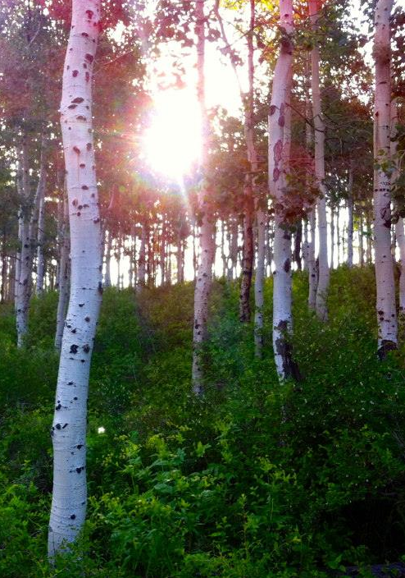
Objectives
Delineate fire history of the Laramie Mountain Range
Calculate fire frequency by combining multiple fire occurrence datasets
Assess the use of annual composite imagery for fire susceptibility mapping
Image Credit: Kelsey Correia
Notes:
The Laramie Mountains Ecological Forecasting project focused on three main objectives for the duration of the term.
-The first goal was to identify and map fire history within the study area between the years of 1984 and 2015.
-Frequency for fires that occurred within the study area were also calculated through the 31-year time series.
-Our last goal was to determine locations within the study area that were susceptible to future fires.
Image Source: Kelsey Correia, Colorado State University
*The Laramie Mountains Ecological Forecasting Team received permission from Kelsey Correia to use her personal photographs for our presentation.

Slide 3
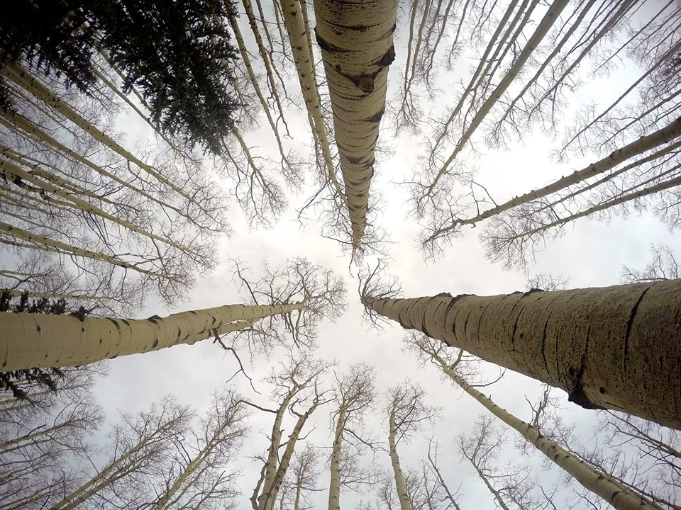
Image Credit: Kelsey Correia,
Community Concerns
Aesthetic and recreational value of aspen
Population fitness of Mule Deer and Elk
Increasing extent of Sudden Aspen Decline (SAD)
Role of fire in aspen regeneration efforts
Notes:
Inspiration for this project stemmed from conversations with our project partners, the Wyoming Game and Fish Department, USDA Forest Service Laramie Ranger District, and Colorado State University, Natural Resource Ecology Laboratory (NREL). Concerns regarding the ecological importance of aspen stands and the decreasing presence of healthy aspen stands within the study area were discussed in-depth.
Mule Deer, Elk, and other ungulate populations’ fitness depends on aspen stands for survival. Aspen are also highly appreciated for their aesthetic and recreational value. The extent of Sudden Aspen Decline (SAD) is increasing throughout the intermountain west and threatens the prosperity of the species. To combat this threat and, ultimately, assist the dependent ecosystems, specific land management plans and prescribed burns are being considered for the area in order to facilitate the regeneration of new, healthy aspen stands.
Image Source: Kelsey Correia, Colorado State University

Slide 4
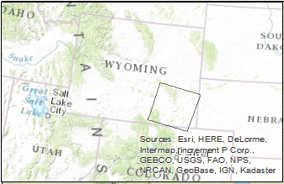
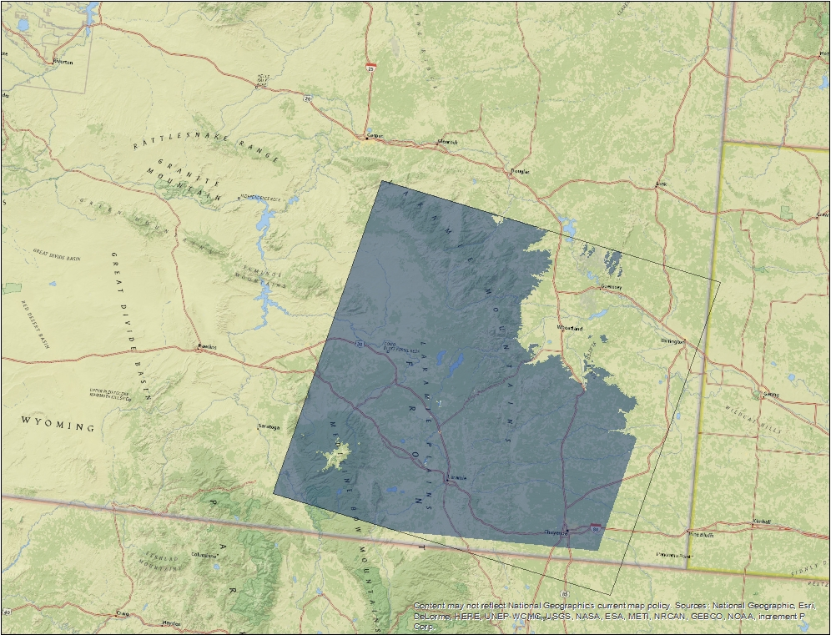
Laramie Mountains Ecological Forecasting
Study Area
Study area extent
Path, row outline
Notes:
The Laramie Mountain Range consists of two units in southern Wyoming, the Pole Mountain (or Sherman) unit and Laramie Peaks unit. With such an expansive range, the area provides a multitude of ecosystem services, including year round recreational opportunities, timber harvest, wildlife habitat, and forage for livestock.
The study area is encompassed by WRS2 Path 34/Row 31 and focuses on areas within aspen species range (elevations of 1580 to 3200 m). The study period is between June 1984 and August 2015 during the growing season months (June to August) when fires are the most prevalent.
Image source: Laramie Mountains Ecological Forecasting Team

Slide 5

Methodology
Data Acquisition
Data
Processing
Modeling
Results
Landsat Imagery
LandsatLinkr
Program
Fire History
Time Series
Supervised
Classification
SRTM
Data
Topographic
Indices
Fire
Frequency
Cluster Analysis
Ancillary
Data
Fire Occurrence Database
Fire Susceptibility
Notes:
Our general workflow included four main stages: Data Acquisition, Data Processing, Modeling, and Analysis of Results.
The following slides explain the components of each stage in more detail.

Slide 6
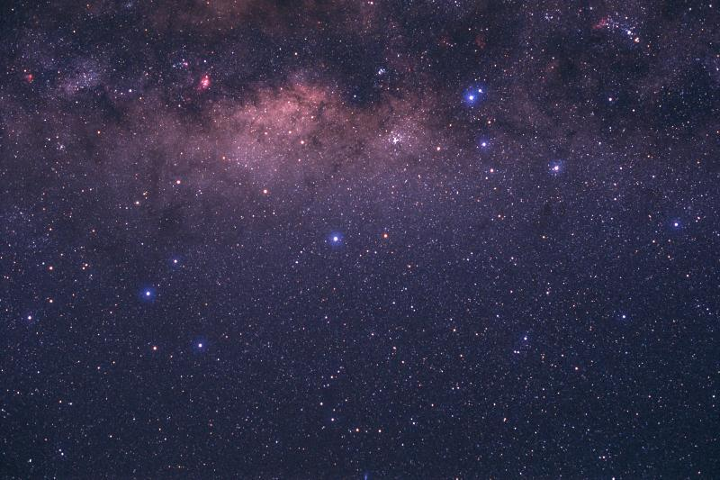

NASA Sensors
Landsat 7 Enhanced Thematic Mapper Plus (ETM+)
Landsat 5 Thematic Mapper (TM)
Landsat 8 Operational Land Imager & Thermal Infrared Sensor (OLI & TIRS)
Shuttle Radar Topography Mission (SRTM)
Image Credit: El Pensieve De Dinorider
Notes:
Through the United States Geological Survey (USGS) EarthExplorer portal, we downloaded tiles from the Shuttle Radar Topography Mission (SRTM) digital elevation model (DEM) data for the range of our study area. Also through the EarthExplorer portal, we compiled all available Landsat 5 TM, Landsat 7 ETM+, and Landsat 8 OLI/TIRS imagery with less than 20% cloud cover for the 1984-2015 growing seasons (June through August).
Image Source: El Pensieve De Dinorider, http://dinorider.blogspot.com/2005_06_01_dinorider_archive.html, http://creativecommons.org/licenses/by-nc-nd/4.0/legalcode

Slide 7
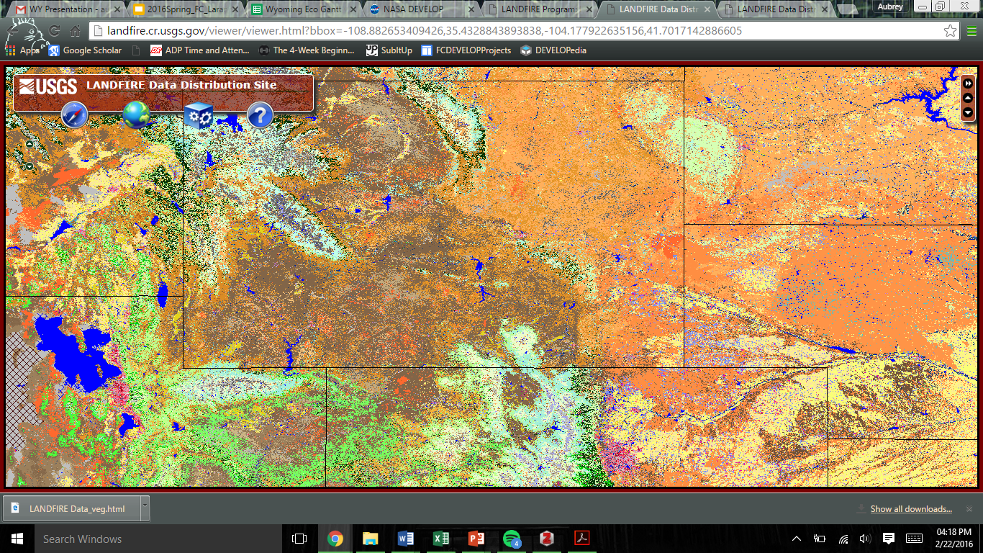
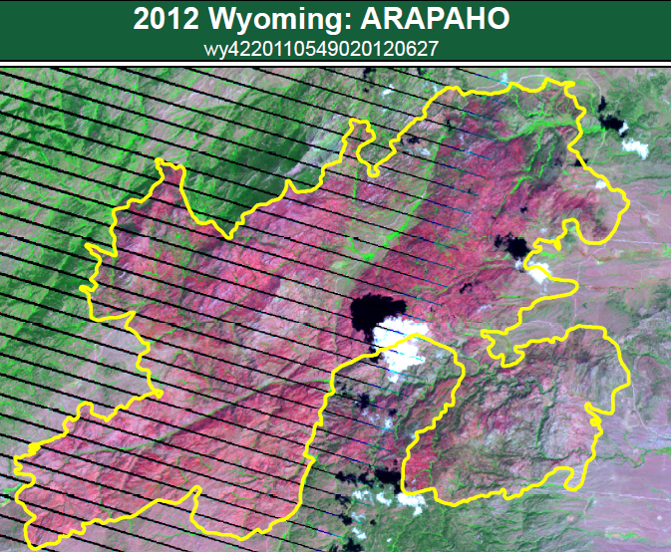
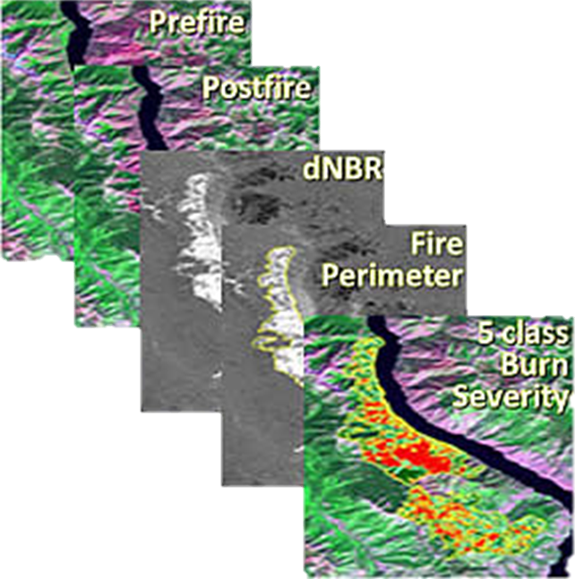
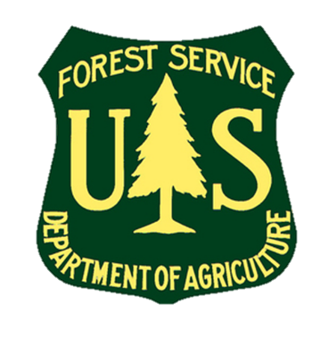
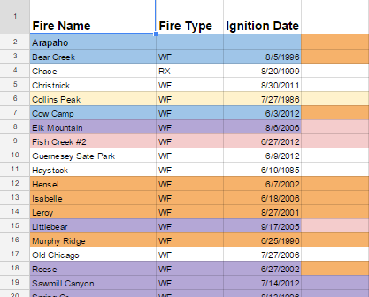
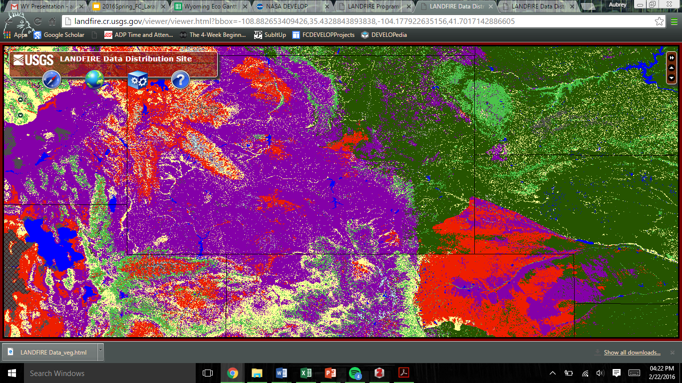
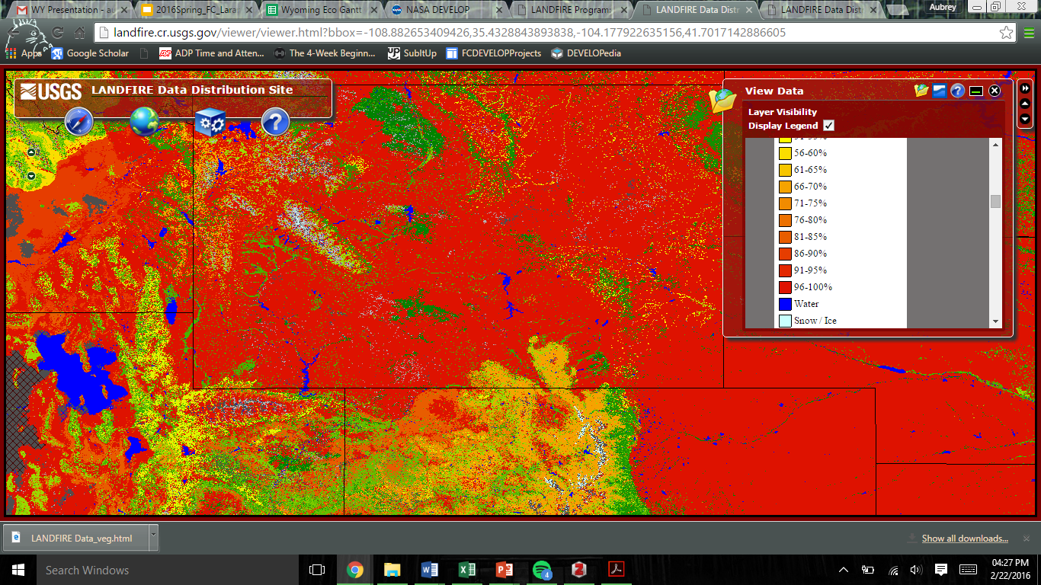
Ancillary Data
LANDFIRE Layers
Field data from USDA Forest Service, Laramie Ranger District
Monitoring Trends in Burn Severity (MTBS)
Notes:
The USDA Forest Service, Laramie Ranger District provided us with shapefiles and metadata (point and polygon) for Administrative Boundaries, Vegetation Records, and Fire History Records within our study area extent. Additional vegetation and fire history records were acquired from the Landscape Fire and Resource Management Planning Tools Program (LANDFIRE) and Monitoring Trends in Burn Severity (MTBS).
Image Source:
http://www.mtbs.gov/data/individualfiredata.html; http://nrfirescience.org/event/landfire-3-customizing-data; http://www.fs.usda.gov/prc

Slide 8
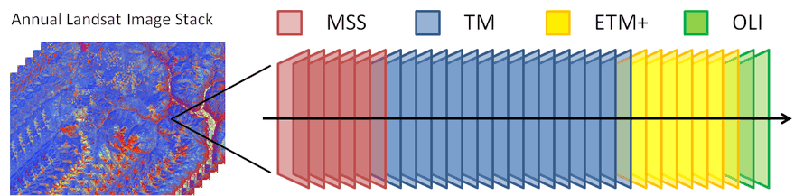
LandsatLinkr
SRTM
Platform | Data Product | Spatial Resolution | Images
Landsat 5 | TM | 30 m | 110
Landsat 7 | ETM+ (SLC-off) | 30 m | 12
Landsat 8 | OLI & TIRS | 30 m (OLI) & 100 m (TIRS) | 43
SRTM | DEM | 30 m | 6
Image Source: Justin Braaten
Notes:
We preprocessed a total of 171 downloaded images with LandsatLinkr, an automated system that creates spectrally consistent Landsat imagery across SRTM, TM, ETM+, and OLI sensors. A specific breakdown of the collected imagery can be see in the table.
The tiles of SRTM elevation data were mosaicked together to create a digital elevation map of the area using the LandsatLinkr package in the R statistical computing language and environment. Aspen in the intermountain west typically occur between 1,500 m and 3,200 m in elevation. The study site for this project was determined by excluding locations with elevation values outside of this range. Processing of SRTM data was performed in QGIS Desktop version 2.12.1.
Data downloaded from EarthExplorer were decompressed, stacked, resampled, and reprojected within LandsatLinkr. Tasseled-cap indices were calculated for each TM and ETM+ image. OLI data were spectrally calibrated to ETM+ data, and annual cloud-free composite images were generated as stand-alone outputs, as well as a time series stack consisting of all annual cloud-free image composites.
Annual composites for each year were mosaicked together for each year. Locations outside of the study area were masked, and the resulting image stack was used for subsequent data analysis.
Image Source: http://landsatlinkr.jdbcode.com/

Slide 9
Burn Scar
Image Credit: Laramie Mountains Ecological Forecasting Team
Modeling
Supervised classification to identify burn scars
Fire Regime Condition Class Mapping Tool for fire frequency
Cluster Analysis to calculate fire susceptibility
Notes:
A variety of different tools were used to model our final results. To identify fire history in the yearly composites, supervised and unsupervised classifications were performed with the same training data. A downloaded tool, called the Fire Regime Condition Class Mapping Tool, was utilized to detect and map fire frequency within our study area. And lastly, fire susceptibility was calculated with the use of a cluster analysis.
Image Source: Laramie Mountains Ecological Forecasting Team

Slide 10
Results
Burn scar classification maps identifying fire affected pixels
Fire frequency map
Fire susceptibility mapping with a nearest-neighbors approach
Agricultural Plots
Image Credit:
Laramie Mountains Ecological Forecasting Team
Notes:
Our final results consisted of a fire history map for each year within the study period, a fire frequency map, and a fire susceptibility map for the study area.
Image source: Laramie Mountains Ecological Forecasting Team

Slide 11
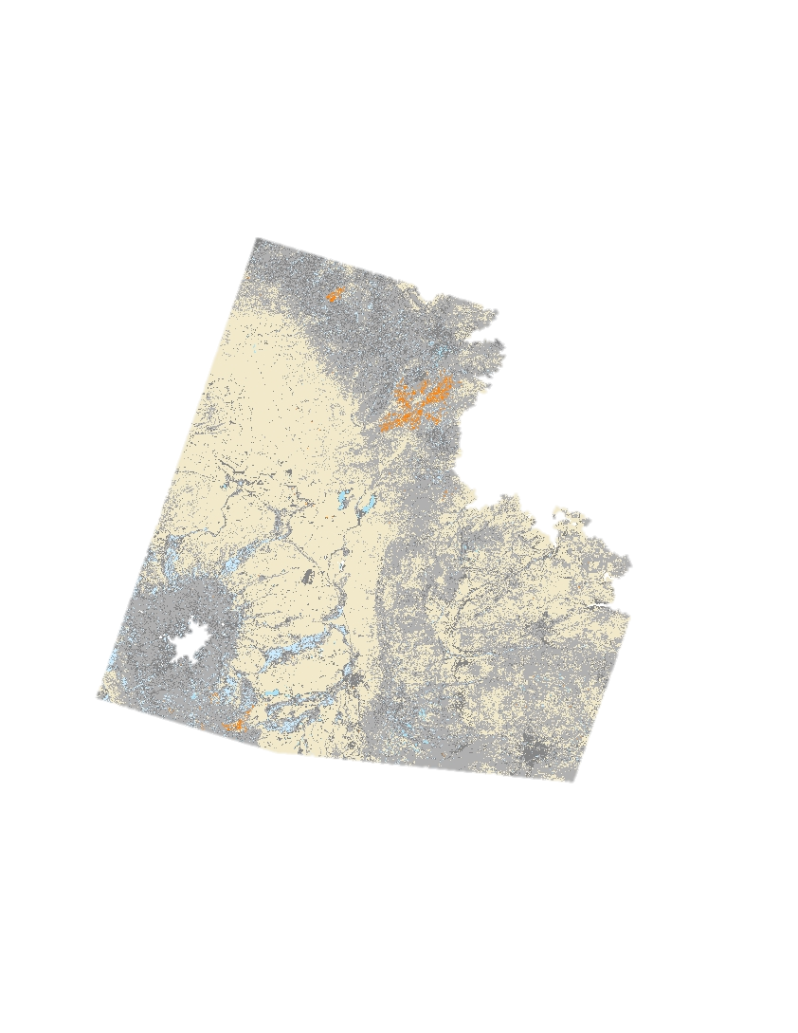
Fire History
Legend
2012 Fire Affected Pixels
Image source: Laramie Mountains Ecological Forecasting Team
Notes:
A Maximum Likelihood supervised classification was performed on composited tasseled-cap (tcap) images in order to identify individual pixels affected by fire.
The above graphic highlights the Arapaho (South) and Russell’s Camp (North) Fires, which both burned in 2012, in orange.
Training samples were created by zooming in on individual pixels and assigning its spectral signature to its specific cover type. Models were given the signature files and proceeded to discern whether a pixel was burned or unburned across multiple years of composite imagery.
Image source: Laramie Mountains Ecological Forecasting Team

Slide 12
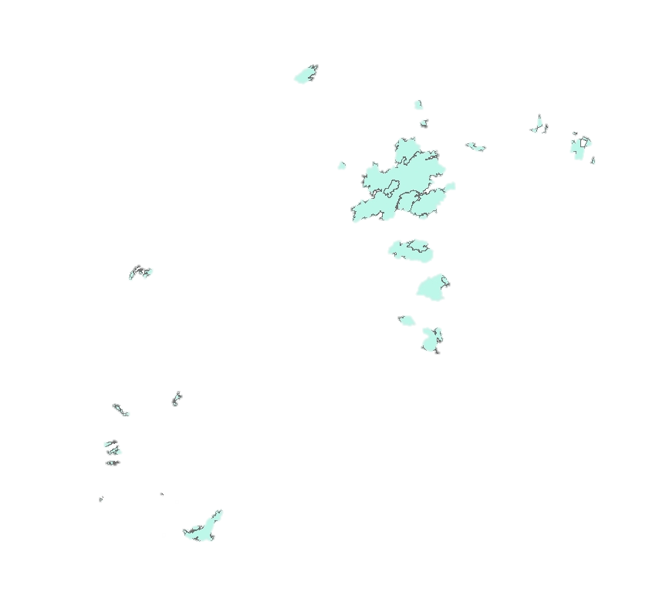
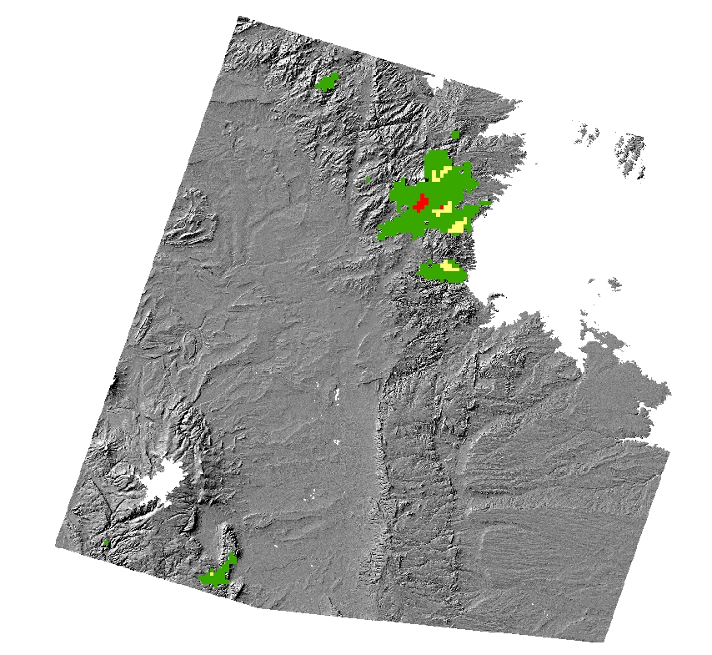
Fire Frequency
Legend
Burned Once
Burned Twice
Burned Three Times
Image source: Laramie Mountains Ecological Forecasting Team
Notes:
This map shows the fire frequency for the study area created using the Fire Regime Condition Classification Mapping Tool (FRCCmt). The polygons that just disappeared are fire polygons received from USFS, Laramie Ranger District that represent all recorded fires within the study period and depict how accurately the FRCCmt delineated fire extent and occurrence. Areas in green have burned once, areas in green have burned twice, and areas in red have burned three times during the study period.
Image source: Laramie Mountains Ecological Forecasting Team

Slide 13
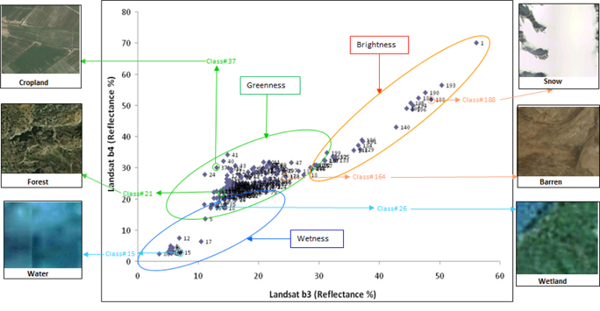
Fire Susceptibility
Tasseled Cap Indices
Image Credit: Thenkabail & Wu, 2012
Notes:
Tcap indices derived from Landsat imagery have been used successfully in the past for land cover classification. Particular land-cover / land-use types can often be distinguished from each other based on their tasseled cap values. However, tcap indices are sensor specific limiting the ability to compare them across different platforms without calibration. LandatLinkr includes cross sensor calibration such that tcap values should be comparable through the entire time series of Landsat images used in this project. With regards to modeling fire susceptibility, we were principally interested in the potential for cluster analysis on the imagery using the tcap indices and a series of derived topographic indices.
Image source: Thenkabail, P. S., and Z. Wu. 2012. “An Automated Cropland Classification Algorithm (ACCA) for Tajikistan by Combining Landsat, MODIS, and Secondary Data.“ Remote Sensing 4(10): 2890-2918.
Image source (link): www.mdpi.com/2072-4292/4/10/2890/htm

Slide 14
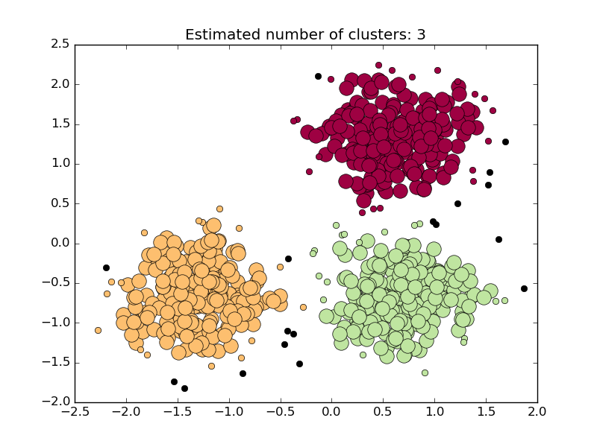
Fire Susceptibility
DBSCAN Clustering
Image Credit: scikit-learn.org
Notes:
We chose the Density Based Spatial Clustering of Applications with Noise (DBSCAN) method to conduct a cluster analysis in the attempt to model fire susceptibility. DBSCAN has several advantages as a clustering algorithm. DBSCAN cluster analysis consists of three basic point types. Core points are those that have a specified density of other points within a user-defined search radius. Boundary points are points that have one or several points within the search radius, but not enough to be considered as core points. Noise points are those that do not have any other points within the specified radius. This provides the advantage of not forcing all points to be within clusters, and allows for the detection of outliers in the data.
Data preprocessing and DBSCAN model construction were performed in the statistical software program, R, and the python library, graphlab create. We chose DBSCAN with the rationale that differing land-cover types would fall into different clusters, and that fires would also reside in multiple clusters. For example, fires in previously unburned forest would be different than fires in previously burned forests, and these would both be different than points in grass fires.
DBSCAN has two user-defined parameters (density and radius). Estimating these parameter values can be quite a challenge, and our end results from DBSCAN ranged between 18 and 2,000+ clusters. Future work would need to focus on interpreting the spectral qualities of these clusters, and how they relate to land-cover types.
Image source: http://scikit-learn.org/stable/auto_examples/cluster/plot_dbscan.html#example-cluster-plot-dbscan-py

Slide 15
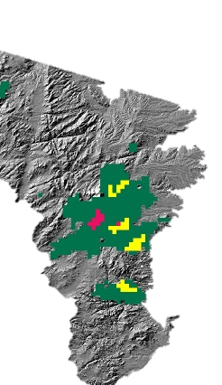
Fire Susceptibility
ID | tcb | tcg | cti | hli | elev
1 | 0.137782 | 0.101163 | 0.61669 | -0.09702 | -0.0141
2 | 0.688912 | -0.34839 | 0.182464 | -0.47759 | -0.22924
3 | 0.236648 | -0.5919 | -0.27303 | 0.417763 | -1.37776
4 | -0.10097 | 0.312562 | -0.96887 | 1.66037 | 0.518783
5 | -0.60582 | -0.2146 | -0.65893 | -0.55419 | -1.20234
20001 | -0.0263 | 0.213553 | 0.61669 | -0.09702 | -0.0141
20002 | 0.533249 | -0.51698 | 0.182464 | -0.47759 | -0.22924
20003 | -0.05259 | -0.69627 | -0.27303 | 0.417763 | -1.37776
20004 | -0.18406 | 0.130598 | -0.96887 | 1.66037 | 0.518783
20005 | -0.21246 | -0.37248 | -0.65893 | -0.55419 | -1.20234
Image source: Laramie Mountains Ecological Forecasting Team
Notes:
Concurrently with the implementation of DBSCAN (and also in R and graphlab create), we created a nearest-neighbors model. Parameter estimates for DBSCAN were largely based on the distribution of distances observed in the nearest-neighbor model. We generated 100 random points within the footprints of the Cow Camp and Squirrel Creek fires (both occurred in 2012), as well as 20,000 random points within the entire study area. Image values at the point locations were calculated for all tasseled cap indices, as well as for derived topographic indices. Each point had a unique ID for the given year, and a vector of index values. All study area points (20,000) were sampled again for each image (i.e., year) and appended to those of the first year resulting in a 580,000 x 6 matrix. We created a nearest-neighbors model using this matrix which identified the 100 nearest neighbors for each vector (row). Euclidean distance and cosine similarity measures were used to determine similarity between vectors.
We then determined the same indices values for the points within the Cow Camp and Squirrel Creek fires for the 2011 image. Our intent was to establish the vector of values for each pixel the year prior to burning, and to assess the similarity of other pixels to those values as a proxy for fire susceptibility should an ignition source occur (as it did in 2012 for the Cow Camp and Squirrel Creek points). The 2011 points were then used to query the nearest-neighbors model to determine which points in the larger sample were most similar to those in Cow Camp and Squirrel Creek points the year prior to the fires.
Image source: Laramie Mountains Ecological Forecasting Team

Slide 16
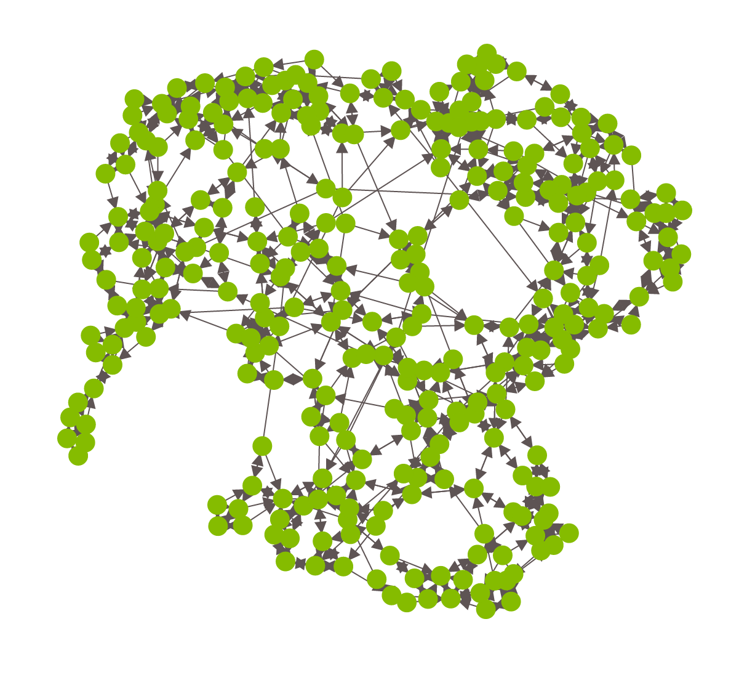
Fire Susceptibility
3 nearest neighbors graph
Cow Camp fire 2012
Image source: Laramie Mountains Ecological Forecasting Team
Notes:
We constructed a similarity graph for the 2011 points to visualize the relative degree of clustering between the larger sample of points. While a full nearest-neighbors similarity graph was beyond the limits of our computing abilities, displayed here is a 3-nearest-neighbors similarity graph for the points within the Cow Camp fire sample.
Image source: Laramie Mountains Ecological Forecasting Team

Slide 17
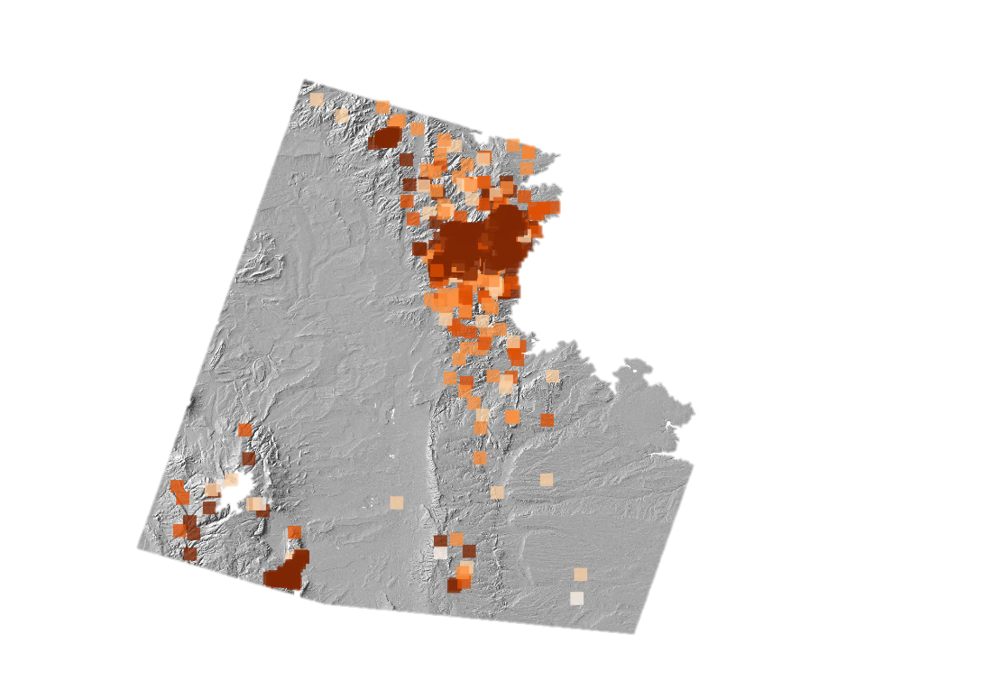
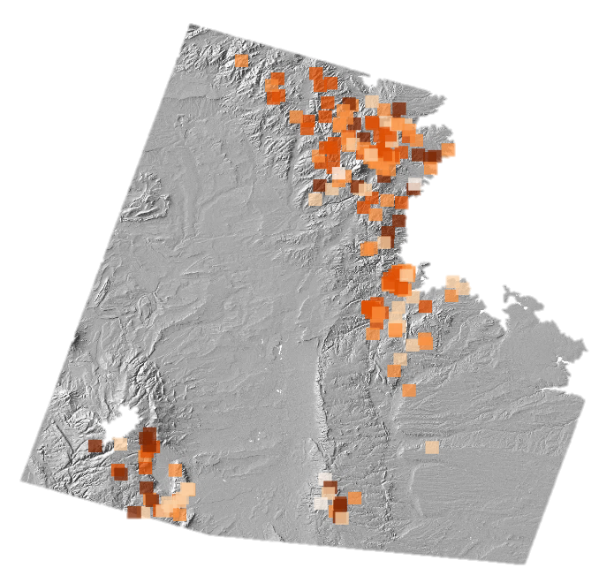

Fire Susceptibility
2010
2011
2012
Legend
1st Nearest Neighbor
2nd Nearest Neighbor
5 nearest neighbors
Fire points duplicated
3rd Nearest Neighbor
4th Nearest Neighbor
5th Nearest Neighbor
Image source: Laramie Mountains Ecological Forecasting Team
Notes:
Illustrated above is the result of not excluding the 2011 points from the full nearest-neighbors model. In these images (most notably 2012). locations that identified fires for the given year (which were included in the full nearest-neighbors model for illustrative purposes) are their own first nearest-neighbor. As the points were in the nearest-neighbors model, for the year in which they were present, they are always their own nearest-neighbor (an issue commonly referred to as ‘duplication’).
Image source: Laramie Mountains Ecological Forecasting Team

Slide 18
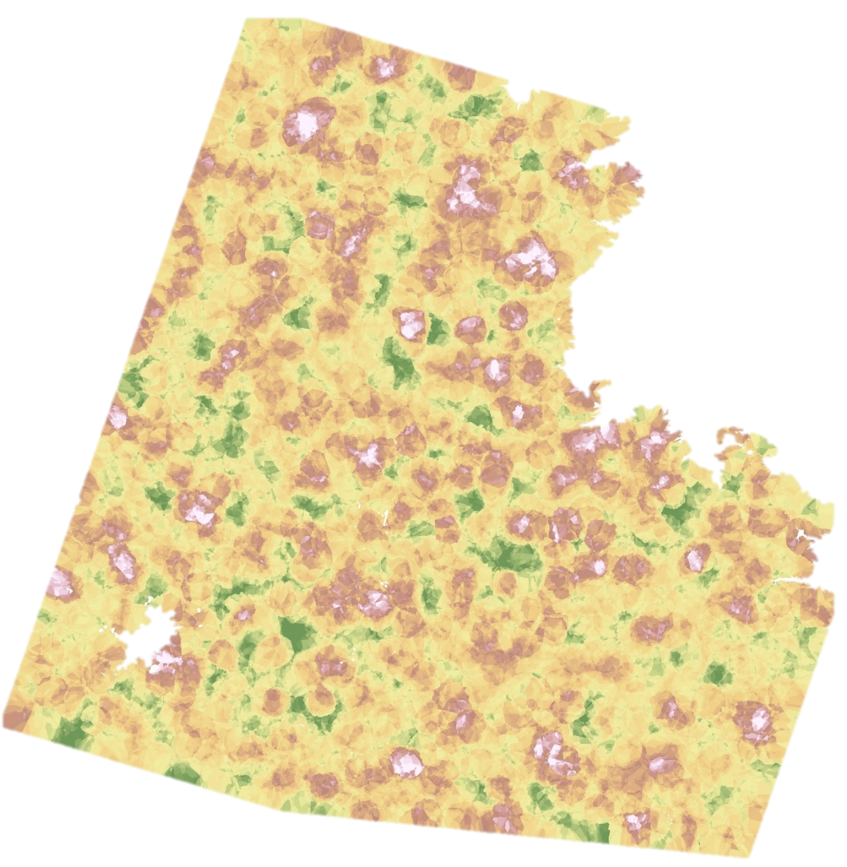
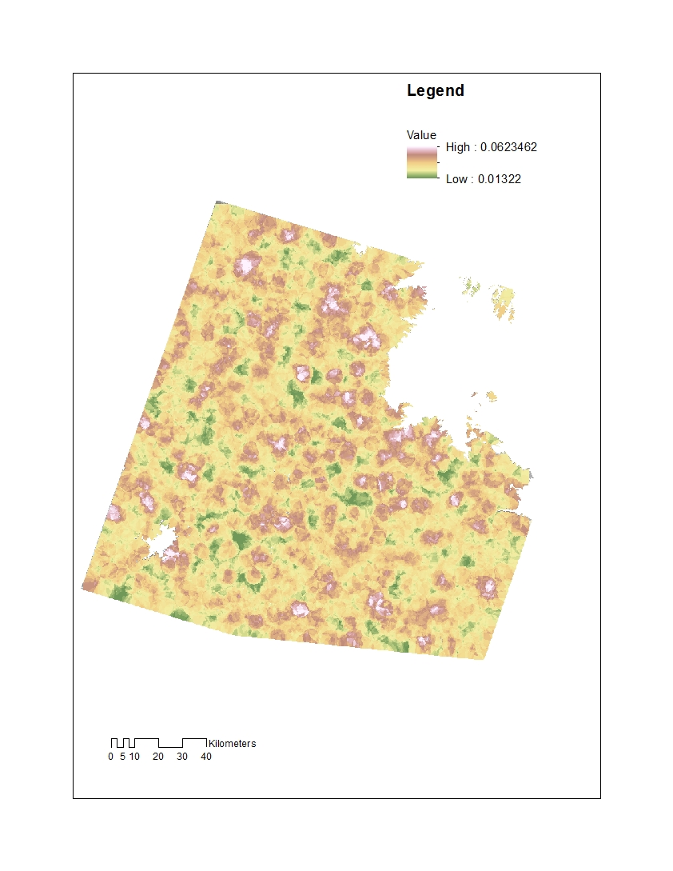
Fire Susceptibility
Interpolated distance to fire points
Legend
High: 0.06235
Low: 0.01322
Image source: Laramie Mountains Ecological Forecasting Team
Notes:
By withholding the 2011 points from the full nearest-neighbors model, and using them to query the full model, we were able to avoid duplication of these points. This image represents an interpolation of cosine similarity values for all points for the 2012. Zooming in on the area of several large fires in 2012, relatively high values for cosine similarity (suggesting values more similar to the Cow Camp and Squirrel Creek 2011 point values).
Image source: Laramie Mountains Ecological Forecasting Team

Slide 19
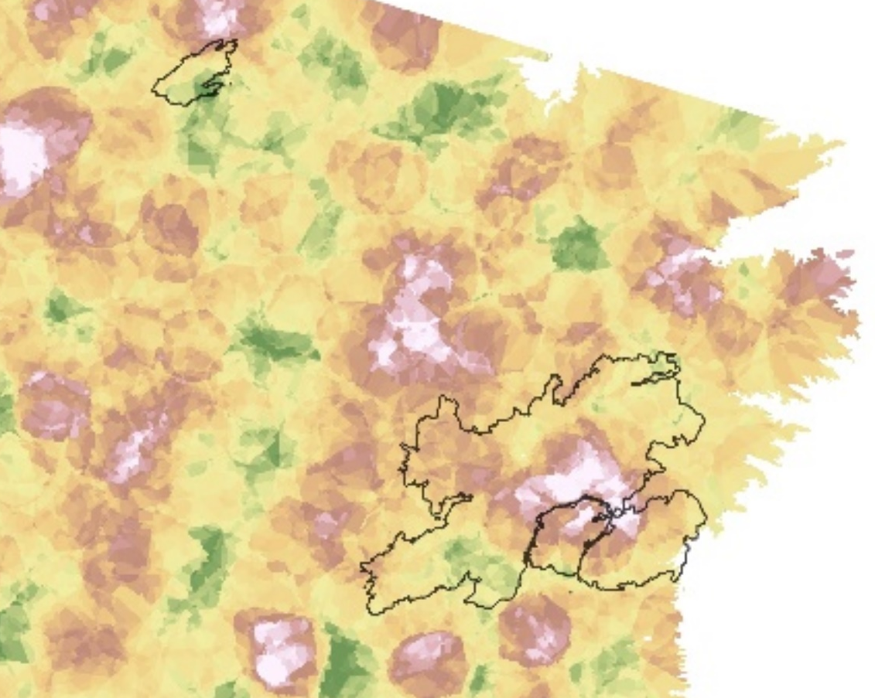
Fire Susceptibility
Legend
High: 0.06235
Low: 0.01322
Image source: Laramie Mountains Ecological Forecasting Team
Notes:
Overlaying the outlines of several fires that occurred in 2012, larger fires did tend to have higher cosine similarity values suggesting that the nearest-neighbors model is identifying similarities between those areas and the point values in the 2011 points (i.e., that these areas were similar in their spectral and topographic values to the Cow Camp and Squirrel Creek points). However, in 2012 fires with smaller extents (seen in the Russell Creek fire outline in the upper left of the image), the number of random points within their footprints often resulted in less similarity with the 2011 points even though they burned in the same year.
Generating more random points within the study area in the attempt to reduce this phenomenon is possible, but quickly becomes taxing in terms of computation time and data storage.
Image source: Laramie Mountains Ecological Forecasting Team

Slide 20
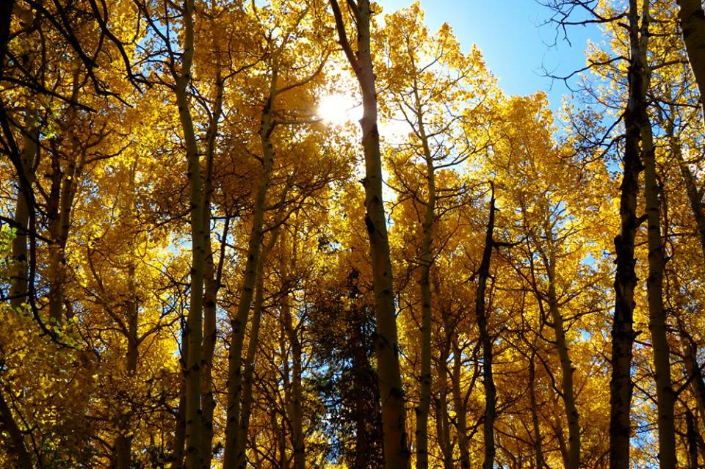
Conclusions
Multiple approaches to image classification and clustering
Aids partners in better understanding local fire ecology
Assists in land management and conservation efforts
Image Credit: Kelsey Correia
Notes:
We employed multiple supervised classification and clustering methods during this project to detect burned areas during the entire 30 year time-series, as well as model fire susceptibility.
It is our hope that this work will prove to be useful resources to our project partners in their continued efforts to understand local fire patterns and their relevance to land management and conservation efforts.
Image source: Kelsey Correia, Colorado State University

Slide 21
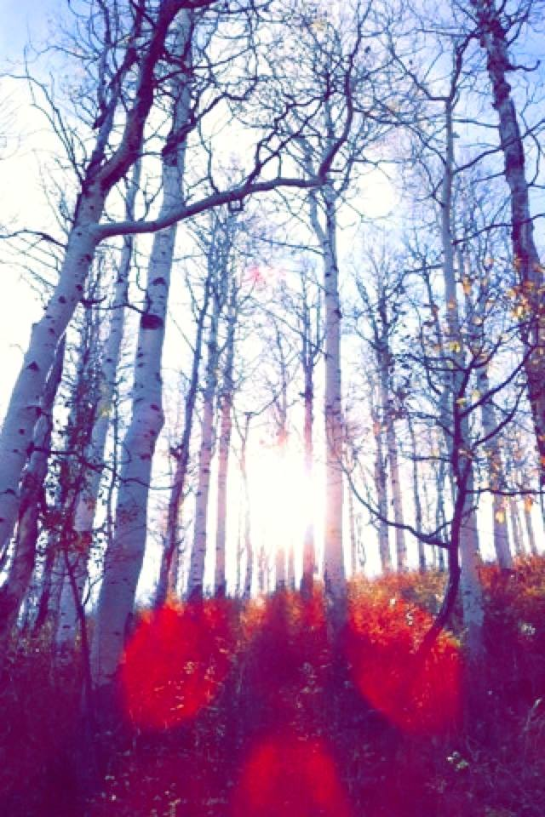
Errors & Uncertainties
Data limitations in image availability and quality
Annual composites
Parameter estimation
Combining multiple indices
Image Credit: Kelsey Correia
Notes:
Among the chief limitations of this approach was the (surprising) lack of cloud free images over our study site. During our initial image collection we limited the images we collected to those with less than 20% cloud cover over the entire scene. However, due primarily to the terrain within our study area, whatever clouds were present in the images, were typically located within the study area, reducing the amount of information they were able to contribute to the full record. LandsatLinkr is a valuable tool for dealing with such imagery, however, the annual cloud-free composites aggregate non-cloud obscured pixel values for the entire year, thus muting a fair portion of the intra-annual change that was of interest.
Parameter estimation is also an area that should receive considered attention in the continuation of this project. Clustering and classification algorithms can be powerful in their modeling capabilities, but model complexity (e.g., estimating numerous parameters) leads us to view the current results as preliminary and in need of refinement.
In addition to parameter exploration, a careful analysis of potential covariates to include in the models should be prioritized. Our initial exploration of potential covariates, suggest that the set of covariates can greatly influence model performance and interpretability.
Image source: Kelsey Correia, Colorado State University

Slide 22
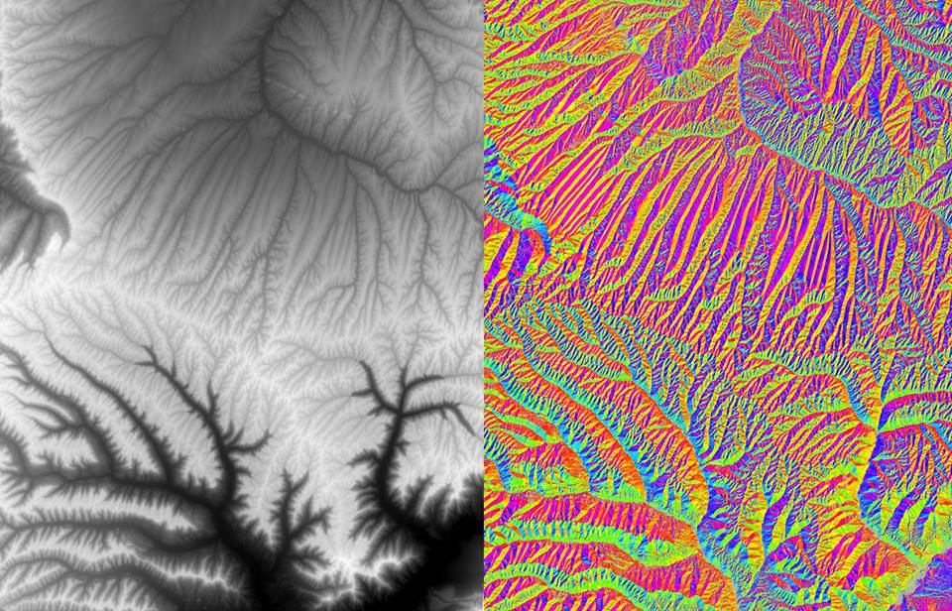
Future Work
DEVELOP Summer 2016 Term
Utilizing aspen as an indicator species for healthy ungulate habitat
Expanding research on fire as a management tool
Conducting field work to supplement satellite data
Image Credit: Kelsey Correia
Notes:
The project will be expanded upon during the summer term where a Species Distribution Model (SDM) will be utilized to delineate aspen cover throughout the Laramie Mountain Range. The identification of aspen will be indicative of local habitat quality and the areas’ carrying capacities for mule deer and elk. Incorporating fire history and severity maps, as well as calculated fire return intervals with the aspen cover maps, will further inform land managers on the relationship between fire and aspen regeneration, which will aid in conservation efforts.
Additional future work includes conducting field work in the area to locate aspen stands and ground truth results. Studying the characteristics of these stands (i.e. stand density, average diameter at breast height (DBH), number of young aspen suckers, etc.) will provide additional information regarding aspen growth and regeneration.
Image source: Kelsey Correia, Colorado State University

Slide 23
Advisors
Dr. Paul Evangelista (Colorado State University, NREL)
Dr. Amanda West (Colorado State University, NREL)
Partners
Wyoming Game and Fish Department
USDA Forest Service, Laramie Ranger District
Colorado State University, Natural Resource Ecology Lab (NREL)
Others
Dr. Bill Romme (Colorado State University, NREL)
Brian Woodward (Center Lead, USGS at Colorado State University)

