Slide 1
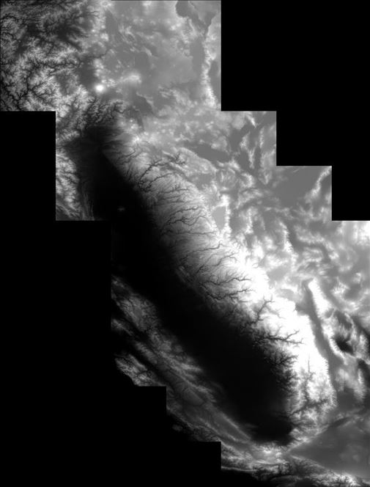
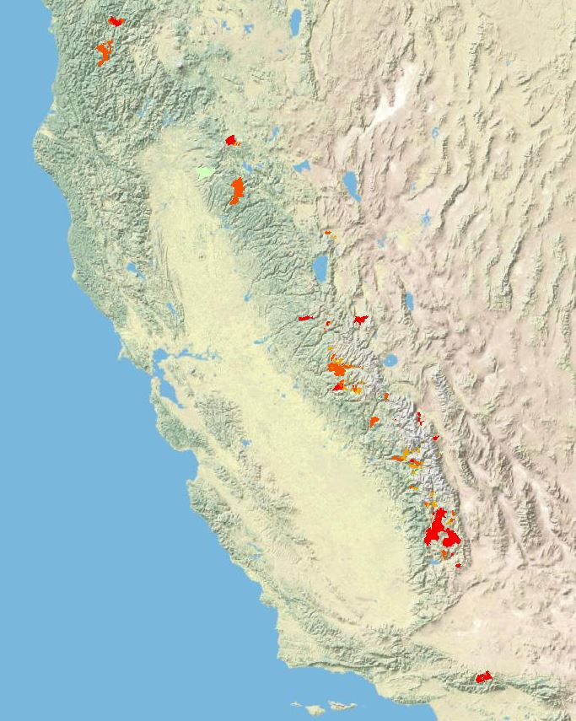
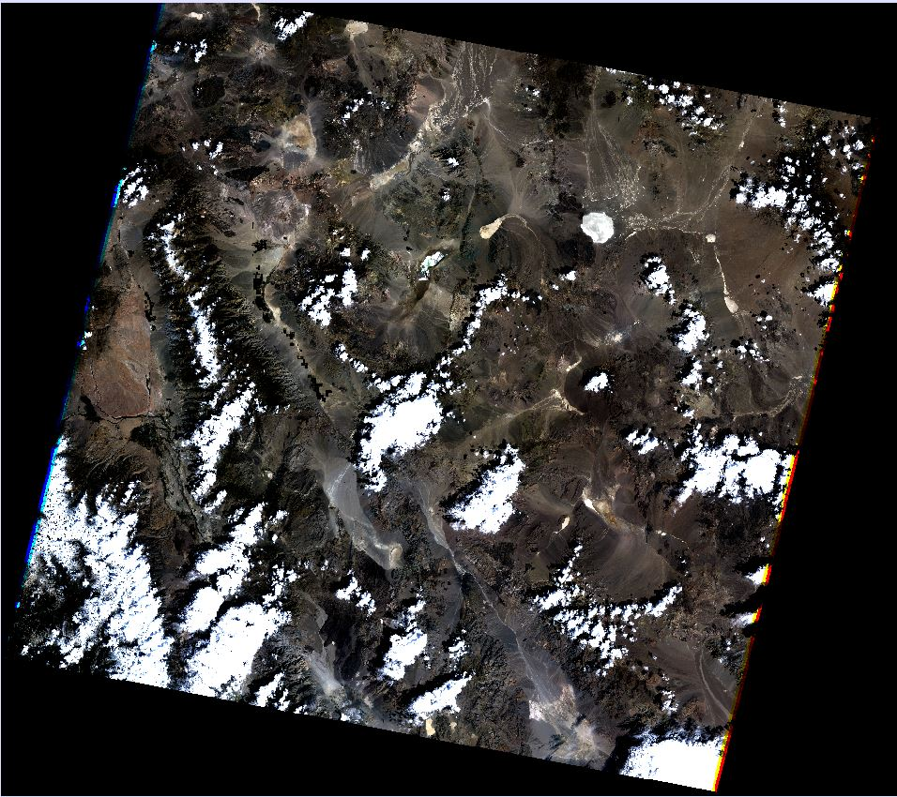
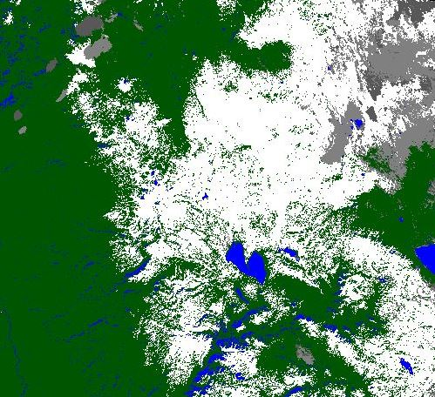
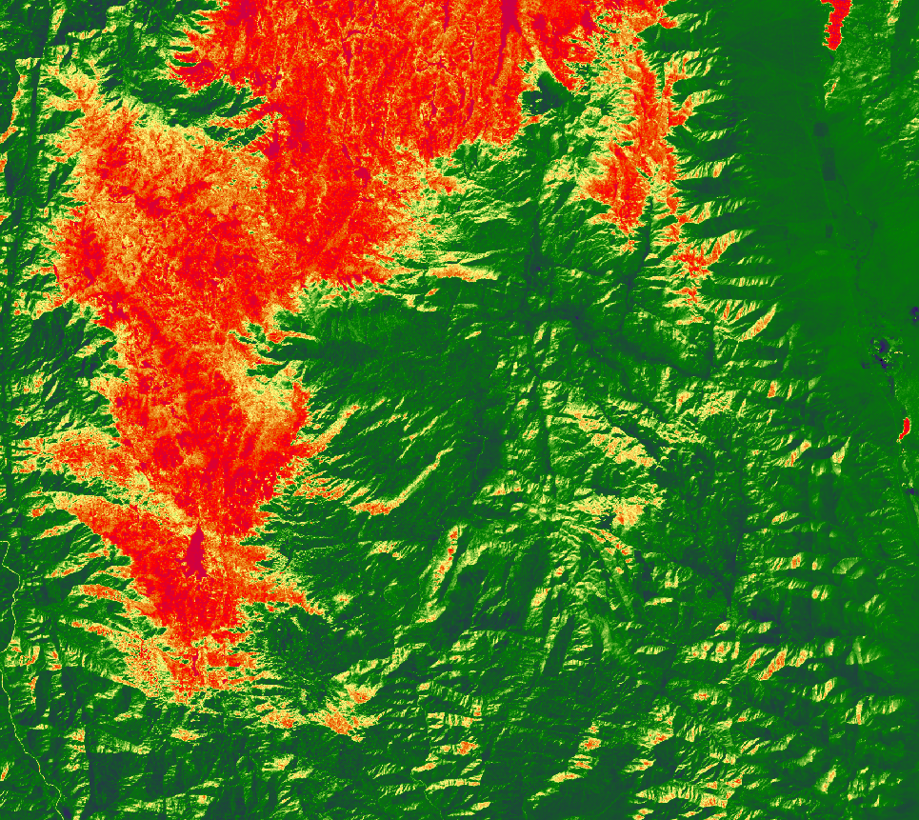
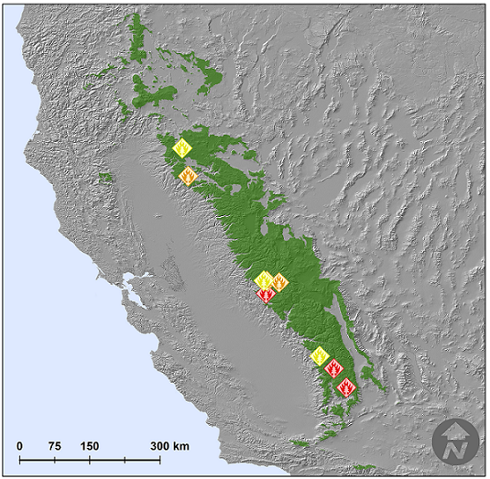
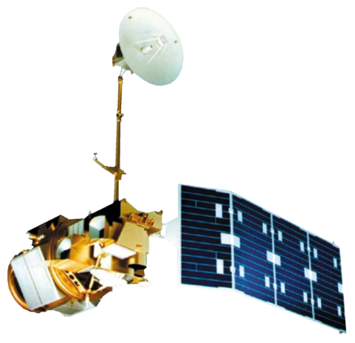
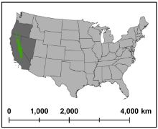
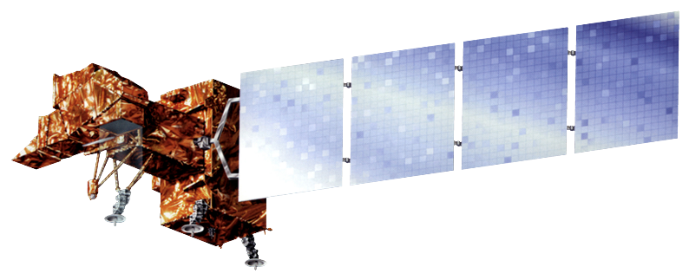
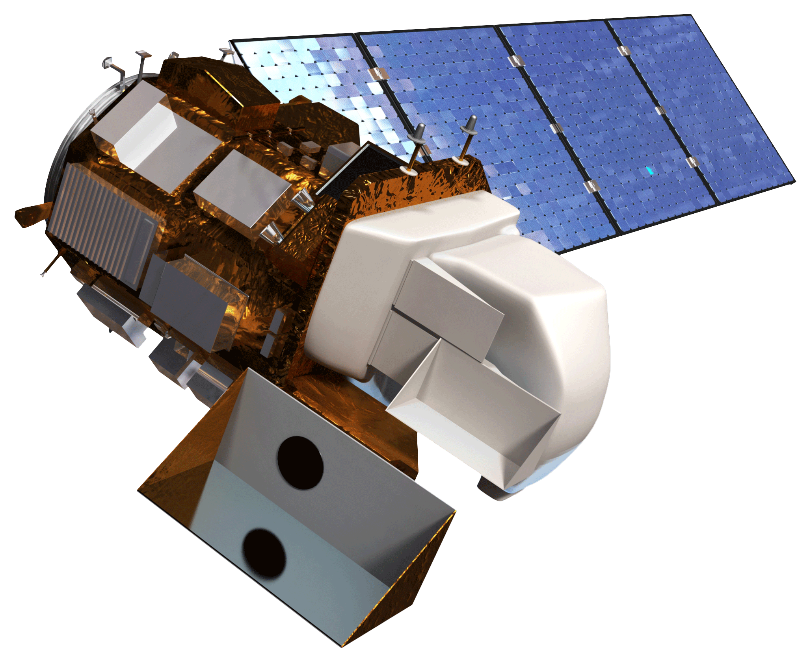
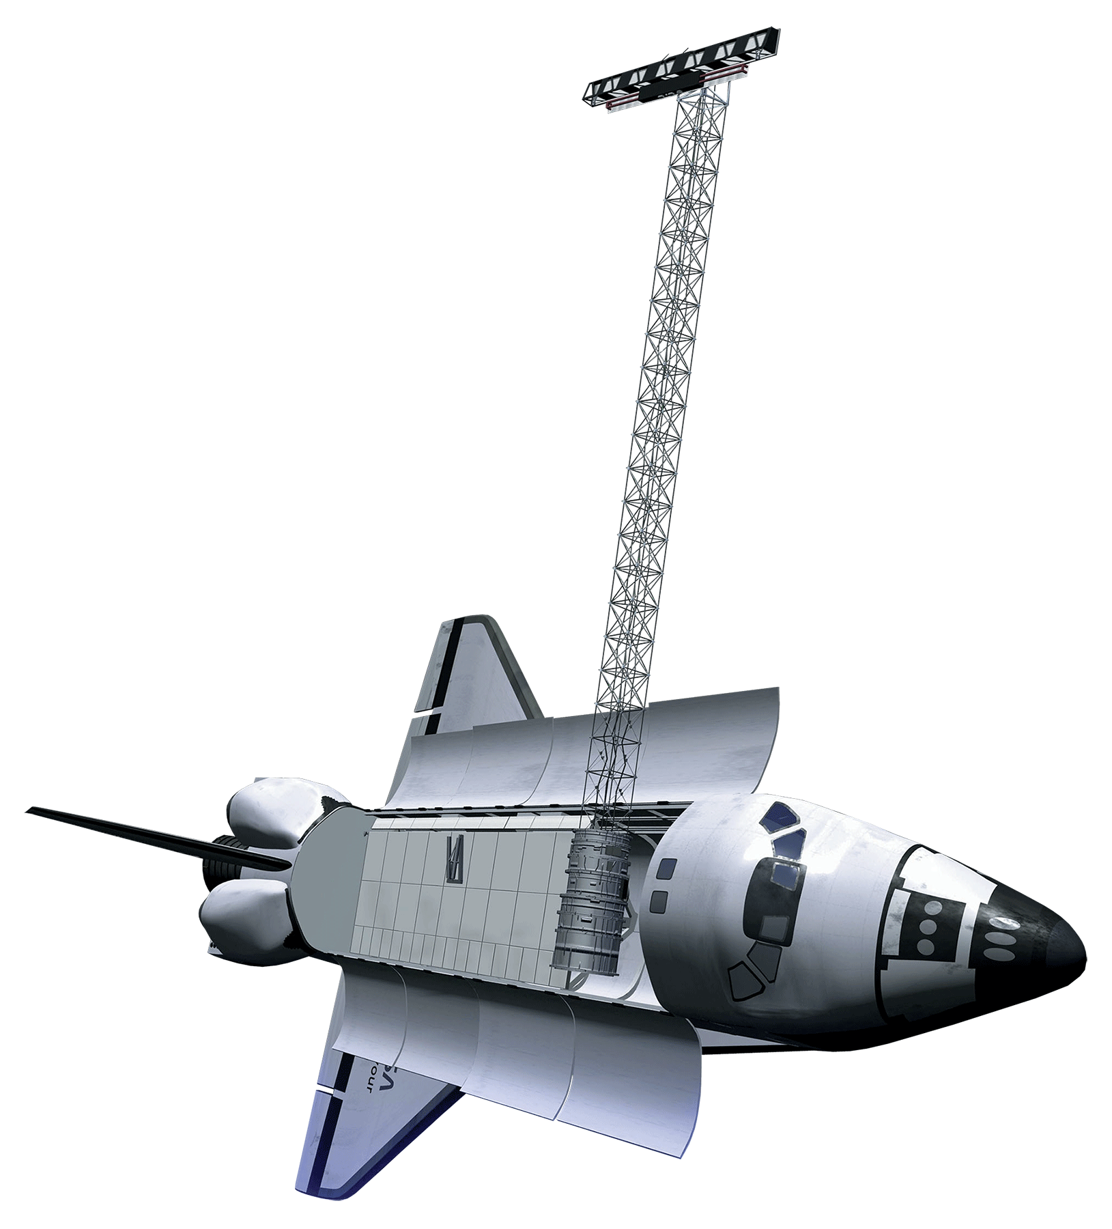
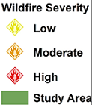
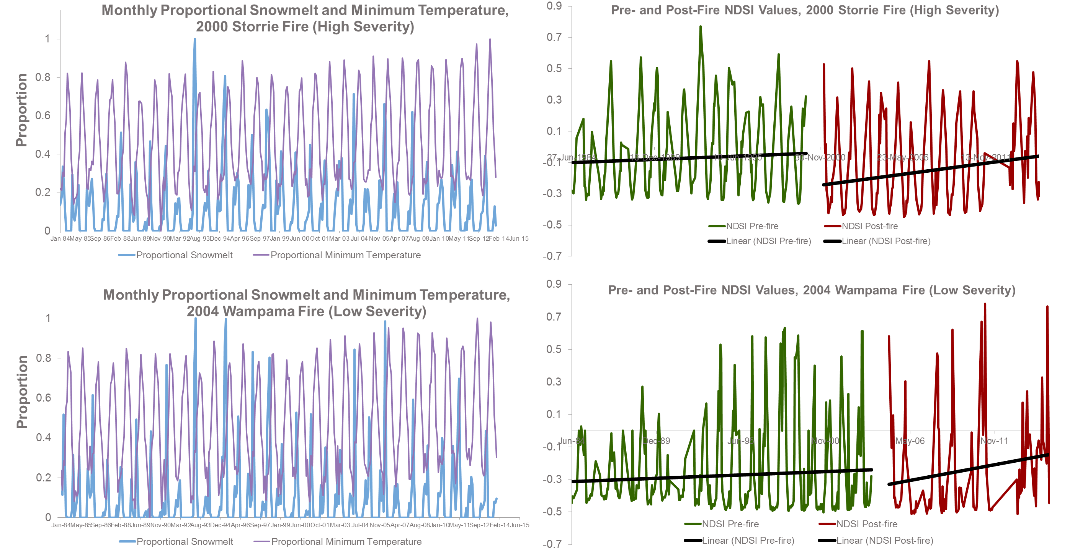
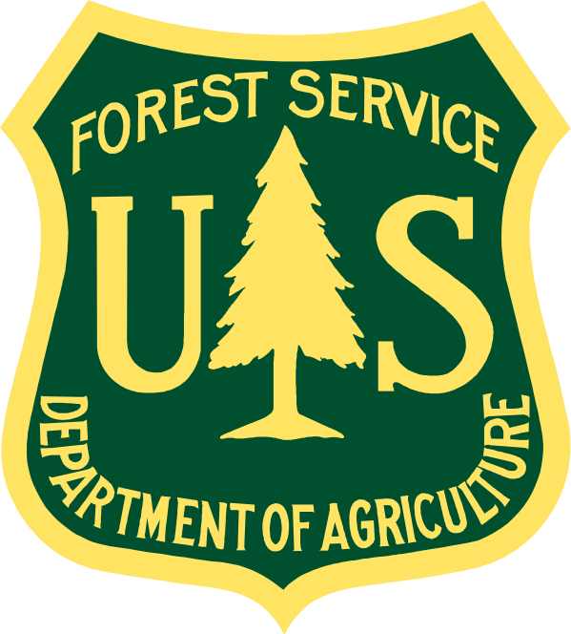
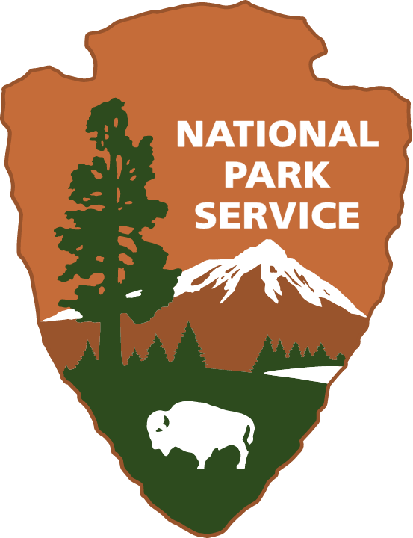
Sierra Nevada Water Resources
Quantifying the Effects of Wildfire Severity on Snow Water Equivalent in the Sierra Nevada
Sean Cunningham (Team Lead)¹, Vishal Arya¹, Clayton Sodergren¹, Nolan Cate¹, Justin Anzelc¹
¹NASA DEVELOP Program at NASA Ames Research Center
Abstract
Methodology
Snowpack in the Sierra Nevada is a crucial component of the California water supply. Climate change effects on forest ecosystems in this region have reduced snowpack and resulted in earlier snowmelt. Wildfire frequency and severity in the Sierra Nevada have also increased, due to higher temperatures, drought, and a legacy of fire suppression policies leading to augmented fuel loads beyond their range of historic variability. These combined factors have the potential to severely impact the California water supply. The effects of wildfire severity on snowpack and snow water equivalent have not been quantified. To achieve this, the team at DEVELOP partnered with the USDA Forest Service and National Park Service and used NASA Earth Observing Systems data to quantify the effect of low, moderate, and high severity wildfire on snowpack and snow water equivalent in the Sierra Nevada. This information will improve management of forest ecosystems and water resources in a changing environment.
Initial Data
Preprocessing
Final Analysis
Download SRTM Data
Mosaic DEM and clip to M261 watersheds for elevation mask
Nine fires for study area (Three low, two moderate, and four high severity)
Download USFS Region 5 Burn Severity Data
Clip to wilderness areas and elevation > 1500 m, create Fire Severity Index
+
Download Landsat Imagery from 1984-2014
Fmask, reclassify, zeropad, resample, and mask
Time series trend analysis, NDVI, NDSI
Acquire 2014 CA Basin Characterization Model
Define projection, convert to geotiff, clip to study area, extract zonal statistics
Correlations between fire severity, snowpack and climate variables
Study Area
Objectives
Earth Observations
Use Landsat data to map snow and vegetation cover from 1984-2015 within the area of nine wildfires and quantify the effect of wildfire burn severity on snow cover.
Quantify the effects of wildfire burn severity on land-surface temperature (LST), soil water storage, snow melt timing and snow water equivalent (SWE) using the California 2014 Basin Characterization Model (BCM) data.
Conduct seasonal trend analysis to quantify changes in the seasonality of snow cover in relation to wildfire burn severity.
Landsat 4-5 (TM)
Landsat 7 (ETM+)
Landsat 8 (OLI)
SRTM
Results
Low, moderate, and high severity wildfires within the Sierra Nevada were analyzed. Three low severity, two moderate severity, and four high severity wildfires were selected.
Acknowledgements
Special thanks to Marc Meyer of the USDA Forest Service and Jim Roche of the National Park Service.
The authors also wish to thank the Ames DEVELOP management team, Andrew Nguyen and Chippie Kislik, for their overall support and help with this project.
Project Partners
Team Members
Conclusions
NDSI values in both low and high severity fires increased post-fire.
Minimum temperature in burned areas increased post-fire.
There was no significant difference in snowmelt in burned areas post-fire.
From Left to Right: Clayton Sodergren, Nolan Cate, Justin Anzelc, Vishal Arya, Sean Cunningham
NASA Ames Research Center

