Slide 1
Virginia Water Resources II
Utilizing NASA Earth Observations to Identify Harmful Algal Blooms in the Chesapeake Bay
Arika Egan (Project Lead)
Jessica Jozwik
Zachary Tate
Tyler Rhodes
Jakub Blach

Slide 2
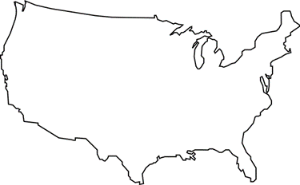
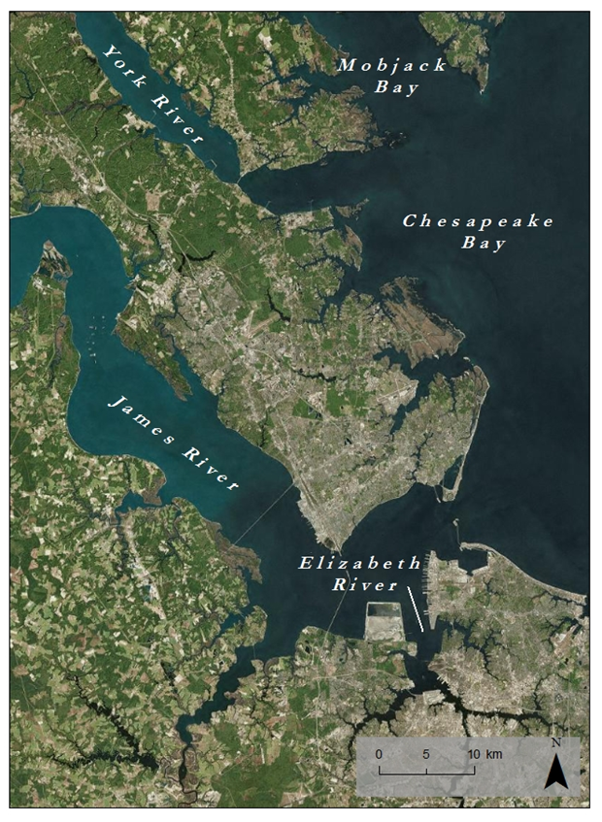
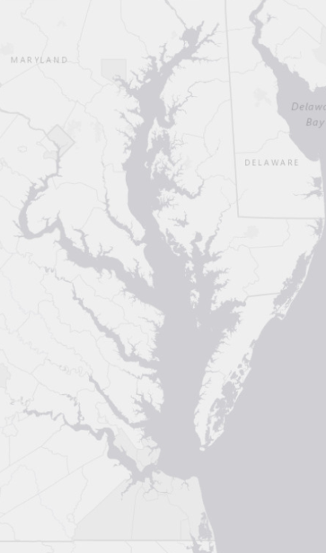
Chesapeake Bay Watershed
Study Area:
Lower Chesapeake Bay
Study Period: May 2011-October 2015
Notes:
Our Study Area is comprised of Virginia’s Lower Chesapeake Bay, The James River, The York River, The Elizabeth River, and Mobjack Bay.
Our Data was collected between May 2011 and October 2015. ***We may have to change our study period for this project, depending on what dates we use to clarify***

Slide 3
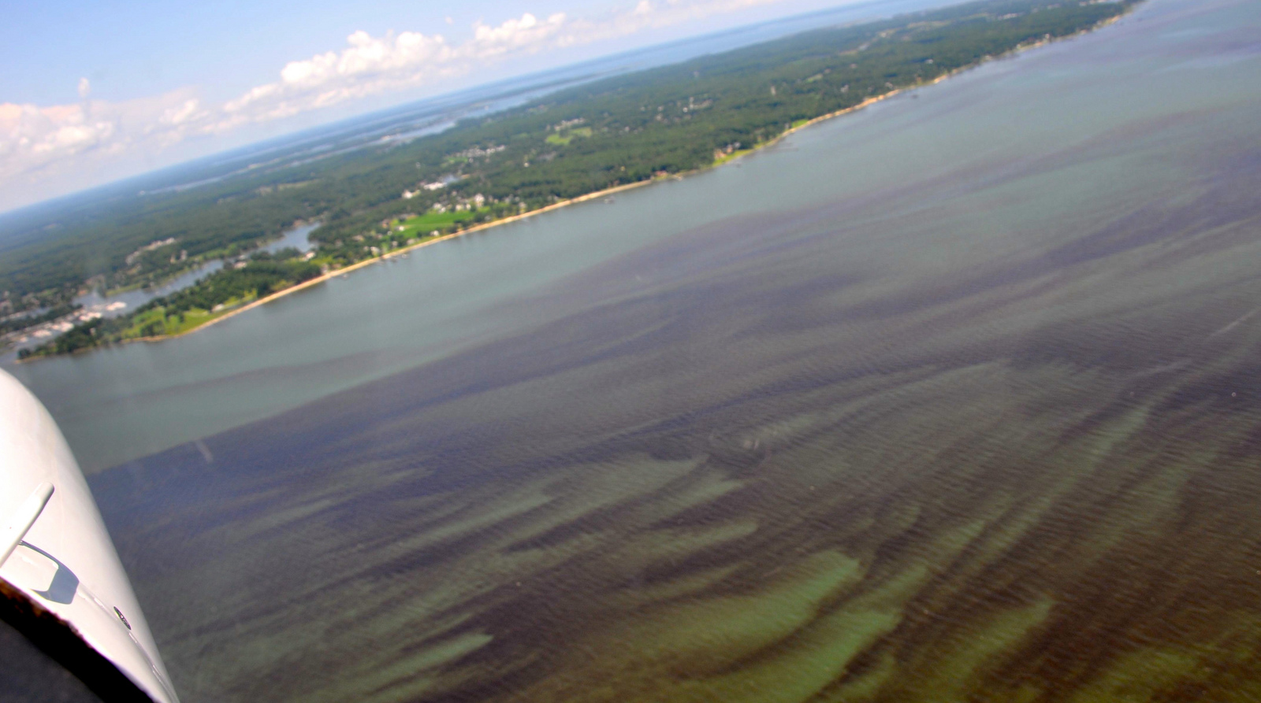
Kim Reece. Sarah’s Creek. 10/19/2015
Harmful Algal Blooms (HABs)
Population Growth
Nutrient Runoff
Excessive Growth of Algae
Notes:
The population of the Chesapeake Bay now pushes 18 million people.
Increasing population has lead to an increase in nutrient runoff into the Bay. Agricultural and urban runoff, vehicle emissions, sewage treatment plants, and the burning of fossil fuels all are responsible for nutrient loading in the Chesapeake Bay.
Increased nutrients promote excessive growth of algae.

Slide 4
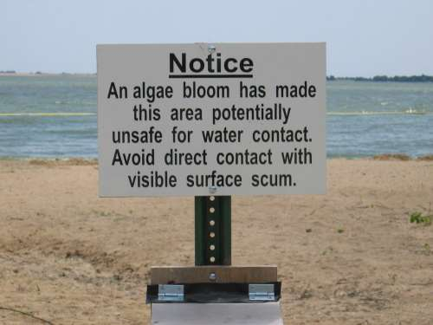
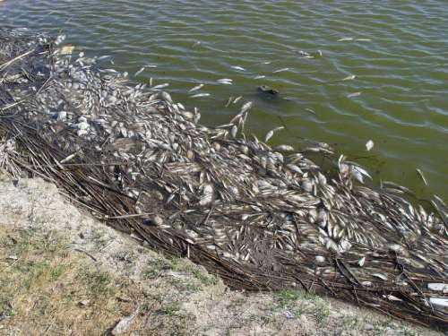
Community Concerns
Degrade water quality
Reduce sunlight
Deplete oxygen
Produce toxins
Threaten:
Fishing industry
Tourism industry
Human health
Ecological health
Jennifer Graham. Harmful Algal Blooms. 10/19/2015
Mike Hooper. Dead Fish Washed Ashore during Golden Alga Toxic Bloom. 10/19/15
Notes:
HABs block the penetration of sunlight through the water column, reducing the amount of available light for photosynthesis and plant growth.
As they die and decompose, they deplete dissolved oxygen in the water that is necessary to sustain animal life.
Certain species produce toxins that can mutate fish, cause human illness, and give off unpleasant smells.
As a result, the fishing industry is harmed, beaches are closed, human health is threatened, and areas of the Bay are less capable of sustaining plant and animal life.

Slide 5
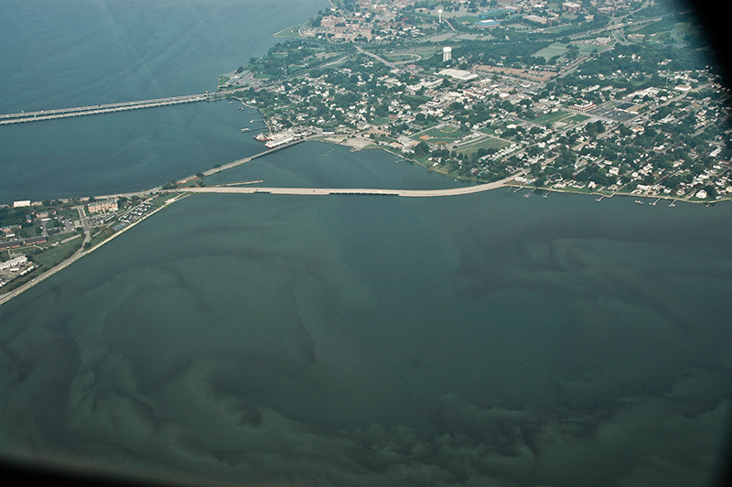
Current
Practices
HAB Task Force
Detect & Study
HAB Hotline
Report
VA Health Department
Respond
Chesapeake Bay Foundation. Hampton Roads Algal Bloom. 10/19/2015
Notes:
There are two ways HABs are Detected: Through HAB Task Force Testing and Reports to the HAB Hotline
HAB TASK FORCE:
Comprised of VIMS, DEQ, ODU, VA Dept of Health and VA Marine Resources Commission
Responsible for Detecting and studying HABs.
Maintains 20 fixed testing stations throughout the bay. Test water quality parameters and genetic testing of phytoplankton monthly from May-November
24 HOUR HAB HOTLINE
1. Relies on community members to report suspicious smells, colors, or fish kills.
There is currently no reliable method of real-time monitoring of HABs in the Chesapeake Bay. Researches must coordinate data collection cruises to gauge severity and duration of HABs, and must organize costly flyovers to study magnitude of the blooms. We thus seek to remedy this by…

Slide 6
Objectives
Create
Create a tool to estimate chlorophyll-a concentrations from Landsat 8 OLI Data
Cultivate
Cultivate a better understanding of the causes and impacts of HABs
Improve
Improve routine and emergency assessment of HABs
Improve policies and regulations that prevent HABs
Notes:
The goal of this project was to create a python tool to be used in ArcGIS that will produce a map of chlorophyll concentration for the Chesapeake Bay Watershed. It will do this by taking in Landsat 8 data and processing it with an algorithm created during this project.
By identifying the locations of HABs, our partners will be able to analyze the area to better understand the cause of the bloom.
New Landsat imagery of the watershed is produced every week. The speed of this production, combined with the estimation tool, will allow our partners to more effectively monitor HABs when they occur. This is more efficient than the current system of routine monitoring and civilian reports of HABs.
This tool will better help determine the size, duration, frequency, and cause of HABs. These data are important factors in policy writing and can help improve regulations to prevent HABs.

Slide 7
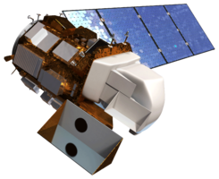
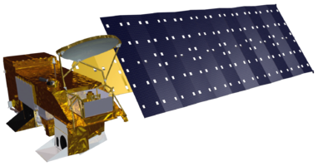
Satellites Used
Landsat 8 OLI
Aqua MODIS
Notes:
Landsat 8 OLI: Downloaded with USGS Earth Explorer. Path 14 Row 34 and Path 15 Row 34 captured our study area. 30m resolution
AquaMODIS: Downloaded from NOAA’s CoastWatch East Coast Node, used to detect chlorophyll-a. 1.4km resolution

Slide 8
Methodology
Acquisition
Landsat 8 OLI surface reflectance
VECOS in situ water quality data
ArcGIS
Masks were created to remove land and clouds
R
Ran linear and nonlinear regression models
Aqua MODIS chlorophyll a
Matched Landsat and VIMS in-situ data
NOAA Bathymetry data
Created true color reflectance images for Landsat 8 bands 1-5
Combined layers into data table
Plotted data on scatter plot
Used best fit relationship as predictive model
Chesapeake Bay
Chlorophyll Hotspot Identifier
Python
Notes:
True color composites were compiled by dividing the pixel values by 10,000 for bands 1-5 of the Landsat8 data.
Land pixels were removed using a water mask created by calculating the NVDI with bands 4 and 5 to determine density of plant growth. A water mask was created by reclassifying pixels in the NDVI with a value less than 0 (“VALUE < 0”) as 1, and reclassifying all other pixels as “NoData”. This mask was used on the Landsat bands to obtain water-only images.
Clouds were removed using a cloud mask created with the cf_mask_layer from the Landsat CDR data download. Pixels of value 2 and 4 were Reclassified as “NoData”. All other pixels were reclassified to “1”. This mask was applied to the water-only bands, and the result was an image with land pixels and cloud pixels removed.
We imported the in-situ data into ArcMap and used the points of the in-situ as the reference shape file for extracting the pixel values of the Landsat data.
Once the pixel values were extracted, they were saved to a .csv that also included the in-situ chl measurements.
This .csv was imported into R, where the data was plotted on a scatter plot. Linear and nonlinear regression models were run to find a best fit equation.
The equation was used in the python tool to create a map of chlorophyll concentration.

Slide 9
Results

Slide 10
Conclusions

Slide 11
Errors and Uncertainties

Slide 12
Future Work

Slide 13
Advisors
Dr. Kenton Ross, NASA DEVELOP
Robert VanGundy, University of Virginia’s College at Wise
Dr. DeWayne Cecil, Global Science and Technology, Inc.
Malanie Salyer, NASA DEVELOP Wise County
Partners
Dr. Kim Reece, Virginia Institute of Marine Science
Russ Baxter, Virginia Deputy Secretary of Natural Resources for the Chesapeake Bay
Will Hunley, Hampton Roads Sanitation Department
Todd Egerton, Old Dominion University
Others
Dr. Sara Lubkin and Cassandra Morgan

