Slide 1
ALASKA ECOLOGICAL CONSERVATION
Using NASA Earth Observations to Identify Recent Changes in River Ice Phenology and Its Impacts on Caribou Migration
Mahnoor Naeem
Ben Silver
Levi Mitchell
Christian Sarro
Massachusetts – Boston| Spring 2024

Slide 2
Massachusetts – Boston Team
Mahnoor Naeem
Ben Silver
Levi Mitchell
Christian Sarro

Slide 3
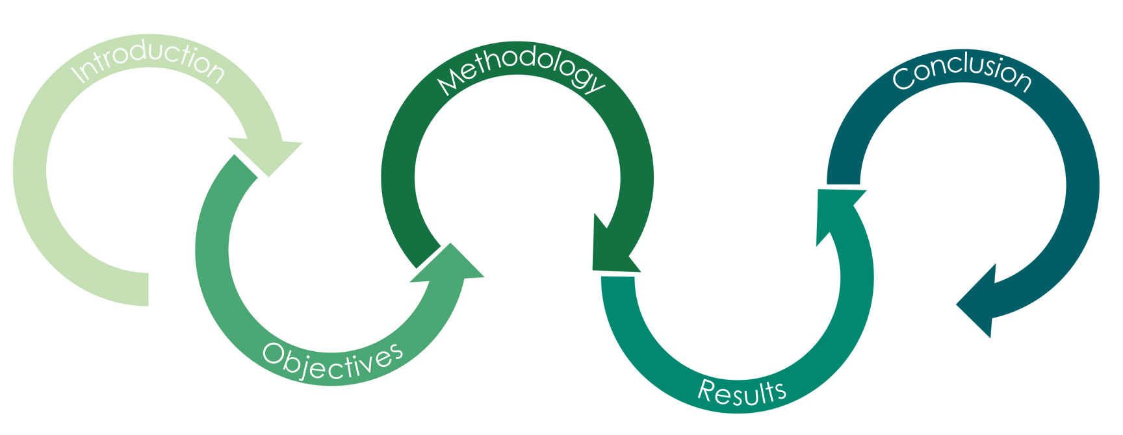
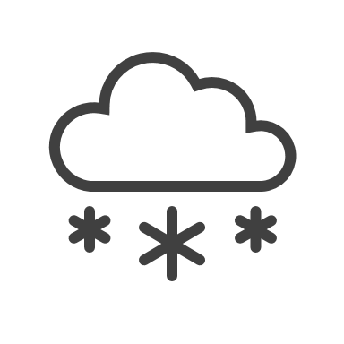
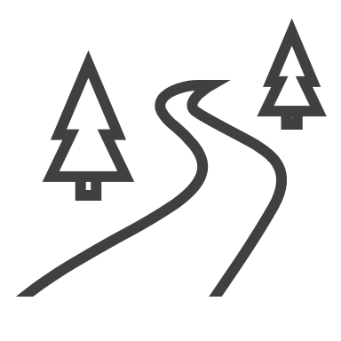
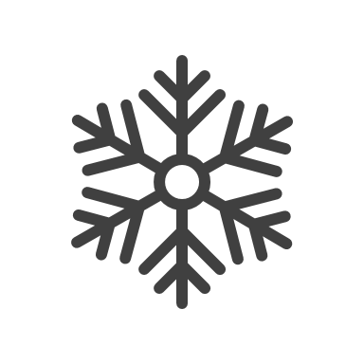
Presentation Outline
Study area, partner, & background information
Using Earth observations and other data to explore analysis
Future work, conclusions & acknowledgments
Converting community concerns to project objectives
End products, errors & uncertainties
Notes:
------------------------------------------------------------------------------------------------------
Icons: Microsoft Office

Slide 4
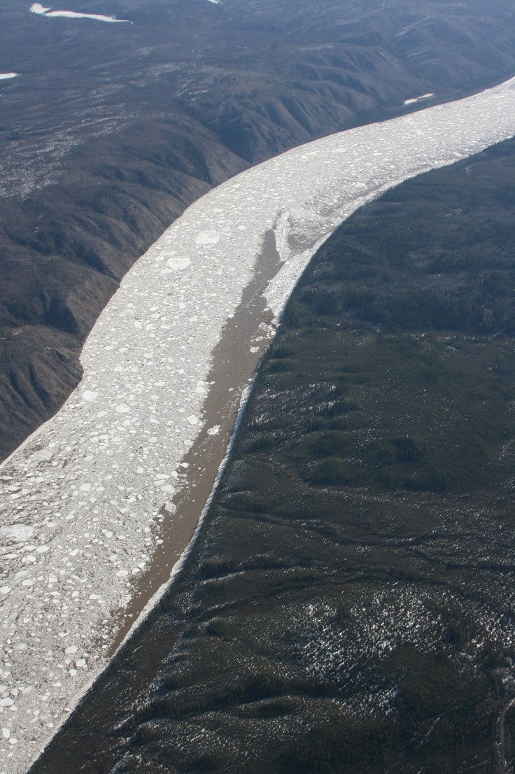
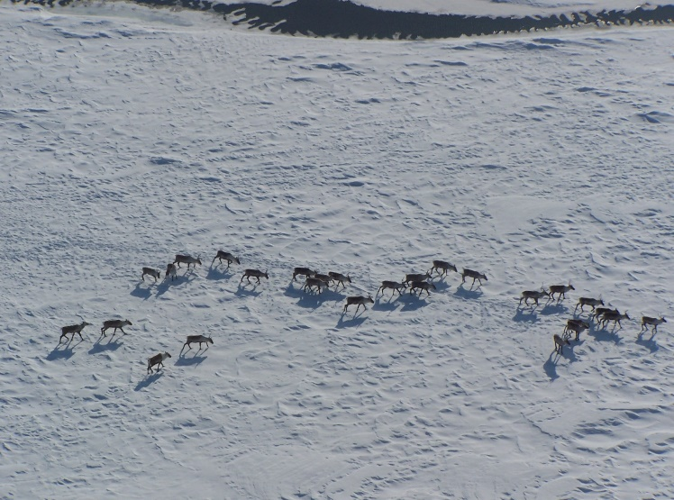
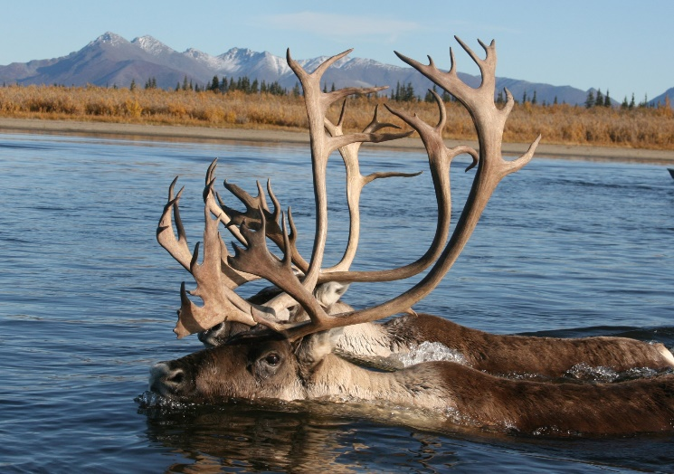
Caribou & Ice Relationship
Changes in River Ice Phenology
Longer and Altered Migration
Credit: Kyle Joly, NPS
Less Reproductive Success
Less Predictable Migrations
Credit: Kyle Joly, NPS
Credit: Kyle Joly, NPS
Notes:
Climate breakdown has caused disproportionate warming in arctic regions and higher latitudes, and these changes have delayed the onset of river ice as well as increased the time between the onset of freezing and ice levels that are crossable. Caribou are adept swimmers and commonly swim across open water including rivers, but increased duration of partially-frozen rivers poses the risk of delaying, lengthening, and altering migratory patterns in the fall season where caribou travel towards calving grounds and readily available, high-energy feed in the southern extent of their range. Migratory cues in caribou are triggered mainly by snow fall and falling temperatures and supplemented by changes in plant senescence and changes in wind. Partially-frozen rivers act as barriers to migration, and cause migratory patterns in caribou to become more bioenergetically costly, negatively affecting reproductive success and herd size. These changes would also affect the variability of migration routes, which could present challenges of access in the communities that rely on the herd as a food source.
There are feedbacks created by migration in caribou that have a positive effect on herd size, in conjunction with feedbacks in herd size that increase migratory capability. It is accepted that there are threshold herd sizes that allow the herd to trigger long-distance migrations. The impediment of migration through extending durations in partially-frozen river ice (such as pancake ice) would have negative effects on the population of the herd through the diminishment of these mechanisms.
--------------------------------------------------------------------------------------------------------
Cameron, M.D., Eisaguirre, J.M., Breed, G.A. et al. (2021). Mechanistic movement models identify continuously updated autumn migration cues in Arctic caribou. Mov Ecol 9:54. https://doi.org/10.1186/s40462-021-00288-0
Joly, K., Gunn, A., Côté, S. D., Panzacchi, M., Adamczewski, J., Suitor, M. J., and Gurarie, E. (2021). Caribou and reindeer migrations in the changing Arctic. Animal Migration, 8:1 https://doi.org/10.1515/ami-2020-0110
----------------------------------------------------------------------------------------------------------------
Images used with permission
Image Credit: Kyle Joly, National Park Service; used with permission
Image Credit: Kyle Joly, National Park Service; used with permission
Image Credit: Kyle Joly, National Park Service; used with permission
Icons: Microsoft Office

Slide 5
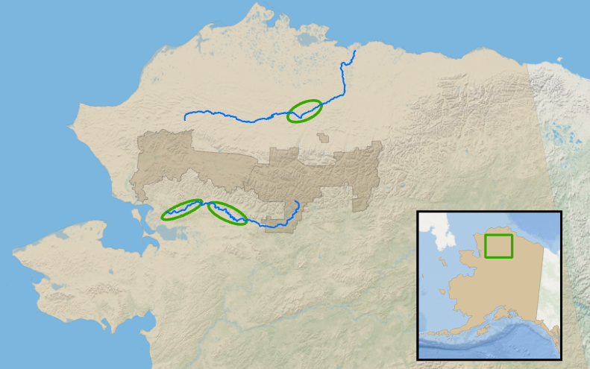
Study Area & Period
N
Colville River
Study Area: Northwestern Alaska
Colville River
Kobuk River
Study Period: 2017–2023, September to November
Kobuk River
Alaska
Rivers
Crossing Zones
0
50
100
Miles
Park Boundaries
Basemap: ESRI, GEBCO, Garmin, NaturalVue
Notes:
Our study area was northwestern Alaska. This region was selected due to the high abundance of caribou (Rangifer tarandus) that migrate through Gates of the Arctic National Park and Noatak National Preserve. Three main landmarks that caribou may cross over their journey are the Colville and Kobuk rivers, so the study area was focused on crossing locations specified by the National Park Service. We acquired polygon shapefiles of these waterbodies from the USGS National Hydrography Dataset and overlaid them with georeferenced approximations of caribou crossing regions provided by our project partners.
Caribou migrate southward in early to mid-October and return to calving grounds in April. We focused on fall migration during this study because our partners were interested in how the timing and duration of ice formation in the fall impacts caribou ability to travel across rivers. Our partners hypothesize that rapidly changing arctic climate conditions have delayed annual ice formation and the start of fall migrations. We acquired NASA Earth observation satellite data from 2017 – 2023 to investigate these changes. To visualize the river in its solid, liquid, and intermediate stages, we examined data from the beginning of the fall (early September) to middle of the winter (early February). Due to low sunlight, no images could be obtained from December and the Arctic National Park and Preserve. Additionally, images could not be obtained every day in the study period due to the temporal resolutions in Landsat and Sentinel imagery.
-------------------------------------------------------------------------
Icons: Microsoft Office
Basemap Credit: Basemap: ESRI, GEBCO, Garmin, NaturalVue

Slide 6
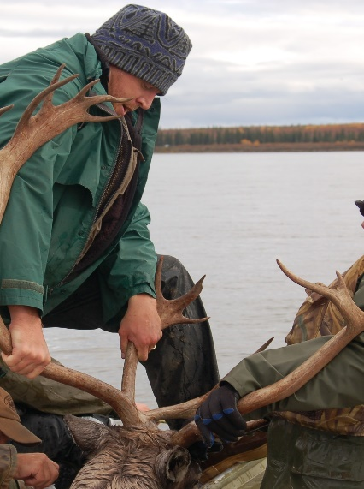
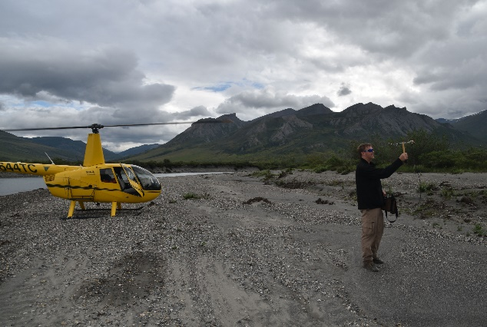
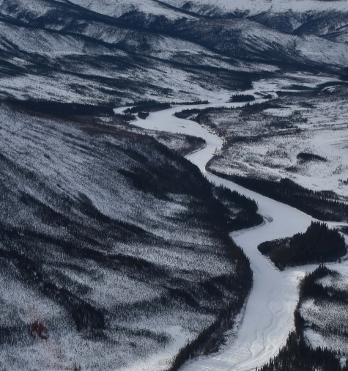
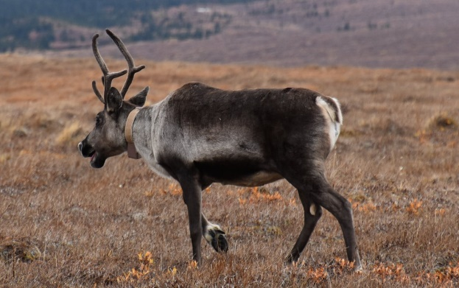
Partners
Dr. Kyle Joly, Wildlife Biologist
National Parks Service – Region 11: Alaska
Credit: Kyle Joly, NPS
Credit: Kyle Joly, NPS
Credit: Kyle Joly, NPS
Credit: Kyle Joly, NPS
Notes:
The partner for this project is the National Parks Service. The agency is divided into geographic regions across the United States. The region that this project focuses on is region 11. The National Park Service currently studies the interactions between wildlife in Northwestern Alaska, including caribou, and their habitat, through fieldwork, GIS, and remote sensing. One initiative NPS is currently involved in is managing caribou harvesting. With the rapid decline of caribou in the region, NPS is interested in learning more about the timing of caribou migration and the deflections and delays significantly impacting migration.
The NPS Region 11 Regional Park Office is based in Anchorage. Employees manage 15 national parks, preserves, monuments and national historical parks in Alaska, as well as the 13 national wild rivers, two affiliated areas, 50 National Historic landmarks, and a national heritage area in the state.
Kyle Joly is a wildlife biologist with a focus on spatial ecology of caribou who has been exploring the Alaska interior for more than twenty years while working for the Gates of the Arctic National Park and Preserve and the Yukon-Charley National Park and Preserve.
----------------------------------------------------------------------------------------------------------------------------------------------------------------------------------
Image Source (National Parks Service Logo) https://www.nps.gov/theme/assets/dist/images/branding/logo.png
Image Credit: Kyle Joly, National Park Service; used with permission
Image Credit: Kyle Joly, National Park Service; used with permission
Image Credit: Kyle Joly, National Park Service; used with permission
Image Credit: Kyle Joly, National Park Service; used with permission

Slide 7
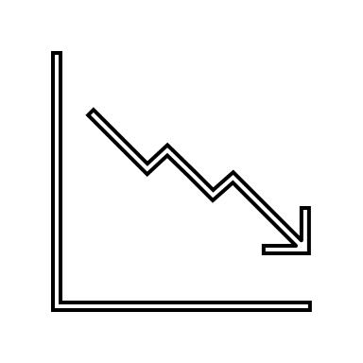
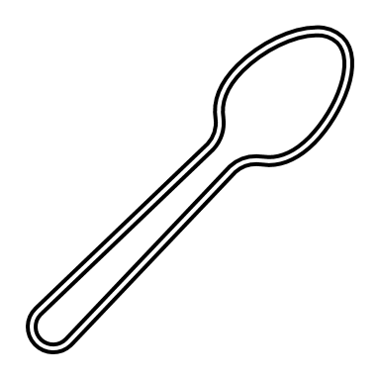
Community Concerns
Changes in the timing of fall river freeze up causes...
Rapid caribou population decline of 338,000 in the last decade
A threat to traditional hunting practices
Intensified food insecurity
Economic decline in the region
Notes:
The Western Arctic Caribou Herd population declined from 490,000 in 2003 to 152,000 in 2023. This rate of decline is alarming and signals significant changes to the ecosystem.
The local population in Northwestern Alaska relies on hunting for many parts of their lifestyle, including food and culture. Hunting, for many in the region, including indigenous people is a part of their cultural identity, and with the unusual patterns of freezing in the fall time, it becomes difficult for hunters to predict the conditions to hunt safely.
Going off of the threat posed to traditional hunting practices, this concern extends to the problem of food security and the economy of the region. With unpredictable hunting conditions and the caribou population decline, food insecurity is exacerbated. Caribou meat is an essential source of nutrition for communities in the region. As hunting caribous becomes less possible, people have to rely on alternate/exported food sources which may be difficult to access, expensive, and less culturally significant. This goes hand in hand with the economic repercussions in the area. Many people rely on hunting as a source of income, including the sale of antlers, hides, and more. With river ice freezing uncertainties causing problems with hunting ability and caribou populations, it is causing an economic decline in the region.
----------------------------------------------------------------------------------------------
Icons: Microsoft Office

Slide 8
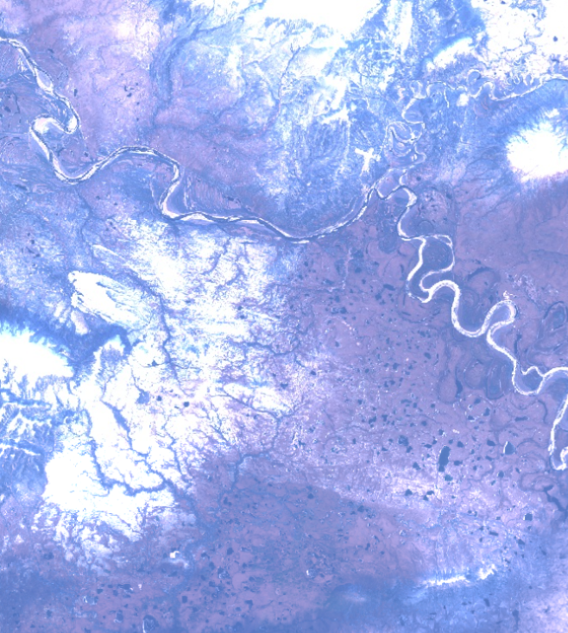
Objectives
Time Series
Plot optical and radar time series
Analyze annual changes
River Phases
Detect liquid to solid changes
Isolate uncrossable periods for
caribou
Feasibility
Detect ice types
Identify ice formation dates
Notes:
The objectives of this study were to investigate the feasibility of earth observation systems through a time series identifying river phenology phases. First, we investigated the extents to which ice types can be identified through remote sensing, this includes snow covered river ice, clear, and black ice detectable through remote sensing. We then sought to identify ice formation and thawing dates indicating the length of seasons year to year. Plotting spectral reflectance to indicate critical thresholds of river ice was the next objective of our study. This would allow us to detect increments of time as the river ice forms. This increment is characterized by the flowing ice chunks or "pancake ice" which makes the river dangerous to cross. This period would then be isolated as an uncrossable segment of the fall season for Caribou.
-----------------------------------------------------------------------------------------------------------
Icons: Microsoft Office
Image taken on Sentinel-2 MSI accessed via Google Earth Engine.

Slide 9
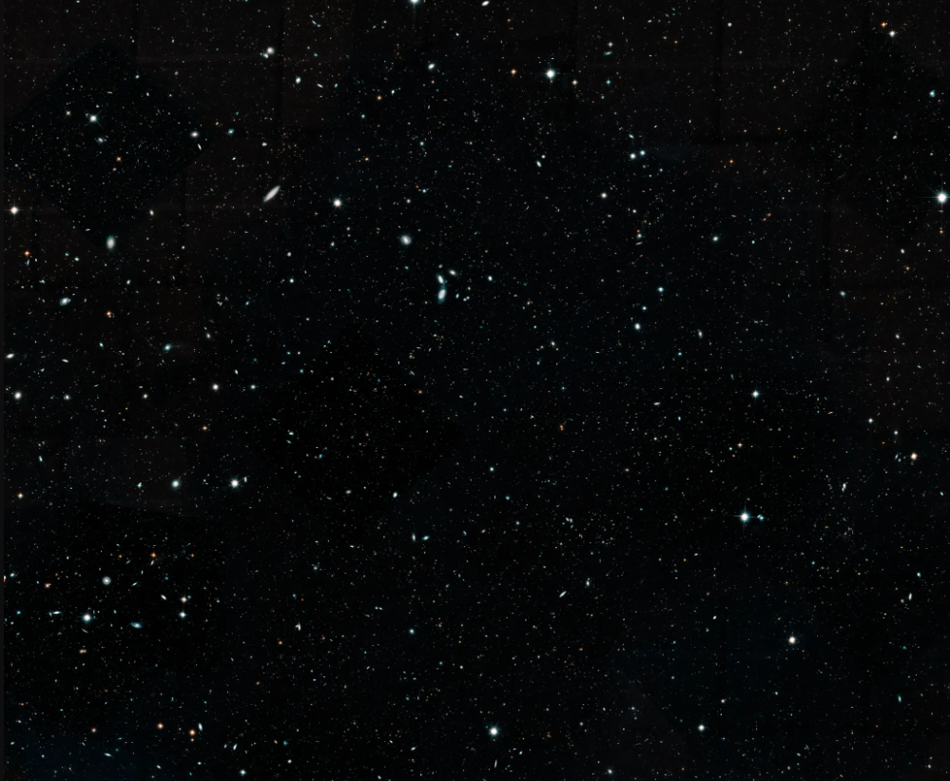
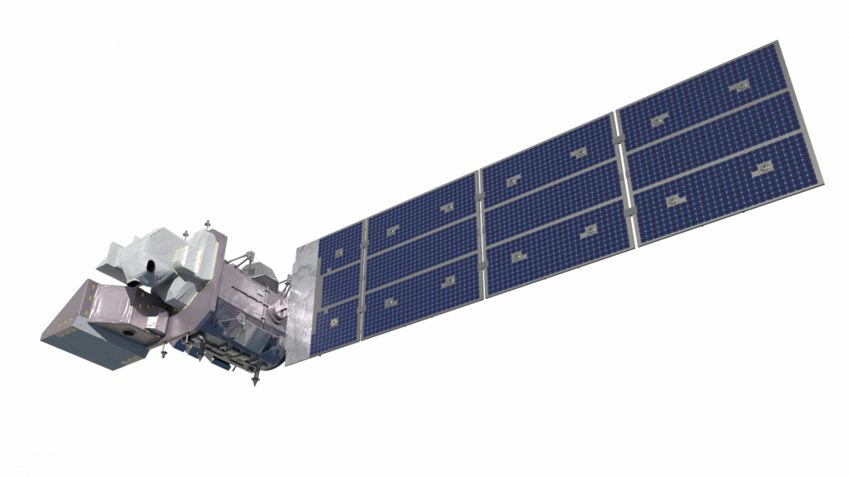
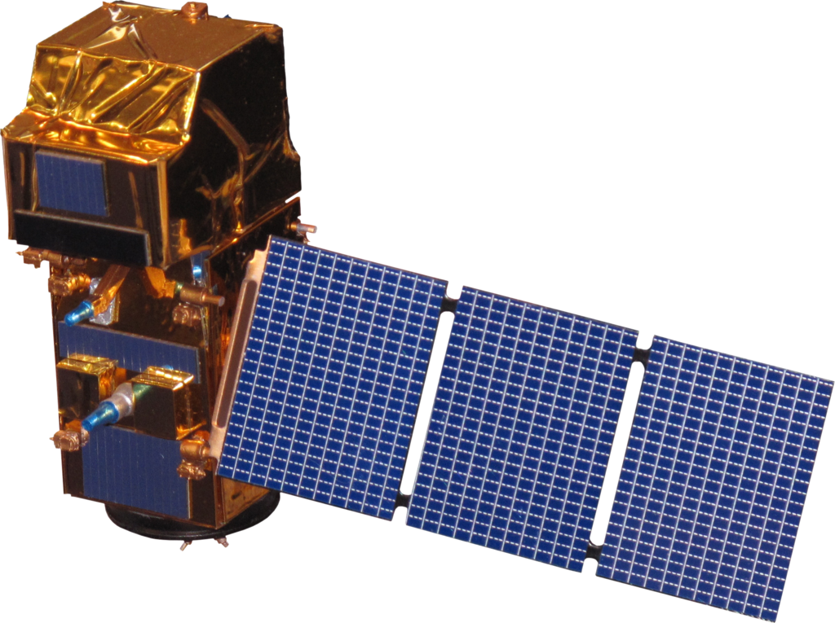
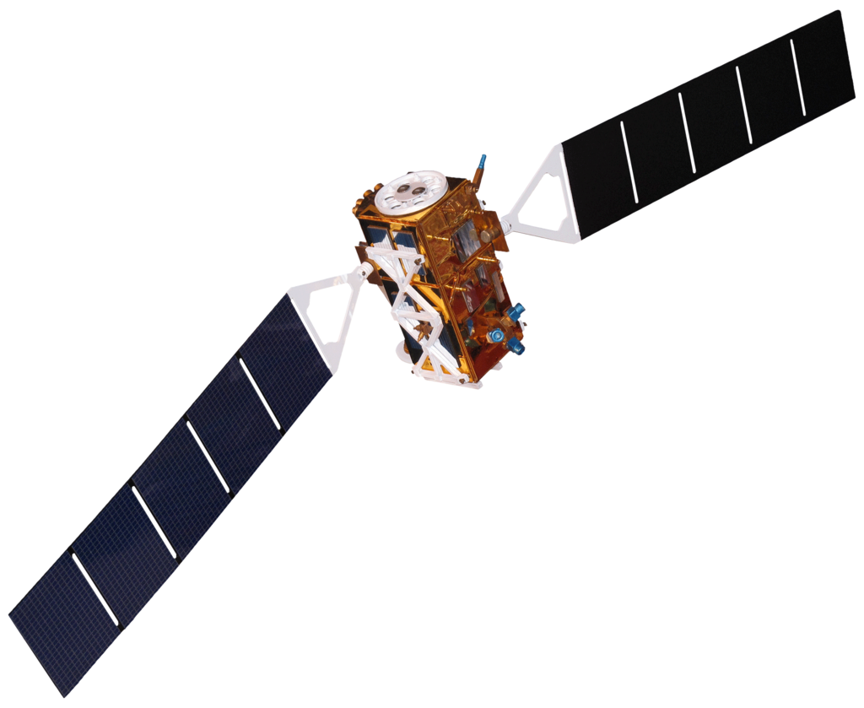
Earth Observations
Sentinel-2 A/B MSI
Landsat 9 OLI-2
Landsat 8 OLI
Sentinel-1 SAR
C-band
Images Credit: NASA & Rama
Notes:
Five satellites were used for our Earth observations of river phenology in Alaska. Our study utilized both optical and radar imagery to meet our objective of a time series. The harmonized imagery set including the Landsat 8, and Landsat 9, and Sentinel-2 A & B were employed on Google Earth Engine. The Sentinal-1 SAR was used for our active sensor analysis for ice coverage.
-------------Image Information----------------
Space Background
Image Credit: NASA
Image Source: https://science.nasa.gov/missions/hubble/hubble-astronomers-assemble-wide-view-of-the-evolving-universe/
Landsat 8 OLI Satellite Icon
Image Credit: NASA
Image source: https://science.nasa.gov/wp-content/uploads/2023/05/landsat8.png (public domain)
Landsat 9 OLI-2 Satellite Icon
Image Credit: NASA
Image source: https://science.nasa.gov/wp-content/uploads/2023/05/landsat9.png (public domain)
Sentinel-1 Satellite Icon
Image Credit: Rama
Image Source Sentinel-1: File:Sentinel 1-IMG 5874-white.jpg - Wikimedia Commons (CC BY-SA 2.0 FR)
Sentinel-2 Satellite Icon
Image Credit: Rama
Image Source Sentinel-2: https://commons.wikimedia.org/wiki/File:Sentinel_2-IMG_5873-white_(crop).jpg CC BY-SA 2.0 FR
Icons: Microsoft Office

Slide 10
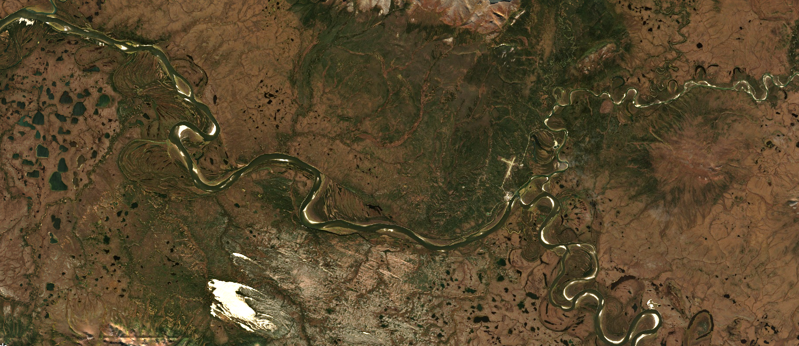
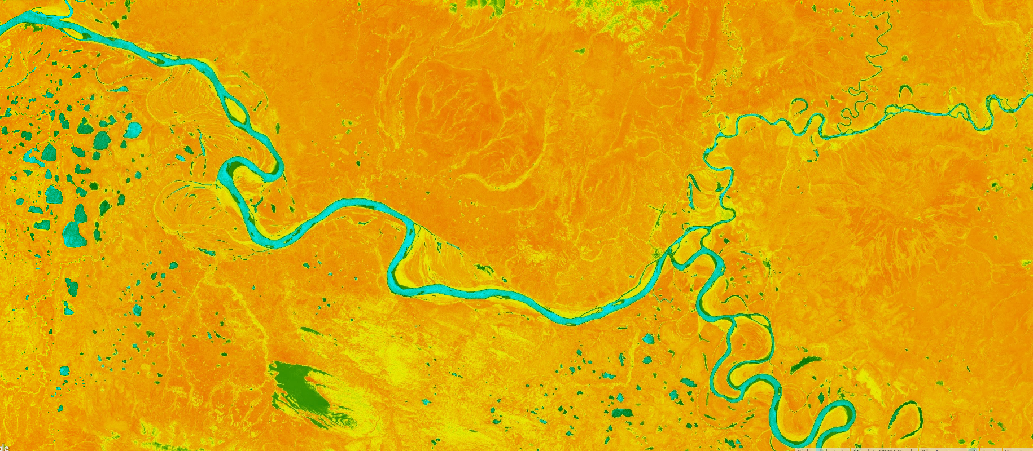
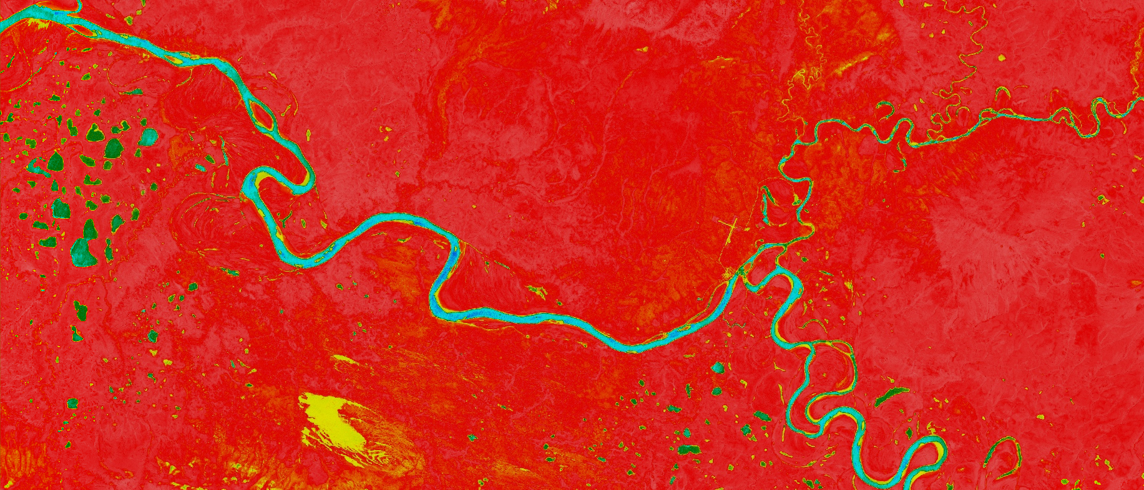
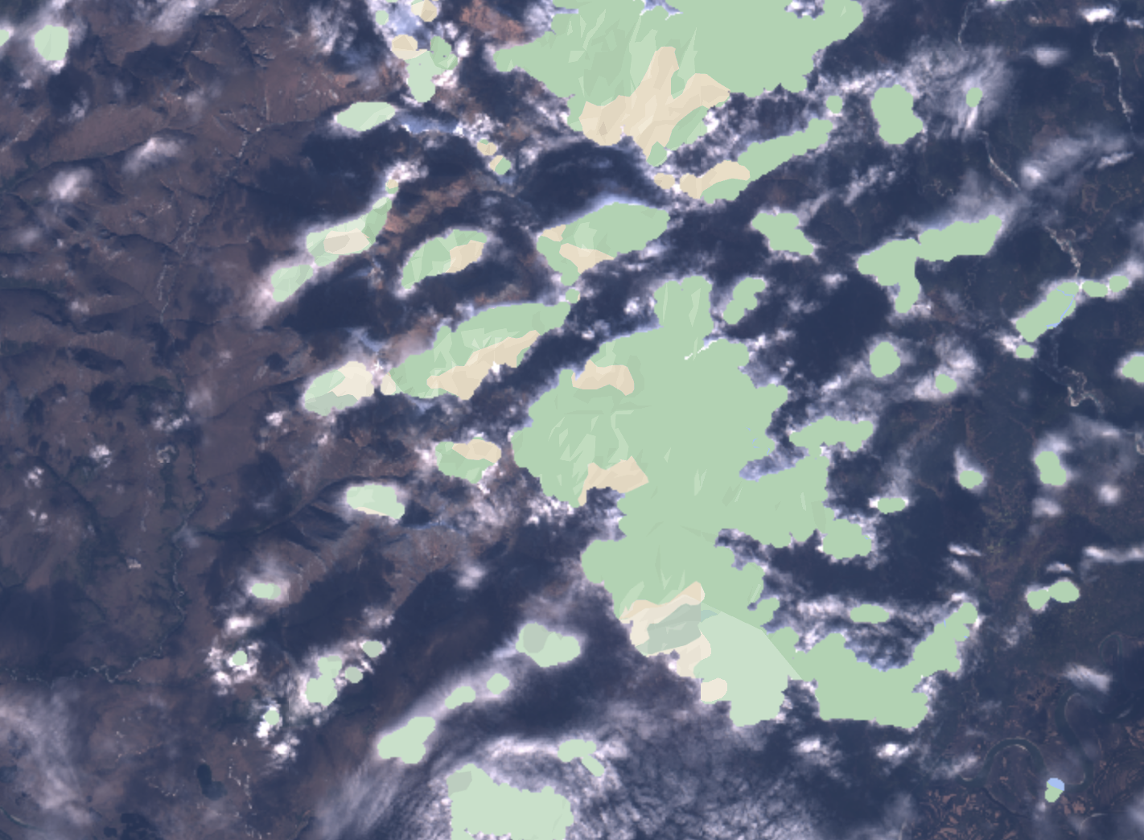
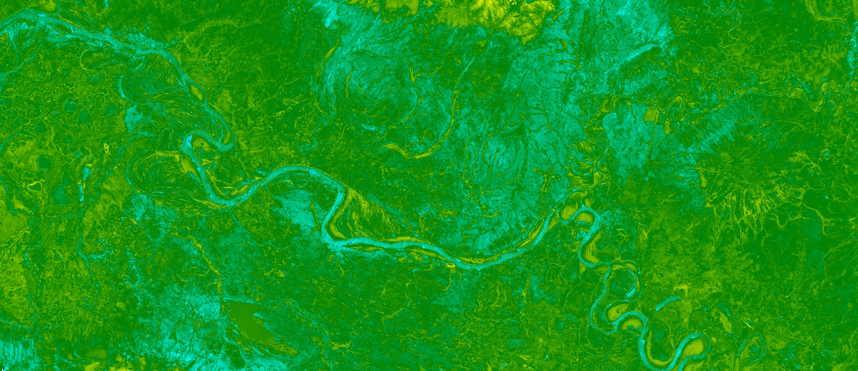
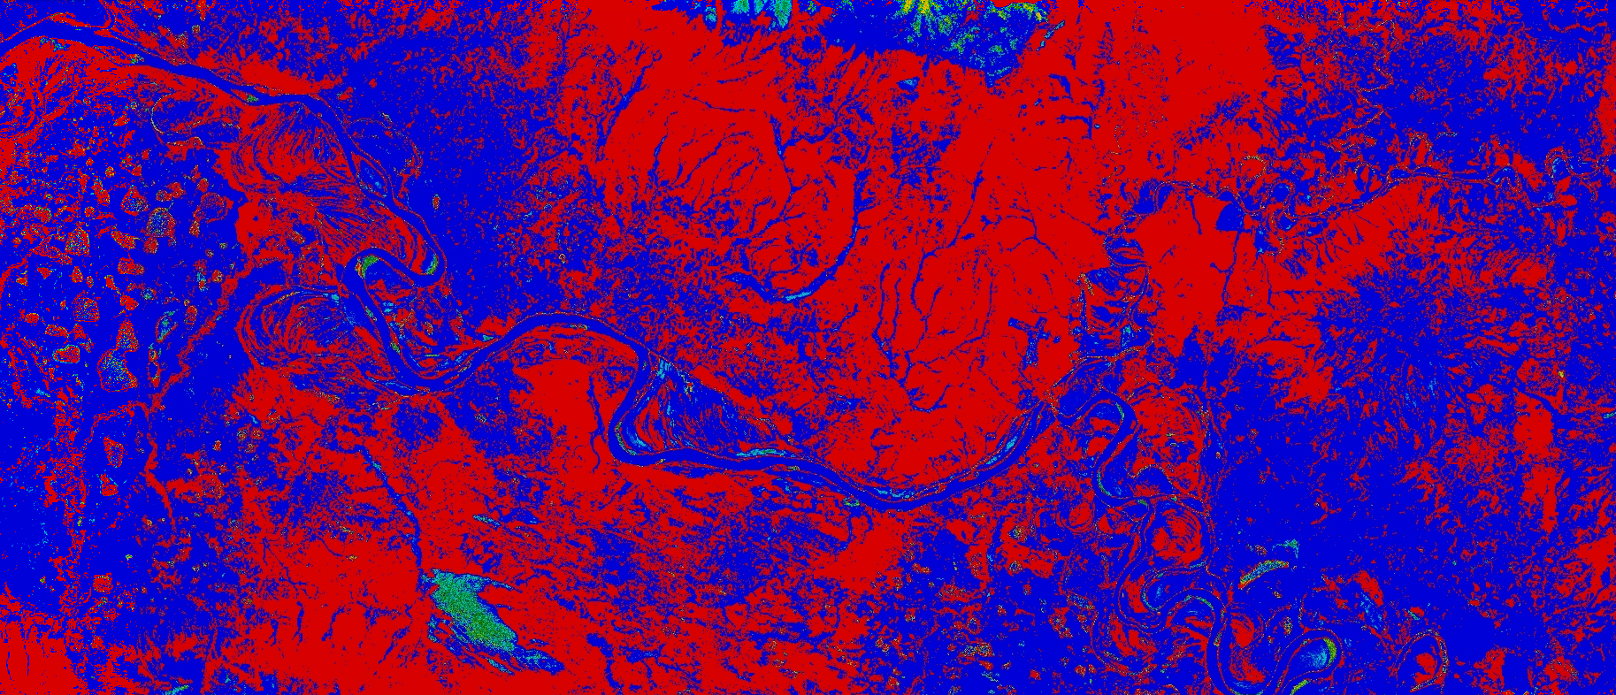
Methodology – Optical Imagery
RGB
Time Series Plots
Landsat 8 OLI
NDWI NIR
Time Series Maps
Cloud Mask
NDWI SWIR
Landsat 9 OLI-2
River phase changes
NDII
Sentinel-2 A/B MSI
Yearly Fall Freezing Timeline
RDRI
Images Credit: NASA & Rama
Notes:
Specific river study areas were generated, rather than extracted from a hydrography dataset, due to seasonal fluctuations in river flow, volume, and adjacent water bodies. Using caribou migration sites provided by the project partners, team members digitized polygons around the study sites using Google Earth Engine (GEE). Pixels for processing were identified by referencing Landsat 8 OLI Tier 2 and Sentinel-2A/B SR optical imagery, normalized difference water index (NDWI), and the NHDPlus river shapefile. These layers were set to 50% transparency to capture consistent overlapping river flow to counter seasonal changes.
Images were collected from September 1st to November 30th to capture the annual period of ice formation in the Colville and Kobuk rivers, which influences the feasibility of caribou migration. While some river areas did not completely freeze by November 30th, optical imagery was no longer available due to the shortening of days in Alaska. Image availability varied site to site, as data for the northern Colville study site ended in mid-October, while the southern Kobuk River continued through November. Landsat and Sentinel Image collections for each year were filtered to only include images with under 30% cloud coverage.
Mosaics were generated annually for each date containing images, and a new image collection was defined for the resulting series. A cloud mask was applied to each image in the collection to remove cloud interference for index analysis. The cloud mask was created from the quality assessment band within the metadata containing the information on the quality of each pixel, including cloud classification. It then performed a bitwise operation to remove any pixels from the image that are classified as clouds or cloud shadows.
A normalized difference water index (NDWI) was used to determine free-flowing water. For Sentinel-2A/B the normalized difference index was completed with the B3 (Green) and B8 (NIR) bands. Landsat NDWI calculations used B3 (Green) and B5 (NIR). Each pixel in the river shapefile provided an NDWI value reduced to print the mean value of NDWI for the river. This was then used to determine the threshold for free-flowing water. A second NDWI index was implemented utilizing the short-wave infrared bands (SWIR) using Sentinel-2's B3 (Green) and B11 (SWIR) bands and Landsat 8 and 9’s bands B3 (Green) and B6 (SWIR).
The normalized difference infrared index (NDII) has been used in various ways to detect moisture and land surface water (Ji et al, 2011). The calculation was completed through the normalized difference function in GEE using the near-infrared and shortwave infrared bands. The B8 (NIR)/B11 (SWIR1) and B5 (NIR)/B7 (SWIR1) bands were used for the Sentinel 2-A/B and Landsat 8/9 data, respectively. This yielded an estimate of infrared energy for each pixel within the river shapefile, which is a useful indicator in identifying open water. This value was reduced and exported to determine a mean NDII value for the study site.
The relative difference river ice index (RDRI) separated the visible light from the shortwave infrared (Li et al., 2021). This index was created by Li and colleagues to detect and distinguish between river ice and snow cover by taking the difference in the reflectivity in the red and NIR bands and dividing that by the sum of the reflectivity of the NIR and SWIR bands (Li et al., 2021). Index mean values were calculated through the reducer function in GEE. For each index, the image collection means were converted to feature collections. exported to a table, and then plotted along a time series chart to determine river ice phases.
No pre-existing literature existed which determined an index for river ice cross-ability. Li and colleagues’ research on the Tibetan plateau supplied a basis for establishing an RDRI threshold (Li et al., 2021). To determine frozen, unfrozen and mixed ice types, we referenced the NDWI and RDRI values during summer imagery to determine an upper boundary for a thawed river. The same methodology was applied for establishing a frozen boundary from winter river imagery. Investigating threshold values present for the ice formation period was a significant and novel ambition of this feasibility study.
------------------------------Image Information Below ------------------------------
Landsat 8 OLI Satellite Icon
Image Credit: NASA
Image source: https://science.nasa.gov/wp-content/uploads/2023/05/landsat8.png (public domain)
Landsat 9 OLI-2 Satellite Icon
Image Credit: NASA
Image source: https://science.nasa.gov/wp-content/uploads/2023/05/landsat9.png (public domain)
Sentinel-2 Satellite Icon
Image Credit: Rama
Image Source Sentinel-2: https://commons.wikimedia.org/wiki/File:Sentinel_2-IMG_5873-white_(crop).jpg CC BY-SA 2.0 FR
All other images and figures created by the DEVELOP team

Slide 11
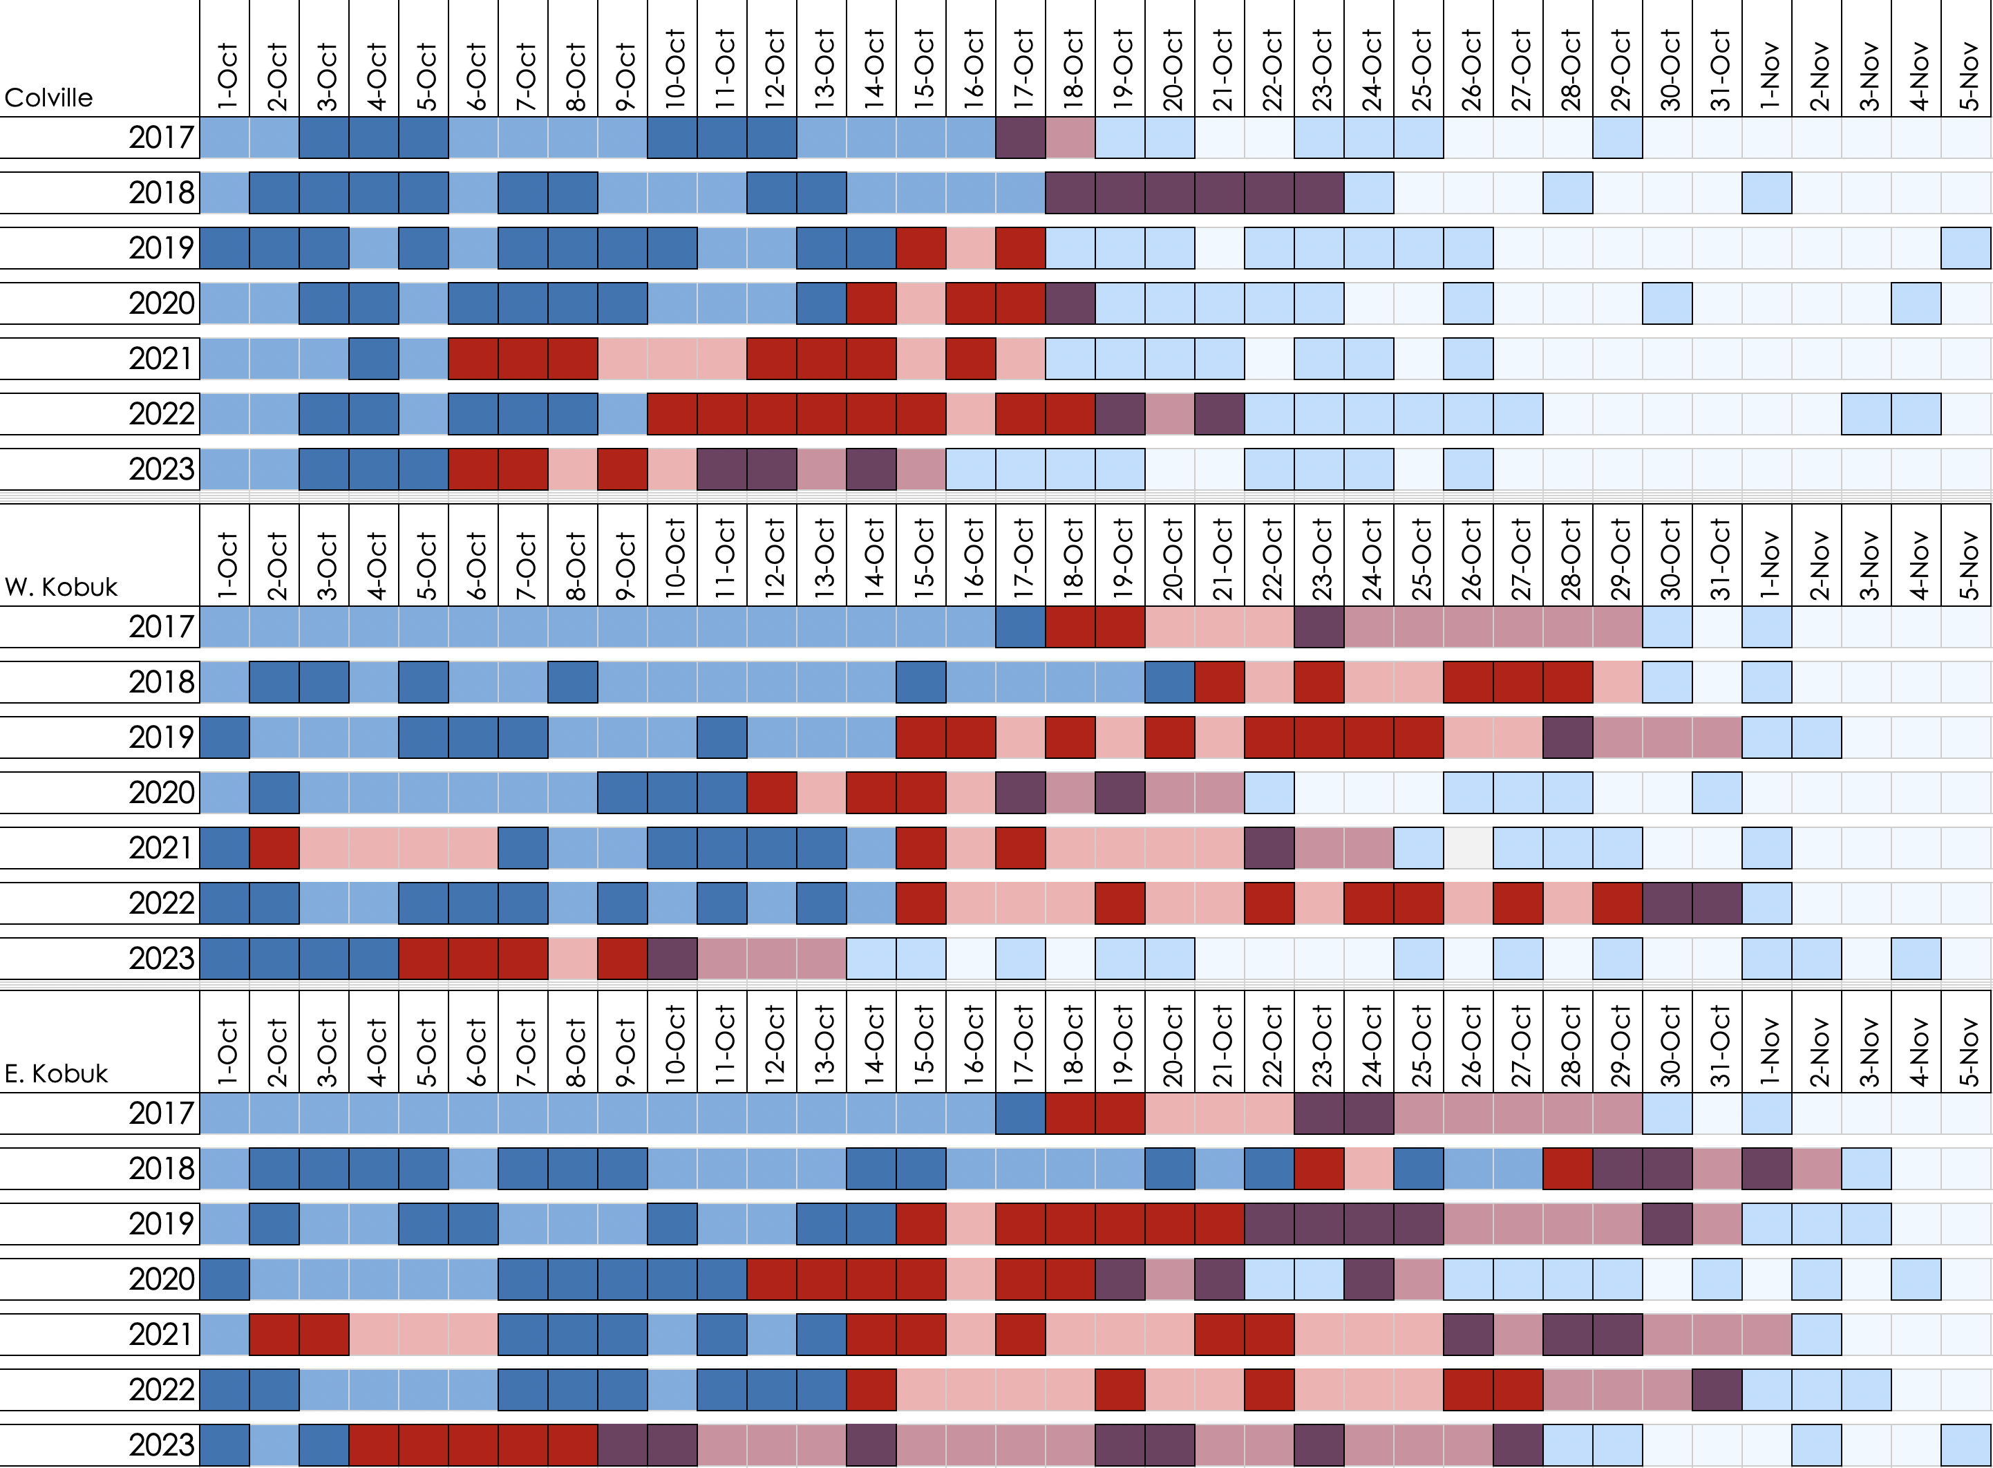
Results – Yearly Fall Freezing Timeline
Notes:
These graphics identify the yearly arrivals of ice, formation of ice jams, and full freezing in the stretches of the East Kobuk, West Kobuk , and Colville Rivers. The boldest colors signify days with a satellite observation from either Sentinel-2, Landsat 8, or Landsat 9. The days with lighter shades indicate days without imagery where a continuation of ice conditions was assumed for the visualization of ice formation periods until an imagery confirmation. This method was conducted with only optical imagery. The graphics are arranged to compare the yearly fluctuations in ice formation as well as the differences among study sites.

Slide 12
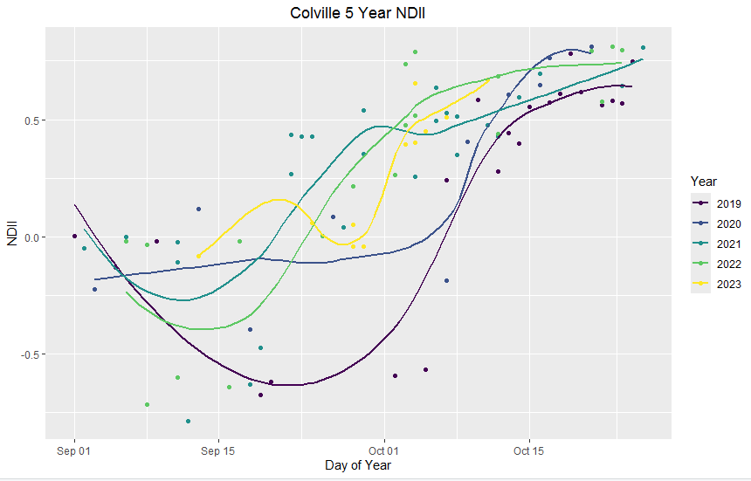
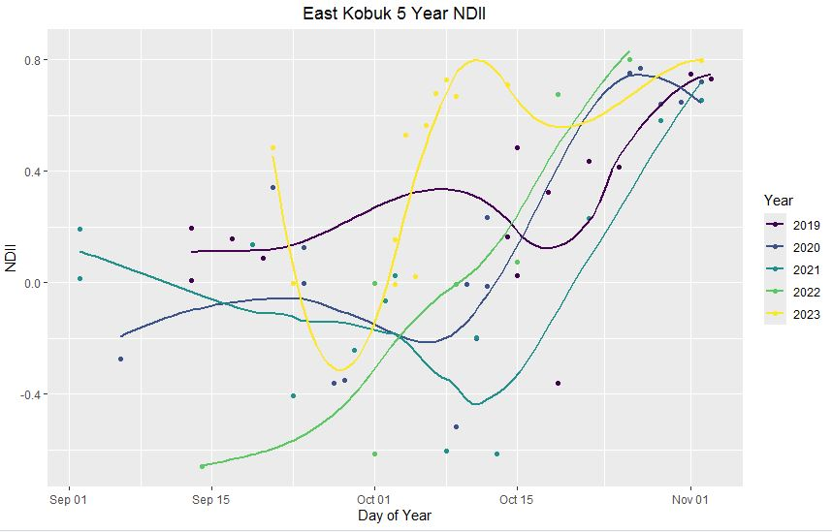
Results – Spectral Reflectance Time Series (NDII)
Notes:
Annual spectral reflectance indices using NDII over stretches of the East Kobuk and Colville River depict the river ice phenology and the date of freezing for each year show promising results for the use of NDII to capture changes in ice phenology in arctic and subarctic regions.

Slide 13
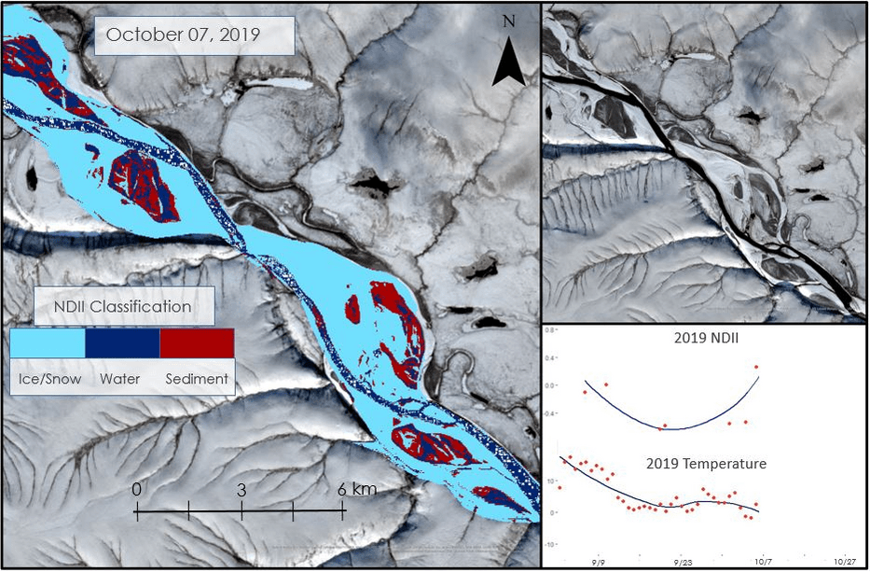
Results – Fall 2019 Freezing Timeline
Colville River
Notes:
We used the Normalized Difference Infrared Index to identify ice in optical imagery over the study period
This region was selected due to high image availability
The above time series visualization illustrates the ice formation period over one year (2019) within a seven-mile stretch of the Colville
We can compare the index classifications to the true color land cover depictions in the top right images
Light blue indicates snow/ice cover, dark blue indicates open water, and red indicates sediment
The open water region shrinks over the course of the fall, starting during the approximate 2019 ice onset date of October 14
We also compared NDII and temperature
The predictive functions have similar shapes
Near the start of the ice formation period, both temperature and NDII curves begin to increase until stabilizing once ice is nearly completely frozen

Slide 14
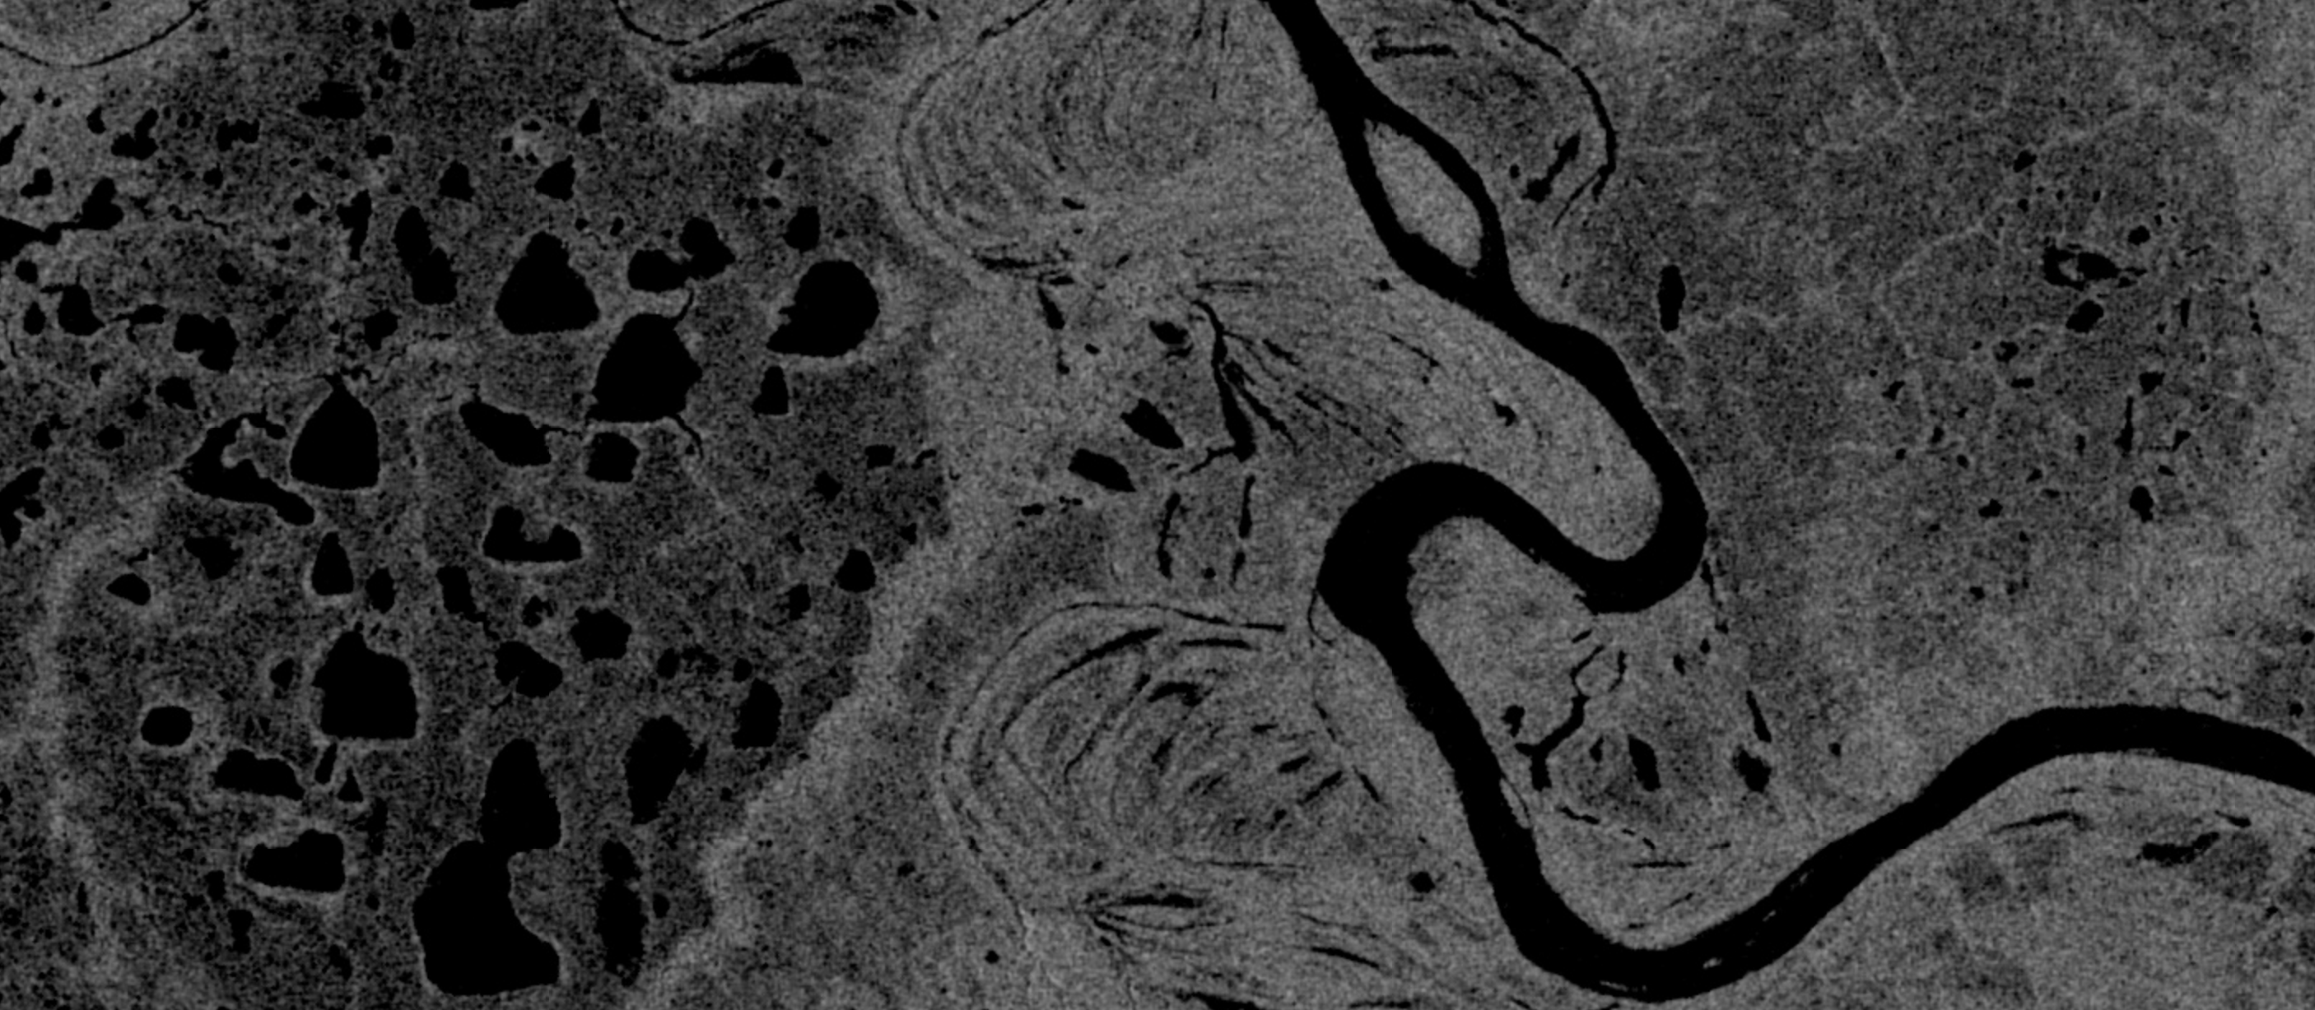
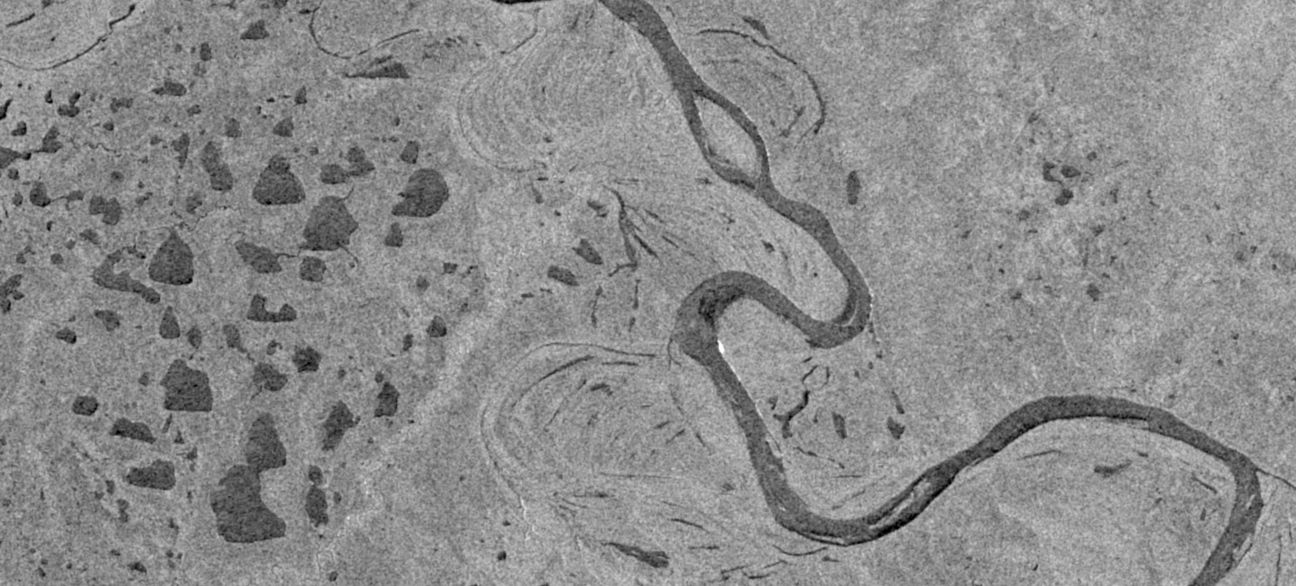
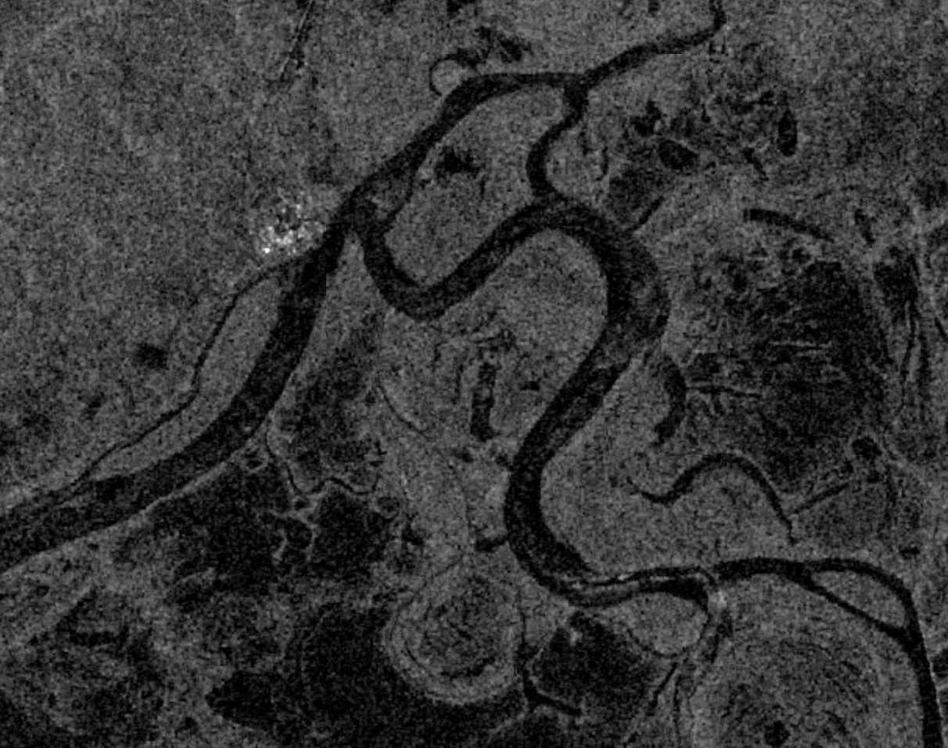
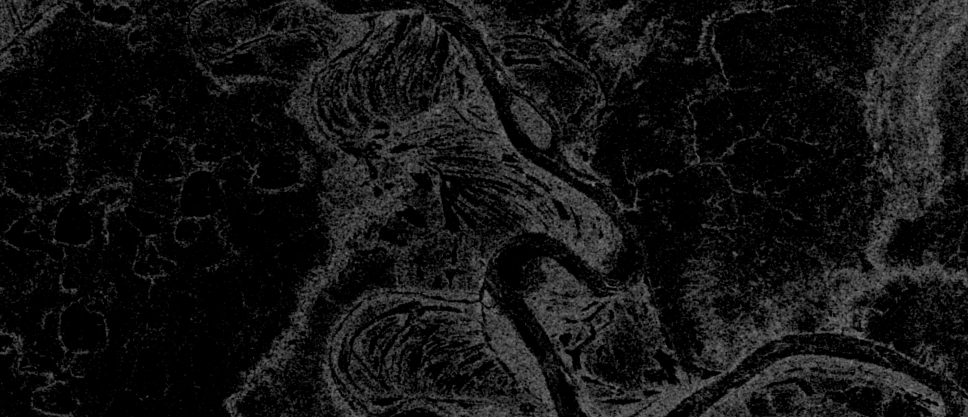
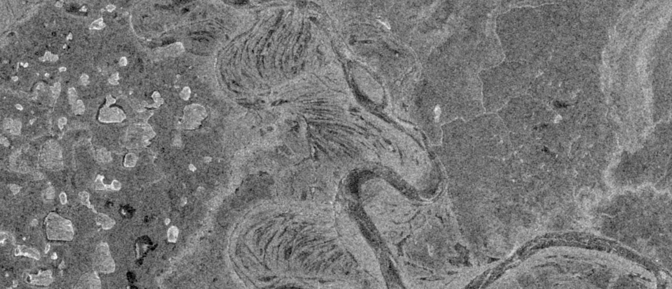
Methodology – SAR Imagery
Time-series Plots
VH Ascending
VV Ascending
Temperature VS Backscatter Plots
Speckle Filter
Sentinel-1 SAR
C-band
VH Descending
Fall Freezing Timeline Plots & Maps
VV Descending
Images Credit: Rama
Notes:
Synthetic Aperture Radar (SAR) was utilized to analyze backscatter to detect ice formation. Sentinel-1 C-SAR data was filtered to acquire imagery for the fall, particularly from September 1st to November 30th to focus the analysis on the fall freeze-up period as well as to supplement the results found with the passive sensors. The dataset was filtered to only include images with the VV and VH polarizations and the Interferometric Wide instrument mode as they are commonly used for surface analysis. A speckle filter was applied to the Sentinel-1 images to reduce the noise and speckles.
The SAR imagery was analyzed by investigating the mean values of the VV and VH bands from the ascending and descending satellites aboard Sentinel-1. The mean backscatter values were taken for both the descending and ascending orbits to detect differences between the two, primarily looking for significantly higher backscatter values which may indicate ice presence.
------------------------------Image Information Below ------------------------------
Sentinel-1 Satellite Icon
Image Credit: ESA
Image Source: https://science.nasa.gov/multimedia-galleries/spacecraft-icons (public domain)
All images and figures created by the DEVELOP team

Slide 15
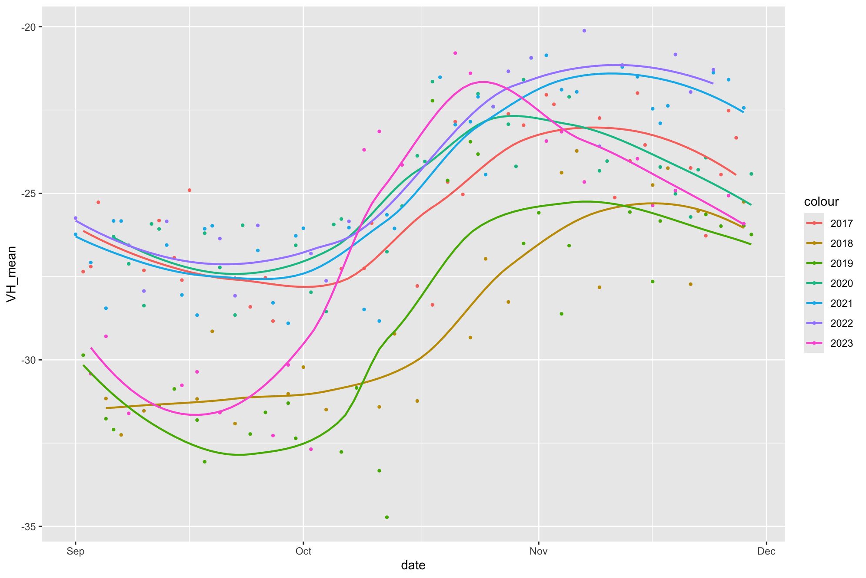
Results – Backscatter Time Series
West Kobuk VH Backscatter Mean – 2017 to 2023
Year
VH Mean
Date
Notes:
Through our analysis using Sentinel-1 we found that the VH band mean backscatter was consistently low when water was present and relatively higher when ice was formed. During the formation process, the VH backscatter values had a somewhat linear increase. This trend was seen throughout the study period from 2017 to 2023. However, across the years the inflection point changed. For example, in 2023, the ice formation began around a week earlier than other years and had a quicker jump from water to ice. In 2019, water was present in the river for longer and ice began forming in mid-October.

Slide 16
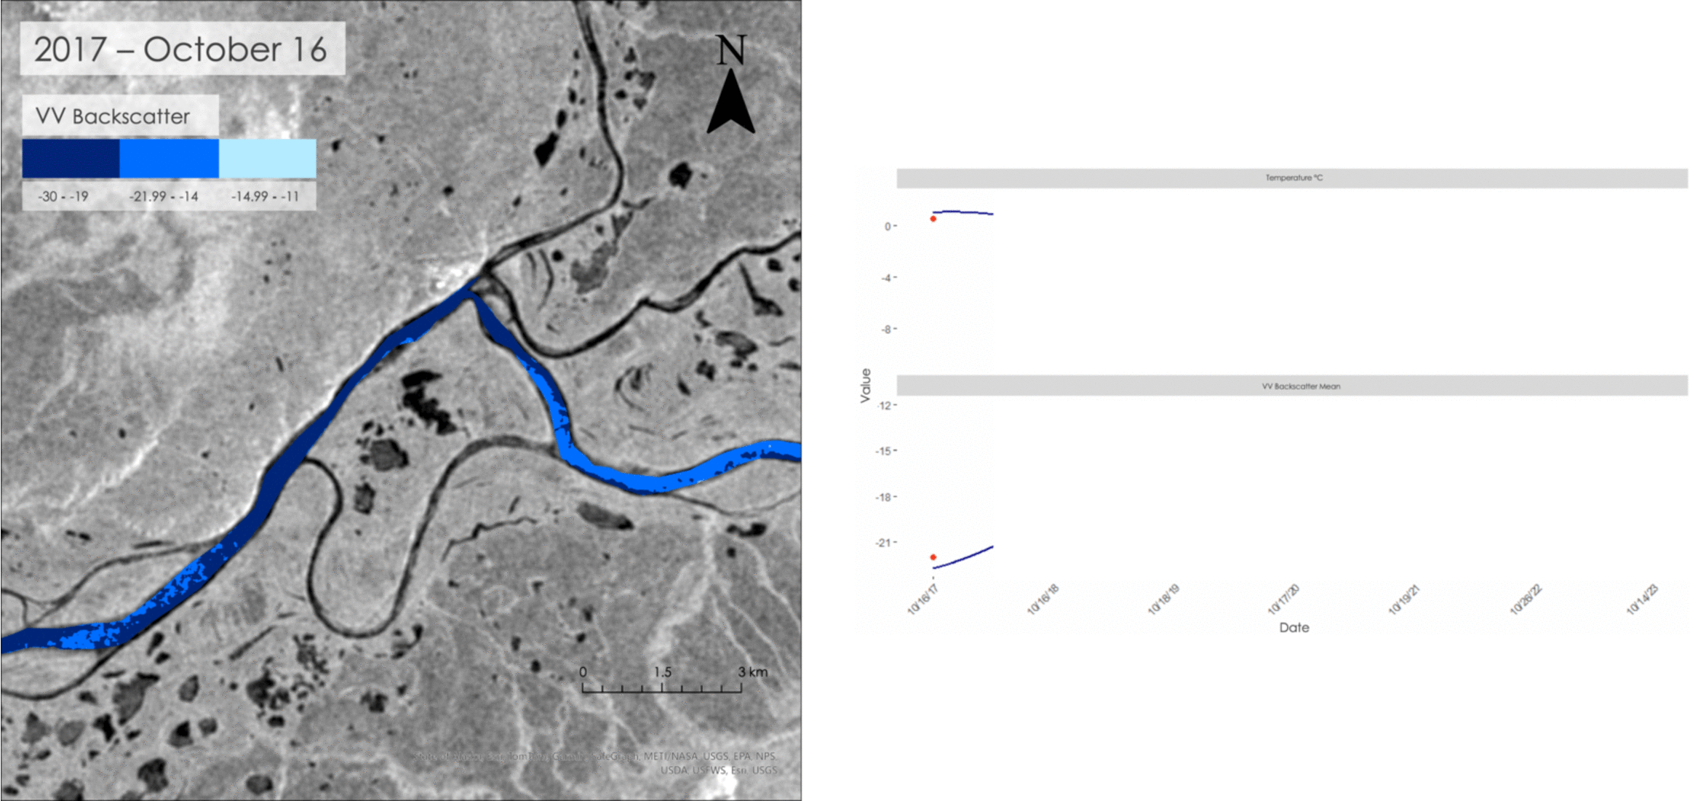
Results – Mid October Over the Years (2017–2023)
West Kobuk River
Notes:
This GIF depicts one day each year in mid October from 2017 to 2023. The dates were picked to try to be as close to one another as possible during the river ice formation time however because of satellite imagery availability this was not always possible. (mention Sentinel-1 ascending stopping in 2022). In 2017 and 2018, the VV mean values were low indicating a smooth surface of water. 2019 has a high VV value meaning the river's surface became more rough. This data is shown with the temperature data for the respective dates.

Slide 17
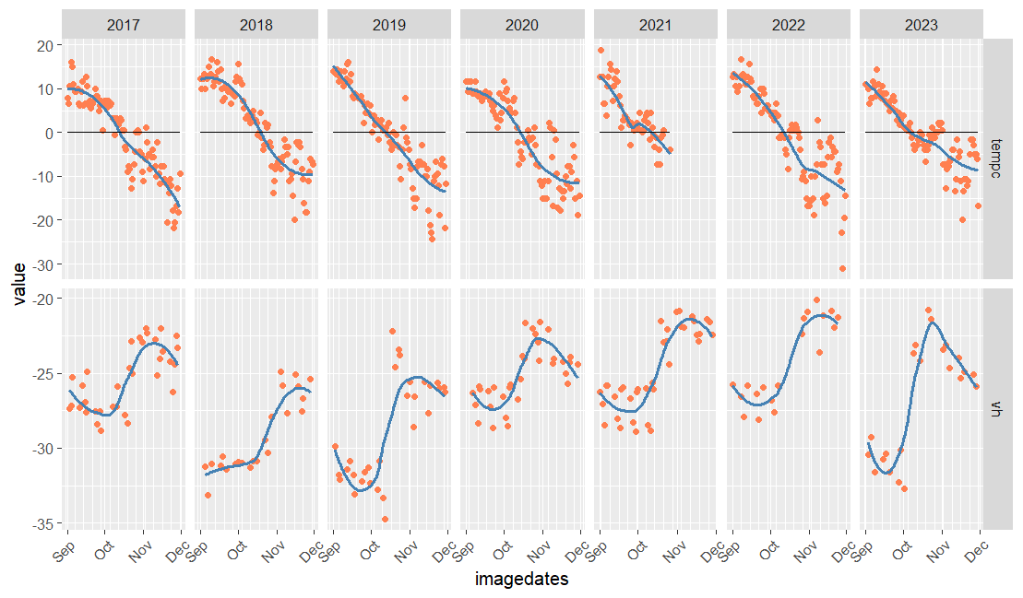
Results – Temperature VS Backscatter
West Kobuk River
Temperature °C
VH Mean
Date
Notes:
This plot depicts the correlation between temperature and VH backscatter mean. Around the time when temperature hits 0 degrees Celsius, the VV backscatter begins to increase as ice begins to form and as temperature lowers, the backscatter continues to increase.

Slide 18
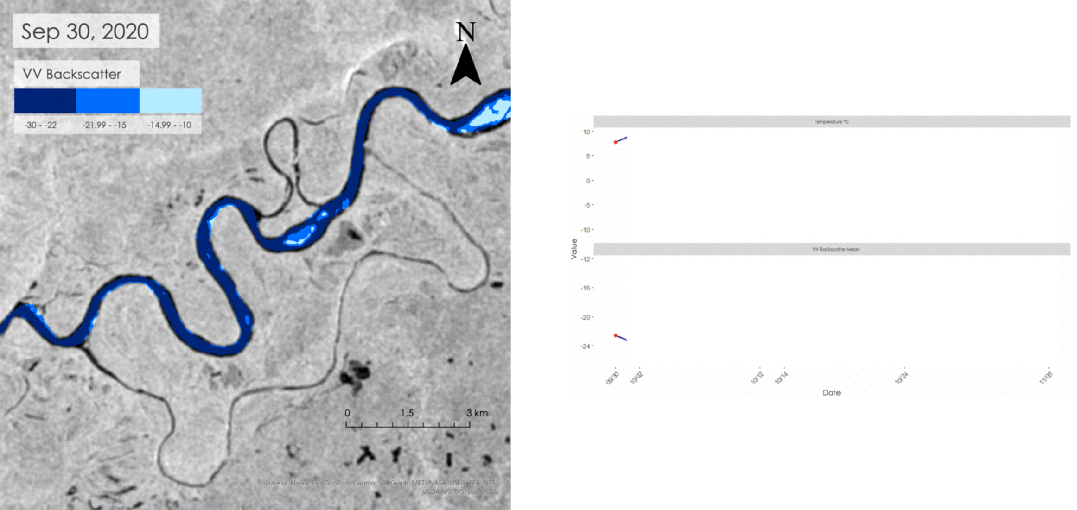
Results – Fall 2020 Freezing Timeline
West Kobuk River
Notes:
This GIF depicts the timeline of the river freezing up in the fall of 2020. The images were chosen based on satellite image availability for that portion of the river. The images are complimented by the temperature and VV backscatter mean plots. A correlation can be seen between VV backscatter values and the air temperature. The darker blue area of the river is reflective of lower VV values which indicates a smoother surface which can be seen as water. The lighter blue is reflective of high VV values which indicate rougher surfaces, possibly depicting ice.

Slide 19
Results - Errors & Uncertainties
Image
Availability
Cloud
Coverage
River Pixel Identification
Caribou Crossability
Notes:
There were errors in our study pertaining to the satellite images and river phenology more generally. While we used multiple Earth observations datasets, each presented unique challenges. While we originally intended to use the Harmonized Landsat Sentinel-2 (HLS) dataset, there were considerable gaps that undermined its usability. Both the Landsat and Sentinel datasets have low temporal resolutions that limited the number of days with useable images, and the lack of sunlight in the winter prevented us from having any images after early November. Even usable images often only partially overlapped with the caribou migration sites identified by our project partners. Some years also lacked data, as Landsat 8 had no data for 2022 and 2023 and Sentinel-1B was discontinued after 2022 due to satellite malfunctions. Many images from both satellites contained cloud cover, and we struggled to accurately remove them. Our methods were effective for some images but also extraneously removed snow cover. Identifying pixels for analysis was also challenging due to complexities in working with hydrological data. Season water level fluctuations, unequal flow distribution, and changes in river sediment deposition all yielded uncertainty in accurately identifying water, even if partially alleviated through NDWI calculations. Because of spatial heterogeneity throughout long river sections, our summary statistics may not accurately explain ice phenology conditions at different points in the same study area. Finally, while we could identify ice, we could not differentiate between different ice cover types. Any areas with ice therefore are not necessarily be strong or thick enough for caribou to cross.
----------------------------------------------------------------------------------------------
Icons: Microsoft Office

Slide 20
Conclusion
SAR data appeared to be more successful than spectral reflectance in analyzing river ice presence
Indices could not robustly distinguish between spectral similarities of snow, ice, and cloud
Optical imagery can better identify the ice onset date than SAR
Radar
Optical
Indices
Effectiveness
Notes:
Radar is a more accurate river ice presence predictor than optical
We noticed stronger trends in the relationships between backscatter and time than spectral reflectance index values
Could be due to its higher temporal resolution and insensitivity cloud coverages
Optical imagery can better identify ice onset dates:
While there is a correlation between backscatter measurements and ice coverage, there are no known binary decision thresholds
Indices could not robustly distinguish between spectral similarities of snow/ice/cloud
This means that we had to classify snow/ice as the same color for the optical time series maps
It also means that clouds might be impacting index values
In summary, we found radar data more useful in quantifying ice coverage throughout the study period due to the aforementioned correlations and lack of cloud distortions, but optical is still useful in qualitatively assessing ice phase changes
----------------------------------------------------------------------------------------------
Icons: Microsoft Office

Slide 21
Conclusion – Future Work
Missing Optical Imagery
Temperature Data Validation
Crossable Ice Thresholds
Notes:
Missing Optical Imagery: While the Sentinel-1 A/B datasets contained ample usable data, the optical data contained considerable gaps. Future work should use more substantial optical imagery datasets through acquiring missing 2017 and 2018 Sentinel-2 imagery within the study area. This includes harnessing the advantages of higher Landsat data availability from the recent release of Landsat-9 imagery.
Temperature Data Validation: The aforementioned optical imagery challenges warrant additional data validation initiatives to verify the presence/absence of ice throughout the study period. We began comparing temperature and index/backscattering values, but future research should complete more advanced validation initiatives. Stakeholders could aggregate measurements from multiple weather stations and/or compare ice phenology results to in situ data to more accurately estimate ice formation times and duration.
Crossable Ice Thresholds: While we could predict presence and absence of ice, our data offered a limited capacity to characterize ice types or quantify its thickness. Knowing this information would allow biologists to differentiate between ice strong enough to support caribou and conduct more accurate risk assessments at crossing locations.
Ice Classification Models: Limitations in both optical and radar imagery underscore the importance of designing more advanced ice analysis workflows. Given similarities in the spectral reflectances between ice and snow/cloud cover, future researchers should develop a supervised classification model. This algorithm should be trained on images encompassing various dates, atmospheric conditions, topographies, etc.
----------------------------------------------------------------------------------------------
Icons: Microsoft Office

Slide 22
Project Partner
Dr. Kyle Joly, National Parks Service – Gates of the Arctic National Park and Preserve
Science Advisors
Dr. Cédric Fichot, Boston University
NASA DEVELOP
Madison Arndt, DEVELOP Lead, Massachusetts – Boston
Special Thanks
Seamore Zhu, Boston University PhD Student
This material contains modified Copernicus Sentinel data (2017-2023), processed by ESA.​

