Slide 1
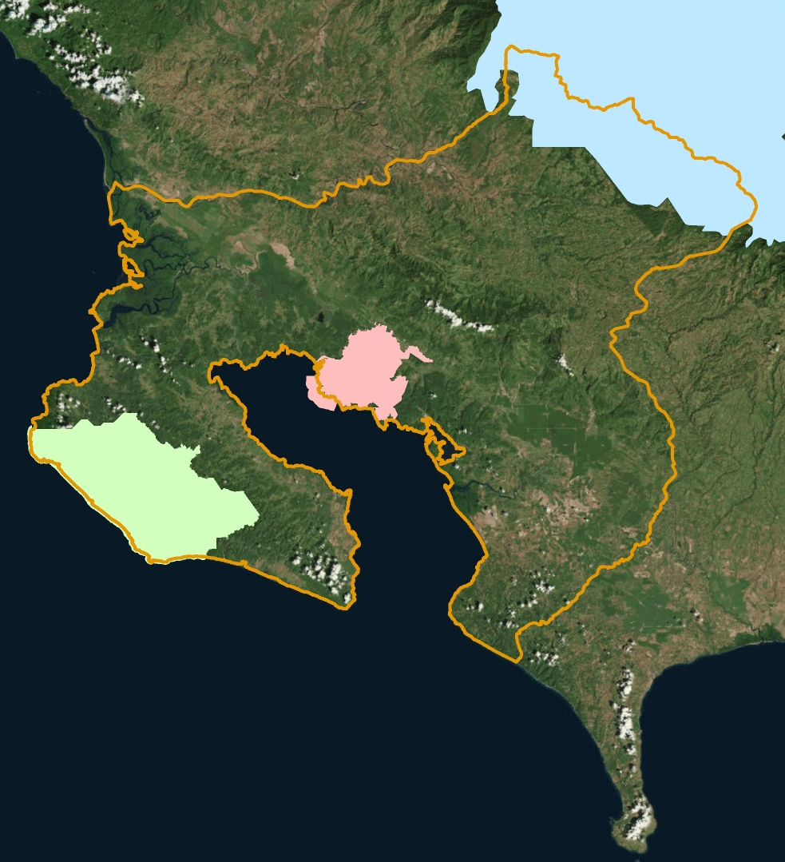
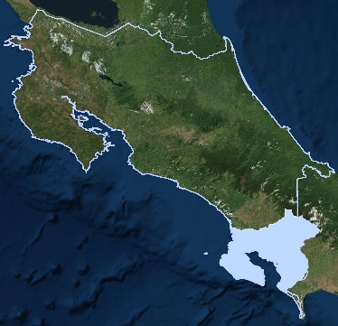
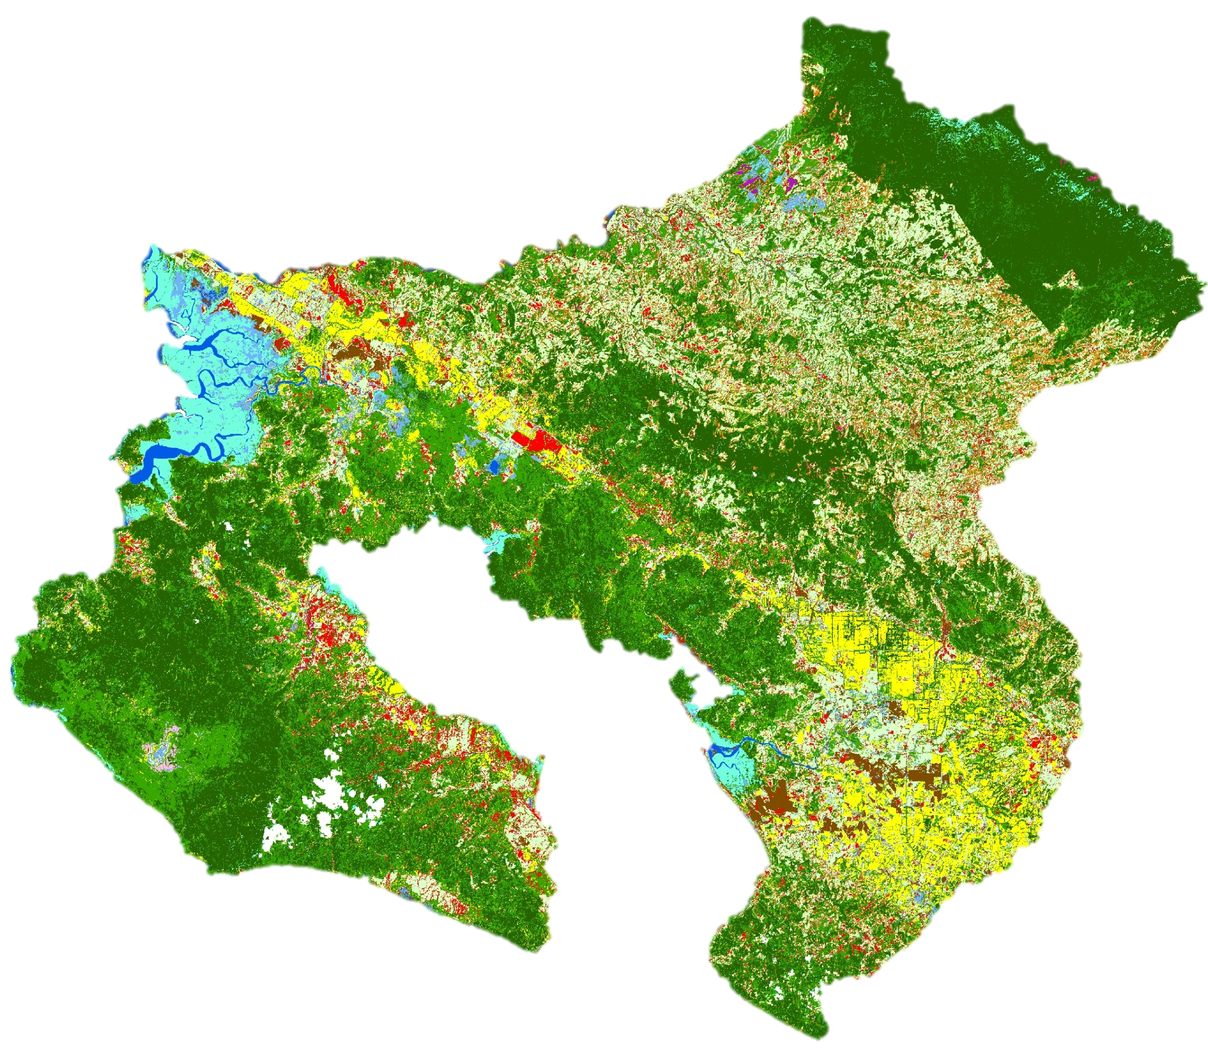
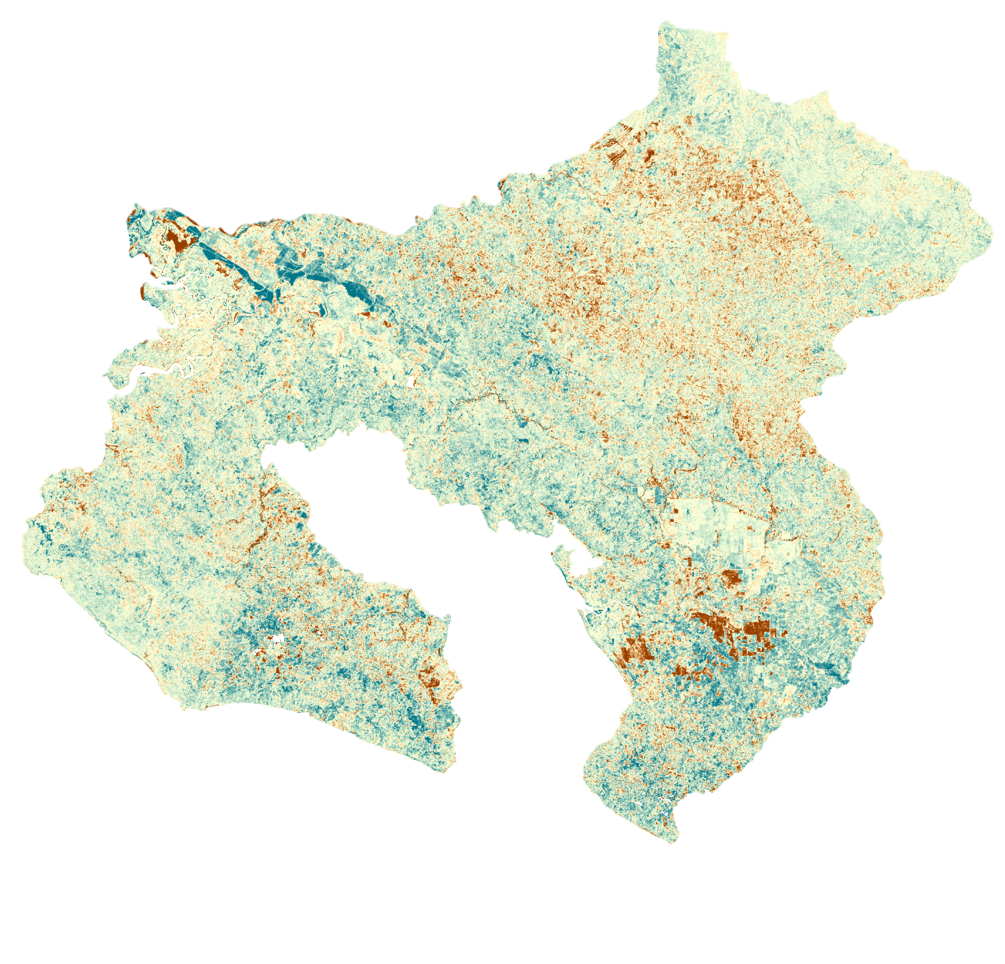
Determining Habitat Suitability to Establish a Jaguar Corridor between the Talamanca Mountains and the Osa Peninsula in Costa Rica
Abstract
Study Area
Talamanca-Osa Ecological Forecasting
Costa Rica houses many diverse environments, including La Amistad International Peace Park in the Talamanca Mountains and Corcovado National Park on the Osa Peninsula. Jaguars (Panthera onca) can be found throughout these two parks, but urbanization and agricultural development have fragmented habitats, isolating these populations. As a result, this apex predator and keystone species, is endangered throughout the country. NASA DEVELOP partnered with the Arizona Center for Nature Conservation – Phoenix Zoo and Osa Conservation to design a jaguar corridor between these two protected areas to connect isolated populations by linking habitat fragments, facilitating movement. This project used Landsat 5 Thematic Mapper (TM), Landsat 8 Operational Land Imager (OLI) and PlanetScope satellite imagery to assess historical vegetation health and classify current land use and land cover. Forecasting classifications to 2030 identified potential risk areas for agricultural expansion, increased development, preserved habitat fragments, and human-jaguar conflict. This land use trend analysis informed a suitability assessment for the implementation of a jaguar corridor.
Costa Rica
Objectives
0 5 10 20 30 40
Produce January 1987 through March 2019 Normalized Difference Vegetation Index (NDVI) and Enhanced Vegetation Index (EVI) time series maps to evaluate trends in vegetation health
Conduct current (March 2018 to March 2019) land use and land cover classifications to evaluate habitat loss, fragmentation and the suitability of implementing a jaguar corridor
Forecast land use and land cover classifications to 2030 to identify areas of potential human-jaguar conflicts and habitat loss
Provide guidance on how to use land use and land cover forecasts to determine the location of a potential jaguar corridor.
Km
Study area
Corcovado National Park
Piedras Blancas National Park
La Amistad National Park
N
Methodology
Landsat 5 TM
EVI maps
EVI Change Map
Landsat 8 OLI
NDVI maps
NDVI Change Map
Earth Observations
1987
1997
2017
2019
Landsat 5 TM
Landsat 8 OLI
PlanetScope
Landsat 8 OLI
Land Use and Land Cover Map
TerrSet
Land Use and Land Cover Map 2030
PlanetScope
Results
2018 to 2019
NDVI
EVI
Coffee
Exposed Soil/Urban
Grassland/Pasture
Mangrove
Melina/Teak
Natural Palm
Palm Plantation
Páramos
Pineapple
Primary Forest
Secondary Forest
Water
Wetlands
Median NDVI and EVI time series
N
Increased EVI
0 5 10 20 30 40
Km
Preliminary land use and land cover classification for 2018 through 2019
N
Acknowledgements
Decreased EVI
The team would like to thank the project partners, as well as the following people from the NASA DEVELOP Program:
Dr. Marguerite Madden (Science Advisor, University of Georgia)
Steve Padgett-Vazquez (Science Advisor, University of Georgia)
Marie Bouffard (DEVELOP Center Lead, Georgia-Athens Node)
Shelby Ingram (Project Coordination Fellow, Georgia-Athens Node)
Dr. Sergio Bernardes (Assistant Director Center for Geospatial Research, University of Georgia)
Suravi Shrestha & Taufiq Rashid (Osa Peninsula Water Resources II project)
0 5 10 20 30 40
Km
Conclusions
EVI change comparing 1986 and 2018 through 2019
The results of our NDVI and EVI analyses show an overall increase in vegetation between 1987 and 2019.
The region between Piedras Blancas and La Amistad National Parks experienced a decrease in vegetation and an increase in habitat fragmentation between 1987 and 2019.
Palm plantations dominate the area close to the Inter American Highway, highlighting the need for focused restoration efforts in the region.
Localized NDVI and EVI decrease between 1987 and 2019 can be attributed to urbanization and exposed soil.
Team Members
Project Partners
Arizona Center for Nature Conservation – Phoenix Zoo
Osa Conservation
Hikari Murayama
Project Lead
Brooke Bartlett
Ryan Palmer
Samuel Furey
Georgia – Athens| Spring 2019

