Slide 1
Jobos Bay
Water Resources II
Using Earth Observations to Analyze Coastal Changes, Mangrove Extent, and Water Quality in Southern Puerto Rico
Lily Oliver
Susan Jarvis
Rachael Barrows
Katherine Hahn
Virginia – Langley
Notes:
Hello and thank you for joining us today! My name is [insert name], and this is our Jobos Bay Water Resources II: [insert team member's names]. Our team will be presenting information on the mangrove extent, land use land cover, and water quality in and around Jobos Bay, Puerto Rico that we have gathered over the past 10 weeks. We are excited to share this information with you, and it has been a pleasure to be able to work with our science advisors at NASA and partners at the Jobos Bay National Estuarine Research Reserve.

Slide 2
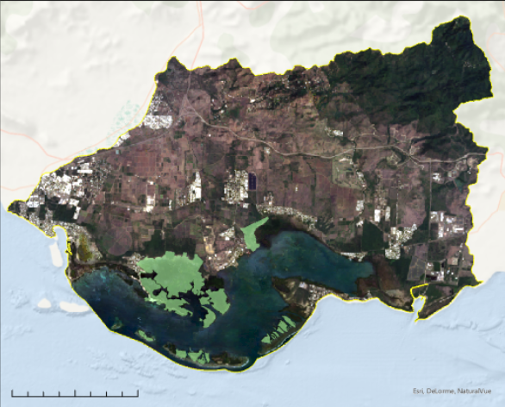
Study Area: Jobos Bay
Jobos Bay National
Estuarine Research
Reserve (JBNERR)
Aguirre Forest
Watershed and surrounding community
Puerto Rico
Jobos Bay
Aguierre Forest
N
JBNERR Extent
Study Area Extent
0
5
Kilometers
Image Credit: ESRI
Notes:
The study area of this project focused on Jobos Bay, Puerto Rico. This includes the Jobos Bay National Estuarine Research Reserve (JBNERR), the surrounding watershed and community, and the Aguierre forest to the East of the bay. Jobos Bay lies between the municipalities of Salinas and Guayama and is influenced by five main watersheds. Lying on the South-East part of Puerto Rico, Jobos Bay is directly in the path of storms. Our study period, therefore, focused around the 2017 hurricanes and the recovery of the bay since then.
----- Image Credits -----
1. Study Area Map: Landsat 8 OLI 2021 composite; ESRI World Ocean Base
2. Inset Map: Light Grey Base from ESRI
3. Arrow | PowerPoint Symbol Public Domain

Slide 3
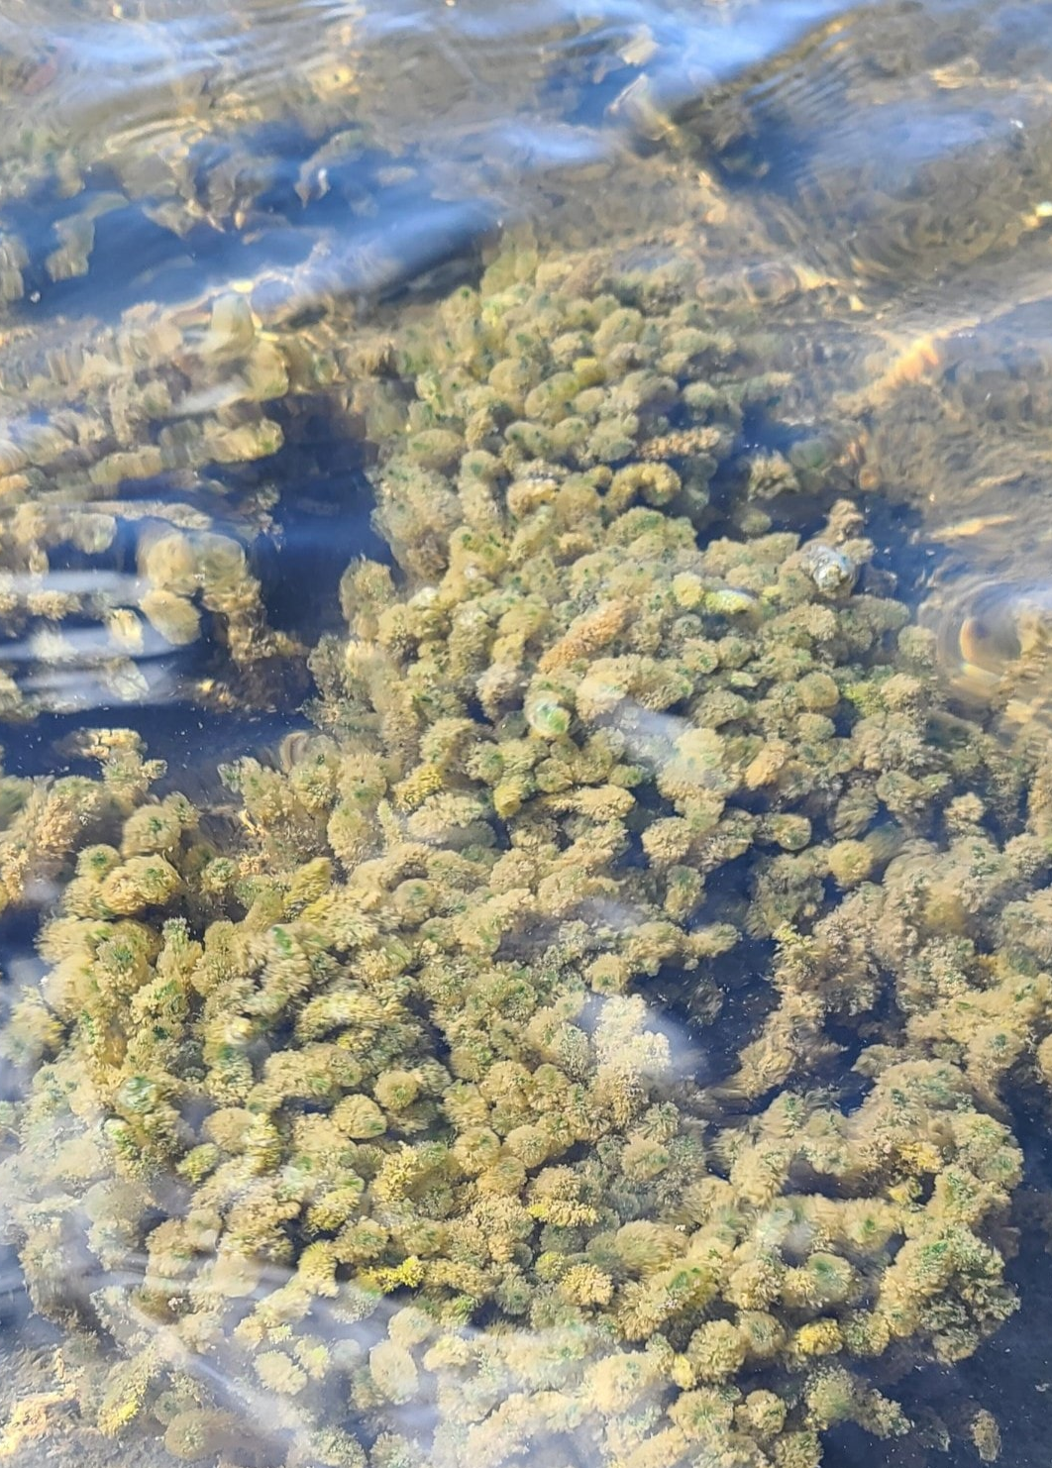
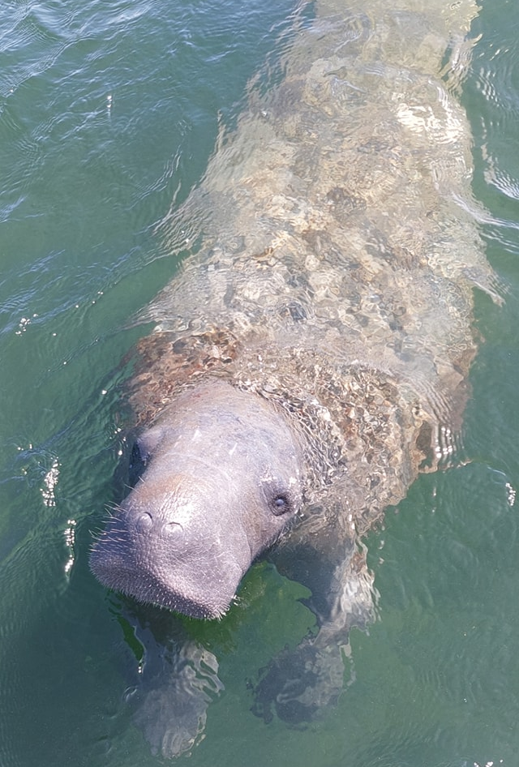
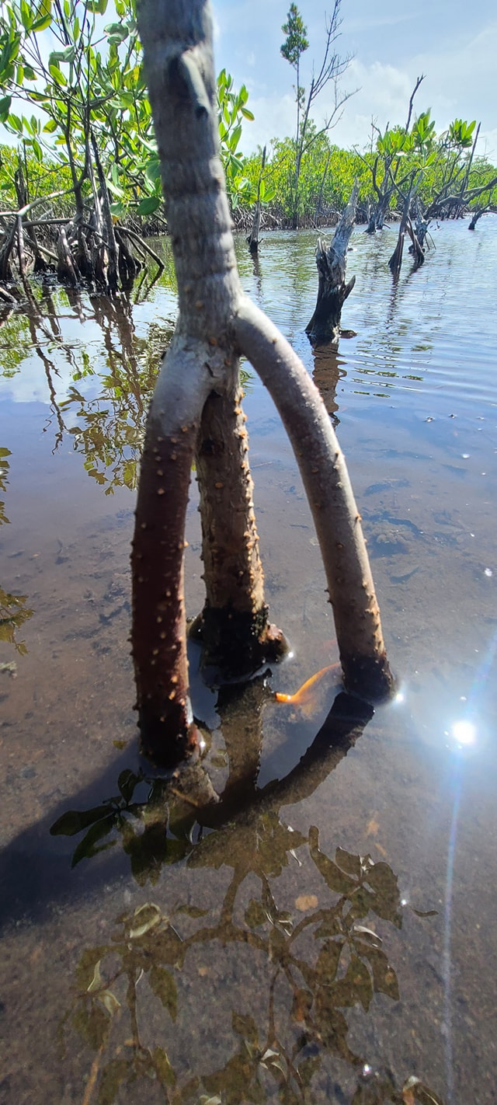
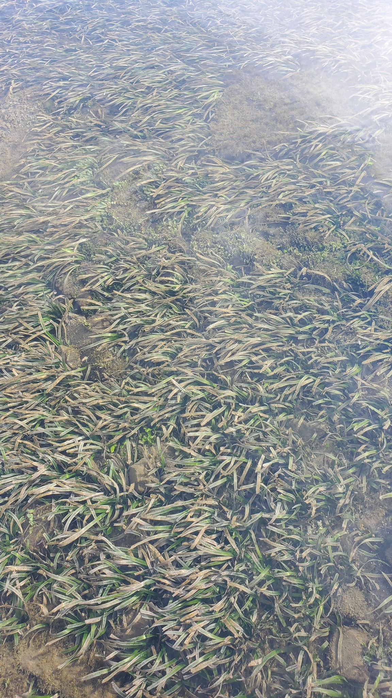
Background: Jobos Bay
Sea Grass Meadows
Mangroves
Protected Species
Coral Reef
Image Credit: JBNERR
Notes:
To know why Jobos Bay was chosen for study and protection, we must understand its ecological and social importance. Jobos Bay provides recreation, education, and protection to the surrounding communities. Jobos Bay also holds many important nursery habitats for economically important fish as well as protected species like the Antillian Manatee. These habitats include coral reefs and seagrass beds as well as mangrove forests. Mangroves provide protective services to the land, including erosion prevention, flood mitigation, and nutrient and habitat creation. The water quality of the bay is affected by surrounding agriculture and development and can in turn impact the ecosystems residing in it.
----- Image Credits -----
1. Coral Reef | JBNERR Facebook Page | retrieved from https://www.facebook.com/jobanerr/photos used with permission
2. Mangrove Roots | JBNERR Facebook Page | retrieved from https://www.facebook.com/jobanerr/photos used with permission
3. Manatee| JBNERR Facebook Page | retrieved from https://www.facebook.com/jobanerr/photos used with permission
4. Sea Grass | JBNERR Facebook Page | retrieved from https://www.facebook.com/jobanerr/photos used with permission

Slide 4
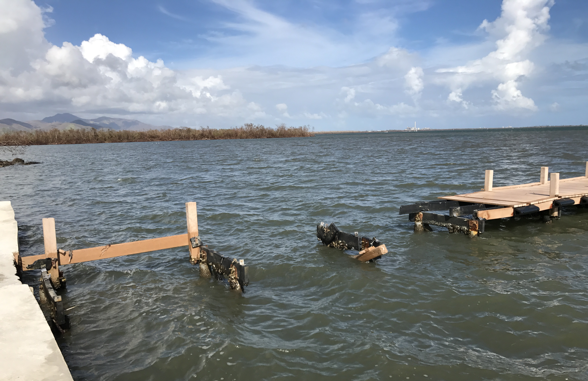
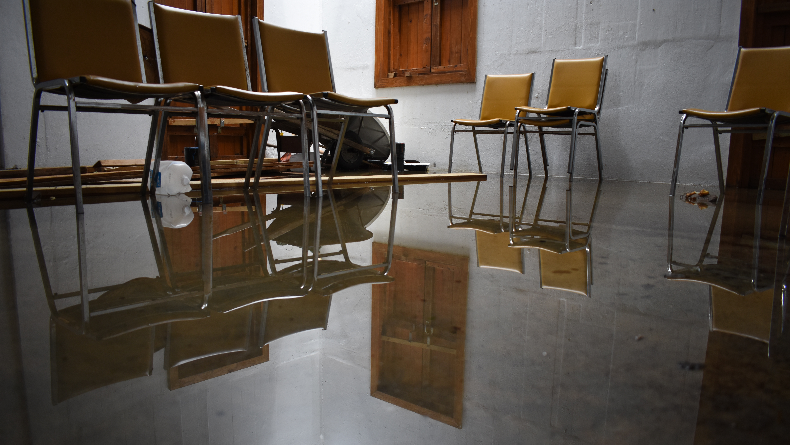
Community Concerns
Increased high-intensity storms
Reduced functionality of mangrove forests benefits
Land use encroachment and
effect on water quality
Reduction of JBNERR's services
Limited current research
Image Credit: JBNERR
Notes:
This brings us to the issues Jobos Bay faces and why it needs protection. The island was recently impacted by Hurricanes Irma and Maria in 2017, and Jobos Bay is still recovering. Mangroves are highly affected by these storms, and their services to the surrounding community can decrease with this damage. Also, changing land use can harm both mangrove extent and water quality. The cultural, educational, and recreational services Jobos Bay National Estuarine Research Reserve provides to the surrounding community depend on sustaining its ecosystem, and there is worry about reduction of these benefits, especially because there has been limited past research on these impacts.
----- Image Credits -----
1. Broken Dock| received from partners at JBNERR | used with permission
2. Flooded Room| received from partners at JBNERR | used with permission

Slide 5
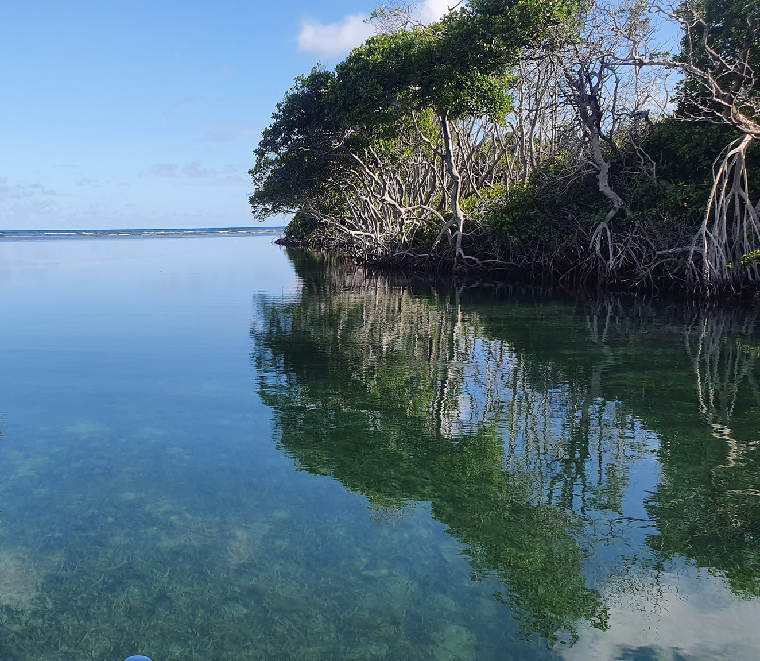
Jobos Bay National Estuarine Research Reserve
Research
Education
Management
Community Participation
Image Credit: JBNERR
Notes:
Our partners at the Jobos Bay National Estuarine Research Reserve (JBNERR) monitor the reserve for its marine recreation, commercial and recreational fishing, and ecotourism. To promote these functions of the reserve, JBNERR conducts research, education, management, and community participation through workshops, seminars, and hands on experience opportunities. JBNERR is managed by the Puerto Rican Department of Natural and Environmental Resources and the National Oceanic and Atmospheric Administration (NOAA) Office of Coastal Management. They manage the reserve using a combination of drone imagery and in-situ data monitoring, and our project will help them with future methodology and monitoring decisions.
----- Image Credits -----
Mangroves over water | JBNERR Facebook Page | retrieved from https://www.facebook.com/jobanerr/photos used with permission

Slide 6
Project Objectives
Create 2021 LULC analysis
Analyze hurricane effects on mangroves and track recovery
Compare in-situ and satellite water quality data
Notes:
Our project objectives were to provide JBNERR with data to help inform their management decisions. Our goals were to create LULC analysis for 2021 to observe current land cover conditions for Jobos Bay and analyze the effects on mangroves and track the recovery, and compare in-situ and satellite water quality measuring techniques.

Slide 7
Methodology: Mangroves
Mangrove extent maps
ArcGIS Pro
Landsat 8 OLI
January – June composites
Mask, threshold, apply indices
Train mangrove model
Quantify mangrove extent
Google Earth Engine
Assess accuracy
ArcGIS Pro &
Google Earth Pro
Image Credit: NASA
Notes:
For mangrove analysis, our goal was to map changes in mangrove extent related to Hurricanes Irma and Maria, while differentiating mangrove vegetation from other terrestrial vegetation. This information helps to analyze the storm impacts on mangroves and gives JBNERR information on which areas need the most restoration. To do this, we composited Landsat 8 Operational Land Imager imagery from January through June of 2017, 2018, and 2021 in Google Earth Engine. We chose these months, rather than directly after the September hurricanes, to minimize over estimation of mangrove destruction due to the effect of leaf stripping by high winds. We masked out water from the imagery and removed areas with low vegetation, then applied several indices that are specifically helpful for mangrove classification. Finally, we trained the model with points for mangroves, non-mangrove vegetation, and other land cover, and quantified mangrove extent from the model outputs. We assessed classification accuracy with stratified random sampling, and used these maps, along with the quantification of mangrove area, to understand the both short term and long term impacts of Hurricanes Maria and Irma on mangroves in Jobos Bay.
----- Image Credits -----
Satellite Images | NASA Public Domain | retrieved from https://www.devpedia.developexchange.com/dp/index.php?title=List_of_Satellite_Pictures

Slide 8
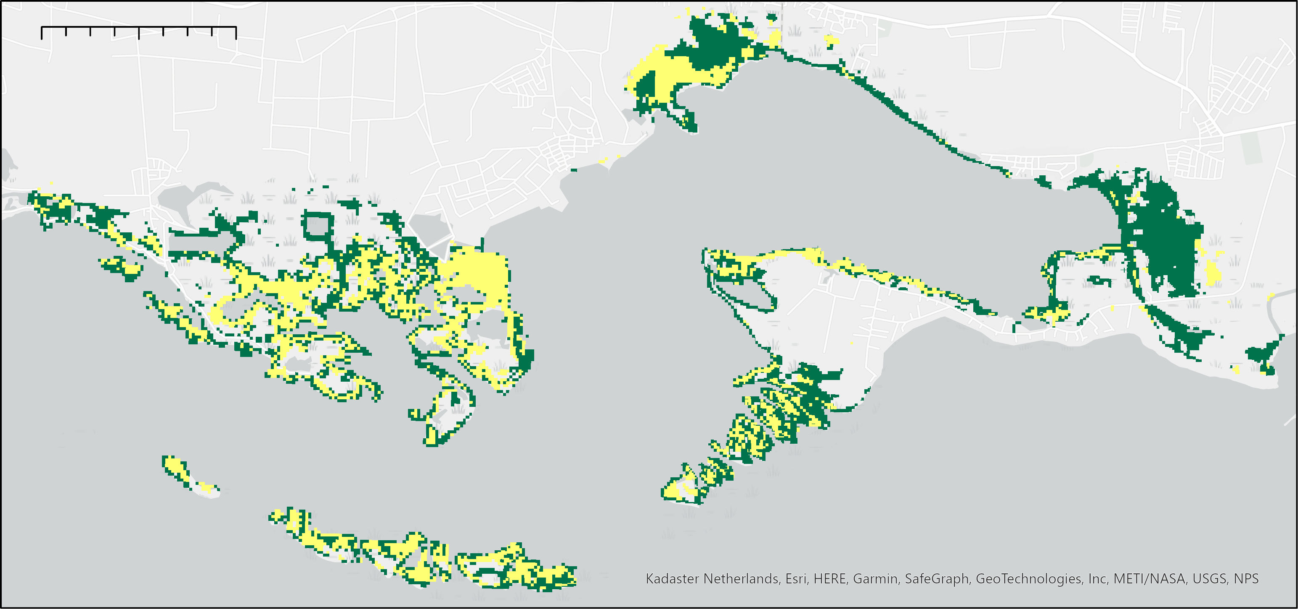
Results: Mangroves
0
1
2 Kilometers
2017 Mangrove Extent
2018 Mangrove Extent
N
Notes:
So, from this process we mapped about 10 square km of mangroves before the hurricanes, and about 1.2 square km after the hurricanes. Based on these results, we estimate an over 85% decrease in pre-hurricane mangrove extent. This is important information because it tells us what the potential impacts of high intensity storms are on Jobos Bay especially if these types of events are becoming more frequent.
Note: Green 2017 layer is under yellow 2018 layer
----Image Credit---
1. Mangrove Extent by team, Light Grey Base from ESRI
2. Arrow | PowerPoint Symbol Public Domain

Slide 9
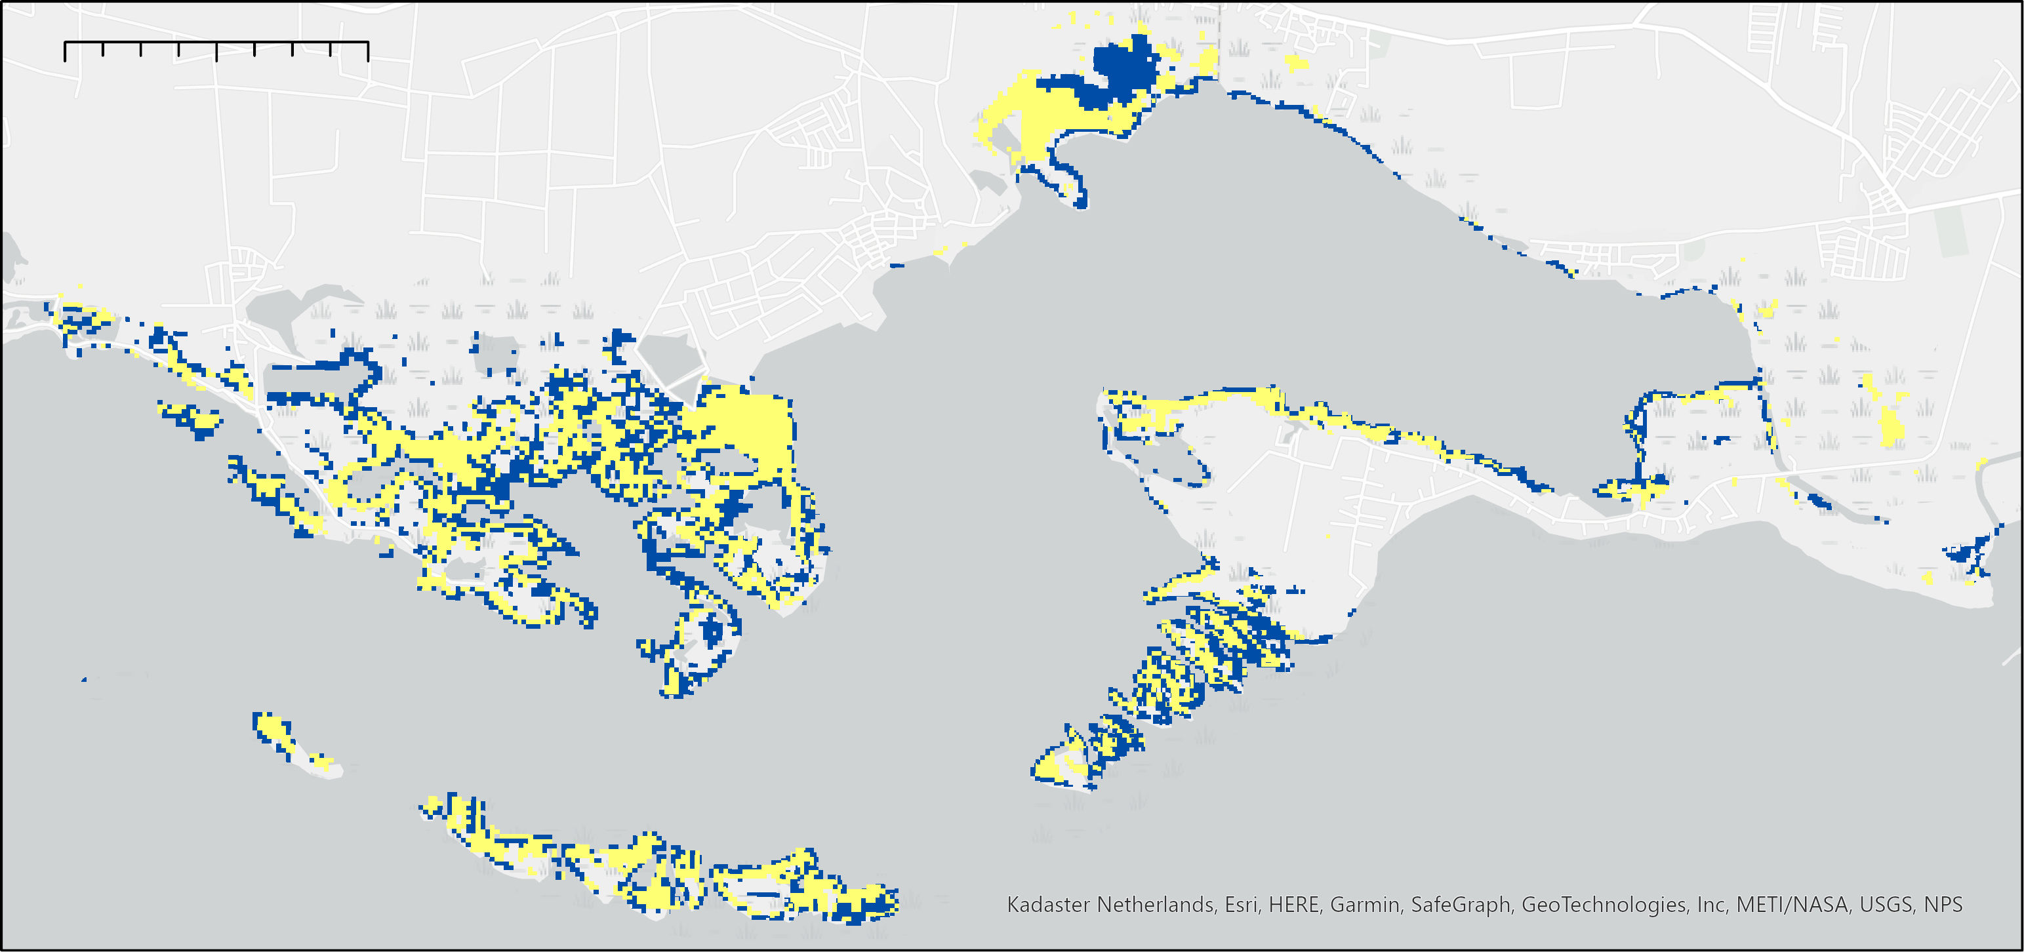
Results: Mangroves
0
1
2 Kilometers
2018 Mangrove Extent
2021 Mangrove Extent
N
Notes:
We also wanted to understand what the impact of these storms are in the long term, and we can see that mangrove extent increased from 1.2 square km that we mapped after the hurricanes, to about 7.3 square kilometers in 2021. So, in the three years after the hurricanes, the current mangrove area is restored to about 70% of the pre-hurricane mangrove area. While this may not be a direct relation, since other events such as restoration efforts, droughts, and development have also impacted mangrove extent in this time, it does give the partners some idea of how mangrove forests are impacted on a longer time scale by specific storm events like Maria and Irma.
Note: Blue 2021 layer is under yellow 2018 layer
----Image Credit---
1. Mangrove Extent by team, Light Grey Base from ESRI
2. Arrow | PowerPoint Symbol Public Domain

Slide 10
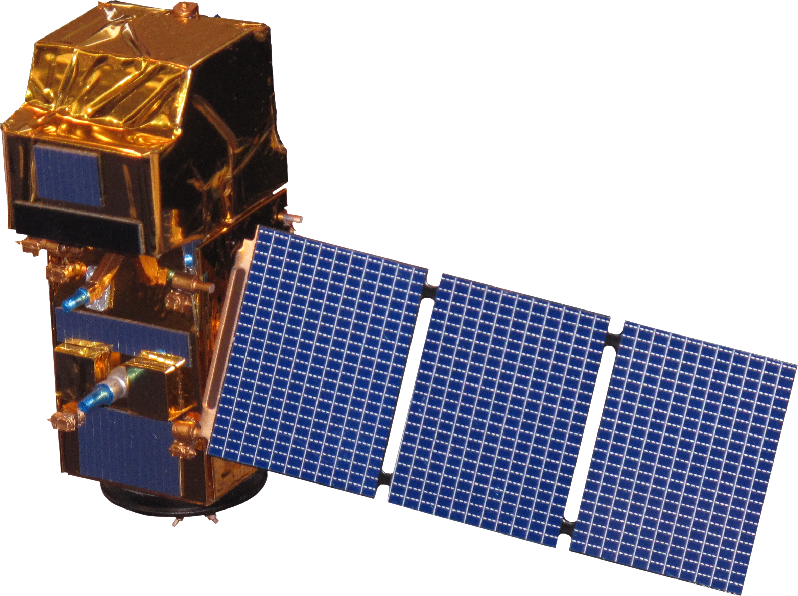
Methodology: LULC
Collect
Sentinel-2 MSI
Imagery
Assign training data
Set classifier, chose land cover classes
Google Earth Engine
ArcGIS Pro
Save LULC composites for future work
Validation and accuracy assessment
Compare
Unsupervised pixels with Supervised
Image Credit: ESA
Notes:
Thanks Lily.
For the Land Use Land Cover classification,
Sentinel-2 MSI: MultiSpectral Instrument, Level-2A, 10m resolution Imagery composites were collected in Google Earth Engine. The date range was Jan 1, 2021 to June 30, 2021.
Once the imagery was filtered for cloud cover to get the least cloudy image, and the dates were composited together correctly over our study area, the imagery was exported into Arc GIS Pro to assign the training data and begin the classification processing steps within the Arc GIS Pro Classification Wizard.
Our team chose to classify (10) land cover types and applied a minimum of 15 training polygons to each class.
----- Image Credits -----
Satellite Images | ESA retrieved from http://www.devpedia.developexchange.com/dp/index.php?title=List_of_Satellite_Pictures

Slide 11
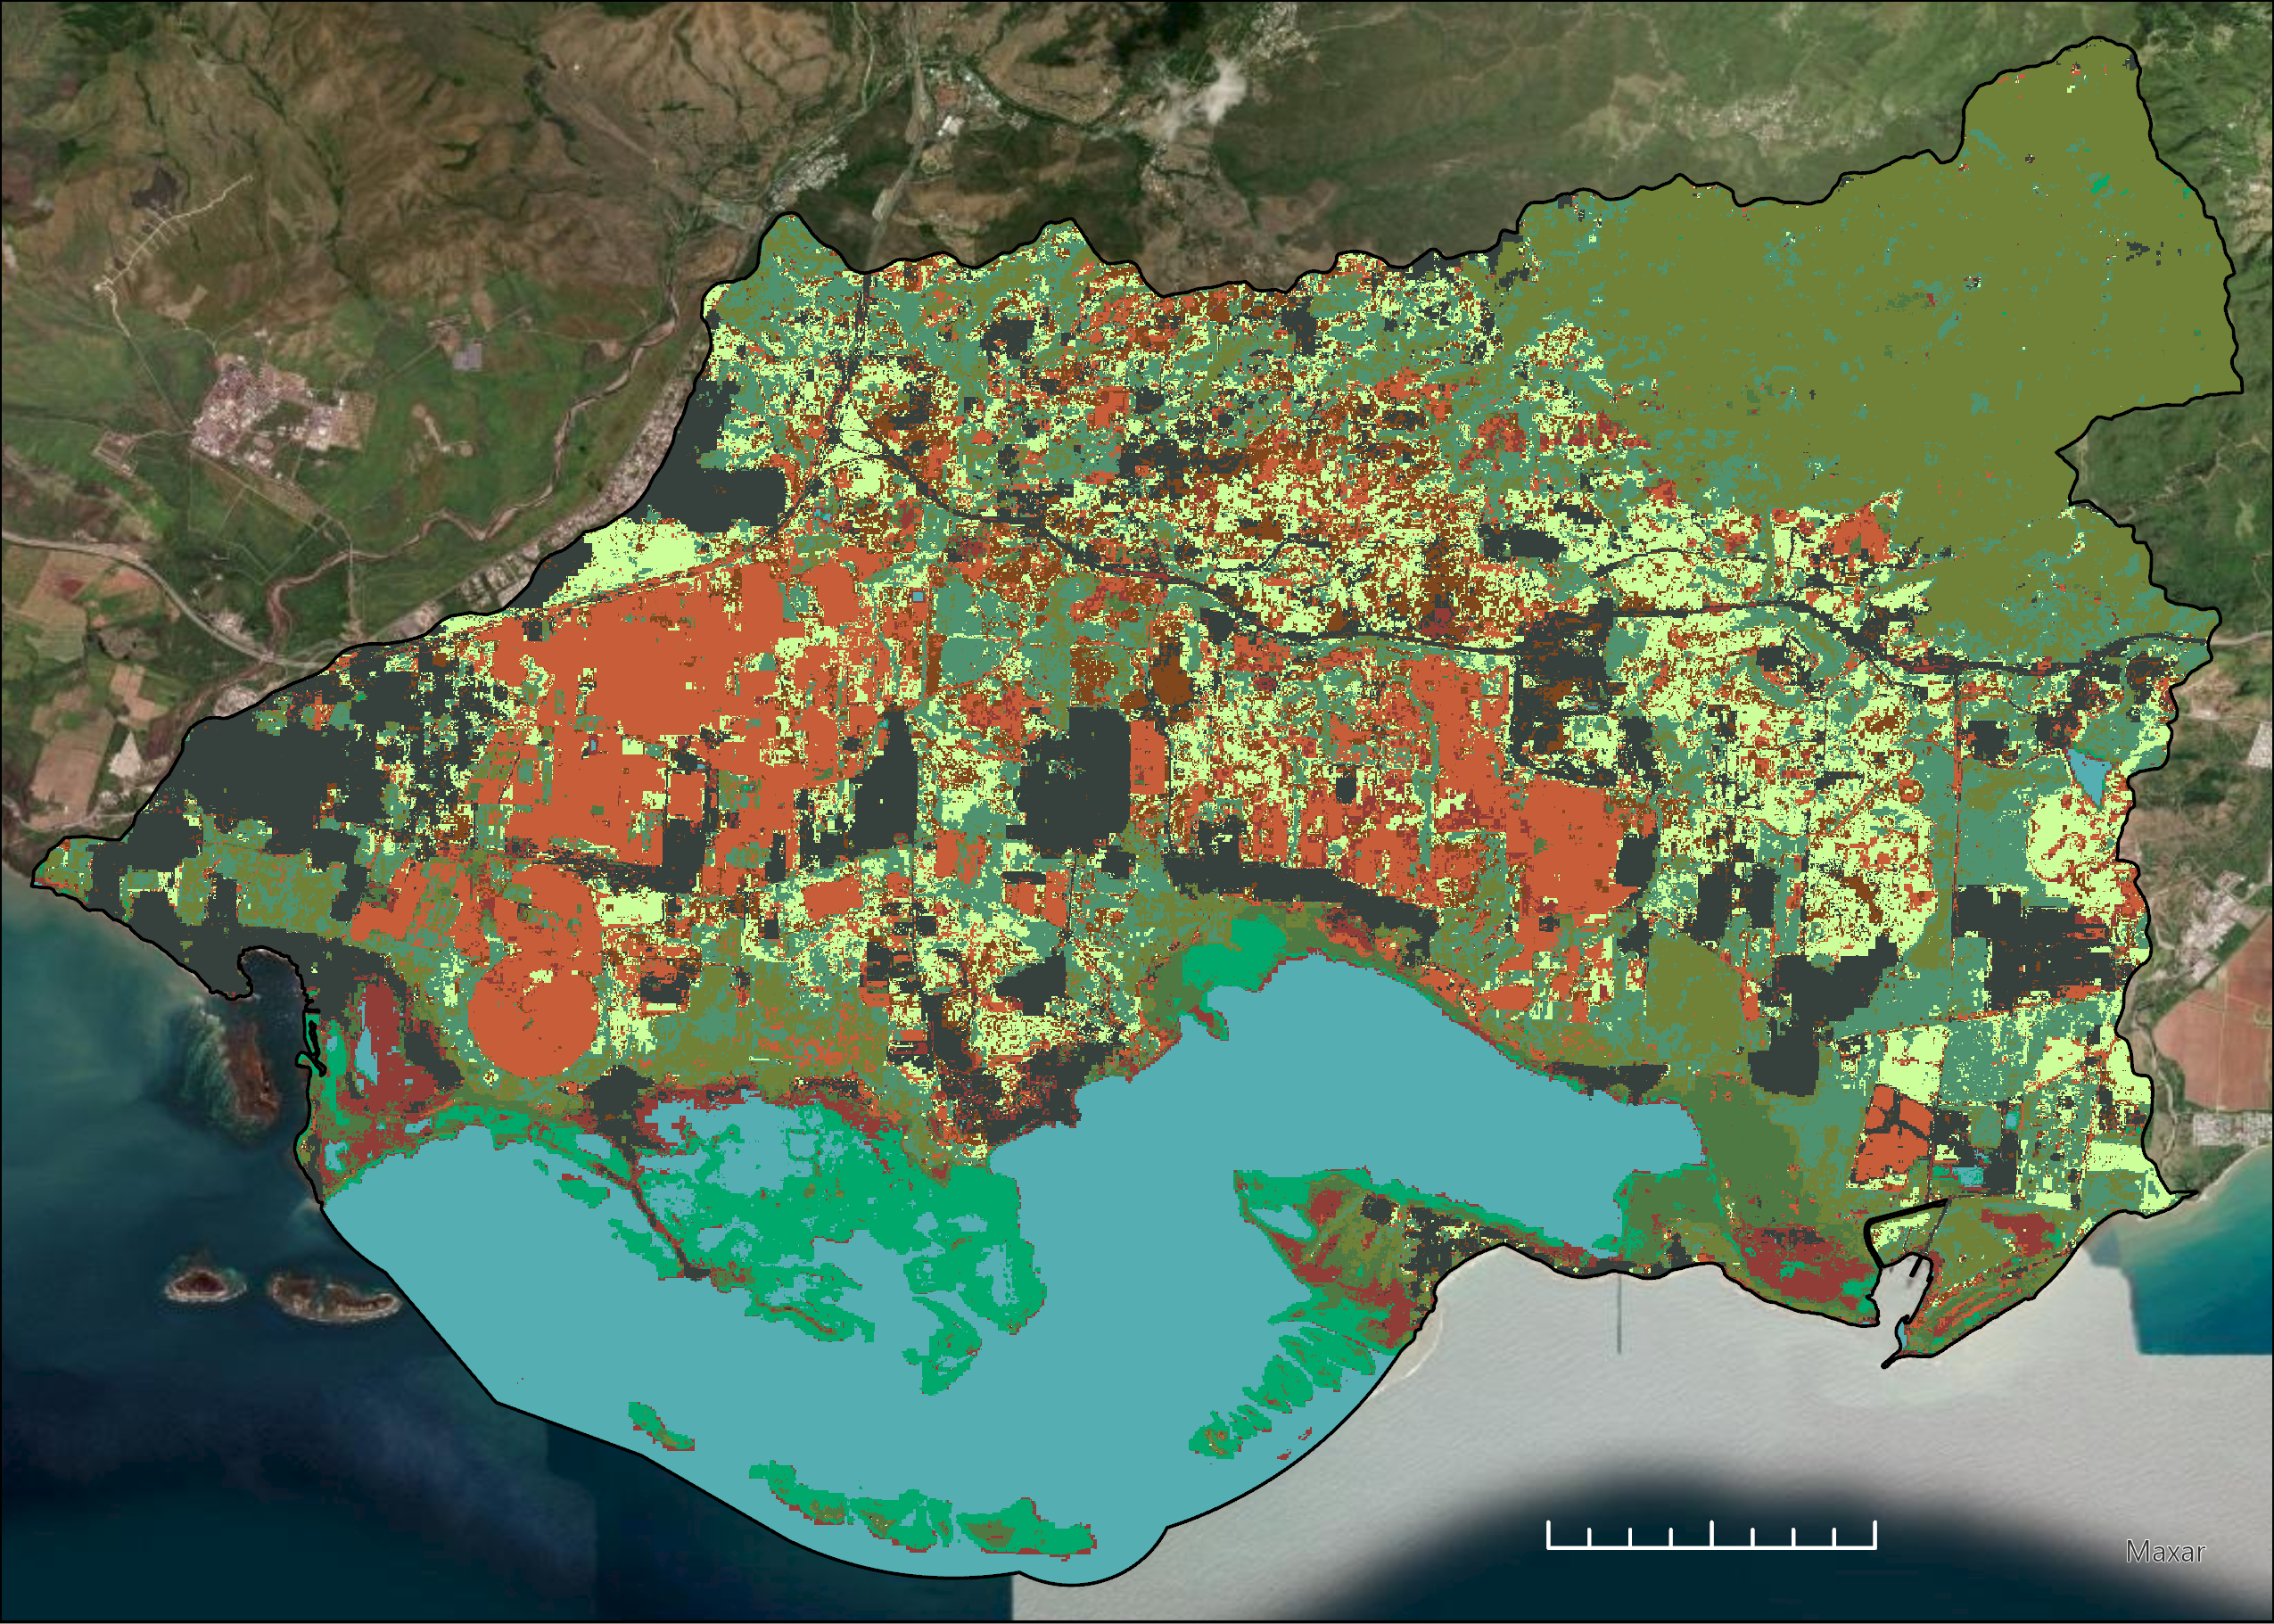
Results: LULC
Water
Agriculture
Barren
Forest (wet)
Grasslands
Scrub (upland)
Scrub (wet)
Forest (land)
Mudflats
Urban buildup
N
0
1.5
3
Kilometers
ESRI World Ocean Base
Notes:
The image shows the results of the 2021 LULC analysis with 10 land cover classes. We chose to use the Classification wizard in Arc GIS Pro, and we used the Random forest classifier for the supervised classification and matched our color palette to the Jobos Bay Team 1 for a closer comparison.
The results from the processed imagery within ArcGIS Pro supported the findings of the mangrove recovery analysis. The LULC analysis was able to pick up the increases in mangrove extent from 2020 to 2021. Mangroves are classified within the ‘scrub wet’ class.
The results were then refined and compared against ESRI 2020 LULC, and the previous Jobos Bay team's 2020 LULC analysis. For validation efforts, we began with running 500 accuracy assessment point features, and ground-truthing the points against the Sentinel-2 imagery to create a confusion matrix to obtain an overall percentage of how accurately the locations the points were classified match the supervised classification schema.
----- Image Credits -----
1. Image Collection: LULC Map: Sentinel-2 MSI: MultiSpectral Instrument, Level-2A, 10 m resolution composite; ESRI World Ocean Base
2. Arrow | PowerPoint Symbol Public Domain

Slide 12
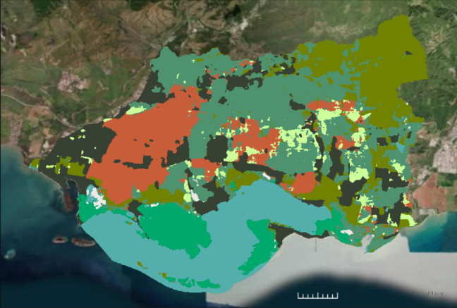
Results: LULC Compared to 2020 Esri Product
N
N
N
0
1
2
Kilometers
0
1.5
3
Kilometers
ESRI World Ocean Base
ESRI World Ocean Base
Esri 2020 Land Cover Product
Water
Scrub (upland)
ArcGIS Pro 2021 Classification Wizard
Agriculture
Scrub (wet)
Barren
Forest (land)
Forest (wet)
Mudflats
Grasslands
Urban buildup
Notes:
To validate our work with an authoritative source, we compared our LULC results with a publicly-available LULC dataset produced by Esri using Sentinel-2 Imagery. This product has fewer available land cover classes available (Water, Trees, Grass, Flooded Vegetation, Crops, Scrub/Shrub, Built Area and Bare Ground), but our 2021 model showed similar patterns to the Esri Product. For this visualization, the Esri land cover data were displayed using the classes from the 2021 classification. Our product was able to show more information at a different scale, and provides and in-depth, updated visualization of how the LULC for our study area has changed from 2020 to 2021. The results from the Arc GIS Pro classification wizard tool allow for greater detail when analyzing landcover compared to the Esri 2020 classification.
----- Image Credits -----
1. Image Collection: LULC Map: Sentinel-2 MSI: MultiSpectral Instrument, Level-2A, 10 m resolution composite; ESRI World Ocean Base
2. Arrow | PowerPoint Symbol Public Domain

Slide 13
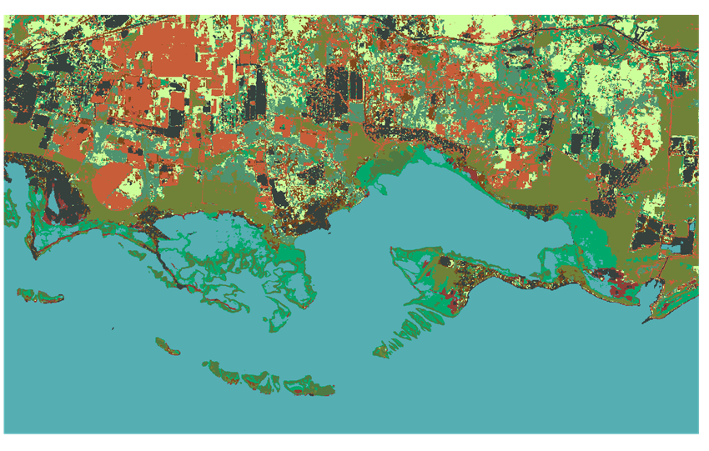
Results: LULC
N
N
0
2.5
5
0
1.5
3
Kilometers
ESRI World Ocean Base
Kilometers
ESRI World Ocean Base
GEE Random Forest 2020 Jobos Bay 1 Team
Water
Scrub (upland)
ArcGIS Pro 2021 Classification Wizard
Agriculture
Scrub (wet)
Barren
Forest (land)
Forest (wet)
Mudflats
Grasslands
Urban buildup
Notes:
This visualization highlights the results of our LULC classifications for 2021, and the 10 land cover classes utilized in comparison with the LULC analysis ran by the previous term Jobos Bay team.
The previous term utilized Google Earth Engine and pre-processed their imagery through Arc GIS Pro. The 2021 LULC analysis was processed entirely within Arc GIS Pro with the Classification Wizard Tool. The different methodologies both produced similar map visualizations, and they highlight the opportunities of continuing education within JBNERR for experimenting with different remote sensing strategies for comparison and validation.
----- Image Credits -----
1. Image Collection: LULC Map: Sentinel-2 MSI: MultiSpectral Instrument, Level-2A, 10 m resolution composite; ESRI World Ocean Base
2. 2020 Jobos Bay 1I Team | Spencer, O., McGhee, E., & Conklin, T. (2021). Jobos Bay Water Resources: Using Earth Observations to Analyze Shoreline Changes and Understand the Effects of Sea Level Rise in Southern Puerto Rico [Unpublished Manuscript]. NASA DEVELOP National Program.
3. Arrow | PowerPoint Symbol Public Domain

Slide 14
Methodology: Water Quality
Download Sentinel-2 and Landsat 8 data
Cloud mask and atmospherically correct data
Turbidity and
Chl-a data generated for satellite overpass
DEVELOP ORCAA tool
Compare
in-situ and satellite measurements
In-situ measurements collected by
Dr. Armstrong & Dr. Hernandez López
Image Credit: NASA, ESA
Notes:
For our water quality analysis, our goal was to provide a check on the methodology of using satellite and in-situ measurements together. DEVELOP's Optical Reef Assessment Tool (ORCAA) allows users to monitor, track, and evaluate water parameters by loading in NASA satellite data. We, therefore, loaded in Sentinel 2 and Landsat 8 data for the Jobos Bay overpass that coincided with the dates of in-situ measurement, which was the 23rd of March. We did not have data in time for this presentation, but we should be able to provide the analysis in our technical paper to be finished at the end of the project. The paper will be given to our partners and can inform their future management techniques.
----- Image Credits -----
1. Satellite Images | NASA Public Domain, ESA | retrieved from https://www.devpedia.developexchange.com/dp/index.php?title=List_of_Satellite_Pictures
2. In-situ Image | PowerPoint Symbol Public Domain

Slide 15
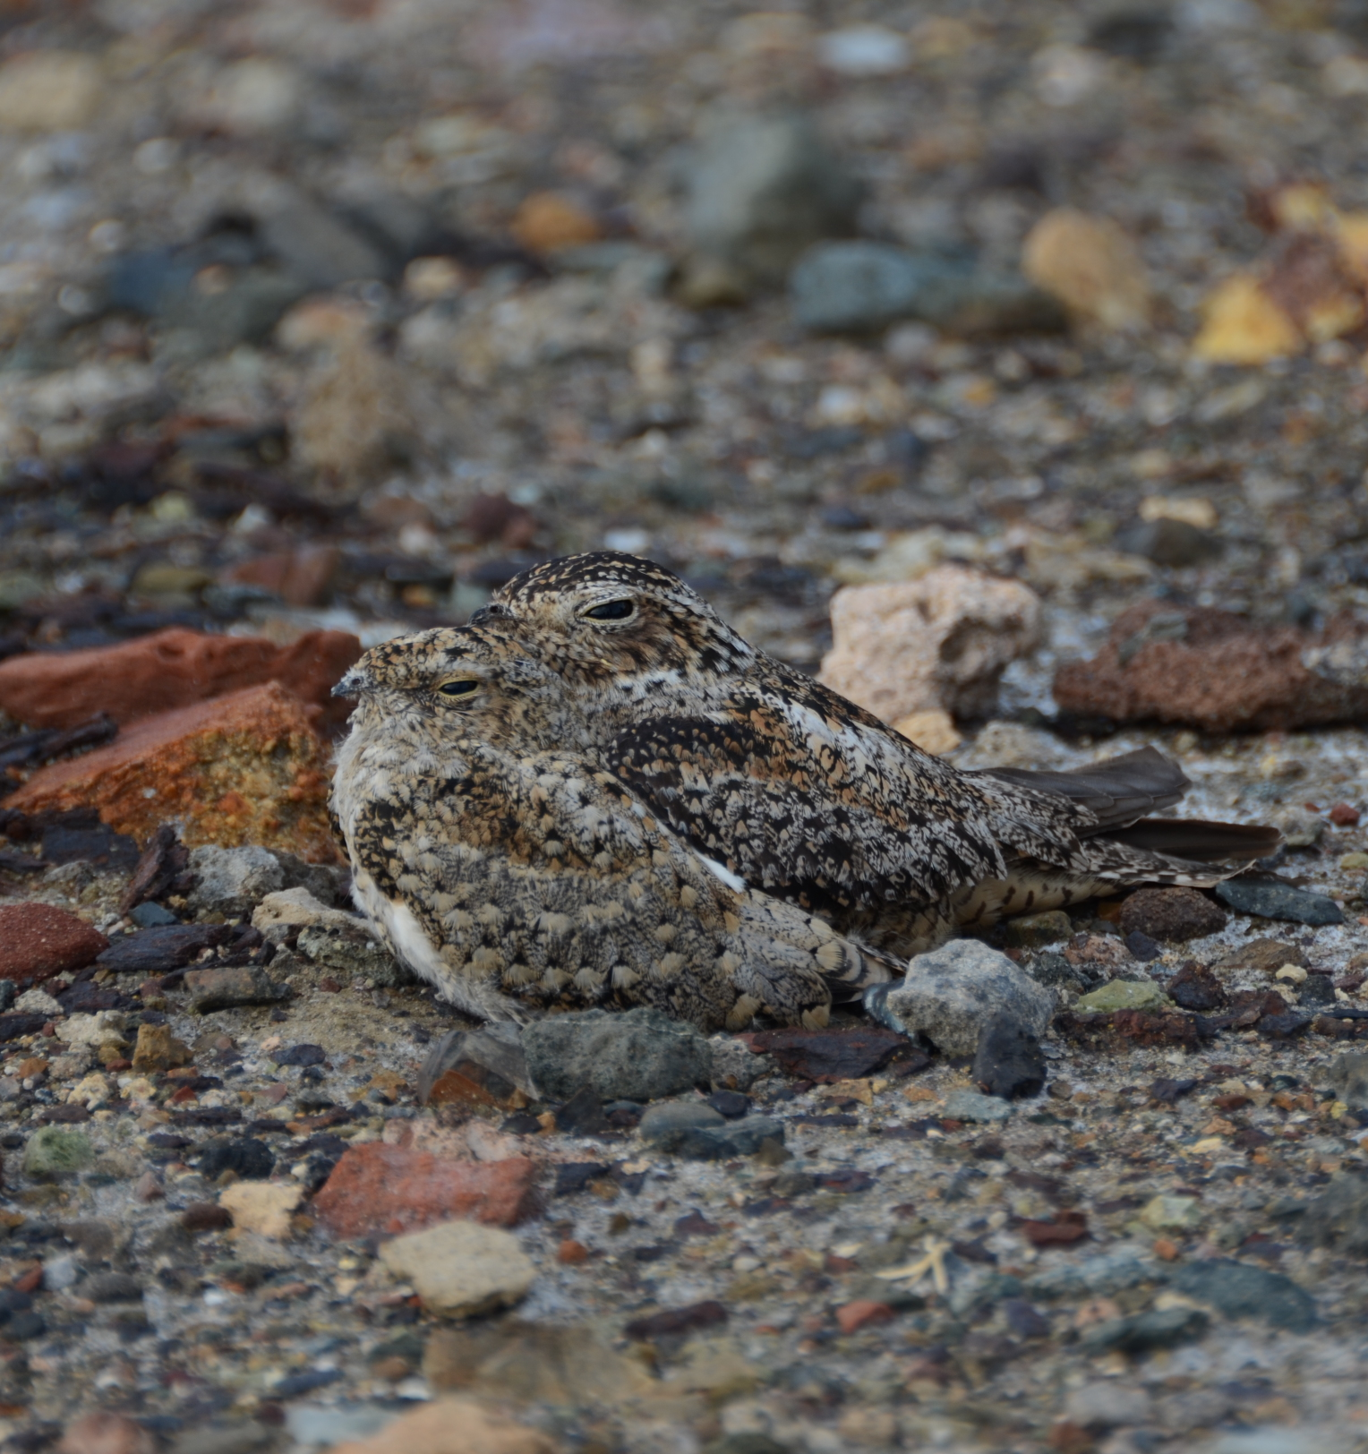
Limitations & Uncertainties
Bottom reflectance
Leaf stripping effect
Dataset availability
Image Credit: JBNERR
Notes:
The limitations for our project were bottom surface reflectance, sun glint, Sentinel-2 Availability, data limitations, leaf stripping, and time.
Bottom surface reflectance and sun glint are obstacles when using satellite imagery on shallow waters. The reflectance of the bottom surface in shallow waters or reef dominated waters results in incorrect results and sun glint can cause image color distortion, impacting water quality measurements.
While we aimed to set our study period to avoid the effects of leaf stripping, which would cause overestimation of mangrove death due to the hurricanes. However, it's possible that this was still a factor in the months after the hurricanes and that this was captured in the analysis.
For our land use land cover analysis Sentinel-2 MSI, Level-2A was a limitation for because the start date of available imagery in GEE did not align with our project time frame. The conversion of Sentinel-2MSI, Level-2A to Sentinel-2MSI Level 1C provided a secondary limitation when trying to compare 2017 LULC data.
----- Image Credits -----
Nighthawks| received from partners at JBNERR | used with permission

Slide 16
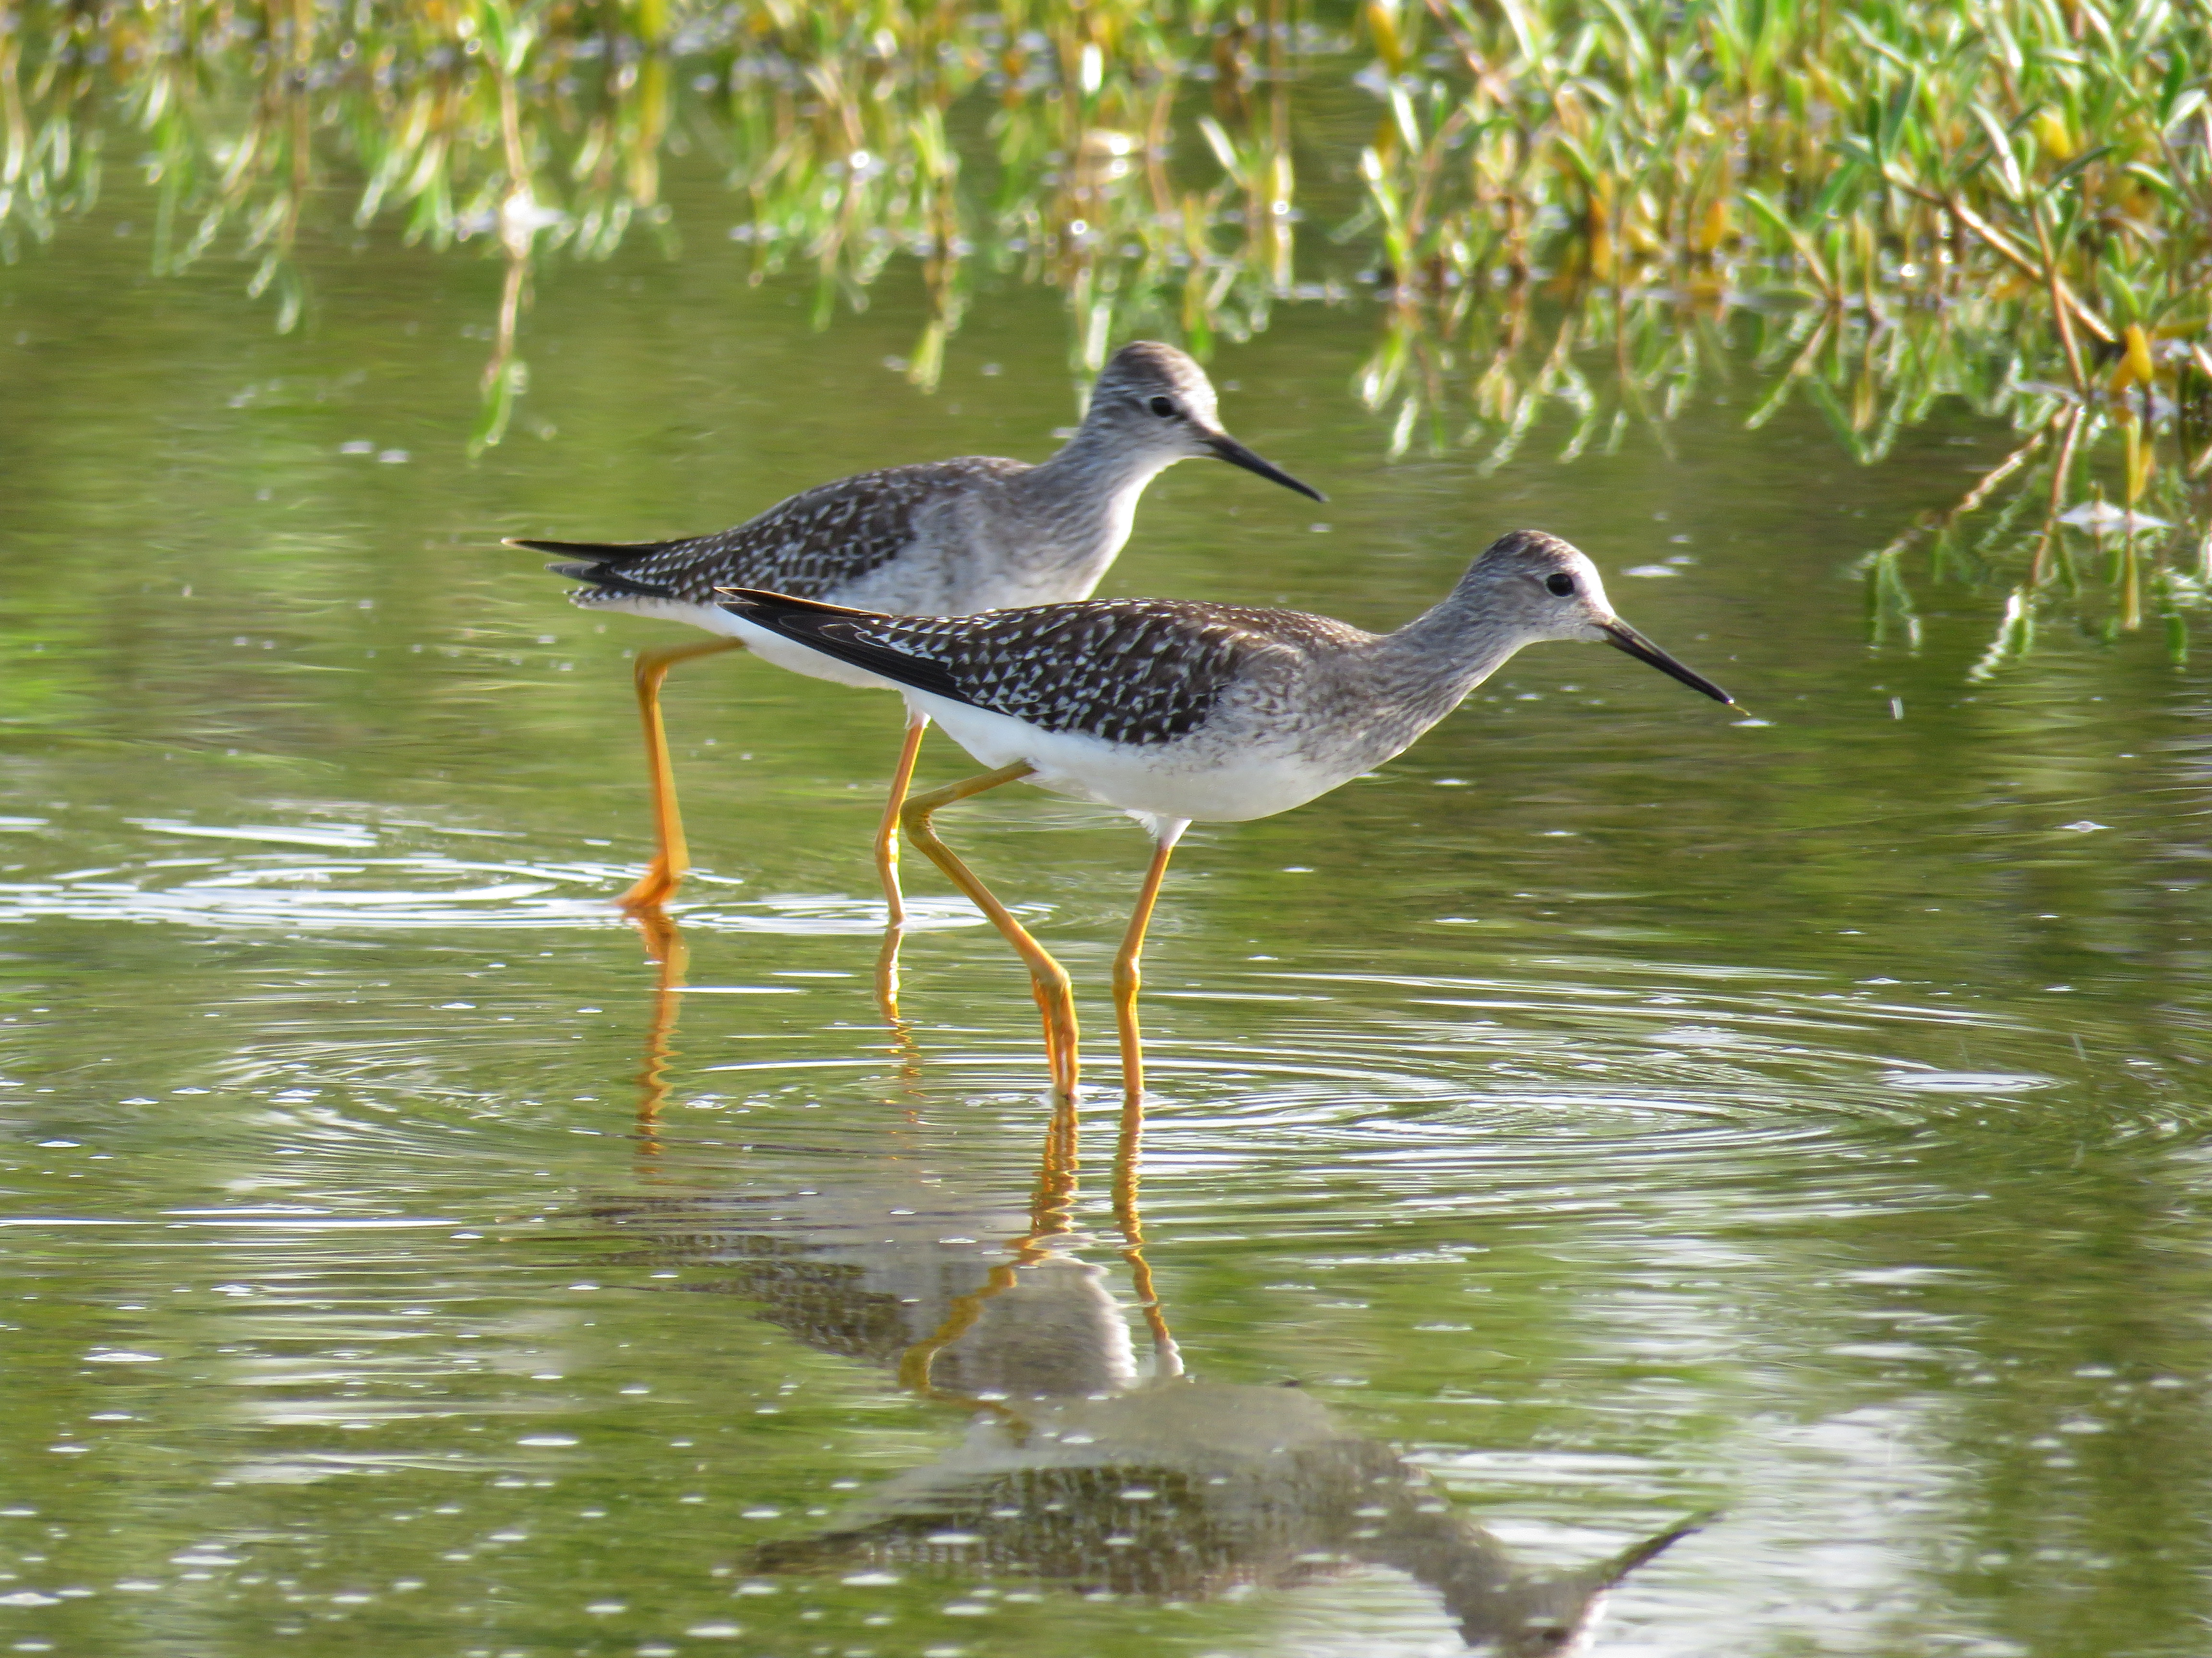
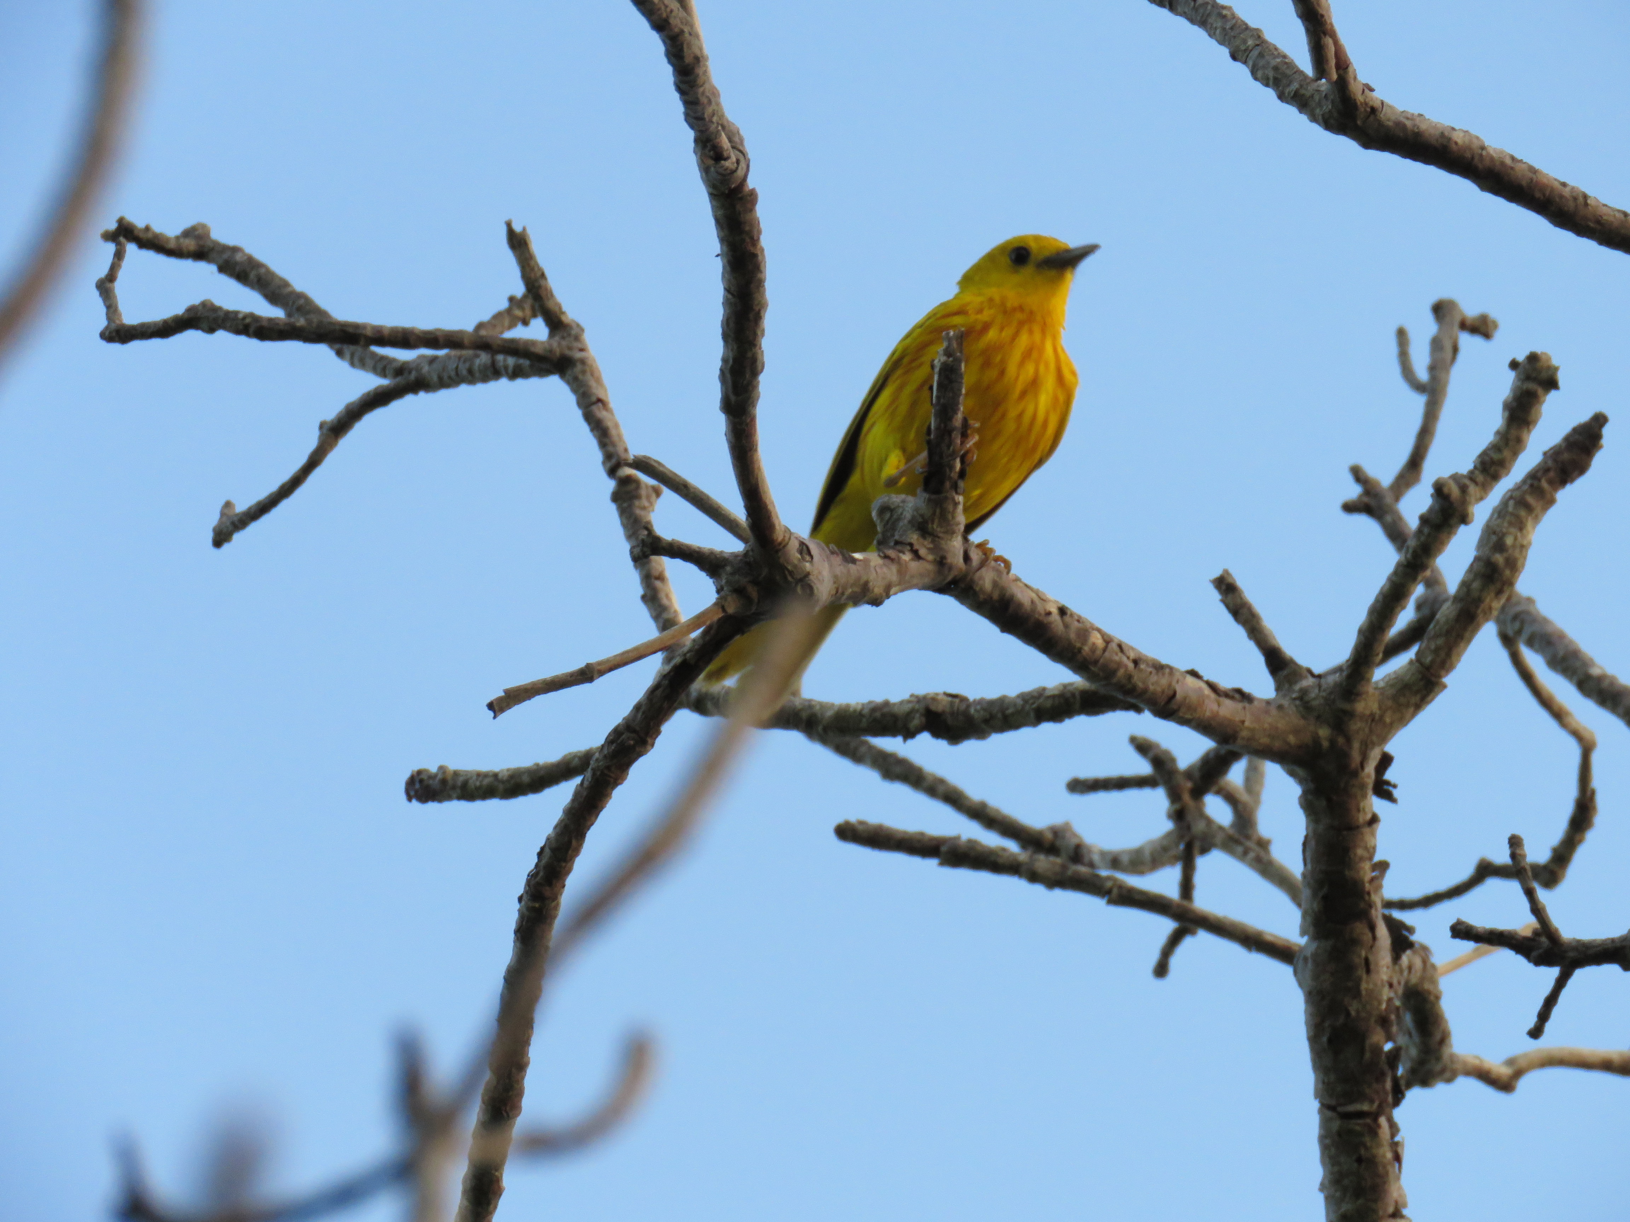
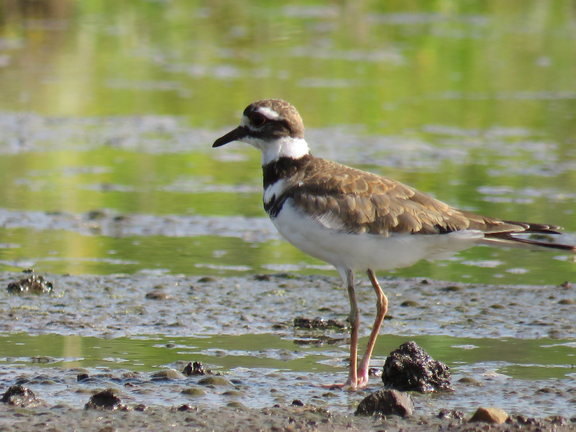
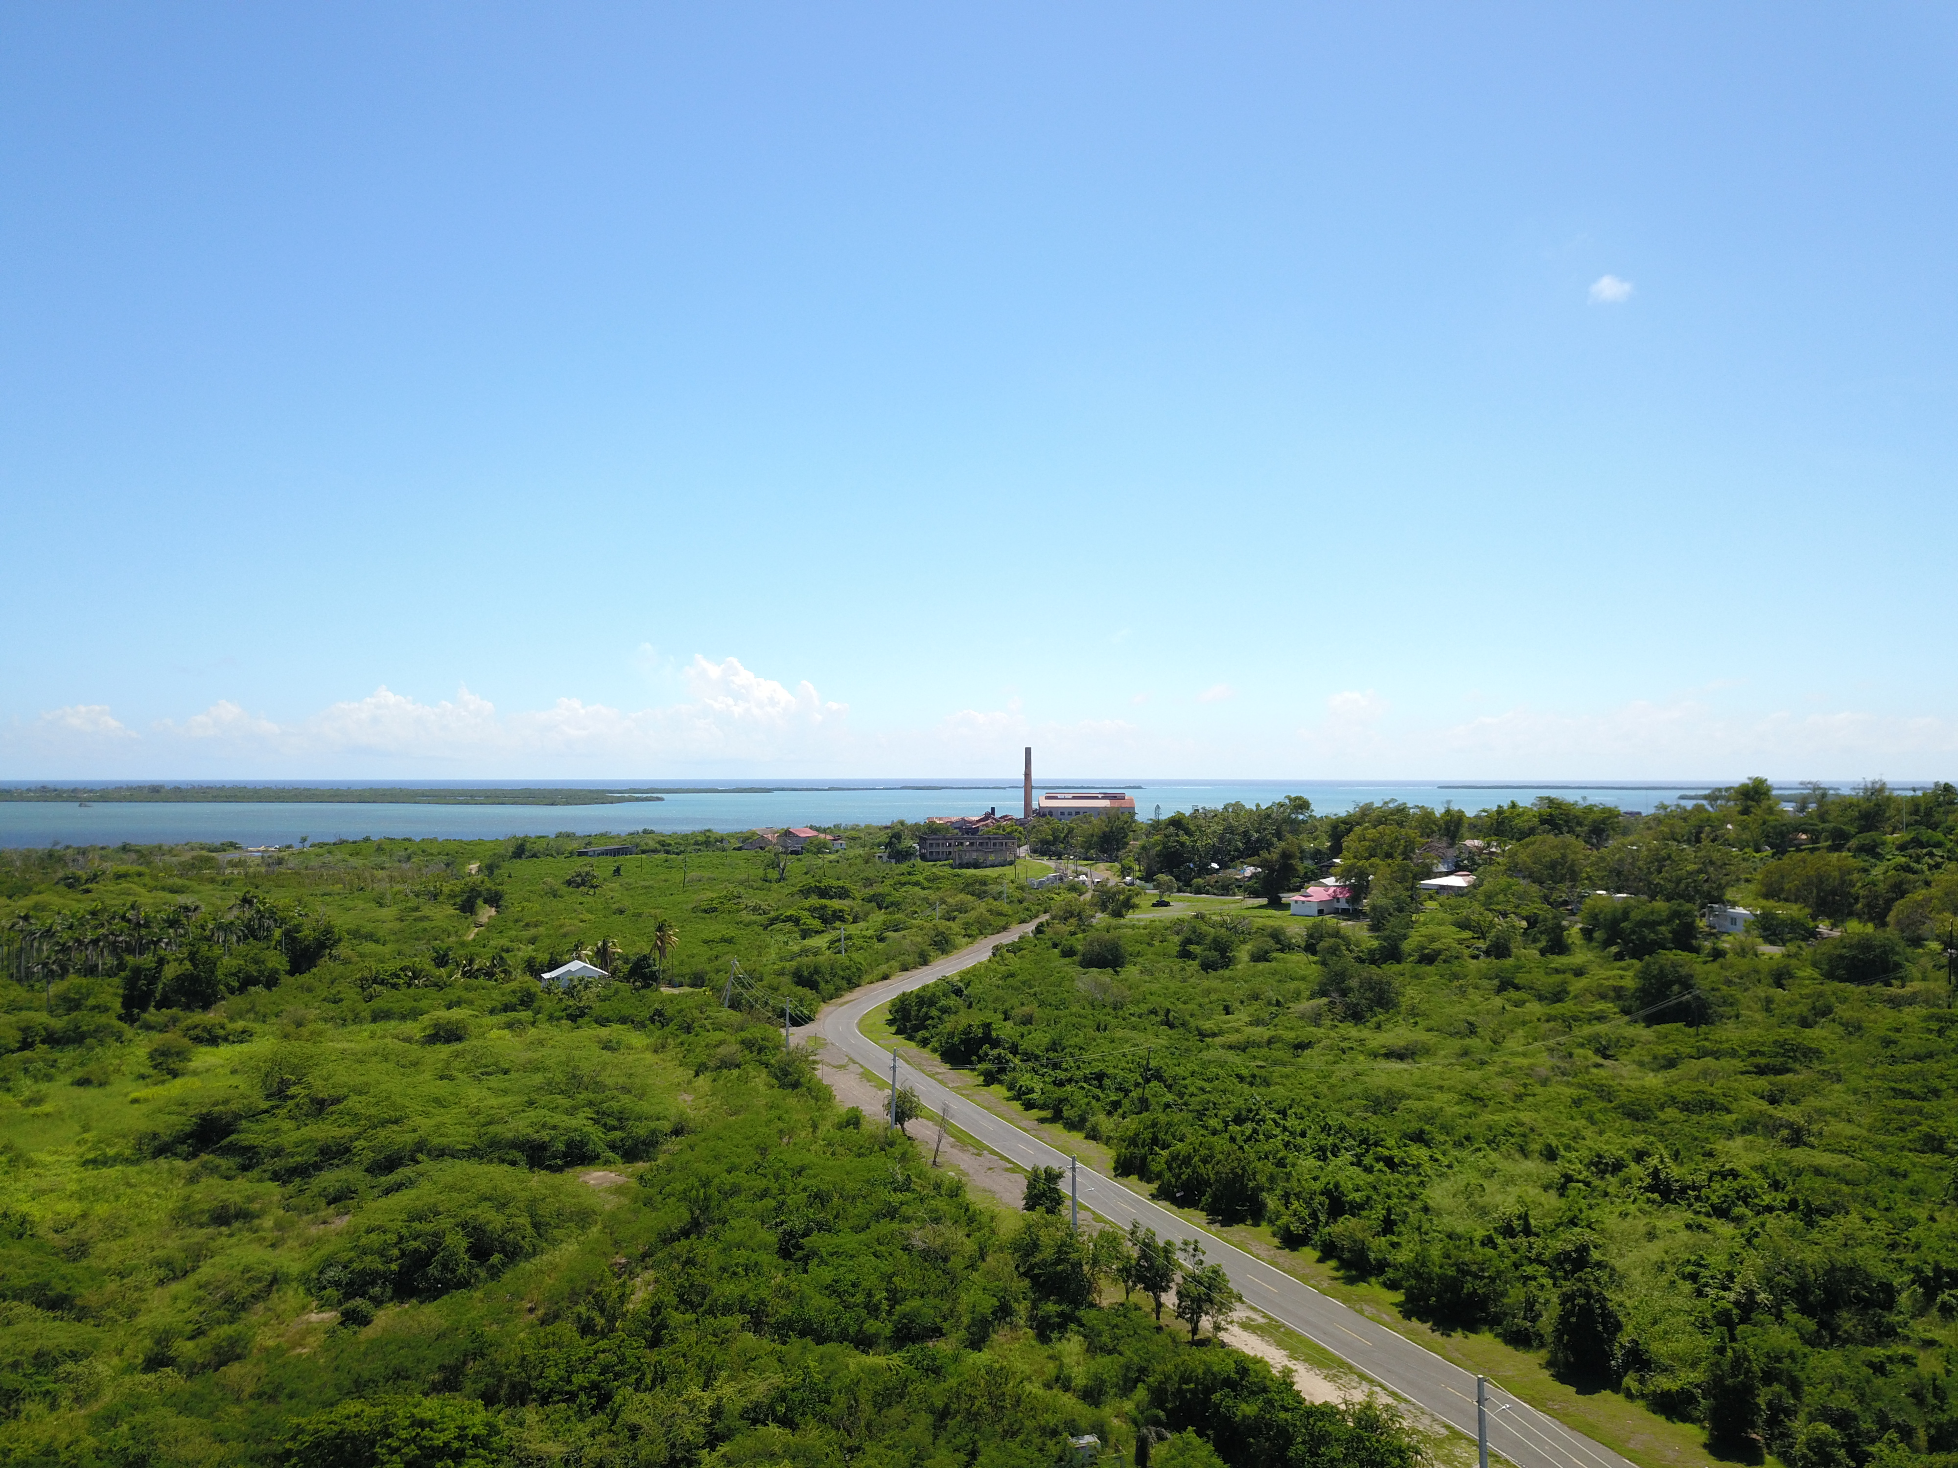
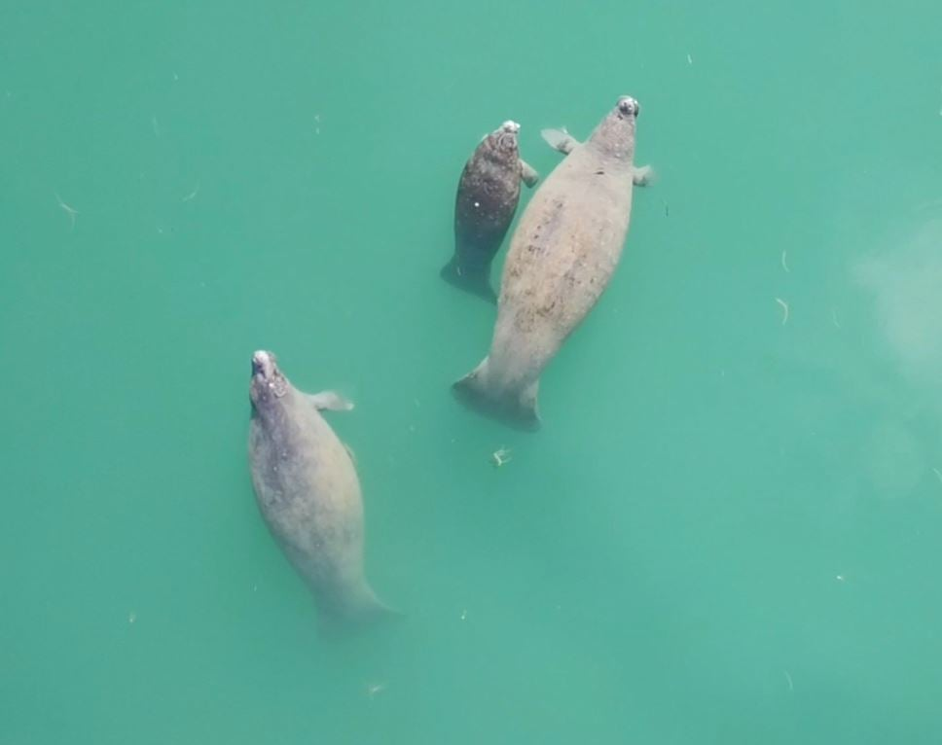
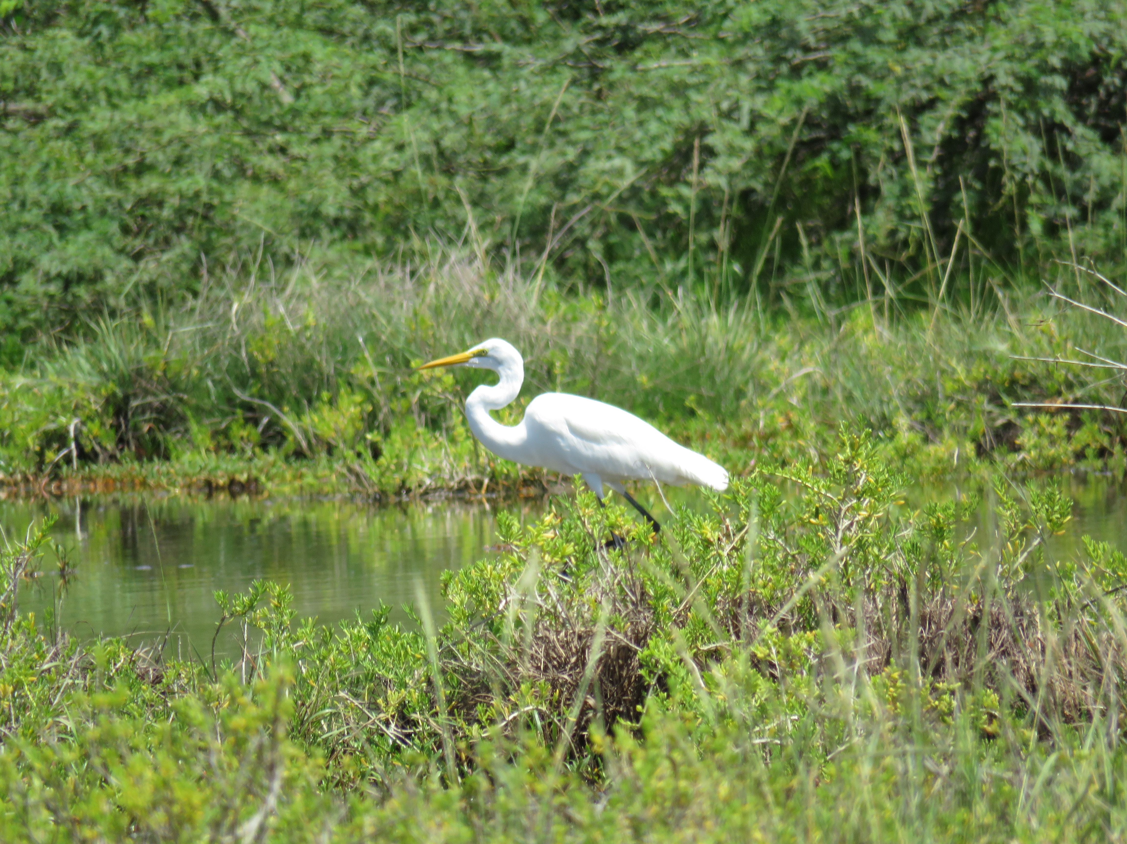
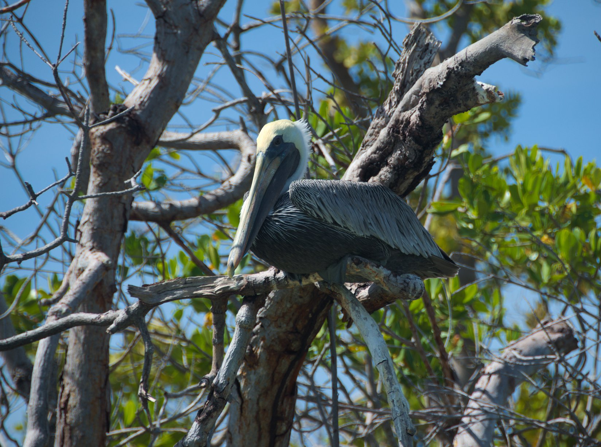
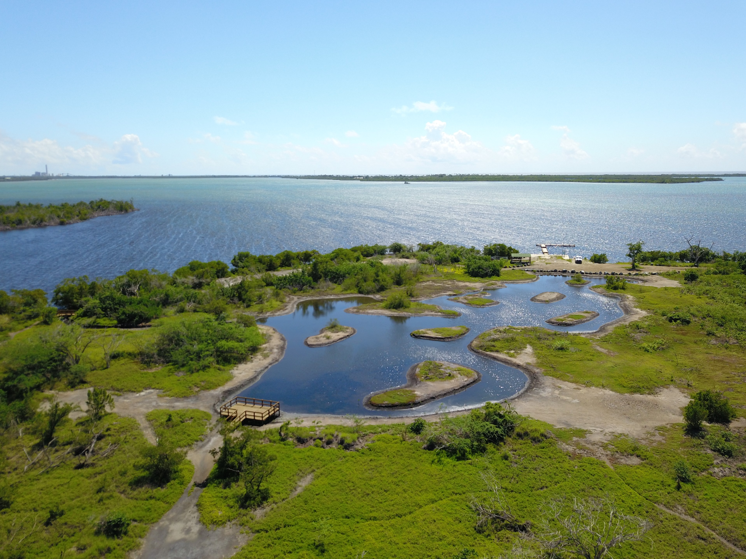
Conclusions
Success of mangrove recovery
Various methods can highlight remote sensing utility
Satellite data can be used in comparison with in-situ water quality analysis
Image Credit: JBNERR
Notes:
Conclusions we came to during our project were that mangrove extent has visibly grown since Hurricane Maria through restoration efforts and natural growth. We learned through our attempts to improve on the previous team's LULC work that there are various ways to complete and analysis and that these methods can change the result. Expanding the variety of tools that you use, even just from one coding software, like ArcPro, to another, like Google Earth Engine, can change the ease and results of your analysis. This can be helpful for our partners to know so they can see the variety of tools available to them. We learned through our water quality analysis the benefit of using satellite data alongside in-situ data to get a more wholistic view of an area.
----- Image Credits -----
1. Lesser Yellow Legs | received from partners at JBNERR, used with permission
2. Killdeer| JBNERR Facebook Page | retrieved from partner permission
3. Manatees| JBNERR Facebook Page | retrieved from partner permission
4. Pelican| received from partners at JBNERR, used with permission
5. Yellow Warbler| JBNERR Facebook Page | retrieved from partner permission
6. Open Shrubs| JBNERR Facebook Page | retrieved from partner permission
7. Heron| JBNERR Facebook Page | retrieved from partner permission
8. Swampland| JBNERR Facebook Page | retrieved from partner permission

Slide 17
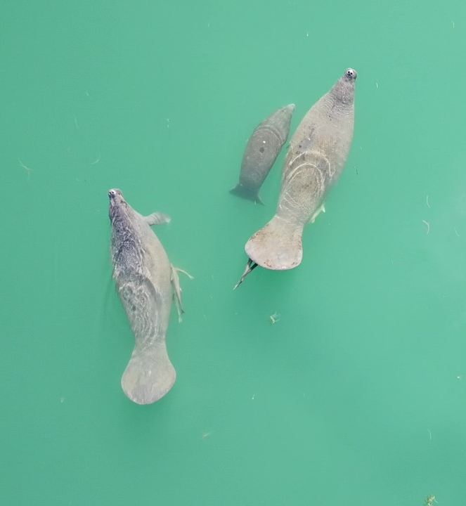
Future Work
Future Work
Analyzing causes of mangrove change
Risk management
Water quality analysis with updated ORCAA
Continuous land cover analysis
Image Credit: JBNERR
Notes:
In our project, we were able to see that mangrove extent has grown since the 2017 hurricanes, but we cannot prove a specific reason as to why. Further work looking into causes of mangrove increase can help researchers at JBNERR know which management practices are working and continue to implement useful practices.
This work could also help with risk management and understanding how to prevent further mangrove loss in the case of future storms.
Also, the second version of the ORCAA tool, which we used for our water quality analysis, is currently under construction, but would be useful for future water quality research. The new version will have kd90 and kdPAR parameters, which are useful for comparing between satellite and in-situ observations and will correct for bottom surface reflectance better.
One other future consideration is continuing to do updated LULC analysis because of development of the shoreline, which can drastically change mangrove extent and impact the ecosystem.
In September 2019, the U.S. Fish and Wildlife Service Caribbean Ecological Services Field Office (CESFO) completed a restoration project at the Jobos Bay National Estuarine Research Reserve in southern Puerto Rico. The project enhanced approximately 1.24 acres of mangrove-wetland forest and salt flats habitat providing better habitat for a variety of fish, crustaceans, insects, resident and migratory birds as well as other wildlife species. In addition, it will increase research, outreach and educational opportunities in the area.
----- Image Credits -----
Manatees| received from partners at JBNERR | used with permission

Slide 18
Partners
Aitza E. Pabón Valentín (JBNERR Director)
Angel Dieppa (JBNERR Research and Monitoring Coordinator)
Milton Muñoz Hincapié (JBNERR Stewardship Coordinator)
Science Advisors
Dr. Juan Torres-Pérez (NASA Ames Research Center)
Dr. Kenton Ross (NASA Langley Research Center)
Lauren Childs-Gleason (NASA Langley Research Center)
Past Contributors
Olivia Spencer, Ethan McGhee, Liliana Hernandez Gonzalez, Taylor Conklin, Andrew Altizer
Additional Thanks To: Adriana Le Compte (DEVELOP LaRC Fellow), Dr. Roy Armstrong & Dr. William J Hernandez López (University of Puerto Rico, Department of Marine Sciences)
Notes:
We want to acknowledge our partners at JBNERR, Aitza, Angel, and Milton, as well as to Dr. Juan Torres-Perez, Dr. Kenton Ross, and Lauren Childs-Gleason for their dedication and guidance on this project. Further thanks goes to Olivia, Ethan, Liliana, Taylor, and Andrew, the Jobos Bay I Team who provided a foundation for our project. Finally, thank you to Adriana Le Compte, our fellow, and Dr. Roy Armstrong and Dr. William Hernandez Lopez for guidance and in-situ work.
Maps throughout this work were created using ArcGIS® software by Esri. ArcGIS® and ArcMap™ are the intellectual property of Esri and are used herein under license.

