Slide 1
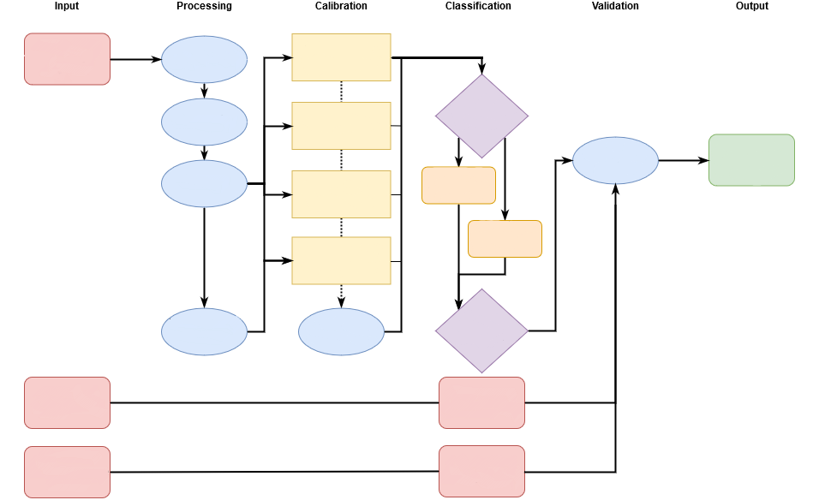
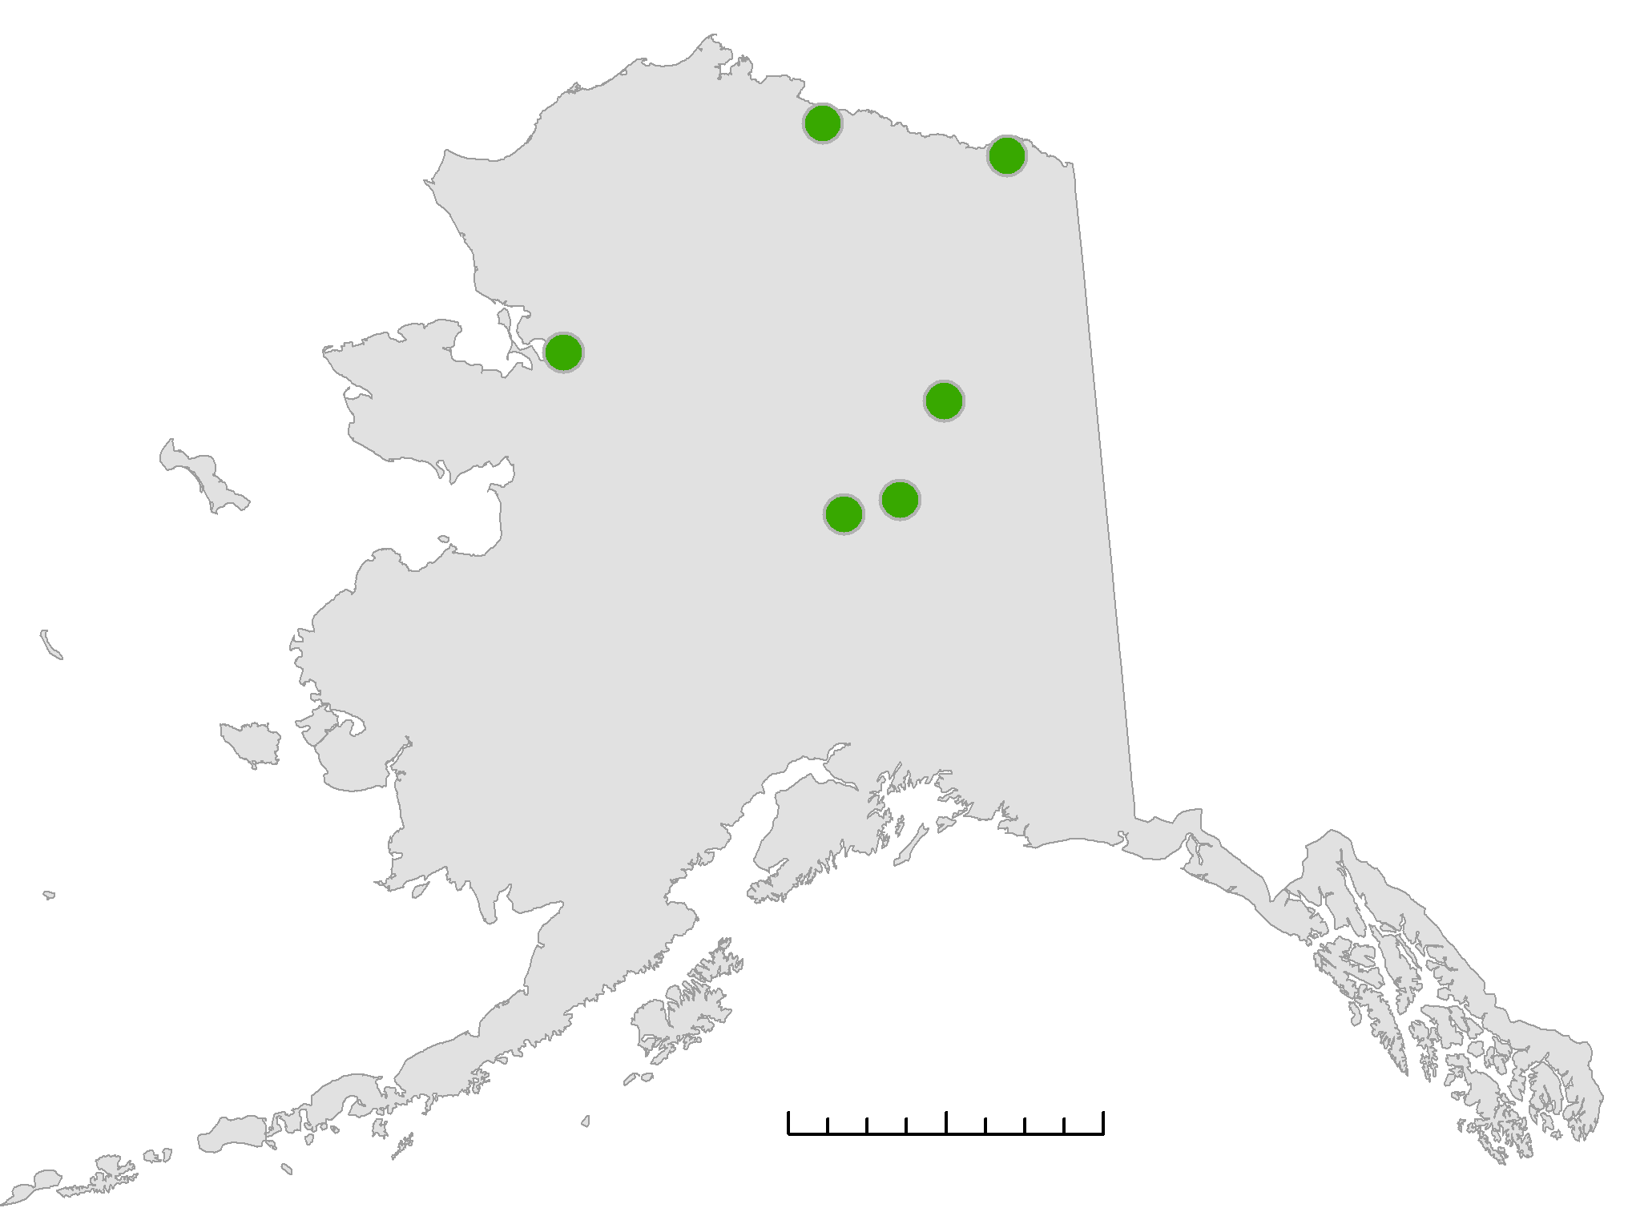
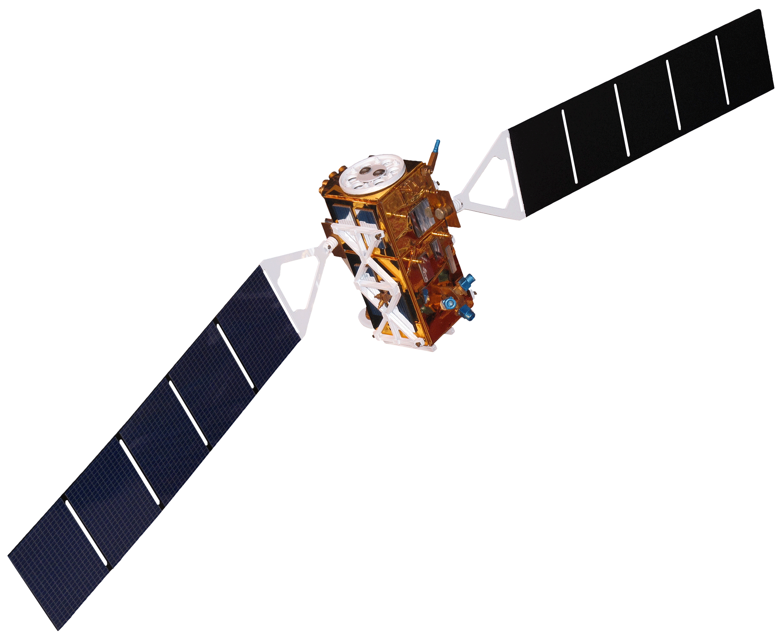
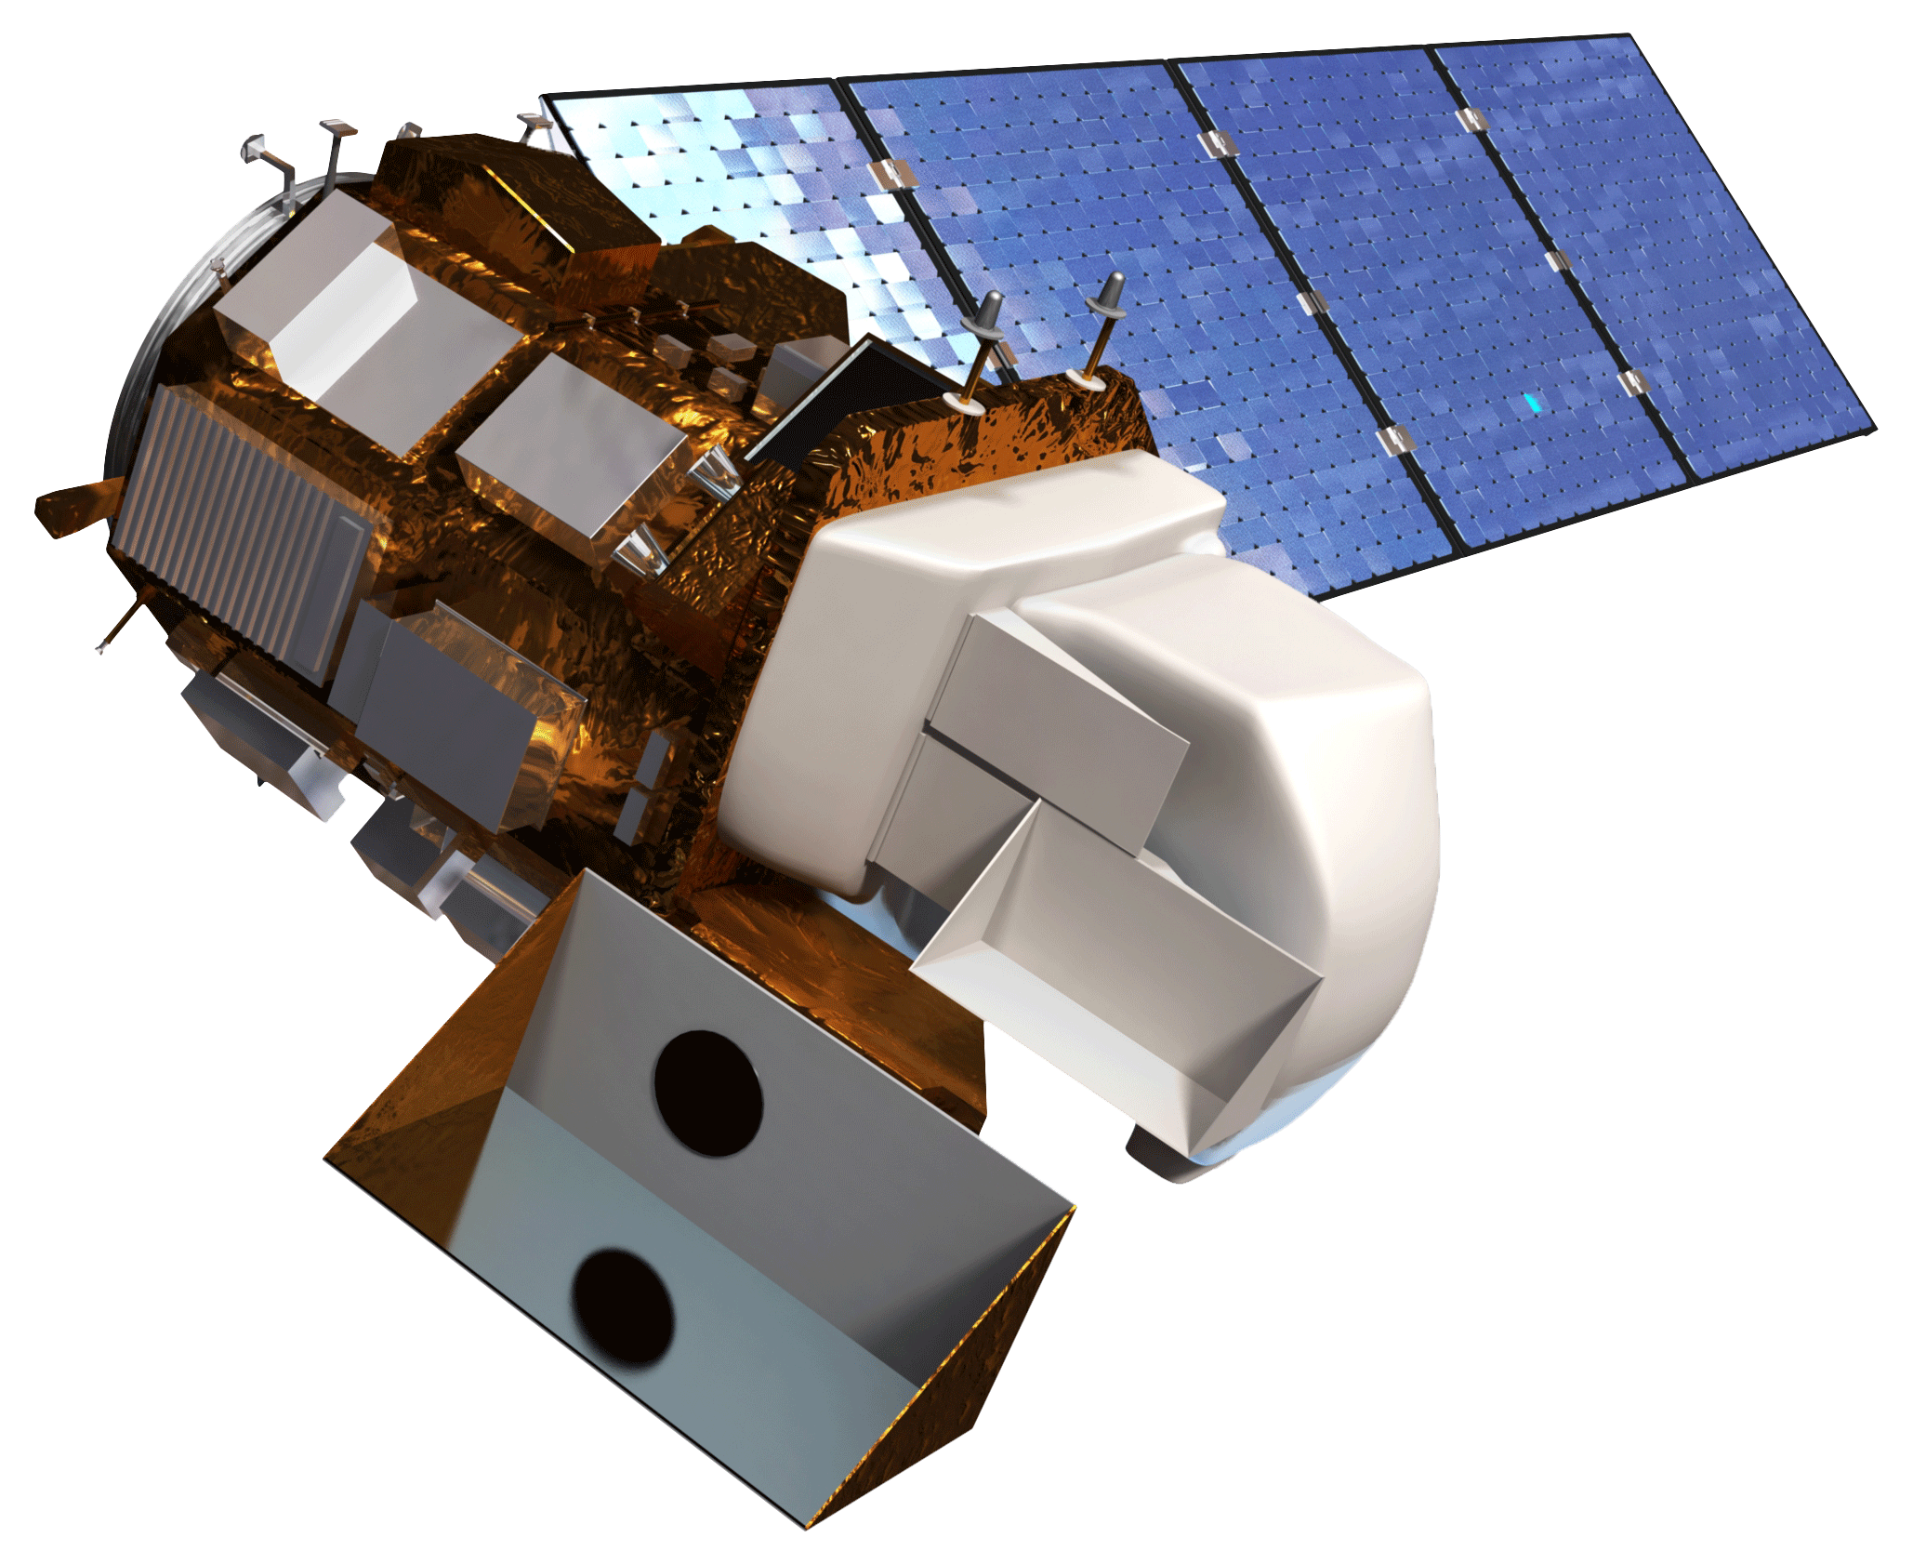
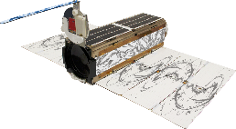
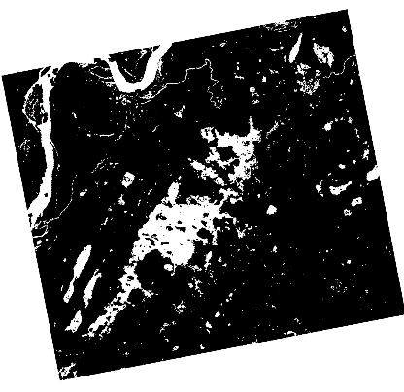
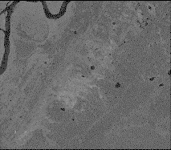
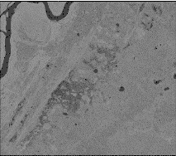
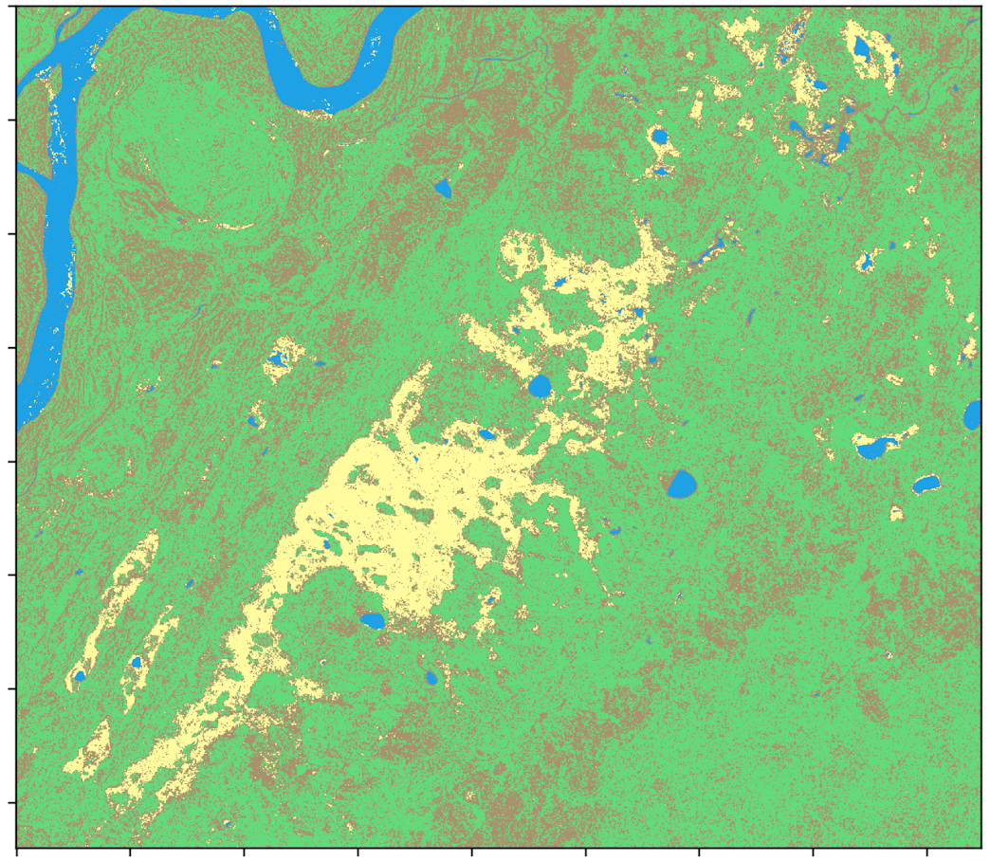
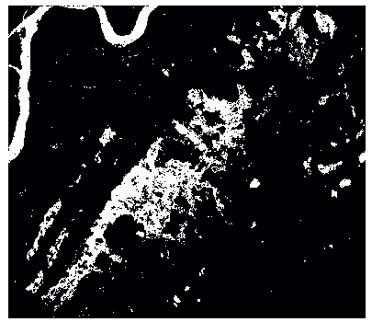
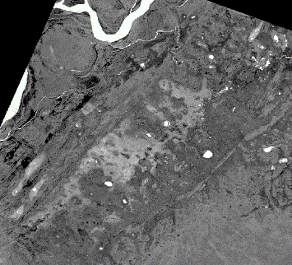
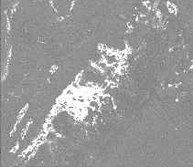
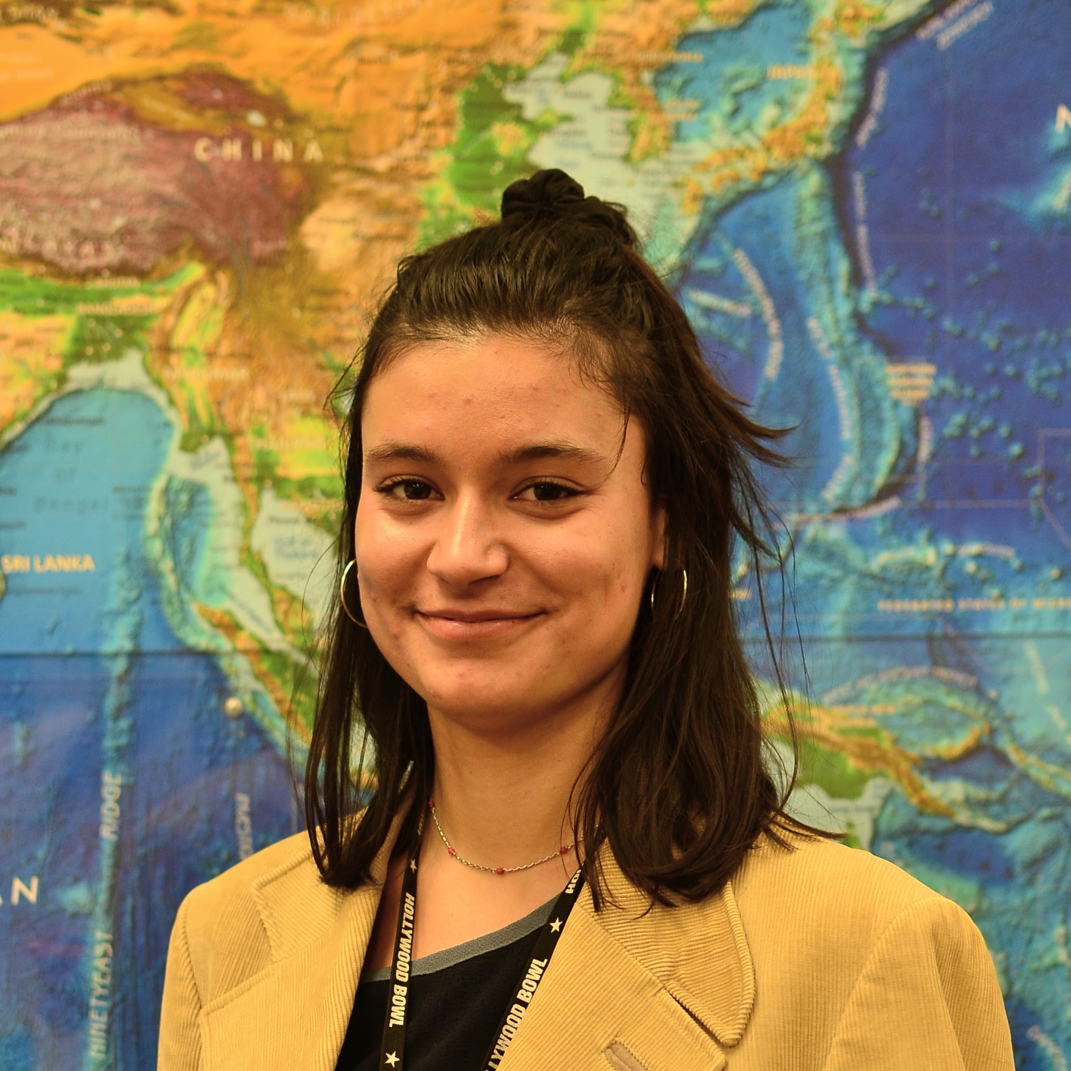
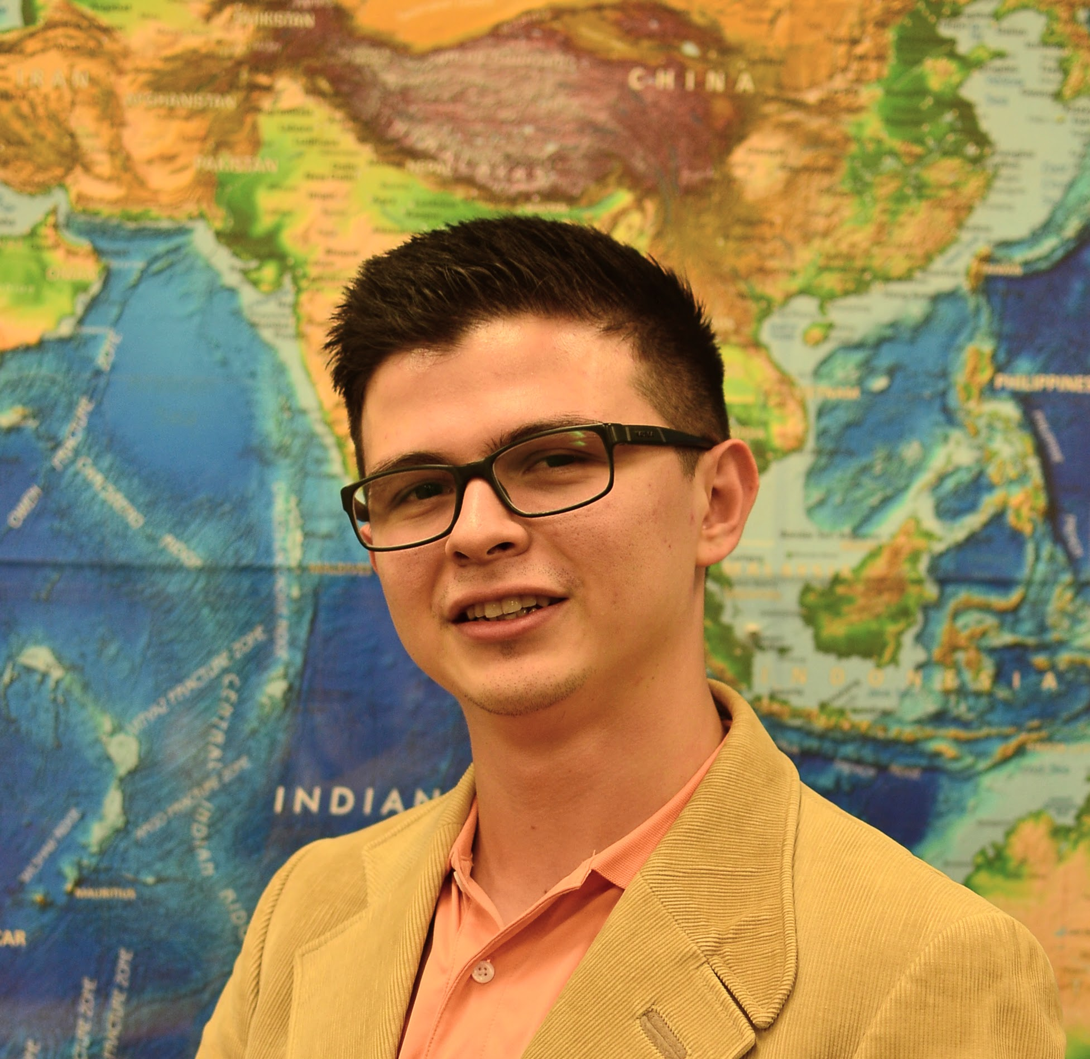
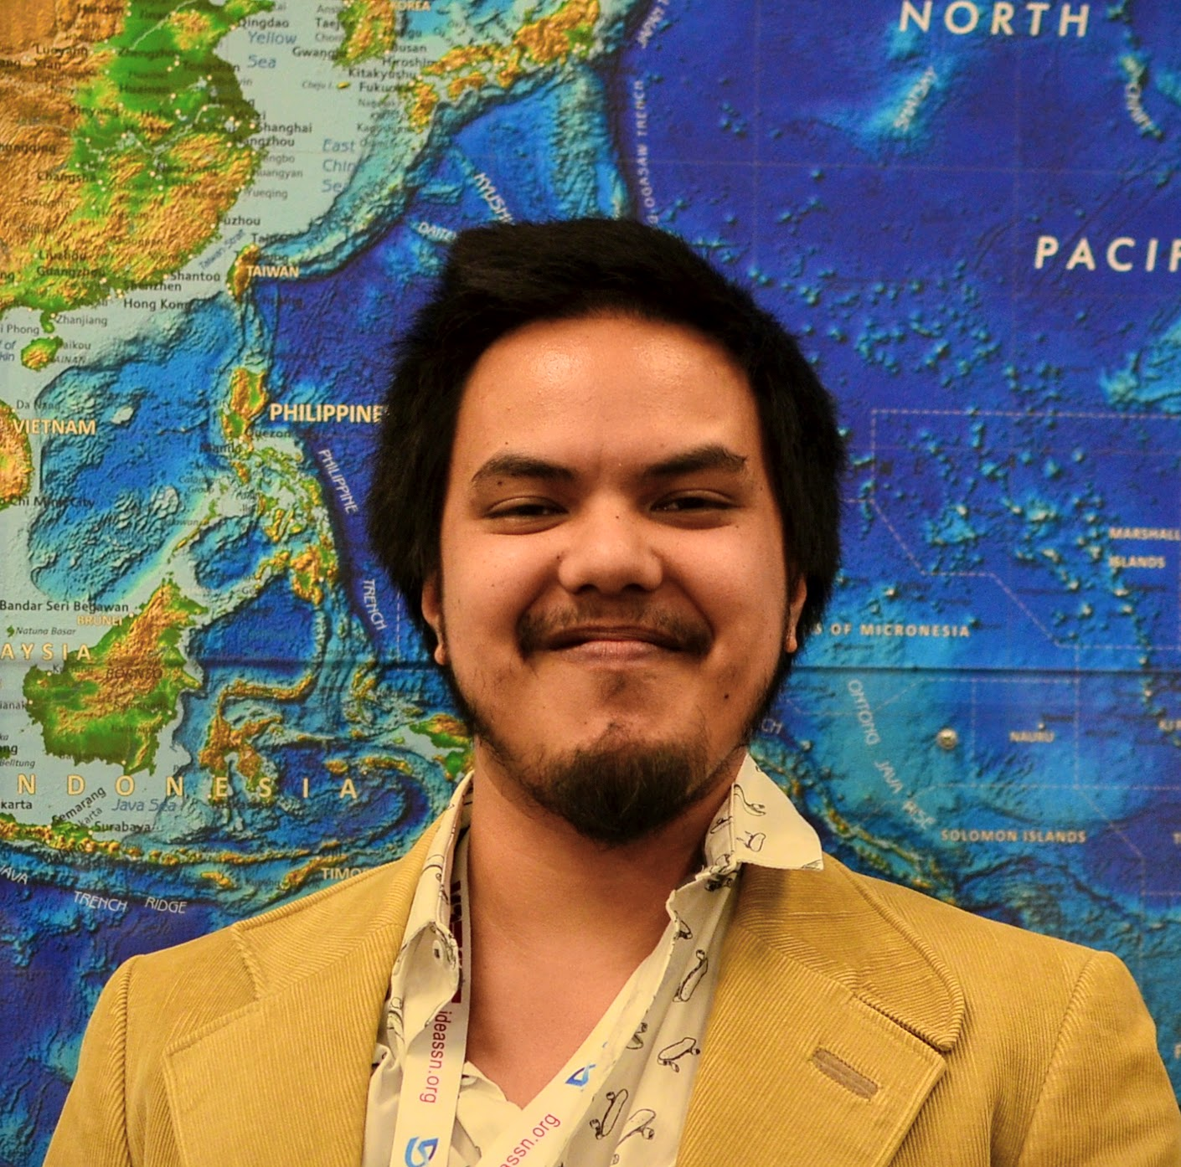
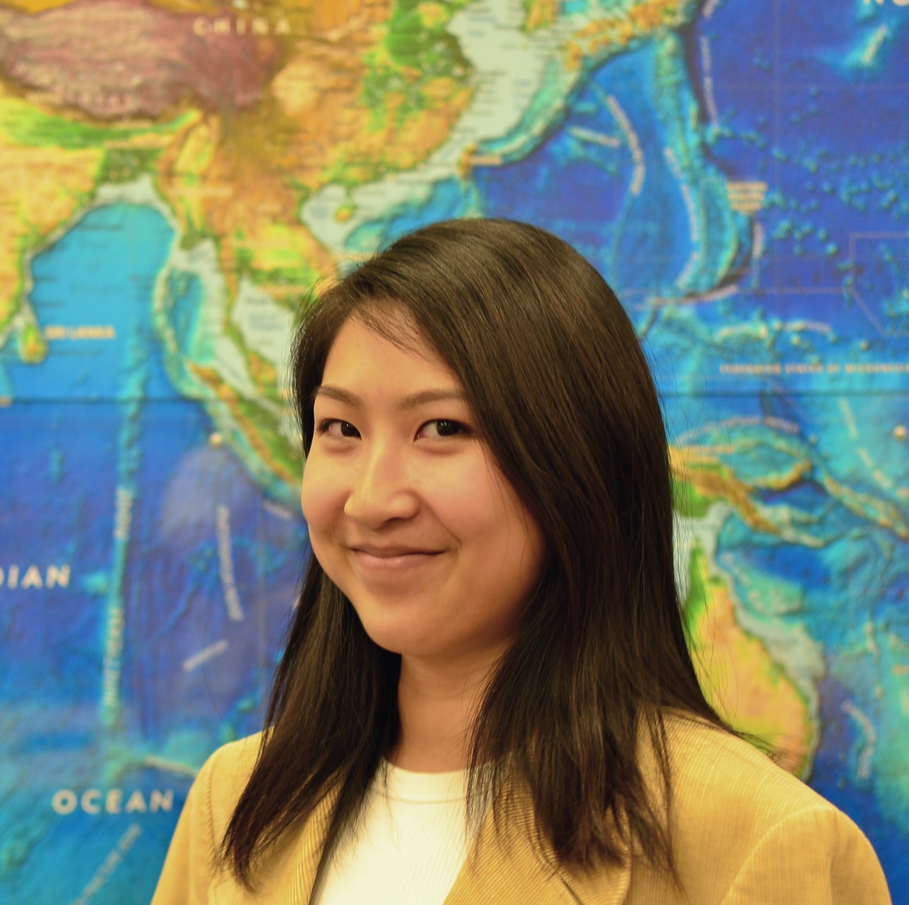
Automated Wetland Hydroperiod Mapping by Integrating Optical Satellite Imagery and Synthetic Aperture Radar
Abstract
Objectives
Alaska’s wetlands cover approximately one third of the state and provide a multitude of ecosystem services, including nutrient retention, water purification, and provision of habitat for fish, wildlife, and vegetation. The temporal variation in wetland inundation affects these ecosystem functions, and for effective wetland policy and management, it is important to track patterns and changes in inundation. In collaboration with the US Fish and Wildlife Service (USFWS) and the Alaska Satellite Facility (ASF), the fall 2018 NASA DEVELOP Alaska Ecological Forecasting team produced an inundation tool to detect and classify inundation extent in Alaska’s wetlands from C-band synthetic aperture radar (C-SAR) data. The team used Earth observation products, including Sentinel-1 C-SAR, Landsat 8 Operational Land Imager (OLI), PlanetScope, and RapidEye satellite imagery, to create the tool’s thresholding algorithm and generate land cover classifications for validation. The inundation tool effectively mapped wetland inundation due to SAR imagery’s sensitivity to water and reliable data collection on cloudy days. The optical datasets, Landsat 8 OLI and high resolution Planet imagery, were limited by cloud cover and detection of inundation below vegetation and canopy cover but were helpful for visual validations of Sentinel-1 C-SAR classifications. The tool’s ability to map wetland inundation can support the development and refinement of National Wetland Inventory (NWI) wetland maps in Alaska and build the capacity of operational federal programs to use SAR.
Create algorithm to detect wetland inundation extent from Sentinel-1 C-band SAR data
Validate algorithm using optical imagery
Integrate algorithm with the Alaska Satellite Facility SAR processing tool, HyP3
Enhance the National Wetland Inventory’s mapping capability through inundation map generation
Methodology
Input
Processing
Calibration
Classification
Validation
Output
Sentinel - 1
C-SAR
VV VH
UTM Projection
Multi-Temporal
Mean Ratio
Image Coregistration
VV / VH
Ratio
VV, VH,
VV/VH
Thresholds
Study Area
Earth Observations
Subset
Average Region
Brightness
Classification
Per Date
Accuracy
Assessment
Wetland Inundation Map
Crea Creek
Area 1002
Sentinel-1 C-SAR
Average Pixel
Brightness
Multi-Temp
Classification
Selawik
Modeling site
NWI Project
Landsat 8 OLI
Multi-Temporal
Average
Refined
Classification
NWI Project
Canvasback Lake
Normalize
Bear Lake
Potential NISAR cal/val site
Main algorithm testing site
Goldstream Valley
Modeling site
Landsat 8 OLI
Landcover
Classification
PlanetScope & RapidEye
PlanetScope
Optical
Data
Landcover
Classification
0
125
250
500 km
Results
Bear Lake: Mapping Temporal Fluctuations in Inundation
Single Date Classifications
Bear Lake: Typical Inundation State
Multi-Temporal Averages from June 2017 to September 2017
July 7, 2017
July 6, 2017
July 7, 2017
VV Polarization
VH Polarization
Unclassified
VV / VH Ratio Polarization
Inundated
Not inundated
Figure 2: Dynamic Surface Water Extent model output on Landsat 8 OLI. Areas in white are classified as inundated.
0 2.5 5 10 km
Open water
Figure 1: Inundation extent or areas open water and inundated vegetation (in white) derived from Sentinel-1 C-SAR data.
Figure 3: Normalized difference water index for PlanetScope image. Brighter areas indicate higher NDWI values.
Figure 4: Multi-temporal averages of VV, VH, and VV/ VH polarizations. Brighter areas indicate higher backscatter.
Figure 5: Classification of multi-temporal averages using VV, VH, and VV/VH brightness thresholds.
Conclusions
SAR’s sensitivity to water and reliable data collection on cloudy days make it a valuable source of data for mapping inundation in Alaska.
Landsat 8 OLI and Planet Imagery were limited by cloud cover and detection of inundation below canopy cover, but were helpful for validating Sentinel-1 C-SAR classifications.
This algorithm allows for the efficient production of inundation maps in Alaska that can supplement current wetland mapping efforts.
Project Partners
Acknowledgements
Team Members
US Fish and Wildlife Service, National Wetlands Inventory
Alaska Satellite Facility
Bruce Chapman, NASA Jet Propulsion Laboratory
Megan Lang, US FWS, National Wetlands Inventory
Jeremy Nicoll, Alaska Satellite Facility
Franz Meyer, Alaska Satellite Facility
This material contains modified Copernicus Sentinel data (2017), processed by ESA.
Annemarie Peacock
Project Lead
Briant Fabela
Adam Vaccaro
Alice Lin
Alaska Ecological Forecasting
California – JPL | Fall 2018

